Slide 1
Entomology BSC 301
Instructor: Dr. Steven Juliano
Office: Felmley Annex 335
E-mail: sajulian@ilstu.edu
phone: 309 438-2642
Office Hours: W 2:00 – 3:00PM, Th 10:00-11:00AM, & by appointment
Web page: http://bio.illinoisstate.edu/sajulian/
ReggieNet: Syllabus, Lectures, Readings, Assignments
Lecture: MWF 12:00-12:50PM, FSA 136
Textbooks: The Insects: An outline of Entomology, 4th ed.
(PJ Gullan & PS Cranston), Wiley-Blackwell
Peterson Field Guide: Insects 2nd ed.
(DJ Borror & RE White), Houghton, Mifflin, Harcourt

Slide 2
Entomology BSC 01 Laboratory
Teaching Assistant: Jillian Wormington
Office: Felmley Annex 144
E-mail: jdwormi@ilstu.edu
phone: 309 438-2661
Office Hours: by appointment
Laboratory: M 1:00-3:50PM FSA 136
Collection supplies:
Pins, pinning boxes, pinning blocks, some other supplies available from Phi Sigma Bookstore, Felmley Hall 101A;
Other supplies from BioQuip (website available from ReggieNet Site)

Slide 3
Grading
Lecture - 66%.
Two in-class examinations
Tentative dates in syllabus
examinations together are worth 50% of your lecture grade
Cumulative final during final examination week
final is worth 50% of your lecture grade
Laboratory 33%
Two Lab Practical Exams – together worth 50% of lab grade
Insect collection – worth 50% of lab grade

Slide 4
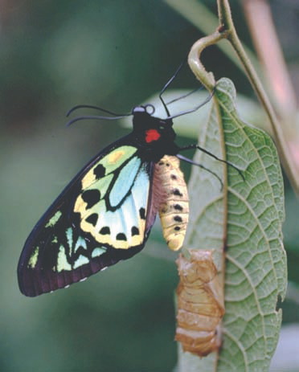
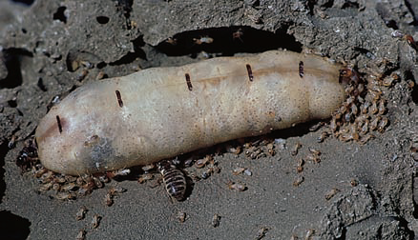
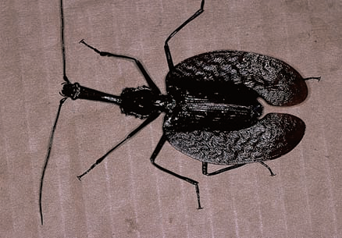
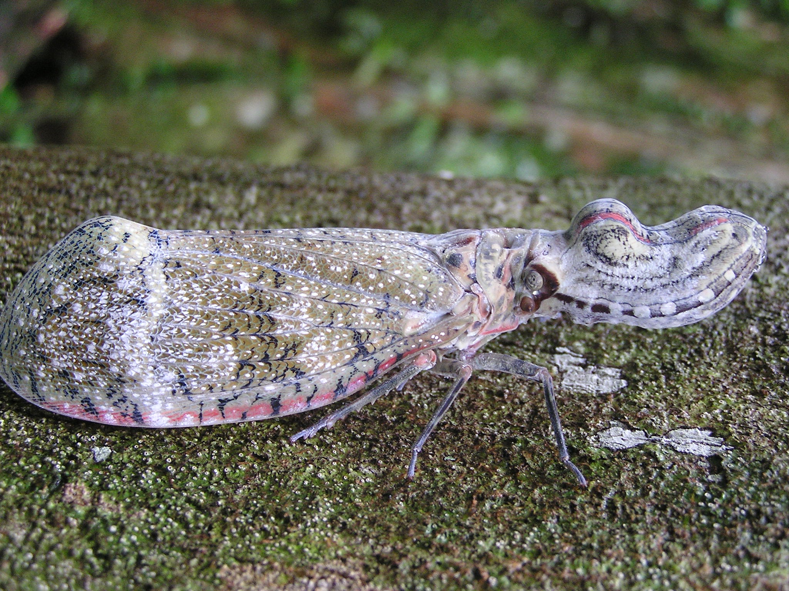
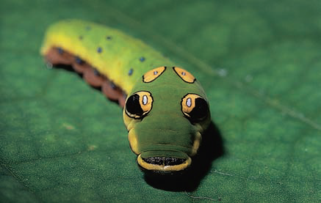
First week lab
Week 1 – Field trip and insect collecting

Slide 5
What is Entomology?
Entomology -- The science concerning insects
Class Insecta
Entomology is both a basic science and an applied science
Tradition in US emphasizes insect control
Basic sciences use insects to address many conceptual questions in Ecology, Evolution, Physiology, Molecular Biology, Genetics, etc.
Applied entomology also includes questions about beneficial (to humans) insects.

Slide 6
Biodiversity
Variety in taxonomic, genetic, ecological traits
includes species diversity
genetic diversity
ecological diversity, function, adaptation
Endemism
Insect biodiversity greatly exceeds that of all other groups
Ch. 1

Slide 7
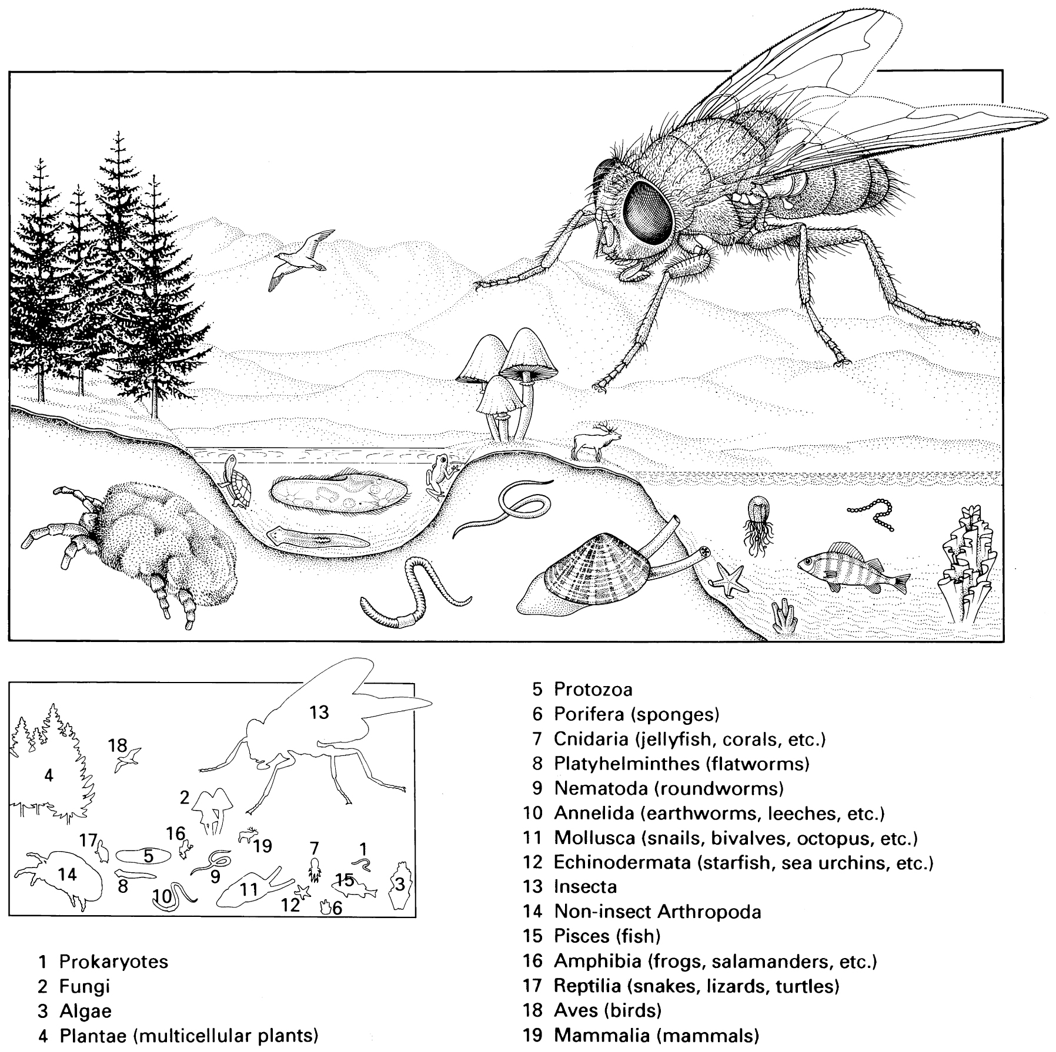
10⁶ described insect species
Coleoptera 350,000
Diptera 150,000
Hymenoptera 115,000
Lepidoptera 150,000
No one really knows how many undescribed
Small order: Odonata
6000 species

Slide 8
Taxonomic diversity
“To a first approximation, all species are extinct”
David Raup
Evolutionary history of insects dates back to the early carboniferous era 350 mya
Coincides with first appearance and diversification of vascular plants
Possibly as far back as Devonian 400 mya
Major adaptive radiation in the carboniferous
Several major groups extinct at the end of the Permian
Major adaptive radiation of the big groups in the Triassic

Slide 9
Ecological diversity
Insects dominate terrestrial and freshwater habitats
Minor component of marine systems
Only one of two phyla to evolve powered flight
Probably 2 independent events in insects
3 independent events in vertebrates
Reasons for high taxonomic diversity
Small size -> specialization
Short generation time & rapid evolution
Complex life cycle
Flight
Phytophagy (generally coevolution with vascular plants)
Eusociality

Slide 10
Trophic diversity
Herbivores
Leaves, stems, roots, fruit
Flowers, pollen, nectar
Seed predators
Ecto-, endo-parasitic
Carnivores
Predators
Parasitoids
Blood
Ecto-, endo-parasitic
Fungi, prokaryotes
Detritivores
Endoparasitic
Omnivores
Commensal
Filter feeders
Carrion
Feces
Dung

Slide 11
Classification and nomenclature
Kingdom - Animalia
Phylum – Arthropoda
Superclass - Hexapoda
Class – Entognatha, Insecta
Order - [-optera]
Family – [ -idae]
Genus
Species
Genus, species names given in latin
Rules of priority for naming, describing, and designating type specimens
Author name often follows species name
Parentheses ()designate name change

Slide 12
Names
Aedes aegypti (Linneaus)
Aedes aegypti (L.)
Carolus Linneaus originally described and named this species, but subsequently his original name (Culex aegypti) was superseded by the current name, when the species was placed in the genus Aedes.
When described taxon is invalidated, new describer’s name is usually appended
Aedes aegypti (Diptera: Culicidae)

Slide 13
Collecting, preserving, identifying insects [Ch. 17]
Collecting responsibly
Collect minimum number needed
Obtain permits, permissions
Minimize damage to habitats an other organisms
Record information about date and location of collection
Curate, label, and identify specimens
Deposit specimens in an appropriate repository
Research collections: Publish research results
Instructional collections: learn the most from the collected specimens; add them to the teaching collection

Slide 14
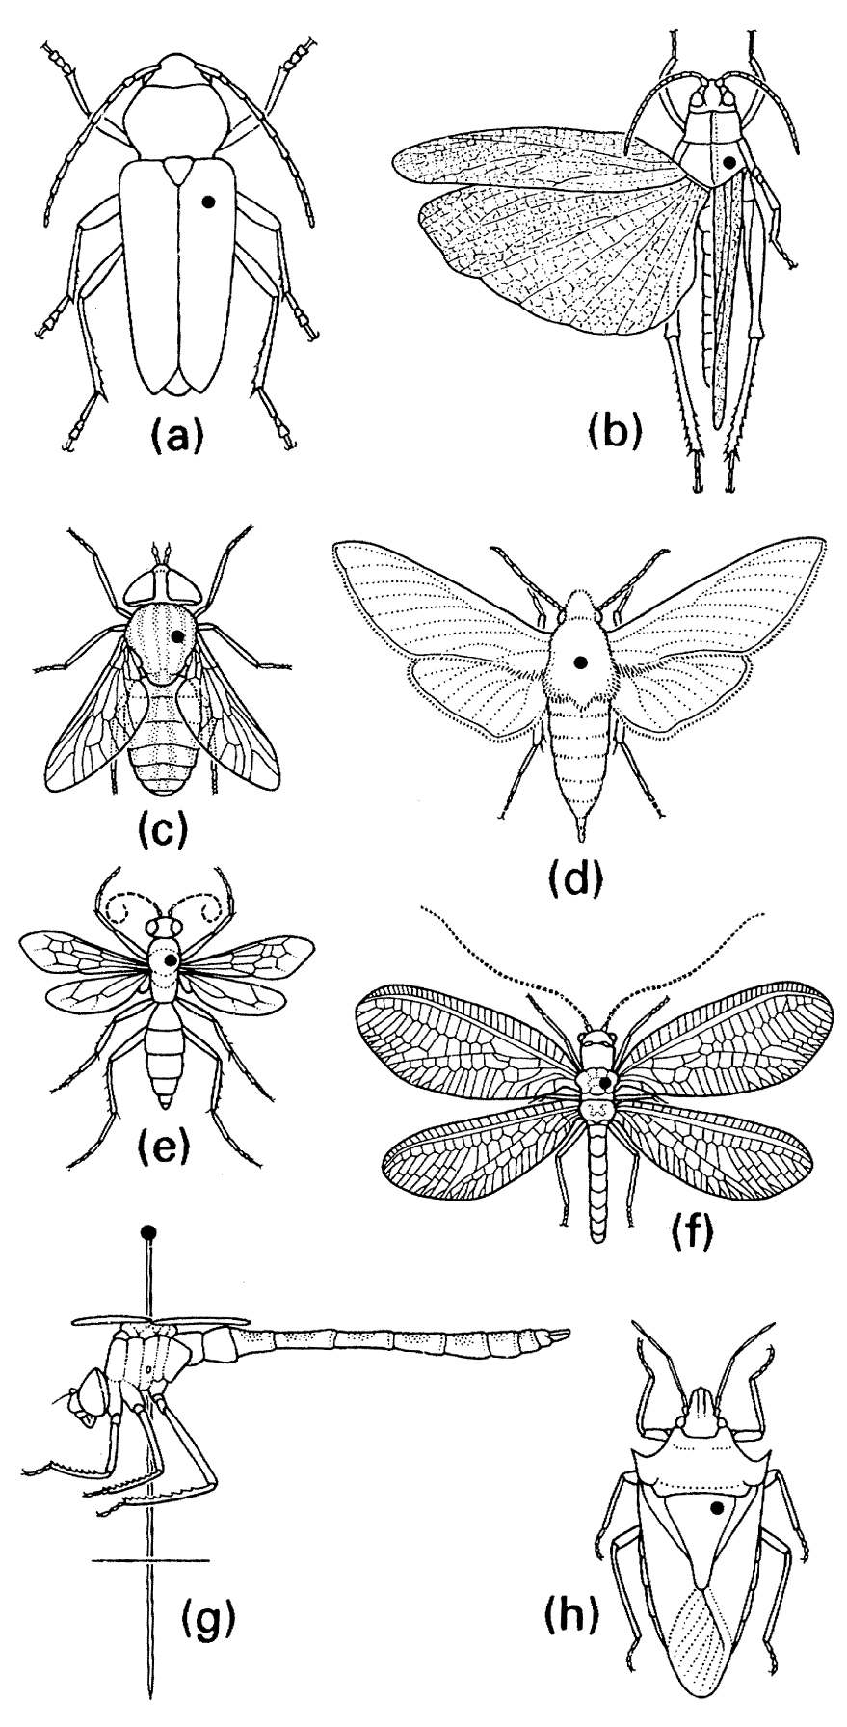
Pinning

Slide 15
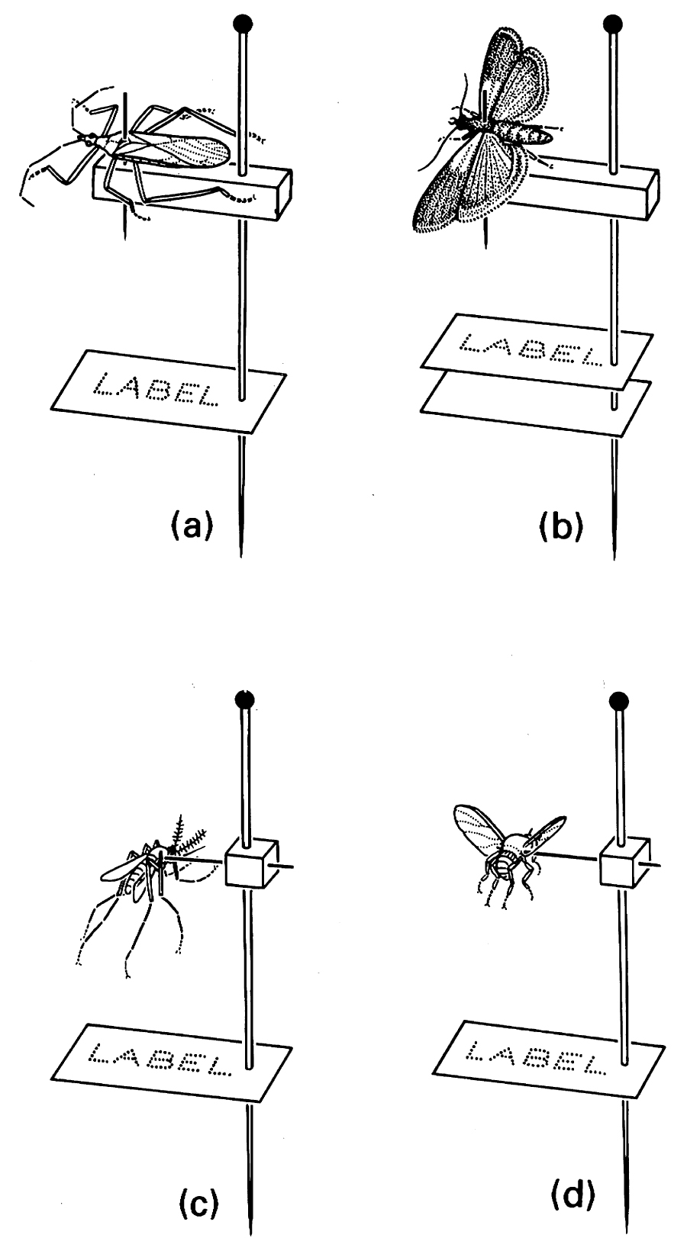
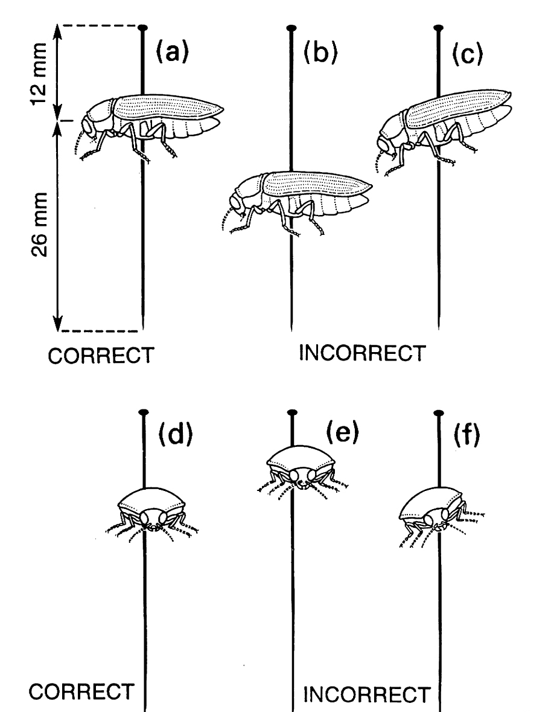

Slide 16
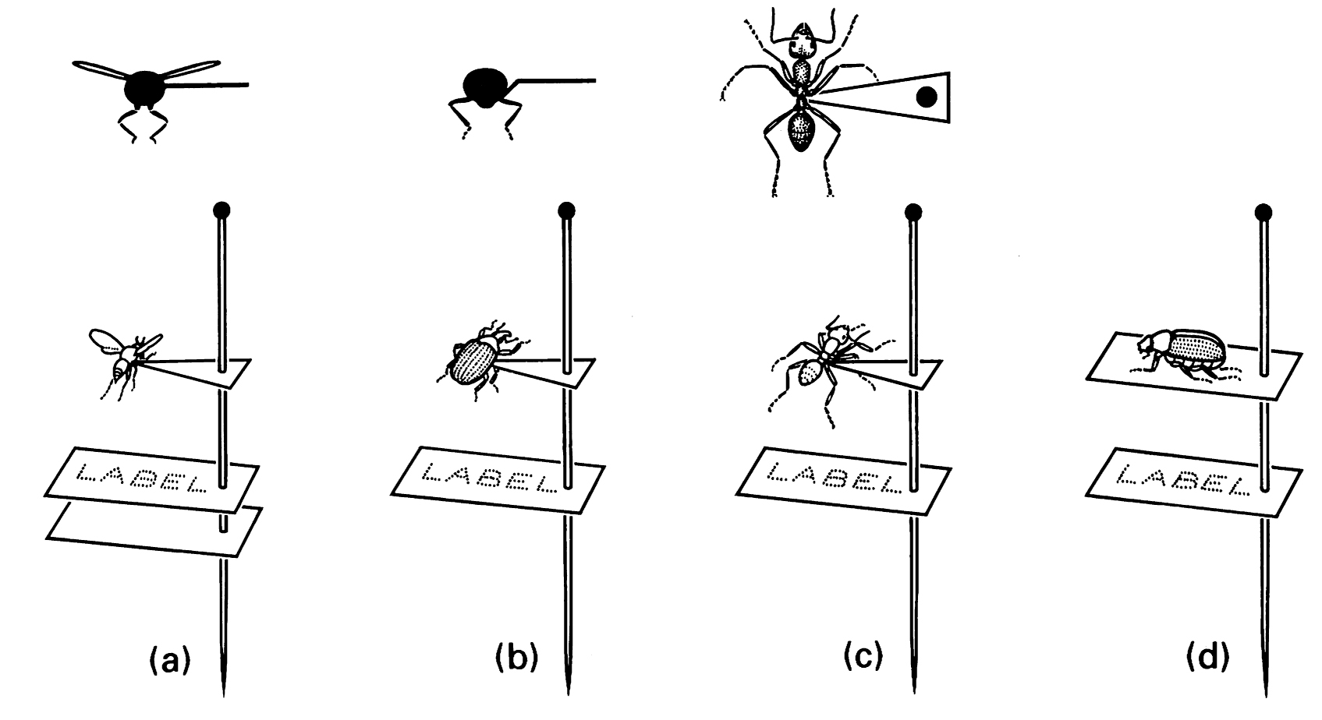
Pointing and carding

Slide 17
Labeling
Typically two labels
First:
Location (Country, State, County, etc. )
GPS coordinates (latitude, longitude)
Date (unambiguous distinction of month and day)
Collector
(possibly: habitat, collection method, etc.)
Second:
Identification
Identity of person identifying
Date of ID
Additional information on other labels or on associated annotated list (instructional purposes – see syllabus)
Number specimens; number list

Slide 18
Other techniques
Liquid preservation
Ethanol
Fixation vs. preservation
Slide mounting
Balsam
Euparyl, Hoyer’s, others
Clearing
Dissection
Associating dissected parts with body

Slide 19
Curation
Dried, pinned specimens
Dry
Protect from insects (Dermestid beetles, roaches, silverfish, booklice)
Fragile
Slides
Balsam = permanent
Others require sealant
Ethanol
Replenishing fluids

Slide 20
Insect cuticle
Exoskeleton
Apodemes
Wings
Epicuticle
1-3 μm
Wax, hydrocarbons
Procuticle
10-500 μm
Exocuticle sclerotized
Chitin-protein complex

Slide 21
Components of cuticle
Chitin
Polymer of nitrogenous carbohydrate
N-acetyl-D-Glucosamine
Unbranched
H bonds among chains strengthens cuticle

Slide 22
Components of cuticle
Protein
Sclerotization
Exocuticle only
Quinone based tanning
phenolic bridges between protein chains
Melanin also darkens, hardens cuticle
Zinc, Manganese deposited in hardest cuticle (e.g., mandibles)
Unsclerotized cuticle
Membranes
Tough, flexible
Highly folded protein chains extend by unfolding

Slide 23
Things on the cuticle
Multicellular spines
Setae
Acanthae
Microtrichae

Slide 24
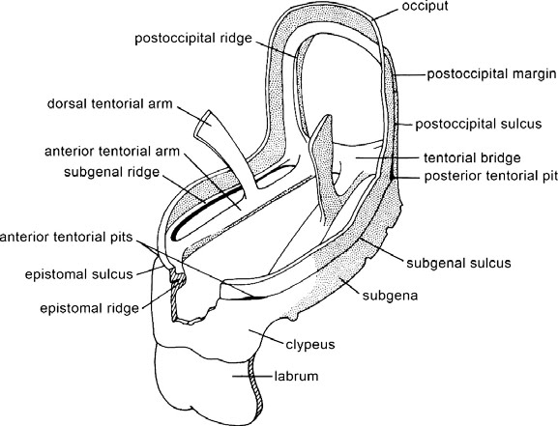
Muscle attachment

Slide 25
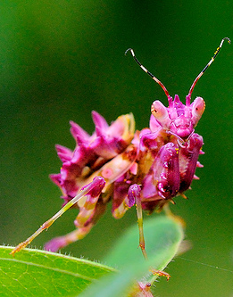
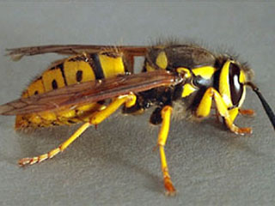
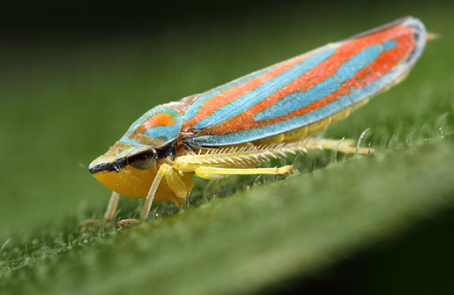
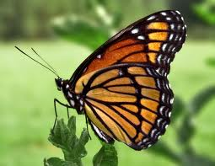
Color
Pigments
Melanin
Black
Carotenoids, Ommochromes, Papiliochromes, Pteridines
Yellow/reds
Flavonoids
Yellow
Tetrapyrroles
Red/blue/green
Quinones
Yellow/red/blue-green

Slide 26
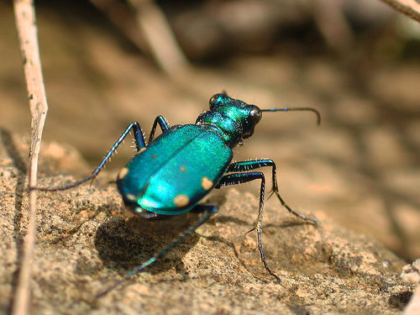
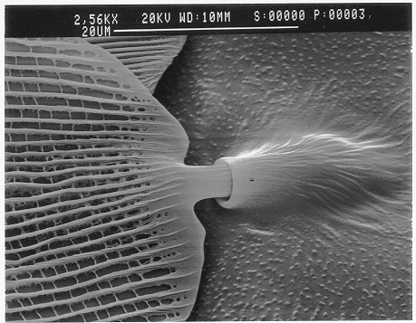
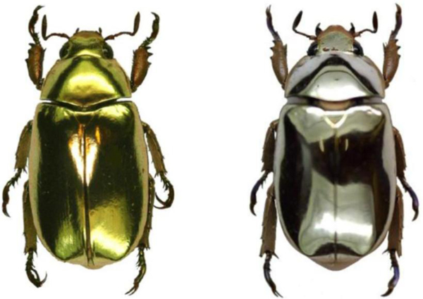
Color
Structural color
Diffraction via ridges on cuticle
Irridescent
Layering of chitin
Metallic

Slide 27
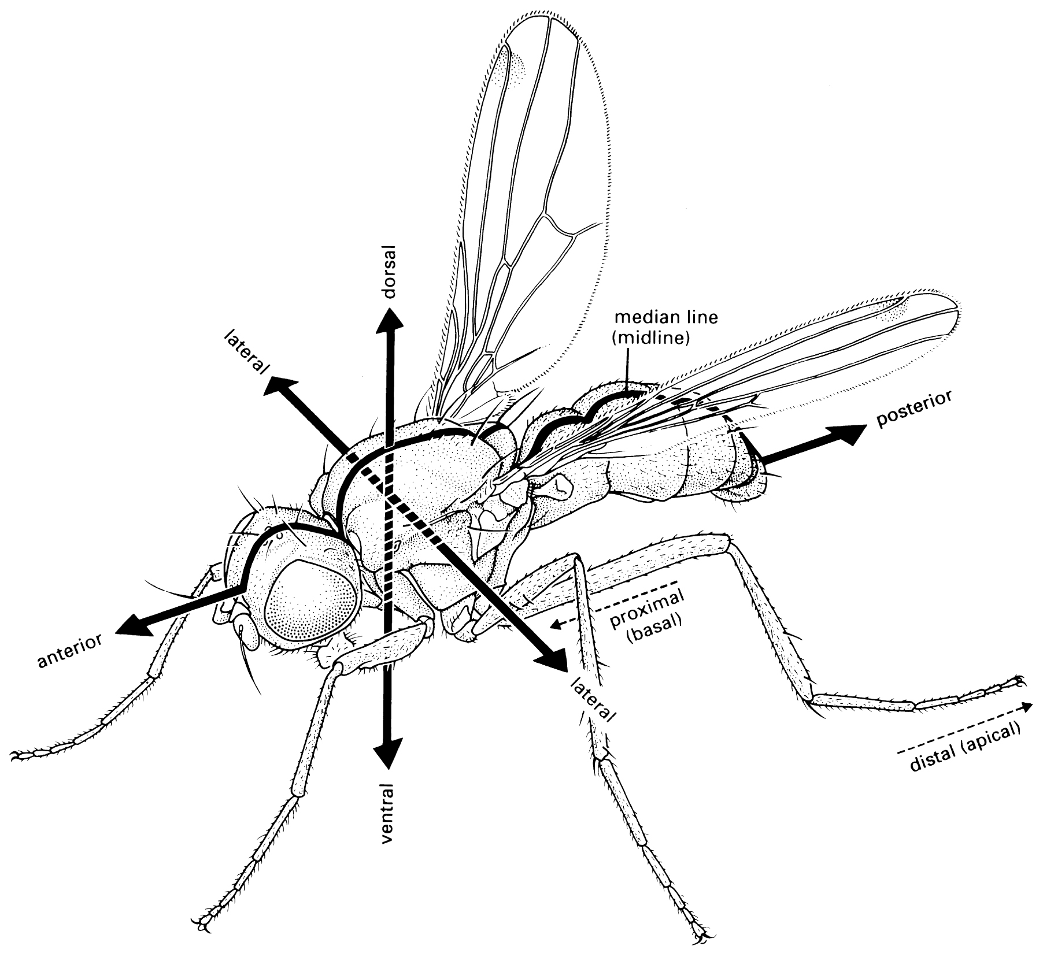
External anatomy Fig. 2.8

Slide 28
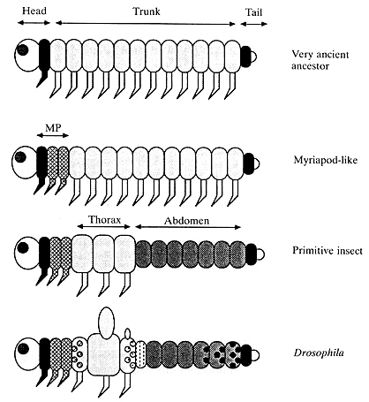
External anatomy
Ancestrally all arthropods are believed to have metameric segments (metamerism)
Generalized limbs
Evolution of insects (and other arthropods) proceeds by tagmosis – creation of body regions

Slide 29
Generic external anatomy (Fig. 8.4)
Tagmata
Head
Thorax
Abdomen

Slide 30
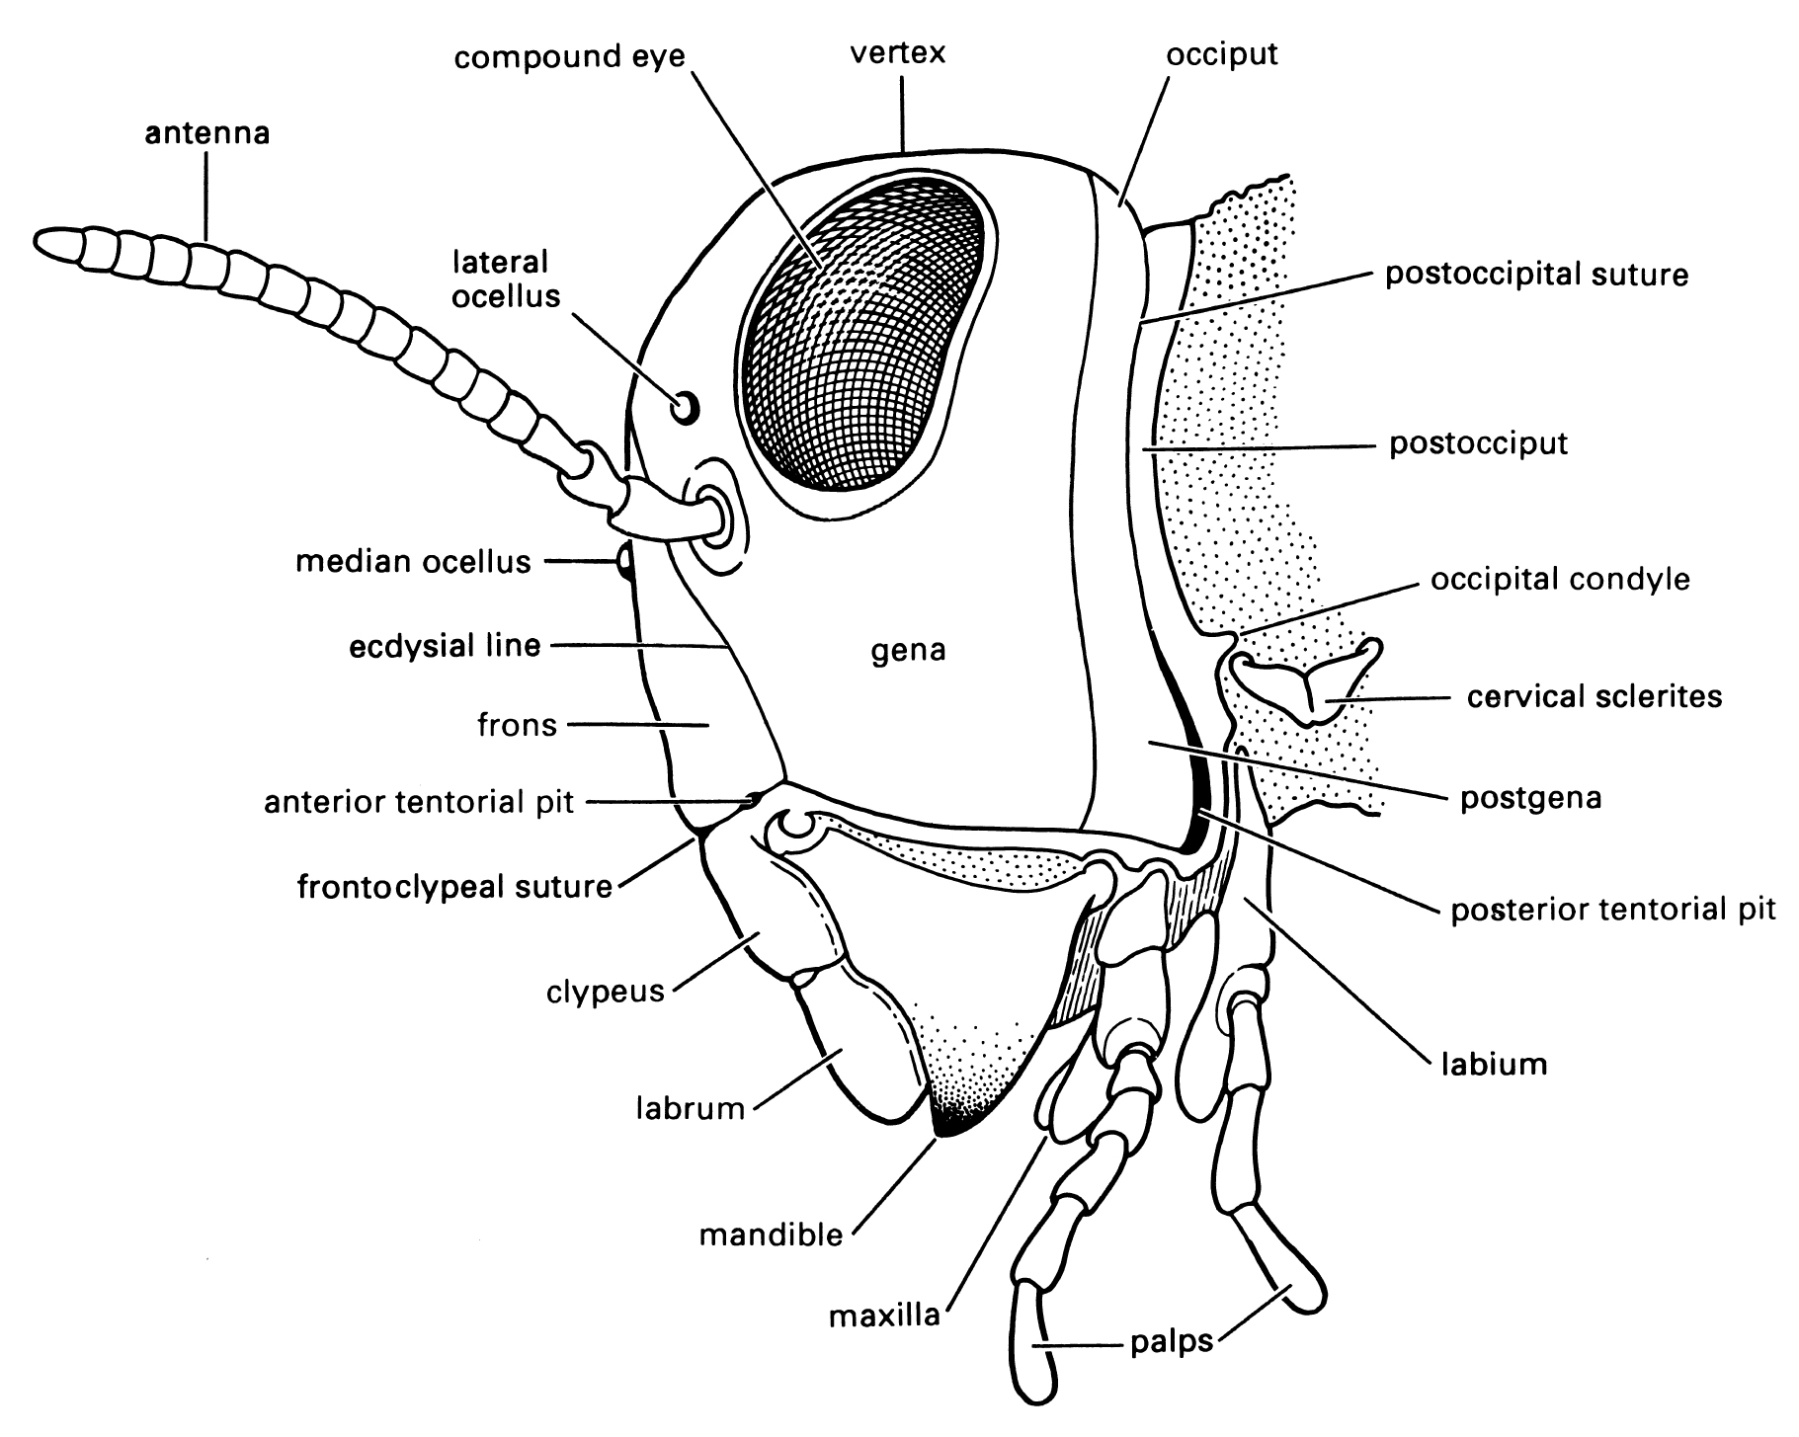
Head Fig. 2.9
Generalized chewing mouthparts. Postulated to be the ancestral insect condition
Head is postulated to consist of 6 metamers
Preantennal
Antennal
Labral
Mandibular
Maxillary
Labial
Limbs from metamers form antennae mouthparts

Slide 31
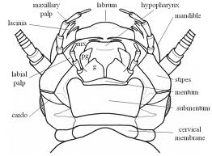
Chewing mouthparts Fig. 2.10

Slide 32
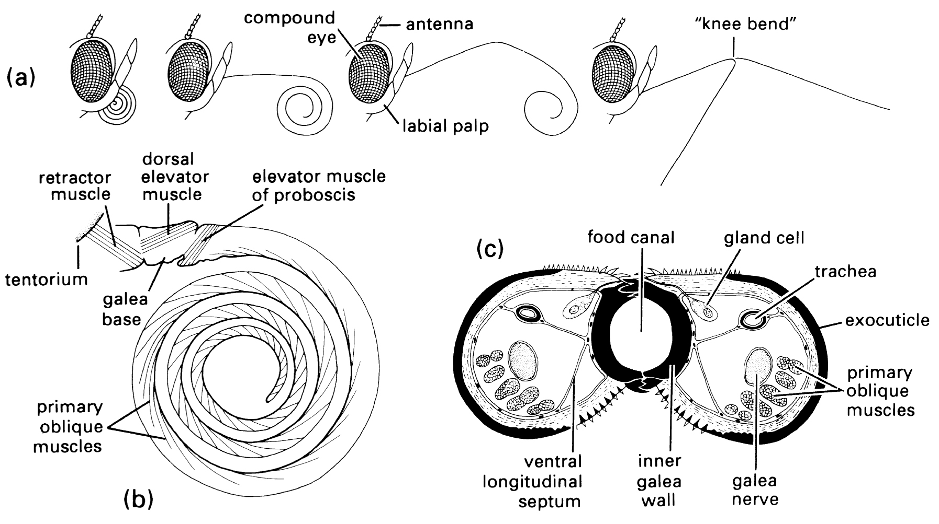
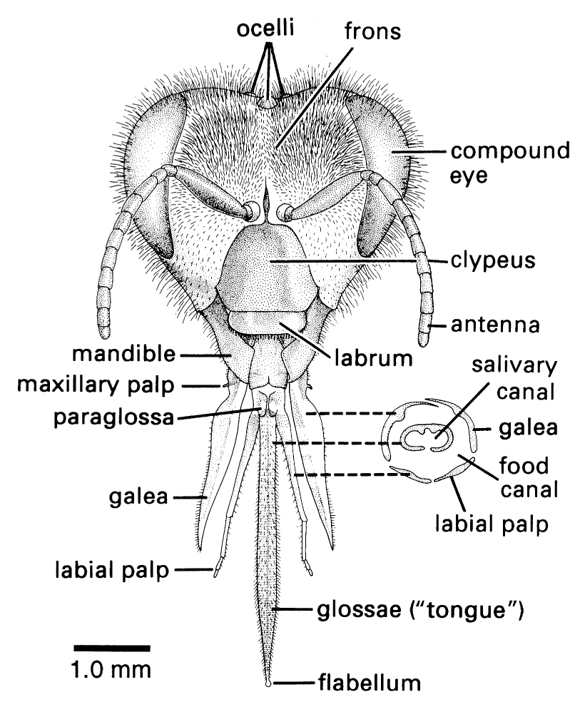
Modified mouthparts: Lepidoptera (Fig. 2.12), Hymenoptera [Apidae] (Fig. 2.11)
Mouth parts specialized for lapping, sucking, but not piercing

Slide 33
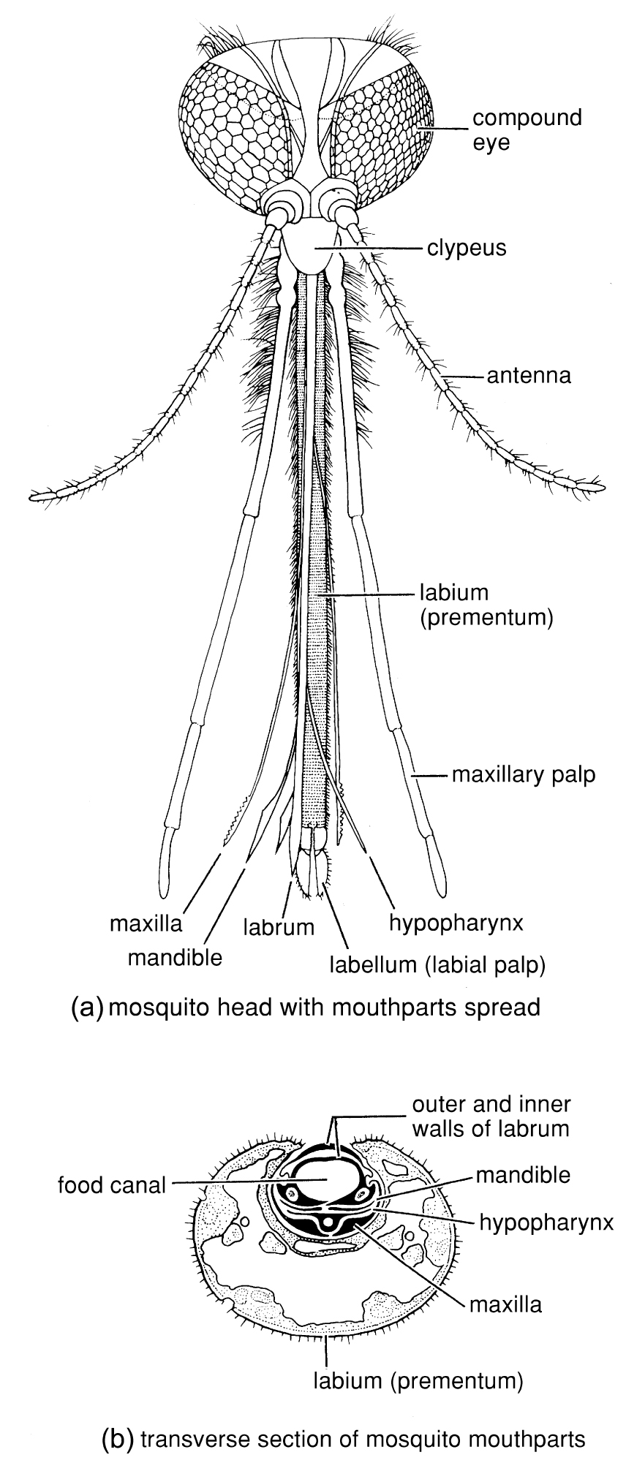
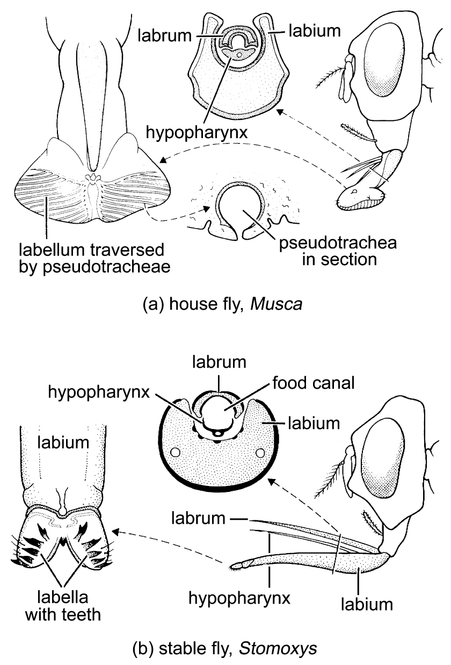
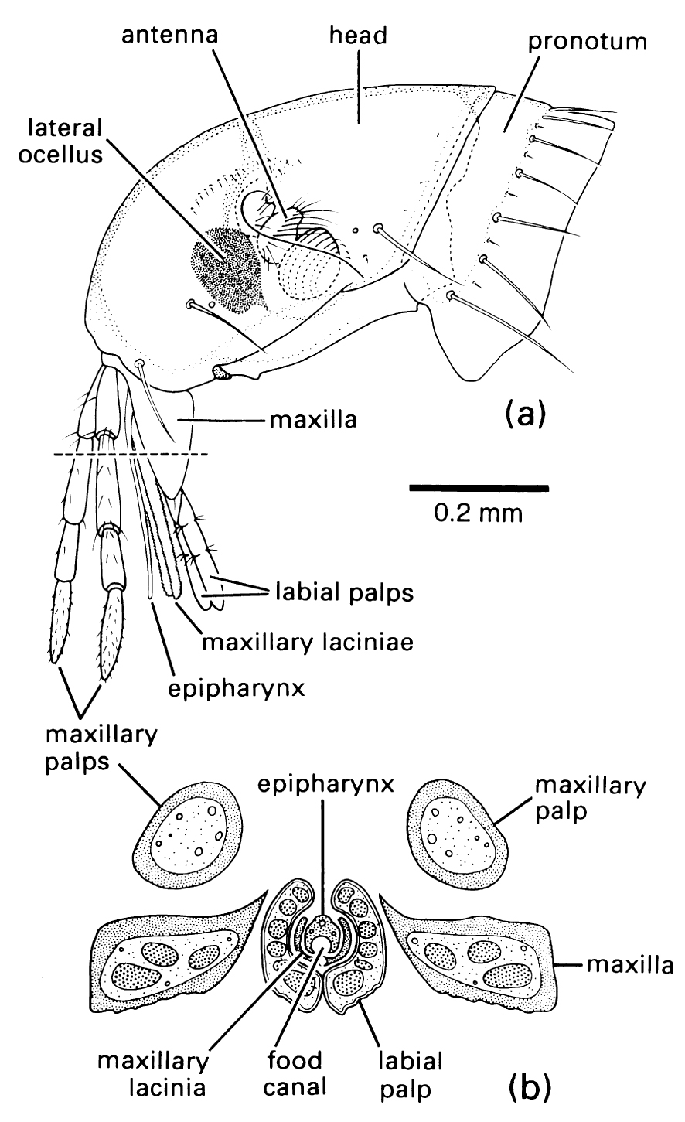
Modified mouthparts: Diptera (Figs. 2.13, 2.14), Siphonaptera (Fig. 2.17)
Mouthparts specialized for piercing and sucking, or lapping

Slide 34
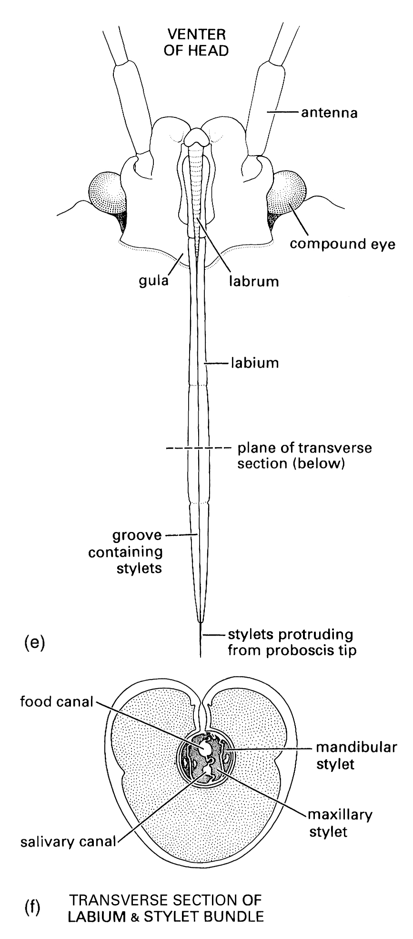
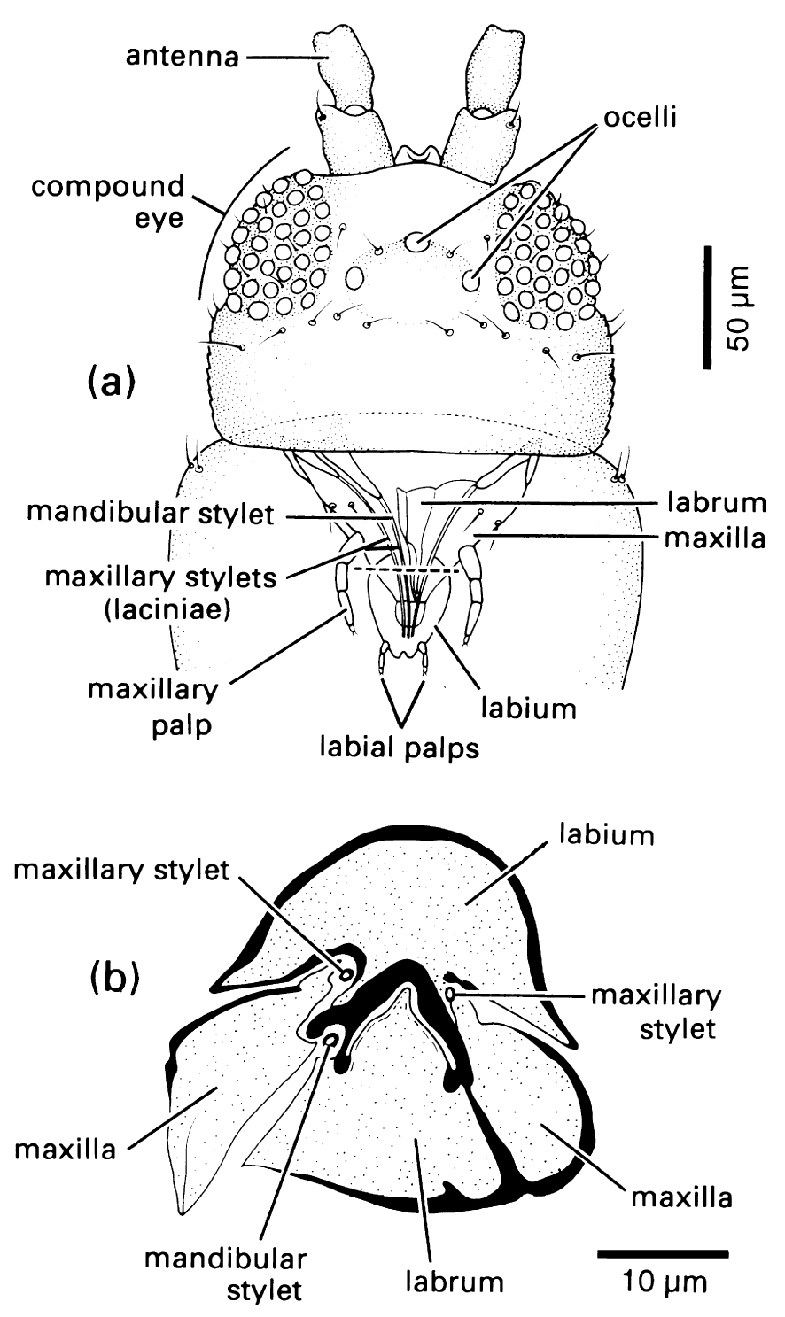
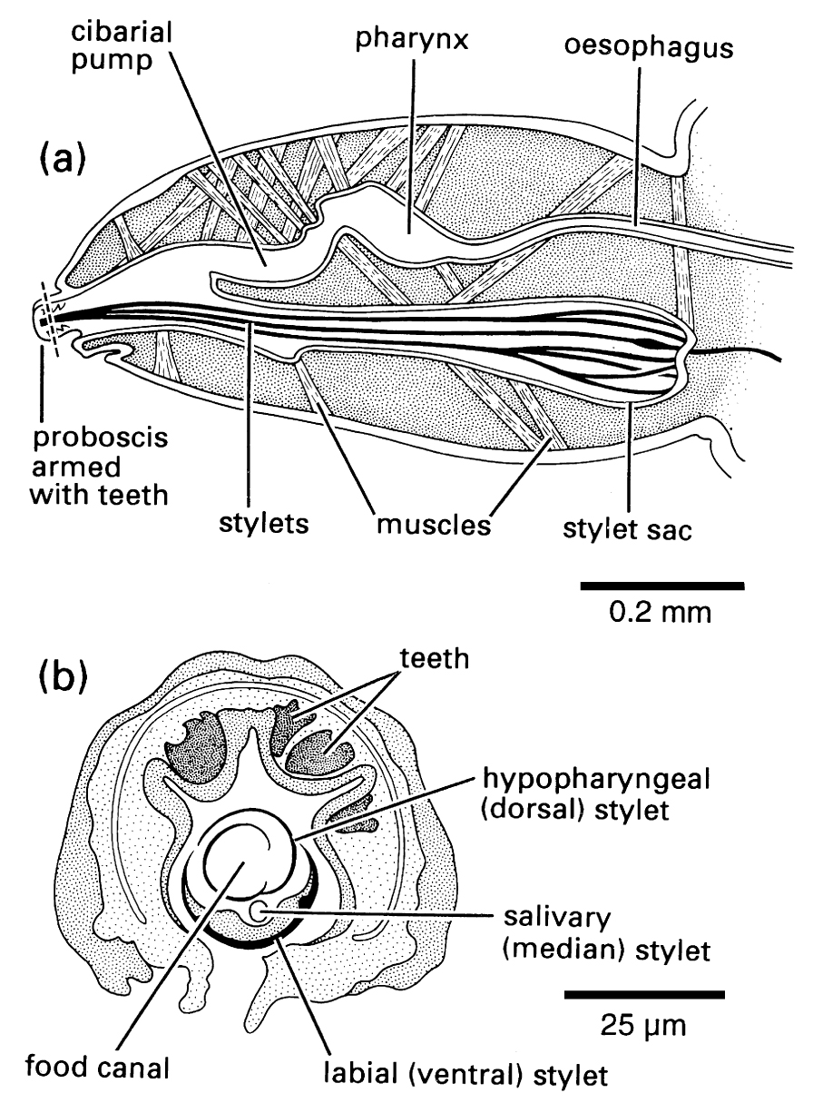
Modified mouthparts: Hemiptera (taxobox 20), Thysanoptera (Fig. 2.15), Psocodea [Anoplura] (Fig. 2.16)
Mouthparts specialized for piercing and sucking

Slide 35
Evolution of piercing-sucking mouthparts
Evolved multiple times independently
Includes some extinct orders (e.g., Paleodictyoptera)
Multiple times within one order (e.g., Diptera)
Piercing accomplished using:
Maxillae and Mandibles (e.g., Hemiptera, Mosquitoes, etc.)
Maxillae and one Mandible (Thysanoptera)
Labium and Hypopharynx (Psocodea: Anoplura)
Maxillae and Epipharynx (Siphonaptera)
Labium (e.g., Stable fly)
Other
May be lost and regained (Diptera)

Slide 36
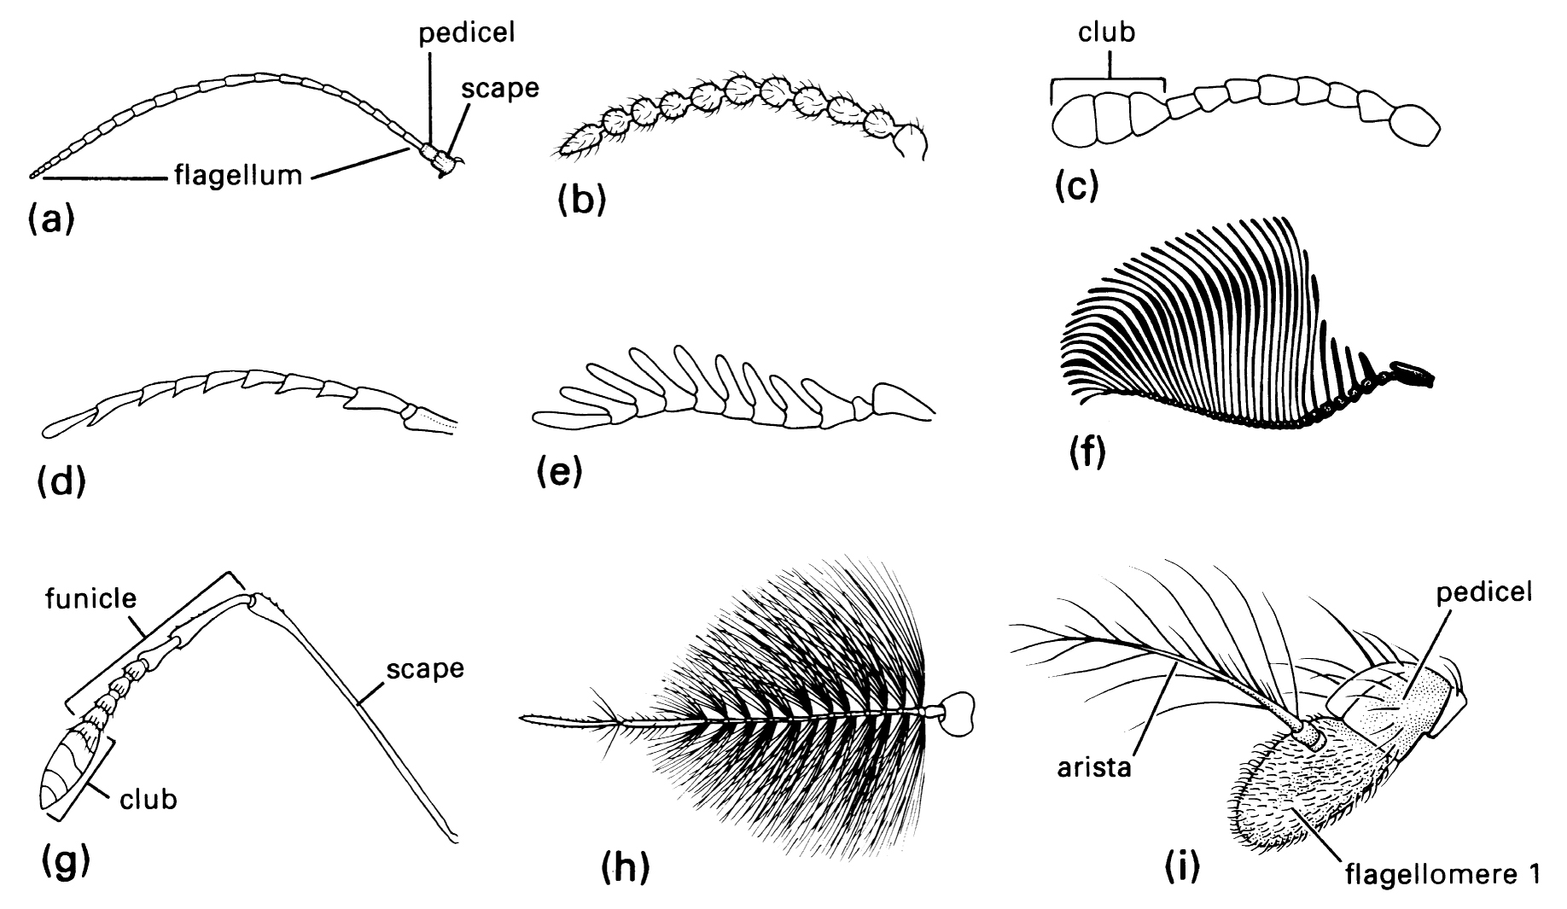
Sensory organs
Antennae
Sensilla
Chemo- , mechano-reception
Eyes
Ocelli
Compound eyes
Sensilla on mouthparts
chemoreception

Slide 37
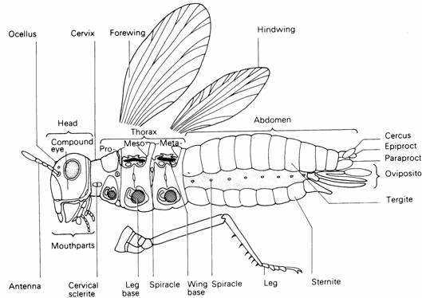
Thorax
Three metamers
Prothorax
Mesothorax
Metathorax
Each with 1 leg
Living insects: Meso- and Meta- have one wing
Fossil insects: prothoracic wings

Slide 38
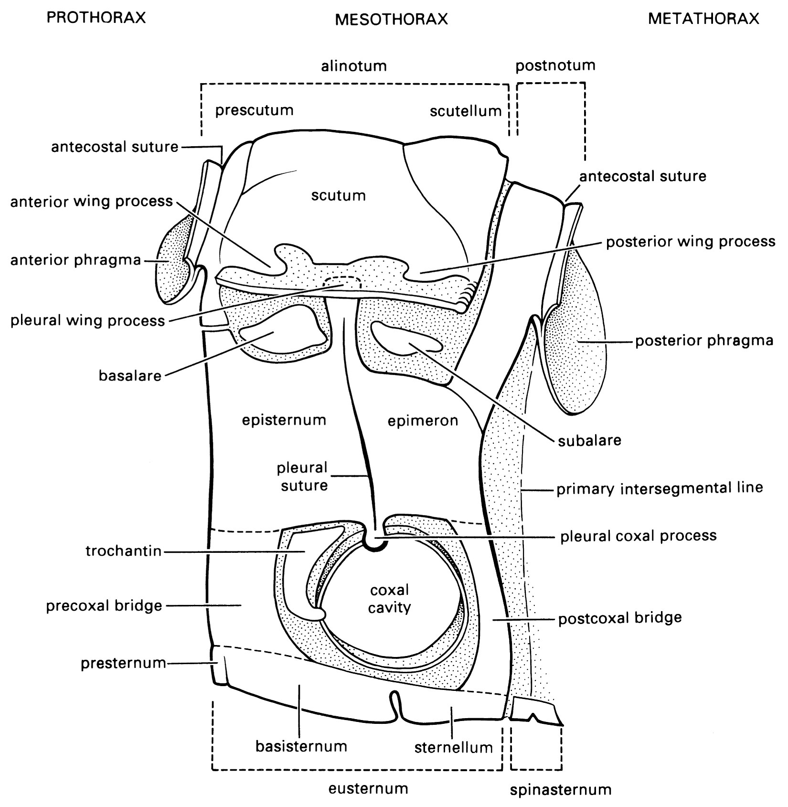
Thorax metamers
Sclerites
Separated by intersegmental membranes
Sutures mark locations of exoskeletal apodemes

Slide 39
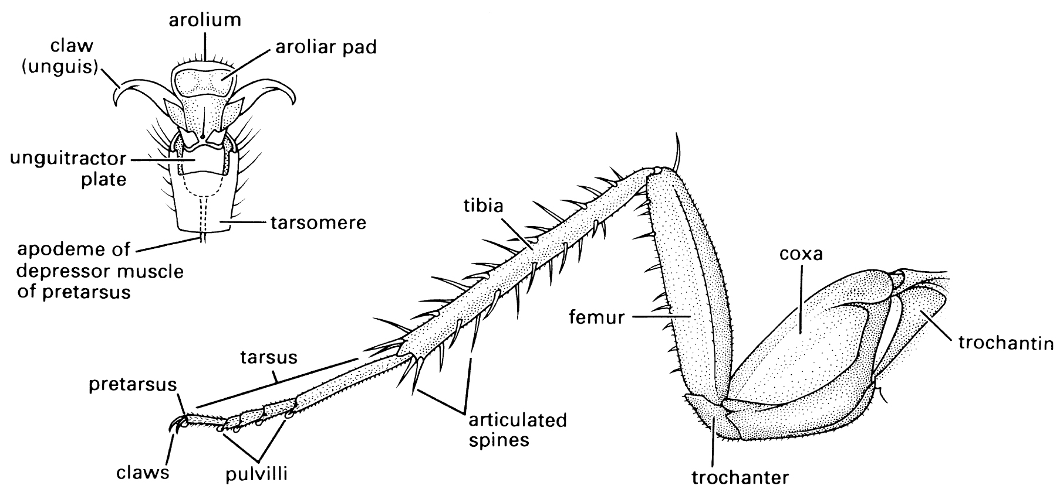
Thorax: legs
Coxa
Trochanter
Femur
Tibia
Tarsus
Tarsomeres
Claws

Slide 40
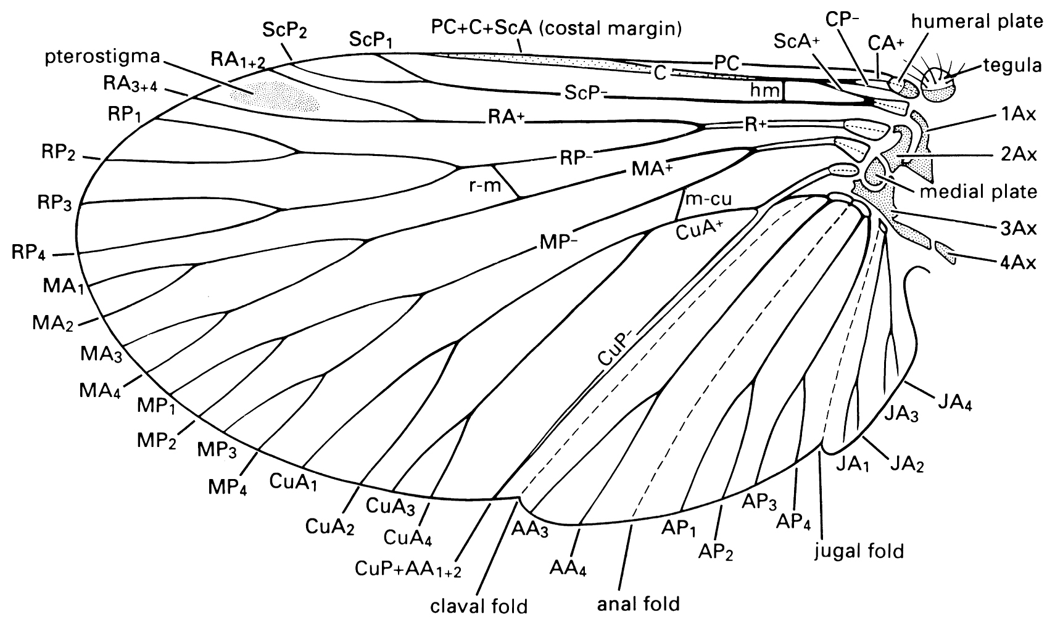
Wings
Cuticular extensions supported by sclerotized veins
Venation modified, reduced
Diagnostic
Variable terminology among orders

Slide 41
Wing modifications
Flight
Mesothoracic wing only
Diptera
Metathoracic wing only
Coleoptera
Orthoptera
many Hemiptera
others
Both (hamuli)
Hymenoptera
Lepidoptera
Odonata
Ephemeroptera
others
Flightlessness & wing loss
Siphonaptera
Anoplura
Strepsiptera females
Others
Wing scales
Lepidoptera
Trichoptera

Slide 42
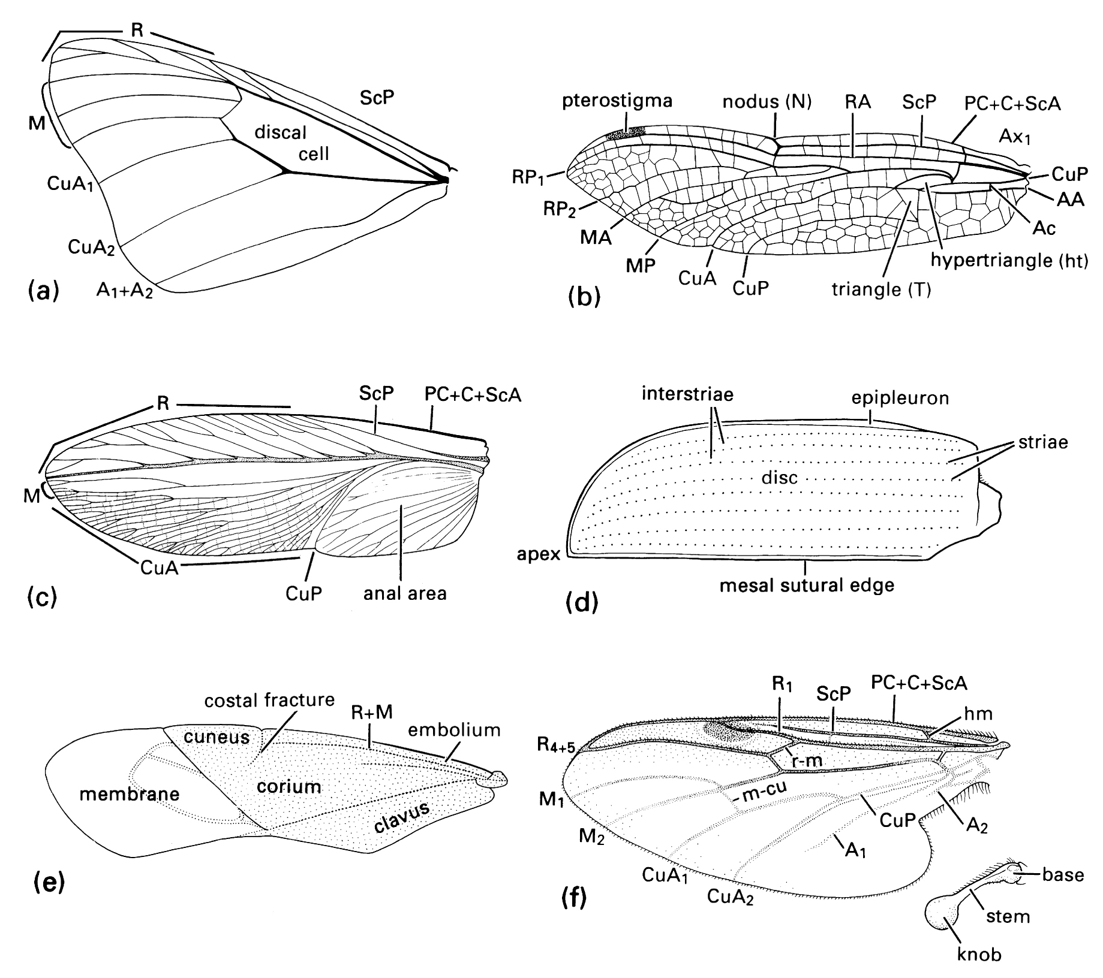
Wing Modifications
Tegmina
Blattodea
Orthoptera
Mantodea
Elytra
Coleoptera
Hemelytra
Hemiptera
Halteres
Diptera
Strepsiptera

Slide 43
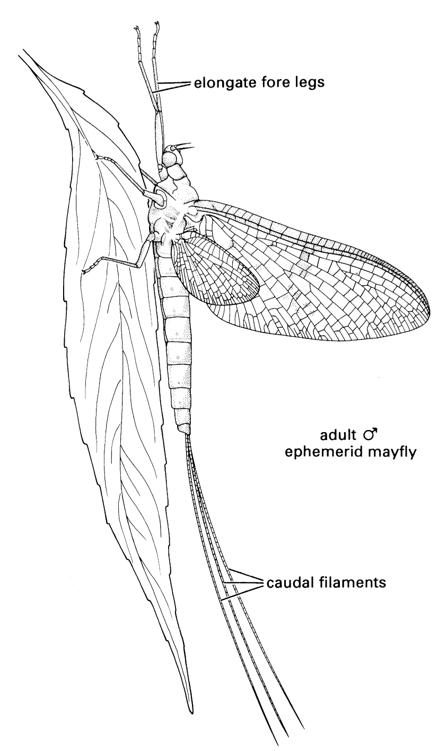
Wing folding
Paleoptera
No folding
Ephemeroptera
Odonata
Neoptera
Folding
All other orders

Slide 44
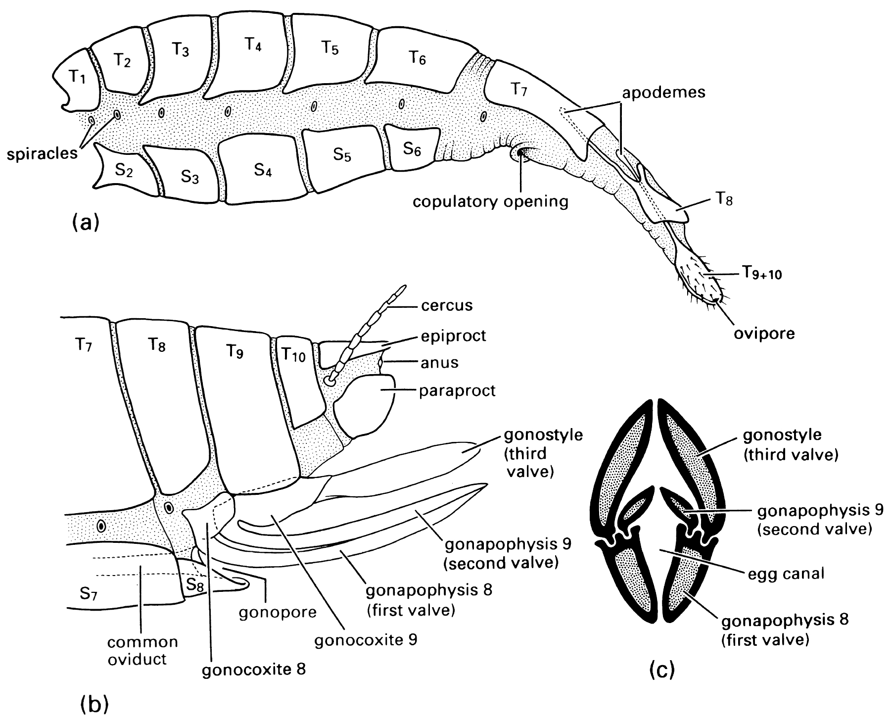
Abdomen
Ancestrally 11 metamers
Apterygotes have appendages
1st 7 segments
More or less identical
“pregenital”
Last 3 segments
Genital segments

Slide 45
Male genetalia
Aedeagus
Complexity
Reproductive isolation
Clasping
Parameres
Claspers
Gonocoxites

