Slide 1
Ensuring paternity Sheep blow fly, Lucilia cuprina box 5.4

Slide 2
Monogamous mating and eusociality
Mating system is central to the proposed evolution of eusociality (coming in ch. 12)
Colonies of social insects (Hymenoptera, Isoptera)
Reproductive individuals (Queen, King, Drone)
Nonreproductive individuals (Workers, Soldiers)
Cooperative reproduction
Overlapping of generations (mothers, daughters)
Typically offspring forgo reproduction, help mother raise more offspring
Monogamy: Ensures high relatedness among offspring
Thus high fitness gain for helping raise sisters
Monogamy window for the early evolution of eusociality
After evolution of eusociality, monogamy may be secondarily lost

Slide 3
Oviposition
Most insects lay eggs (Oviparity)
A few give birth to 1st instar larvae (Viviparity)
Ovoviviparity: eggs retained in the reproductive tract; hatch before or at oviposition; Blattidae, Aphidae, Scale insects, Thysanoptera, Parasitic Diptera
Pseudoplacental viviparity: yolkless eggs retained in reproductive tract; provisioned via placental like organ; aphids, other Hemiptera, Pscodea, Dermaptera
Hemocoelous viviparity: eggs develop in the hemocoel; absorb nutrients from hemolymph; Strepsiptera; some Cecidomyiidae
Adenotrophic viviparity: Larva hatches internally; feeds from specialized “milk” gland; Higher Diptera – Glossinidae, Hippoboscidae, Nycteribidae, Streblidae

Slide 4
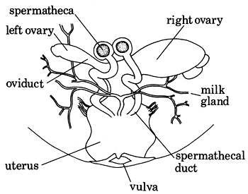
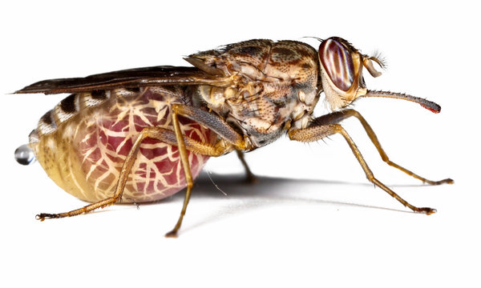
Tsetse fly

Slide 5
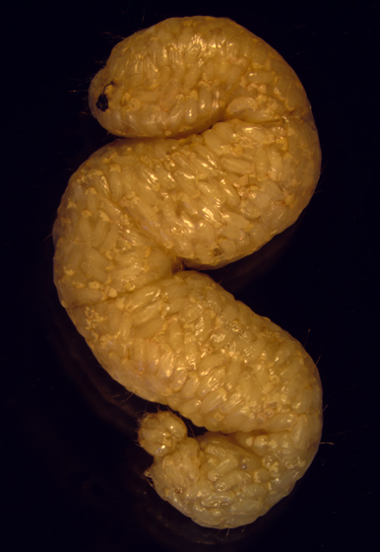
Polyembryonic development
Hymenoptera
Multiple embryos from one egg
Family Encrytidae (Hymenoptera)
Parasitoids
Hosts variable in size
Polyembryony enables parasitoids to maximize production from single host
Trophamnion: membrane that allows absorption of nutrients from the host
Enables multiplication of the embryo without additional yolk

Slide 6
Wolbachia
Now for something really strange
Endosymbiotic bacteria (parasitic?)
Common in some insects, other groups
Cytoplasmic inheritance (like mitochondria)
Distort host reproduction in ways that benefit Wolbachia

Slide 7
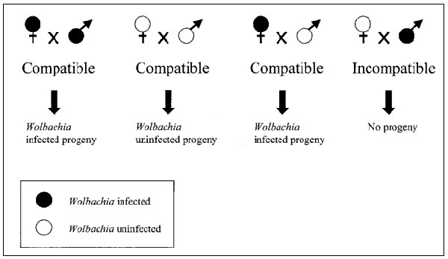
Wolbachia
Cytoplasmic incompatibility
Gives reproductive advantage to Wolbachia infected females
Result: Wolbachia infections spread throughout the population

Slide 8
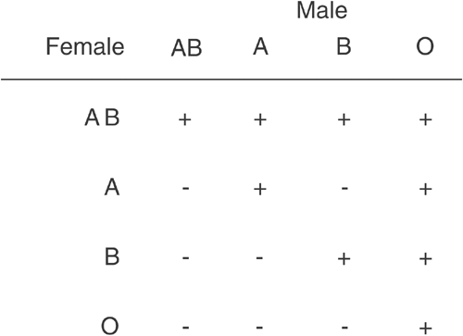
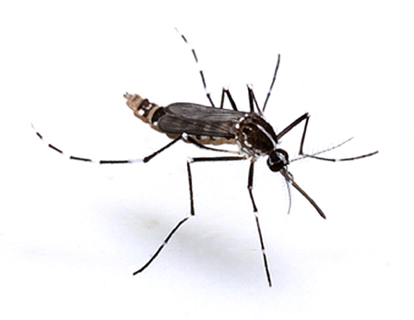
Superinfection

Slide 9
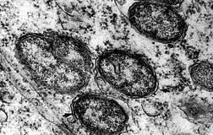
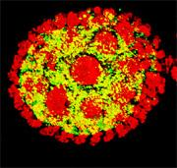
Wolbachia
Sex ratio distortion
Wolbachia cause duplication of female genome in unfertilized eggs of Hymenoptera
Makes egg diploid
Males converted to females
Propagates more Wolbachia
Feminization
Non Hymenoptera
Turns genetic males into females
Turns off male-determining genes
Male killing

Slide 10
Hormonal control of reproduction

Slide 11
Hormonal control of female reproduction in Romalea
Newly eclosed females have little stored reserves
No reproduction (anautogenous)
Feeding by the adult results in accumulation of Hexamerins (“storage proteins”)
Hemolymph
Fat body
Critical amount of Hexamerins triggers hormone cascade
Juvenile hormone
Ecdysteroids

Slide 12
Hormonal control of female reproduction in Romalea
Vitellogenesis
Amino acids in Hexamerins used to synthesize Vitellogenin
Vitellogenin circulates via hemolymphs
Transferred via nurse cells to oocytes
Converted to vitellin (yolk protein)
Once hormonal signal is given, process proceeds independent of feeding
Oocytes can be resorbed if insufficient vitellin is available
Reduces number of eggs laid
Timing seems to be inflexible once initiated (“canalized”)

Slide 13
Sensory systems & Behavior (Ch. 4)
The challenge of an exoskeleton
Mechanical
Thermal
Chemical
Visual
Behavior

Slide 14
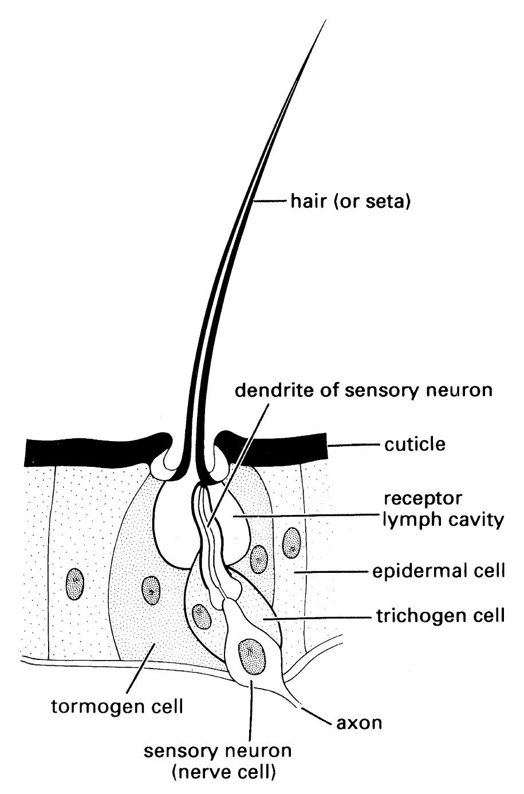
Mechanoreception
Trichoid sensilla
Conical seta in a mobile socket
Tormogen cell
Grows the socket
Sensory Neuron
Detects seta movement
Trichogen cell
Grows the seta

Slide 15
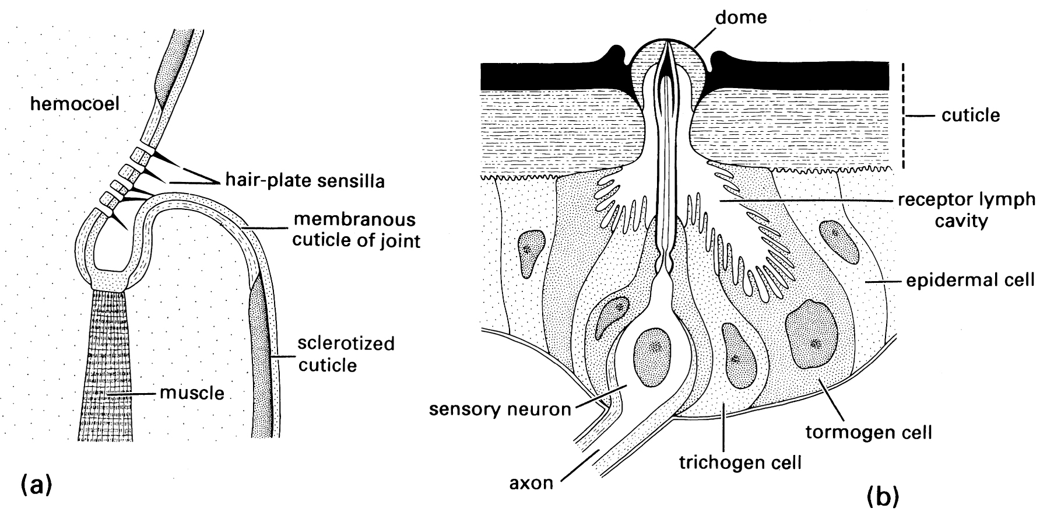
Mechanoreception: Propioception
Detecting where your body parts are and what they are doing.
Hair plate (joints)
Stretch receptor (muscles, internal organs)
Campaniform sensillum (Exoskeleton)

Slide 16
Sound
Also mechanoreception: vibration
Insects hear 1 Hz – 100,000 Hz
Humans by comparison: 20 – 20,000 Hz
Substrate vibrations (solid or water)
Chordotonal Organ – detect vibrations
Antenna (pedicel)
Trichoid sensilla also sense vibrations
Tympana
Membrane covered chordotonal organ
Air sacs

Slide 17
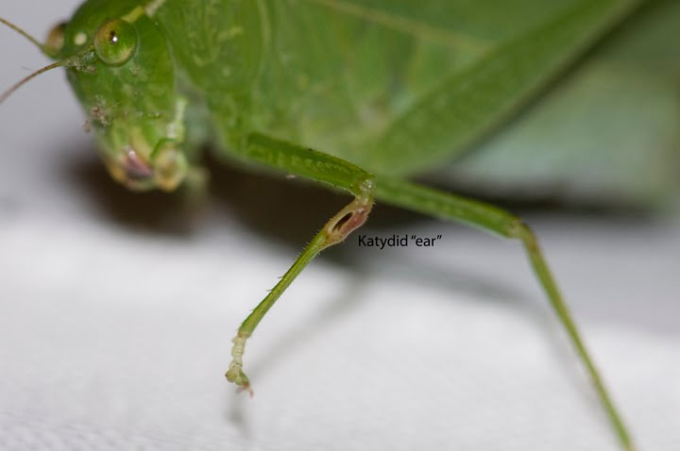
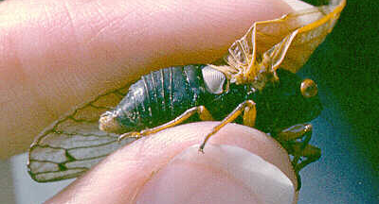
Tympana
Evolved repeatedly in different groups
Prothoracic legs in crickets, katydids
Metathorax in Noctuid moths
Neck membrane in scarab beetles
Prosternum in some flies
Between metathoracic legs in mantids
Anterior abdomen in many groups incl. Cicadas
Wing bases some moths, Neuroptera

Slide 18
Tympana Katydid
a) body and leg
b) leg cross section
c) longitudinal section through prothoracic leg

Slide 19
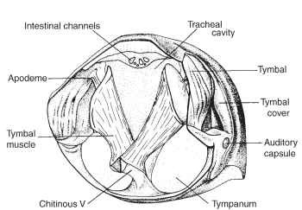
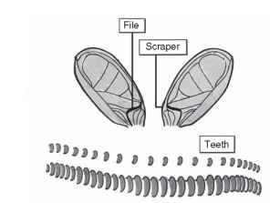
Stridulation
Crickets
Tegmina
File rubbed against scraper
Amplified by subtegminal space or burrow
Cicadas
Tymbal – specialized exoskeleton

Slide 20
Heat
Sensing heat: text
Thermoregulation:
Poikilothermic (as opposed to homeothermic)
Temperature varies with environment and behavior
Most are ectotherms
Regulate temperature via behavior
Some are endotherms
Regulate temperature via internally generated heat
Temperature does not typically remain constant

Slide 21
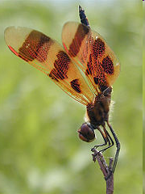
Heat balance for an insect
Convection (+/−)
WIND
Direct
Radiation (+)
Re-radiation (−)
Evaporation(−)
Reflected
Radiation (+)
Conduction (+/−)

Slide 22
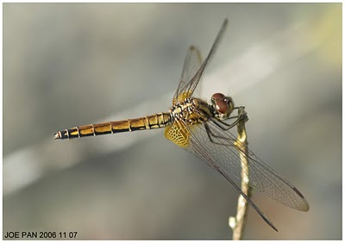
Position and radiant heat input
Maximize surface
Minimize surface

Slide 23
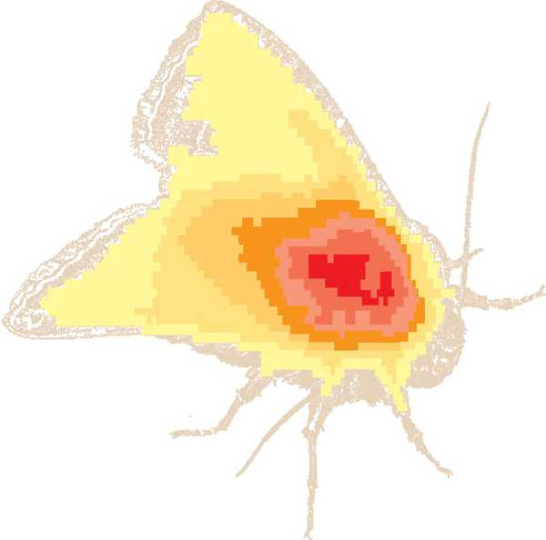
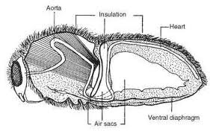
Endothermy
Large insects can generate heat via thoracic muscles
Used to warm up prior to flight
Bees, Moths, Butterflies, Wasps
Move wing muscles without (some times with) moving wings
Countercurrent bloodflow

Slide 24
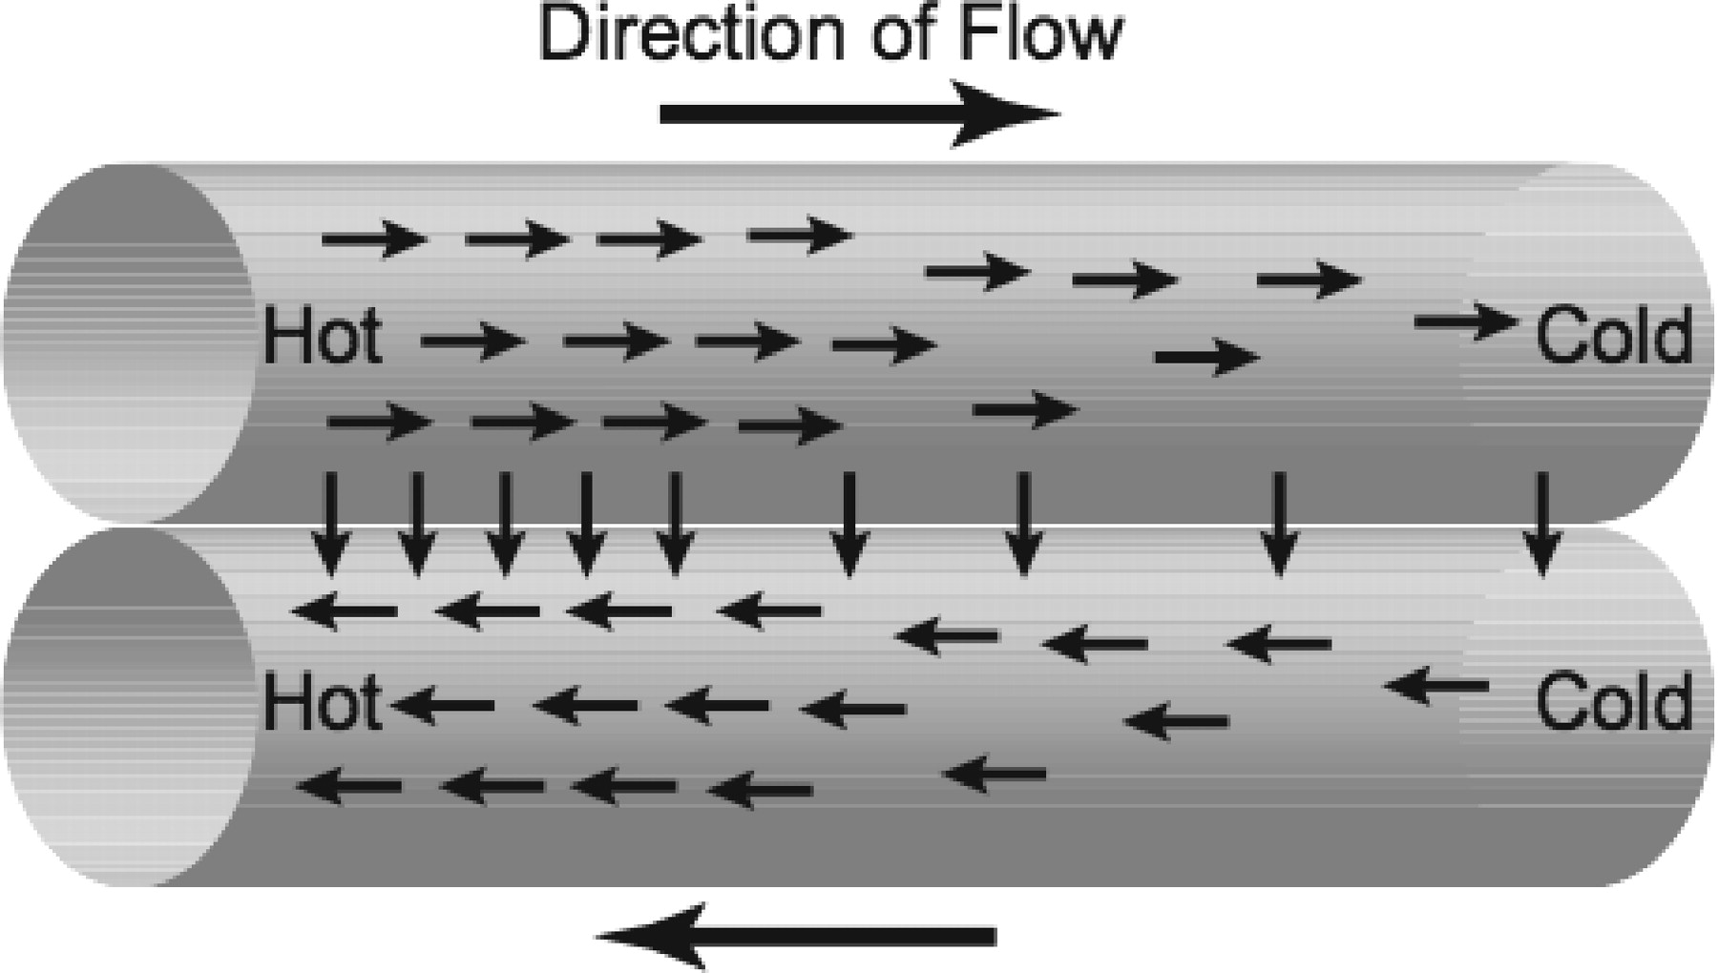
Countercurrent heat exchange
Thorax
Abdomen

Slide 25
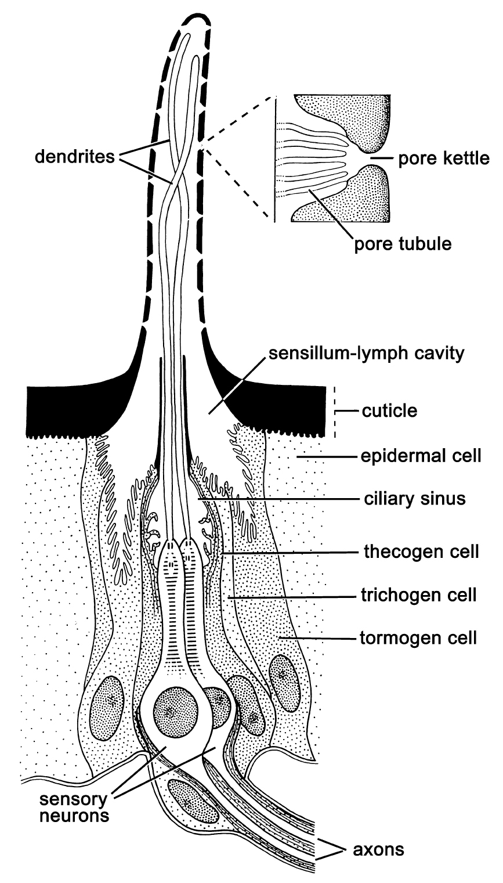
Chemoreception
Contact (Taste)
Air/water borne (Smell)
Sensilla
Uniporous [1º contact]
Multiporous [airborne]

Slide 26
Kinds of chemical stimuli: communication
Semiochemicals: Chemical signals that affect behavior of the receiver
Between members of the same species:
Pheromones: communication between conspecifics; affects behavior or development of receiver
Between members of different species:
Allelochemicals
Kairomones: benefits the receiver; disadvantageous to the producer
Allomones: benefits the producer; neutral to receiver
Synomones: benefits both the receiver and the producer

Slide 27
Pheromones
Released from exocrene glands to exterior environment
Product of selection acting on the releaser and receiver
Behavioral releasers: Receiver behaves in a particular way after sensing signal
Developmental primers: development and physiology of receiver changes in a particular direction after receiving the signal

Slide 28
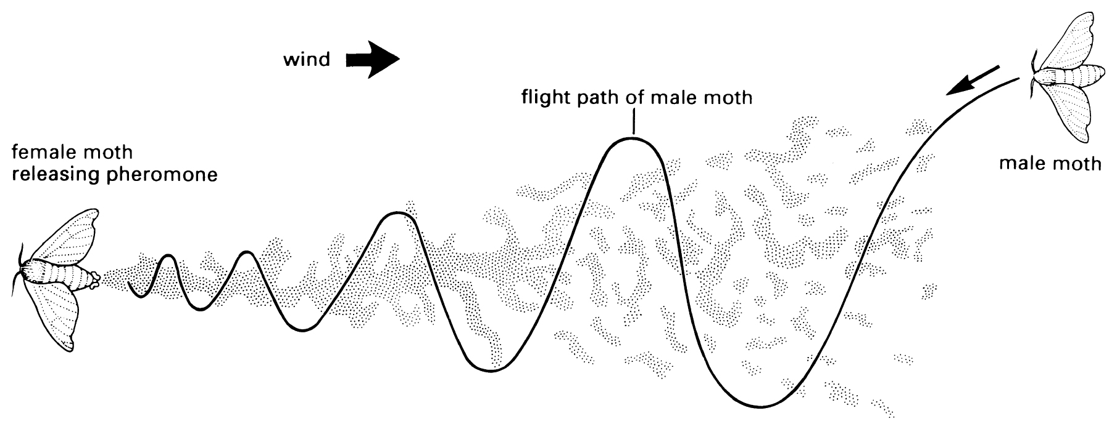
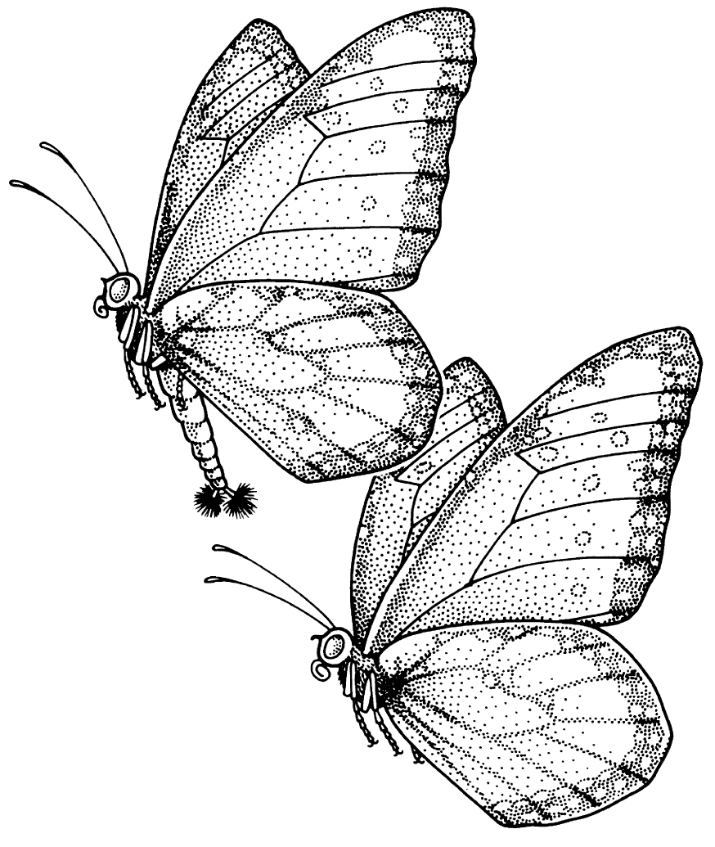
Pheromones
Sex pheromones
Sex attraction pheromones (volatile, long range)
Mostly female releases; male responds
Often synthesized from components of diet
Often mixtures of chemicals
Chiral forms may have different activity
Courtship pheromones (close range)
May be the same or different from sex pheromone

Slide 29
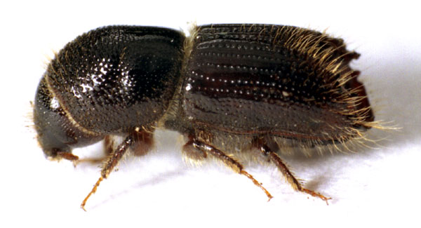
Pheromones
Aggregation pheromones
Attract members of both sexes
Sometimes for mating
Often for other benefits of aggregation
Dilution of predator effect
Resource harvesting
Bark beetles
Larvae feed on inner bark of damaged, dying trees
Synergistic action of male and female released chemicals (and host chemicals) attracts adults
Overwhelms tree defenses

Slide 30
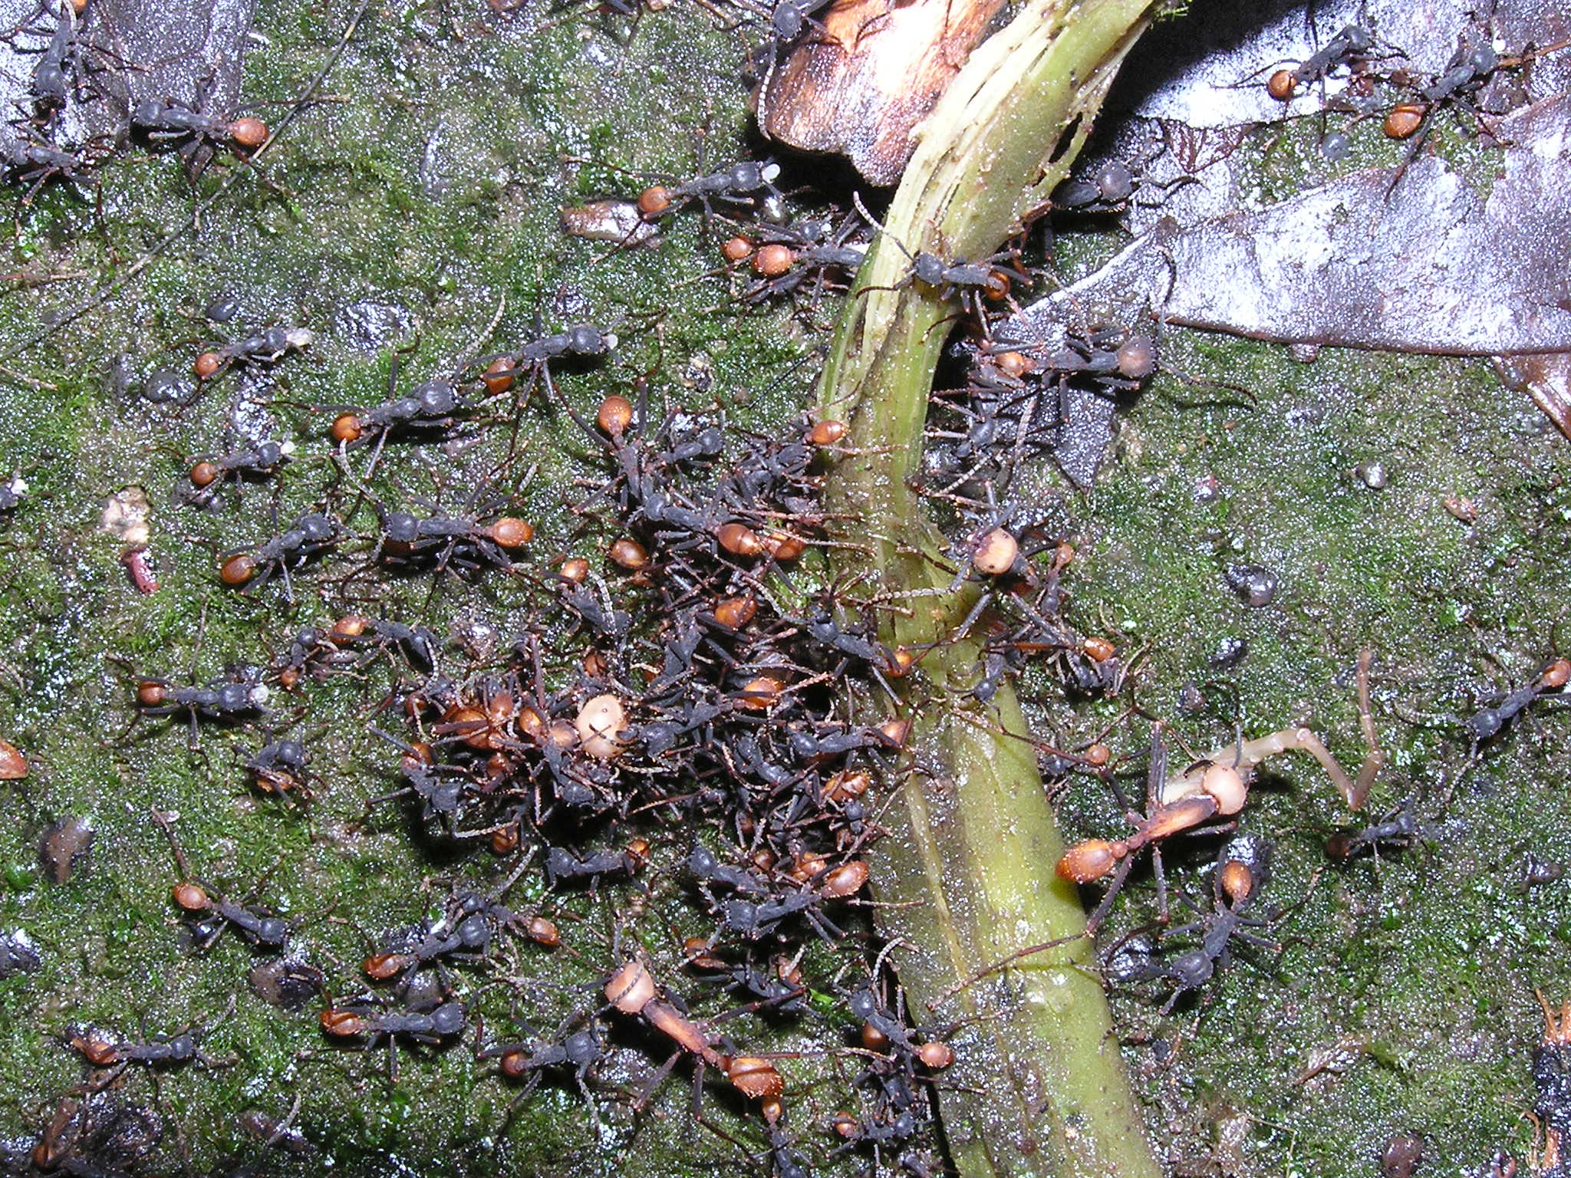
Pheromones
Trail marking pheromones
Ants, other social insects
Volatile, short lived
Not directional
do not cue direction nest ←→food source

Slide 31
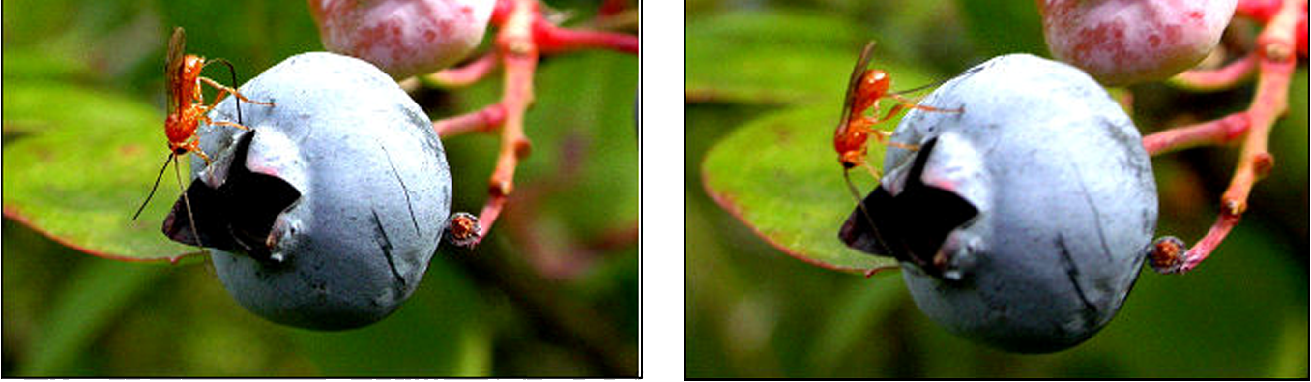
Pheromones
Spacing (epidiectic, dispersion) pheromones
Serve to spread out conspecifics and minimize intraspecific competition
Marking pheromones for plant and animal parasites, parasitoids
Rhagoletis mendax
Diachasma alloeum

Slide 32
Pheromones
Alarm pheromones
Social and subsocial insects
Pheromone releases evasive, aggressive, or defensive behavior in the receiver
Alarm cues ≠ alarm pheromone
Pheromone: specific glandular secretion; product of selection on the sender and recipient
Cue: any chemical signal detected by recipient; selection only on recipient.

Slide 33
Allomones
Producer benefits
Recipient neutral
Warning chemicals:
Deter predation
Predator loses a meal, but also avoids distasteful, toxic meal
May be produced directly by producer or may be sequestered components of diet
Often associated with visual cues (aposematic coloration)
Hymenoptera: associated with ovipositor (sting)

Slide 34
Kairomones
Basically scent of another species
Advantageous for recipient to detect and to respond
Disadvantageous to sender
Prey, host cues
Predator, parasite cues
Pheromones (within species communication) may also be kairomones (e.g., pheromone is cue for a predator)
Tapping into communication channels of prey.

Slide 35
Synomones
Plant chemicals that are produced by herbivore damage
Serve as cues to parasitoids of herbivore
Selection on parasitoid for better host finding
Selection on plant?
Beneficial to plant
Adaptation? Or Exaptation.
Adaptation: selected for its current function
Exaptation: character exists and was selected for some other function, and incidentally as a beneficial function

Slide 36
CO₂ receptors
Biting Diptera cue in on CO₂ and skin chemicals to locate blood meal hosts
Fruit flies (Tephritidae) lay eggs in damaged fruit – cue in on CO₂
Even plant feeding insects use CO₂ as a cue as many parts of plants produce CO₂
Sensed via sensilla on maxillae, palps, antennae

Slide 37
Vision
Three kinds of eyes
Photoreceptor: Rhabdom cell
Nerve cells: Retinula cells
Lenses
Stemmata: simple eyes of larvae
Simple light / dark sensors; detect movement, but probably don’t give an image in the usual sense
Low acuity

Slide 38
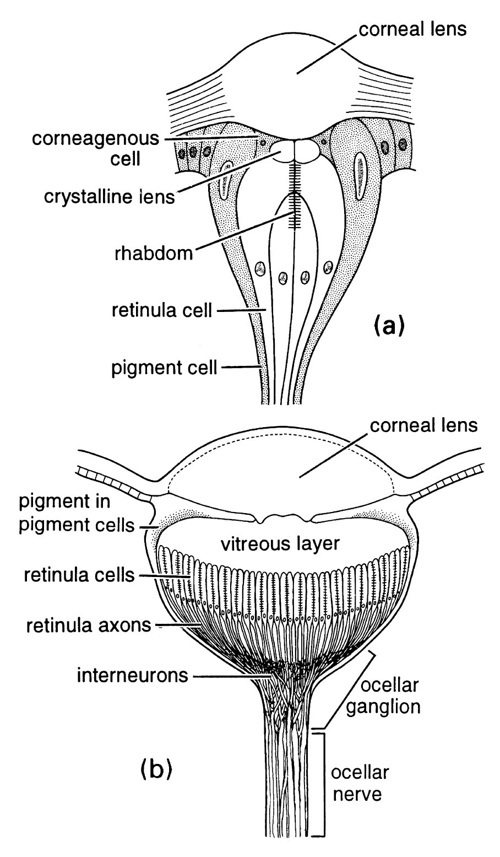
Simple eyes
Stemmata: simple eyes of larvae
Simple light / dark sensors; movement; probably no image
Low acuity
Ocelli: simple eyes of adults, nymphs
Simple light / dark sensors
Not homologous with stemmata
More retinula cells
Operate in low light
Horizon detectors; position

Slide 39
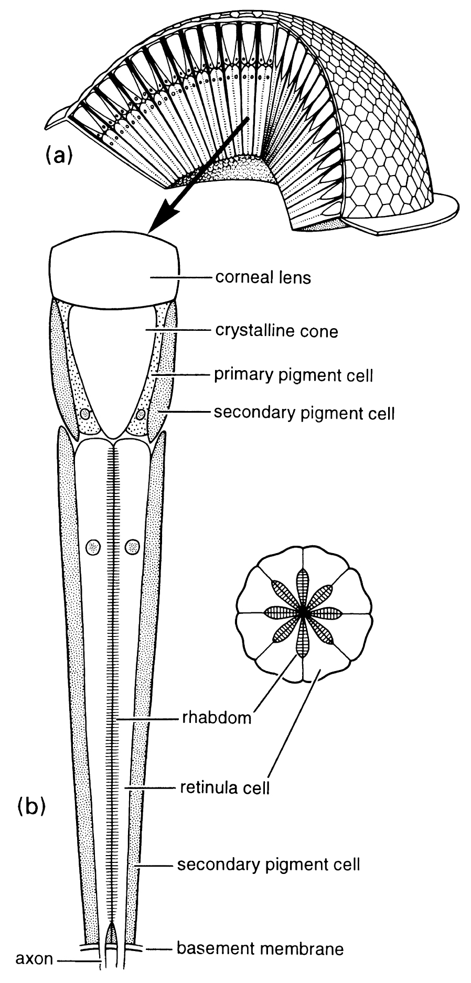
Compound eyes
Present in crustacea
Rival vertebrate, cephalopod eye for sophistication
Unit: Ommatidia
Many ommatidia together provide excellent motion detection
Apposition eye: ommatidia isolated by pigment cells
Best resolution
Superposition eye: light crosses ommatidia
Best sensitivity

Slide 40
Color vision
Up to pentachromatic (contrast with trichromatic vision of the most color sensitive vertebrates)
Insects see ultraviolet, and many plants provide ultraviolet cues to pollinators
Insects often see polarized light
Light organized into wavelengths that have a particular angle
Used by bees to navigate relative to polarized sky light

