Slide 1
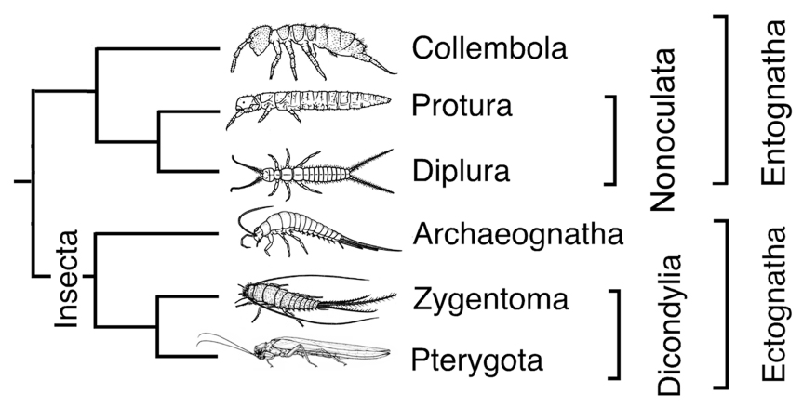
Ectognatha and Entognatha

Slide 2
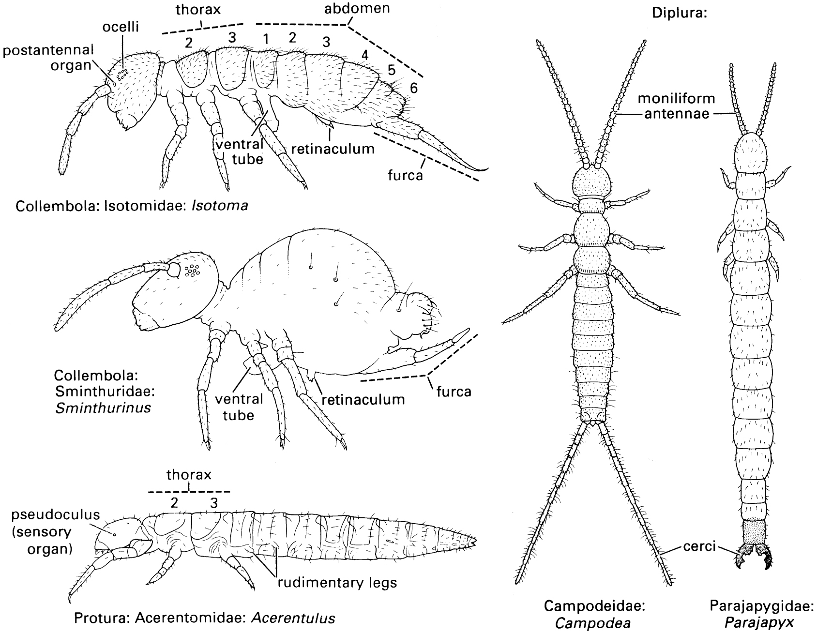
http://www.youtube.com/watch?v=OwOL-MHcQ1w&playnext=1&list=PL2E192202BEDB356A&feature=results_main

Slide 3
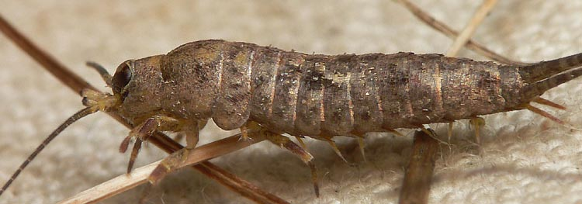
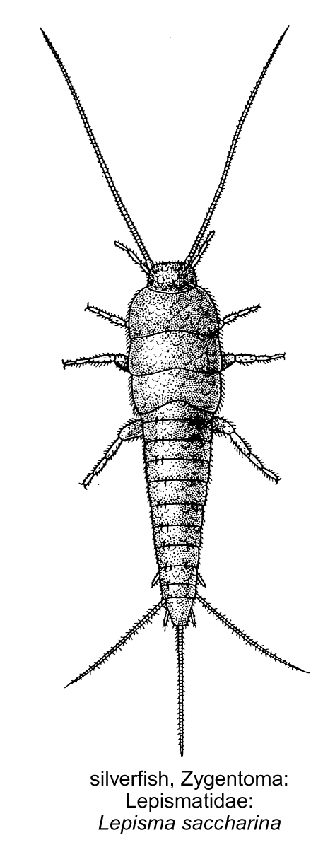
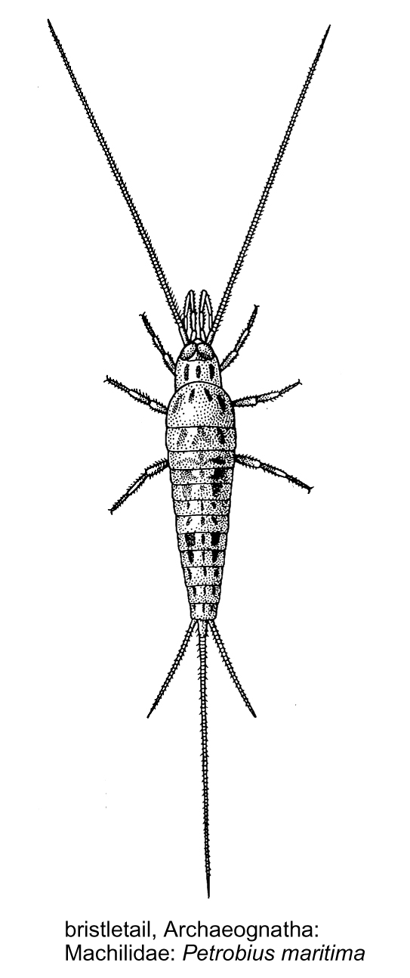
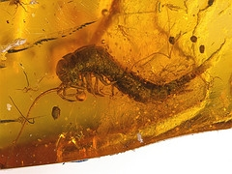
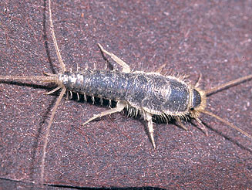

Slide 4
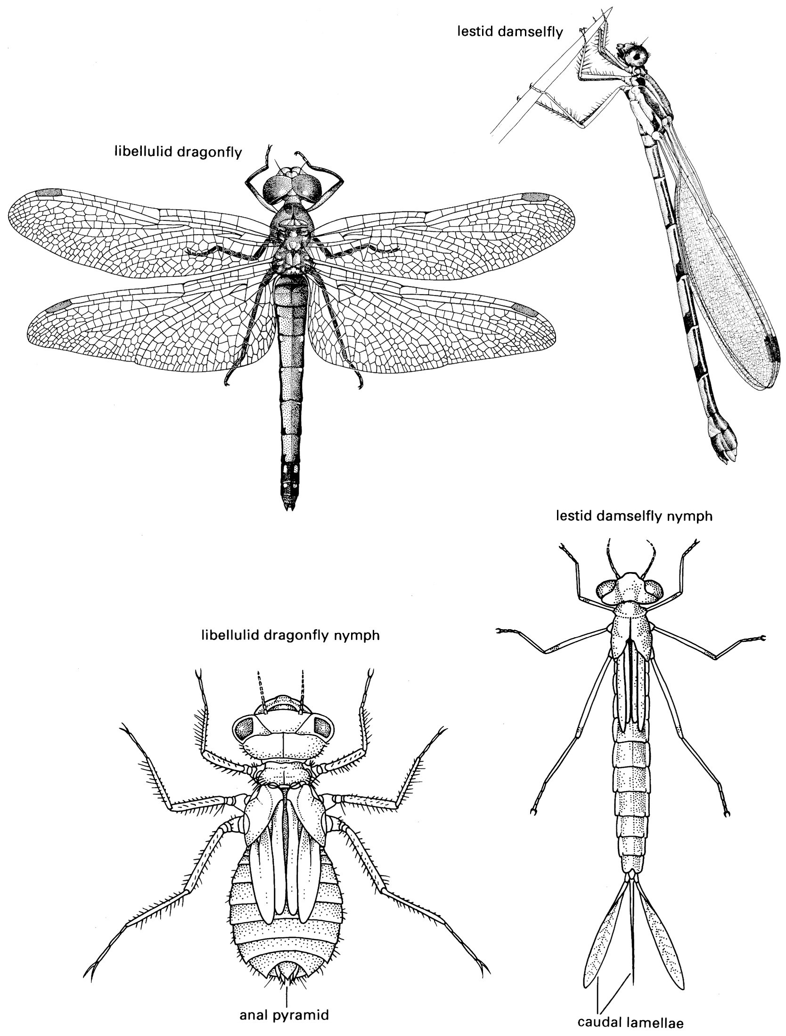
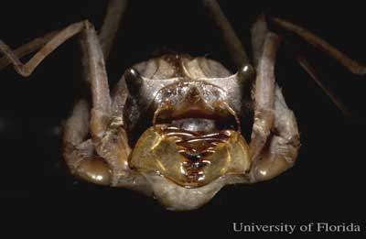
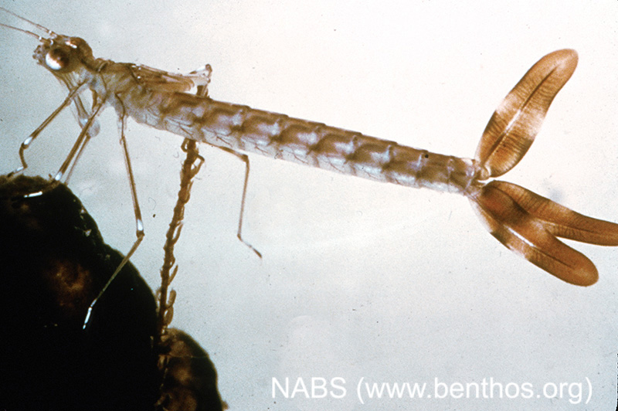
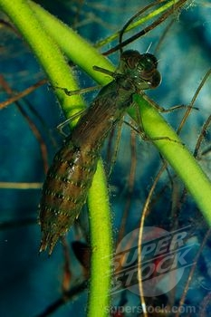
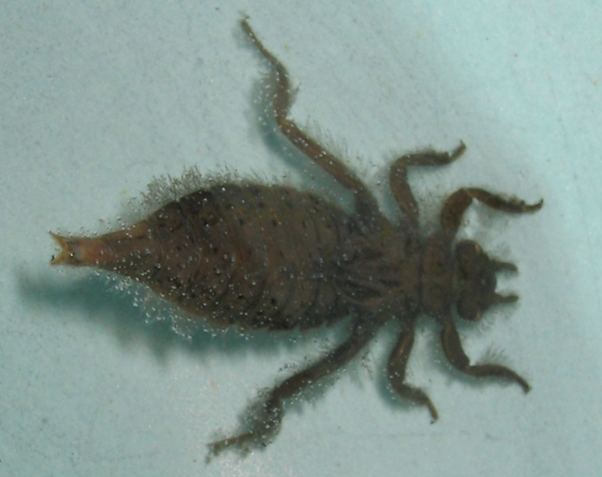
http://www.youtube.com/watch?feature=endscreen&v=W557aSVdW_g&NR=1

Slide 5
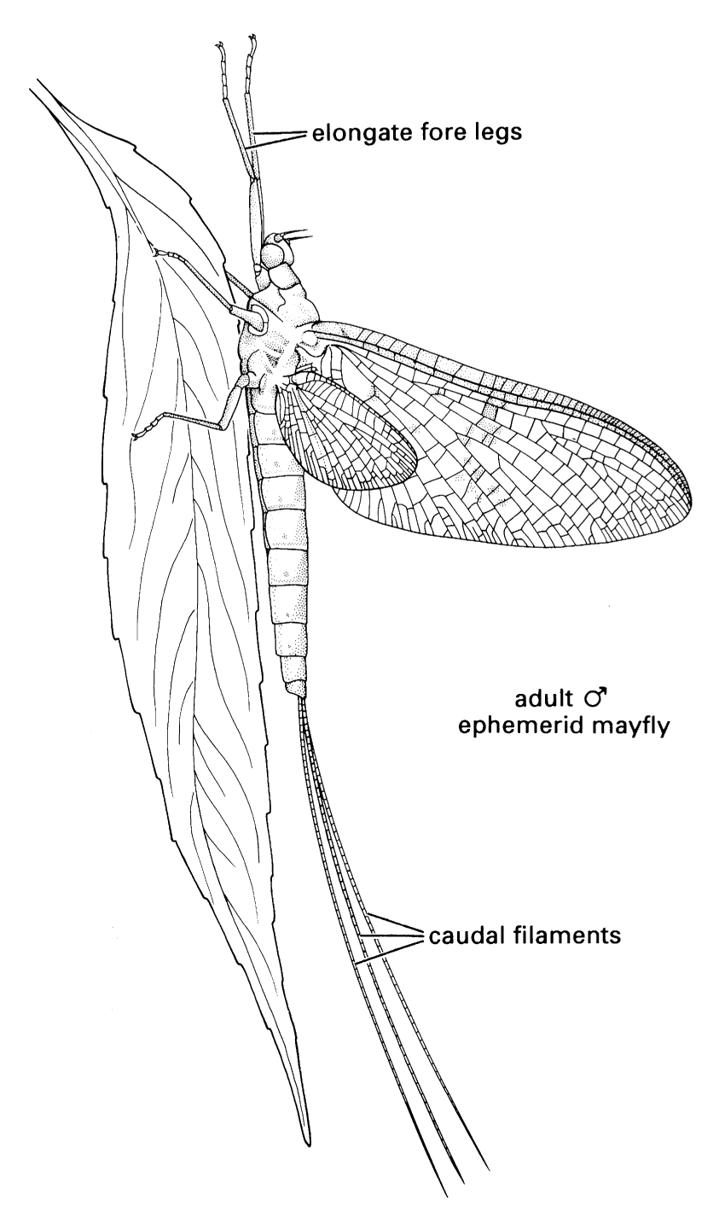
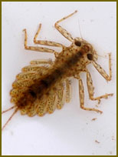
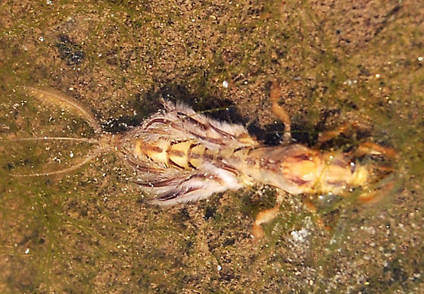
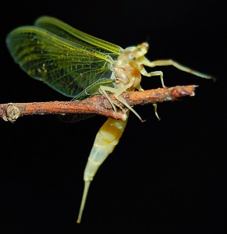
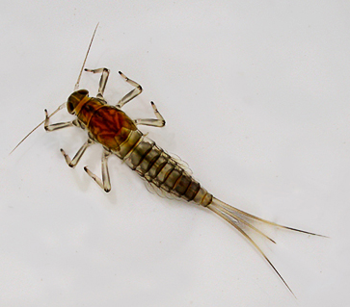

Slide 6
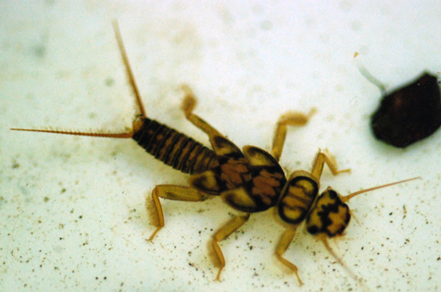
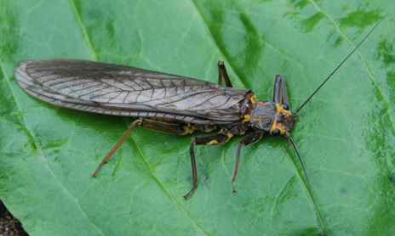
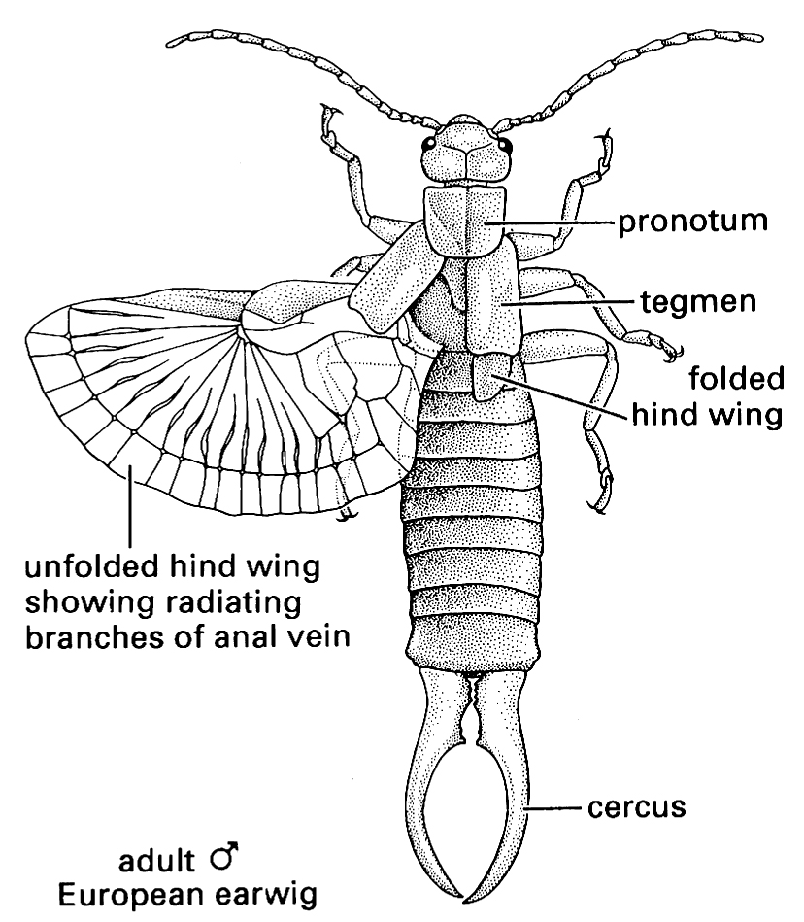
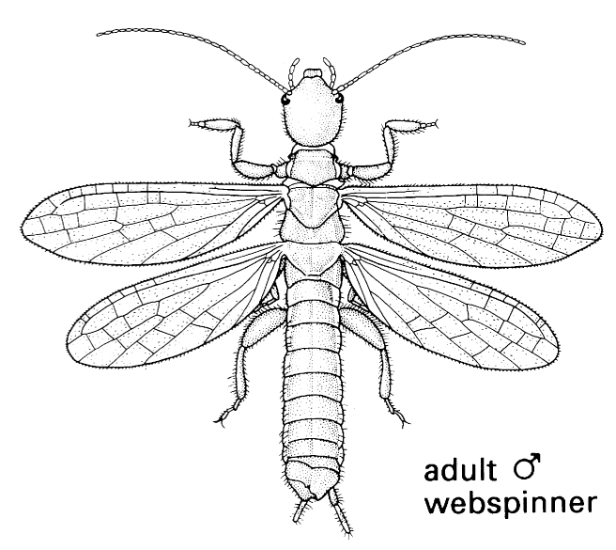

Slide 7
Dictyoptera

Slide 8
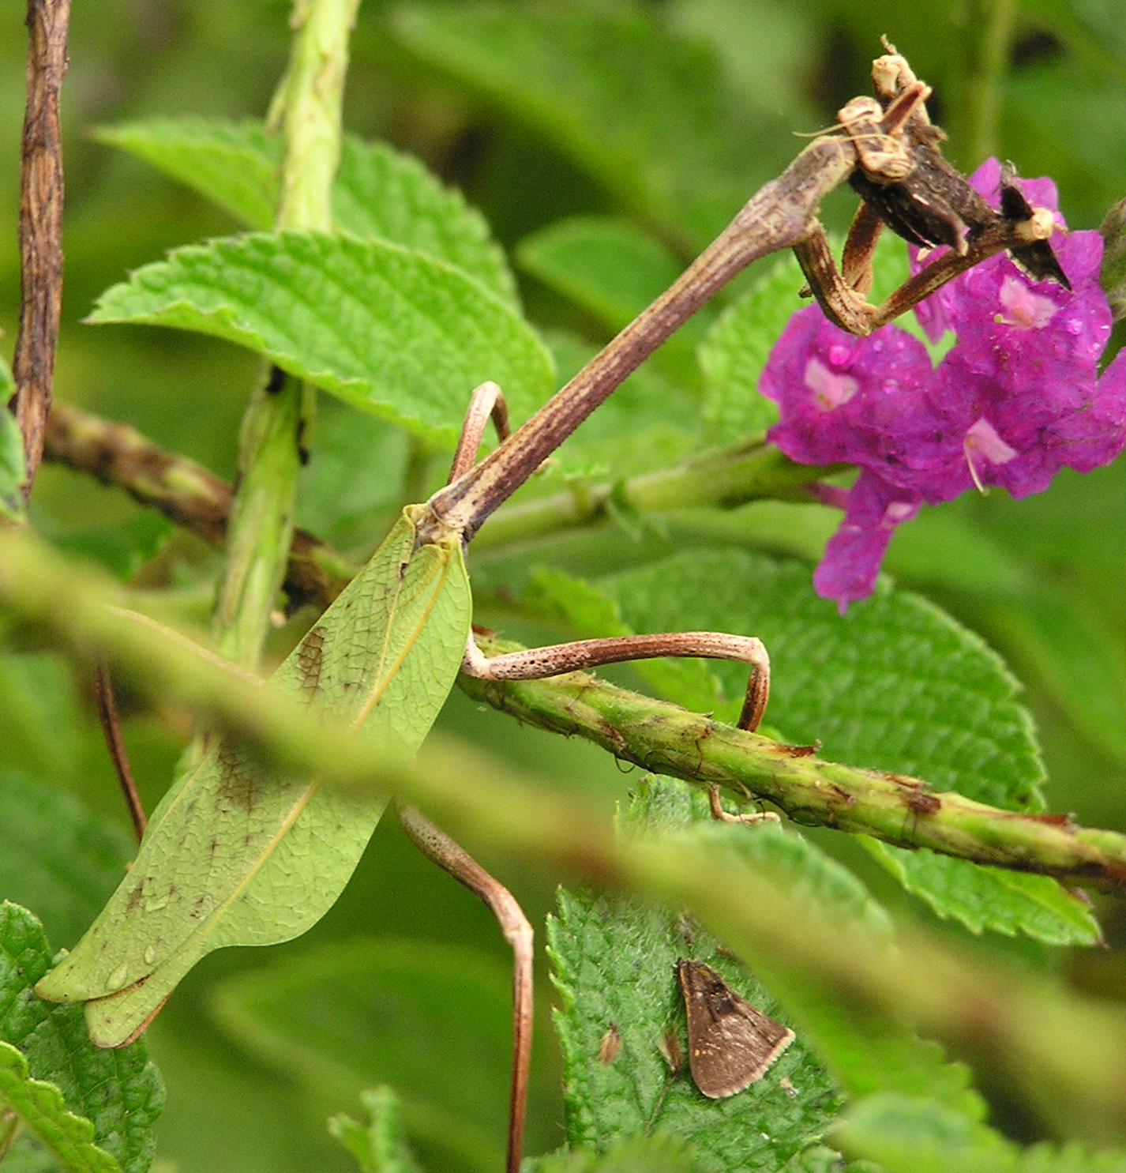
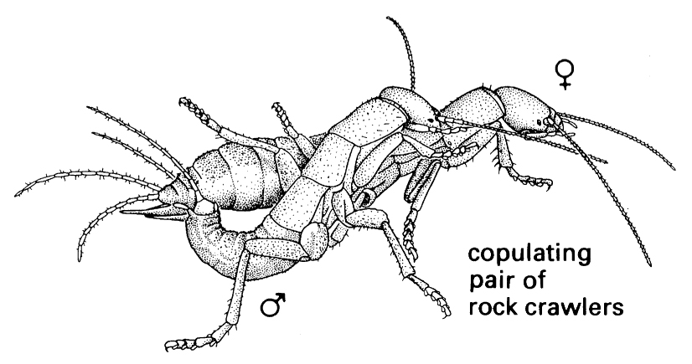
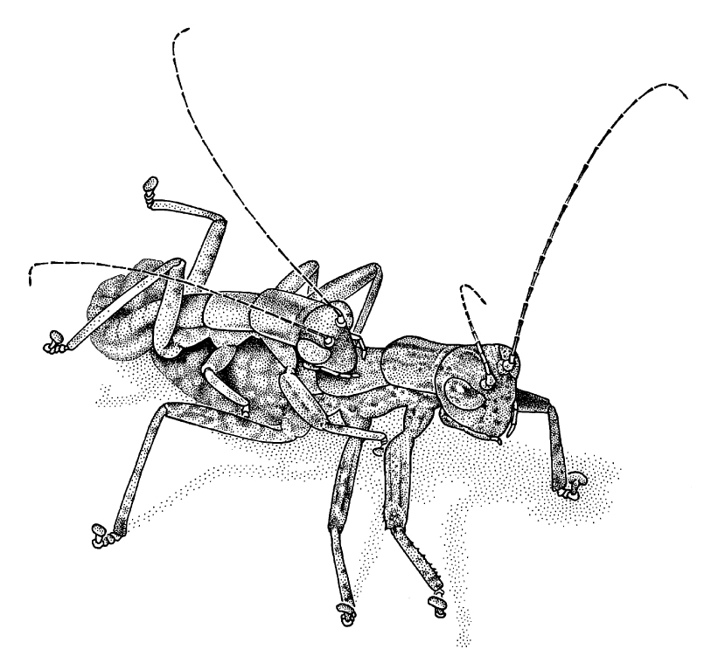
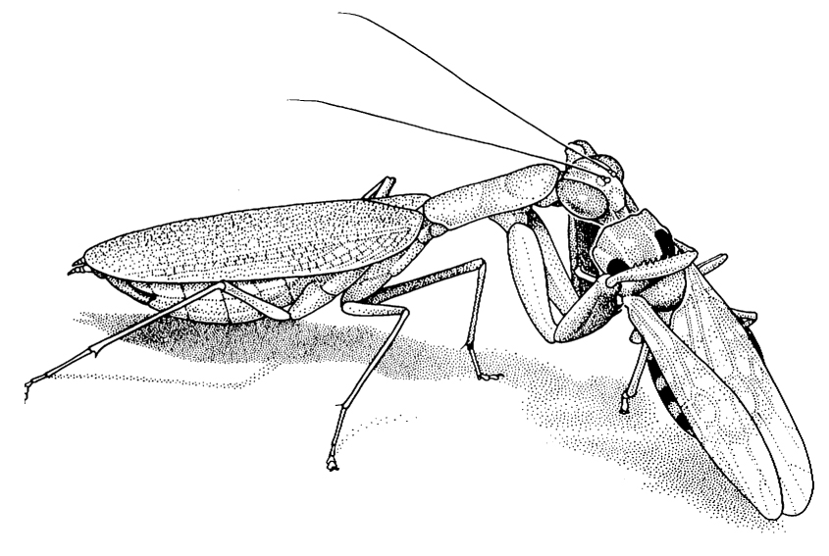
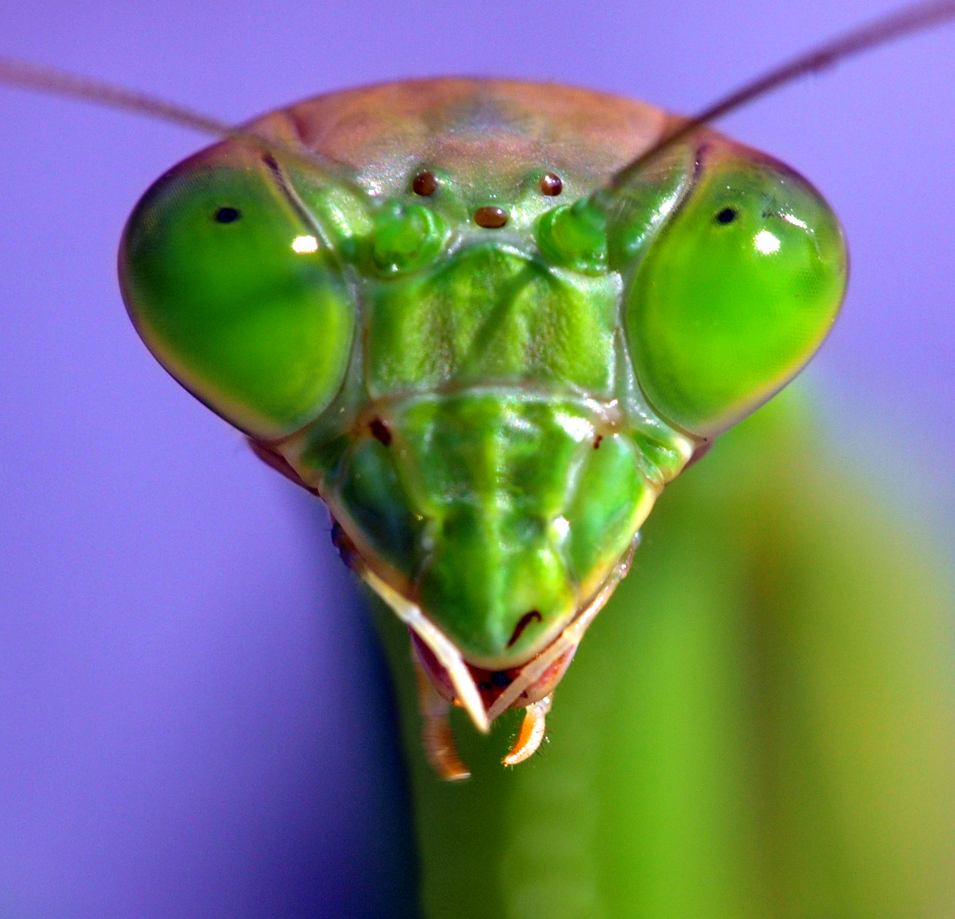
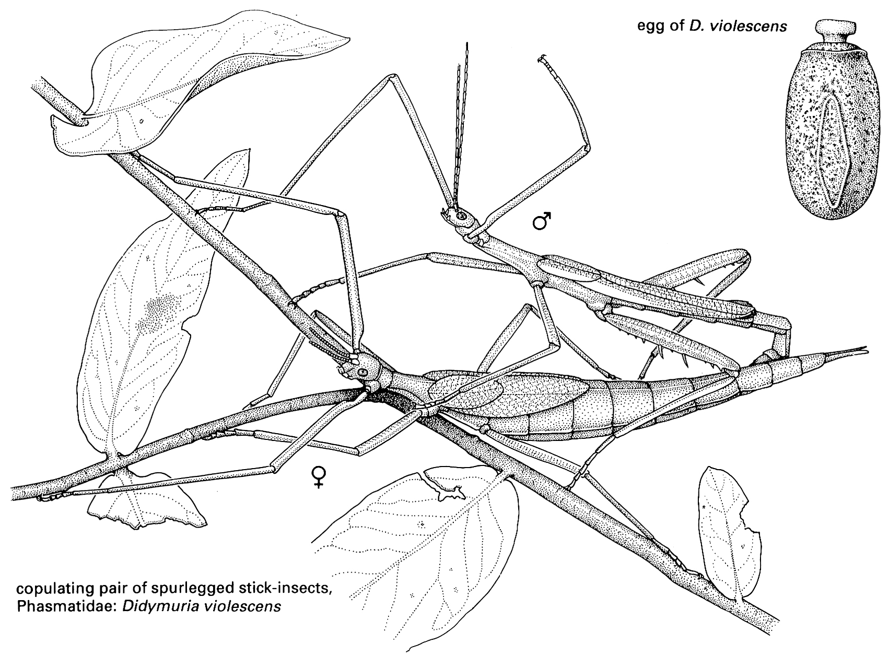

Slide 9
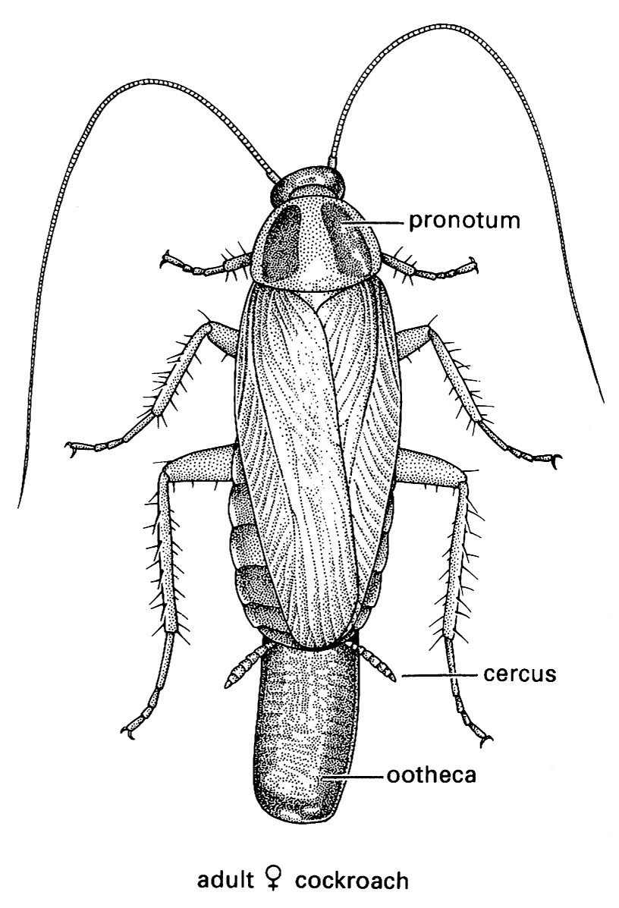
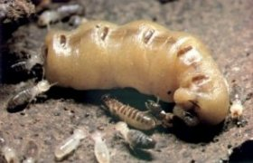
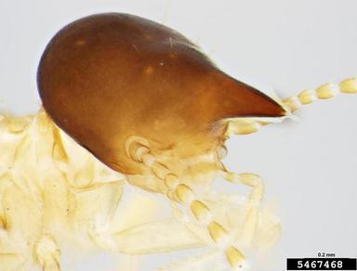
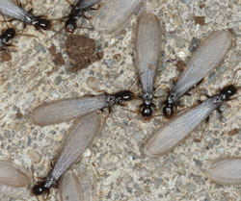
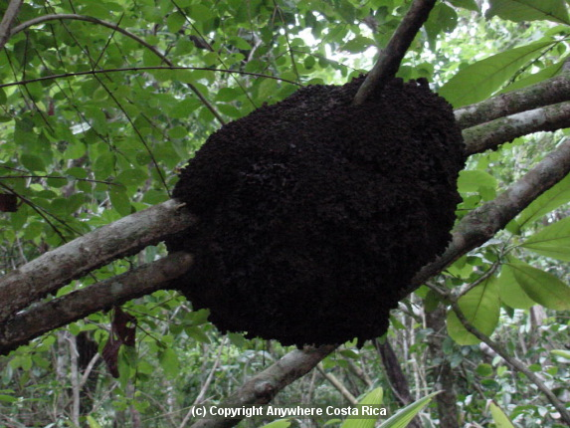
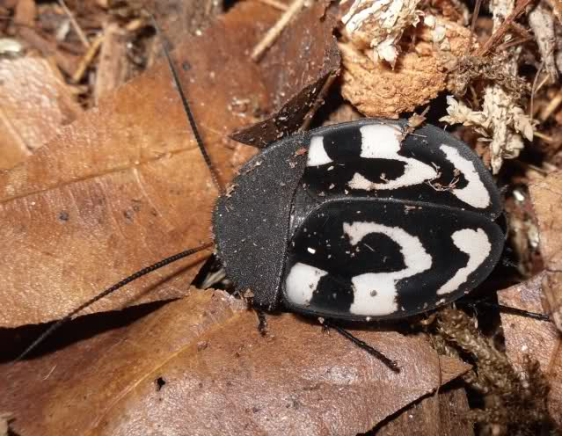

Slide 10
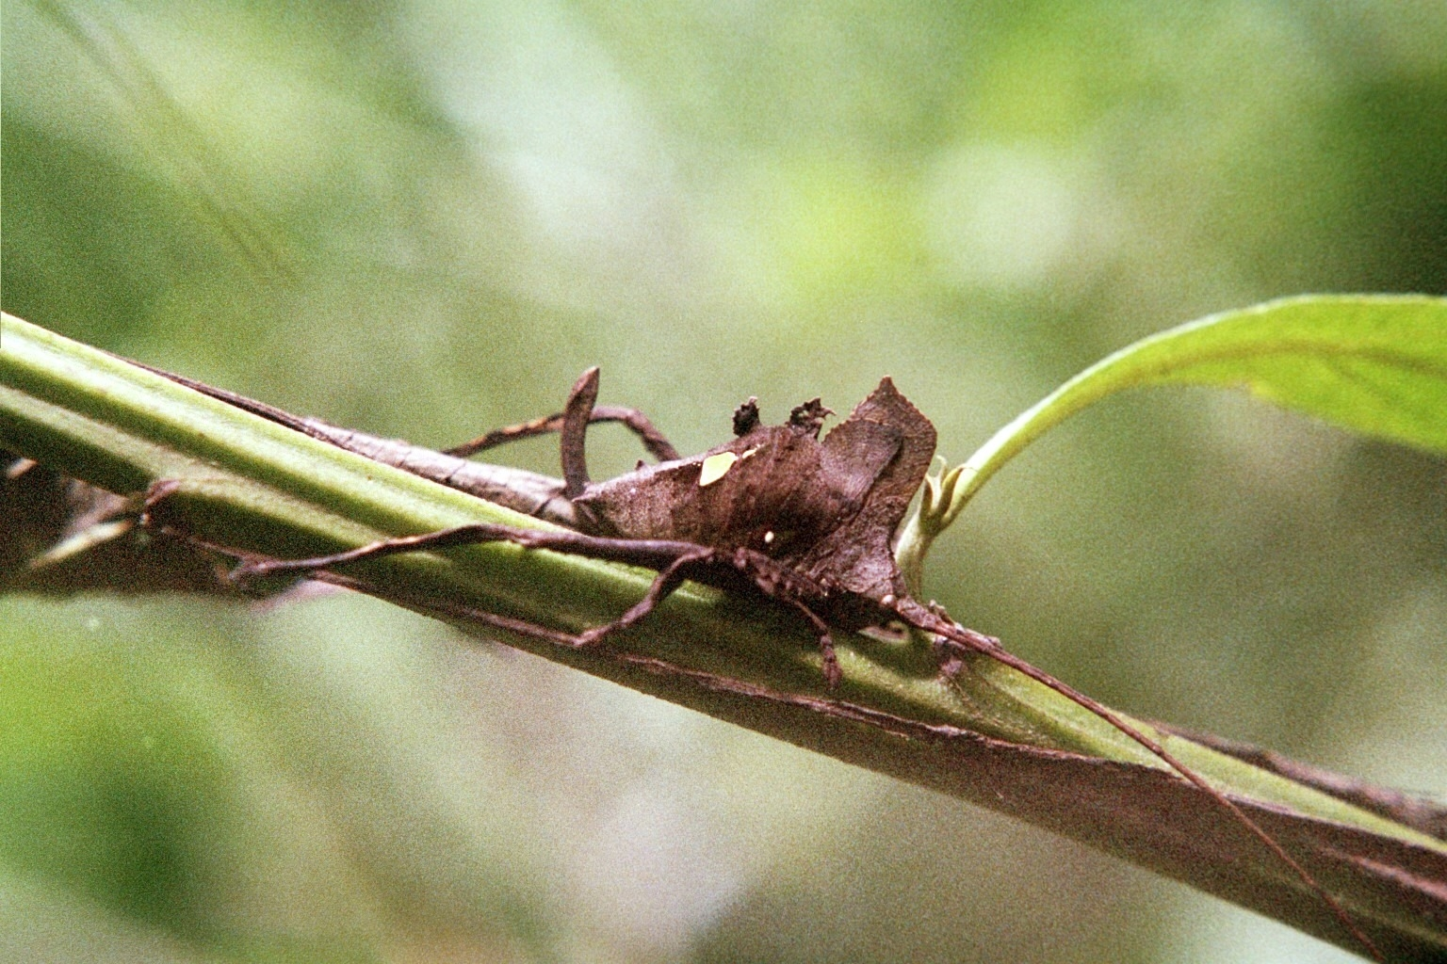
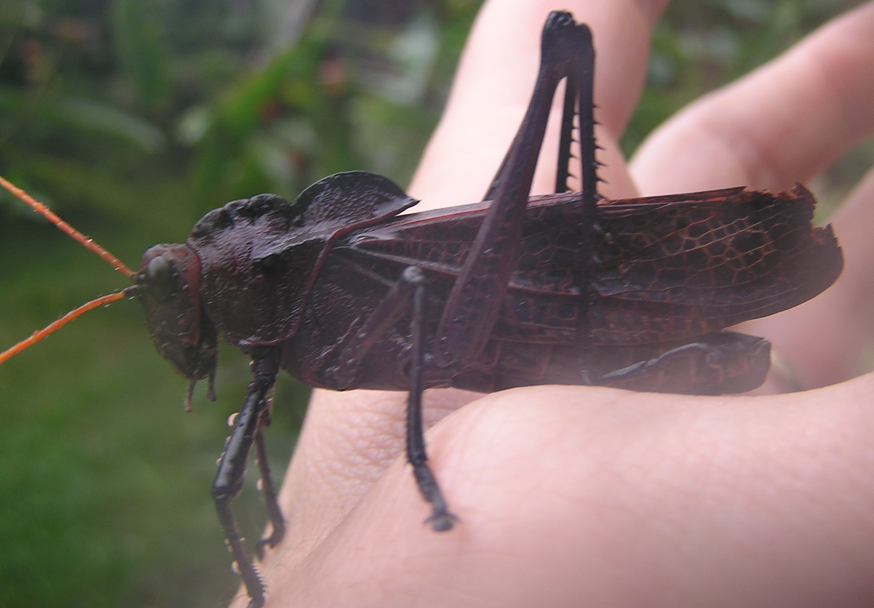
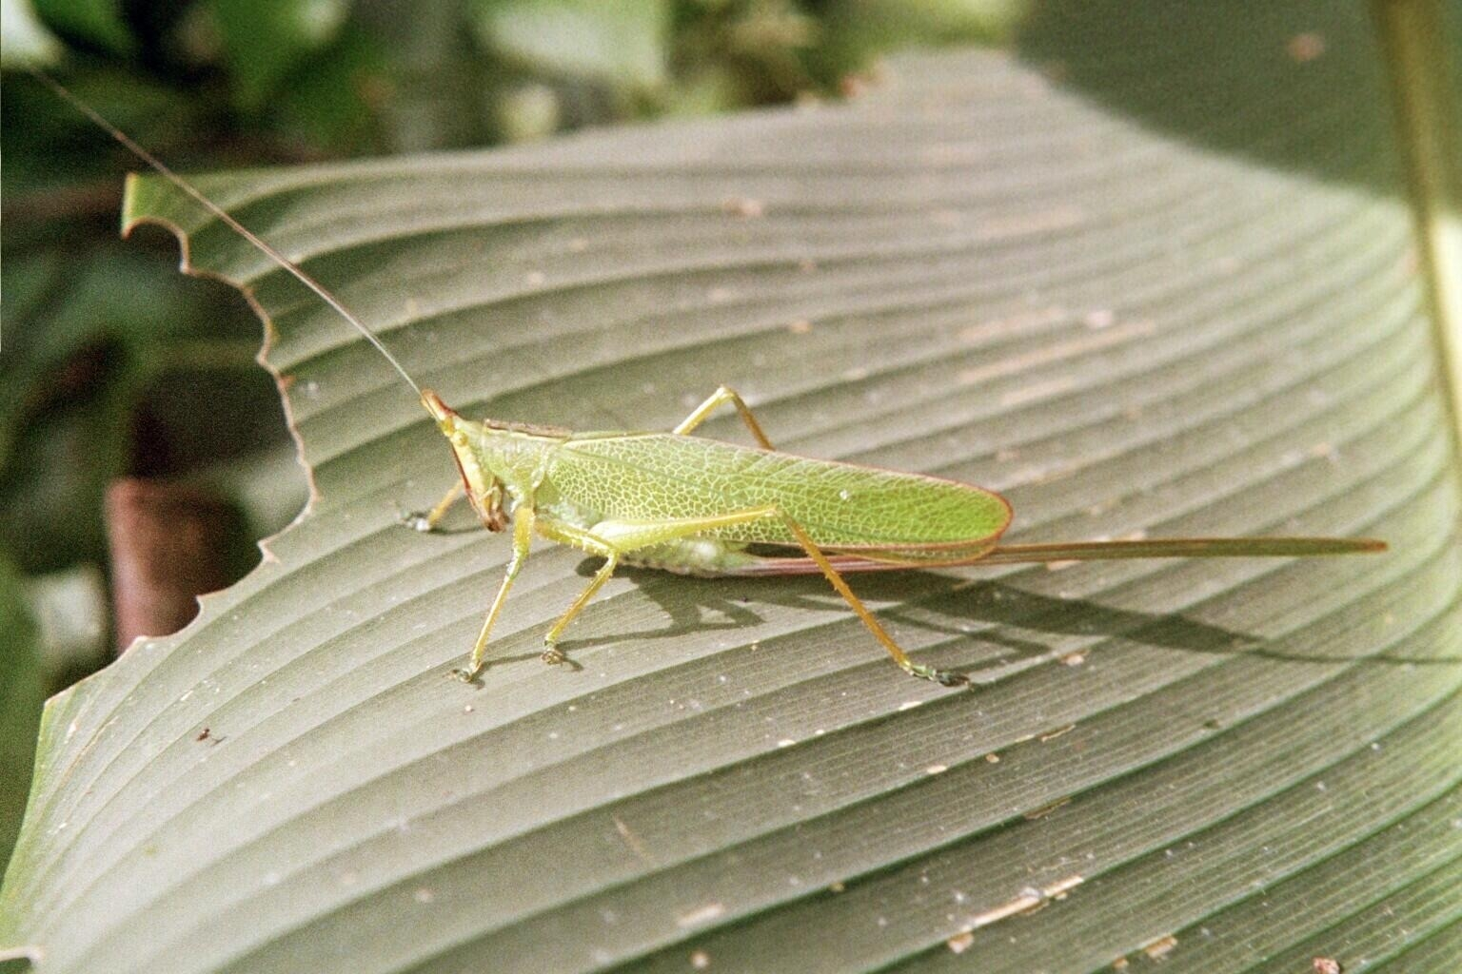
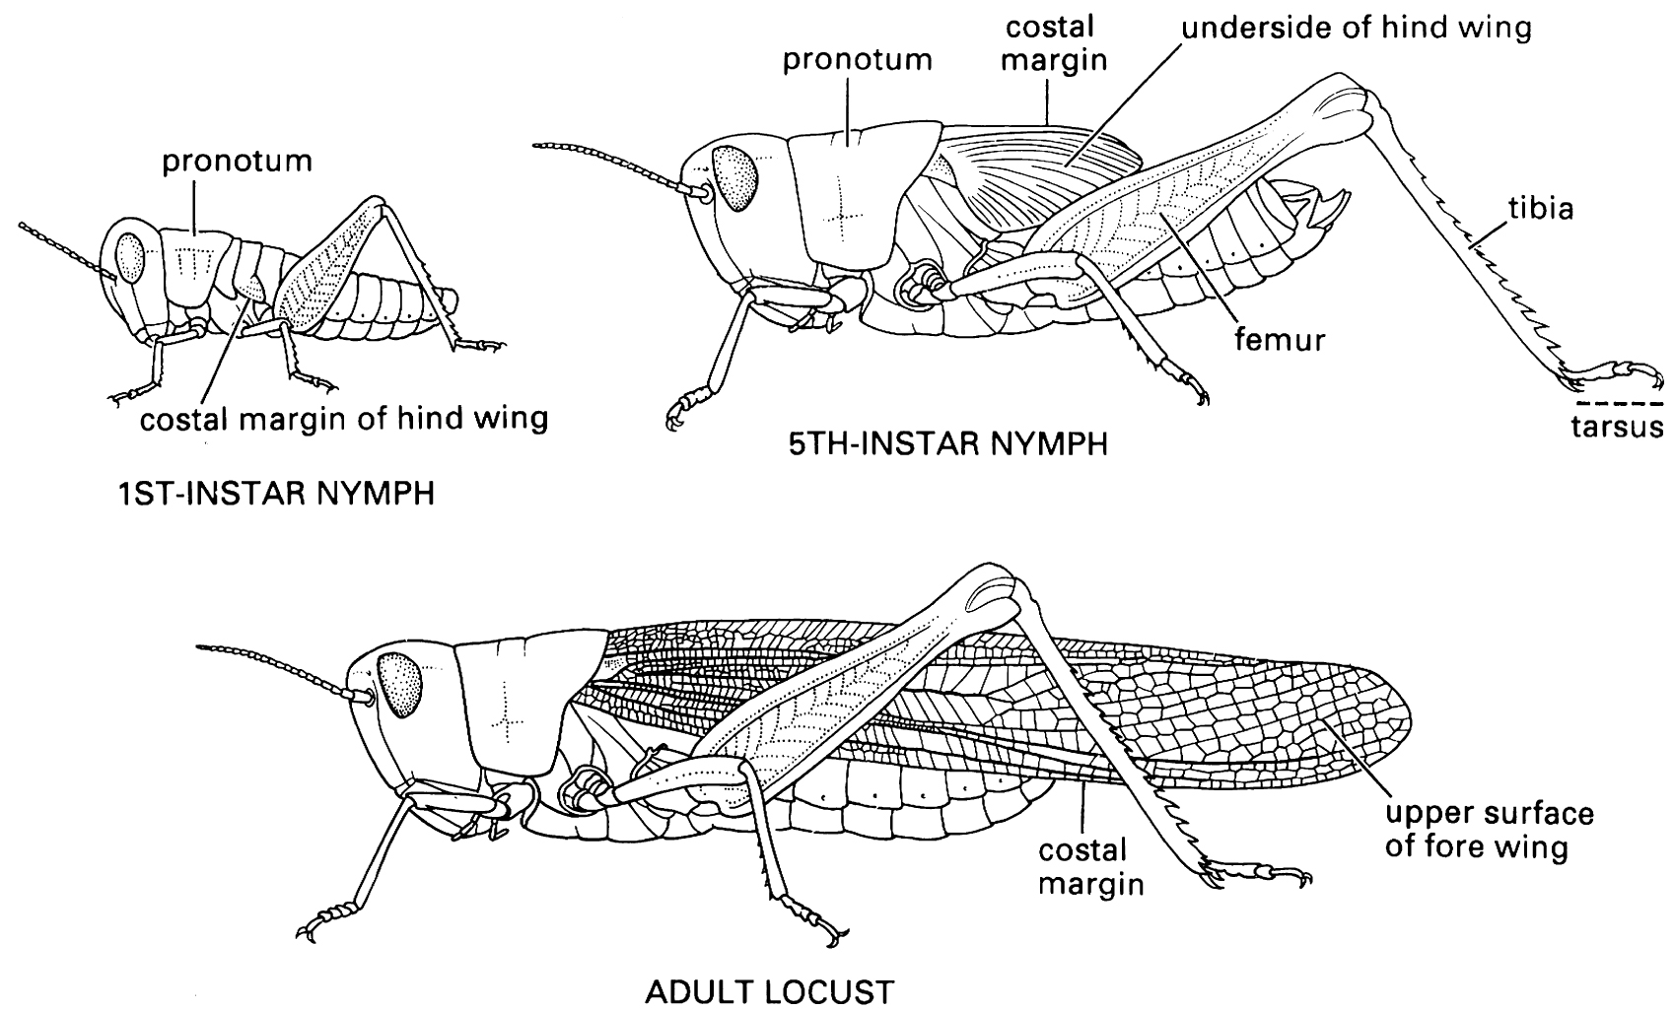
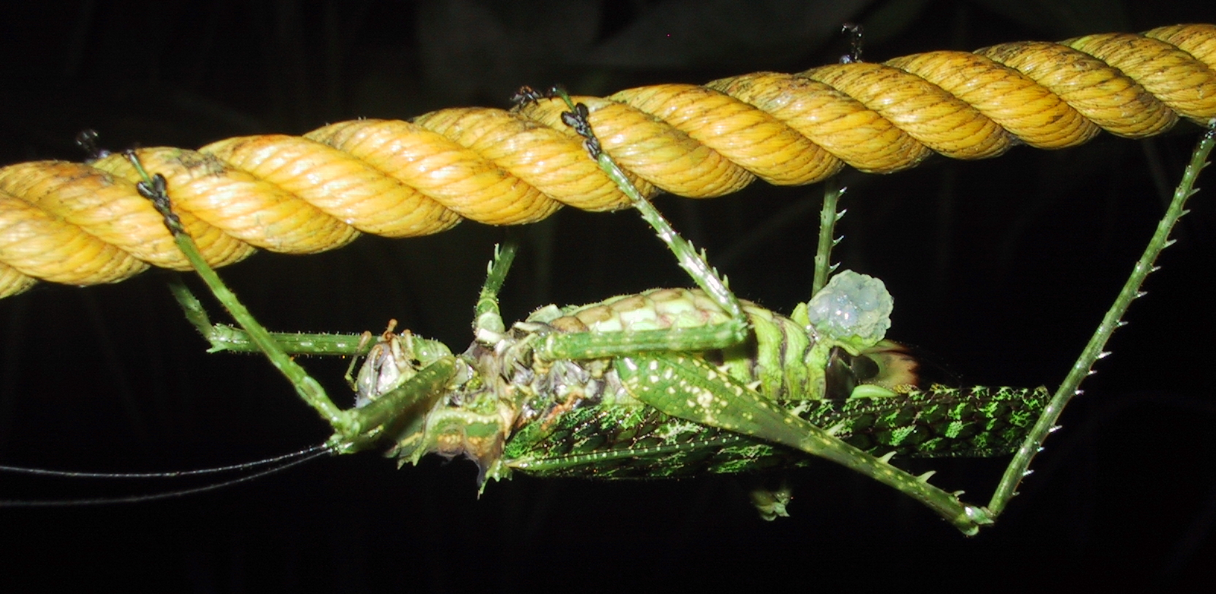

Slide 11
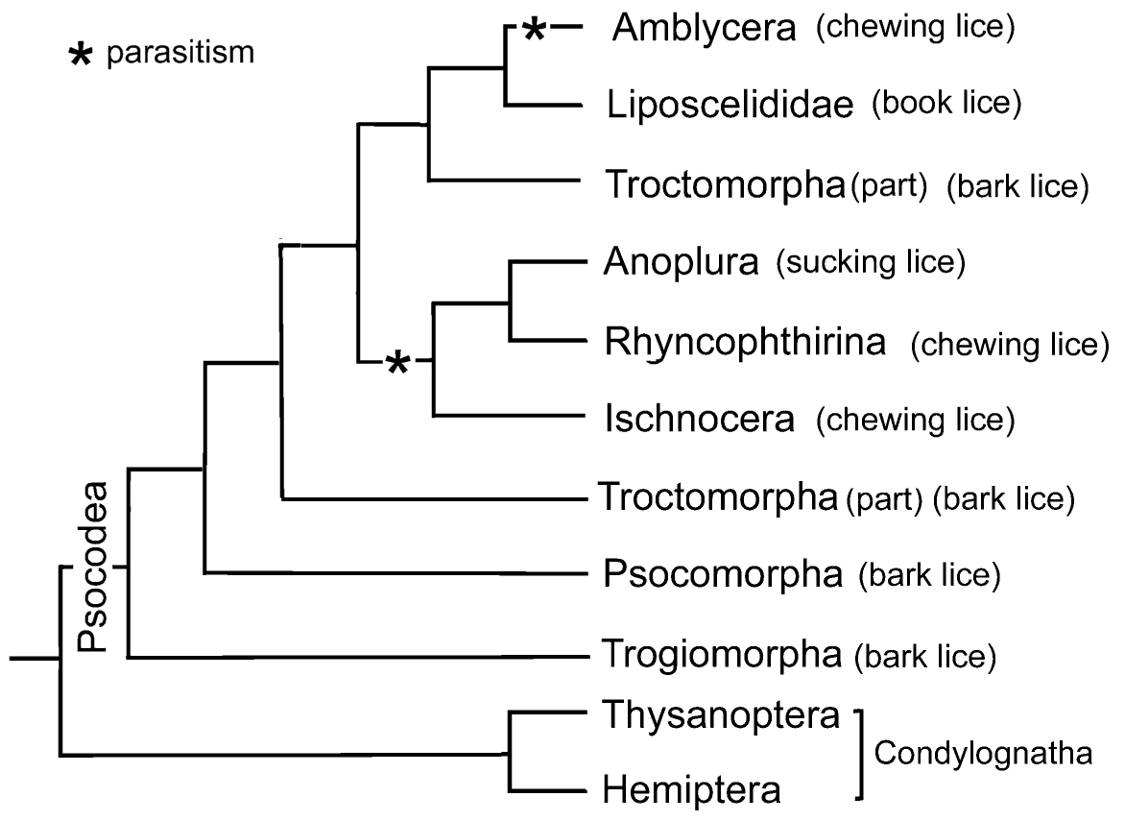
Paraneoptera

Slide 12
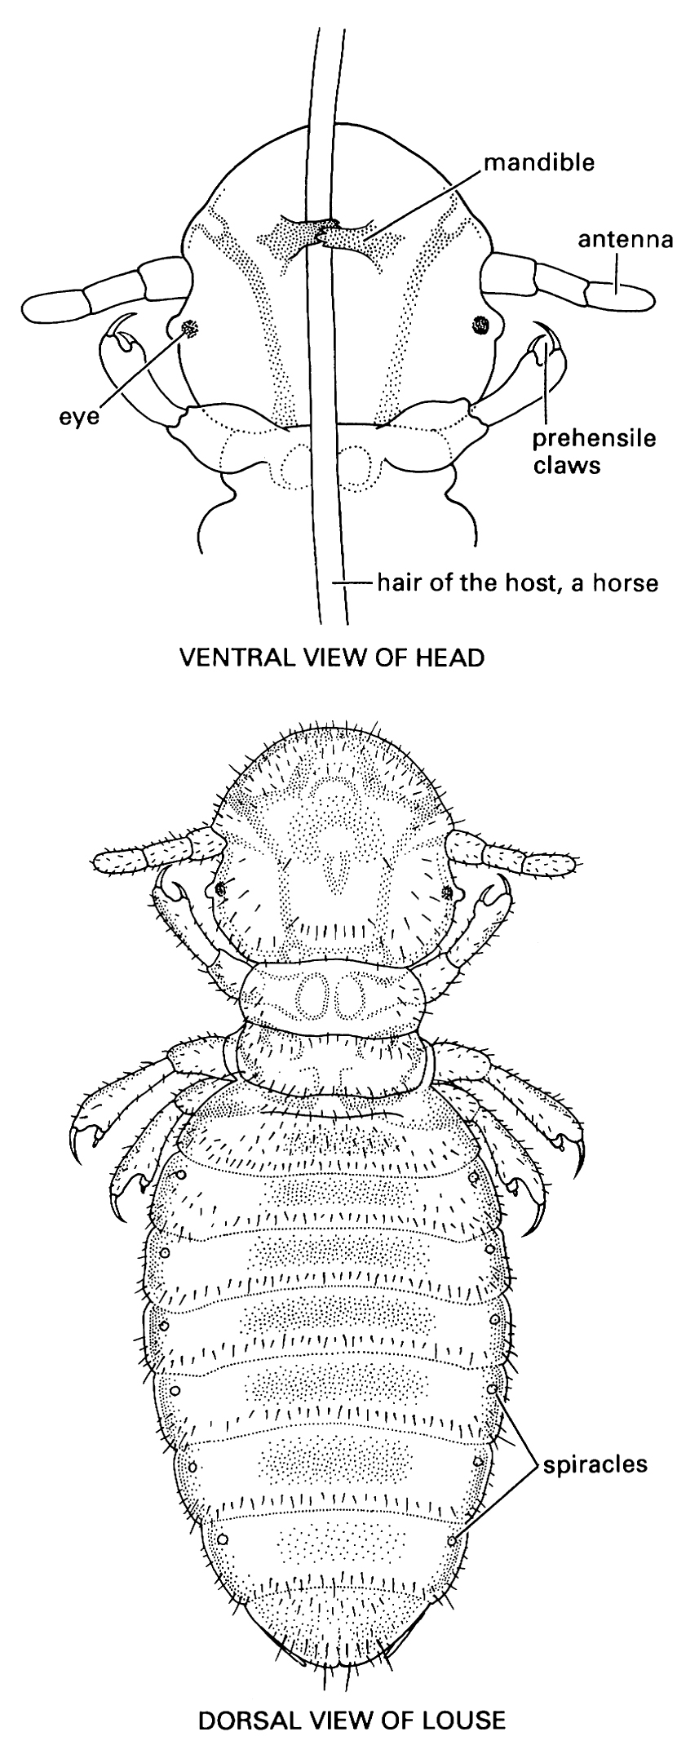
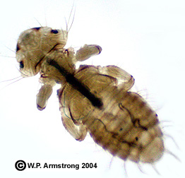
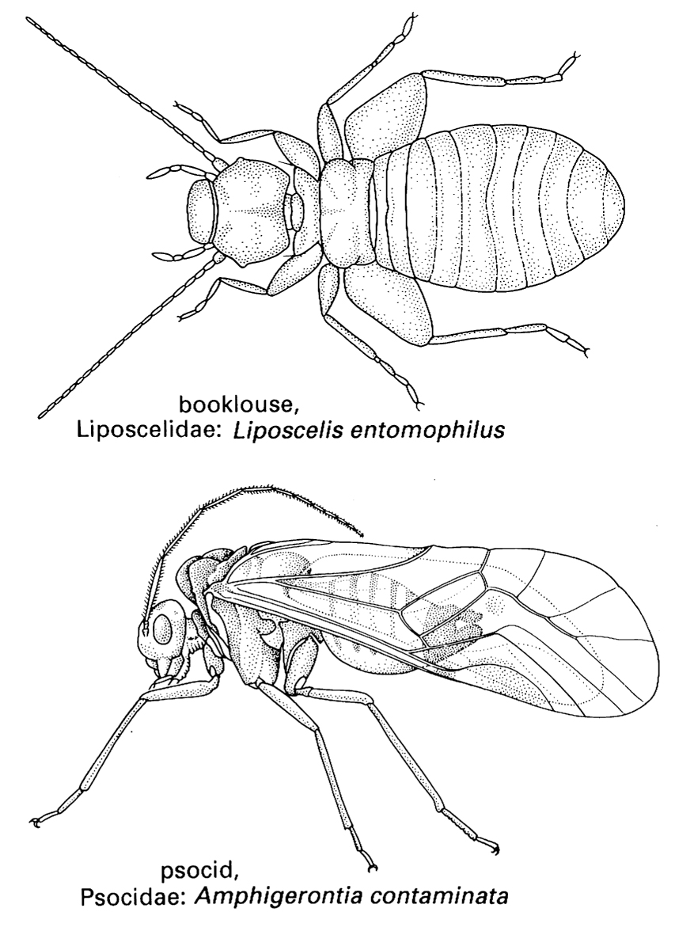
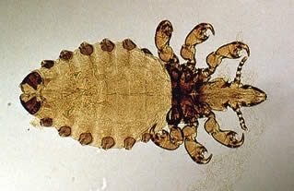

Slide 13
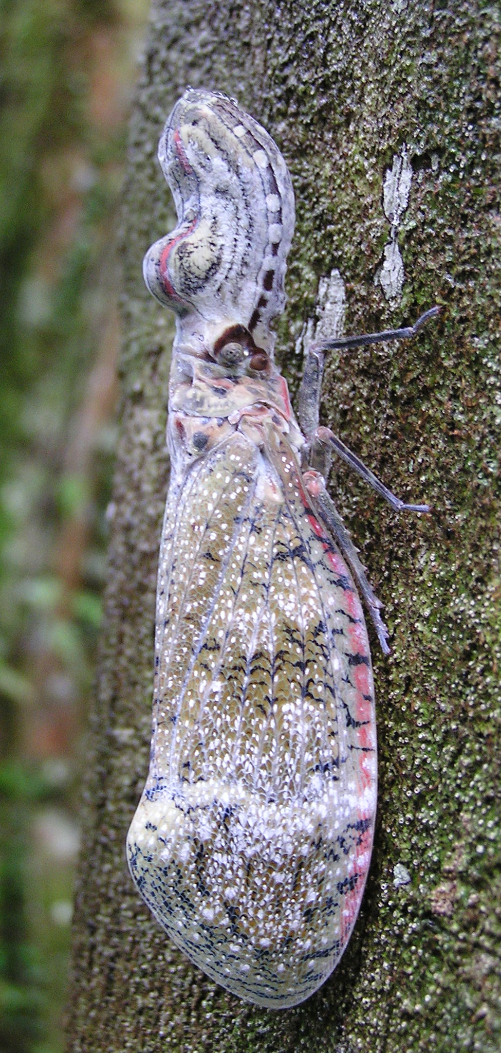
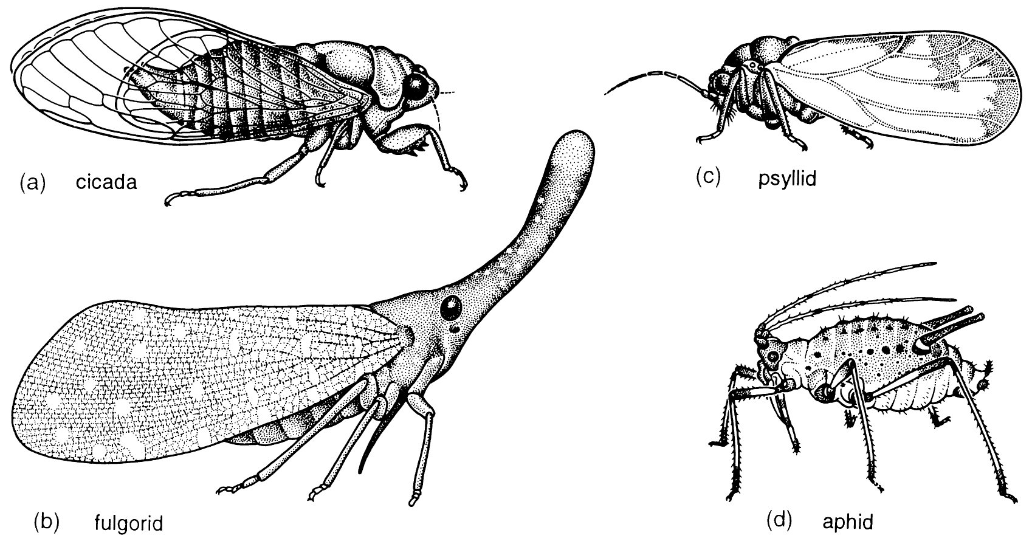
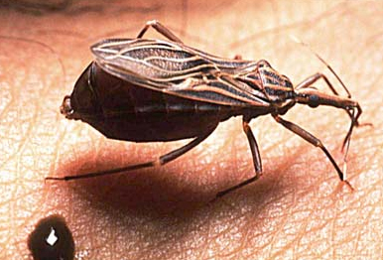
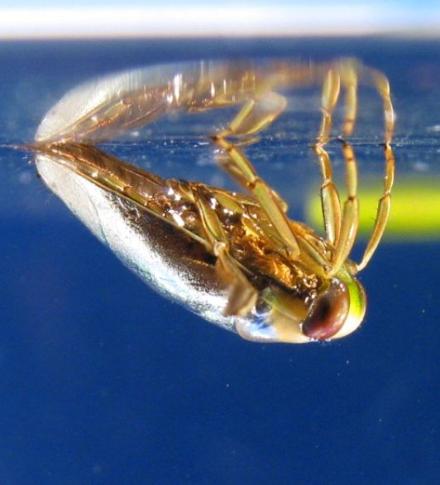
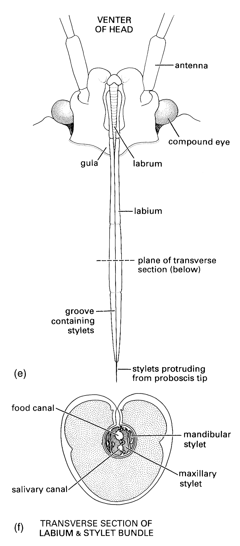

Slide 14
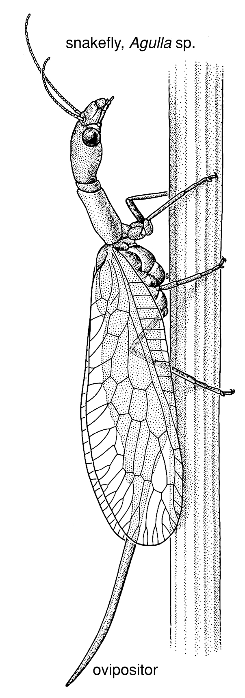
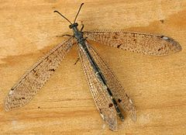

Slide 17
Antliophora

Slide 22
Evolution within the insecta (Ch. 8)
Oldest fossil: Devonian 400 mya
Collembola
Carboniferous (300 mya): Major radiation of insect groups
Paleodictyoptera
Megasecoptera
Diaphanopterodea
Protelytroptera
Protodonata
No existing pterygote insects are clearly represented in the carboniferous

Slide 24
Protodonata
70 cm

Slide 25
Paleodictyoptera

Slide 26
Protelytroptera

Slide 27
Carboniferous/Permian insects
Large size (40-70 cm wingspan)
Greater O₂ concentration
Respiration
Flight
Piercing sucking mouthparts appear common
Plant feeding [ferns, gymnosperms]
Aquatic nymphs probably common
Many groups disappeared with the Permian extinction

Slide 28
Mesozoic
Triassic
All modern orders except Lepidoptera present
Cretaceous
Amber
Major radiation of flowering plants
Coincided with major radiation of Endopterygote insects
Insect-plant coevolution for pollination, herbivory
End Cretaceous extinctions, mostly what appear to be specialist herbivores

Slide 29
Tertiary Amber
Miocene [17-20 mya]
Ecocene [44 mya]
DNA has been claimed from amber preserved insects
Complete sequences not available
Contamination
Families, genera 10’s of millions of years old
Many species may be ~million years old

Slide 30
Freshwater or Terrestrial origin
Many basal Pterygote groups have freshwater larvae
Entognatha, Apterygote insects strictly terrestrial
Insect origins in freshwater?
Older orders
Ephemeroptera, Odonata, Plecoptera, extinct orders
Adults strictly aerial/terrestrial
Evolution of gills from trachea vs. evolution of trachea from gills

Slide 31
Evolution of wings
Hypotheses for morphological origin
Paranotal lobes
Epicoxa (basal limb segment)
Exite, or exite+endite
Molecular developmental evidence
Gill homolog
Serial homology with abdominal gills
Both wings and gills may have evolved from limb exites
Implies multiple invasions of terrestrial environment
Entognatha
Apterygotes
Pterygotes

Slide 32
Function of proto-wings?
What is selective advantage of protowing?
Hypotheses
Floating
akin to ballooning in spiders
Paragliding
dropping from high point; as in gliding vertebrates
Better leaping
Same hypothesis applied to birds
Surface sailing
Wing as a sail for adults of aquatic insects
Can see this work now

Slide 33
http://www.youtube.com/watch?v=xZ1qrkRfHXY

Slide 34
Evolution of metamorphosis
Evolved in the Permian; adaptive radiation in Mesozoic
Two hypotheses
1. Larvae homologous to nymphal stages of hemimetabolous insects
Pupa represents a new stage
2. Larvae homologous to pronymphal stage
Pronymph: prehatchling or hatchling stage
Morphologically distinct from nymphs
Within egg
Hatches from egg, mobile, membrane encased, feeds on yolk
Molts to first instar nymph
Nymphal stages compressed into the pupa

Slide 35
Mantis pronymph

Slide 36
Pronymph hypothesis

