Slide 1
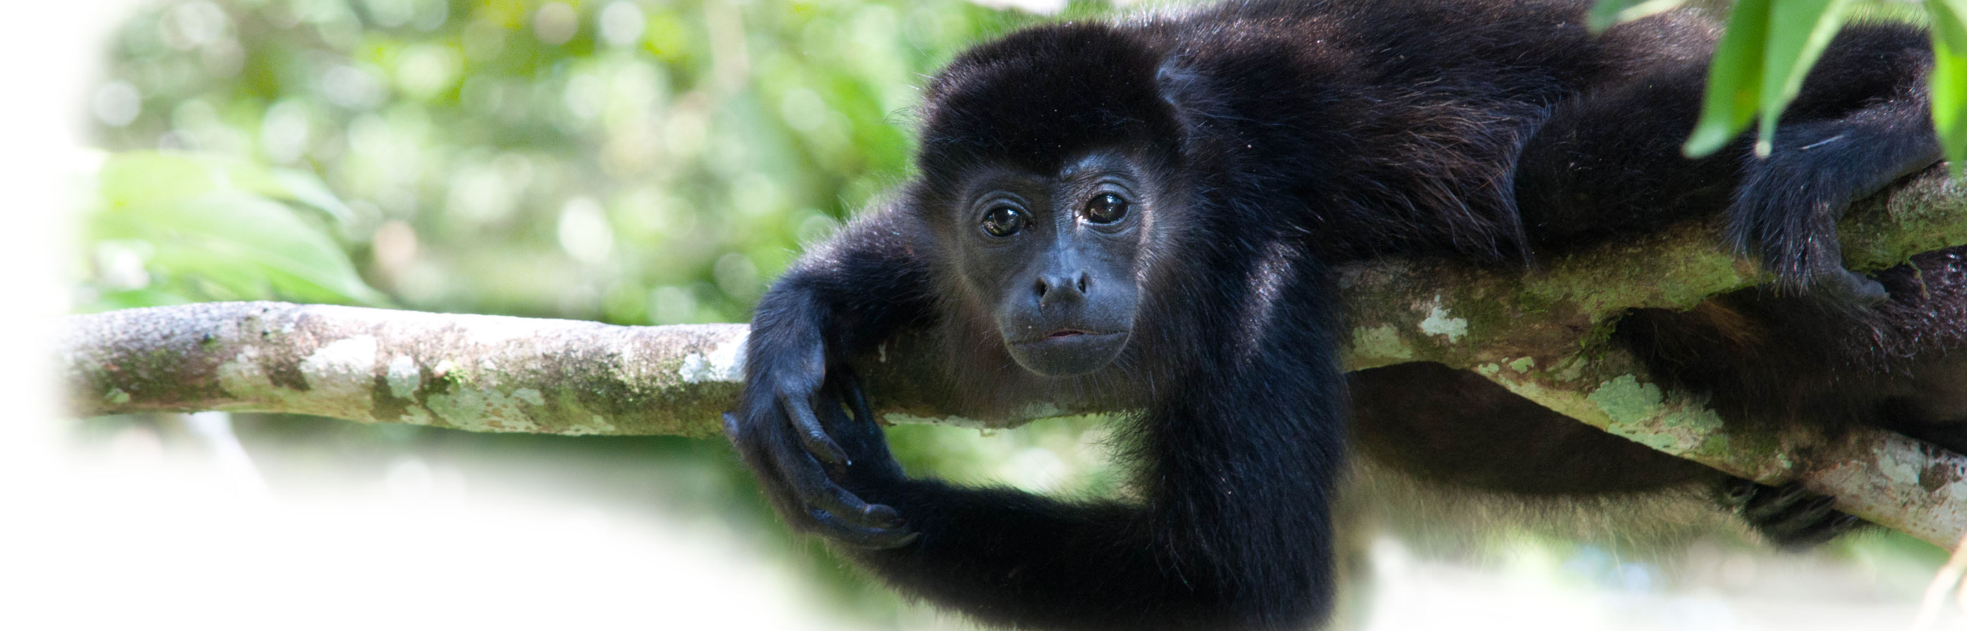
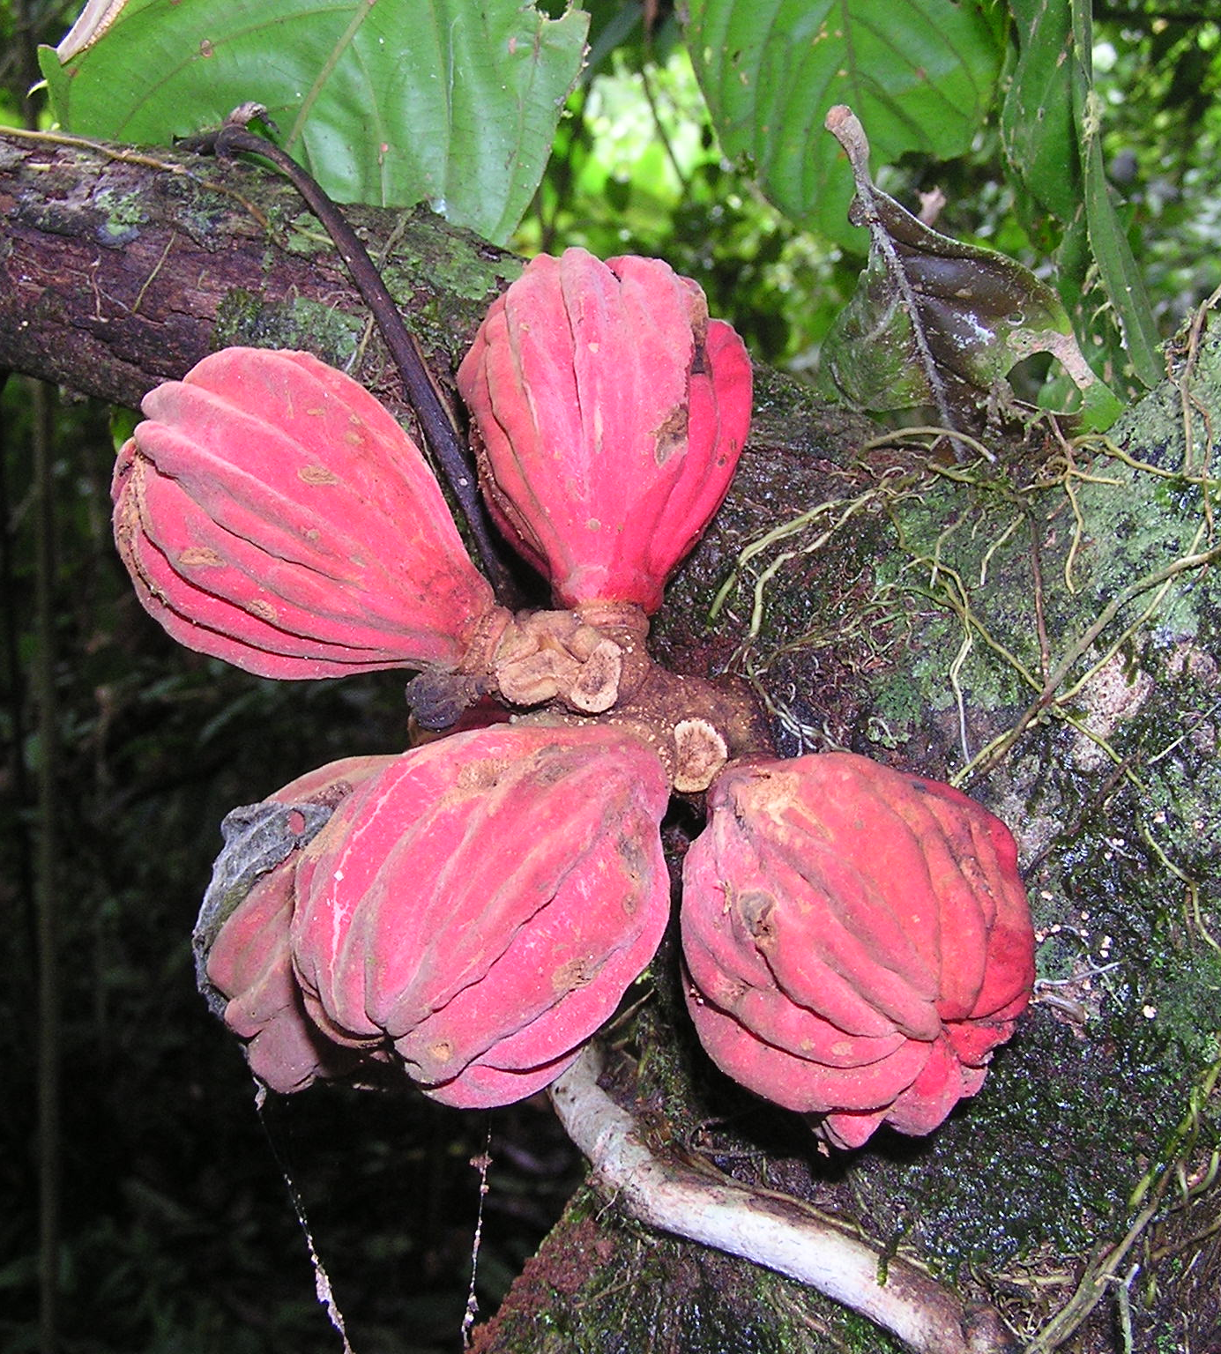
TROPICAL RAINFOREST
ECOLOGY 2013
BSC 311 Rainforest Ecology
Organizational Meeting
Monday March 4 at 12:00 noon in Felmley 129
Rainforest ecology/natural history course and research trip to La Selva field station in Costa Rica
BSC 311 - 3 cr. Hrs; Fall 2013 (T Th 11:00-11:50AM)
BSC 201 - Ecology required during/prior to the course
Cost approximately $1850 depends on airfares
Includes: transportation, lodging, and all but 2 meals and personal gear
Deposit of $650 due by the end of Spring Semester
Interested in taking this course?
Dr. Joseph Armstrong FSA 123, 438-2601, jearmstr@ilstu.edu
Dr. Steve Juliano FSA 335, 438-2642 sajulian@ilstu.edu

Slide 2
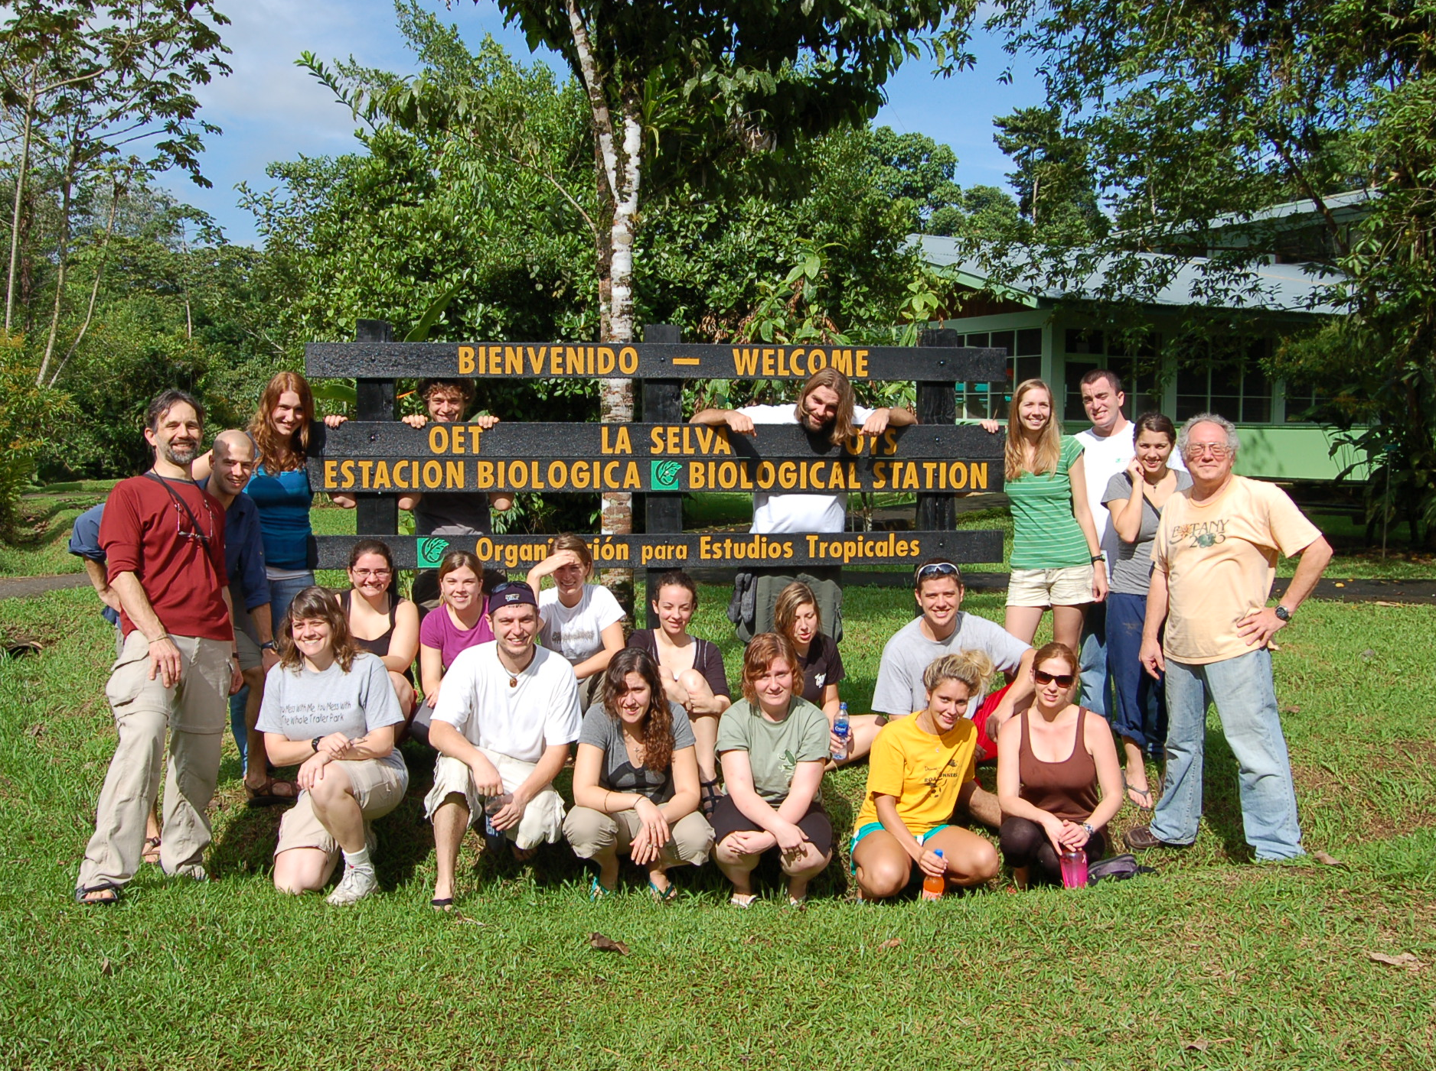

Slide 3
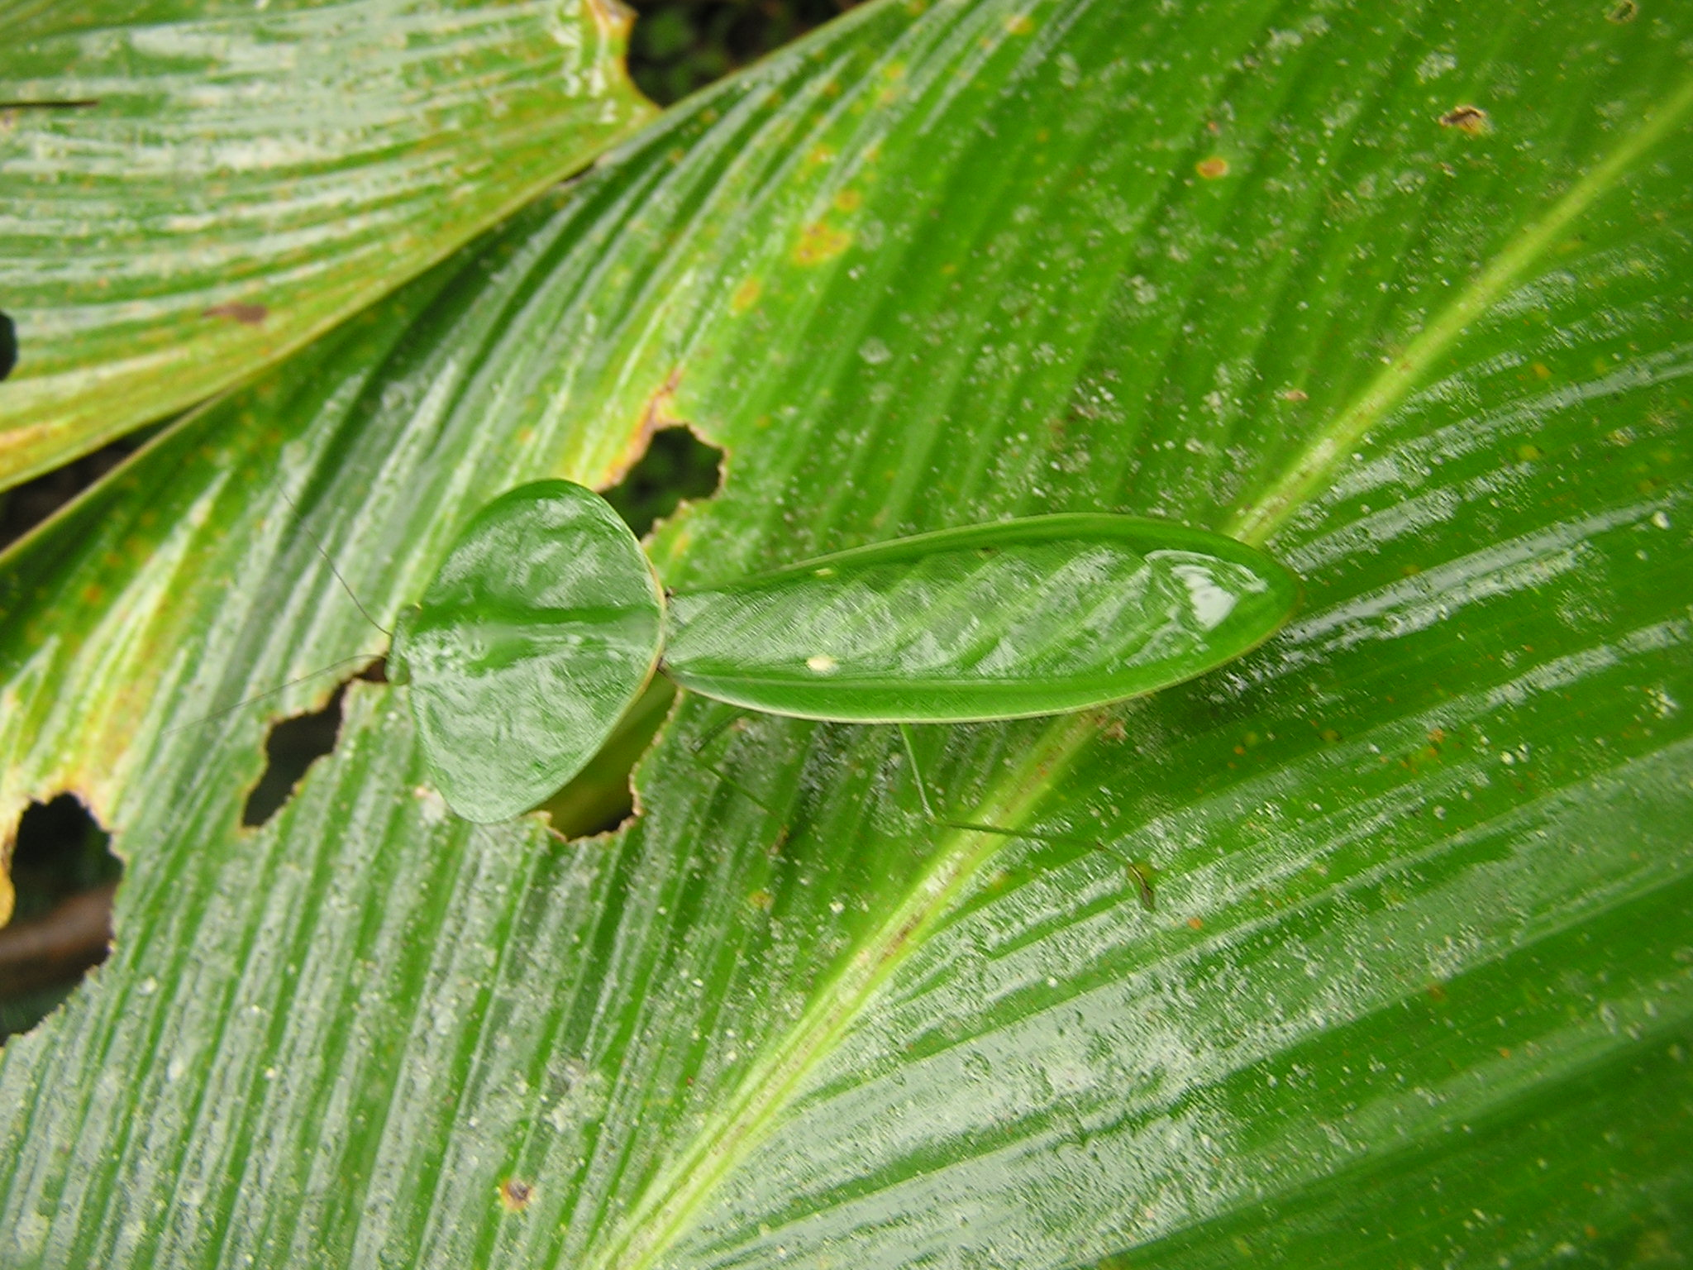

Slide 4
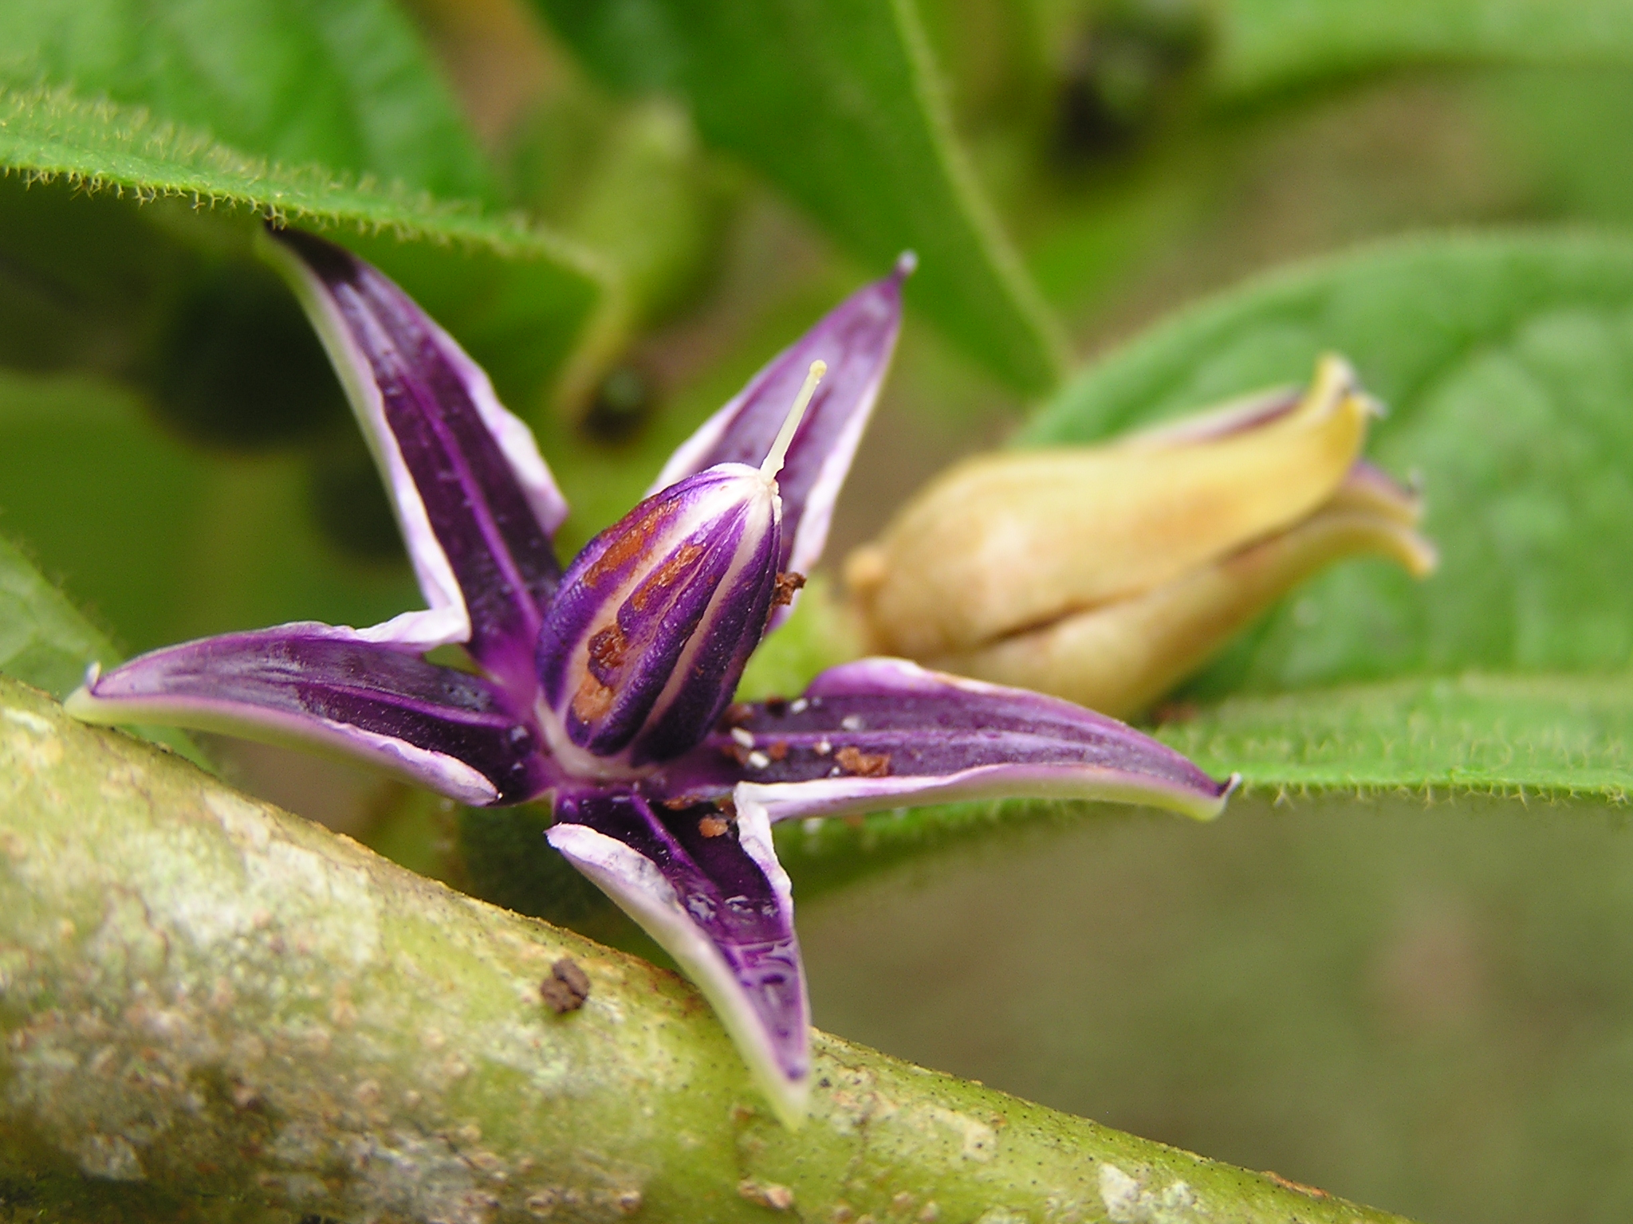

Slide 5
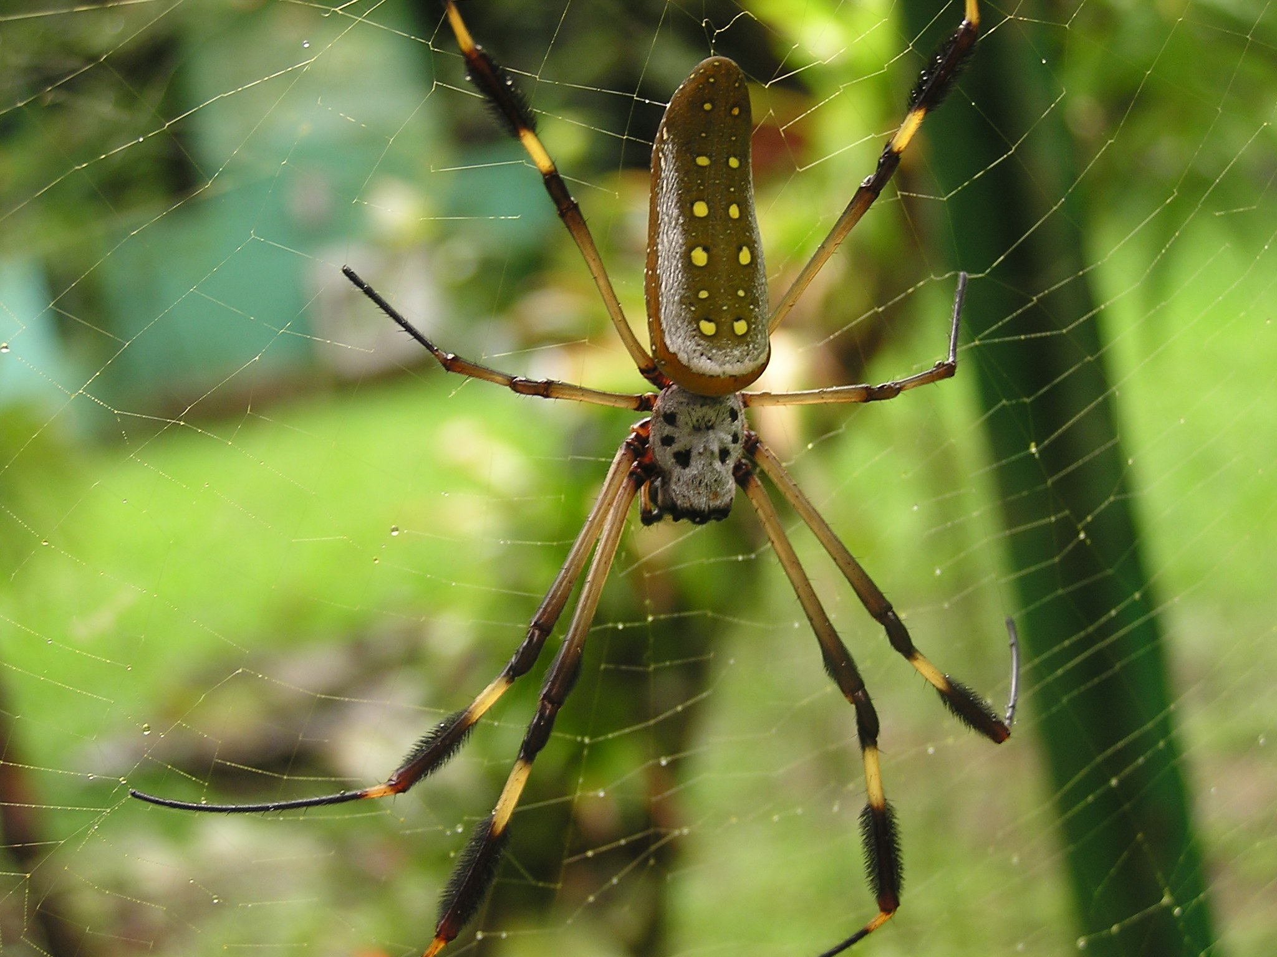

Slide 6
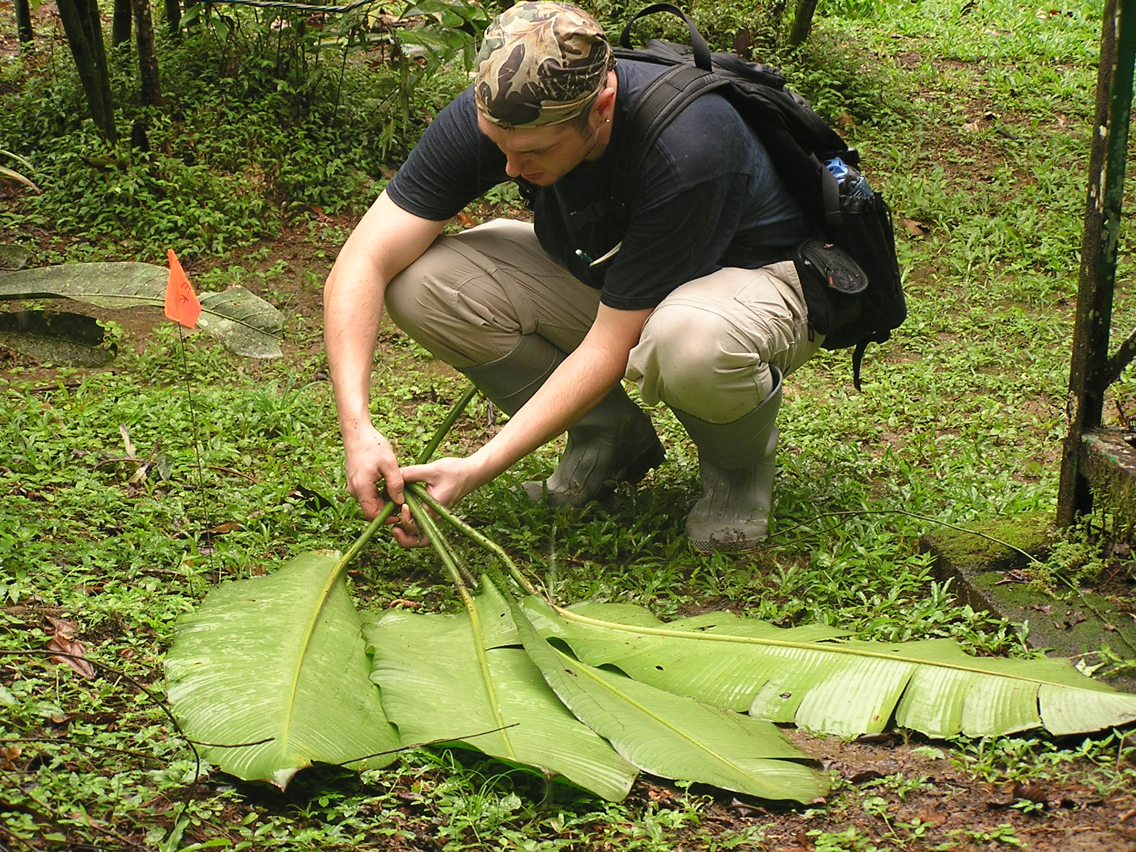

Slide 7
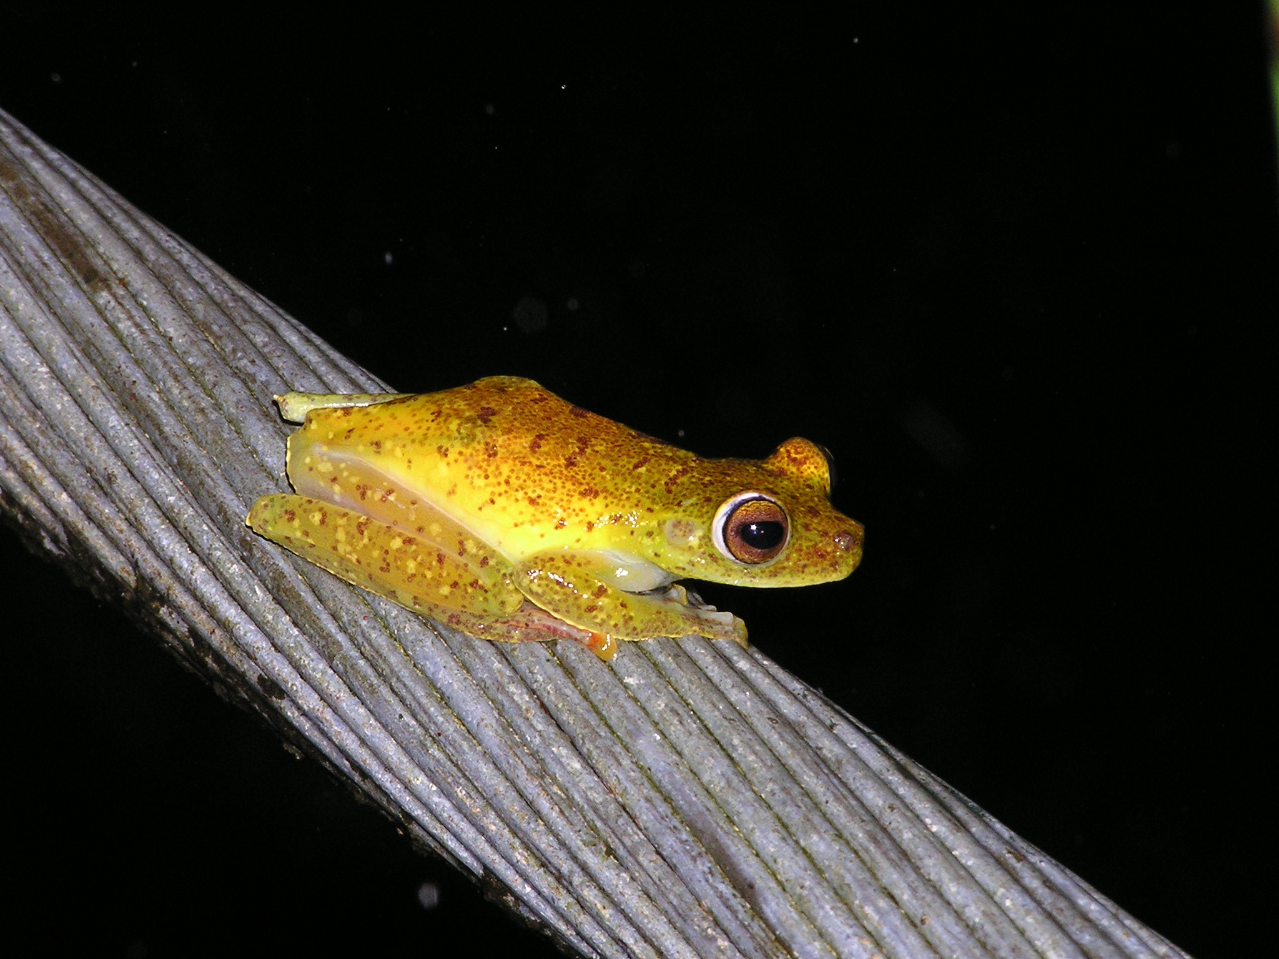

Slide 8
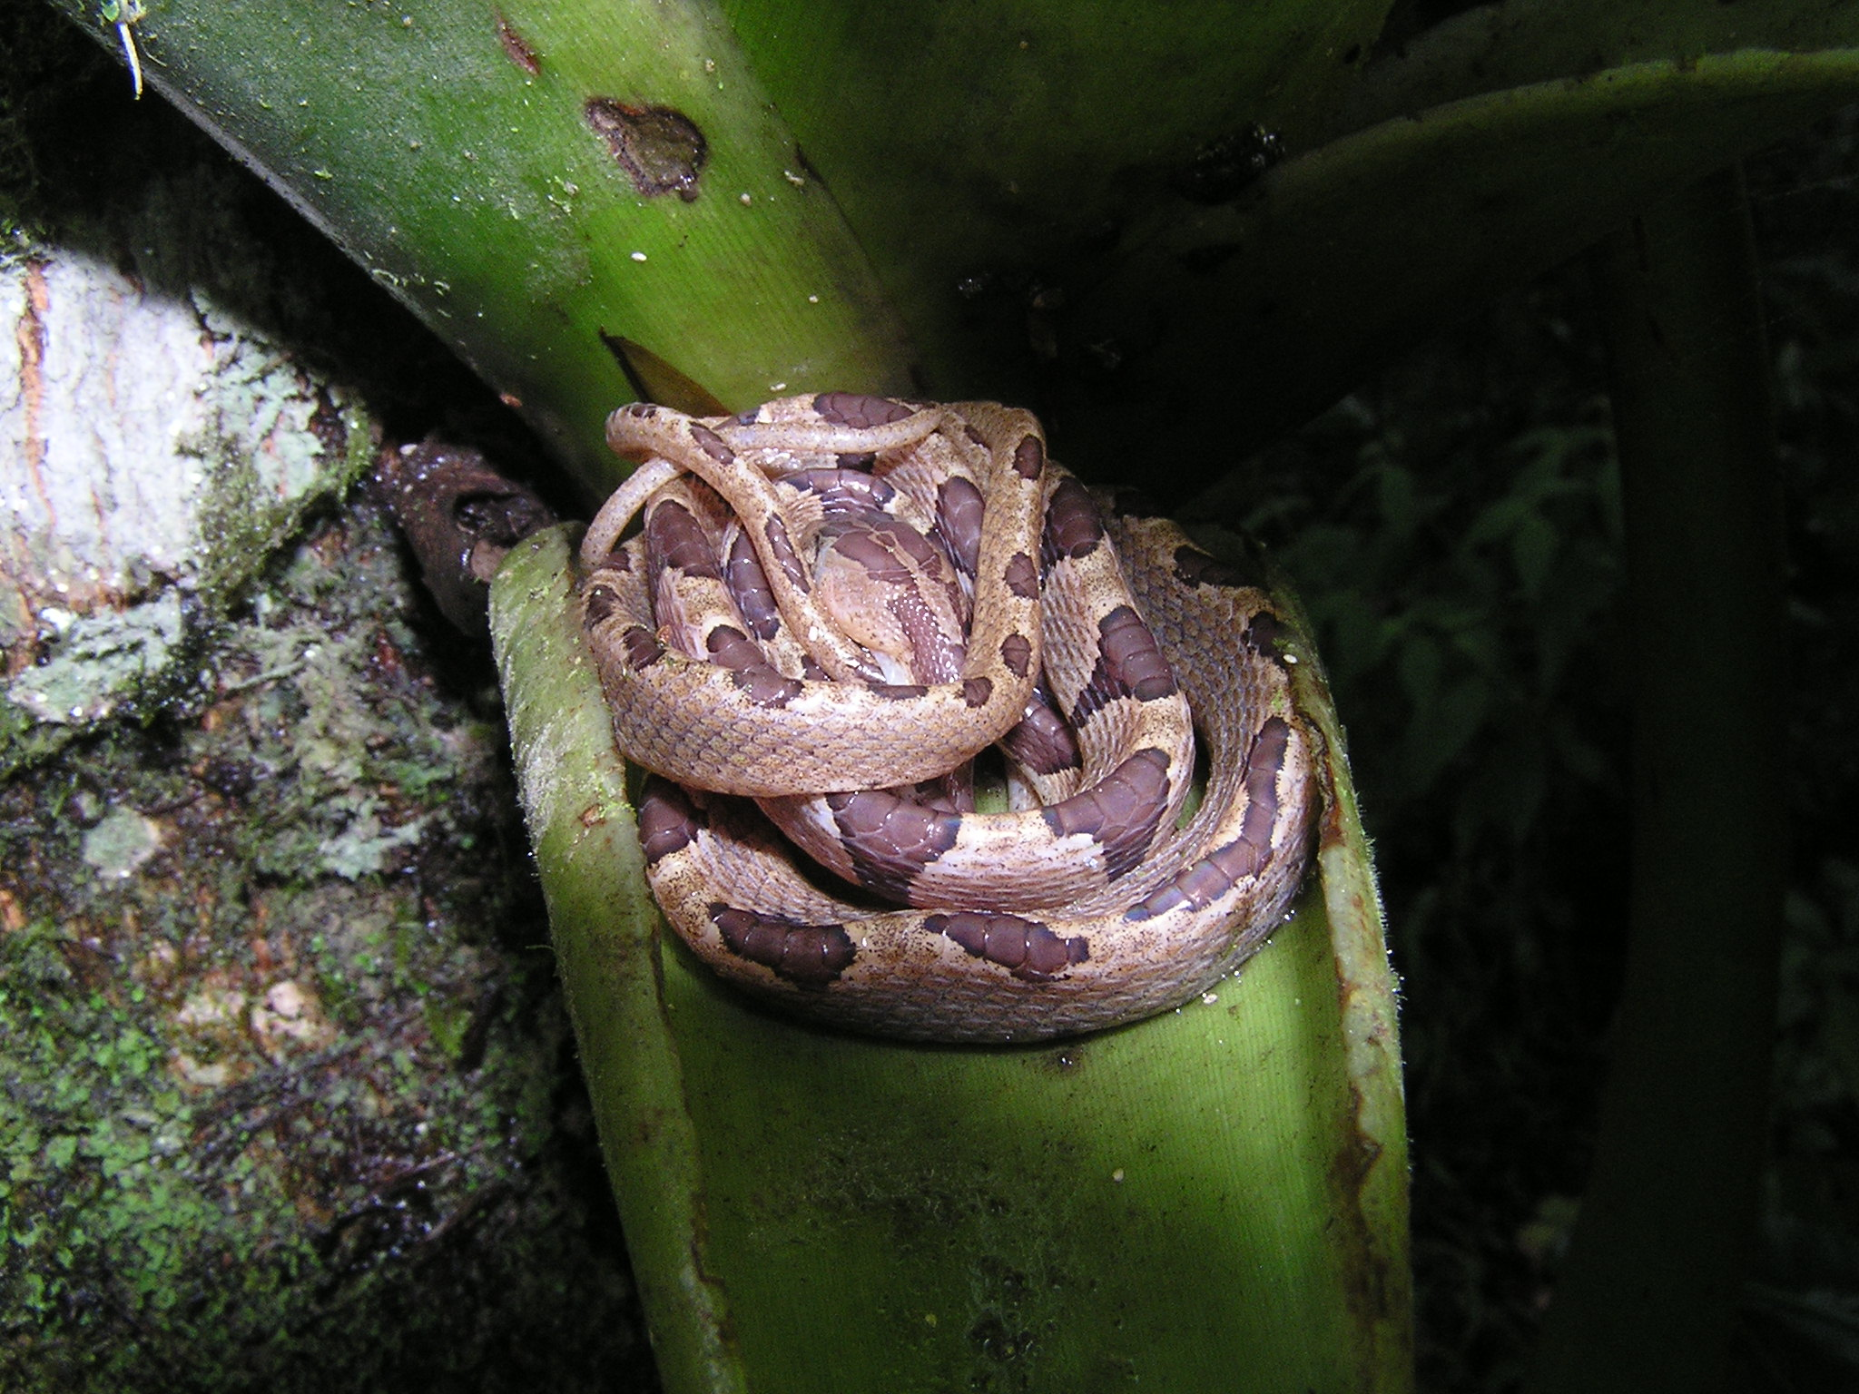

Slide 9
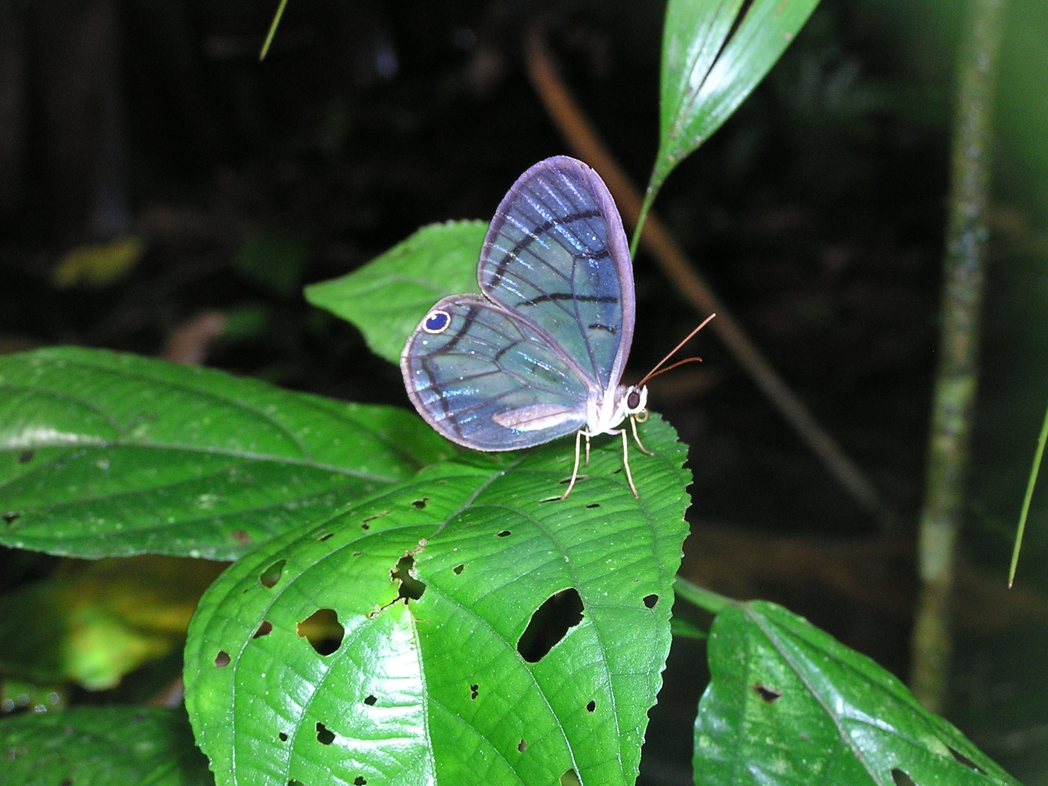

Slide 10
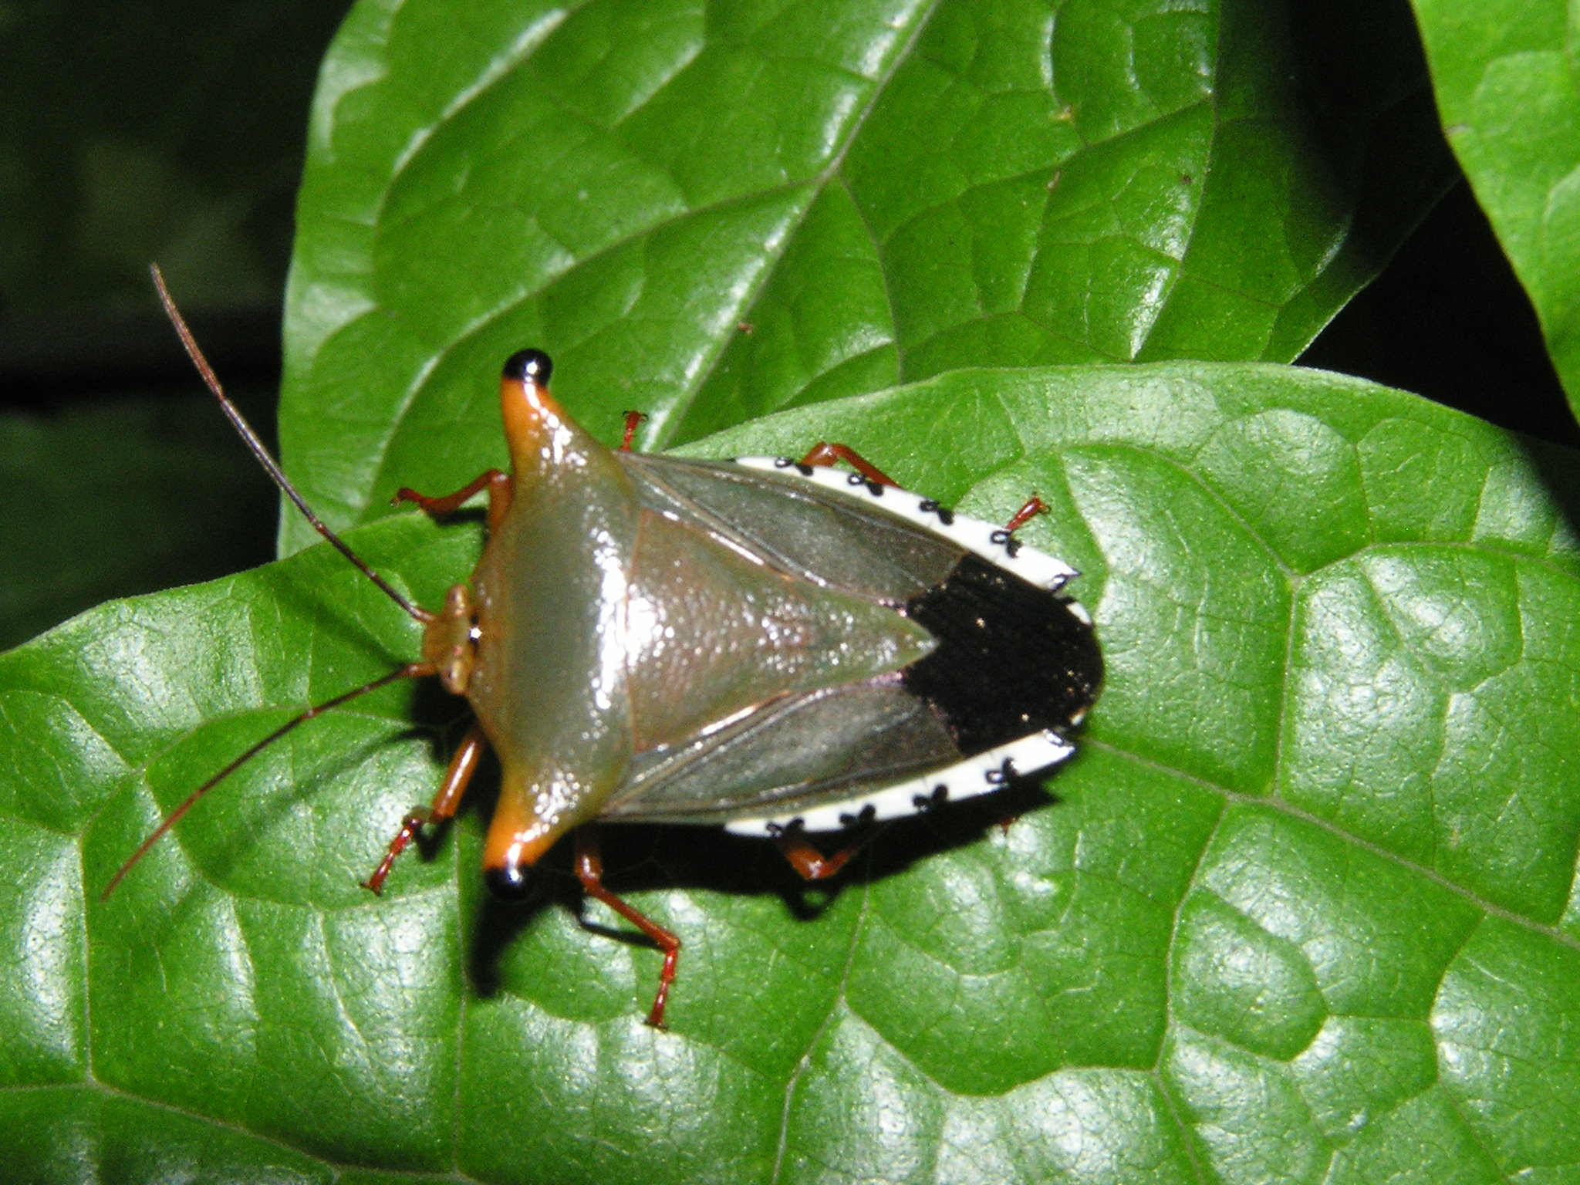

Slide 11
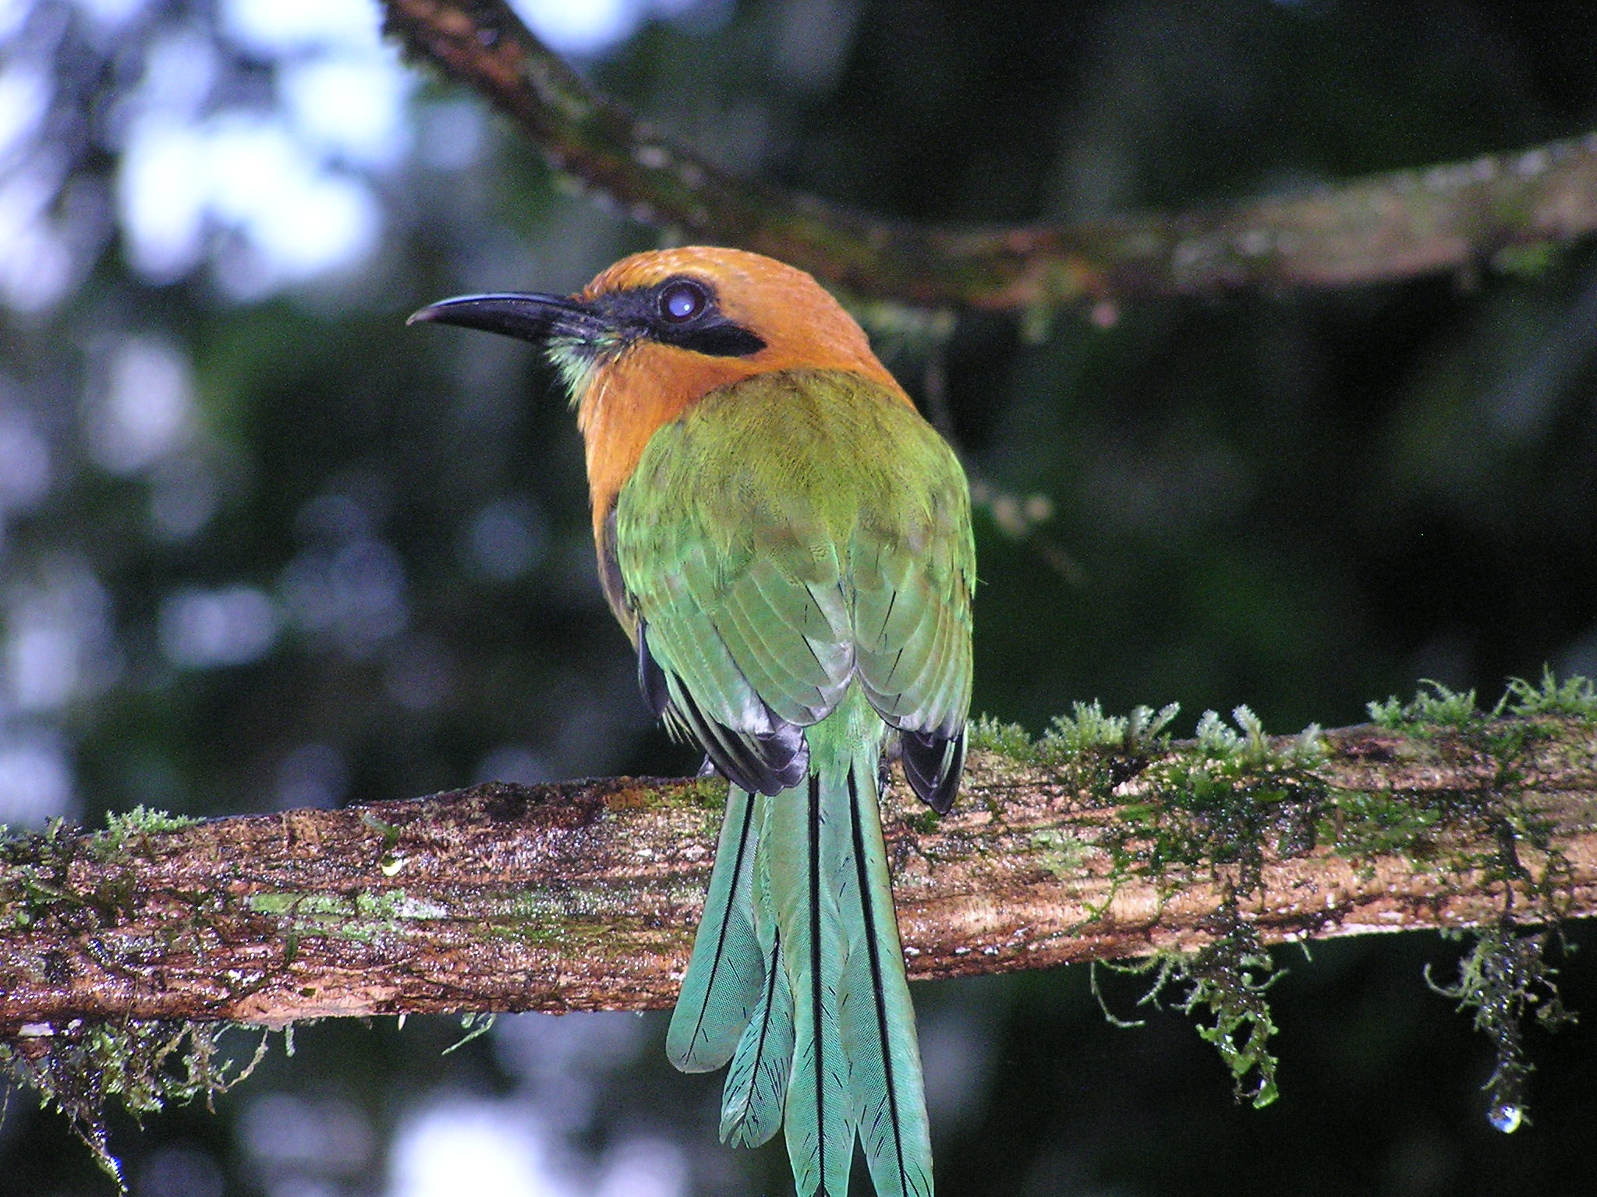

Slide 12
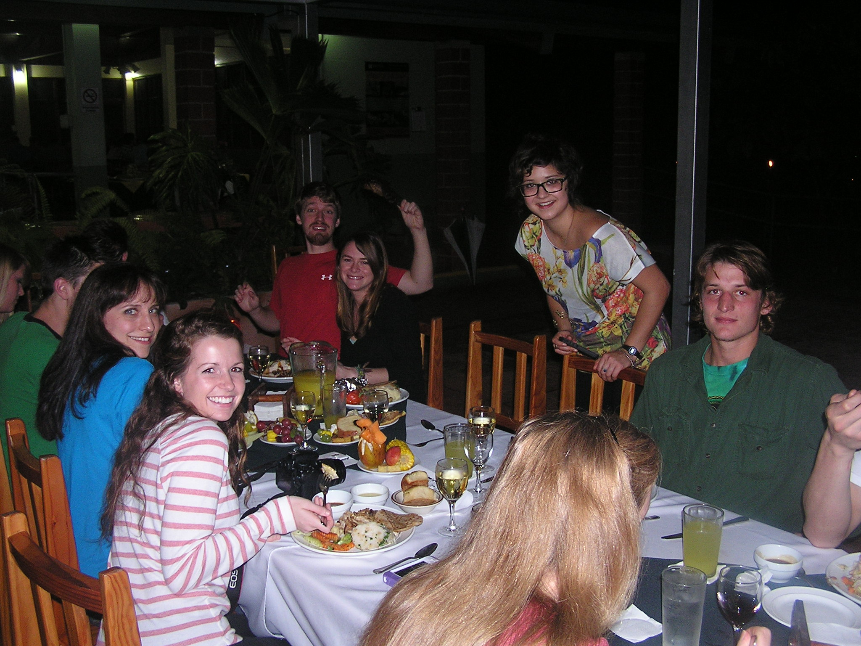

Slide 13
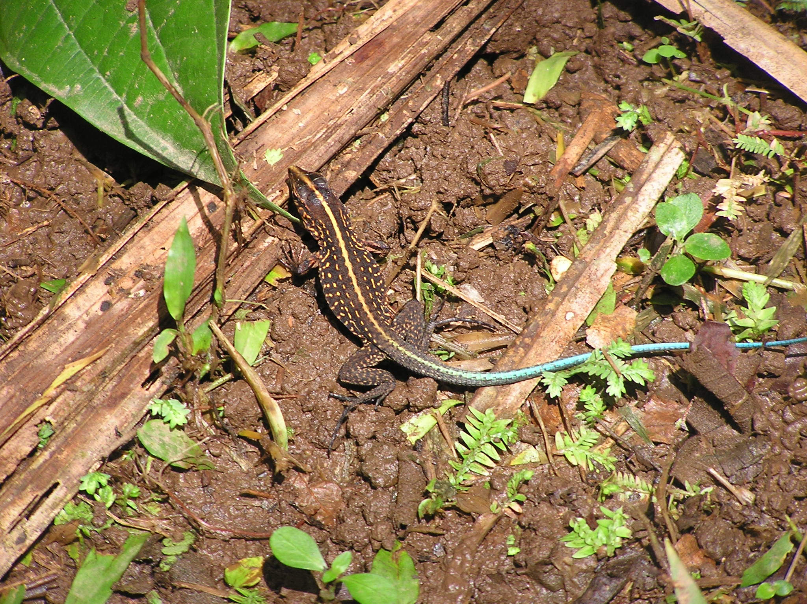

Slide 14
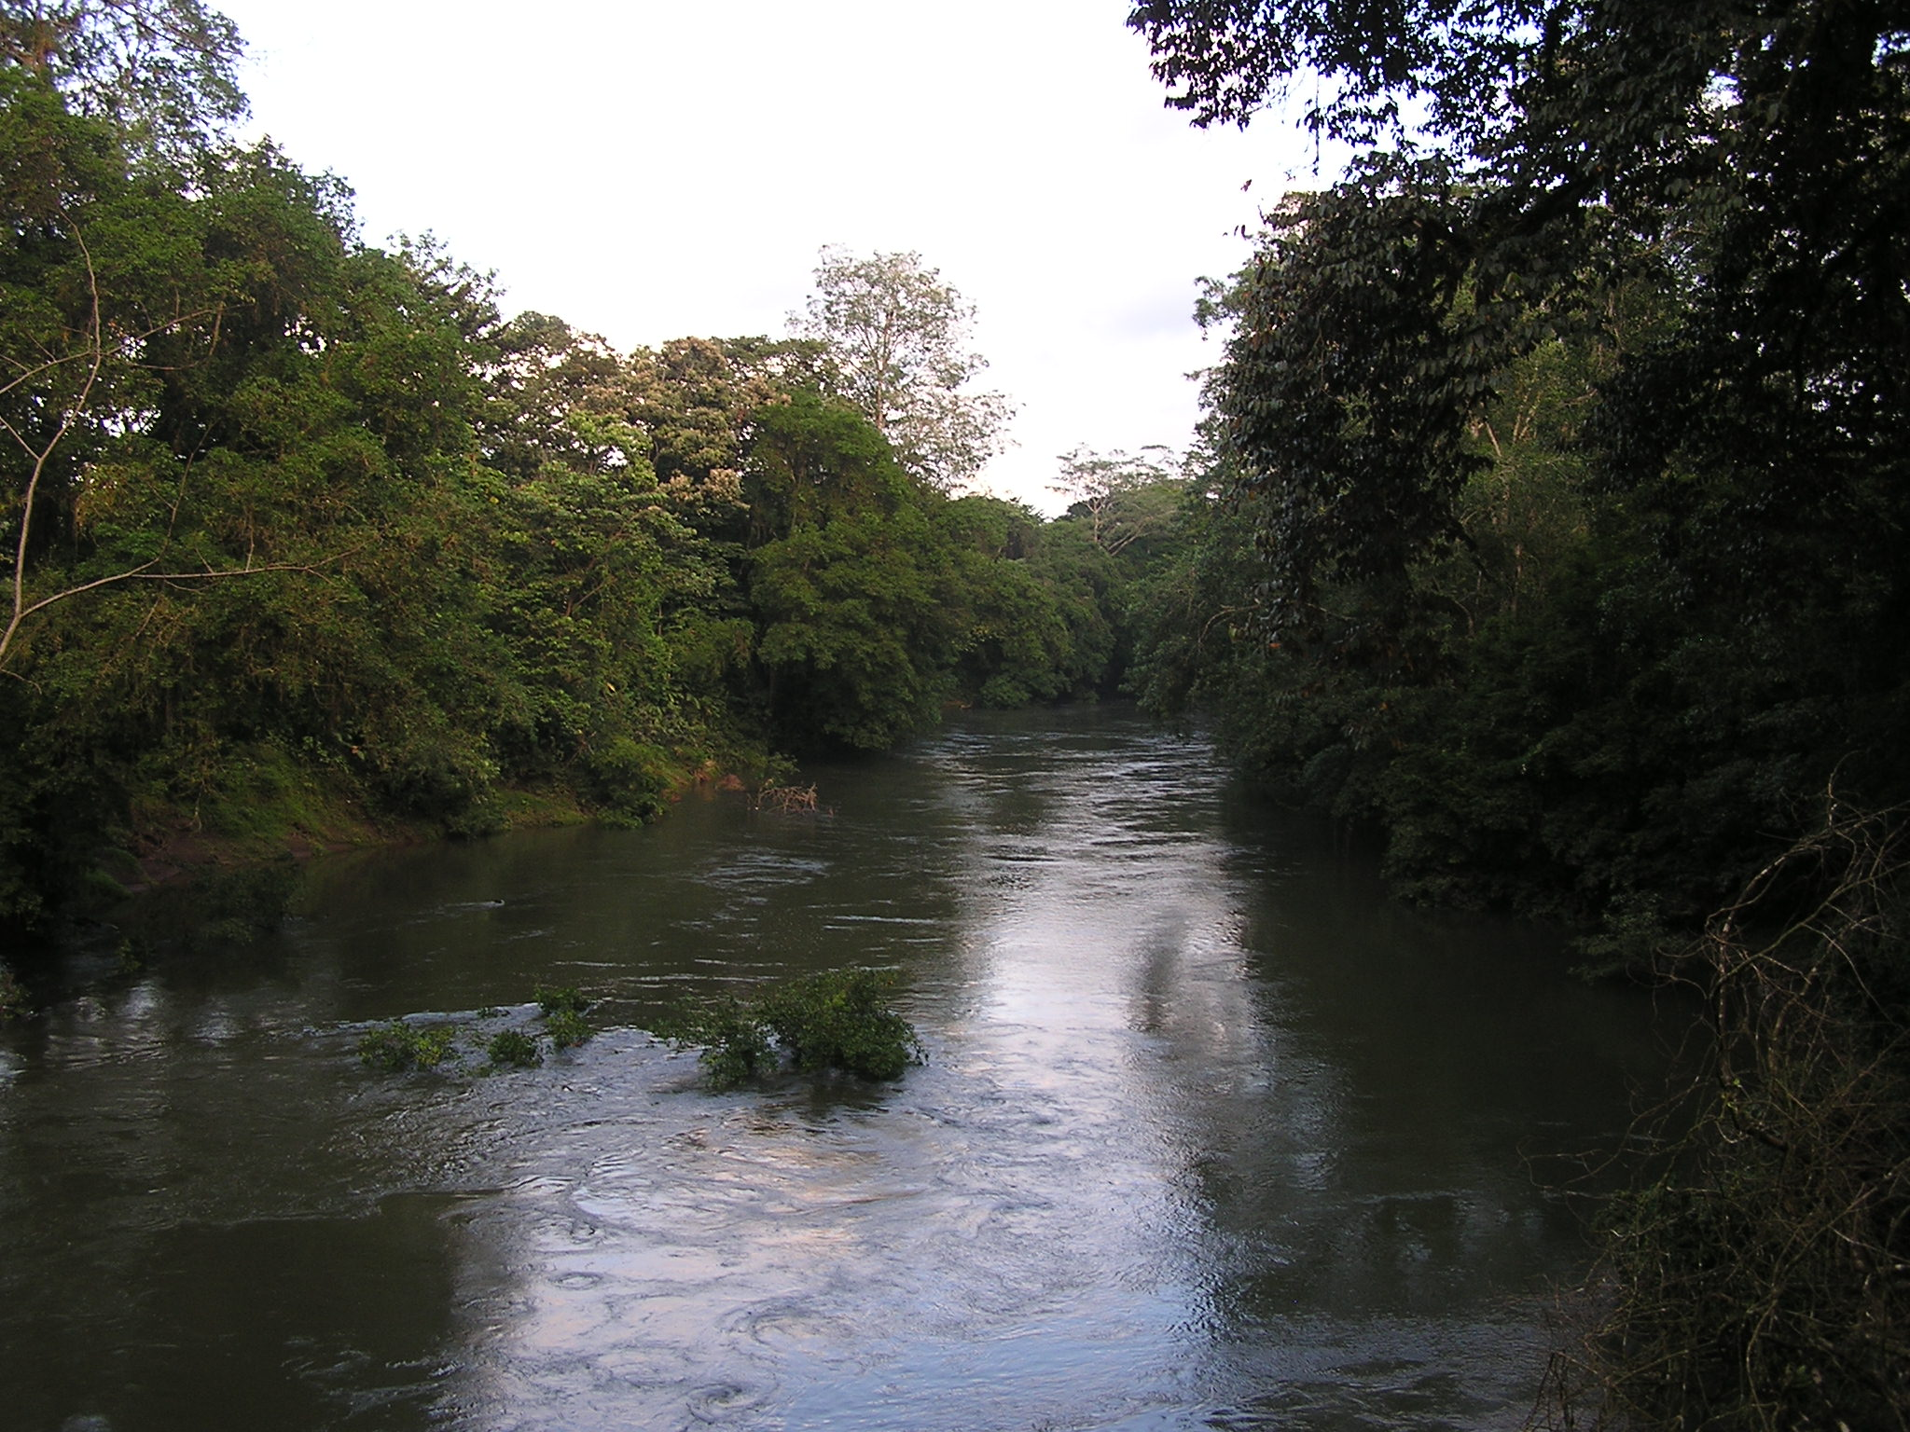

Slide 15
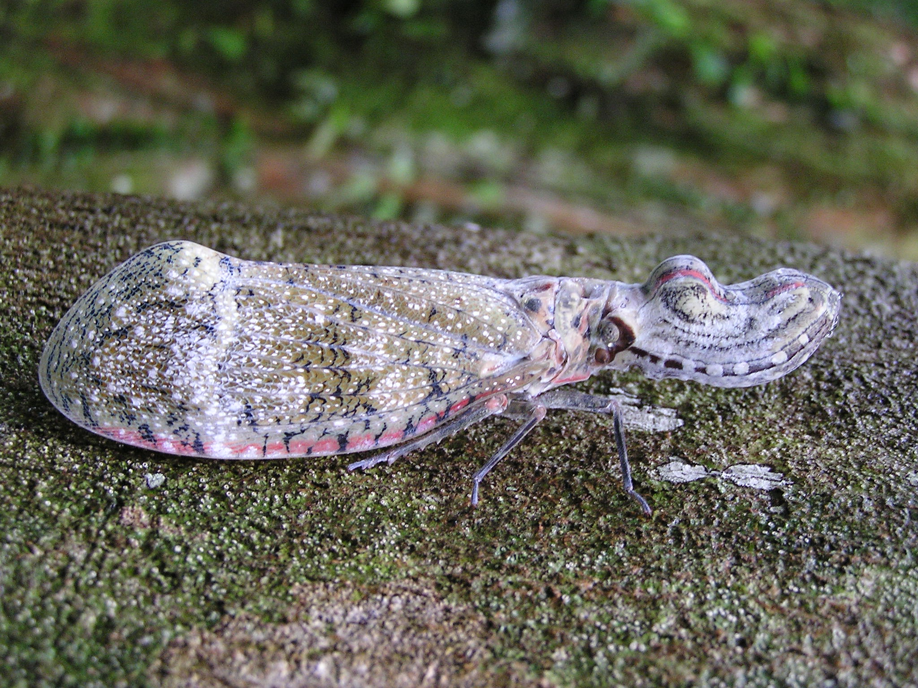

Slide 16
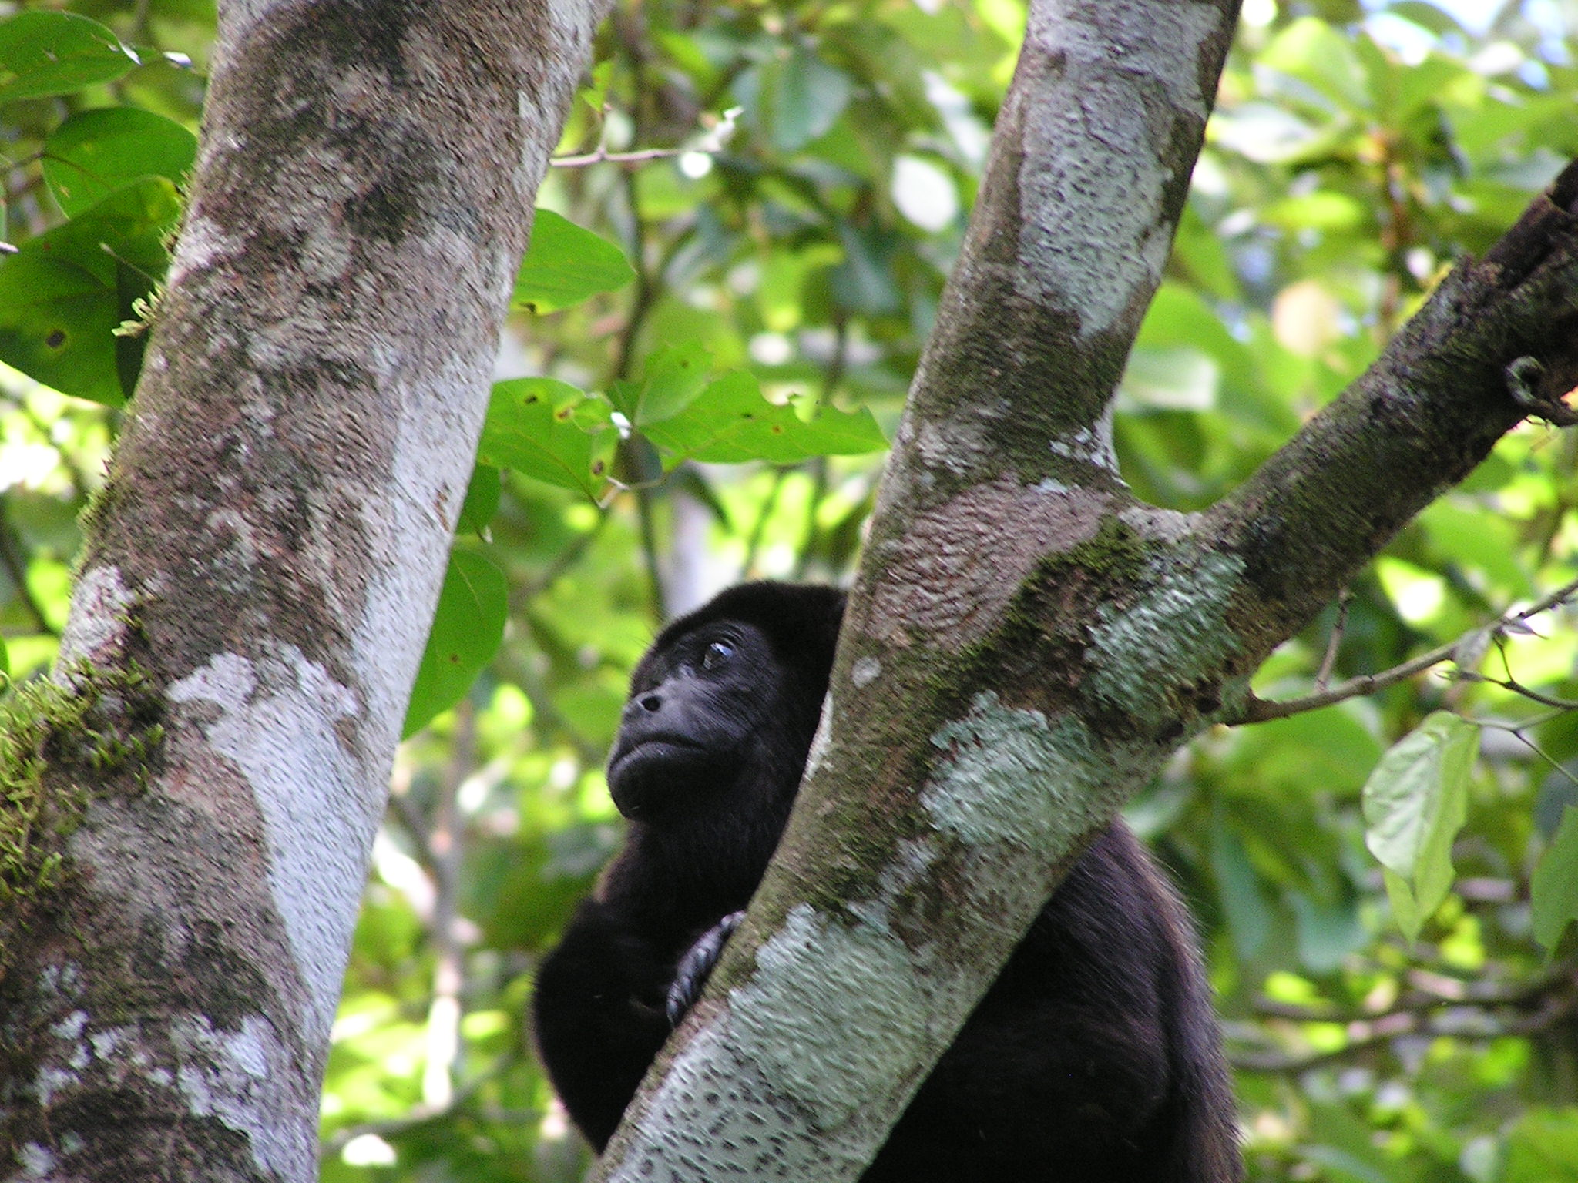

Slide 17
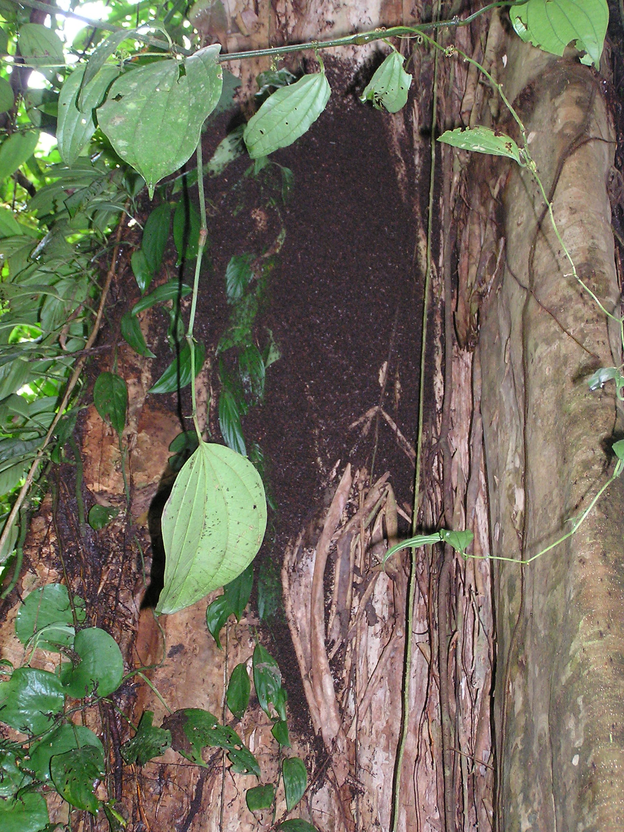

Slide 18
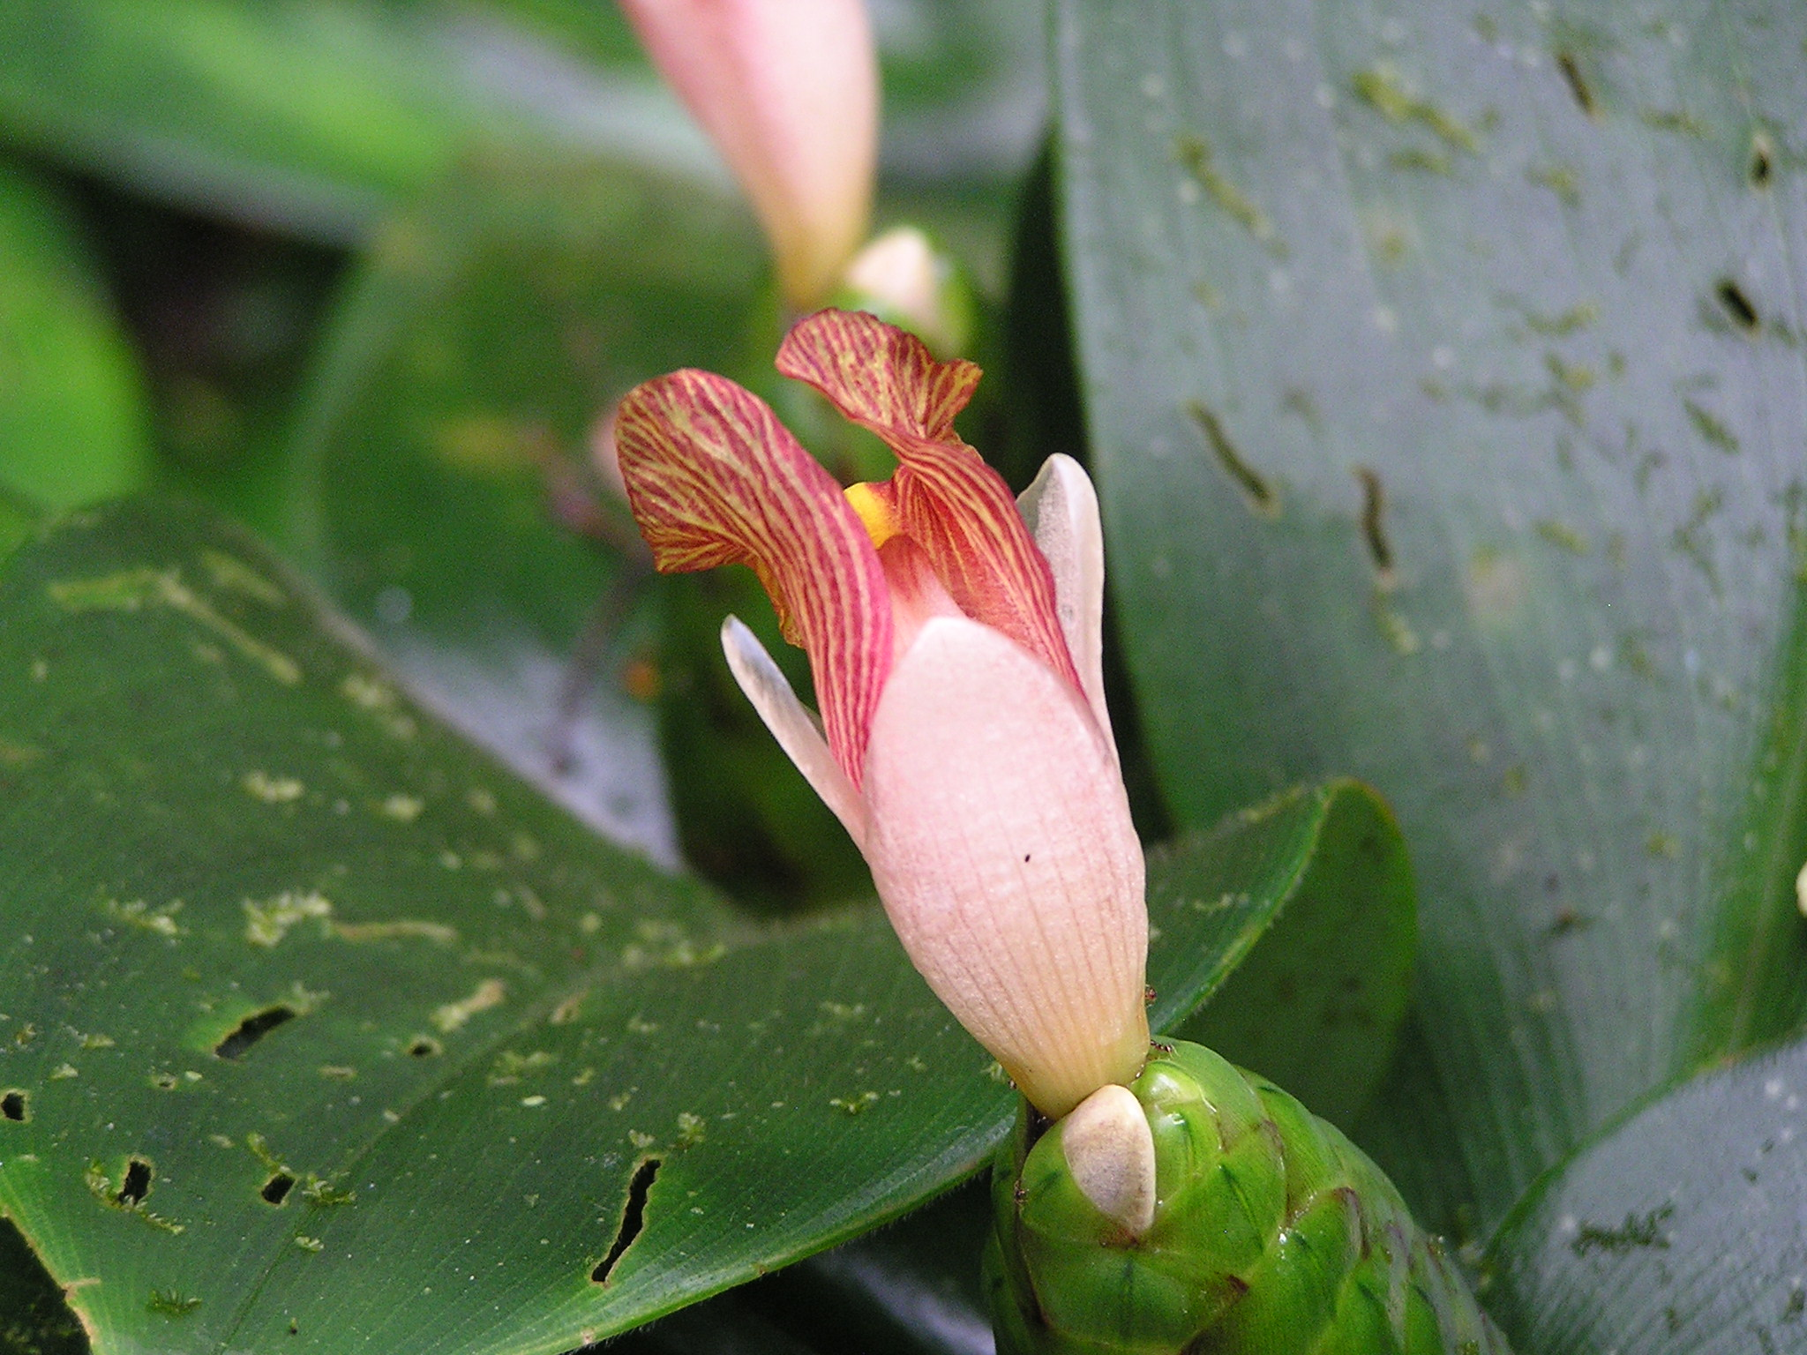

Slide 19
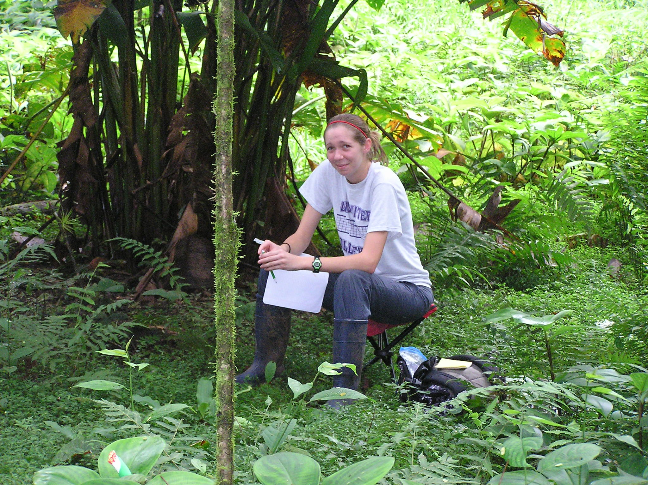

Slide 20
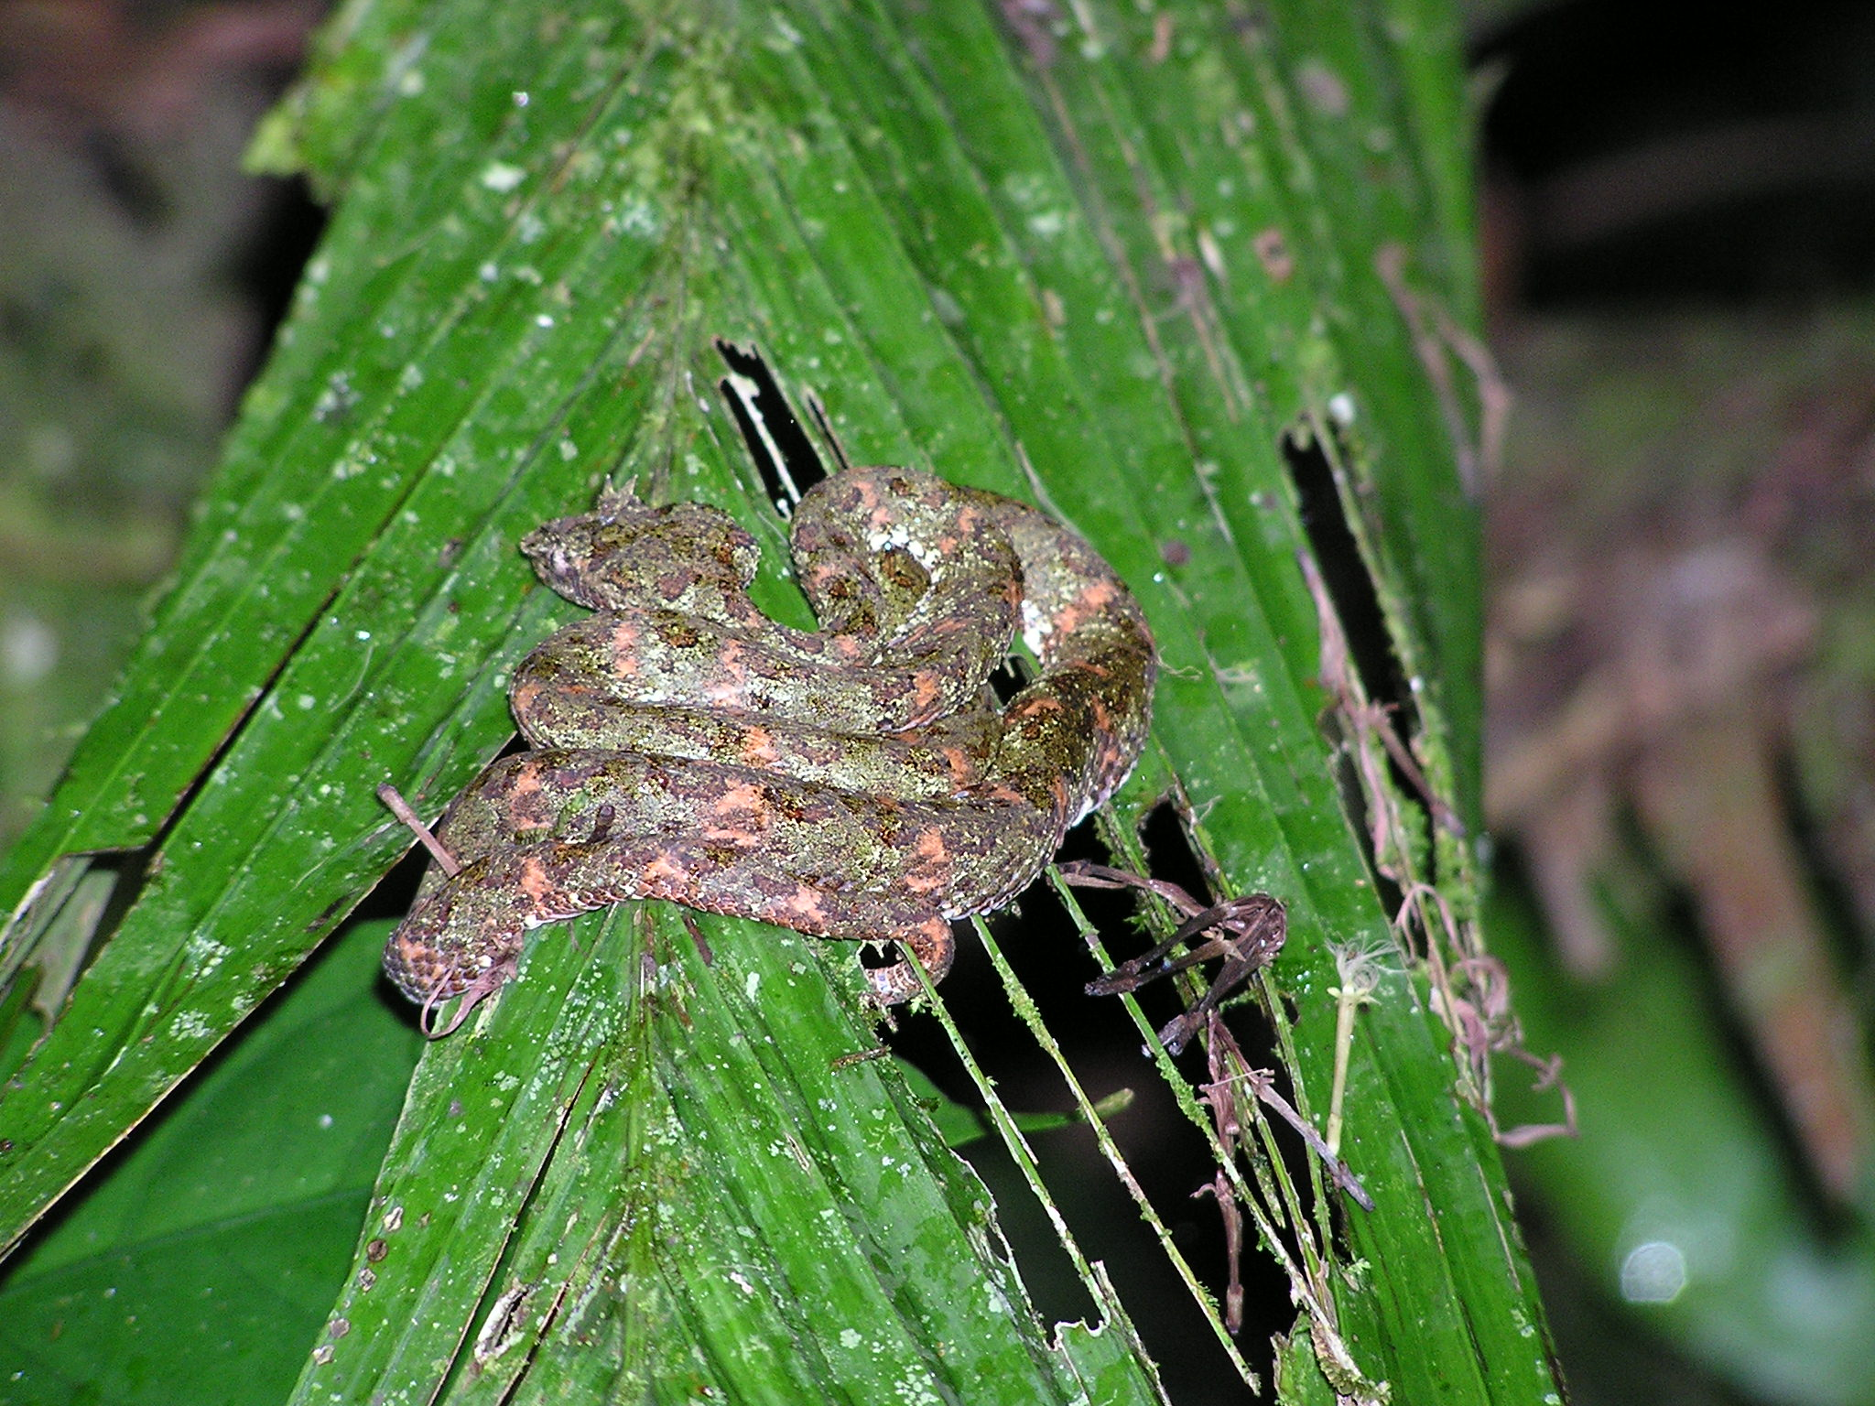

Slide 21
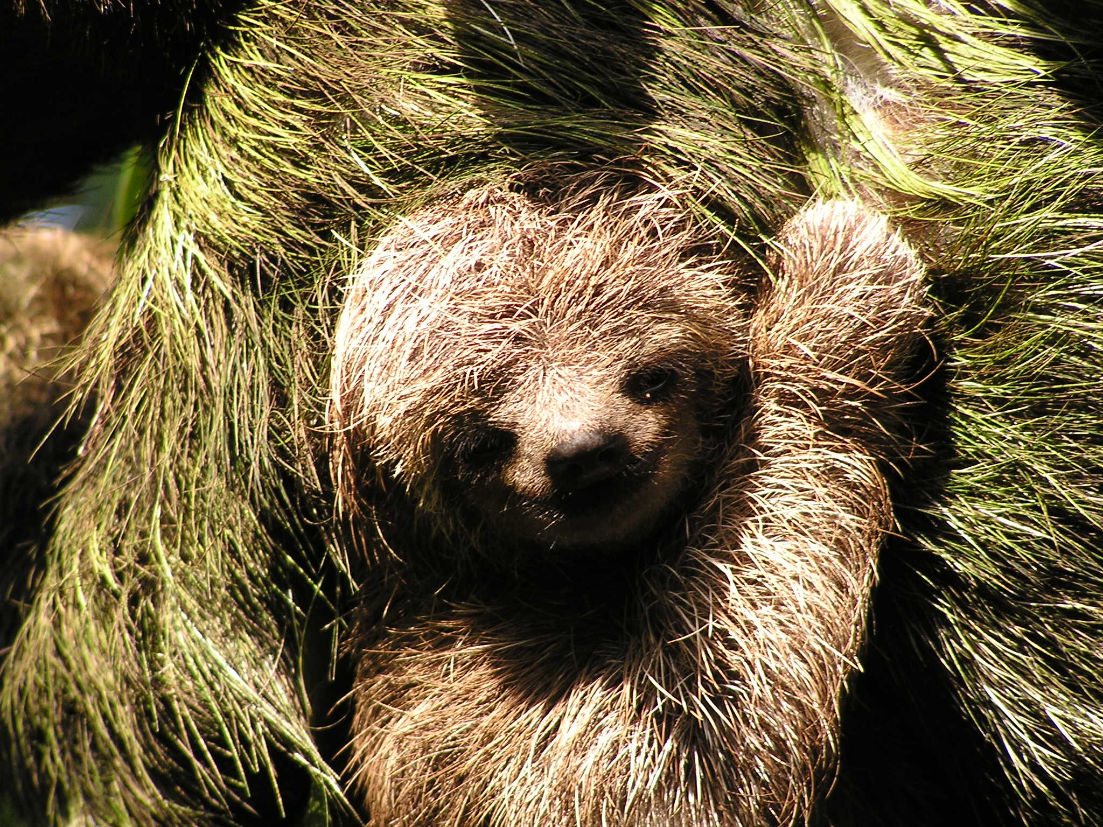

Slide 22
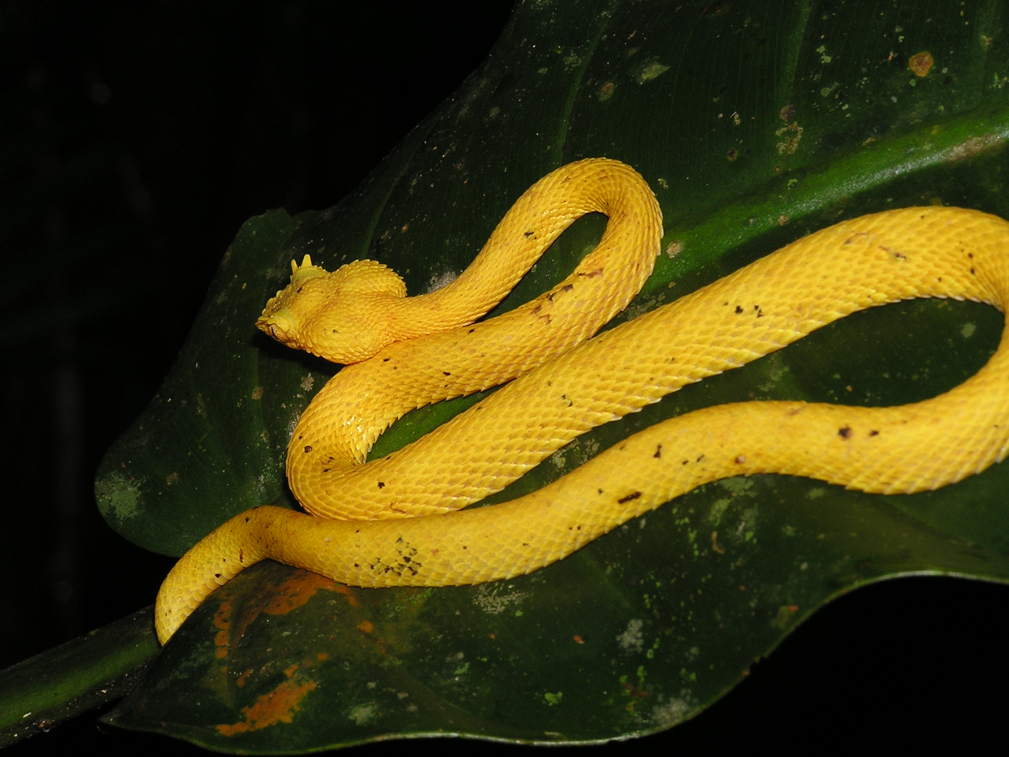

Slide 23
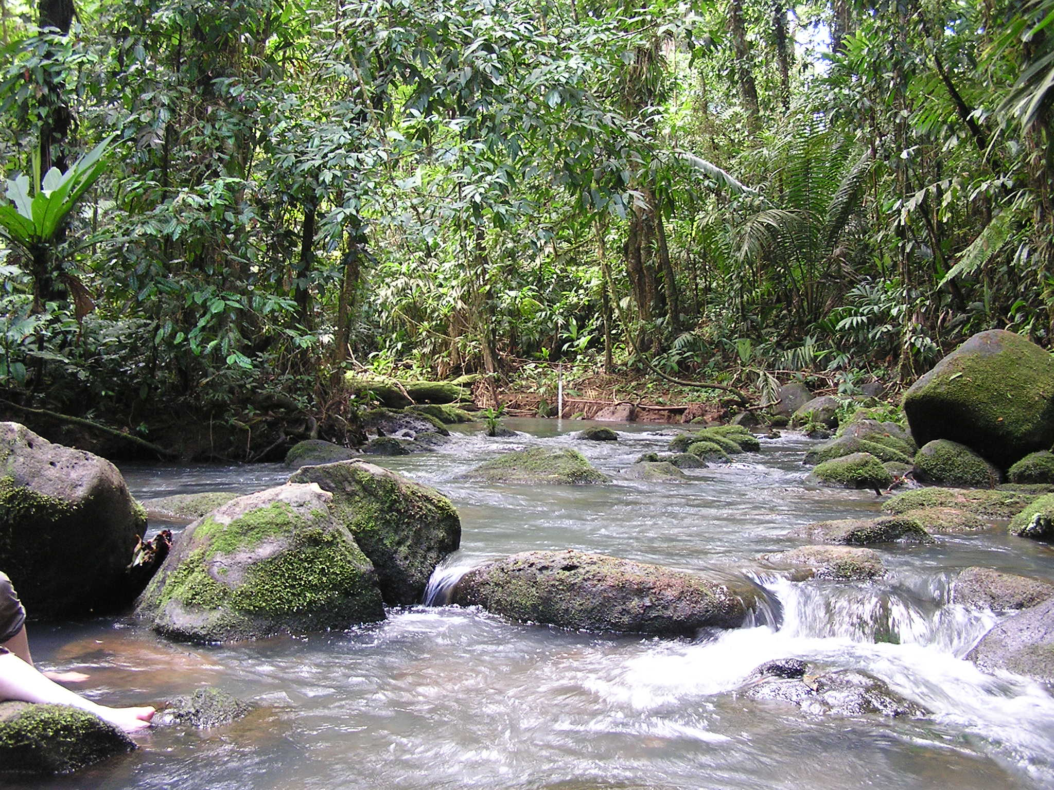

Slide 24
