Slide 1
Tuesday,
Fill out the Opscan with your name and ID

Slide 2
Question One
Which layer of the epidermis is responsible for growth?
A. Stratum corneum
B. Stratum lucidum
C. Stratum spinosum
D. Stratum petra
E. Stratum basale

Slide 3
Question Two
Which of the following is NOT a pigment that lends color to the skin?
A. Melanin
B. Carotene
C. Hemoglobin
D. Keratin

Slide 4
Question Three
Where would you find vellus?
A. It’s the deepest layer of the dermis
B. It’s the name of the oily secretion produced by the sebaceous glands
C. It’s the cell type that is altered in melanomas
D. It’s a type of hair found on women and children
E. It’s the pale, half-moon structure at the base of the fingernail.

Slide 5
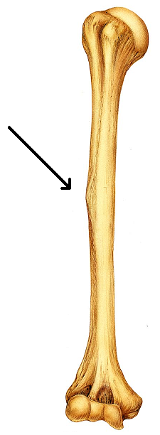
Question Four
This is an image of the humerus. The arrow is pointing to a small elevated region of bone. What term is best used to describe this?
A. facet
B. condyle
C. tubercle
D. foramina
E. fossa

Slide 6
Make sure your name and ID are on you paper
Please pass your papers to the end of the row and then forward.

