Slide 1
Make sure your name and ID are one your Opscan form

Slide 2
Question One
Where would you find a syndesmosis?
A. Distal tibia-fibula
B. Intervertebral disks
C. teeth-jaw
D. Skull bones
E. Interphalangeal joints

Slide 3
Question Two
The connective tissue that surrounds an individual muscle fiber is called
A. Endomysium
B. Perimysium
C. Ectomysium
D. Epimysium
E. Visceromysium

Slide 4
Question Three
Troponin is absent in smooth muscle. What is present instead?
A. Calcitonin
B. Melatonin
C. Calmodulin
D. Potassium
E. Sarcoplasmic reticulum

Slide 5
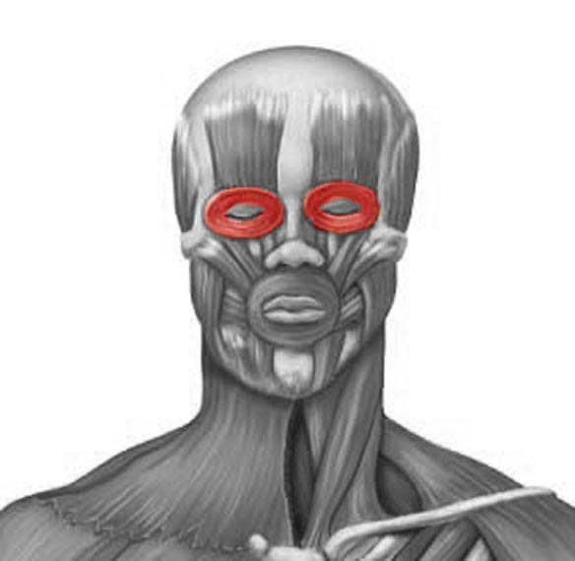
Question Four
This muscle is responsible for closing the eyes
A. Levator palpebrae
B. Orbicularis oris
C. Frontalis
D. Orbicularis oculi
E. Depressor Palpebrae

Slide 6
Check to be sure your name and ID are on your Opscan forms
Pass your forms to the end of your row and then towards the front of the class.

