Slide 1
Chapter Eleven
Exam Four Material Chapters 11, 12

Slide 2
Nervous System
The master _________________________________ system of the body
Functions
monitoring stimuli
Integration
________________________ output
response to stimuli

Slide 3
Organization of the Nervous System
Central nervous system (CNS)
Integration and command center
Peripheral nervous system (PNS)
Carries messages to and from the spinal cord and brain

Slide 4
PNS: Two Functional Divisions
Sensory (_______________________) division
Sensory afferent fibers
carry impulses from _
Visceral afferent fibers
transmit impulses from _
Motor (__________________________) division
Transmits impulses from the _

Slide 5
Motor Division: Two Main Parts
__________________________ nervous system
________________________________ control of skeletal muscles
_____________________________ nervous system (ANS)
Regulates _
sympathetic
parasympathetic

Slide 6
Histology of Nerve Tissue
The two cell divisions in the nervous system are:
excitable cells that transmit electrical signals
cells that _

Slide 7
Supporting Cells: Neuroglia
The supporting cells: neuroglia or glial cells
Provide a _
Segregate and insulate neurons
____________________________ young neurons to the proper connections
Promote _

Slide 8
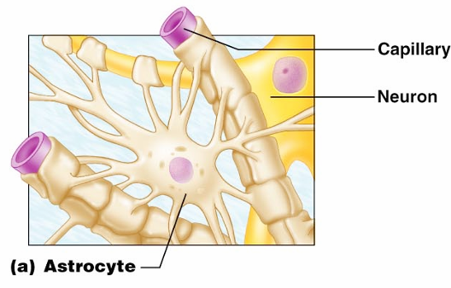
Astrocytes
Most _
They cling to neurons and their synaptic endings, and _

Slide 9
Astrocytes
Functionally, they:
Support and brace neurons
______________________________ neurons to their nutrient supplies
Guide migration of young neurons
Control the _

Slide 10
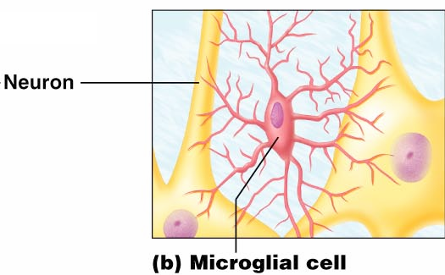
Microglia
small, ovoid cells with spiny processes
____________________________ that monitor the health of neurons

Slide 11
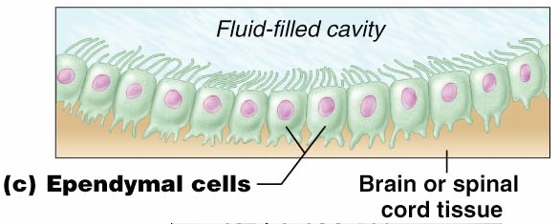
Ependymal Cells
Ependymal cells
range in shape from squamous to columnar
They ____________________________________ of the brain and spinal column

Slide 12
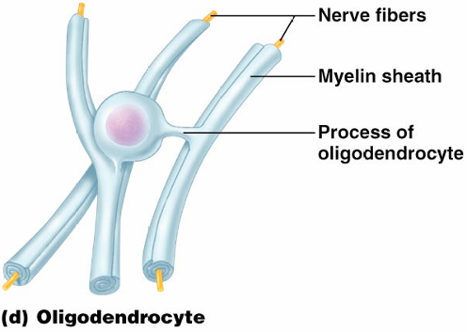
Oligodendrocytes,
Oligodendrocytes

Slide 13
Schwann Cells, and Satellite Cells
Schwann cells
surround _
Satellite cells
surround _

Slide 14
Neurons
Structural units of the nervous system
Composed of a _
Long-lived, _____________________, and have a high metabolic rate
Their plasma membrane function in:
Cell-to-cell signaling during development

Slide 15
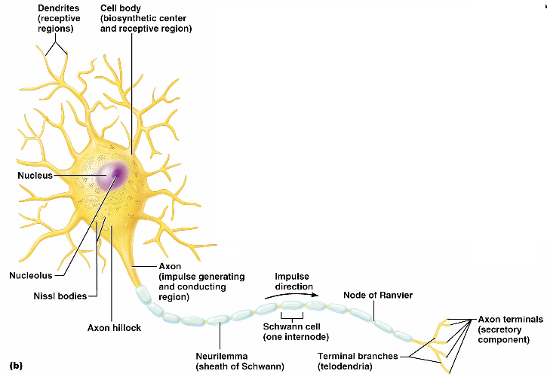
Neurons (Nerve Cells)

Slide 16
Nerve Cell Body: Soma
Contains the _
Is the major biosynthetic center
Is the focal point for the outgrowth of neuronal processes
Has well-developed _
Contains an axon hillock
cone-shaped area _

Slide 17
Processes
Armlike extensions from the soma
Called _________________ in the _
Called _________________ in the _
There are two types:

Slide 18
Dendrites of Motor Neurons
Short, tapering, and diffusely branched processes
They are the ______________________________, regions of the neuron
Electrical signals are conveyed as _________________________________ (not action potentials)

Slide 19
Axons: Structure
Slender processes _
Long axons are called _
Usually there is only one unbranched axon per neuron
Rare branches, if present, are called _
Axonal terminal
branched terminus of an axon

Slide 20
Axons: Function
Secrete ________________________________ from the axonal terminals
Movement along axons occurs in two ways
_____________________________________ axonal terminal
____________________________________ axonal terminal

Slide 21
Myelin Sheath
Whitish, fatty (protein-lipoid), _______________________________ around most long axons
It functions to:
Electrically ___________________________ fibers from one another
Increase the _

Slide 22
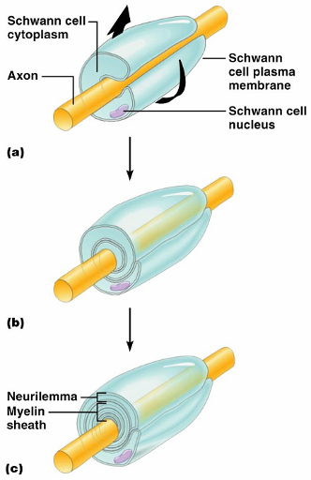
Myelin Sheath and Neurilemma
Formed by _________________ cells in the _
A Schwann cell:
Envelopes an axon
Encloses the axon with its plasma membrane
Has concentric layers of membrane that make up the myelin sheath
Neurilemma

Slide 23
Nodes of Ranvier
____________________ in the myelin sheath _
They are the sites where _

Slide 24
Unmyelinated Axons
A Schwann cell surrounds nerve fibers _
Schwann cells partially enclose 15 or more axons

Slide 25
Axons of the CNS
Both myelinated and unmyelinated fibers are present
______________________________ are formed by _
Nodes of Ranvier are _
There is no neurilemma

Slide 26
Regions of the Brain and Spinal Cord
________________________ matter
dense collections of _
________________________ matter
mostly _

Slide 27
Neuron Classification
Structural:
Multipolar
Bipolar
Unipolar

Slide 28
Neuron Classification
Functional:
transmit impulses _
Motor _
carry impulses _
_________________________________ (association neurons)
shuttle signals through CNS pathways

Slide 29
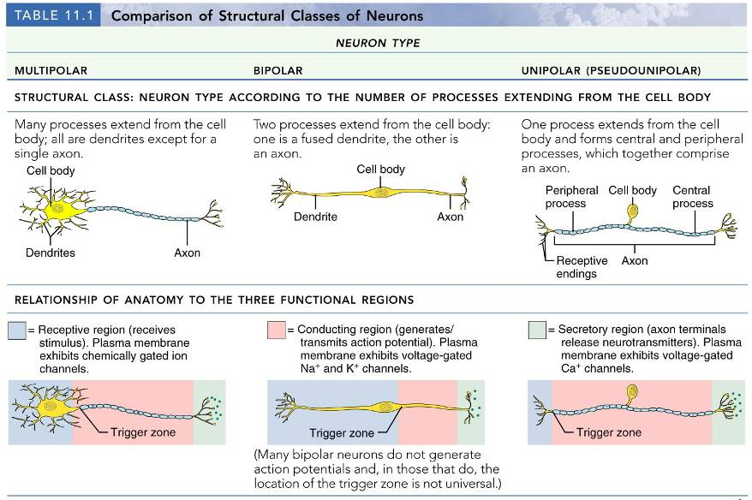

Slide 30
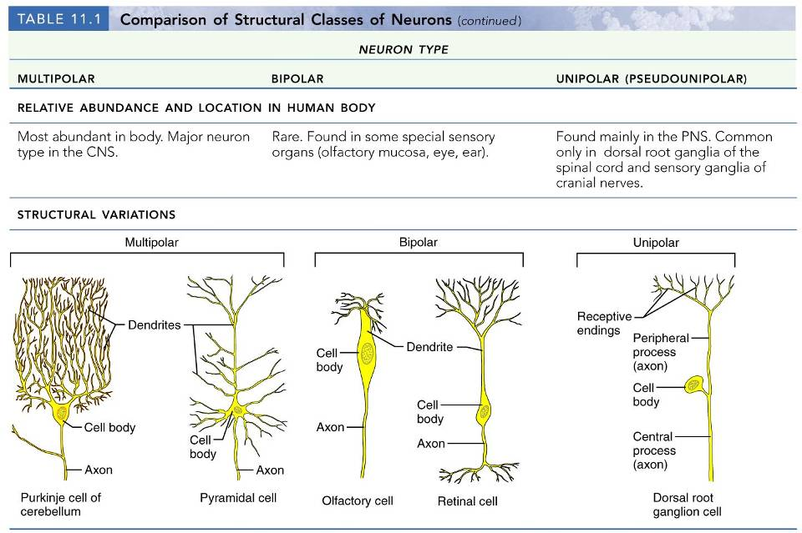

Slide 32
Neurophysiology
Neurons are _
Action potentials, or nerve impulses, are:
__________________________________ carried along the length of axons
The underlying _______________________________ of the nervous system

Slide 33
Electrical Current and the Body
Reflects the flow of ________________ rather than electrons
There is a potential on either side of membranes when:
The number of ions is _
The membrane provides a resistance to ion flow

Slide 34
Role of Ion Channels
Types of plasma membrane ion channels:
always open
open with binding of a specific neurotransmitter
open and close in response to membrane potential
open and close in response to physical deformation of receptors

Slide 35
Electrochemical Gradient
chemical gradient
________ movement from an area of _
electrical gradient
Ion movement toward an area of _
Electrochemical gradient
the ____________________________________ gradients taken together

Slide 36
Resting Membrane Potential (V_{r})
The potential difference (–70 mV) across the membrane of a resting neuron
It is generated by different concentrations of Na⁺, K⁺, Cl⁻, and protein anions (A⁻)
Ionic differences are the consequence of:
Differential __________________________ of the neurilemma to Na⁺ and K⁺
Operation of the _

Slide 37
Membrane Potentials: Signals
Membrane potential changes are produced by:
Changes in membrane permeability to ions
Alterations of ion concentrations across the membrane
Types of signals

Slide 38
Changes in Membrane Potential
Changes are caused by three events
the inside of the membrane becomes _
the membrane returns to its resting membrane potential
the inside of the membrane becomes _______________________________________ than the resting potential

Slide 39
Graded Potentials
_________________________________ in membrane potential
Magnitude varies directly with the strength of the stimulus
Sufficiently strong graded potentials can initiate action potentials

Slide 40
Graded Potentials
Current is quickly dissipated due to the _
Only travel over _

Slide 41
Action Potentials (APs)
A brief reversal of membrane potential with a total amplitude of 100 mV
Action potentials are only generated by _
do ________ decrease in strength over distance
principal means of neural communication
An ________________________ in the axon of a neuron _

Slide 42
Action Potential: Resting State
Leakage accounts for small movements of Na⁺ and K⁺
Each Na⁺ channel has two voltage-regulated gates

Slide 43
Action Potential: Depolarization Phase
Na⁺_______________________________ increases; membrane potential reverses
Threshold
a critical level of depolarization
-55 to -50 mV
At threshold, depolarization becomes _

Slide 44
Action Potential: Repolarization Phase
Sodium inactivation gates close
Membrane permeability to Na⁺ declines to resting levels
As sodium gates close, _
K⁺ exits the cell and _

Slide 45
Action Potential: Hyperpolarization
Potassium gates remain open, causing an _
This movement causes _________________________________ of the membrane (undershoot)
The neuron is ___________________________ to stimulus and depolarization during this time

Slide 46
Action Potential: Role of the Sodium-Potassium Pump
___________________________________ electrical conditions of the neuron
Does _________ restore the resting ionic conditions
Ionic redistribution back to resting conditions _

Slide 47
Phases of the Action Potential
1 –
2 –
3 –
4 –

Slide 48
Phases of the Action Potential

Slide 49
Threshold and Action Potentials
Threshold
Established by the total amount of current flowing through the membrane
Subthreshold: _
Threshold: _
All-or-none phenomenon
action potentials _

Slide 50
Coding for Stimulus Intensity
All action potentials are _______________ and are independent of stimulus intensity
Strong stimuli can generate an action potential more often than weaker stimuli
The CNS determines stimulus intensity by the _

Slide 51
Absolute Refractory Period
The absolute refractory period:
Ensures that _
Enforces one-way transmission of nerve impulses

Slide 52
Relative Refractory Period
The interval following the absolute refractory period when _
The threshold level is _______________________, allowing _______________________________ to increase the frequency of action potential events

Slide 53
Conduction Velocities of Axons
Rate of impulse propagation is determined by:
the larger the diameter, the faster the impulse
Presence of a _
myelination dramatically _

Slide 54
Saltatory Conduction
Current passes through a myelinated axon only _
Voltage-gated Na⁺ channels are concentrated at these nodes
Action potentials are triggered only at the nodes and _
Much faster than conduction along unmyelinated axons

Slide 55
Nerve Fiber Classification
Nerve fibers are classified according to:
Degree of _

Slide 56
Synapses
A junction that mediates information transfer from one neuron:
Presynaptic neuron
conducts impulses _
Postsynaptic neuron
transmits impulses _

Slide 57
Synaptic Cleft
Fluid-filled space _
Prevents nerve impulses from directly passing from one neuron to the next
Transmission across the synaptic cleft:
___________________________________ (as opposed to an electrical one)
Ensures ____________________________ communication between neurons

Slide 58
Synaptic Cleft: Information Transfer
Nerve impulses reach the axonal terminal of the presynaptic neuron and _
Neurotransmitter is released into the synaptic cleft via _
Neurotransmitter crosses the synaptic cleft
binds to _
Postsynaptic membrane permeability changes, causing an _

Slide 59
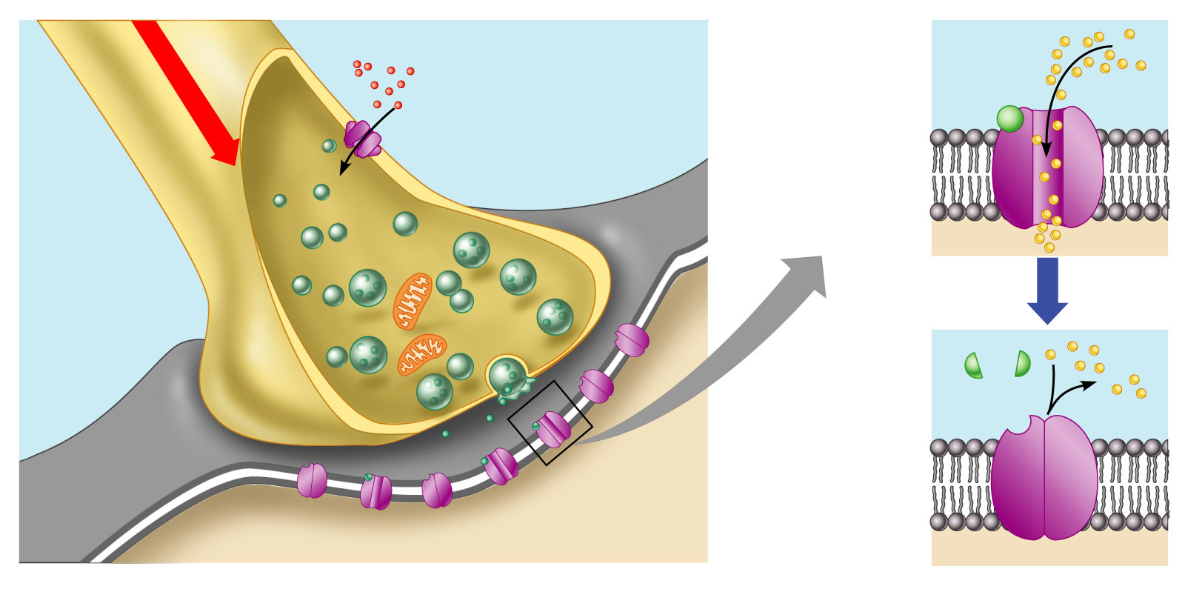
Synaptic Cleft: Information Transfer
Ca²⁺
Neurotransmitter
Na⁺
Action potential
Axon terminal of
presynaptic neuron
Receptor
1
Mitochondrion
Postsynaptic
membrane
Axon of
presynaptic
neuron
Postsynaptic
membrane
Ion channel open
Synaptic vesicles
containing
neurotransmitter
molecules
5
Degraded
neurotransmitter
2
Synaptic
cleft
3
4
Ion channel
(closed)
Ion channel closed
Ion channel (open)
Figure 11.18

Slide 60
Termination of Neurotransmitter Effects
Neurotransmitter bound to a postsynaptic receptor:
Produces a _
_________________________________________ of additional “messages”
Must be removed from its receptor
Removal of neurotransmitters occurs when they:
degraded by _
__________________________________ by astrocytes or the presynaptic terminals
Diffuse from the synaptic cleft

Slide 61
Postsynaptic Potentials
Neurotransmitter receptors mediate changes in membrane potential according to:
The _
The amount of ______________________ the neurotransmitter is bound to receptors
The two types of postsynaptic potentials are:
EPSP – __________________________ postsynaptic potentials
IPSP – __________________________ postsynaptic potentials

Slide 62
Excitatory Postsynaptic Potentials
EPSPs are ________________________ that _____________________________ an action potential in an axon
Use only chemically gated channels
Na⁺ and K⁺ flow in opposite directions at the same time
Postsynaptic membranes do not generate action potentials

Slide 63
Inhibitory Synapses and IPSPs
Neurotransmitter binding to a receptor at _________________________________:
Causes the membrane to become more permeable to potassium and chloride ions
_________________________the postsynaptic neuron’s ability to produce an action potential

Slide 64
Summation
A single EPSP cannot induce an action potential
EPSPs must _______________________ temporally or spatially to induce an action potential
Temporal summation
presynaptic neurons transmit impulses in _

Slide 65
Summation
Spatial summation
postsynaptic neuron is stimulated by a _
IPSPs can also summate with EPSPs, _

Slide 66
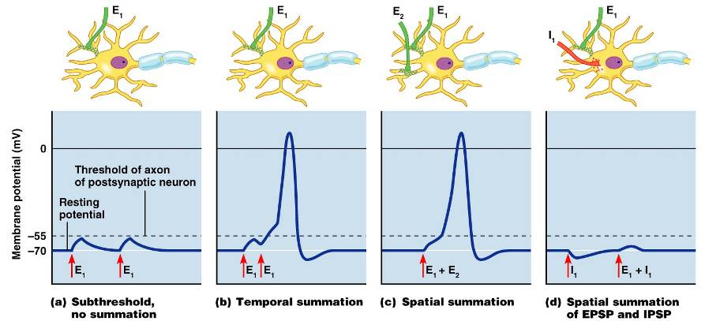
Summation

Slide 67
Neurotransmitters
Chemicals used for neuronal communication with the body and the brain
50 different neurotransmitters have been identified
Classified

Slide 68
Chemical Neurotransmitters
Biogenic amines
Peptides
Novel messengers:
ATP
dissolved gases _

Slide 69
Neurotransmitters: Acetylcholine
____________________ neurotransmitter identified, and best understood
Released at the _
Synthesized and enclosed in _

Slide 70
Neurotransmitters: Acetylcholine
Degraded by the enzyme acetylcholinesterase _
Released by:
All neurons that _
Some neurons in the _

Slide 71
Neurotransmitters: Biogenic Amines
Include:
Catecholamines
Indolamines
Broadly distributed in the _
Play roles in emotional behaviors and our biological clock

Slide 72
Neurotransmitters: Amino Acids
Include:
Gamma (γ)-aminobutyric acid
Glycine
Glutamate
Found only in the _

Slide 73
Neurotransmitters: Peptides
Include:
Substance P
Beta endorphin, dynorphin, and enkephalins
Act as _____________________________; reduce pain perception
Bind to the same receptors as opiates and morphine
Gut-brain peptides

Slide 74
Neurotransmitters: Novel Messengers
ATP
Is found in both the _
Produces ____________________________________ responses depending on receptor type
Provokes _

Slide 75
Neurotransmitters: Novel Messengers
Nitric oxide
Is involved in _
Carbon monoxide (CO) is a main regulator of cGMP in the brain

Slide 76
Functional Classification of Neurotransmitters
Two classifications: excitatory and inhibitory
Excitatory neurotransmitters cause _
Inhibitory neurotransmitters cause _

Slide 77
Functional Classification of Neurotransmitters
Some neurotransmitters have _
Determined by the ____________________ type of the postsynaptic neuron
Example: _
_____________________________ at neuromuscular junctions with skeletal muscle

Slide 78
Neurotransmitter Receptor Mechanisms
Direct: neurotransmitters that open _
Promote _
Examples: _____________ and amino acids
Indirect: neurotransmitters that _
Promote _
Examples: biogenic amines, peptides, and dissolved gases

Slide 79
Neural Integration: Neuronal Pools
Functional groups of neurons that:
__________________________ incoming information
Forward the processed information to its appropriate destination

Slide 80
Neural Integration: Neuronal Pools
Simple neuronal pool
Input fiber
Discharge zone
neurons _________________________________ with the incoming fiber
Facilitated zone
neurons farther away from _

Slide 81
Types of Circuits in Neuronal Pools
Divergent

Slide 82
Types of Circuits in Neuronal Pools
Convergent

Slide 83
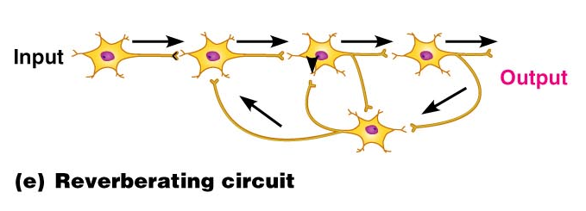
Types of Circuits in Neuronal Pools
Reverberating

Slide 84
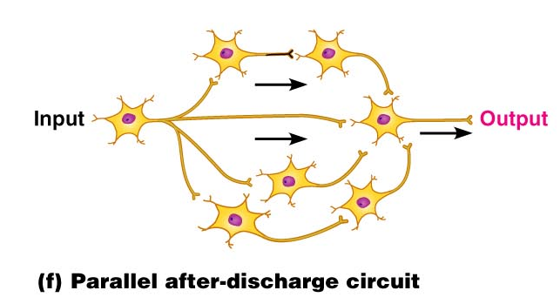
Types of Circuits in Neuronal Pools
Parallel after-discharge

Slide 85
Patterns of Neural Processing
Serial Processing
Input travels along one pathway to a specific destination
Works in an _
Example:

Slide 86
Patterns of Neural Processing
Parallel Processing
Input travels along _
Pathways are integrated in different CNS systems
Example:

Slide 87
Chapter 12

Slide 88
Central Nervous System (CNS)
CNS – composed of the _
Elaboration of the anterior portion of the CNS
Increase in ___________________________ in the head
Highest level is reached in the human brain

Slide 89
The Brain
Composed of wrinkled, pinkish gray tissue
Surface anatomy includes

Slide 90
Adult Brain Structures
cerebrum: cortex, white matter, and basal nuclei
thalamus, hypothalamus, and epithalamus
brain stem: midbrain
Metencephalon
brain stem: pons
Myelencephalon
brain stem: medulla oblongata

Slide 91
Adult Neural Canal Regions
Adult structures derived from the neural canal
Telencephalon –
Diencephalon –
Mesencephalon –
Metencephalon and myelencephalon –

Slide 92
Basic Pattern of the Central Nervous System
Spinal Cord
______________________________ surrounded by a _
Gray matter is surrounded by _
myelinated fiber _
Brain
Similar to spinal cord but with _
Cerebellum has gray matter in nuclei
Cerebrum has nuclei and additional gray matter in the cortex

Slide 93
Ventricles of the Brain
Arise from expansion of the lumen of the neural tube
The ventricles are:
The paired _
The third ventricle found in the diencephalon
The fourth ventricle found in the hindbrain dorsal to the pons

Slide 94
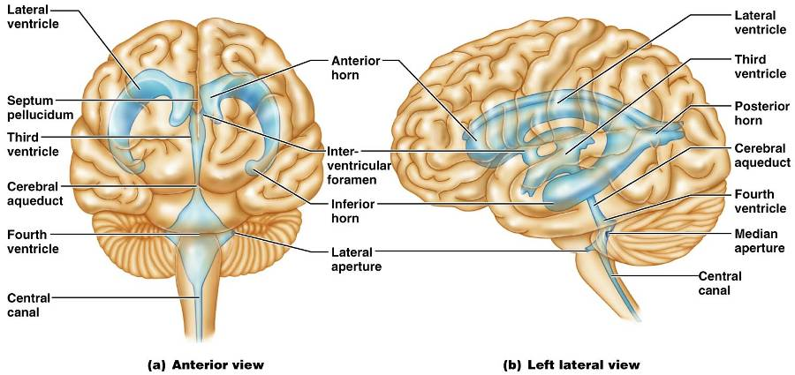
Ventricles of the Brain

Slide 95
Cerebral Hemispheres
Contains ridges
and shallow grooves
Contain deep grooves
Are separated by the _
Have three basic regions:
cortex, white matter, and basal nuclei

Slide 96
Major Lobes, Gyri, and Sulci of the Cerebral Hemisphere
Deep sulci divide the hemispheres into five lobes:
separates the frontal and parietal lobes

Slide 97
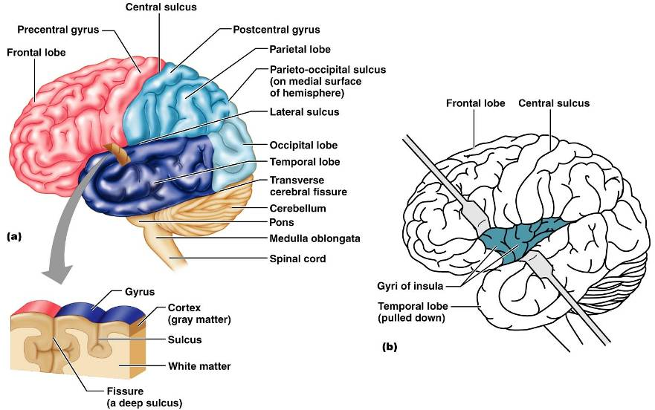
Brain Lobes

Slide 98
Major Lobes, Gyri, and Sulci of the Cerebral Hemisphere
separates the parietal and occipital lobes
separates the parietal and temporal lobes
The

Slide 99
Cerebral Cortex
The cortex
superficial gray matter
accounts for 40% of the mass of the brain
It enables
Each hemisphere acts _____________________________ (controls the opposite side of the body)
Hemispheres are not equal in function
No functional area acts alone; conscious behavior involves the entire cortex

Slide 100
Functional Areas of the Cerebral Cortex
The three types of functional areas are:
control voluntary movement
conscious awareness of sensation
integrate diverse information

Slide 101
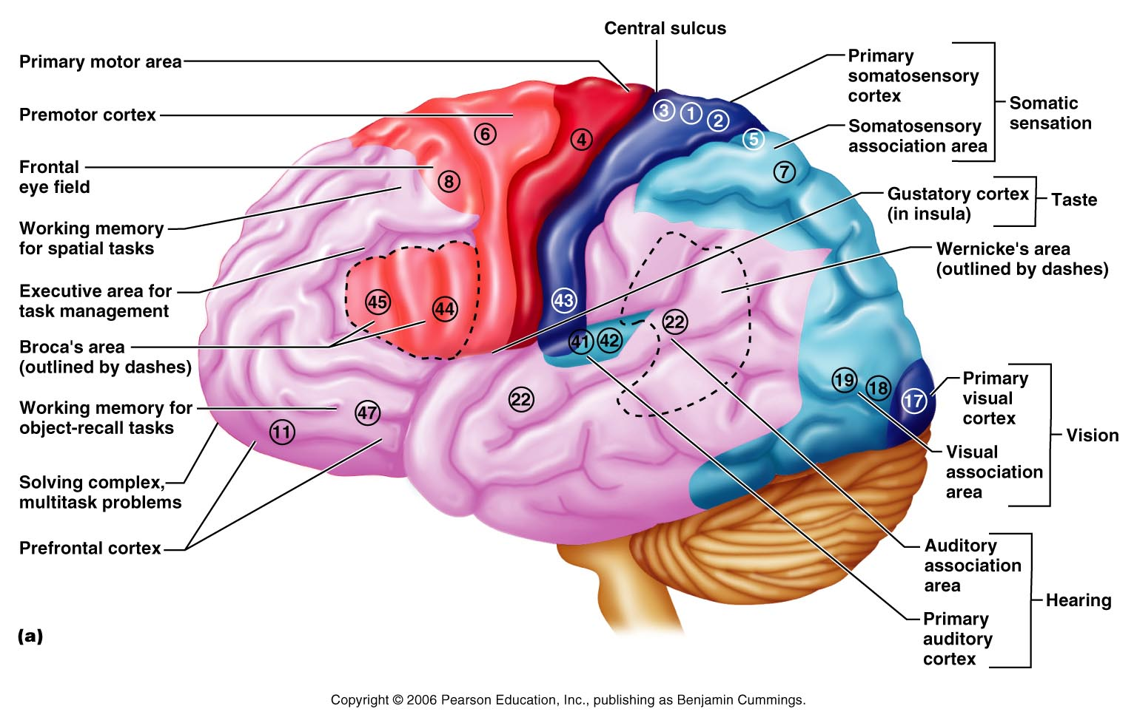
Functional Areas of the Cerebral Cortex

Slide 102
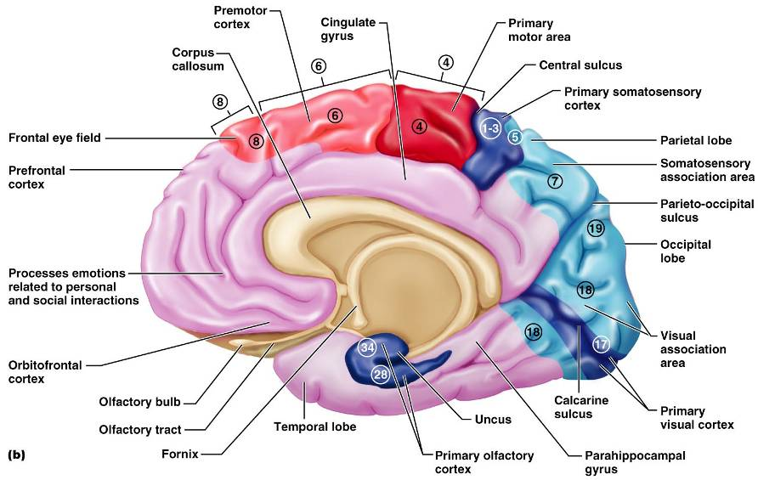
Functional Areas of the Cerebral Cortex

Slide 103
Cerebral Cortex: Motor Areas
Primary _
Premotor cortex
Frontal eye field

Slide 104
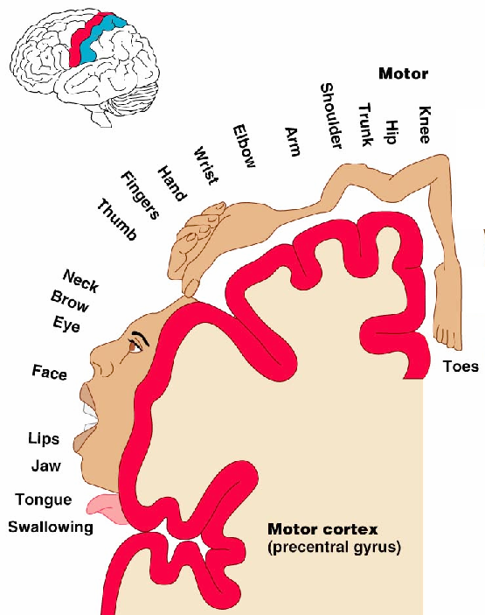
Primary Motor Cortex
Located in the _
Pyramidal cells whose axons make up the _
Allows conscious control of precise, skilled, voluntary movements

Slide 105
Premotor Cortex
Located _
Controls _
Coordinates simultaneous or sequential actions
Involved in the planning of movements

Slide 106
Broca’s Area
Broca’s area
Located anterior to the inferior region of the premotor area
Present in _
A motor speech area that _
Is active as one prepares to speak

Slide 107
Frontal Eye Field
Located anterior to the premotor cortex and superior to Broca’s area
Controls _

Slide 108
Sensory Areas
Primary _
Somatosensory association cortex
Visual and _
Olfactory, ___________________________, and vestibular cortices

Slide 109
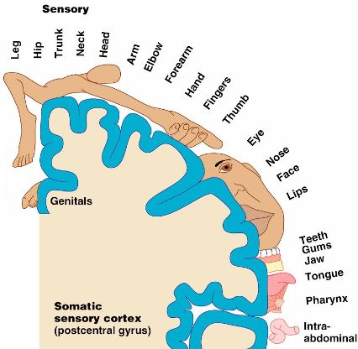
PrImary Somatosensory Cortex
Located in the postcentral gyrus, this area:
Receives information from the _
Exhibits _

Slide 110
Somatosensory Association Cortex
Located posterior to the primary somatosensory cortex
Forms _____________________________ understanding of the stimulus
Determines size, texture, and relationship of parts

Slide 111
Visual Areas
Primary visual (striate) cortex
Seen on the _
Most of it is buried in the calcarine sulcus
Receives visual information from the retinas
Visual association area
Interprets visual stimuli (e.g., color, form, and movement)

Slide 112
Auditory Areas
Primary auditory cortex
Located at the superior margin of the _
Receives information related to _
Auditory association area
Located posterior to the primary auditory cortex
____________________________________ and permits perception of sounds

Slide 113
Association Areas
Language areas
General (common) interpretation area

Slide 114
Prefrontal Cortex
Located in the _
Involved with ________________________, cognition, recall, and _
Necessary for judgment, _______________________, persistence, and conscience
Closely linked to the __________________ system (emotional part of the brain)

Slide 115
Cerebellar Cognitive Function
Plays a role in _
Recognizes and ______________________ sequences of events

Slide 116
Language Areas
Located in a large area surrounding the ________________ (or language-dominant) _
Major parts and functions:
sounding out unfamiliar words
speech preparation and production
language comprehension and word analysis
Lateral and ventral temporal lobe
coordinate auditory and visual aspects of language

Slide 117
General (Common) Interpretation Area
__________________________ region including parts of the temporal, parietal, and occipital lobes
Found in one hemisphere, _
Integrates incoming signals _
Involved in processing spatial relationships

Slide 118
Visceral Association Area
Located in the _
Involved in conscious perception of _

Slide 119
Lateralization of Cortical Function
Lateralization
each hemisphere has _
Cerebral dominance
designates the hemisphere _
Left hemisphere
controls _
Right hemisphere
controls _

Slide 120
Cerebral White Matter
Consists of deep _
It is responsible for communication between:
The cerebral cortex and lower CNS center, and areas of the cerebrum

Slide 121
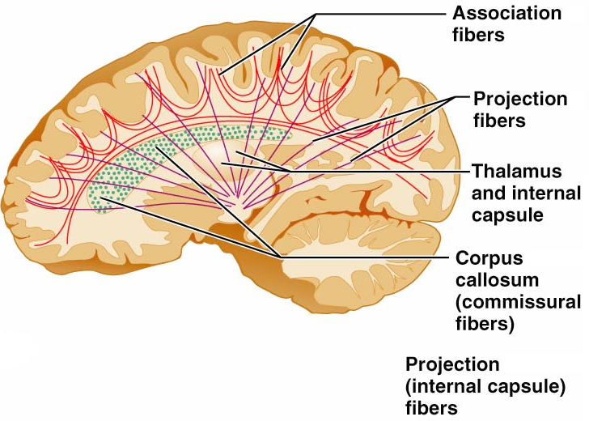
Cerebral White Matter
Types include:
connect corresponding gray areas of the two hemispheres
connect different parts of the same hemisphere
enter the hemispheres from lower brain or cord centers

Slide 122
Basal Nuclei
Masses of _________________________ found deep within the cortical white matter
The corpus striatum is composed of three parts
composed of the putamen and the globus pallidus
_______________________________ running between and through caudate and lentiform nuclei

Slide 123
Functions of Basal Nuclei
the following are thought to be functions of basal nuclei
Influence muscular activity
Regulate _
Regulate intensity of slow or stereotyped movements
_____________________________________ and unnecessary movement

Slide 124
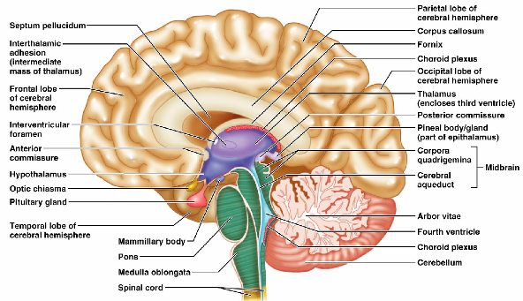
Diencephalon
Central core of the forebrain
Consists of three paired structures –
Encloses the _

Slide 125
Thalamus
Paired, egg-shaped masses that form the superolateral walls of the third ventricle
Contains four groups of nuclei
anterior, ventral, dorsal, and posterior
Nuclei _

Slide 126
Thalamic Function
___________________________________ and synapse in the thalamus
Impulses of similar function are sorted out, _________________________, and ______________________ as a group
All inputs ascending to the cerebral cortex pass through the thalamus
Mediates sensation, motor activities, cortical arousal, learning, and memory

Slide 127
Hypothalamus
Located below the thalamus, it caps the brainstem and forms the inferolateral walls of the third ventricle
Small, paired nuclei bulging anteriorly from the hypothalamus
_________________________________ for olfactory pathways
Infundibulum
stalk of the hypothalamus; _
Main _____________________________________ of the body

Slide 128
Hypothalamic Function
Regulates _
rate and force of _
______________________________ motility
rate and depth of _
many other visceral activities
Perception of _
Maintains normal body _
Regulates feelings of hunger and _
Regulates sleep and the _

Slide 129
Endocrine Functions of the Hypothalamus
____________________________________ control secretion of hormones by the anterior pituitary

Slide 130
Epithalamus
Most _______________________ of the diencephalon; forms roof of the third ventricle
extends from the posterior border and secretes _
a hormone involved with sleep regulation, sleep-wake cycles, and mood
a structure that _

Slide 131
Chapter 12

Slide 132
Brain Stem
Consists of three regions
Similar to spinal cord
but contains _
Controls ___________________________ behaviors necessary for survival
Provides the pathway for tracts between higher and lower brain centers

Slide 133
Midbrain
Located between the diencephalon and the pons
Midbrain structures include:
two bulging structures that contain descending pyramidal motor tracts
hollow tube that connects the _
Various nuclei

Slide 134
Pons
________________________________ region between the midbrain and the medulla oblongata
Fibers of the pons:
Connect higher brain centers and the spinal cord
_____________________________________ between the motor cortex and the cerebellum

Slide 135
Pons
Origin of cranial nerves

Slide 136
Medulla Oblongata
Most _______________________ part of the brain stem
Contains a ___________________________ of the fourth ventricle
two longitudinal ridges formed by _
___________________________ of the pyramids
____________________________ points of the corticospinal tracts

Slide 137
The Cerebellum
Located _
Protrudes under the occipital lobes of the cerebrum
Makes up 11% of the brain’s mass
Provides ____________________________ and appropriate patterns of skeletal muscle contraction
Cerebellar activity occurs _

Slide 138
Cerebellar Cognitive Function
Plays a role in _
Recognizes and ___________________________ sequences of events

Slide 139
Consciousness
Encompasses perception of _____________ __________________________________, and capabilities associated with higher mental processing
Involves simultaneous activity of large areas of the cerebral cortex
Is superimposed on other types of neural activity

Slide 140
Consciousness
Is holistic and _
Clinical consciousness is defined on a continuum that grades levels of behavior

Slide 141
Protection of the Brain
The brain is protected by _
Harmful substances are shielded from the brain by the _

Slide 142
Meninges
Three connective tissue membranes lie external to the CNS
Functions of the meninges
_____________________________________ and enclose venous sinuses
Contain cerebrospinal fluid (CSF)
Form ___________________________ within the skull

Slide 143
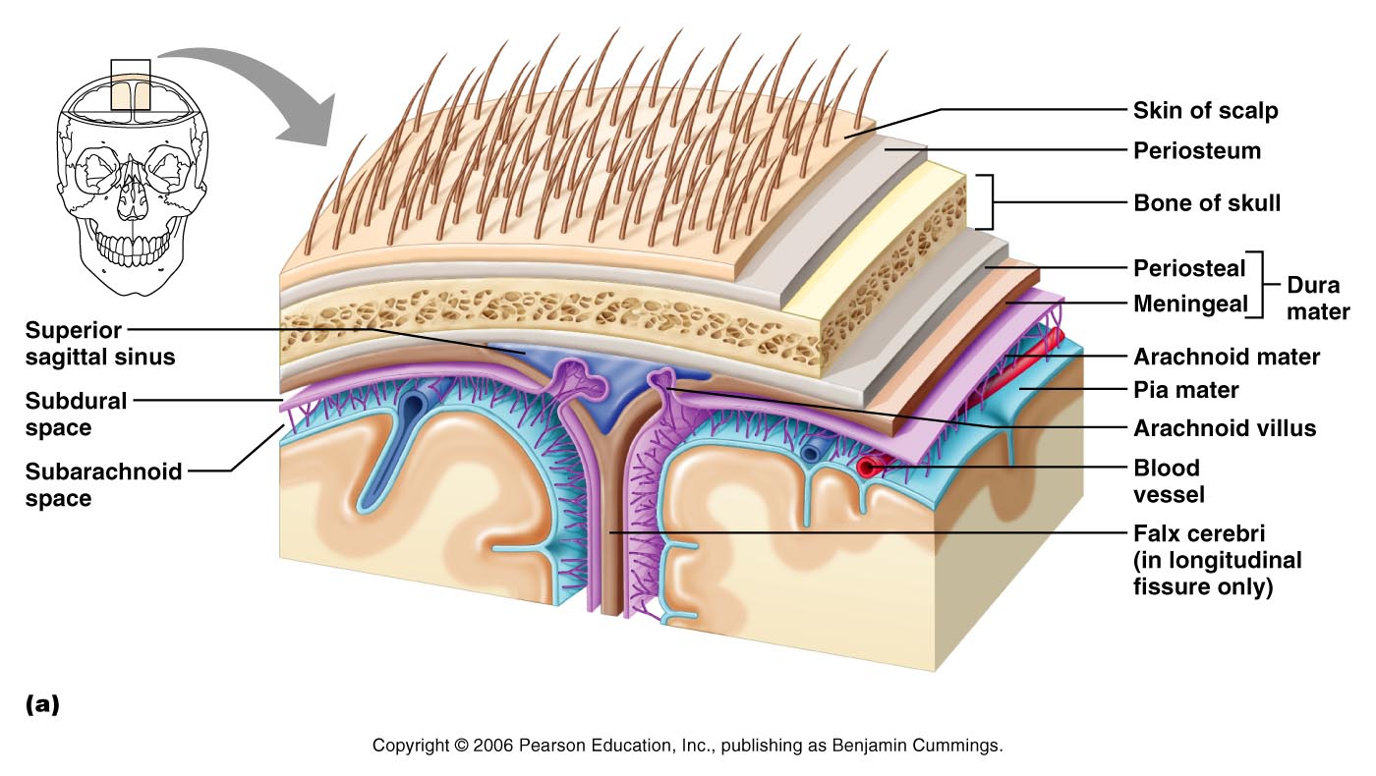
Meninges

Slide 144
Dura Mater
Leathery, strong covering composed of _
The two layers _______________________ in certain areas and _

Slide 145
Dura Mater
Three ___________________________ extend inward and limit excessive movement of the brain
fold that dips into the _
Falx _
runs along the _
Tentorium cerebelli
horizontal dural fold extends into the _

Slide 146
Arachnoid Mater
forms a _
It is separated from the dura mater by the _
Beneath the arachnoid is a wide subarachnoid space filled with CSF and large blood vessels
Arachnoid villi protrude superiorly and _

Slide 147
Pia Mater
_______________________ layer composed of delicate connective tissue that _

Slide 148
Cerebrospinal Fluid (CSF)
Watery solution similar in composition _
Forms a _____________________________ that gives buoyancy to the CNS organs

Slide 149
Cerebrospinal Fluid (CSF)
Prevents the brain from _
Protects the CNS from _
_______________________________ the brain and carries chemical signals throughout it

Slide 150
Choroid Plexuses
Clusters of _________________ that form tissue fluid filters, which hang from the roof of each ventricle
Help _

Slide 151
Blood-Brain Barrier
Protective mechanism that helps maintain a stable environment for the brain
Bloodborne substances are separated from neurons by:
Continuous _
Relatively thick _
Bulbous feet of _

Slide 152
Blood-Brain Barrier: Functions
Selective barrier that allows _______________________ to pass freely
Is ineffective against substances that can diffuse through plasma membranes
Absent in some areas __________________________________ allowing these areas to monitor the chemical composition of the blood
_____________________ increases the ability of chemicals to pass through the blood-brain barrier

