Slide 1
Matter
Matter—anything that has mass and occupies space
Weight—pull of gravity on mass
3 states of matter
Solid—
Liquid—
Gas— changeable shape and volume

Slide 2
Composition of Matter: Elements
Elements
Matter is composed of elements
Elements cannot be broken into simpler substances by ordinary chemical methods
Each has unique properties
Detectable with our senses, or are measurable
How atoms interact (bond) with one another

Slide 3
Composition of Matter
Atoms
Give each element its physical & chemical properties
Smallest particles of an element with properties of that element
One- or two-letter chemical shorthand for each element

Slide 4
Atomic Structure
Atoms are composed of subatomic particles
Protons, neutrons, electrons
Protons and neutrons _
Electrons orbit nucleus _

Slide 5
Atomic Structure: The Nucleus
Almost entire mass of the atom
Neutrons
Mass = 1 atomic mass unit (amu)
Protons
Mass = 1 amu

Slide 6
Atomic Structure: Electrons
Electrons in orbitals within electron cloud
1/2000 the mass of a proton (0 amu)
Number of protons and electrons _

Slide 7
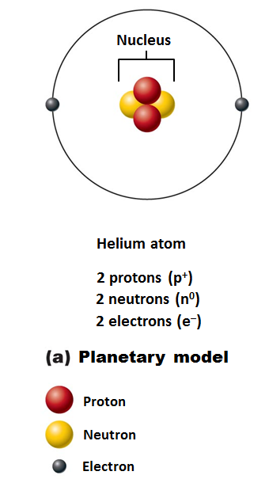
Models of the Atom
Planetary model
Incorrectly depicts fixed circular electron paths

Slide 8
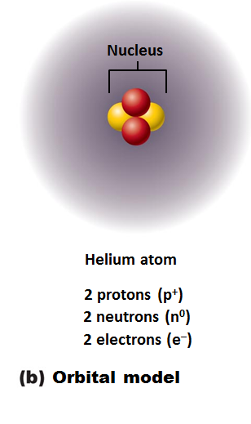
Models of the Atom
current model used by chemists
an electron cloud
Useful for predicting chemical behavior of atoms

Slide 9
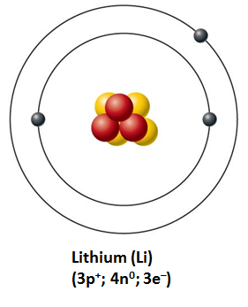
Identifying Elements
Different elements contain _
Hydrogen has 1 proton, 0 neutrons, and 1 electron
Lithium has 3 protons, 4 neutrons, and 3 electrons

Slide 10
Atomic Number and Mass Number
Atomic number =
Mass number
Total number of _
Total mass of atom

Slide 11
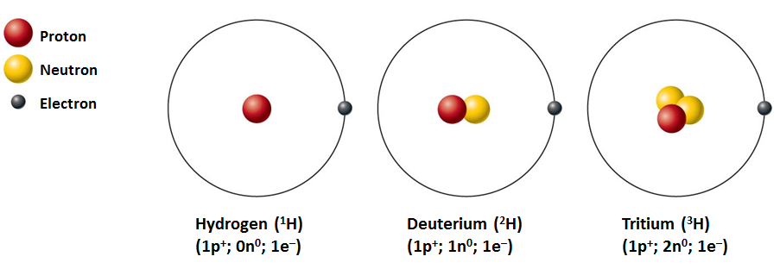
Isotopes and Atomic Weight
Isotopes
Structural variations of atoms
Differ in the number of _
Atomic numbers same; mass numbers different

Slide 12
Isotopes and Atomic Weight
Atomic weight
___________________________ of mass numbers (relative weights) _

Slide 13
Combining Matter: Molecules and Compounds
Most atoms chemically combined with other atoms to form molecules and compounds
Two or more atoms bonded together
Can be the _
Or _
Smallest particle of a compound with specific characteristics of the compound
Compound
Two or more different kinds of atoms bonded together
C₆H₁₂O₆ , but not H₂

Slide 14
Mixtures
Most matter exists as mixtures
Two or more components _
Three types of mixtures

Slide 15
Types of Mixtures: Solutions
Homogeneous mixtures
Most are true solutions in body
Gases, liquids, or solids dissolved in water
Usually transparent, e.g., atmospheric air or saline solution
Solvent
Substance present in greatest amount
Present in smaller amounts
Ex. If glucose is dissolved in blood, glucose is solute; blood is solvent

Slide 16
Colloids and Suspensions
Colloids
a substance _
emulsions
Heterogeneous mixtures
cytosol
Other examples:
Fog (water dispersed in air)
Smoke (burned particulates suspended in air)
Milk (fats dispersed in water)

Slide 17
Colloids and Suspensions
Suspensions
Heterogeneous mixtures
Large, _
Unlike colloids which don’t separate
Other examples
Muddy water
Flour/water

Slide 18
Mixtures versus Compounds
Mixtures
_________________________________________ between components
Can be separated by physical means, such as _
Compounds
Can be separated only by breaking bonds

Slide 19
Chemical Bonds
Chemical bonds are ______________________________________ between electrons of reacting atoms
Electrons can occupy up to seven electron shells (energy levels) around nucleus
Electrons in _
Have most potential energy
Are _
Octet rule (rule of eights)
Except for the first shell (full with ___________________________) atoms interact to have eight electrons in their valence shell

Slide 20
Chemically Inert Elements
Valence shell fully occupied or contains eight electrons
Noble gases
Helium
Neon
Argon
Krypton
Xenon
Radon

Slide 21
Chemically Reactive Elements
Tend to gain, lose, or share electrons (form bonds) with other atoms to achieve stability

Slide 22
Types of Chemical Bonds
Three major types

Slide 23
Ionic Bonds
Ions
Atom gains or loses electrons and becomes charged
Transfer of valence shell electrons from one atom to another forms ions
One becomes an _
Atom that gained one or more electrons
One becomes a _
Atom that lost one or more electrons
Attraction of opposite charges results in an ionic bond

Slide 24
Ionic Compounds
Most ionic compounds are _
When dry salts form __________________________ instead of individual molecules
Example is NaCl (sodium chloride)

Slide 25
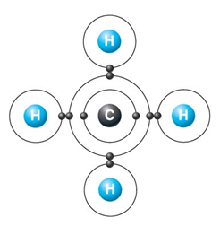
Covalent Bonds
Formed by sharing of _
Allows each atom to fill its valence shell _

Slide 26
Nonpolar Covalent Bonds
Electrons _
Produces _____________________________, nonpolar molecules such as CO₂

Slide 27
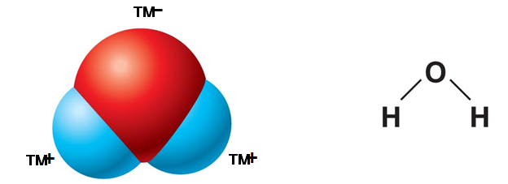
Polar Covalent Bonds
_____________________ sharing of electrons produces polar molecules _
Atoms in bond have different electron-attracting abilities
_________________________: two poles, one electronegative and the other electropositive

Slide 28
Hydrogen Bonds
_____________________________________ between electropositive hydrogen of one molecule and an electronegative atom of another molecule
Common between dipoles such as water
Maintains 3-dimensional shape of large molecules

Slide 29
Patterns of Chemical Reactions
___________________________________ (combination) reactions
Exchange reactions

Slide 30
Synthesis Reactions
A + B → AB
Atoms or molecules combine to form larger, more complex molecule

Slide 31
Decomposition Reactions
AB → A + B
Molecule is broken down into smaller molecules or its constituent atoms
Involve _

Slide 32
Exchange Reactions
AB + C → AC + B
Also called _
Involve both _
Bonds are both made and broken

Slide 33
Oxidation-Reduction (Redox) Reactions
Are decomposition reactions
Reactions in which _
Are also exchange reactions because _
Electron donors lose electrons and _
Electron acceptors receive electrons and _

Slide 34
Please note that due to differing operating systems, some animations will not appear until the presentation is viewed in Presentation Mode (Slide Show view). You may see blank slides in the “Normal” or “Slide Sorter” views. All animations will appear after viewing in Presentation Mode and playing each animation. Most animations will require the latest version of the Flash Player, which is available at http://get.adobe.com/flashplayer.

Slide 35
Reversibility of Chemical Reactions
All chemical reactions are _
A + B → AB
AB → A + B
________________________________________occurs if neither a forward nor reverse reaction is dominant
Many biological reactions are essentially irreversible
Due to _
Due to _

