Slide 1
Classification of Bones
bones of the skull, vertebral column, and rib cage
bones of the upper and lower limbs, shoulder, and hip

Slide 2
Classification of Bones: By Shape
longer than they are wide

Slide 3
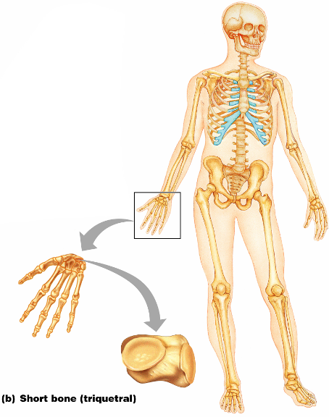
Classification of Bones: By Shape
Cube-shaped bones of the _
Bones that form within tendons _
Figure 6.2b

Slide 4
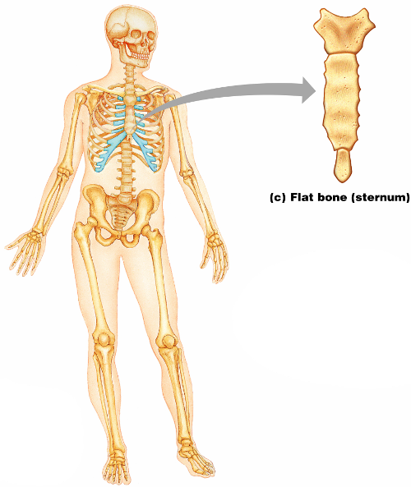
Classification of Bones: By Shape
thin, flattened, and a bit curved
most
Figure 6.2c

Slide 5
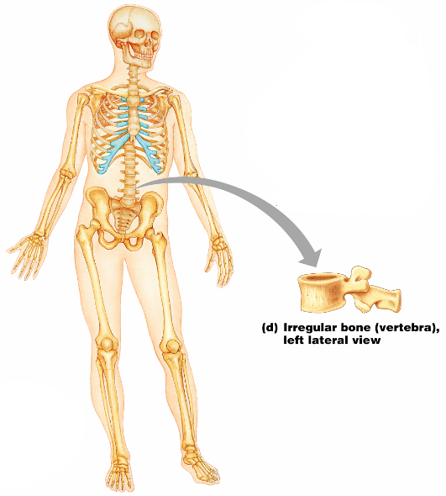
Classification of Bones: By Shape
bones with complicated shapes
Figure 6.2d

Slide 6
Function of Bones
form the framework that supports the body and cradles soft organs
provide a protective case for the brain, spinal cord, and vital organs
provide levers for muscles

Slide 7
Function of Bones
reservoir for minerals, especially calcium and phosphorus
hematopoiesis occurs within the marrow cavities of bones

Slide 8
Bone Markings
Bulges, depressions, and holes that serve as:
Joint surfaces
Conduits for blood vessels and nerves

Slide 9
Bone Markings: Projections – Sites of Muscle and Ligament Attachment
rounded projection
narrow, prominent ridge of bone
large, blunt, irregular surface
narrow ridge of bone
small rounded projection
raised area above a condyle
sharp, slender projection
any bony prominence

Slide 10
Bone Markings: Projections – Projections That Help to Form Joints
bony expansion carried on a narrow neck
smooth, nearly flat articular surface
rounded articular projection
arm-like bar of bone

Slide 11
Bone Markings: Depressions and Openings
canal-like passageway
cavity within a bone
shallow, basin-like depression
furrow
narrow, slit-like opening
round or oval opening through a bone

Slide 12
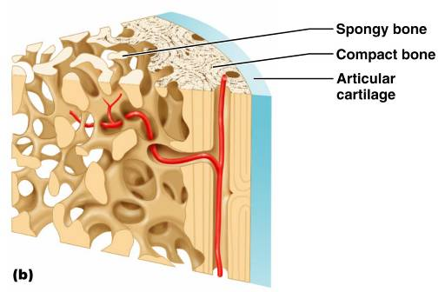
Bone Textures
Compact bone
Spongy bone
honeycomb of trabeculae _

Slide 13
Structure of Long Bone
Long bones consist of a _
Diaphysis
Tubular shaft
Composed of _
surrounds the medullary cavity
Yellow bone marrow in the medullary cavity

Slide 14
Structure of Long Bone
Epiphyses
________________________________ of long bones
Exterior is compact bone, and the _
Joint surface is covered with articular (hyaline) cartilage
Epiphyseal line separates the diaphysis from the epiphyses

Slide 15
Bone Membranes
______________________________ – double-layered protective membrane
Richly supplied with nerve fibers, blood, and lymphatic vessels, which enter the bone via _
Secured to underlying bone by _

Slide 16
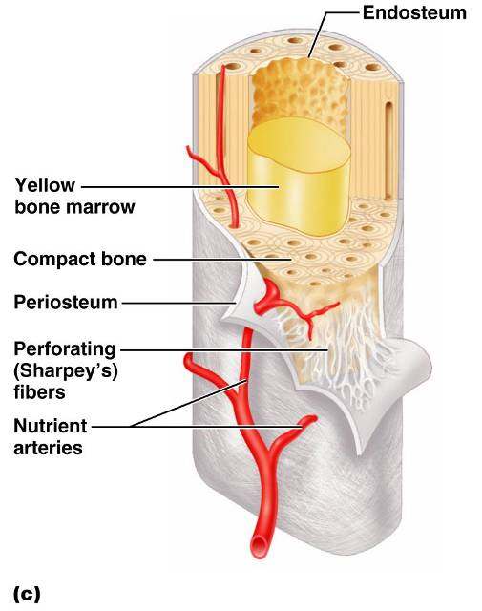
Bone Membranes
delicate membrane covering internal surfaces of bone

Slide 17
Structure of Short, Irregular, and Flat Bones
Thin plates of periosteum-covered compact bone on the outside with endosteum-covered spongy bone on the inside
Have _
Contain bone marrow between the trabeculae

Slide 18
Location of Hematopoietic Tissue (Red Marrow)
In infants
Found in the _
all areas of spongy bone
In adults
Found in the _
the head of the femur
the head of the _

Slide 19
Microscopic Structure of Bone: Compact Bone
_________________________, or osteon – the structural unit of compact bone
weight-bearing, column-like matrix tubes composed mainly of collagen
Haversian, or _
containing blood vessels and nerves
channels lying at right angles to the central canal, connecting blood and nerve supply of the periosteum to that of the Haversian canal

Slide 20
Microscopic Structure of Bone: Compact Bone
Osteocytes
Lacunae
______________________________ in bone that _
Canaliculi
___________________________________ that connect lacunae to each other and the central canal

Slide 21
Chemical Composition of Bone: Organic
Osteoblasts
Osteocytes
mature bone cells
Osteoclasts
large cells that resorb or _

Slide 22
Bone Development
Osteogenesis and ossification – the _________________________________, which leads to:
The formation of the bony skeleton in embryos
Bone growth until early adulthood
Bone thickness, _

Slide 23
Formation of the Bony Skeleton
Begins at ______________________ of embryo development
Intramembranous ossification
bone develops from a _
Endochondral ossification
bone forms by _

Slide 24
Intramembranous Ossification
Formation of most of the _

Slide 25
Stages of Intramembranous Ossification
An _____________________________ appears in the fibrous connective tissue membrane
Bone matrix is secreted within the fibrous membrane
Woven bone and periosteum form
Bone collar of _

Slide 26
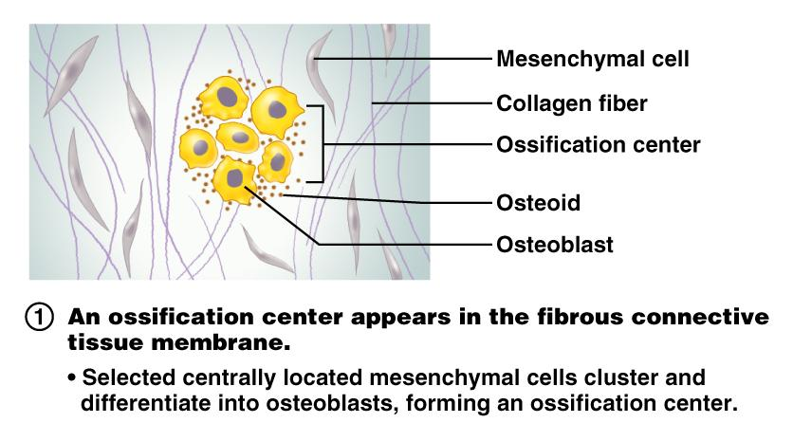
Stages of Intramembranous Ossification
Figure 6.7.1

Slide 27
Stages of Intramembranous Ossification
Figure 6.7.2

Slide 28
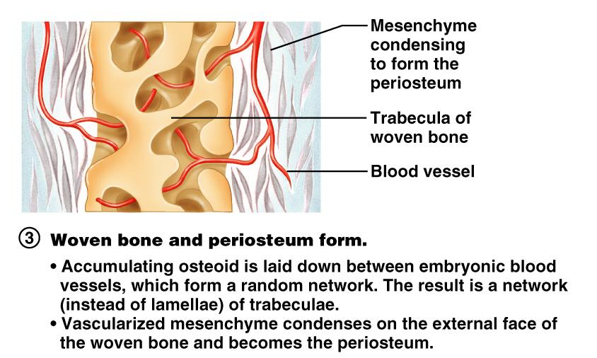
Stages of Intramembranous Ossification
Figure 6.7.3

Slide 29
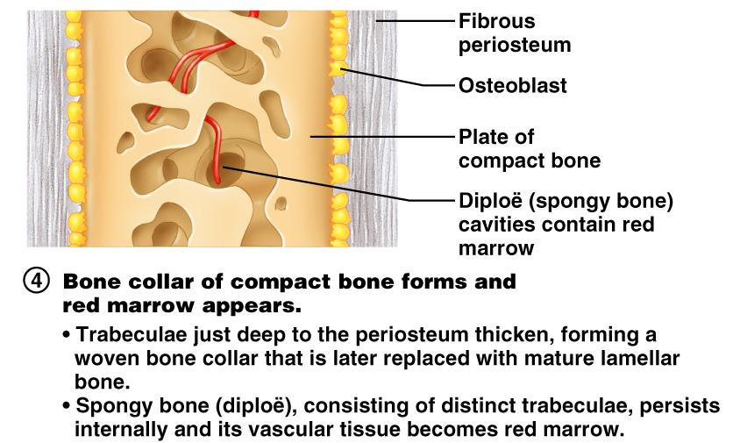
Stages of Intramembranous Ossification
Figure 6.7.4

Slide 30
Endochondral Ossification
Begins in the _
Uses ____________________________” as models for bone construction
Requires breakdown of hyaline cartilage prior to ossification

Slide 31
Stages of Endochondral Ossification
Formation of bone collar
Cavitation of the hyaline cartilage
spongy bone formation
Formation of the medullary cavity; appearance of _
Ossification of the epiphyses, with hyaline cartilage remaining only in the epiphyseal plates

Slide 32
Postnatal Bone Growth
Growth in length of long bones
Cells of the epiphyseal plate proximal to the resting cartilage form three functionally different zones:

Slide 33
Functional Zones in Long Bone Growth
Growth zone
____________________________________, pushing the epiphysis away from the diaphysis
Transformation zone
older cells enlarge, the matrix becomes calcified, cartilage cells die, and the _
Osteogenic zone
new _

Slide 34
Hormonal Regulation of Bone Growth During Youth
During infancy and childhood, epiphyseal plate activity is stimulated by _
During puberty, _
Initially promote adolescent growth spurts
Later induce epiphyseal ___________________________, ending longitudinal bone growth

