Slide 1
Response to Mechanical Stress
Wolff’s law
a bone grows or remodels _
Observations supporting Wolff’s law include
Long bones are thickest midway along the shaft (where bending stress is greatest)
Curved bones are thickest where they are most likely to buckle

Slide 2
Bone Fractures (Breaks)
Bone fractures are classified by:
The _____________________________ of the bone ends after fracture
The _______________________________ of the break
The ______________________________ of the bone to the long axis
Whether or not the bones ends penetrate the skin

Slide 3
Types of Bone Fractures
bone ends retain their normal position
bone ends are out of normal alignment

Slide 4
Types of Bone Fractures
bone is broken all the way through
bone is not broken all the way through
the fracture is ___________________________________ of the bone

Slide 5
Types of Bone Fractures
the fracture is __________________________________to the long axis of the bone
Compound (open)
bone ends do not penetrate the skin

Slide 6
Common Types of Fractures
Comminuted
bone fragments into __________________________ common in the elderly
ragged break when bone is _____________________________________ common sports injury
broken bone portion pressed inward; typical skull fracture

Slide 7
Common Types of Fractures
Compression
___________________________________; common in porous bones
epiphysis separates from diaphysis along epiphyseal line; occurs where cartilage cells are dying
incomplete fracture where one side of the bone breaks and the other side bends; _

Slide 8
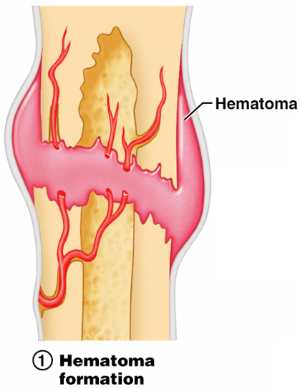
Stages in the Healing of a Bone Fracture
Torn blood vessels hemorrhage
A mass of clotted blood (_______________) forms at the fracture site
Site becomes swollen, painful, and inflamed
Figure 6.13.1

Slide 9
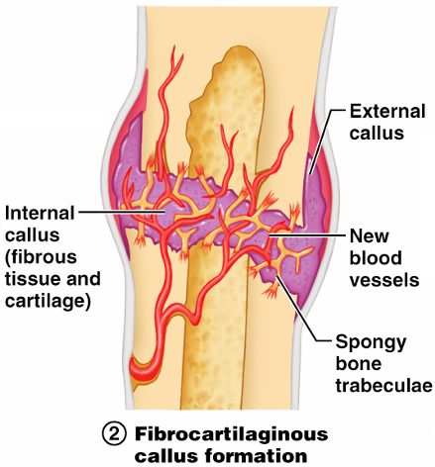
Stages in the Healing of a Bone Fracture
Fibrocartilaginous _
Granulation tissue (soft callus) forms a few days after the fracture
__________________________________ and phagocytic cells begin cleaning debris
Figure 6.13.2

Slide 10
Stages in the Healing of a Bone Fracture
The fibrocartilaginous callus forms when:
___________________________________ migrate to the fracture and begin reconstructing the bone
Fibroblasts secrete __________________________________ that connect broken bone ends
Osteoblasts begin forming spongy bone

Slide 11
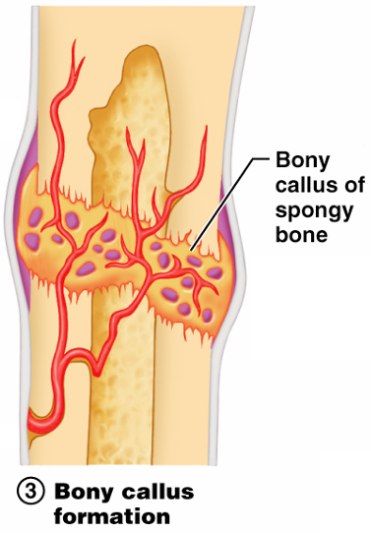
Stages in the Healing of a Bone Fracture
Bony callus formation
New bone trabeculae appear in the fibrocartilaginous callus
Fibrocartilaginous callus _
Bone callus _____________________________________, and continues until firm union is formed 2-3 months later
Figure 6.13.3

Slide 12
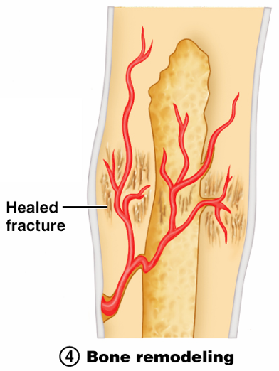
Stages in the Healing of a Bone Fracture
Bone remodeling
Excess material on the bone shaft exterior and in the medullary canal is removed
________________ is laid down to reconstruct shaft walls
Figure 6.13.4

Slide 13
Homeostatic Imbalances
Bones are inadequately mineralized causing softened, weakened bones
Main symptom is pain when weight is put on the affected bone
Caused by insufficient _

Slide 14
Homeostatic Imbalances
Rickets
Bones of children are inadequately mineralized causing softened, weakened bones
________________________________ and deformities of the pelvis, skull, and rib cage are common
Caused by insufficient _

Slide 15
Isolated Cases of Rickets
Rickets has been _
Only isolated cases appear
Example: Infants of breastfeeding mothers deficient in Vitamin D will also be Vitamin D deficient and develop rickets

Slide 16
Homeostatic Imbalances
Osteoporosis
Group of diseases in which _
Occurs most often in postmenopausal women
Bones become so fragile that sneezing or stepping off a curb _

Slide 17
Osteoporosis: Treatment
Increased _
Hormone (estrogen) replacement therapy (HRT) slows bone loss
Natural progesterone cream prompts new bone growth
Statins increase bone mineral density

Slide 18
Chapter Seven

Slide 19
The Axial Skeleton
Eighty bones segregated into three regions

Slide 20
The Skull
______________________________ bony structure
formed by the _
Cranium
protects the brain and is the site of attachment for head and neck muscles
Facial bones
Supply the framework of the _
Provide openings for the passage of air and food
Anchor the facial muscles of expression

Slide 21
Anatomy of the Cranium
The eight cranial bones thin and remarkably strong for their weight
two _
two _
Sphenoid
ethmoid

Slide 22
Wormian Bones
_________________________________ that appear within sutures

Slide 23
Facial Bones
__________________________ of which only the mandible and vomer are unpaired
The paired bones are
Zygomatics
Palatines
inferior conchae

Slide 24
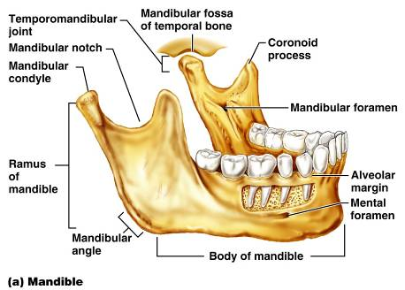
Mandible and Its Markings
The mandible is the _____________________ bone of the face
Its major markings include the
mandibular condyle,
alveolar margin, and
mental foramina

Slide 25
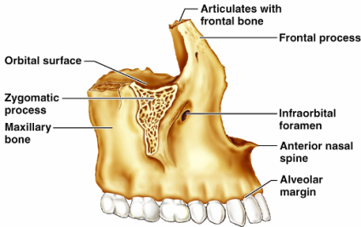
Maxillary Bones
upper jaw and the central portion of the facial skeleton
Their major markings include
palatine,
frontal,
zygomatic processes
the alveolar margins
inferior orbital fissure
the maxillary sinuses

Slide 26
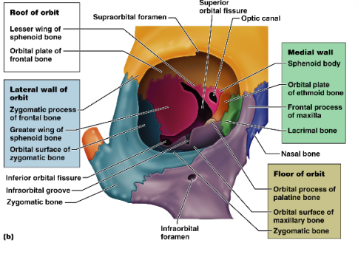
Orbits
Bony cavities in which the eyes are firmly encased and _
Formed by parts of seven bones
Zygomatic
Palatine
Lacrimal
ethmoid

Slide 27
Hyoid Bone
lies just inferior to the mandible in the anterior neck
Only bone of the body that __________________________________ directly with another bone
Attachment point for neck muscles that raise and lower the larynx during swallowing and speech

Slide 28
Vertebral Column
Formed from 26 irregular bones (vertebrae) connected in such a way that a flexible curved structure results
Cervical vertebrae
_____bones of the neck
Thoracic vertebrae
_____ bones of the torso
Lumbar vertebrae
_____ bones of the lower back
Sacrum
bone inferior to the lumbar vertebrae that articulates with the hip bones

Slide 29
Vertebral Column: Curvatures
cervical and lumbar
Secondary curvatures
cervical and lumbar – are convex anteriorly and are _
thoracic and sacral
present at birth
convex posteriorly
causing the infant spine to arch like a four-legged animal

Slide 30
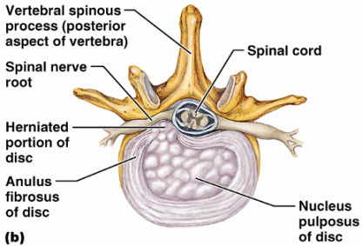
Vertebral Column: Intervertebral Discs
Cushion-like pad composed of two parts
inner gelatinous nucleus that gives the disc its elasticity and compressibility
surrounds the nucleus pulposus with a collar composed of collagen and fibrocartilage

Slide 31
General Structure of Vertebrae
disc-shaped, weight-bearing region
composed of pedicles and laminae that, along with the centrum, enclose the vertebral foramen
make up the vertebral canal through which the spinal cord passes

Slide 32
General Structure of Vertebrae
project posteriorly,
project laterally
Superior and inferior _
protrude superiorly and inferiorly from the pedicle-lamina junctions
Intervertebral foramina
________________________________ formed from notched areas on the _

Slide 33
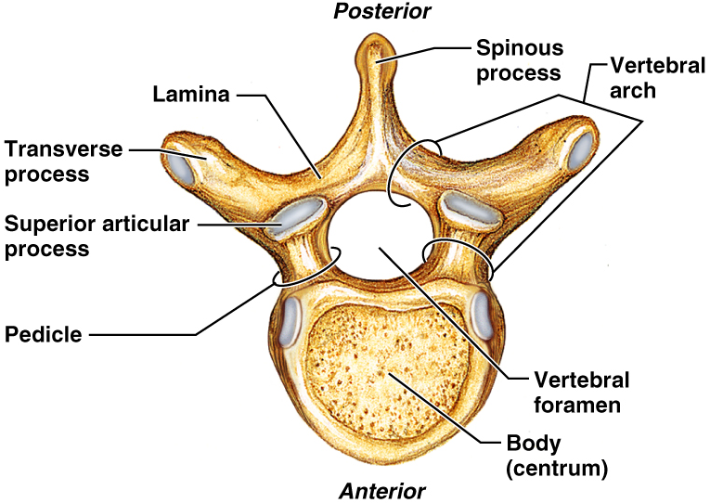
General Structure of Vertebrae

Slide 34
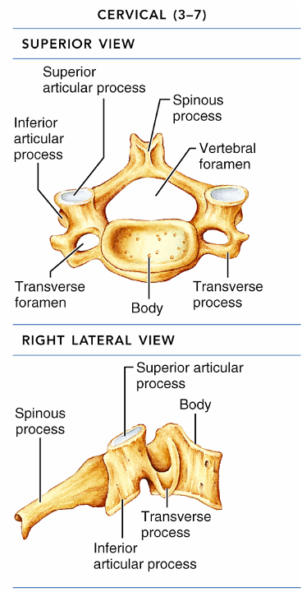
Cervical Vertebrae
Seven vertebrae (C₁-C₇) are the _
C₃-C₇
oval body
short spinous processes,
large, triangular vertebral foramina
Each transverse process contains a _

Slide 35
Cervical Vertebrae: The Atlas (C₁)
The atlas has ___________________ and ______________________
It consists of anterior and posterior arches, and _
The superior surfaces of lateral masses articulate with the _

Slide 36
Cervical Vertebrae: The Axis (C₂)
The axis has a body, spine, and vertebral arches as do other cervical vertebrae
Also has the _______________________
projects superiorly from the body and is cradled in the anterior arch of the atlas
The dens is a ______________ for the rotation of the atlas

