Slide 1
Exam Three Material
Chapters 8, 9, 10

Slide 2
Joints (Articulations)
_____________________________ parts of the skeleton
__________________________________ – site where two or more bones meet
Functions of joints
Give the skeleton _
Hold the skeleton together

Slide 3
Classification of Joints: Structural
_________________________________ classification focuses on the _____________________________________ and whether or not ___________________________ is present
The three structural classifications are:
Fibrous
Cartilaginous
Synovial

Slide 4
Classification of Joints: Functional
_______________________________ classification is based on the ___________________________________ allowed by the joint
The three functional classes of joints are:
Synarthroses –
Amphiarthroses –
Diarthroses –

Slide 5
Fibrous Structural Joints
The bones are joined by _
There is _
Most are _
There are three types –
Syndesmoses

Slide 6
Fibrous Structural Joints: Sutures
Occur between the _
Comprised of interlocking junctions completely filled with _
Bind bones tightly together, but allow for _
In middle age, skull bones ___________________ and are called _

Slide 7
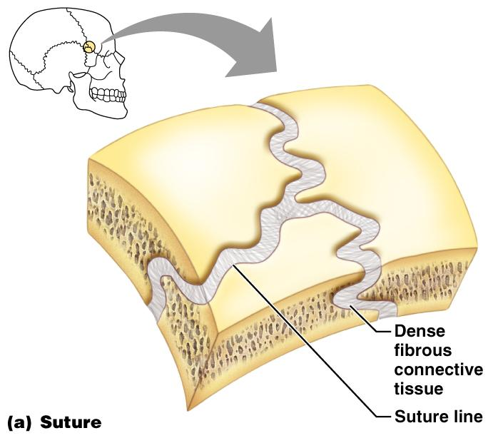
Fibrous Structural Joints: Sutures
Figure 8.1a

Slide 8
Fibrous Structural Joints: Syndesmoses
Bones are connected by a _
Movement varies from immovable to slightly variable
Examples include the connection between the _

Slide 9
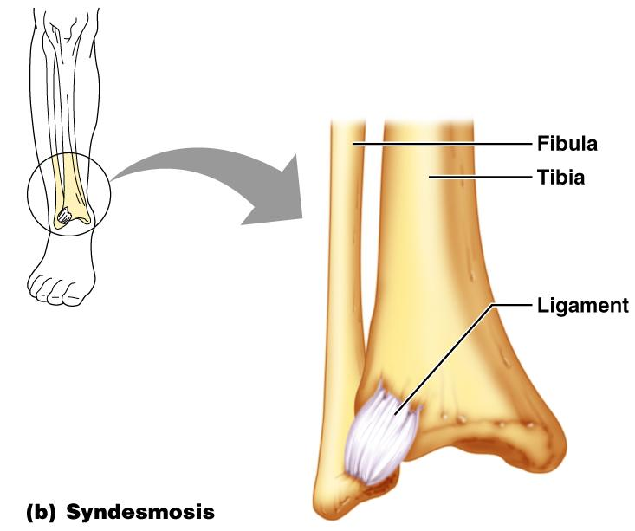
Fibrous Structural Joints: Syndesmoses
Figure 8.1b

Slide 10
Fibrous Structural Joints: Gomphoses
The __________________________________ fibrous joint between a tooth and its _
The fibrous connection is the _

Slide 11
Cartilaginous Joints
Articulating bones are united by _
_________________________a joint cavity
Two types –

Slide 12
Cartilaginous Joints: Synchondroses
A bar or ________________ of _____________________________ cartilage unites the bones
Examples include:
_______________________________ of children
Joint between the _

Slide 13
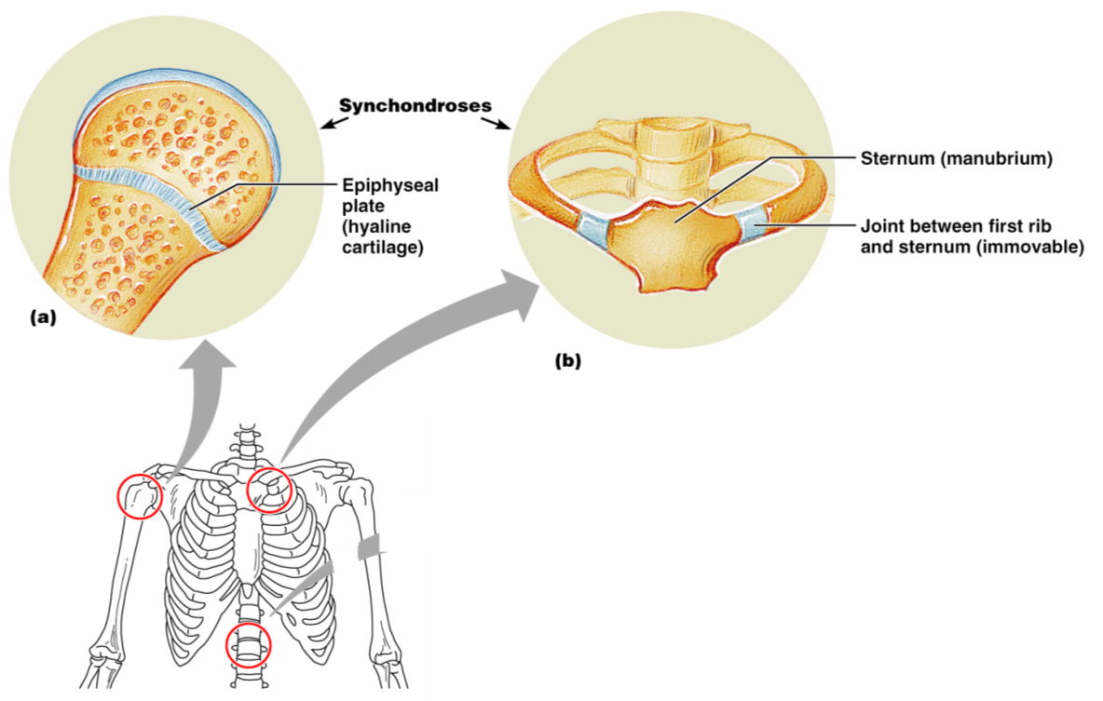
Cartilaginous Joints: Synchondroses
Figure 8.2a, b

Slide 14
Cartilaginous Joints: Symphyses
_________________________________ covers the articulating surface of the bone and is fused to an intervening pad of _
Examples include _________________________ and the _________________________________of the pelvis

Slide 15
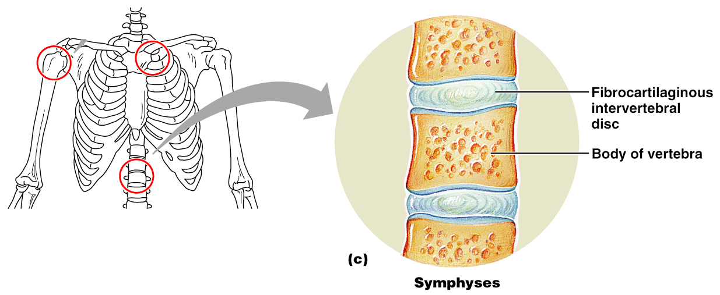
Cartilaginous Joints: Symphyses
Figure 8.2c

Slide 16
Synovial Joints
Those joints in which the articulating bones are separated by a _
Examples – all limb joints, and most joints of the body

Slide 17
Synovial Joints: General Structure
Synovial joints all have the following
Joint (________________________) cavity
Synovial fluid
Reinforcing ligaments

Slide 18
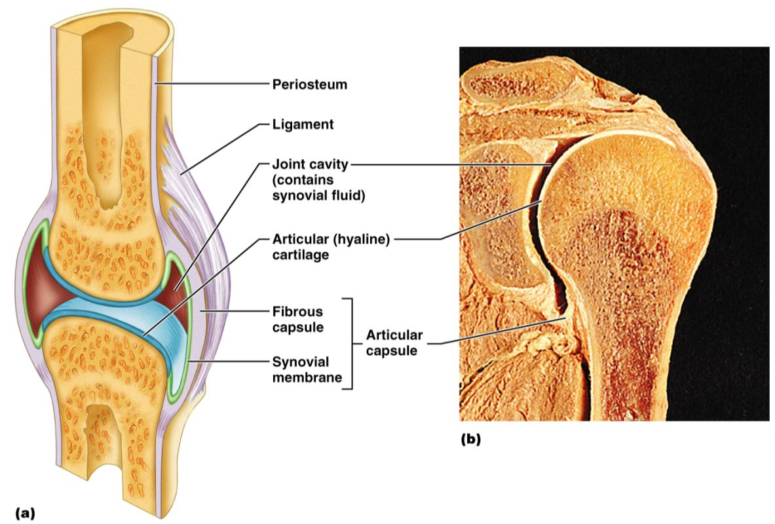
Synovial Joints: General Structure
Figure 8.3a, b

Slide 19
Synovial Joints: Friction-Reducing Structures
___________________________– flattened, fibrous sacs lined with synovial membranes and containing _
Common where ligaments, muscles, skin, tendons, or bones rub together
___________________________________ – elongated bursa that wraps completely around a tendon

Slide 20
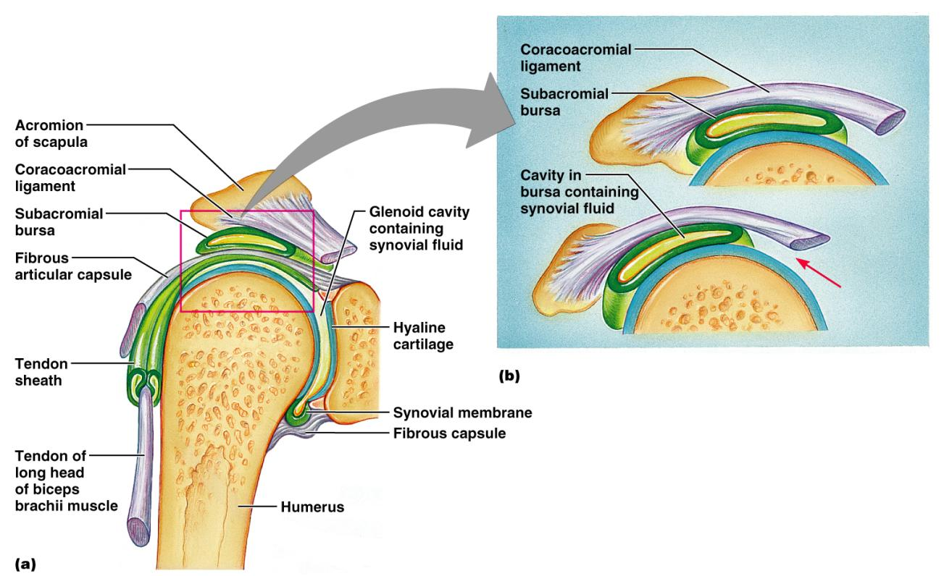
Synovial Joints: Friction-Reducing Structures
Figure 8.4

Slide 21
Synovial Joints: Stability
Stability is determined by:
_____________________________________– shape determines what movements are possible
______________________________________– unite bones and prevent excessive or undesirable motion

Slide 22
Synovial Joints: Stability
__________________________________ is accomplished by:
Muscle tendons across joints acting as _
Tendons that are __________________________ at all times by _

Slide 23
Synovial Joints: Movement
The two muscle attachments across a joint are:
____________________________________– attachment to the _
____________________________________– attachment to the _
Described as movement along transverse, frontal, or sagittal planes

Slide 24
Synovial Joints: Range of Motion
______________________
slipping movements only
______________________
movement in one plane
______________________
movement in two planes
______________________
movement in or around all three planes

Slide 25
Gliding Movements
One _____________________________ glides or slips over another similar surface
Examples
_______________________________ and intertarsal joints
between the flat articular processes of _

Slide 26
Angular Movement
bending movement that decreases the angle of the joint
Extension
reverse of flexion; joint angle is _
____________________________ and plantar flexion
up and down movement of the foot

Slide 27
Angular Movement
movement away from the midline
movement toward the midline
movement describes a ______________________ in space

Slide 28
Rotation
The turning of a bone _
Examples
Between _
___________________________and shoulder joints

Slide 29
Special Movements
____________________________and pronation
Inversion and _
___________________________and retraction
Elevation and _
_

Slide 30
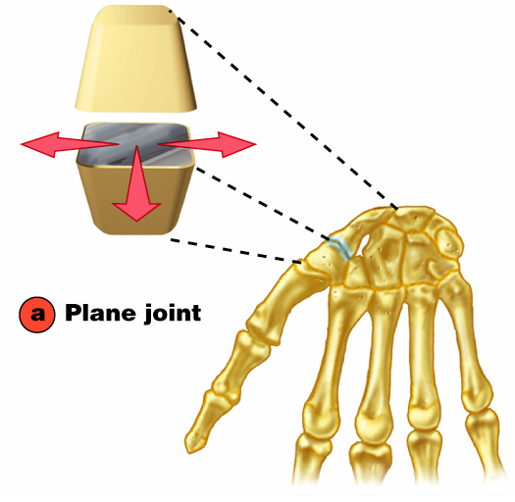
Plane Joint
Plane joints
Articular surfaces are _
Allow only slipping or gliding movements

Slide 31
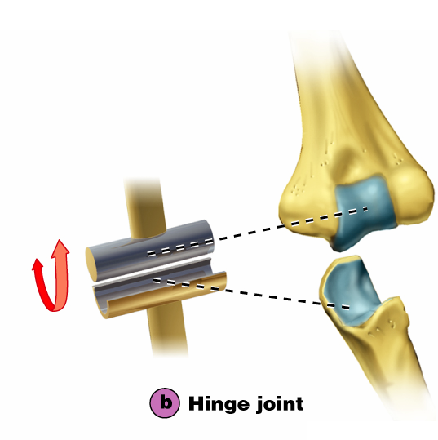
Types of Synovial Joints
Hinge joints
Cylindrical projections of one bone fits into a _
Motion is along a _
Uniaxial joints permit _
Examples: ______________________ and interphalangeal joints

Slide 32
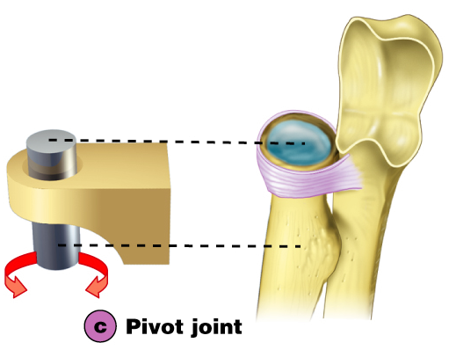
Pivot Joints
Rounded end of one bone protrudes into a “sleeve,” or ring, composed of bone (and possibly ______________________) of another
Only uniaxial movement allowed
Examples: joint between the ____________________________________, and the proximal _

Slide 33
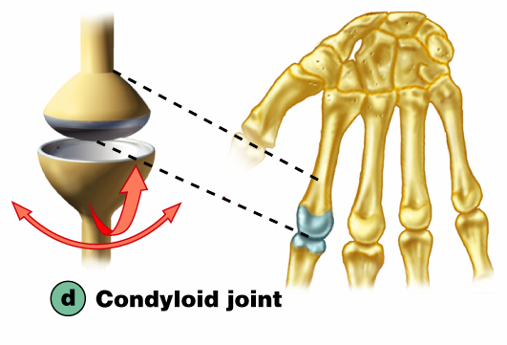
Condyloid or Ellipsoidal Joints
Oval articular surface of one bone fits into a _______________________in another
Both articular surfaces _
Biaxial joints permit all angular motions
Examples: ______________________ (wrist) joints, and _______________________ (knuckle) joints

Slide 34
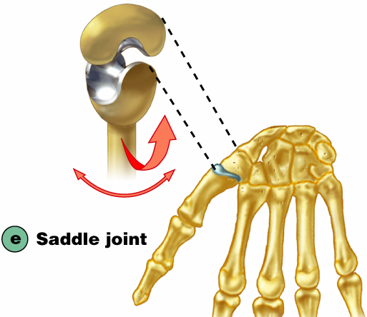
Saddle Joints
Similar to condyloid joints but allow _
Each articular surface has both a _
Example: carpometacarpal joint of the thumb

Slide 35
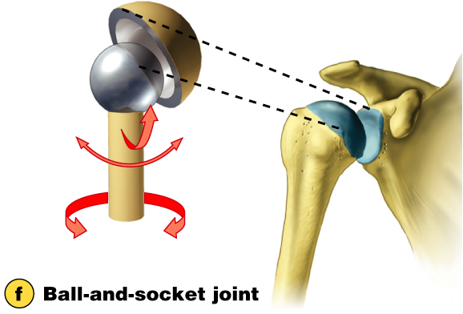
Ball-and-Socket Joints
A __________________________or hemispherical head of one bone articulates with a _
Multiaxial joints permit the _
Examples: shoulder and hip joints

