Slide 1
Synovial Joints: Knee
Largest and ____________________________ joint of the body
Allows _
__________________ joints in one surrounded by a single joint cavity
Femoropatellar joint
Lateral and medial _________________________ joints

Slide 2
Synovial Joints: Shoulder (Glenohumeral)
Ball-and-socket joint in which _________________________is sacrificed to obtain greater _
Head of humerus articulates with the ____________________________________ of the scapula

Slide 3
Synovial Joints: Elbow
_________________________ joint that allows flexion and extension _
Radius and ulna articulate with _

Slide 4
Synovial Joints: Shoulder Stability
Weak stability is maintained by:
Thin, loose joint capsule
Four ligaments – coracohumeral, and three glenohumeral
Tendon of the ______________________________________, which travels through the ____________________________________groove and secures the humerus to the glenoid cavity
____________________________________(four tendons) that encircles the shoulder joint and blends with the articular capsule

Slide 5
Synovial Joints: Hip (Coxal) Joint
Head of the femur articulates with the acetabulum
Good range of motion, but _

Slide 6
Temporomandibular Joint (TMJ)
Mandibular condyle articulate with the _
Two types of movement
____________________________– depression and elevation of mandible
Side to side – (____________________________) grinding of teeth

Slide 7
Sprains
The _____________________________ reinforcing a joint are _
Partially torn ligaments slowly repair themselves
___________________________________ ligaments require prompt surgical repair

Slide 8
Cartilage Injuries
The snap and pop of overstressed cartilage
Common aerobics injury
Repaired with _

Slide 9
Dislocations
Occur when bones are forced out of alignment
Usually accompanied by ___________________________________ inflammation, and joint immobilization
Caused by serious falls and are common sports injuries
_
______________________________________ dislocation of a joint

Slide 10
Inflammatory and Degenerative Conditions
Bursitis
An inflammation of a ______________________ , usually caused by a _
Symptoms are _
Treated with anti-inflammatory drugs; excessive fluid may be aspirated

Slide 11
Inflammatory and Degenerative Conditions
Tendonitis
Inflammation of _______________________________________ typically caused by overuse
Symptoms and treatment are similar to _

Slide 12
Arthritis
More than ______________________________ of inflammatory or degenerative diseases that damage the joints
Most widespread crippling disease in the U.S.
Symptoms
pain, stiffness, and _
Acute forms are caused by ___________________________ and are treated with antibiotics
Chronic forms include osteoarthritis, rheumatoid arthritis, and gouty arthritis

Slide 13
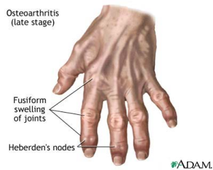
Osteoarthritis (OA)
Most common chronic arthritis; often called “______________________________ ” arthritis
Affects _______________________more than men
______________of all Americans develop OA
More prevalent in the aged, and is probably related to the normal aging process

Slide 14
Osteoarthritis: Course
OA reflects the years of ________________________________________ causing increased production of metalloproteinase enzymes that break down cartilage
As one ages, cartilage is destroyed more quickly than it is replaced
The exposed bone ends ________________________, enlarge, form bone spurs, and _
Joints most affected are the cervical and lumbar spine, fingers, knuckles, knees, and hips

Slide 15
Osteoarthritis: Treatments
OA is slow and _
Treatments include:
Mild ___________________________________, along with moderate activity
Magnetic therapy
Glucosamine sulfate decreases pain and inflammation

Slide 16
Rheumatoid Arthritis (RA)
Chronic, inflammatory, ______________________________________ of unknown cause, with an insidious onset
Usually arises between the ages of ________________, but may occur at any age
Signs and symptoms include joint tenderness, anemia, osteoporosis, _________________________, and cardiovascular problems
The course of RA is marked with _

Slide 17
Rheumatoid Arthritis: Course
RA begins with _________________________ of the affected joint
Inflammatory chemicals are _________________________________ released
Inflammatory blood cells migrate to the joint, causing swelling

Slide 18
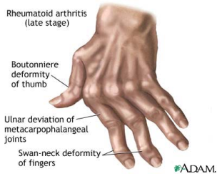
Rheumatoid Arthritis:
Inflamed ________________________________ thickens into a pannus
Pannus ______________________________ , scar tissue forms, articulating bone ends connect
The end result, _______________________, produces bent, deformed fingers

Slide 19
Rheumatoid Arthritis: Treatment
Conservative therapy – _________________, long-term use of antibiotics, and physical therapy
Progressive treatment – anti-inflammatory drugs or _
The drug Enbrel, a biological response modifier, neutralizes the harmful properties of inflammatory chemicals

Slide 20
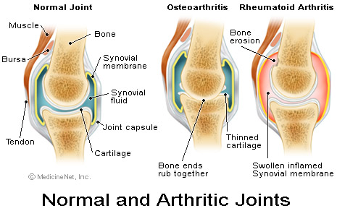
Comparison of arthritic joints

Slide 21
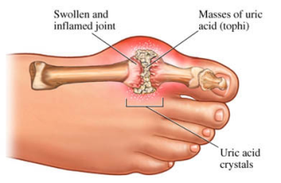
Gouty Arthritis
Deposition of ________________________________________in joints and soft tissues, followed by an _
Typically, gouty arthritis affects the joint at the _
In untreated gouty arthritis, the _________________________________________ and immobilize the joint
Treatment – colchicine, nonsteroidal anti-inflammatory drugs, and glucocorticoids

Slide 22
Muscle Overview
The three types of muscle tissue are
These types differ in structure, location, function, and means of activation

Slide 23
Muscle Similarities
Skeletal and smooth _________________________ are elongated
called _
Muscle contraction depends on two kinds of myofilaments
Muscle terminology is similar
muscle plasma membrane
cytoplasm of a muscle cell
Prefixes
myo, mys, and sarco all refer to _

Slide 24
Skeletal Muscle Tissue
Has obvious ____________________called _
Is controlled _
Contracts rapidly
but _
Is responsible for overall body motility
Is extremely _
can exert wide range of forces

Slide 25
Cardiac Muscle Tissue
Occurs _
Is ______________________________ like skeletal muscle
not _
Rhythmicity controlled by _
Pacemaker located within the heart
Neural controls temper the heart’s response
Elevates or depresses rate as needed

Slide 26
Smooth Muscle Tissue
Found in the walls of hollow _______________________________organs,
the _
urinary bladder,
respiratory passages
Forces food and other substances through internal body channels
It is _

Slide 27
Functional Characteristics of Muscle Tissue
the ability to receive and respond to stimuli
the ability to shorten forcibly
the ability to be stretched or extended
the ability to recoil and resume the original resting length

Slide 28
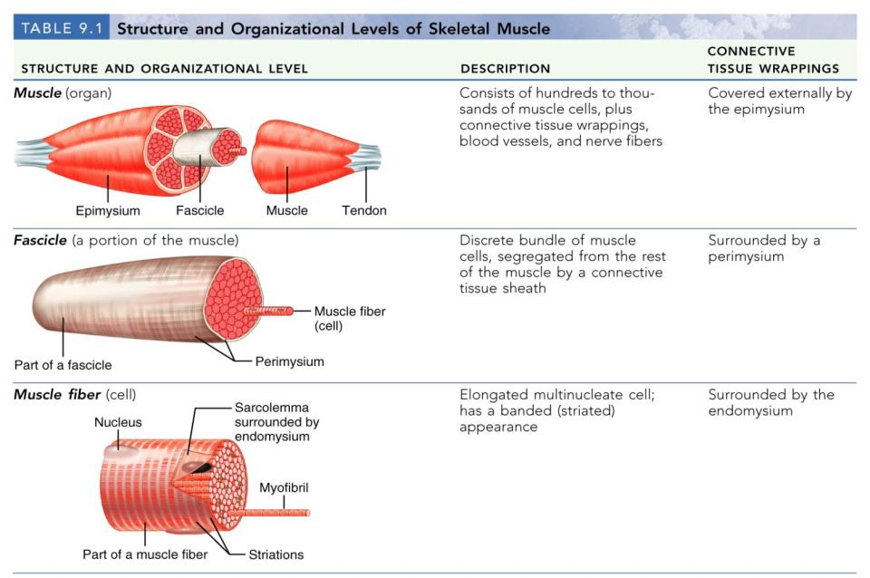
Structure and Organization of Skeletal Muscle

Slide 29
Structure and Organization of Skeletal Muscle
Table 9.1b

Slide 30
Skeletal Muscle
Each muscle is a ___________________________ composed of muscle tissue, blood vessels, nerve fibers, and connective tissue

Slide 31
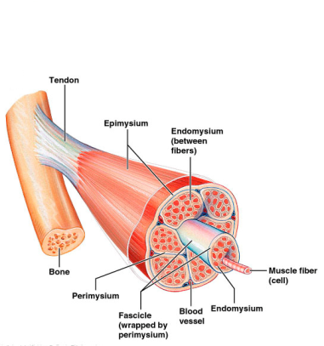
Skeletal Muscle
The three connective tissue sheaths are:
fine sheath of _____________________ tissue composed of reticular fibers surrounding each muscle fiber
fibrous connective tissue that surrounds groups of muscle fibers called _
an overcoat of dense regular connective tissue that surrounds the entire muscle

Slide 32
Skeletal Muscle: Attachments
Most skeletal muscles ______________________________ and are attached to bone _
When muscles contract the movable bone, the muscle’s _

Slide 33
Skeletal Muscle: Attachments
Muscles attach:
epimysium of the muscle is fused to the _
connective tissue wrappings extend beyond the muscle as a _

Slide 34
Microscopic Anatomy of a Skeletal Muscle Fiber
Each fiber is a long, cylindrical cell with __________________________________ just beneath the sarcolemma
Fibers are up to __________________________ long
Each cell is a ___________________________ produced by fusion of embryonic cells

Slide 35
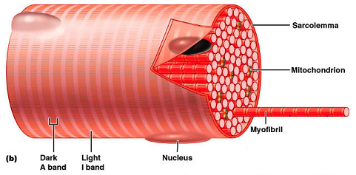
Myofibrils
Myofibrils are densely packed, rodlike contractile elements
They make up most of the _
The arrangement of myofibrils creates a repeating series of _

Slide 36
Sarcomeres
The smallest ________________________ of a muscle
Composed of ______________________________ made up of contractile proteins
Myofilaments are of two types – _

