Slide 1
Muscular Dystrophy
Muscular dystrophy
group of inherited ___________________________________ diseases
muscles enlarge due to _______________________________ tissue deposits,
but muscle fibers _
Caused by a lack of the cytoplasmic protein _
There is no cure, but myoblast transfer therapy shows promise

Slide 2
Duchenne Muscular Dystrophy
Duchenne muscular dystrophy (DMD)
Inherited, ______________________________ disease carried by females and expressed in males (1/3500)
Diagnosed between the ages of _
Victims become __________________________ frequently as their muscles fail

Slide 3
Duchenne muscular dystrophy
Symptoms usually appear before age 6
By age 10, __________________________ may be required for walking, and by age 12, most patients are _
There is ____________________________________________ of the legs and pelvis
associated with a loss of muscle mass
Muscle weakness also occurs in the arms, neck, and other areas, but not as severely or as early as in the lower half of the body.
Calf muscles _
muscle tissue is eventually replaced by fat and connective tissue
Muscle contractures occur in the legs, rendering the muscles unusable because the muscle fibers shorten and fibrosis occurs in connective tissue.
Muscular weakness and skeletal deformities contribute to frequent breathing disorders.
_______________________________________________ occurs in almost all cases.

Slide 4
Myotonic Muscular Dystrophy
__________________________________ of adult muscular dystrophy
caused by a defective gene (Autosomal Dominant)
but unlike the other kinds, the muscle weakness is also accompanied by myotonia
Myotonia:
_____________________________________________ of muscles after the muscle is contracted
Not always disease related. Can be stress induced.

Slide 5
Myotonic Muscular Dystrophy
Symptoms
Delayed muscle relaxation after contraction
Impaired nourishment of _
Weaknesses in the facial muscles, arms and legs, and muscles affecting speech and swallowing
_____________________________________ in men and women
Respiratory problems
Heart abnormalities in early adulthood

Slide 6
Facioscapulohumeral Muscular Dystrophy
autosomal dominant form of muscular dystrophy that affects the muscles of the shoulders and face
begins to show in half of all patients by _
and in 95 percent of patients by age 20
the earlier in life it appears the worse the symptoms will be
Because it doesn’t affect the heart or respiratory muscles, facioscapulohumeral MD _

Slide 7
Facioscapulohumeral Muscular dystrophy
Difficulty _
Aching around shoulders
Prominent shoulder blades
Eyes remain __________________________ during sleep
Little facial expression
among infants and small children
severe cases
Difficulty or _
Difficulty or inability to straighten or bend elbows

Slide 8
Interactions of Skeletal Muscles
Skeletal muscles work _________________________ or in _
Muscles only _______________(never push)
As muscles shorten, the insertion generally moves toward the origin

Slide 9
Muscles: Functional Groups
provide the major force for producing a specific movement
oppose or reverse a particular movement
Add force to a movement
Reduce undesirable or unnecessary movement
synergists that immobilize a bone or muscle’s origin

Slide 10
Naming Skeletal Muscles
bone or body region associated with the muscle
e.g., the deltoid muscle (deltoid = triangle)

Slide 11
Naming Skeletal Muscles
maximus (largest), minimus (smallest), longus (long)
rectus (fibers run straight), transversus, and oblique (fibers run at angles to an imaginary defined axis)

Slide 12
Naming Skeletal Muscles
Number of _
biceps (two origins) and triceps (three origins)
Location of _
named according to point of origin or insertion
flexor or extensor, as in the names of muscles that flex or extend, respectively

Slide 13
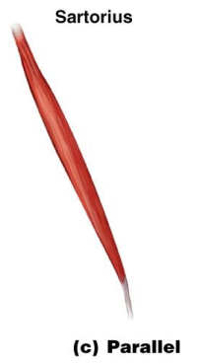
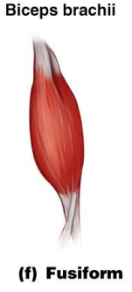
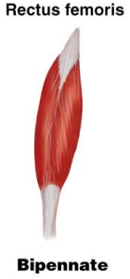
Arrangement of Fascicles
fascicles run parallel to the long axis of the muscle
sartorius
spindle-shaped muscles
biceps brachii
short fascicles that attach obliquely to a central tendon running the length of the muscle
rectus femoris

Slide 14
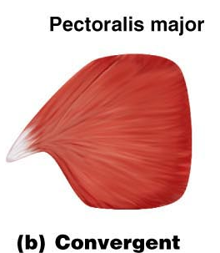
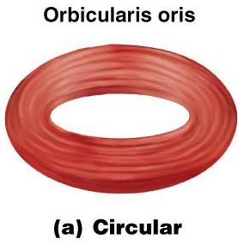
Arrangement of Fascicles
fascicles converge from a broad origin to a single tendon insertion
pectoralis major
fascicles are arranged in concentric rings
orbicularis oris

Slide 15
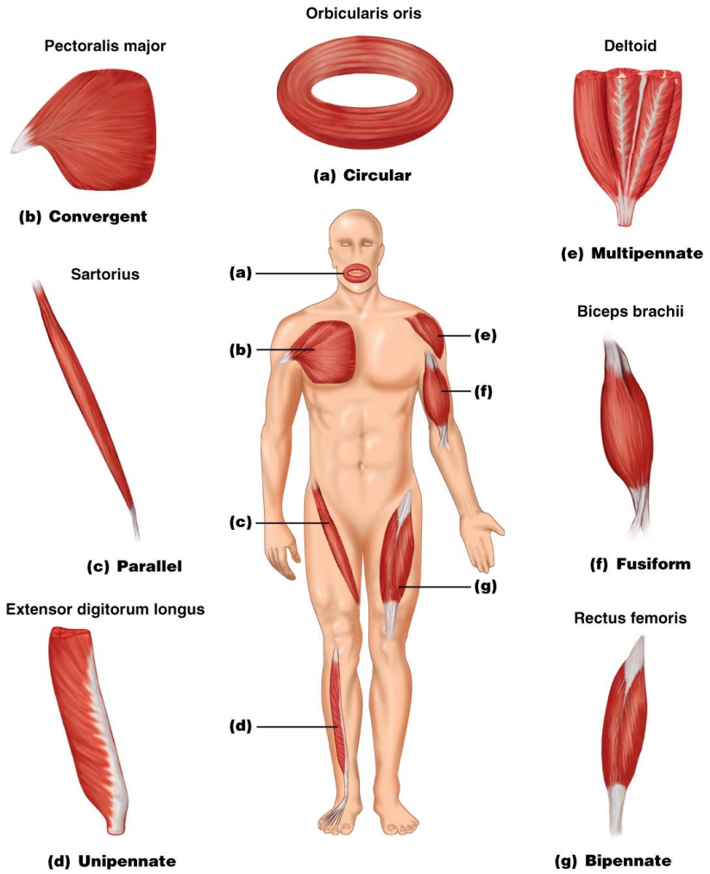
Figure 10.1

Slide 16
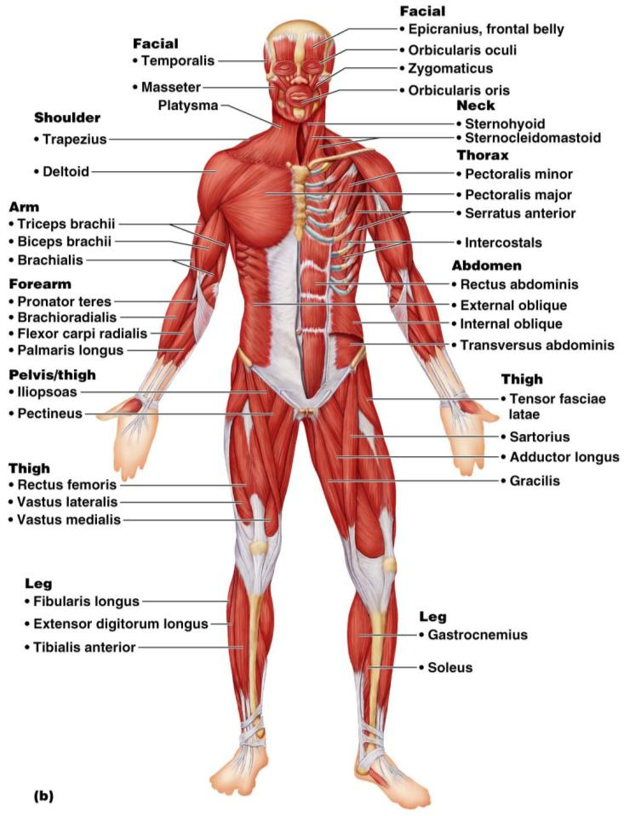
Major Skeletal Muscles: Anterior View
The 40 superficial muscles here are divided into 10 regional areas of the body
Figure 10.4b

Slide 17
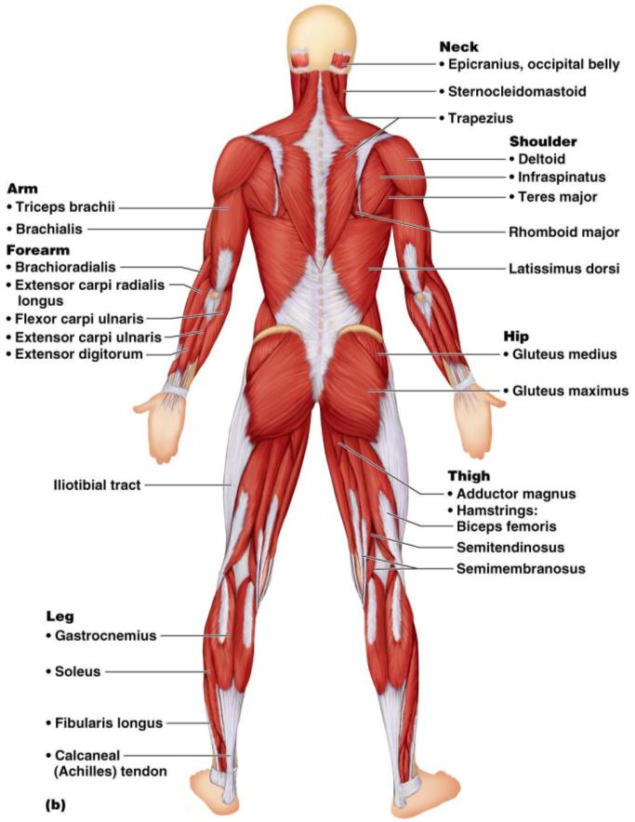
Major Skeletal Muscles: Posterior View
The 27 superficial muscles here are divided into seven regional areas of the body
Figure 10.5b

Slide 18
Muscles: Name, Action, and Innervation
Name and description of the muscle
be alert to information given in the name
Origin and insertion
Action
best learned by _________________________________________ on one’s own body
Nerve supply
name of major nerve that innervates the muscle

Slide 19
Muscles of the Scalp
Epicranius (___________________________) – bipartite muscle consisting of the:
Galea aponeurotica – cranial ___________________________________ connecting above muscles
These two muscles have alternate actions of pulling the scalp forward and backward

Slide 20
Muscles of the Face
11 muscles are involved in lifting the eyebrows, flaring the nostrils, opening and closing the eyes and mouth, and smiling
All are innervated by __________________________________ (facial nerve)
Usually insert ______________________ (rather than bone), and adjacent muscles often fuse

Slide 21
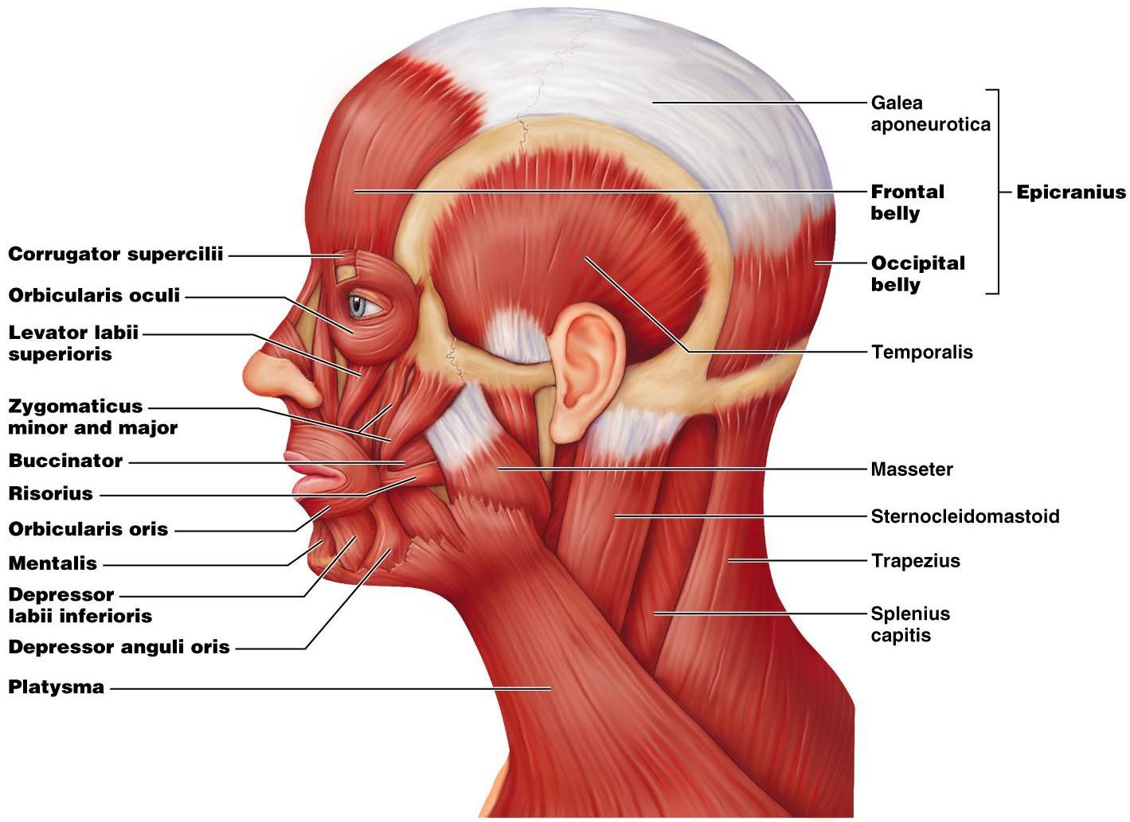

Slide 22
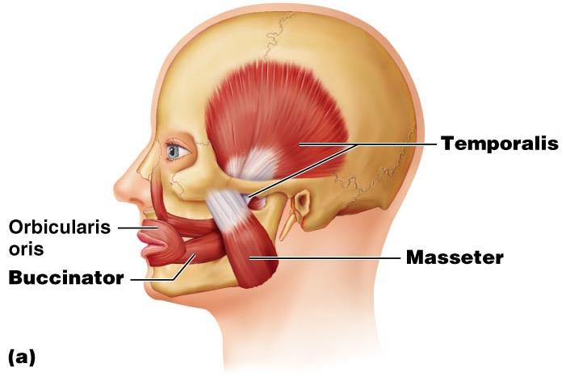
Muscles of Mastication
There are ____________________________________ of muscles involved in mastication
Prime movers
Grinding movements
All are innervated by _

Slide 23
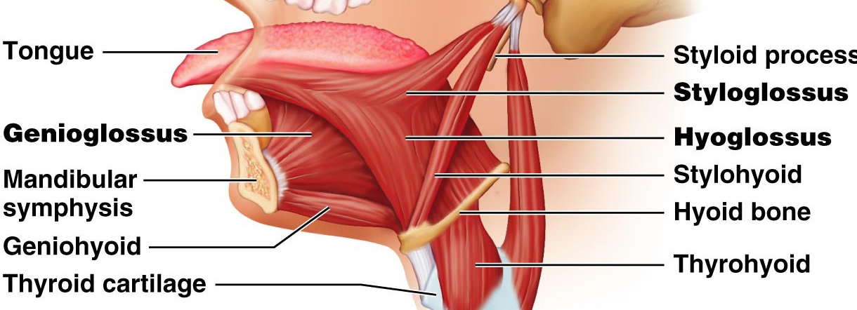
Extrinsic Tongue Muscles
Three major muscles that _
All are innervated by cranial nerve _

Slide 24
Muscles of the Neck: Head Movements
sternocleidomastoid
_____________________________ to head flexion
suprahyoid and infrahyoid
sternocleidomastoid and scalene muscles
Head extension
deep splenius muscles and aided by the _

Slide 25
Trunk Movements: Deep Back Muscles
The prime mover of _
erector spinae
Erector spinae muscles consist of ______________________________ on each side of the vertebrae
Lateral bending of the back
unilateral contraction of these muscles
Other deep back extensors include the semispinalis muscles and the quadratus lumborum

Slide 26
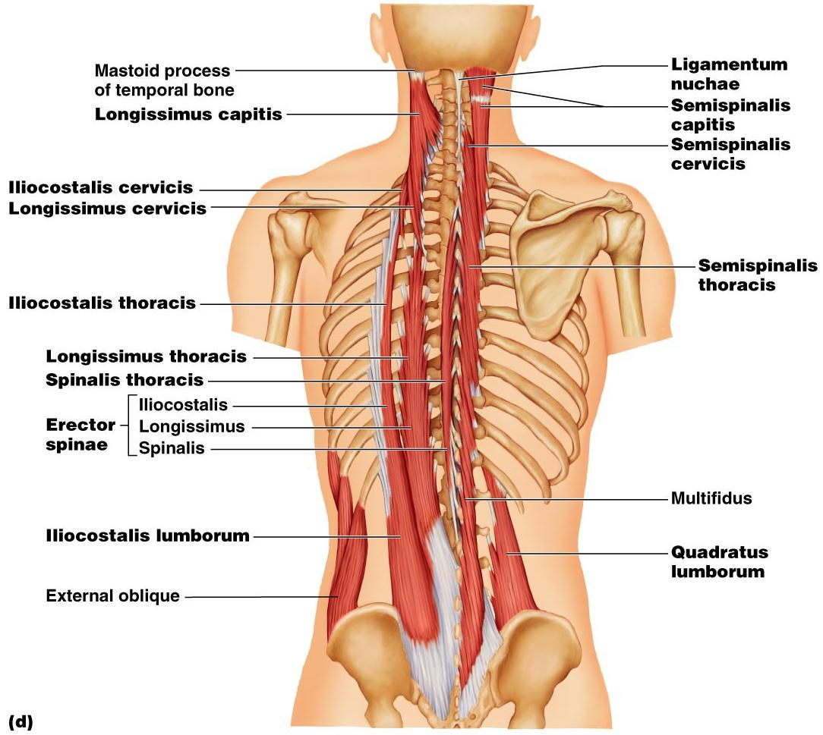
Figure 10.9d

Slide 27
Trunk Movements: Short Muscles
Four short muscles extend from one vertebra to another
These muscles are synergists in ________________________________ of the spine

Slide 28
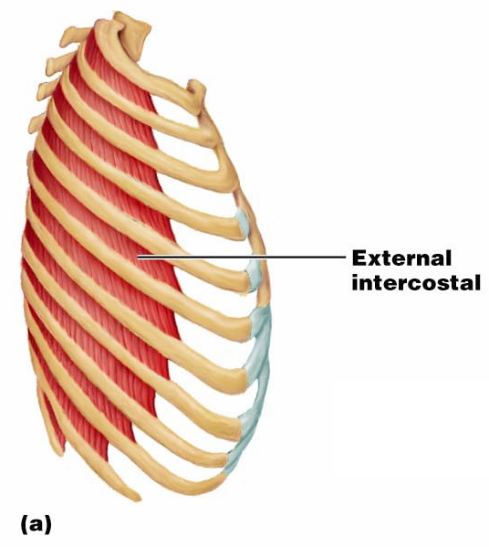
Muscles of Respiration: External Intercostals
The primary function of deep thoracic muscles is to _
______________________
more superficial layer that lifts the rib cage
increases thoracic volume to allow inspiration

Slide 29
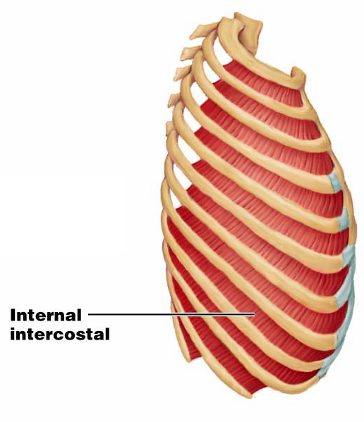
Muscles of Respiration: Internal Intercostals
deeper layer that aids in forced expiration
most important muscle in inspiration

Slide 30
Muscles of the Abdominal Wall
The abdominal wall is composed of four paired muscles
external obliques,
rectus abdominis),
their fasciae, and their _
Fascicles of these muscles run at right and oblique angles to one another, giving the abdominal wall added strength

Slide 31
Muscles of the Abdominal Wall
In addition to forming the abdominal wall, these muscles:
Are involved with ________________________ and rotation of the trunk
Help promote __________________________, defecation, ___________________________, vomiting, coughing, and _

Slide 32
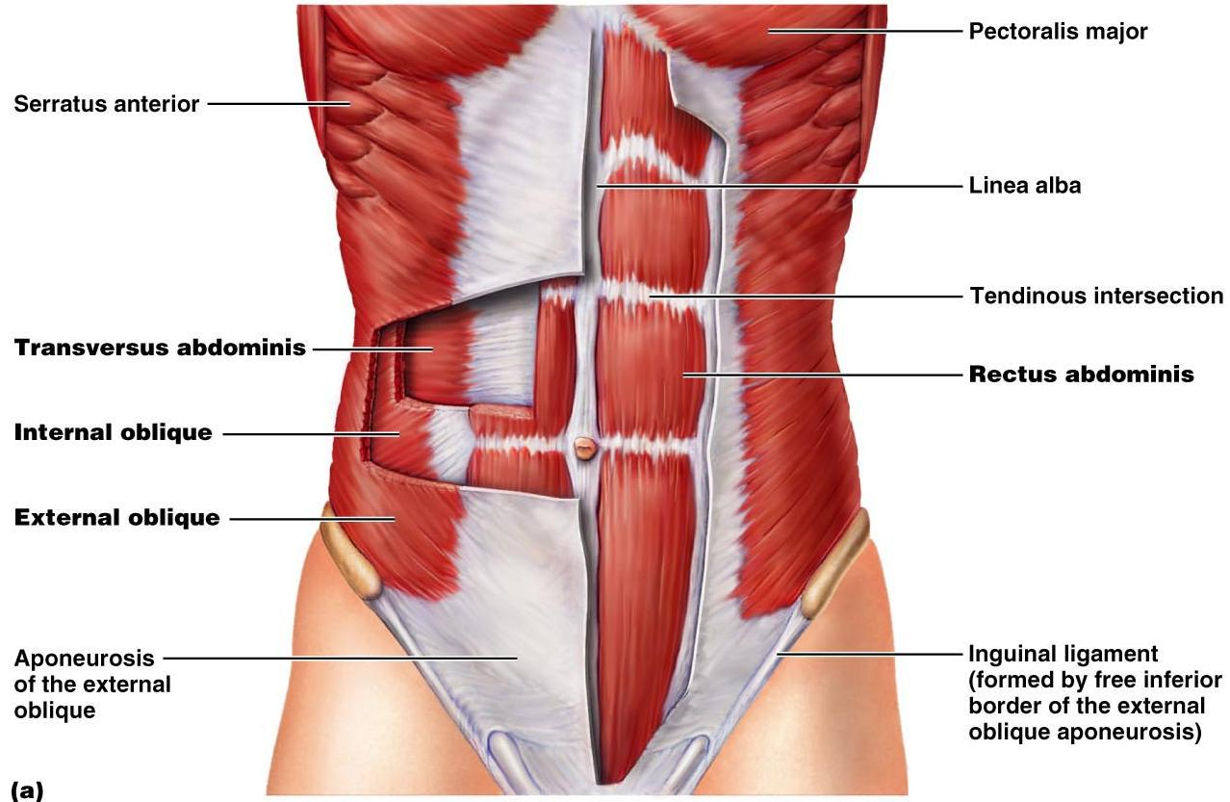
Muscles of the Abdominal Wall
Figure 10.11a

Slide 33
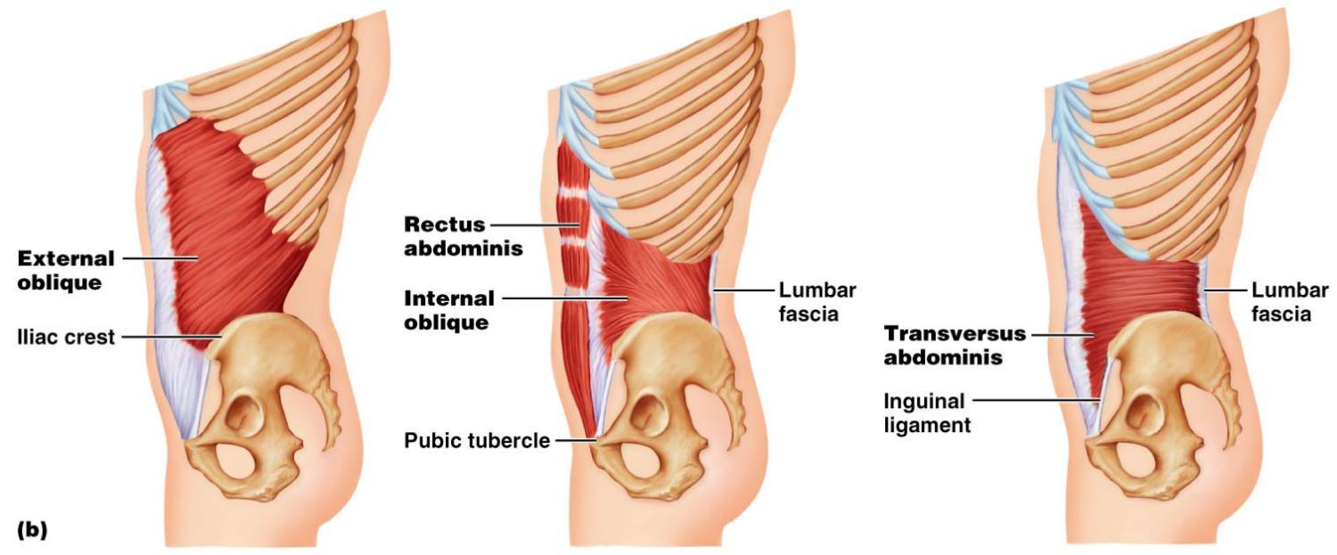
Muscles of the Abdominal Wall
Figure 10.11b

Slide 34
Extrinsic Shoulder Muscles
Muscles of the thorax
Anterior:
pectoralis major, pectoralis minor, serratus anterior, and subclavius
Posterior:
latissimus dorsi, trapezius muscles, levator scapulae, and rhomboids
These muscles are involved with the _________________________________________ including elevation, depression, rotation, and lateral and medial movements
Prime movers of shoulder elevation are the _

Slide 35
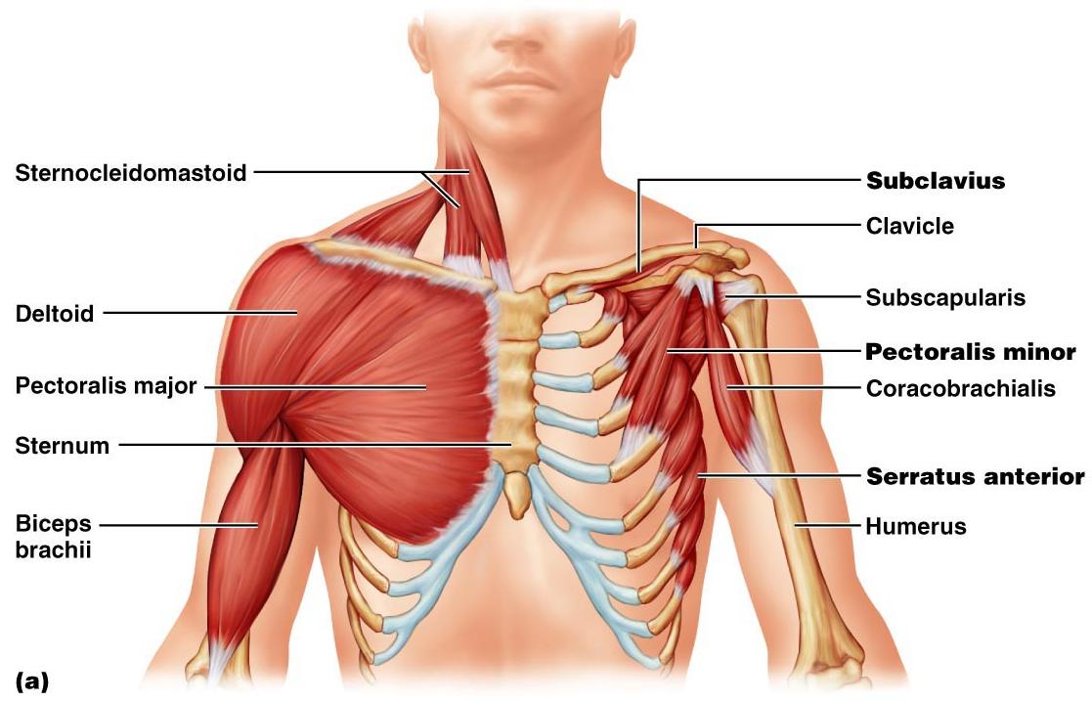
Extrinsic Shoulder Muscles
Figure 10.13a

Slide 36
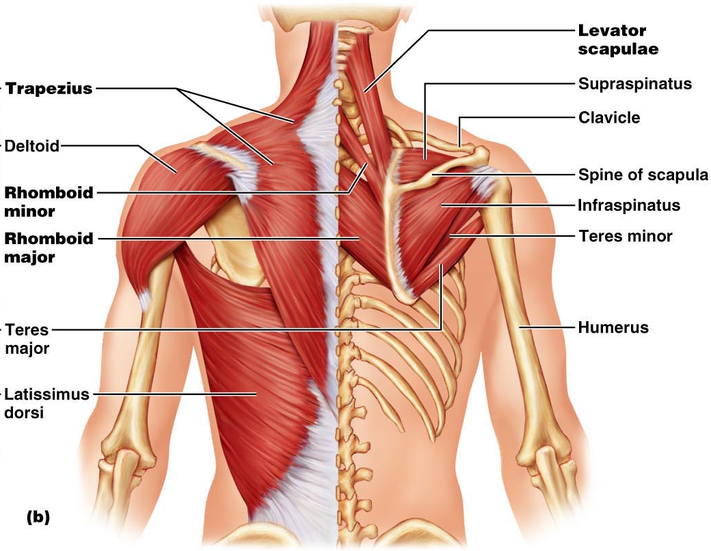
Figure 10.13b

Slide 37
Muscles Crossing the Shoulder
Nine muscles cross the shoulder joint and insert into the humerus
Prime movers include:
Pectoralis major
Latissimus dorsi and posterior fibers of the deltoid
Middle fibers of the deltoid

Slide 38
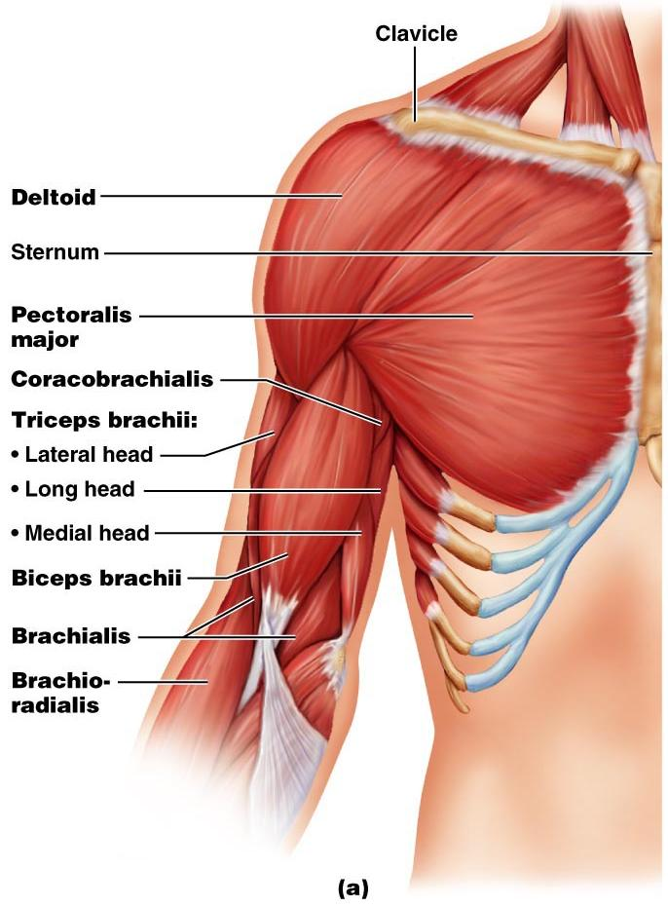
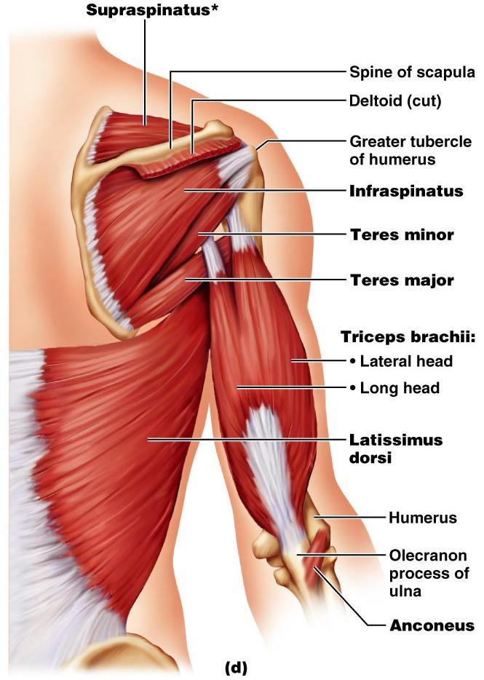
Muscles Crossing the Shoulder

Slide 39
Muscles Crossing the Shoulder
Rotator cuff muscles
Function mainly to reinforce the capsule of the shoulder
Secondarily act as synergists and fixators

Slide 40
Muscles Crossing the Elbow
Forearm extension
prime mover of forearm extension
weak synergist
The

Slide 41
Muscles Crossing the Elbow
Forearm flexion
chief forearm flexors
synergist
The _
helps stabilize the _

