Slide 1
Chapter Eight

Slide 2
Joints (Articulations)
___________________________________ parts of the skeleton
Articulation – _
Functions of joints
Give the skeleton _
Hold the skeleton together

Slide 3
Classification of Joints: Structural
Structural classification focuses on the material binding bones together and _
The three structural classifications are:
Synarthroses –
Amphiarthroses –
Diarthroses –

Slide 4
Classification of Joints: Functional
________________________________ classification is based on the _____________________________________ allowed by the joint
The three functional classes of joints are:
_______________________________________ – immovable
_______________________________________ – slightly movable
_______________________________________ – freely movable

Slide 5
Fibrous Structural Joints
The bones are joined by _
There is _
Most are _
There are three types
Sutures
Syndesmoses
Gomphoses

Slide 6
Fibrous Structural Joints: Sutures
Occur between the _
Comprised of interlocking junctions completely _
Bind bones tightly together, but allow for growth during youth
In middle age, skull bones _

Slide 7
Fibrous Structural Joints: Syndesmoses
Bones are connected by a _
Movement varies from immovable to slightly variable
Examples include the connection between the _

Slide 8
Fibrous Structural Joints: Gomphoses
The ___________________________________ between a tooth and its alveolar socket
The fibrous connection is the _

Slide 9
Cartilaginous Joints
Articulating bones are united by cartilage
Two types –

Slide 10
Cartilaginous Joints: Synchondroses
A bar or plate of hyaline cartilage unites the bones
Examples include:
Joint between the _

Slide 11
Cartilaginous Joints: Symphyses
___________________________________ covers the articulating surface of the bone and is ___________________________ to an intervening pad of fibrocartilage
Examples include _

Slide 12
Synovial Joints
Those joints in which the articulating bones are separated by a _
Examples – ___________________________, and most joints of the body

Slide 13
Synovial Joints: General Structure
Synovial joints all have the following
Joint _______________________________ cavity
Articular capsule
Reinforcing _

Slide 14
Synovial Joints: Friction-Reducing Structures
__________________________________ – flattened, fibrous sacs lined with synovial membranes and containing synovial fluid
Common where ligaments, muscles, skin, tendons, or _
Tendon sheath – ___________________________________ that wraps completely around a tendon

Slide 15
Synovial Joints: Stability
Stability is determined by:
Articular surfaces – _
Ligaments – unite bones and _

Slide 16
Synovial Joints: Stability
Muscle tone is accomplished by:
_______________________________________ across joints acting as stabilizing factors
Tendons that are kept tight at all times by muscle tone

Slide 17
Synovial Joints: Movement
The two muscle attachments across a joint are:
__________________________________ – attachment to the immovable bone
__________________________________ – attachment to the movable bone
Described as movement along transverse, frontal, or sagittal planes

Slide 18
Synovial Joints: Range of Motion
______________________________________ – slipping movements only
______________________________________ – movement in one plane
______________________________________ – movement in two planes
______________________________________ – movement in or around all three planes

Slide 19
Gliding Movements
One flat bone surface glides or slips over another similar surface
Examples –
___________________________ and intertarsal joints
between the _

Slide 20
Angular Movement
Flexion —
Extension
reverse of flexion; _
Dorsiflexion and plantar flexion

Slide 21
Angular Movement
Abduction
movement _
Adduction
movement _
Circumduction
_

Slide 22
Rotation
The turning of a bone _
Examples
Between _
Hip and _

Slide 23
Special Movements
Inversion and eversion
Elevation and depression

Slide 24
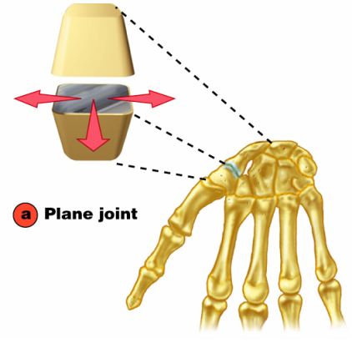
Plane Joint
Plane joints
Articular surfaces are essentially _
Allow only _
Only examples of _

Slide 25
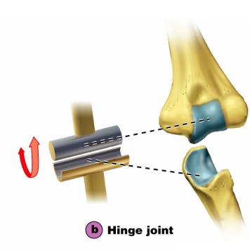
Types of Synovial Joints
Hinge joints
Cylindrical projections of one bone fits into a trough-shaped surface on another
Motion is along a _
Uniaxial joints permit _
Examples: _

Slide 26
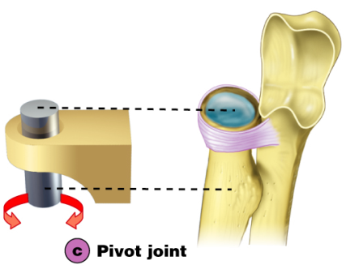
Pivot Joints
Rounded end of one bone protrudes into a “sleeve,” or ring, composed of bone (and possibly ligaments) of another
Only _
Examples: joint between the _

Slide 27
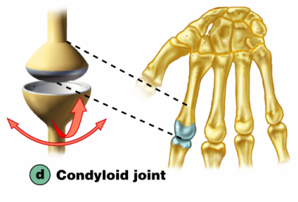
Condyloid or Ellipsoidal Joints
Oval articular surface of one bone fits into a complementary depression in another
Both _
Biaxial joints permit all angular motions
Examples: radiocarpal (wrist) joints, and _

Slide 28
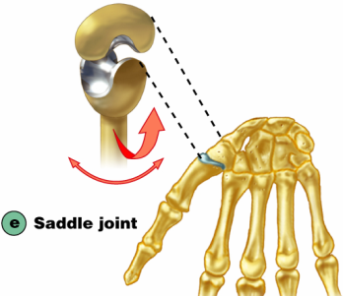
Saddle Joints
Similar to condyloid joints but allow _
Each articular surface has both a _
Example: _

Slide 29
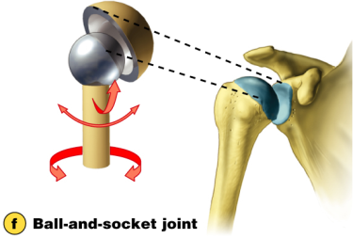
Ball-and-Socket Joints
A spherical or hemispherical head of one bone articulates with a _
Multiaxial joints permit the _
Examples: _

Slide 30
Synovial Joints: Knee
_________________________________ joint of the body
Allows _
Three joints in one surrounded by a single joint cavity
Femoropatellar joint
Lateral and medial tibiofemoral joints

