Slide 1
Synovial Joints: Shoulder (Glenohumeral)
_________________________________ in which ________________________________ to obtain greater freedom of movement
Head of humerus articulates with the _

Slide 2
Synovial Joints: Elbow
_______________________________ that allows flexion and extension only
Radius and ulna articulate with the humerus

Slide 3
Synovial Joints: Shoulder Stability
Weak stability is maintained by:
Thin, loose joint capsule
Four ligaments – coracohumeral, and three glenohumeral
Tendon of the ____________________________, which travels through the intertubercular groove and secures the humerus to the glenoid cavity
_______________________________________ that encircles the shoulder joint and blends with the articular capsule

Slide 4
Synovial Joints: Hip (Coxal) Joint
Head of the femur articulates with the _
Good range of motion, but limited by the _

Slide 5
Temporomandibular Joint (TMJ)
Mandibular condyle articulate with the temporal bone
Two types of movement
Hinge –
Side to side –

Slide 6
Sprains
The ligaments reinforcing a joint are stretched or torn
___________________________________ slowly repair themselves
Completely torn ligaments require prompt surgical repair

Slide 7
Cartilage Injuries
The snap and pop of overstressed cartilage
Repaired with _

Slide 8
Dislocations
Occur when bones are _
Usually accompanied by _
Caused by serious falls and are common sports injuries
Subluxation

Slide 9
Inflammatory and Degenerative Conditions
An inflammation of a bursa, usually caused by _
Symptoms are _
Treated with anti-inflammatory drugs; excessive fluid may be aspirated

Slide 10
Inflammatory and Degenerative Conditions
Inflammation of tendon sheaths typically _
Symptoms and treatment are _

Slide 11
Arthritis
More than 100 different types of inflammatory or degenerative diseases that damage the joints
Most widespread crippling disease in the U.S.
Symptoms
Acute forms are caused by bacteria and are treated with antibiotics
Chronic forms include _

Slide 12
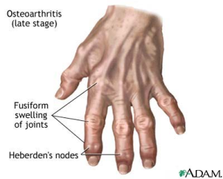
Osteoarthritis (OA)
Most common chronic arthritis; often called _
Affects women more than men
85% of all Americans develop OA
More prevalent in the aged, and is _

Slide 13
Osteoarthritis: Course
OA reflects the _________________________ and compression causing increased production of metalloproteinase enzymes that break down cartilage
As one ages, cartilage is _
The exposed bone ends thicken, enlarge, ______________________________________, and restrict movement
Joints most affected are the cervical and lumbar spine, fingers, knuckles, knees, and hips

Slide 14
Osteoarthritis: Treatments
OA is _
Treatments include:
Mild pain relievers, along with moderate activity
Magnetic therapy
Glucosamine sulfate decreases pain and inflammation

Slide 15
Rheumatoid Arthritis (RA)
Chronic, ____________________________, ______________________ disease of unknown cause, with an insidious onset
Usually arises between the ages of 40 to 50, but may occur at any age
Signs and symptoms include joint tenderness, anemia, osteoporosis, muscle atrophy, and cardiovascular problems
The course of RA is marked with _

Slide 16
Rheumatoid Arthritis: Course
RA begins with ________________________ of the affected joint
_____________________________________ are inappropriately released
Inflammatory blood cells migrate to the joint, causing swelling

Slide 17
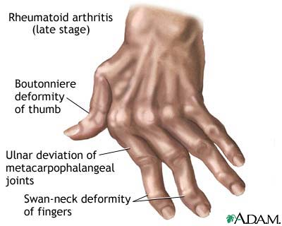
Rheumatoid Arthritis: Course
Inflamed synovial membrane thickens into a pannus
Pannus ______________________________, scar tissue forms, articulating bone ends connect
The end result, _

Slide 18
Rheumatoid Arthritis: Treatment
Conservative therapy – aspirin, long-term use of antibiotics, and physical therapy
Progressive treatment – anti-inflammatory drugs or immunosuppressants
The drug Enbrel, a biological response modifier, neutralizes the harmful properties of inflammatory chemicals

Slide 19
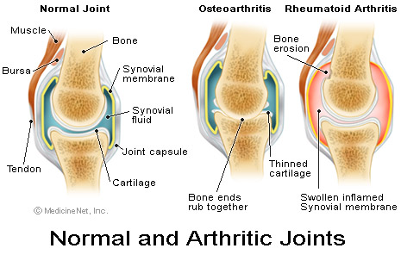
Comparison of arthritic joints

Slide 20
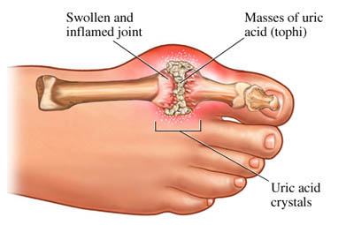
Gouty Arthritis
Deposition of ______________________________________ in joints and soft tissues, followed by an _
Typically, gouty arthritis affects the joint at the base of the _
In untreated gouty arthritis, the _
Treatment – colchicine, nonsteroidal anti-inflammatory drugs, and glucocorticoids

Slide 21
Chapter Nine

Slide 22
Muscle Overview
The three types of muscle tissue are
These types differ in structure, location, function, and means of activation

Slide 23
Muscle Similarities
Skeletal and smooth muscle cells are elongated
called _
Muscle contraction depends on two kinds of myofilaments
Muscle terminology is similar
muscle plasma membrane
___________________________________________ of a muscle cell
Prefixes
myo, mys, and sarco all refer to muscle

Slide 24
Skeletal Muscle Tissue
Has obvious stripes called striations
Is controlled _
Contracts _
but _
Is responsible for overall body motility
Is extremely _
can exert wide range of forces

Slide 25
Cardiac Muscle Tissue
Occurs only in the heart
Is _________________________ like skeletal muscle
Rhythmicity controlled by _
Pacemaker located within the heart
______________________________controls temper the heart’s response
Elevates or depresses rate as needed

Slide 26
Smooth Muscle Tissue
Found in the walls of ______________________ organs,
the stomach,
urinary bladder,
respiratory passages
Forces food and other substances through internal body channels
It is _

Slide 27
Functional Characteristics of Muscle Tissue
Excitability, or irritability
the ability to _
Contractility
the ability to _
Extensibility
the ability to be _
the ability to ____________________________ and resume the original resting length

Slide 28
Skeletal Muscle
_______________________________________ composed of muscle tissue, blood vessels, nerve fibers, and connective tissue

Slide 29
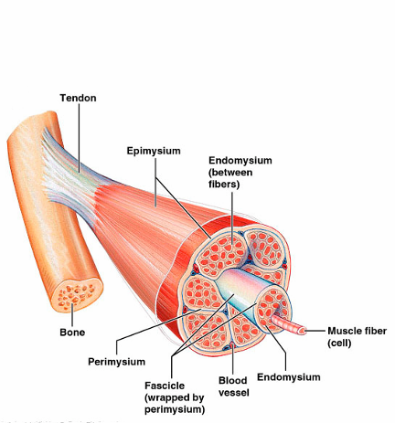
Skeletal Muscle
The three connective tissue sheaths are:
fine sheath of connective tissue composed of reticular fibers surrounding _
fibrous connective tissue that surrounds _
an overcoat of dense regular connective tissue that _

Slide 30
Skeletal Muscle: Attachments
Most skeletal muscles span joints and are attached to bone in at least two places
When muscles contract the movable bone, the muscle’s _

Slide 31
Skeletal Muscle: Attachments
Muscles attach:
Directly
epimysium of the muscle is _______________________________________ of a bone
Indirectly
connective tissue wrappings extend beyond the muscle as a _

