Slide 1
Ultrastructure of Myofilaments: Thick Filaments
Each ______________________________ molecule has a rod-like tail and two globular heads
two interwoven, heavy polypeptide chains
two smaller, light polypeptide chains called cross bridges

Slide 2
Ultrastructure of Myofilaments: Thin Filaments
________________ filaments are chiefly composed of the _
The subunits contain the ____________________________ to which myosin heads attach during contraction
Tropomyosin and troponin are __________________________ bound to actin

Slide 3
Sarcoplasmic Reticulum (SR)
SR is __________________________________ that runs longitudinally and surrounds each myofibril
Functions in the _

Slide 4
T Tubules
T tubules are continuous with the sarcolemma
They _________________________________ to the deepest regions of the muscle
These impulses signal for the _

Slide 5
Sliding Filament Model of Contraction
Thin filaments slide past the thick ones so that the actin and myosin filaments overlap to a greater degree
In the ____________________________ state, thin and thick filaments overlap _
Upon stimulation, _

Slide 6
Sliding Filament Model of Contraction
Each myosin head binds and detaches several times during contraction, acting like a ratchet to generate tension and propel the thin filaments to the center of the sarcomere
As this event occurs throughout the sarcomeres, the muscle shortens
http://www.wiley.com/college/pratt/0471393878/student/animations/actin_myosin/actin_myosin.swf

Slide 7
Skeletal Muscle Contraction
In order to contract, a skeletal muscle must:
Be stimulated _
Propagate an electrical current, or __________________________________, along its sarcolemma
Have a rise in _______________________________ levels, the final trigger for contraction
Linking the electrical signal to the contraction is excitation-contraction coupling

Slide 8
Nerve Stimulus of Skeletal Muscle
Skeletal muscles are stimulated by _________________________ of the somatic nervous system
Axons of these neurons travel in nerves to muscle cells
Axons of motor neurons ______________________________ as they enter muscles
Each axonal branch forms a ______________________ with a single muscle fiber

Slide 9
Neuromuscular Junction
The neuromuscular junction is formed from:
_____________________________________, which have small membranous sacs (________________________________) that contain the neurotransmitter _
The _____________________________________ of a muscle, which is a specific _____________________________________ that contains ___________________________________ and helps form the neuromuscular junction

Slide 10
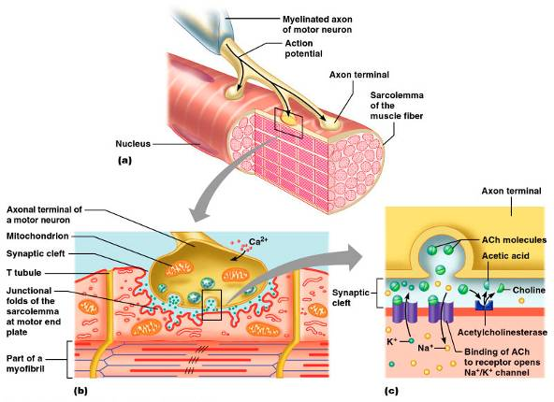
Neuromuscular Junction
Though exceedingly close, axonal ends and muscle fibers are _

Slide 11
Neuromuscular Junction
When a nerve impulse reaches the end of an axon at the neuromuscular junction:
__________________________________________ open and allow Ca²⁺ to enter the axon
Ca²⁺ causes axonal vesicles to ________________ with the axonal membrane
This fusion _________________________________ into the synaptic cleft
ACh diffuses across the synaptic cleft to _
Binding of ACh to its receptors initiates an action potential in the muscle

Slide 12
Destruction of Acetylcholine
ACh bound to ACh receptors is quickly destroyed by the _
This destruction prevents continued muscle fiber contraction in the absence of additional stimuli

Slide 13
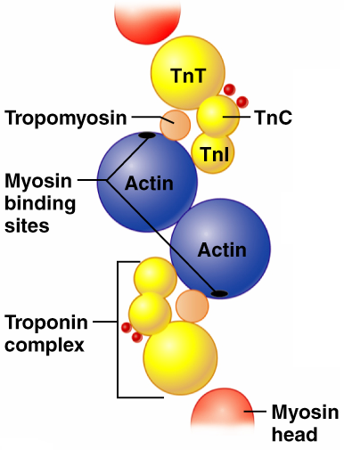
Role of Ionic Calcium (Ca²⁺) in the Contraction Mechanism
At ______________ intracellular Ca²⁺ concentration:
Tropomyosin _____________________ on actin
Myosin cross bridges cannot attach to binding sites on actin
Muscle _
Figure 9.11a

Slide 14
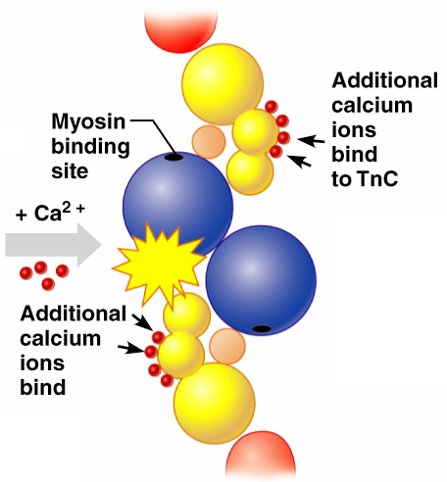
Role of Ionic Calcium (Ca²⁺) in the Contraction Mechanism
At higher intracellular Ca²⁺ concentrations:
Additional _
Calcium-activated troponin binds an additional two Ca²⁺ at a separate regulatory site
Figure 9.11b

Slide 15
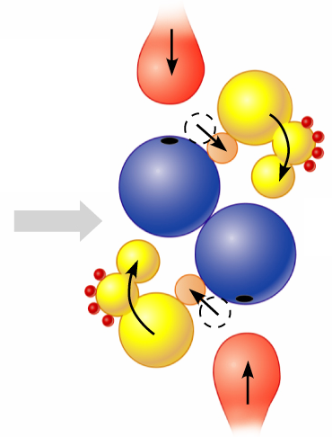
Role of Ionic Calcium (Ca²⁺) in the Contraction Mechanism
Calcium-activated troponin undergoes a __________________ change
This change moves tropomyosin away from _
Figure 9.11c

Slide 16
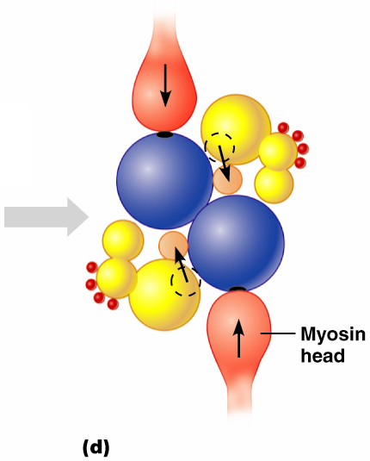
Role of Ionic Calcium (Ca²⁺) in the Contraction Mechanism
____________________ can now bind and cycle
This permits contraction to begin
sliding of the thin filaments by the myosin cross bridges
Figure 9.11d

Slide 17
Sequential Events of Contraction
Cross bridge formation
_____________________________________ attaches to actin filament
Working (power) stroke
myosin head ____________________________ actin filament toward M line
Cross bridge detachment
______________________________________ and the cross bridge detaches
“Cocking” of the myosin head
energy from hydrolysis of ___________________ cocks the myosin head into the _

Slide 18
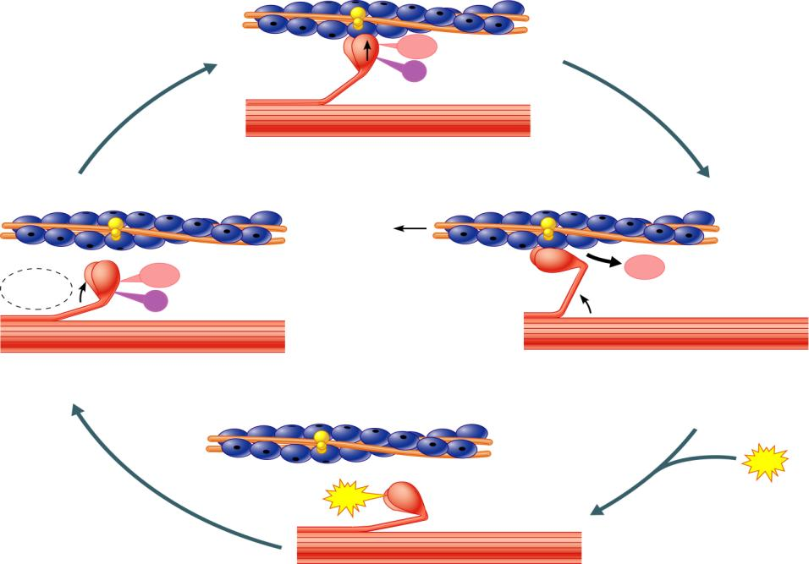
Myosin head
(high-energy
configuration)
ADP
P_{i}
1
Myosin head attaches to the actin
myofilament, forming a cross bridge.
Thin filament
ATP
ADP
ADP
Thick filament
hydrolysis
P_{i}
4
As ATP is split into ADP and P_{i}, the myosin
head is energized (cocked into the high-energy
conformation).
2
Inorganic phosphate (P_{i}) generated in the
previous contraction cycle is released, initiating
the power (working) stroke. The myosin head
pivots and bends as it pulls on the actin filament,
sliding it toward the M line. Then ADP is released.
ATP
ATP
Myosin head
(low-energy
configuration)
3
As new ATP attaches to the myosin head, the link between
myosin and actin weakens, and the cross bridge detaches.
Figure 9.12

Slide 19
Contraction of Skeletal Muscle Fibers
Contraction
refers to the _
ends when cross bridges become inactive, the tension generated declines, and _

Slide 20
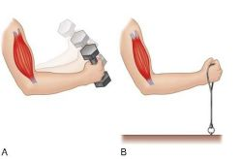
Contraction of Skeletal Muscle (Organ Level)
The two types of muscle contractions are:
Isotonic contraction
___________________ muscle length
muscle shortens during contraction
Iso = same;
_______________________ contraction
muscle does not shorten during contraction
Iso = same; metric =length

Slide 21
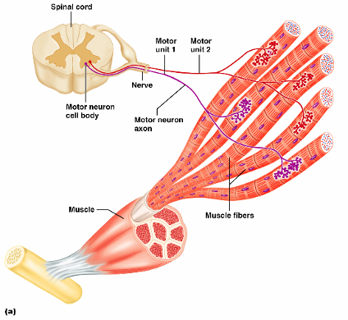
Motor Unit: The Nerve-Muscle Functional Unit
A motor unit is a _
The number of muscle fibers per motor unit varies
from four to several hundred

Slide 22
Motor Unit: The Nerve-Muscle Functional Unit
Muscles that control ______________________ have small motor units
fingers, eyes
Large weight-bearing muscles have _
thighs, hips
Muscle fibers from a motor unit are spread throughout the muscle; therefore, _

Slide 23
Muscle Twitch
A _____________________________ is the response of a muscle to a _
There are three phases to a muscle twitch
Latent period
Period of contraction
Period of relaxation

Slide 24
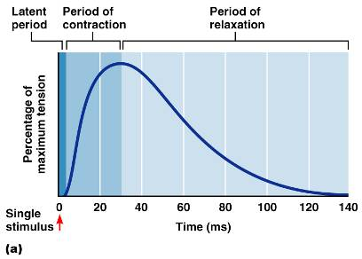
Phases of a Muscle Twitch
first few msec after stimulus; EC coupling taking place
cross bridges form; muscle shortens
Period of _
Ca²⁺ reabsorbed; _
Figure 9.14a

Slide 25
Graded Muscle Responses
Graded muscle responses are:
Variations in the _
Required for proper control of skeletal movement
Responses are graded by:
the _
the ____________________________________ of the stimulus

Slide 26
Muscle Response to Varying Stimuli
A ______________________________ results in a _
a
With frequently delivered stimuli, muscle does not have time to completely relax and it _
Figure 9.15

Slide 27
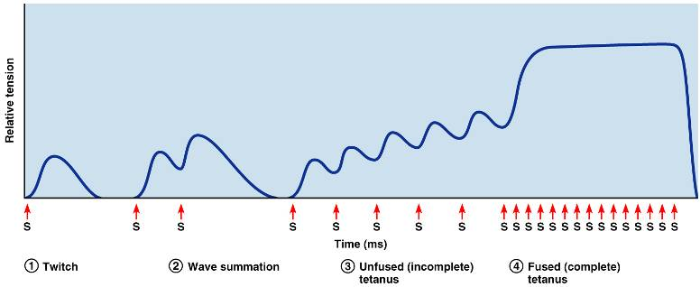
Muscle Response to Varying Stimuli
More rapidly delivered stimuli result in _
If stimuli are given quickly enough, _

Slide 28
Muscle Response: Stimulation Strength
the ___________________________ strength at which the first observable muscle contraction occurs
Beyond threshold, muscle _____________________________________ as stimulus strength is increased
Force of contraction is precisely controlled by multiple motor unit summation
This phenomenon, called ____________________________, brings more and more muscle fibers into play

Slide 29
Treppe: The Staircase Effect
Staircase
____________________________________ in response to multiple stimuli of the same strength
Contractions increase because:
There is ________________________________________ in the sarcoplasm
Muscle enzyme systems become more ______________________ because ________________ is increased as muscle contracts

Slide 30
Muscle Tone
Muscle _______________:
Is the constant, slightly contracted state of all muscles, which _
Keeps the muscles firm, healthy, and _
______________________________ account for muscle tone by:
Activating one motor unit and then another
Responding to activation of ______________________________ in muscles and tendons

