Slide 1
Muscle Metabolism: Energy for Contraction
_____________________is the only source used directly for contractile activity

Slide 2
Muscle Metabolism: Anaerobic Glycolysis
When muscle contractile activity reaches __________ of maximum:
Bulging muscles _
Oxygen delivery is _
Pyruvic acid is converted into _

Slide 3
Muscle Metabolism: Anaerobic Glycolysis
The lactic acid:
Diffuses into the bloodstream
Is picked up and ___________________________________ by the liver, kidneys, and heart
Is converted back into pyruvic acid by the _

Slide 4
Muscle Fatigue
Muscle fatigue
the muscle is in a state of physiological _
Muscle fatigue occurs when:
More ATP being _
There is a relative deficit of ATP, causing contractures
Ionic imbalances

Slide 5
Muscle Fatigue
Intense exercise produces _
with rapid recovery
Na⁺-K⁺ pumps cannot restore ionic balances quickly enough
Low-intensity exercise produces _

Slide 6
Oxygen Debt
Vigorous exercise causes dramatic changes in muscle chemistry
For a muscle to return to a resting state:
Oxygen reserves must be _
Lactic acid must be _
Glycogen stores must be replaced
ATP and CP reserves must be _

Slide 7
Oxygen Debt
Oxygen debt
the ________________________________________ needed for the above restorative processes

Slide 8
Heat Production During Muscle Activity
Only 40% of the energy released in muscle activity is useful as work
The remaining _
Dangerous heat levels are prevented by radiation of heat from the _

Slide 9
Force of Muscle Contraction
The force of contraction is affected by:
The
the more motor fibers in a muscle, the stronger the contraction
The
the bulkier the muscle, the greater its strength
Degree of _
muscles contract strongest when muscle fibers are 80-120% of their normal resting length

Slide 10
Effects of Aerobic Exercise
Aerobic exercise results in an increase of:
Muscle _
Number of _
______________________________ synthesis

Slide 11
Effects of Resistance Exercise
Resistance exercise (typically anaerobic) results in:
Muscle _
Increased
Myofilaments
Glycogen stores

Slide 12
The Overload Principle
Forcing a muscle to work promotes _
Muscles adapt to increased demands
Muscles must be ____________________________________ to produce further gains

Slide 13
Smooth Muscle
Composed of _
Lack the coarse connective tissue sheaths of skeletal muscle,
have fine _

Slide 14
Smooth Muscle
Organized into two layers of closely apposed fibers
Found in walls of _
Have essentially the same contractile mechanisms as skeletal muscle

Slide 15
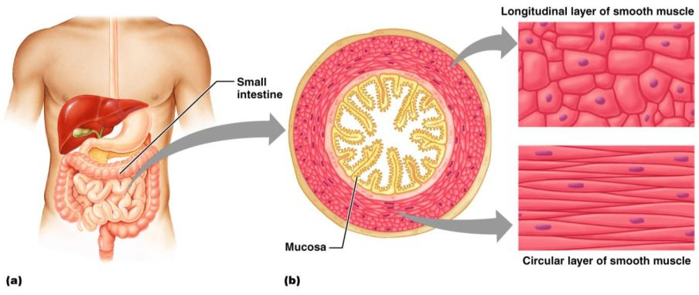
Smooth Muscle
Figure 9.24

Slide 16
Peristalsis
When the longitudinal layer contracts
the organ _
When the circular layer contracts
the organ _
alternating contractions and relaxations of smooth muscles that mix and squeeze substances through the lumen of hollow organs

Slide 17
Innervation of Smooth Muscle
Smooth muscle lacks _
Innervating nerves have bulbous swellings called _
Varicosities release _________________________________ into wide synaptic clefts called _

Slide 18
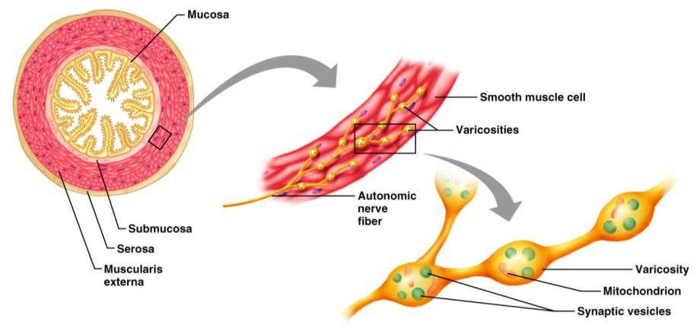
Innervation of Smooth Muscle
Figure 9.25

Slide 19
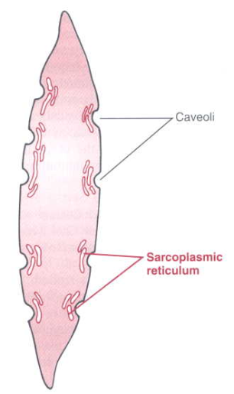
Microscopic Anatomy of Smooth Muscle
Sarcoplasmic Reticulum
is less developed than in skeletal muscle
lacks a specific pattern
Plasma membranes have pouchlike infoldings called caveoli

Slide 20
Microscopic Anatomy of Smooth Muscle
Ca2+ is kept in the extracellular space near the caveoli, allowing rapid influx when channels are opened
There are ____________________________________ and no sarcomeres
Thin and thick filaments are present

Slide 21
Myofilaments in Smooth Muscle
Ratio of thick to thin filaments is much lower than in skeletal muscle
Thick filaments have heads along their entire length
There is _

Slide 22
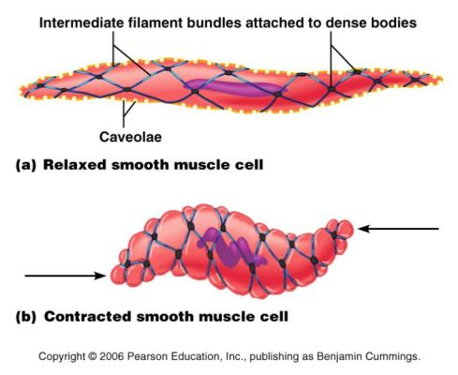
Myofilaments in Smooth Muscle
Thick and thin filaments are ________________________________________ , causing smooth muscle to contract in a corkscrew manner

Slide 23
Contraction of Smooth Muscle
Whole sheets of smooth muscle exhibit _
They contract in ________________________, reflecting their electrical coupling with _
Action potentials are transmitted from cell to cell

Slide 24
Contraction of Smooth Muscle
Some smooth muscle cells:
Act as ___________________________________ and set the contractile pace for whole sheets of muscle
Are ________________________________________ and depolarize without external stimuli

Slide 25
Contraction Mechanism
Actin and myosin interact according to the sliding filament mechanism
The final trigger for contractions is a _
Ca²⁺ is released from the SR and from the extracellular space
Ca²⁺ interacts with ________________________________________ and myosin light chain kinase to activate myosin

Slide 26
Role of Calcium Ion
Ca²⁺ binds to calmodulin and activates it
Activated calmodulin activates the _
Activated kinase _____________________________________ from ATP to myosin cross bridges
Phosphorylated cross bridges interact with actin to produce shortening
Smooth muscle relaxes when _

Slide 27
Special Features of Smooth Muscle Contraction
Unique characteristics of smooth muscle include:
Smooth muscle _
__________________________ , prolonged contractile activity
__________________________ energy requirements
Response to _

Slide 28
Response to Stretch
Smooth muscle exhibits a phenomenon called _____________________________________ in which:
Smooth muscle responds to stretch only briefly, and then _
The new length, however, retains its ability to contract
This enables organs such as the stomach and bladder to _

Slide 29
Hyperplasia
Certain smooth muscles can divide and increase their numbers by undergoing _
This is shown by estrogen’s effect on the uterus
At _
estrogen stimulates the synthesis of more smooth muscle, causing the uterus to grow to adult size
During _
estrogen stimulates uterine growth to accommodate the increasing size of the growing fetus

Slide 30
Types of Smooth Muscle: Single Unit
The cells of single-unit smooth muscle, commonly called _
Contract _
Are electrically coupled to one another via gap junctions
Often exhibit _
Are arranged in opposing sheets and exhibit stress-relaxation response

Slide 31
Types of Smooth Muscle: Multiunit
____________________________________ muscles are found:
In large airways to the lungs
In large _
In arrector pili muscles
Attached to _
In the _

Slide 32
Types of Smooth Muscle: Multiunit
Their characteristics include:
Rare gap junctions
______________________________ spontaneous depolarizations
Structurally __________________________________ muscle fibers
A rich nerve supply, which, with a number of muscle fibers, forms motor units
_____________________________________ in response to neural stimuli

Slide 33
Muscular Dystrophy
Muscular dystrophy
group of inherited _
muscles enlarge due to _________________________________________deposits,
but muscle fibers _
Caused by a lack of the cytoplasmic protein dystrophin
There is no cure, but myoblast transfer therapy shows promise

Slide 34
Duchenne Muscular Dystrophy
Duchenne muscular dystrophy (DMD)
____________________________, sex-linked disease carried by females and expressed in males (1/3500)
Diagnosed between the ages of _
Victims become _________________________________________ frequently as their muscles fail

Slide 35
Duchenne muscular dystrophy
Symptoms usually appear _
By age 10, braces may be required for walking, and by _
There is progressive muscle weakness of the legs and pelvis
associated with a _
Muscle weakness also occurs in the arms, neck, and other areas, but not as severely or as early as in the lower half of the body.
muscle tissue is eventually replaced by fat and connective tissue
Muscle contractures occur in the legs, rendering the muscles unusable because the muscle fibers shorten and fibrosis occurs in connective tissue.
Muscular weakness and skeletal deformities contribute to frequent _
________________________________________ occurs in almost all cases

Slide 36
Myotonic Muscular Dystrophy
most common form of _________________________ muscular dystrophy
caused by a defective gene (Autosomal Dominant)
but unlike the other kinds, the muscle weakness is also _
Myotonia:
________________________________________________ of muscles after the muscle is contracted
Not always disease related. Can be _

Slide 37
Myotonic Muscular Dystrophy
Symptoms
Delayed muscle relaxation after contraction
__________________________________________ of non-muscular tissue
Weaknesses in the ____________________________________________, and muscles affecting speech and swallowing
Baldness in men and women
Respiratory problems
Heart abnormalities in early adulthood

Slide 38
Facioscapulohumeral Muscular Dystrophy
autosomal dominant form of muscular dystrophy that affects the muscles of the _
begins to show in half of all patients by _
and in 95 percent of patients by _
the earlier in life it appears the worse the symptoms will be
Because it doesn’t affect the heart or respiratory muscles, facioscapulohumeral MD usually _

Slide 39
Facioscapulohumeral Muscular dystrophy
Difficulty _
Aching around shoulders
Eyes remain slightly open during sleep
Little facial expression
among infants and small children
severe cases
Difficulty or _
Difficulty or inability to _

