Slide 1
Chapter 10

Slide 2
Interactions of Skeletal Muscles
Skeletal muscles work _
Muscles ______________________ (never push)
As muscles shorten, the insertion generally _

Slide 3
Muscles: Functional Groups
provide the major force for producing a specific movement
oppose or reverse a particular movement
Add force to a movement
Reduce undesirable or unnecessary movement
Fixators
synergists that ____________________________ a bone or muscle’s origin

Slide 4
Naming Skeletal Muscles
bone or body region associated with the muscle
_________________________of muscle
e.g., the deltoid muscle _

Slide 5
Naming Skeletal Muscles
maximus (largest), minimus (smallest), longus (long)
_____________________ (fibers run straight), _________________________, and oblique (fibers run at angles to an imaginary defined axis)

Slide 6
Naming Skeletal Muscles
biceps (__________________________) and triceps (______________________________)
Location of attachments
named according to _
flexor or extensor, as in the names of muscles that flex or extend, respectively

Slide 7
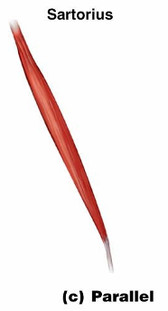
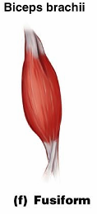
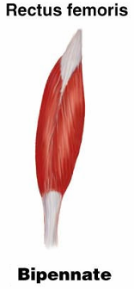
Arrangement of Fascicles
Parallel
fascicles run parallel to the _
Fusiform
short fascicles that attach obliquely to a central tendon running the length of the muscle

Slide 8
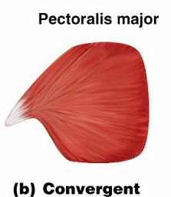
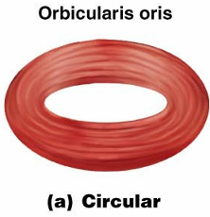
Arrangement of Fascicles
fascicles converge from a broad origin to a single tendon insertion
fascicles are arranged in concentric rings

Slide 9
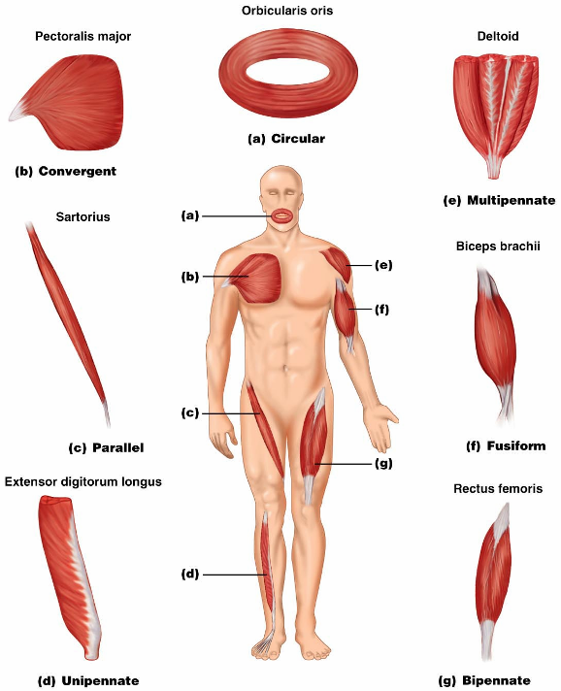

Slide 10
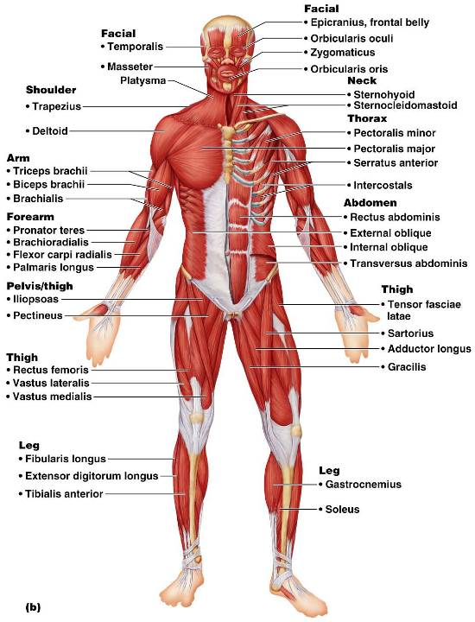
Anterior View
The 40 superficial muscles here are divided into 10 regional areas of the body
Figure 10.4b

Slide 11
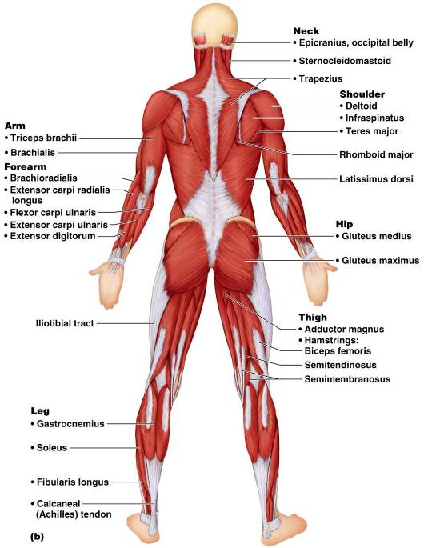
Posterior View
The 27 superficial muscles here are divided into seven regional areas of the body
Figure 10.5b

Slide 12
Muscles: Name, Action, and Innervation
Name and description of the muscle
be alert to _
Origin and insertion
there is always a _
Action
best learned by acting out a muscle’s movement on one’s own body
Nerve supply
name of major nerve that innervates the muscle

Slide 13
Muscles of the Scalp
_____________________________ (occipitofrontalis) – bipartite muscle consisting of the:
Galea aponeurotica – __________________________________ connecting above muscles
These two muscles have alternate actions of _

Slide 14
Muscles of the Face
11 muscles are involved in lifting the eyebrows, flaring the nostrils, opening and closing the eyes and mouth, and smiling
All are innervated by _
Usually ___________________________ (rather than bone), and adjacent muscles often fuse

Slide 15
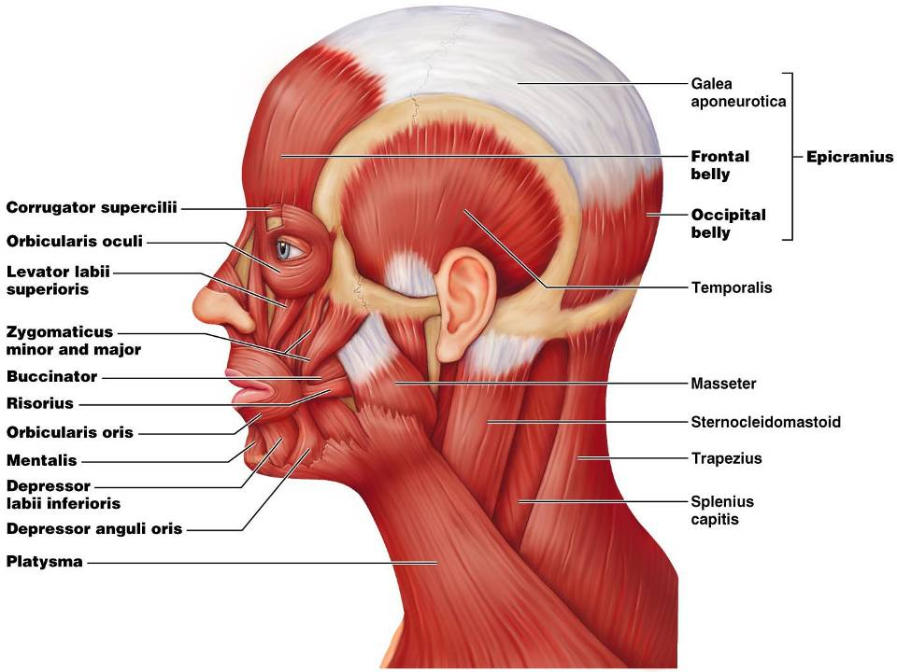

Slide 16
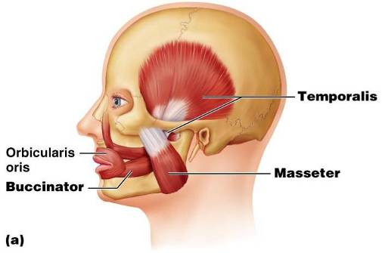
Muscles of Mastication
There are _____________________________ ___________ of muscles involved in mastication
Prime movers
Grinding movements
All are innervated by __________________________________ (trigeminal nerve)

Slide 17
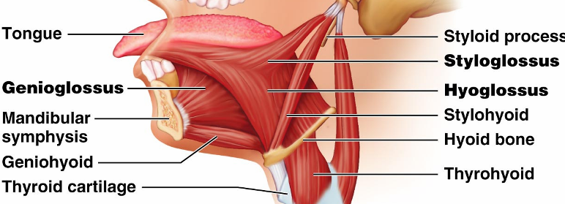
Extrinsic Tongue Muscles
_____________________ major muscles that anchor and move the tongue
All are innervated by _

Slide 18
Muscles of the Neck: Head Movements
Major _
Synergists to head flexion
suprahyoid and infrahyoid
sternocleidomastoid and scalene muscles
Head extension
deep splenius muscles and aided by the _

Slide 19
Trunk Movements: Deep Back Muscles
The prime mover of _
Erector spinae muscles consist of three columns on each side of the vertebrae
Lateral bending of the back
unilateral contraction of these muscles
Other deep back extensors include the semispinalis muscles and the quadratus lumborum

Slide 20
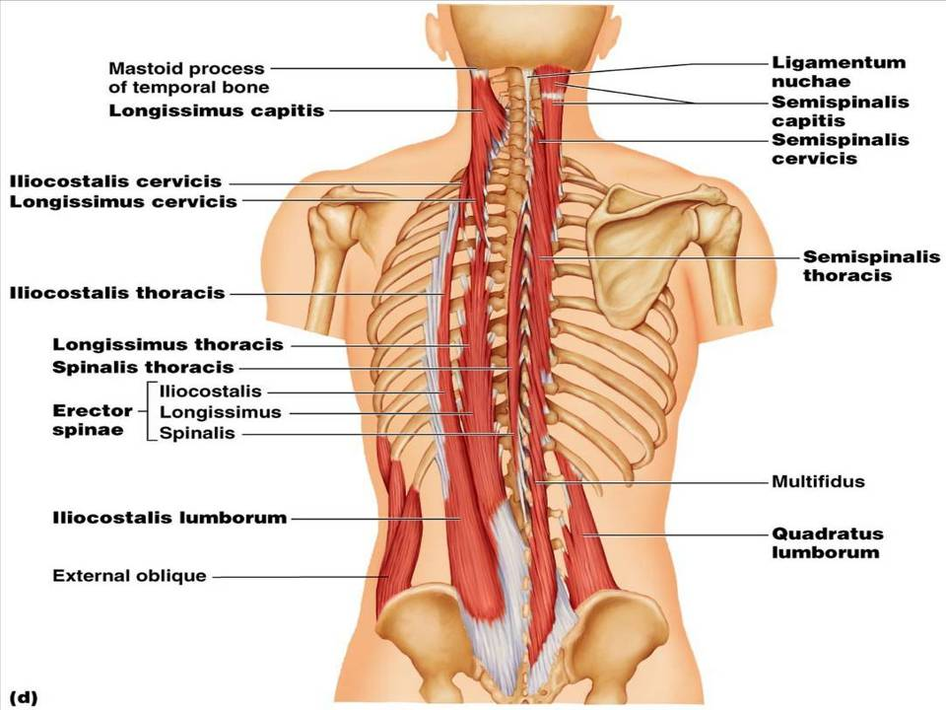
Figure 10.9d

Slide 21
Trunk Movements: Short Muscles
Four short muscles extend from one vertebra to another
These muscles are synergists in _

Slide 22
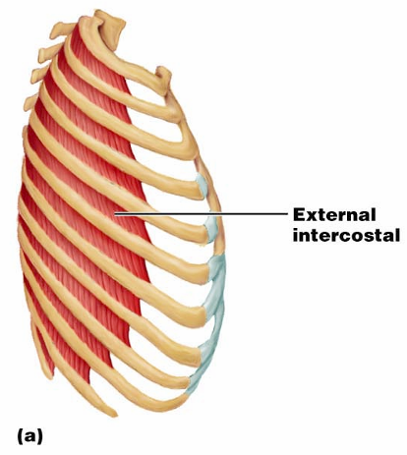
Muscles of Respiration: External Intercostals
The primary function of ___________________ muscles is to promote movement for breathing
___________________
more superficial layer that _

Slide 23
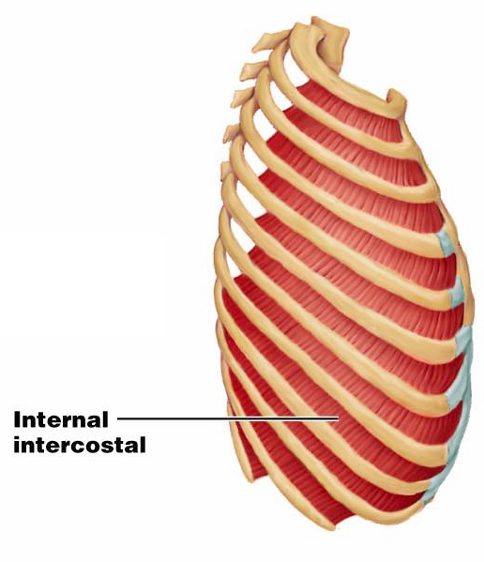
Muscles of Respiration: Internal Intercostals
deeper layer that aids in forced _
most important muscle _

Slide 24
Muscles of the Abdominal Wall
The abdominal wall is composed of four paired muscles
their fasciae, and their aponeuroses
Fascicles of these muscles run at right and oblique angles to one another, giving the abdominal wall added strength

Slide 25
Muscles of the Abdominal Wall
In addition to forming the abdominal wall, these muscles:
Are involved with ____________________________ and ____________________________ of the trunk
Help promote urination, defecation, childbirth, vomiting, coughing, and screaming

Slide 26
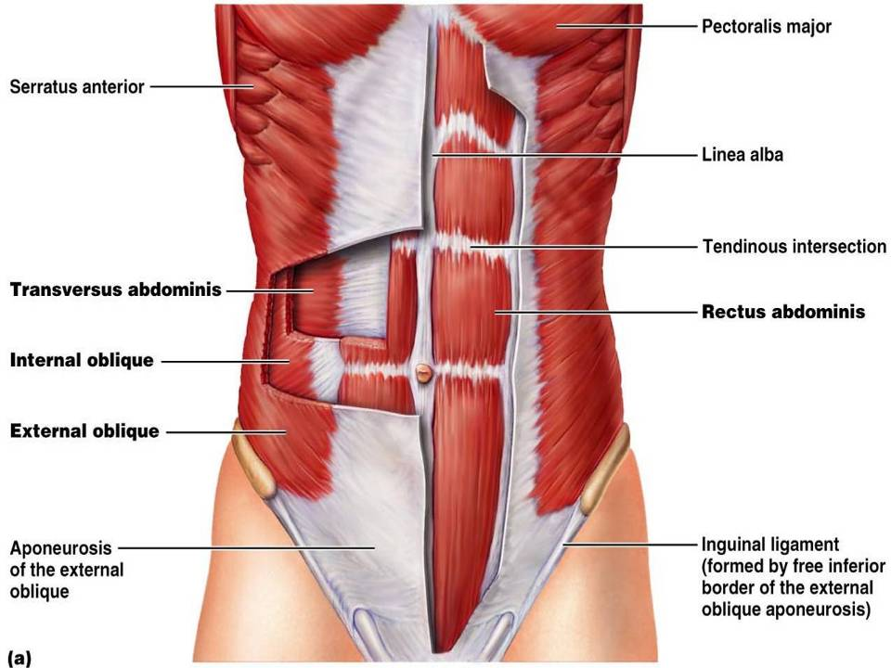

Slide 27
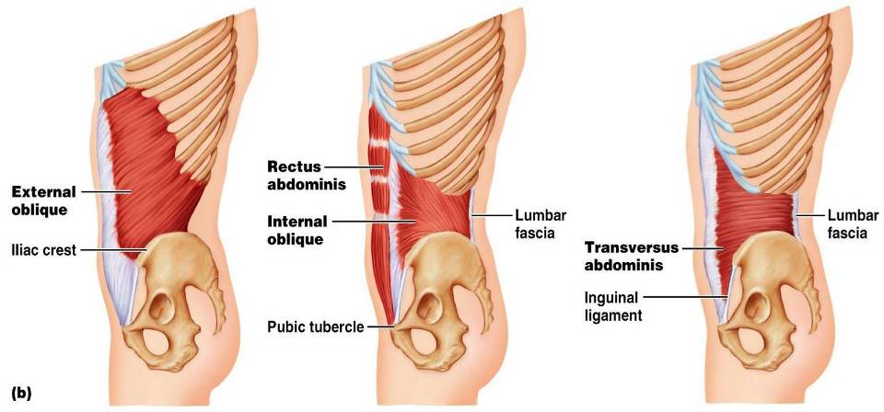
Muscles of the Abdominal Wall

Slide 28
Extrinsic Shoulder Muscles
Muscles of the _
Anterior:
pectoralis major, pectoralis minor, serratus anterior, and subclavius
Posterior:
latissimus dorsi, trapezius muscles, levator scapulae, and rhomboids
These muscles are involved with the movements of the scapula including ____________________________________________________________________________________ and lateral and medial movements
Prime movers of _________________________ are the _

Slide 29
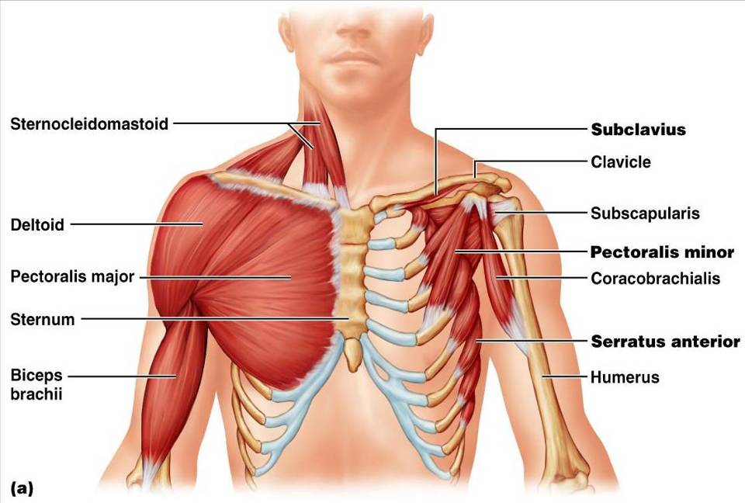
Extrinsic Shoulder Muscles
Figure 10.13a

Slide 30
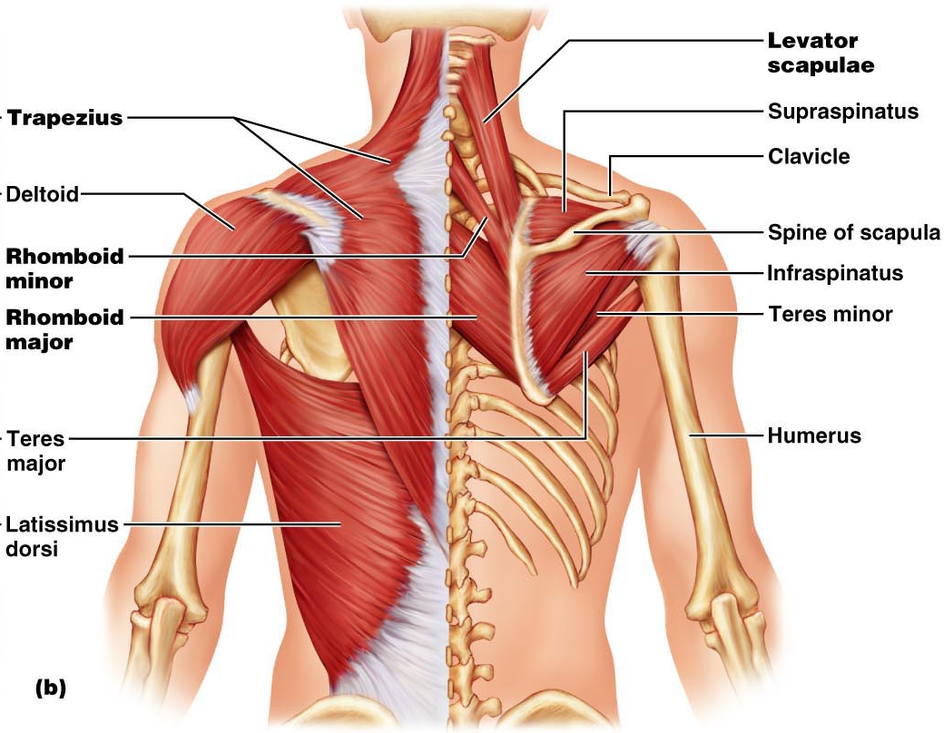
Figure 10.13b

Slide 31
Muscles Crossing the Shoulder
Nine muscles cross the shoulder joint and insert into the humerus
Prime movers include:
arm flexion
arm extension
Middle fibers of the deltoid

Slide 32
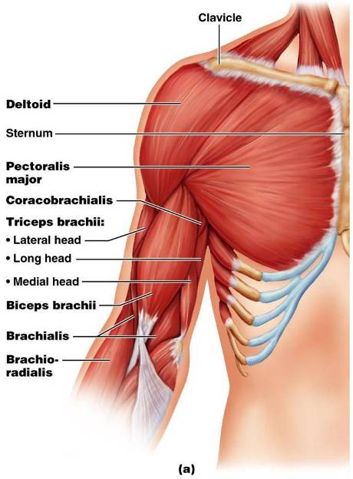
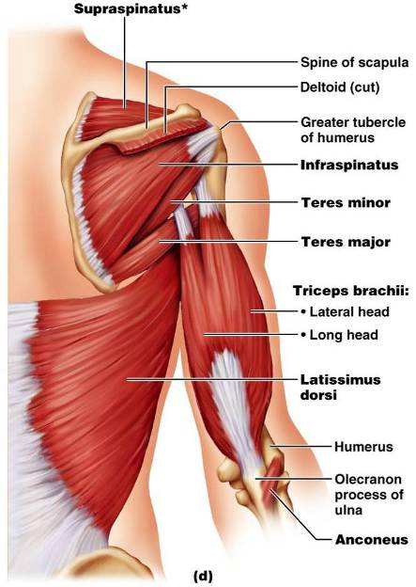
Muscles Crossing the Shoulder

Slide 33
Muscles Crossing the Shoulder
Rotator cuff muscles
Function mainly to reinforce the capsule of the shoulder
Secondarily act as synergists and _

