Slide 1
Muscles Crossing the Elbow
Forearm extension
prime mover of forearm _
The _
weak synergist
The _

Slide 2
Muscles Crossing the Elbow
Forearm flexion
chief forearm _
________________________________________ and _
synergist
The brachioradialis
helps _

Slide 3
Muscles of the Forearm
Forearm muscle groups:
those that cause _
those that move _
These muscles insert via the flexor and extensor retinacula
Most __________________________ muscles are _
Most __________________________ muscles are _

Slide 4
Muscles of the Forearm
The ____________________________ and ________________________________ are not flexors, but ___________________________ the forearm
The supinator muscle is a synergist with the biceps brachii in supinating the forearm

Slide 5
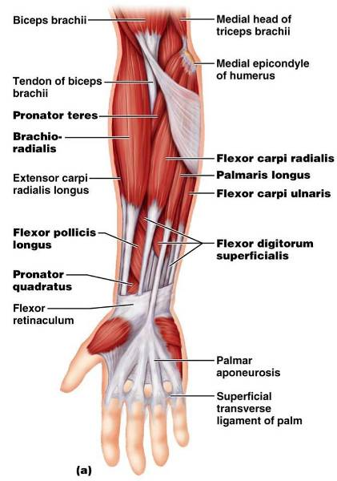
Muscles of the Forearm: Anterior
These muscles are primarily _

Slide 6
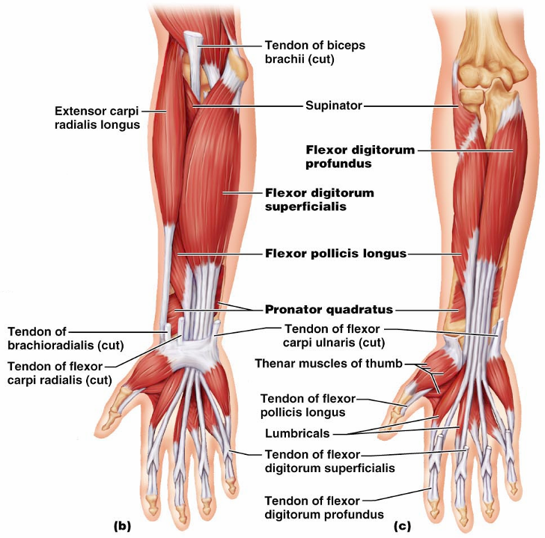
Figure 10.15b, c

Slide 7
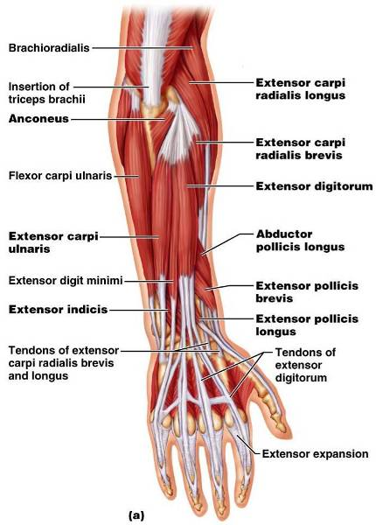
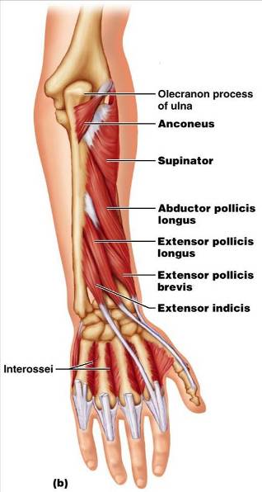
Muscles of the Forearm: Posterior
These muscles are primarily extensors of the wrist and digits
Figure 10.16a

Slide 8
Intrinsic Muscles of the Hand
These small muscles:
Lie in the _
none on the dorsal side
Move the _
Control ____________________________ movements
Are the main ____________________________________ of the fingers
Produce opposition
move the thumb toward the little finger

Slide 9
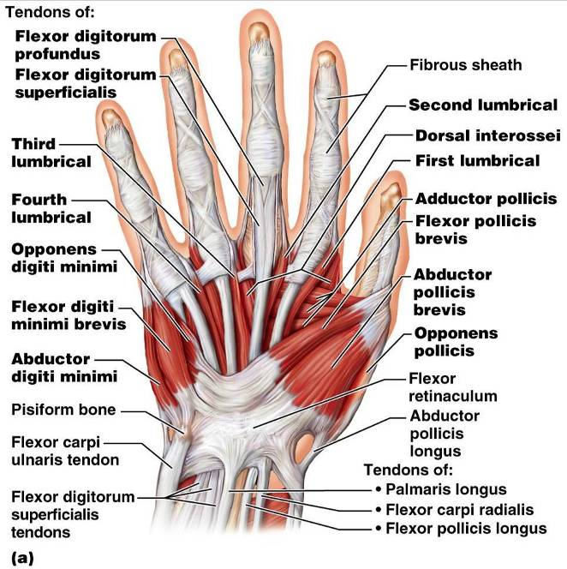
Intrinsic Muscles of the Hand

Slide 10
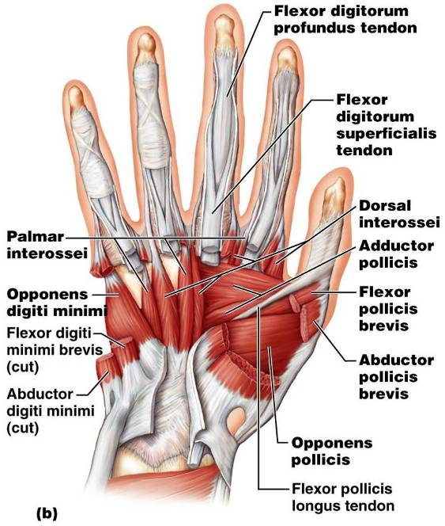
Intrinsic Muscles of the Hand

Slide 11
Finger and Thumb Movements
Flexion
Thumb –
Fingers –
Extension
Thumb –
Fingers –

Slide 12
Intrinsic Muscles of the Hand: Groups
There are ______________________________ of intrinsic hand muscles
The thenar eminence and hypothenar eminence
each have a _
The midpalm muscles, the lumbricals and interossei,
The interossei

Slide 13
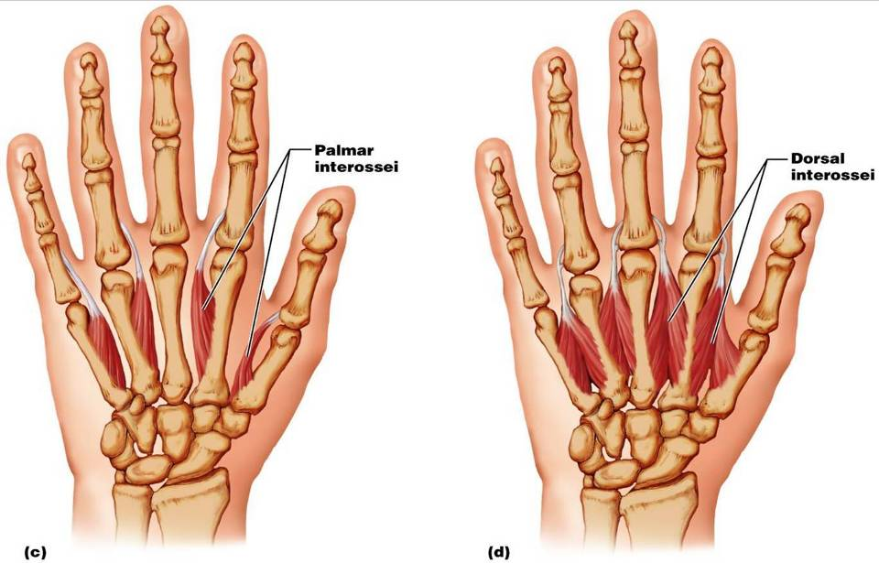
Intrinsic Muscles of the Hand: Groups

Slide 14
Muscles Crossing Hip and Knee Joints
Most ________________________________ muscles of the hip and thigh
___________________________________ at the hip
___________________________________ at the knee
Posterior compartment muscles of the hip and thigh
The medial compartment muscles
These three groups are enclosed by the _

Slide 15
Movements of the thigh at the Hip: Flexion and Extension
The ball-and-socket hip joint permits
Abduction
Adduction
The most important thigh flexors
tensor fasciae latae,
The ________________________ located adductor muscles and sartorius assist in thigh flexion

Slide 16
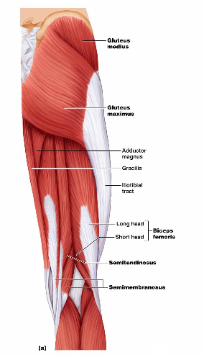
Movements of the Thigh at the Hip: Flexion and Extension
Thigh extension is primarily effected by the _
Forceful extension is aided by the gluteus maximus

Slide 17
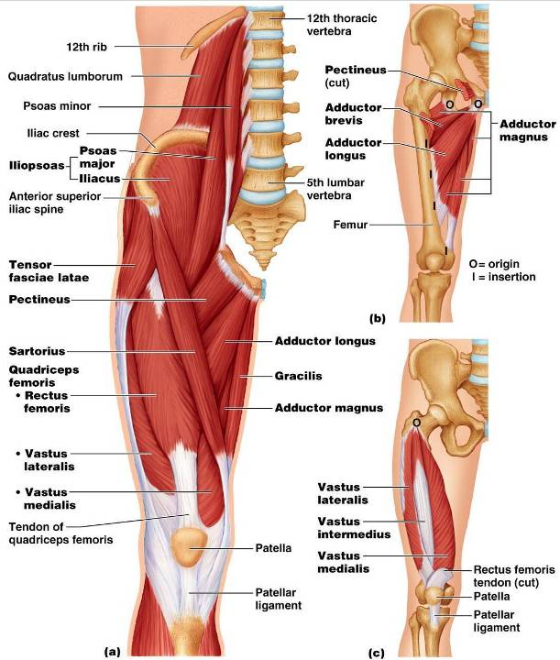

Slide 18
Movements of the Thigh at the Hip:
______________________________ assisted by
antagonized by
lateral rotators
Thigh adduction is the role of _
adductor _
adductor _
adductor _

Slide 19
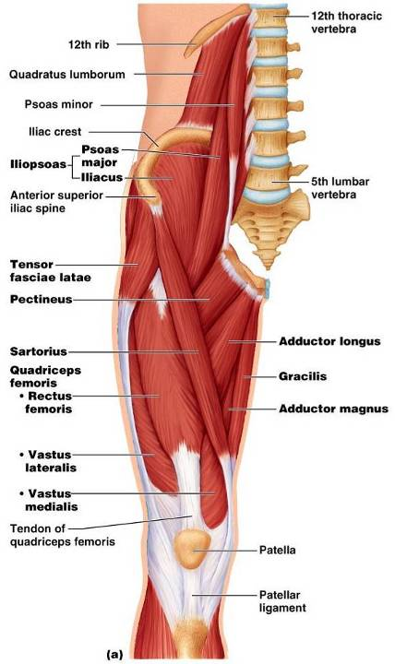
Movements of the Knee Joint
The _
______________ the knee
and act as antagonists to the quadriceps femoris

Slide 20
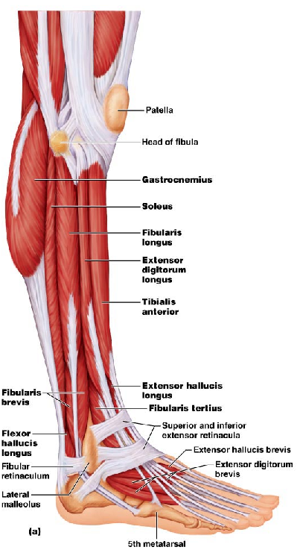
Fascia of the Leg
A deep fascia of the leg is continuous with the fascia lata
_______________________________________________________________: anterior, lateral, and posterior
Distally, the fascia thickens and forms the flexor, extensor, and fibular retinaculae

Slide 21
Muscles of the Leg: Movements
Various leg muscles produce the following movements at the:
Ankle
Intertarsal joints
Toes

Slide 22
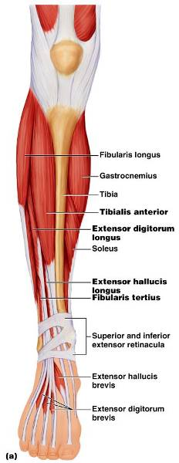
Muscles of the Anterior Compartment
primary toe extensors and ankle dorsiflexors
Figure 10.21a

Slide 23
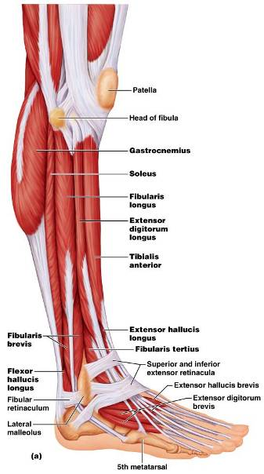
Muscles of the Lateral Compartment
Plantar-flex and evert the foot
Figure 10.22a

Slide 24
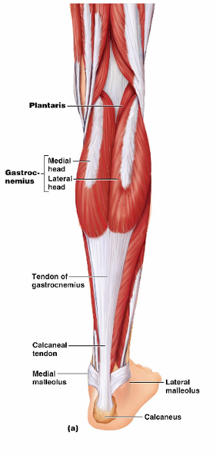
Muscles of the Posterior Compartment
flex the foot and the toes
Tibialis posterior
flexor hallucis longus
Figure 10.23a

Slide 25
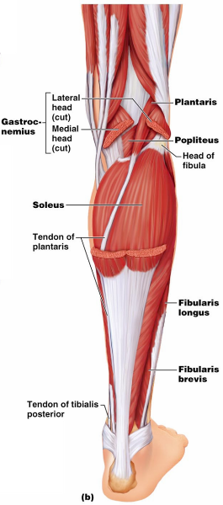
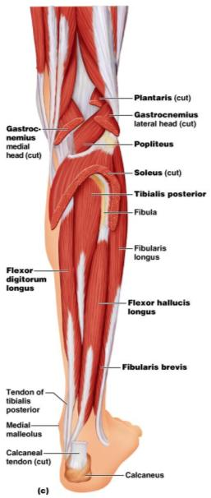
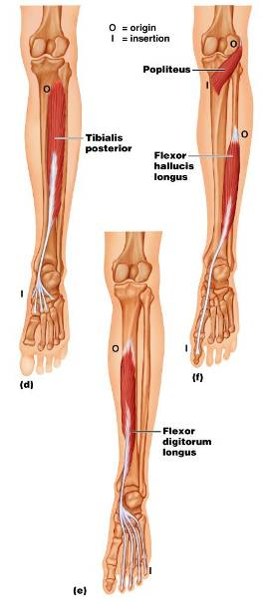
Muscles of the Posterior Compartment
Figure 10.23b, c

Slide 26
Muscle Actions of the Thigh: Summary
Thigh muscles:
Extend the leg (anterior compartment)

Slide 27
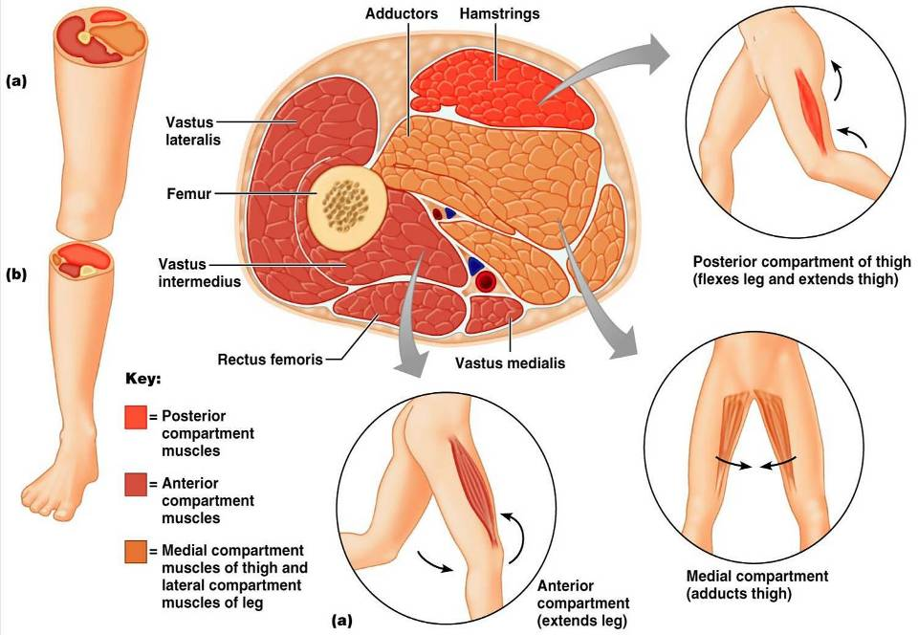

Slide 28
Muscle Actions of the Leg: Summary
Leg muscles:
Plantar flex and evert the foot
Plantar flex the foot and flex the toes
Dorsiflex the foot and extend the toes

Slide 29
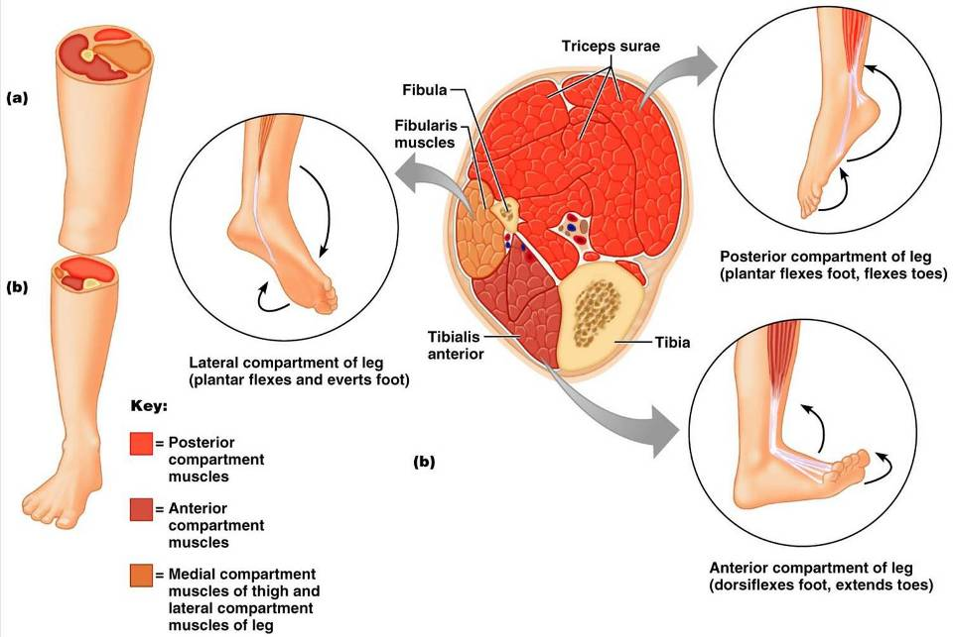

Slide 30
Intrinsic Muscles of the Foot
These muscles help flex, extend, abduct, and adduct the toes
In addition, along with some leg tendons, they _
There is a _____________________________, the extensor digitorum brevis, which _
The plantar muscles occur in four layers

Slide 31
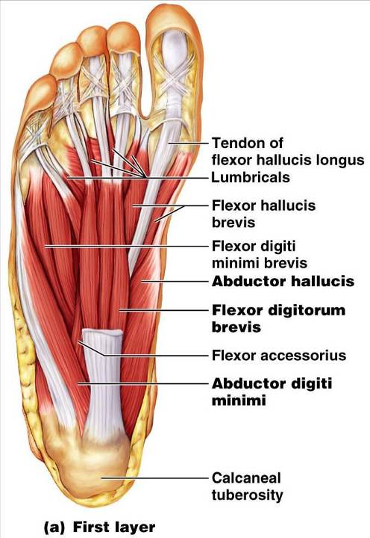
Plantar Muscles: First Layer (Superficial)
Superficial muscles of the _
These muscles are similar to the corresponding muscles of the hand

Slide 32
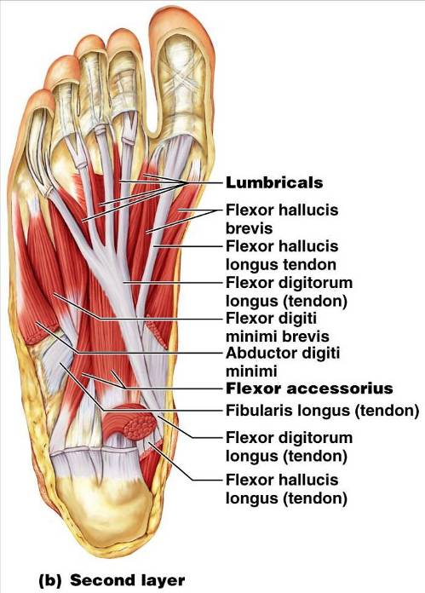
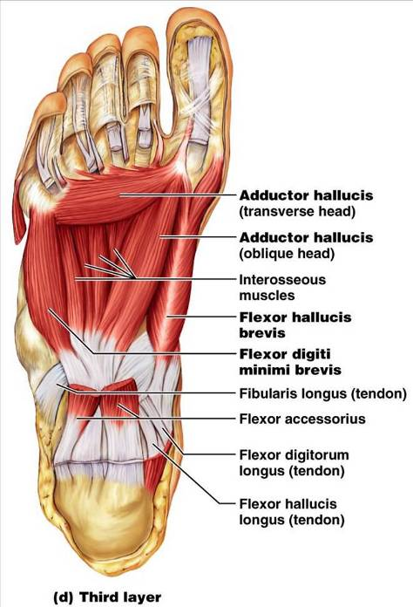

Slide 33
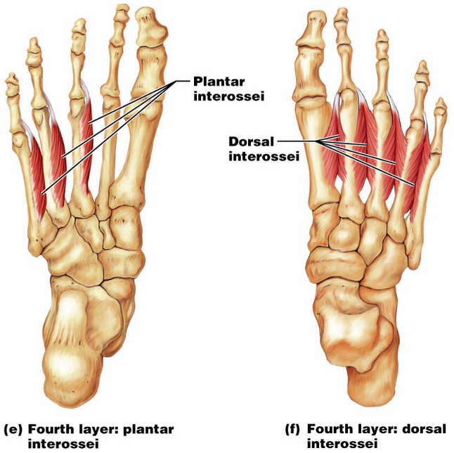
Plantar Muscles: Fourth Layer

