Slide 1
Postsynaptic Potentials
Neurotransmitter receptors mediate changes in membrane potential according to:
The _
The amount of ______________________ the neurotransmitter is bound to receptors
The two types of postsynaptic potentials are:
EPSP – __________________________ postsynaptic potentials
IPSP – __________________________ postsynaptic potentials

Slide 2
Excitatory Postsynaptic Potentials
EPSPs are ________________________ that _____________________________ an action potential in an axon
Use only chemically gated channels
Na⁺ and K⁺ flow in opposite directions at the same time
Postsynaptic membranes do not generate action potentials

Slide 3
Inhibitory Synapses and IPSPs
Neurotransmitter binding to a receptor at _________________________________:
Causes the membrane to become more permeable to potassium and chloride ions
_________________________the postsynaptic neuron’s ability to produce an action potential

Slide 4
Summation
A single EPSP cannot induce an action potential
EPSPs must _______________________ temporally or spatially to induce an action potential
Temporal summation
presynaptic neurons transmit impulses in _

Slide 5
Summation
Spatial summation
postsynaptic neuron is stimulated by a _
IPSPs can also summate with EPSPs, _

Slide 6
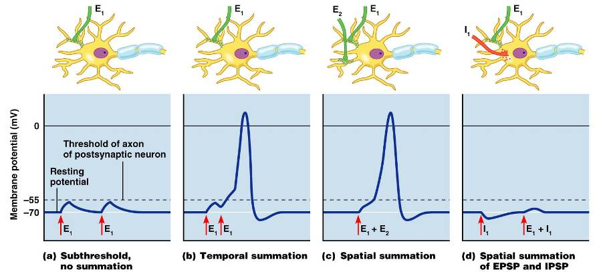
Summation

Slide 7
Neurotransmitters
Chemicals used for neuronal communication with the body and the brain
50 different neurotransmitters have been identified
Classified

Slide 8
Chemical Neurotransmitters
Biogenic amines
Peptides
Novel messengers:
ATP
dissolved gases _

Slide 9
Neurotransmitters: Acetylcholine
____________________ neurotransmitter identified, and best understood
Released at the _
Synthesized and enclosed in _

Slide 10
Neurotransmitters: Acetylcholine
Degraded by the enzyme acetylcholinesterase _
Released by:
All neurons that _
Some neurons in the _

Slide 11
Neurotransmitters: Biogenic Amines
Include:
Catecholamines
Indolamines
Broadly distributed in the _
Play roles in emotional behaviors and our biological clock

Slide 12
Neurotransmitters: Amino Acids
Include:
Gamma (γ)-aminobutyric acid
Glycine
Glutamate
Found only in the _

Slide 13
Neurotransmitters: Peptides
Include:
Substance P
Beta endorphin, dynorphin, and enkephalins
Act as _____________________________; reduce pain perception
Bind to the same receptors as opiates and morphine
Gut-brain peptides

Slide 14
Neurotransmitters: Novel Messengers
ATP
Is found in both the _
Produces ____________________________________ responses depending on receptor type
Provokes _

Slide 15
Neurotransmitters: Novel Messengers
Nitric oxide
Is involved in _
Carbon monoxide (CO) is a main regulator of cGMP in the brain

Slide 16
Functional Classification of Neurotransmitters
Two classifications: excitatory and inhibitory
Excitatory neurotransmitters cause _
Inhibitory neurotransmitters cause _

Slide 17
Functional Classification of Neurotransmitters
Some neurotransmitters have _
Determined by the ____________________ type of the postsynaptic neuron
Example: _
_____________________________ at neuromuscular junctions with skeletal muscle

Slide 18
Neurotransmitter Receptor Mechanisms
Direct: neurotransmitters that open _
Promote _
Examples: _____________ and amino acids
Indirect: neurotransmitters that _
Promote _
Examples: biogenic amines, peptides, and dissolved gases

Slide 19
Neural Integration: Neuronal Pools
Functional groups of neurons that:
__________________________ incoming information
Forward the processed information to its appropriate destination

Slide 20
Neural Integration: Neuronal Pools
Simple neuronal pool
Input fiber
Discharge zone
neurons _________________________________ with the incoming fiber
Facilitated zone
neurons farther away from _

Slide 21
Types of Circuits in Neuronal Pools
Divergent

Slide 22
Types of Circuits in Neuronal Pools
Convergent

Slide 23
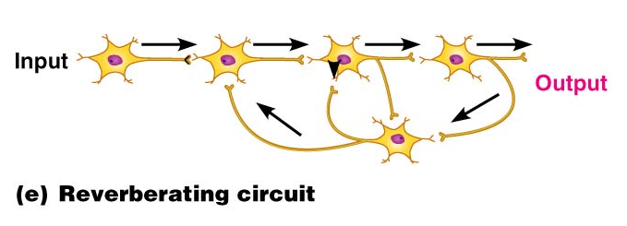
Types of Circuits in Neuronal Pools
Reverberating

Slide 24
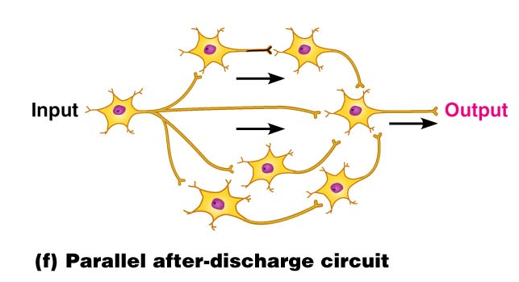
Types of Circuits in Neuronal Pools
Parallel after-discharge

Slide 25
Patterns of Neural Processing
Serial Processing
Input travels along one pathway to a specific destination
Works in an _
Example:

Slide 26
Patterns of Neural Processing
Parallel Processing
Input travels along _
Pathways are integrated in different CNS systems
Example:
End Chapter 11, Begin Chapter 12

Slide 27
Central Nervous System (CNS)
CNS – composed of the _
Elaboration of the anterior portion of the CNS
Increase in ___________________________ in the head
Highest level is reached in the human brain

Slide 28
The Brain
Composed of wrinkled, pinkish gray tissue
Surface anatomy includes

Slide 29
Adult Brain Structures
cerebrum: cortex, white matter, and basal nuclei
thalamus, hypothalamus, and epithalamus
brain stem: midbrain
Metencephalon
brain stem: pons
Myelencephalon
brain stem: medulla oblongata

Slide 30
Adult Neural Canal Regions
Adult structures derived from the neural canal
Telencephalon –
Diencephalon –
Mesencephalon –
Metencephalon and myelencephalon –

