Slide 1
Chapter Eleven
Exam Four Material
Chapter 11, chapter 12 up to spinal cord

Slide 2
Nervous System
The master controlling and communicating system of the body
Functions
monitoring stimuli
interpretation of sensory input
response to stimuli

Slide 3
Organization of the Nervous System
Central nervous system (CNS)
Brain and spinal cord
Peripheral nervous system (PNS)
_________________________ spinal and cranial nerves
Carries messages _

Slide 4
PNS: Two Functional Divisions
Sensory (____________________) division
Sensory afferent fibers
carry impulses from _
Visceral afferent fibers
transmit impulses from _______________________________ to the brain
Motor (________________________) division
Transmits impulses from the CNS to _

Slide 5
Motor Division: Two Main Parts
Somatic nervous system
Conscious control of _
Autonomic nervous system (ANS)
Regulates _
sympathetic
parasympathetic

Slide 6
Histology of Nerve Tissue
The two cell divisions in the nervous system are:
excitable cells that _
cells that _

Slide 7
Supporting Cells: Neuroglia
The supporting cells: neuroglia or glial cells
Provide a supportive scaffolding for neurons
Segregate and _
Guide young neurons to the proper connections
Promote _

Slide 8
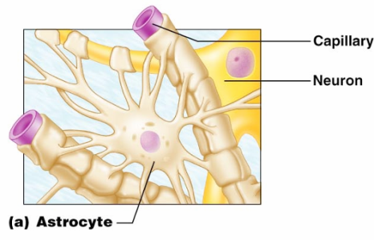
Astrocytes
Most abundant, versatile, and _
They cling to neurons and their synaptic endings, and _

Slide 9
Astrocytes
Functionally, they:
Support and _
_____________________________ neurons to their nutrient supplies
Guide _______________________________ of young neurons
Control the chemical environment

Slide 10
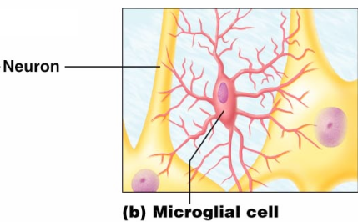
Microglia
Microglia
small, ________________________ with spiny processes
____________________________that monitor the health of neurons

Slide 11
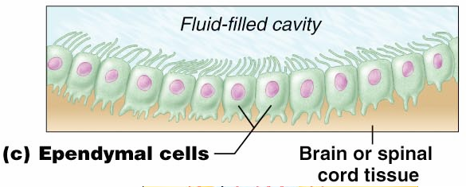
Ependymal Cells
Ependymal cells
range in shape from _
They line the ______________________________________ of the brain and spinal column

Slide 12
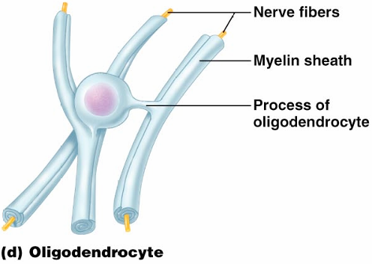
Oligodendrocytes,
Oligodendrocytes
branched cells that _

Slide 13
Schwann Cells, and Satellite Cells
Schwann cells
surround fibers of the _
surround neuron cell bodies _

Slide 14
Neurons
Structural units of the nervous system
Composed of a _
Long-lived, ________________________, and have a high metabolic rate
Their plasma membrane function in:
Cell-to-cell signaling during development

Slide 15
Nerve Cell Body: Soma
Contains the _
Is the major biosynthetic center
Is the focal point for the outgrowth of neuronal processes
Has well-developed ____________________: rough ER
Contains an _
cone-shaped area from which axons arise

Slide 16
Processes
Armlike extensions from the soma
Called __________________ in the _
Called __________________ in the _
There are two types:
Axons
Dendrites

Slide 17
Dendrites of Motor Neurons
Short, tapering, and _
They are the receptive regions of the neuron
input
_________________________________ are conveyed as graded potentials
not action potentials

Slide 18
Axons: Structure
Slender processes arising from the hillock
Long axons are called _
Usually there is only _
Rare branches, if present, are called axon collaterals
branched terminus of an axon

Slide 19
Axons: Function
__________________________________ action potentials
___________________________________ from the axonal terminals
Movement along axons occurs in two ways
toward axonal terminal
away from axonal terminal

Slide 20
Myelin Sheath
__________________________________ (protein-lipoid), segmented ____________________ around most long axons
It functions to:
___________________________________ fibers from one another
____________________________________________ of nerve impulse transmission

Slide 21
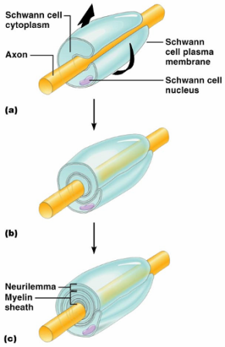
Myelin Sheath and Neurilemma
Formed by Schwann cells in the PNS
A Schwann cell:
Encloses the axon with its plasma membrane
Has concentric layers of membrane that make up the myelin sheath
remaining nucleus and cytoplasm of a Schwann cell

Slide 22
Nodes of Ranvier
___________________ in the myelin sheath between _
They are the sites where axon collaterals can emerge

Slide 23
Unmyelinated Axons
A Schwann cell surrounds nerve fibers but _
Schwann cells partially enclose 15 or more axons

Slide 24
Axons of the CNS
Both myelinated and unmyelinated fibers are present
Myelin sheaths are formed _
Nodes of Ranvier are _
There is no _

