Slide 1
Regions of the Brain and Spinal Cord
dense collections of _
mostly ______________________ and unmyelinated fibers

Slide 2
Neuron Classification
Structural:
three or more processes
two processes (axon and dendrite)
single, short process

Slide 3
Neuron Classification
Functional:
transmit impulses toward the CNS
carry impulses away from the CNS
shuttle signals through CNS pathways

Slide 4
Neurophysiology
Neurons are _
_______________________________, or nerve impulses, are:
_____________________________________ carried along the length of axons
The underlying functional feature of the nervous system

Slide 5
Electrical Current and the Body
Reflects the flow of ____________ rather than ____________________
There is a ___________________________ on either side of membranes when:
The number of ions is different across the membrane
The membrane provides a resistance to ion flow

Slide 6
Role of Ion Channels
Types of plasma membrane ion channels:
always open
open with binding of a specific neurotransmitter
open and close in response to membrane potential
Mechanically gated channels
open and close in response to physical deformation of receptors

Slide 7
Electrochemical Gradient
chemical gradient
_______________________ movement from an area of _
electrical gradient
________________________movement toward an area of _
Electrochemical gradient
the electrical and chemical _

Slide 8
Resting Membrane Potential (V_{r})
The potential _________________________ (–70 mV) across the membrane of a resting neuron
It is generated by different concentrations of Na⁺, K⁺, Cl⁻, and protein anions (A⁻)
Ionic differences are the consequence of:
Differential permeability of the neurilemma to Na⁺ and K⁺

Slide 9
Membrane Potentials: Signals
Membrane potential changes are produced by:
Changes in ___________________________________ to ions
Alterations of ion concentrations across the membrane
Types of signals
graded potentials and action potentials

Slide 10
Changes in Membrane Potential
Changes are caused by three events
the inside of the membrane becomes _
the membrane _____________________________ to its resting membrane potential
the inside of the membrane becomes _____________________________________________ than the resting potential

Slide 11
Graded Potentials
_____________________________________ in membrane potential
Magnitude varies directly with the strength of the stimulus
Sufficiently strong graded potentials _

Slide 12
Graded Potentials
Current is quickly dissipated _
Only travel over _

Slide 13
Action Potentials (APs)
A brief ____________________________________ with a total amplitude of 100 mV
Action potentials are _
do not decrease in strength over distance
principal means of neural communication
An action potential in the axon of a neuron is _

Slide 14
Action Potential: Resting State
________________________ channels are _
Leakage accounts for small movements of Na⁺ and K⁺
Each Na⁺ channel has two ______________________________ gates

Slide 15
Action Potential: Depolarization Phase
Na⁺ permeability increases; membrane potential reverses
____________________________________; K⁺ gates are closed
Threshold
a critical level of depolarization
At threshold, depolarization becomes _

Slide 16
Action Potential: Repolarization Phase
Sodium inactivation gates close
Membrane permeability to Na⁺ declines to resting levels
As sodium gates close, _
_______________________ the cell and internal negativity of the resting neuron is restored

Slide 17
Action Potential: Hyperpolarization
Potassium gates remain open, causing an _
This movement causes ____________________________________ of the membrane (undershoot)
The neuron is ____________________________________ and depolarization during this time

Slide 18
Action Potential: Role of the Sodium-Potassium Pump
Repolarization
__________________________________ electrical conditions of the neuron
Does not restore the _
Ionic redistribution back to resting conditions is restored by the _

Slide 19
Phases of the Action Potential
1 –
2 –
3 –
4 –

Slide 20
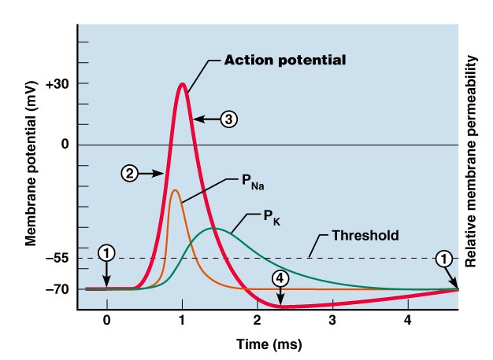
Phases of the Action Potential

Slide 21
Threshold and Action Potentials
Threshold
membrane is _
Established by the total amount of current flowing through the membrane
Subthreshold: _
______________________________: action potentials
___________________________________ phenomenon
action potentials either happen completely, or not at all

Slide 22
Coding for Stimulus Intensity
All action potentials are _________________ and are independent of stimulus intensity
Strong stimuli can generate an action potential ________________________ than weaker stimuli
The CNS determines stimulus intensity by _

Slide 23
Absolute Refractory Period
The ____________________________ period:
Prevents the neuron from generating an action potential
Ensures that each _
Enforces _________________________________ of nerve impulses

Slide 24
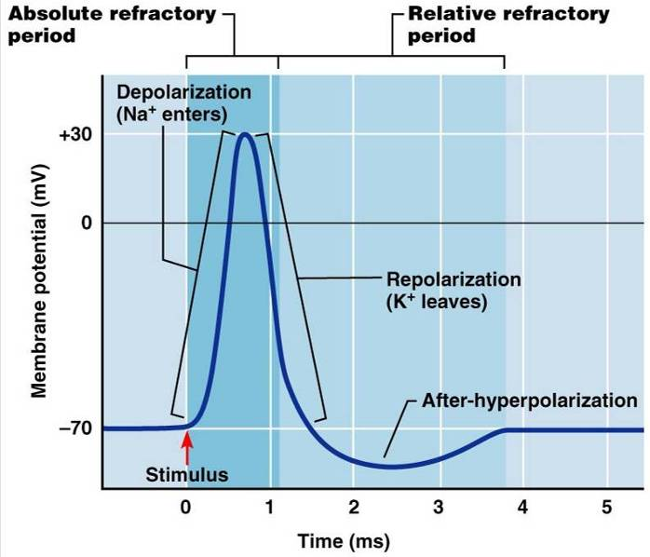
Absolute and Relative Refractory Periods

Slide 25
Relative Refractory Period
The interval following the absolute refractory period when _
The threshold level is elevated, allowing _____________________________________of action potential events

Slide 26
Conduction Velocities of Axons
Rate of impulse propagation is determined by:
the larger the diameter, the _
Presence of a _
myelination dramatically __________________________________ impulse speed

Slide 27
Saltatory Conduction
Current passes through a _
Voltage-gated Na⁺ channels are concentrated at these nodes
Action potentials are triggered only at the nodes and _
Much faster than conduction along unmyelinated axons

Slide 28
Nerve Fiber Classification
Nerve fibers are classified according to:

Slide 29
Synapses
A junction that mediates information transfer from one neuron:
To an _
Presynaptic neuron
conducts impulses _
Postsynaptic neuron
transmits impulses _

Slide 30
Synaptic Cleft
Fluid-filled space separating the presynaptic and postsynaptic neurons
Prevents nerve impulses from __________________________________ from one neuron to the next
Transmission across the synaptic cleft:
Is a ____________________________ event (as opposed to an electrical one)
Ensures unidirectional communication between neurons

Slide 31
Synaptic Cleft: Information Transfer
Nerve impulses reach the axonal terminal of the presynaptic neuron and _
Neurotransmitter is released into the synaptic cleft via _
Neurotransmitter crosses the synaptic cleft
binds to _
Postsynaptic membrane permeability changes, causing an _

Slide 32
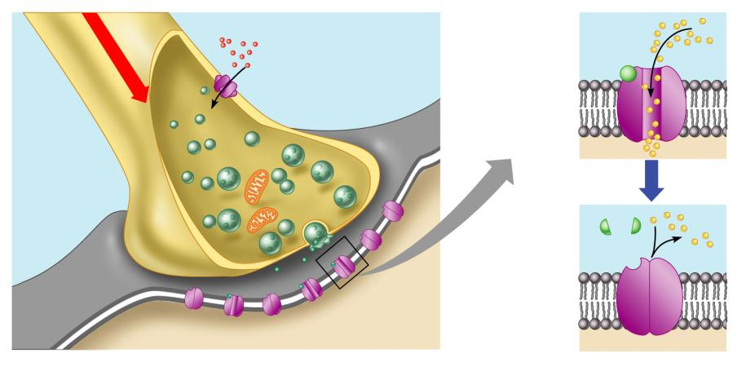
Synaptic Cleft: Information Transfer
Ca²⁺
Neurotransmitter
Na⁺
Action potential
Axon terminal of
presynaptic neuron
Receptor
1
Mitochondrion
Postsynaptic
membrane
Axon of
presynaptic
neuron
Postsynaptic
membrane
Ion channel open
Synaptic vesicles
containing
neurotransmitter
molecules
5
Degraded
neurotransmitter
2
Synaptic
cleft
3
4
Ion channel
(closed)
Ion channel closed
Ion channel (open)
Figure 11.18

Slide 33
Termination of Neurotransmitter Effects
Neurotransmitter bound to a postsynaptic receptor:
Produces a _
Blocks reception of additional “messages”
___________________________________ from its receptor
Removal of neurotransmitters occurs when they:
degraded by _
___________________________________________ by astrocytes or the presynaptic terminals
___________________________________ from the synaptic cleft

