Slide 1
Postsynaptic Potentials
Neurotransmitter receptors mediate changes in membrane potential according to:
The ____________________________ of neurotransmitter released
The amount of time the neurotransmitter is bound to receptors
The two types of postsynaptic potentials are:
EPSP –
IPSP –

Slide 2
Excitatory Postsynaptic Potentials
EPSPs are _____________________________ that _____________________________________ in an axon
Use only chemically gated channels
Na⁺ and K⁺ flow in _
_____________________________membranes _________________ generate action potentials

Slide 3
Inhibitory Synapses and IPSPs
Neurotransmitter binding to a receptor at ___________________________________:
Causes the membrane to become _
Leaves the charge on the inner surface negative
Reduces the postsynaptic neuron’s ability to produce an action potential

Slide 4
Summation
A ____________________ EPSP cannot induce an _
EPSPs must ______________________ temporally or spatially to induce an action potential
___________________________ summation
presynaptic neurons transmit impulses in _

Slide 5
Summation
Spatial summation
postsynaptic neuron is stimulated by a _________________________________________at the same time
________________________ can also ________________________with EPSPs, canceling each other out

Slide 6
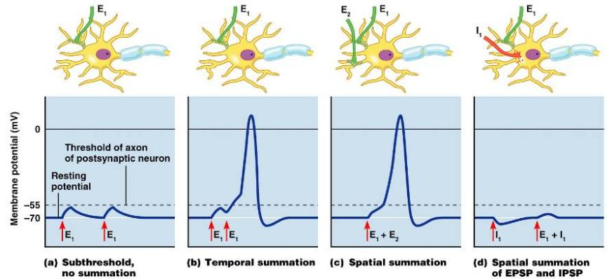
Summation

Slide 7
Neurotransmitters
Chemicals used for neuronal communication with the body and the brain
50 different neurotransmitters have been identified
Classified

Slide 8
Chemical Neurotransmitters
Biogenic amines
Amino acids
Novel messengers:
ATP
dissolved gases NO and CO

Slide 9
Neurotransmitters: Acetylcholine
______________ neurotransmitter identified, and best understood
Released at the _
____________________________________ and enclosed in synaptic vesicles

Slide 10
Neurotransmitters: Acetylcholine
Degraded by the ______________________ acetylcholinesterase (AChE)
Released by:
_____________________neurons in the ___________________________nervous system

Slide 11
Neurotransmitters: Biogenic Amines
Include:
dopamine, norepinephrine (NE), and epinephrine
serotonin and histamine
Broadly distributed in the brain
Play roles in ___________________________ and our biological clock

Slide 12
Neurotransmitters: Amino Acids
Include:
Gamma (γ)-aminobutyric acid
Glycine
Glutamate
Found only in the _

Slide 13
Neurotransmitters: Peptides
Include:
Substance P
mediator of _
Beta endorphin, dynorphin, and enkephalins
Act as ______________________________; reduce pain perception
Bind to the same receptors as opiates and morphine
Gut-brain peptides
somatostatin, and cholecystokinin

Slide 14
Neurotransmitters: Novel Messengers
ATP
Is found in _________________the CNS and PNS
Produces excitatory or inhibitory responses _
Provokes _

Slide 15
Neurotransmitters: Novel Messengers
Nitric oxide (NO)
Is involved in _
__________________________________ (CO) is a main regulator of cGMP in the brain

Slide 16
Functional Classification of Neurotransmitters
Two classifications: excitatory and inhibitory
Excitatory neurotransmitters _
glutamate
Inhibitory neurotransmitters _
GABA and glycine

Slide 17
Functional Classification of Neurotransmitters
Some neurotransmitters have ______________________ excitatory and inhibitory effects
Determined by the receptor type of the postsynaptic neuron
Example: acetylcholine
Excitatory at _
Inhibitory in _

Slide 18
Neurotransmitter Receptor Mechanisms
Direct: neurotransmitters that open ____________ channels
Promote _
Examples: ACh and amino acids
Indirect: neurotransmitters that act through _
Promote _
Examples: biogenic amines, peptides, and _

Slide 19
Neural Integration: Neuronal Pools
Functional groups of neurons that:
_________________________ incoming information
Forward the processed information to its _

Slide 20
Neural Integration: Neuronal Pools
Simple neuronal pool
Input fiber
neurons most closely associated with the incoming fiber
neurons farther away from incoming fiber

Slide 21
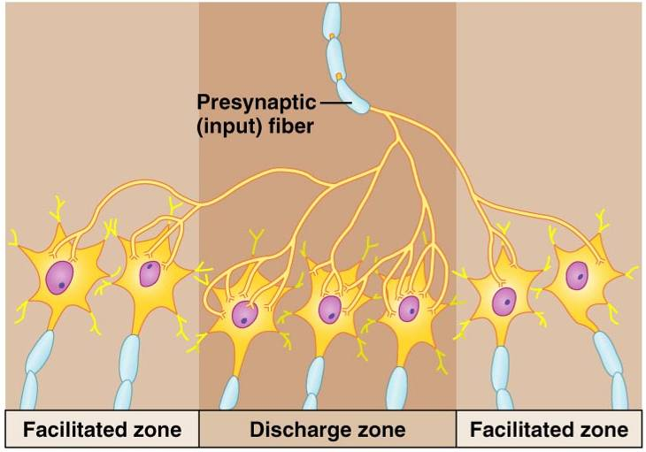
Simple Neuronal Pool

Slide 22
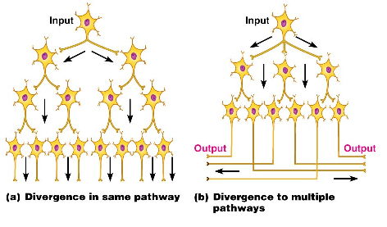
Types of Circuits in Neuronal Pools
one incoming fiber stimulates ever increasing number of fibers, often _

Slide 23
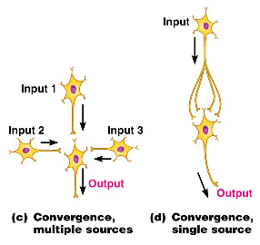
Types of Circuits in Neuronal Pools
opposite of divergent circuits, resulting in either _

Slide 24
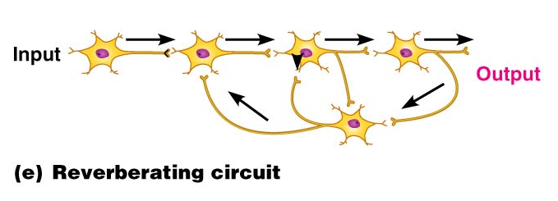
Types of Circuits in Neuronal Pools
chain of neurons containing collateral ________________________________________ in the chain

Slide 25
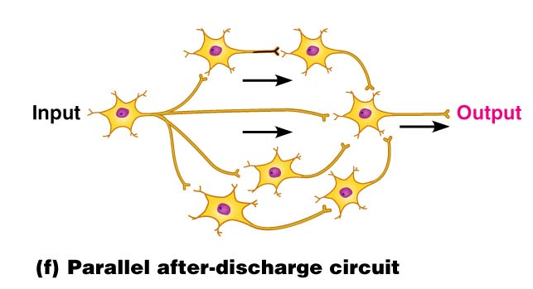
Types of Circuits in Neuronal Pools
Parallel after-discharge
incoming neurons stimulate _

Slide 26
Patterns of Neural Processing
Serial Processing
Input travels along one pathway to a specific destination
Works in an _
Example: _

Slide 27
Patterns of Neural Processing
Parallel Processing
Input travels along _
Pathways are integrated in different CNS systems
One stimulus promotes _
Example: a ________________________may remind one of the odor and _

Slide 28
Chapter 12

Slide 29
Central Nervous System (CNS)
CNS – composed of the _
Elaboration of the anterior portion of the CNS
Increase in __________________________________ in the head
Highest level is reached in the human brain

Slide 30
The Brain
Composed of _
Surface anatomy includes
Brain stem

Slide 31
Adult Brain Structures
cerebrum: cortex, white matter, and basal nuclei
thalamus, hypothalamus, and epithalamus
Mesencephalon
brain stem: _
Metencephalon
brain stem: _
Myelencephalon
brain stem: _

Slide 32
Basic Pattern of the Central Nervous System
Spinal Cord
____________________________ surrounded by a _
Gray matter is surrounded by _
Brain
Similar to spinal cord but with _
Cerebellum has _
Cerebrum has nuclei and additional gray matter in the cortex

Slide 33
Ventricles of the Brain
Arise from expansion of the ___________________ of the _
The ventricles are:
The _
The third ventricle found in the diencephalon
The fourth ventricle found in the hindbrain dorsal to the pons

