Slide 1
Cerebral Hemispheres
Contains _
and shallow _
Contain _
Are separated by the longitudinal fissure
Have three basic regions:

Slide 2
Major Lobes, Gyri, and Sulci of the Cerebral Hemisphere
Deep sulci divide the hemispheres into five lobes:
Central sulcus
separates the _

Slide 3
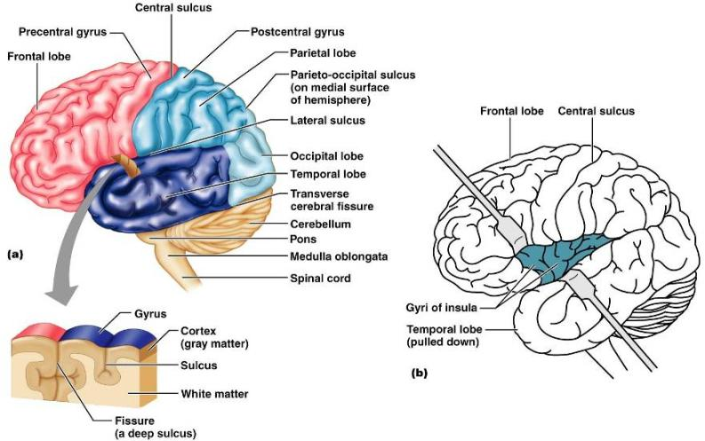
Brain Lobes

Slide 4
Major Lobes, Gyri, and Sulci of the Cerebral Hemisphere
Parieto-occipital sulcus
separates the _
Lateral sulcus
separates the _
The ___________________________ and ________________________ gyri border the central sulcus

Slide 5
Cerebral Cortex
The cortex
accounts for 40% of the mass of the brain
It enables sensation, communication, memory, understanding, and voluntary movements
Each hemisphere acts _____________________________________________ (controls the opposite side of the body)
Hemispheres are not equal in function
No functional area acts alone; conscious behavior involves the _

Slide 6
Functional Areas of the Cerebral Cortex
The three types of functional areas are:
control ____________________________________ movement
conscious awareness of _
Association areas
____________________________________________ diverse information

Slide 7
Cerebral Cortex: Motor Areas
Primary (somatic) motor cortex
Frontal eye field

Slide 8
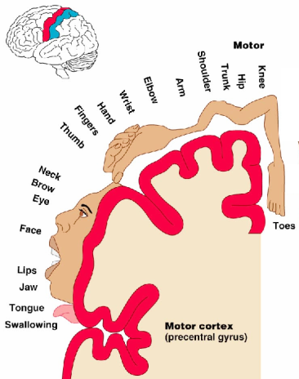
Primary Motor Cortex
Located in the _
_____________________ whose axons make up the corticospinal tracts
Allows conscious control of precise, _

Slide 9
Premotor Cortex
Located _____________________________ to the precentral gyrus
Controls learned, repetitious, or _
Coordinates simultaneous or sequential actions
Involved in the _

Slide 10
Broca’s Area
Located anterior to the inferior region of the premotor area
Present in one hemisphere _
A ______________________________________ area that directs muscles of the _
Is active as one prepares to speak

Slide 11
Frontal Eye Field
Frontal eye field
Located anterior to the premotor cortex and superior to Broca’s area
Controls _

Slide 12
Sensory Areas
Somatosensory association cortex
Olfactory, gustatory, and vestibular cortices

Slide 13
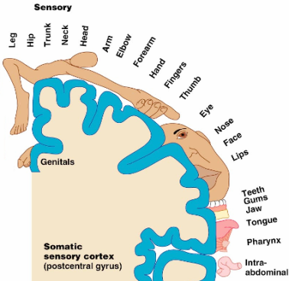
PrImary Somatosensory Cortex
Located in the postcentral gyrus, this area:
____________________ information from the skin and skeletal muscles
Exhibits _

Slide 14
Somatosensory Association Cortex
Located posterior to the primary somatosensory cortex
_______________________________ sensory information
Forms _____________________________________ understanding of the stimulus
Determines size, texture, and ________________________________________ of parts

Slide 15
Visual Areas
Primary visual (____________________) cortex
Seen on the extreme posterior tip of the _
Most of it is buried in the calcarine sulcus
Receives visual information from the _
Visual association area
___________________________________ the primary visual cortex
________________________________________ visual stimuli (e.g., color, form, and movement)

Slide 16
Auditory Areas
Primary auditory cortex
Located at the superior margin of the _
Receives information related to _
Auditory association area
Located posterior to the primary auditory cortex
Stores memories of sounds and permits perception of sounds

Slide 17
Association Areas
Prefrontal cortex
General (common) interpretation area

Slide 18
Prefrontal Cortex
Located in the anterior portion of the _
Involved with __________________________, cognition, recall, and _
Necessary for _________________________, reasoning, persistence, and conscience
Closely linked to the ______________________________ system (emotional part of the brain)

Slide 19
Cerebellar Cognitive Function
Plays a role in _
Recognizes and predicts sequences of events

Slide 20
Language Areas
Located in a large area surrounding the left (or language-dominant) lateral sulcus
Major parts and functions:
Wernicke’s area
Broca’s area
Lateral prefrontal cortex
Lateral and ventral temporal lobe

Slide 21
General (Common) Interpretation Area
Ill-defined region including parts of the temporal, parietal, and occipital lobes
Found in one hemisphere, usually the _
____________________________________ incoming signals into a single thought
Involved in processing spatial relationships

Slide 22
Visceral Association Area
Located in the cortex of the insula
Involved in _

Slide 23
Lateralization of Cortical Function
Lateralization
each hemisphere has abilities _____________________________________________ with its partner
Cerebral dominance
designates the hemisphere _
Left hemisphere
controls _
Right hemisphere
controls visual-spatial skills, _

Slide 24
Cerebral White Matter
Consists of deep _____________________________________ and their tracts
It is responsible for communication between:
The ___________________________________ and lower CNS center, and areas of the cerebrum

Slide 25
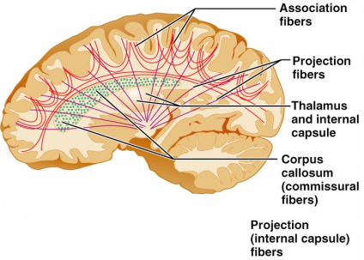
Cerebral White Matter
Types include:
connect corresponding gray areas of the two hemispheres
Association fibers
connect _
enter the hemispheres from lower brain or cord centers

Slide 26
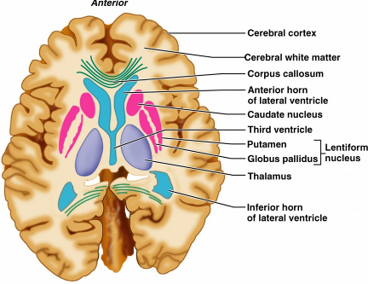
Basal Nuclei
Masses of _______________________________________ found deep within the _
The _______________________________________ is composed of three parts
Caudate nucleus
Lentiform nucleus
composed of the putamen and the globus pallidus
Fibers of internal capsule running between and through caudate and lentiform nuclei

Slide 27
Functions of Basal Nuclei
the following are thought to be functions of basal nuclei
Influence _
Regulate ________________________________ and cognition
Regulate intensity of slow or stereotyped movements
Inhibit antagonistic and _

Slide 28
Diencephalon
Consists of three paired structures –
thalamus, hypothalamus, and epithalamus
Encloses the _

Slide 29
Thalamus
Paired, ______________________________ that form the superolateral walls of the third ventricle
Contains four groups of _
anterior, ventral, dorsal, and posterior
Nuclei _____________________________________ from the cerebral cortex

Slide 30
Thalamic Function
___________________________________ impulses _____________________________ in the thalamus
Impulses of similar function are sorted out, edited, and _
All inputs ascending to the cerebral cortex pass through the thalamus
Mediates sensation, motor activities, cortical arousal, learning, and memory

