Slide 1
Hypothalamus
Located ___________________________________, it caps the brainstem and forms the inferolateral walls of the third ventricle
Mammillary bodies
Small, paired nuclei bulging anteriorly from the hypothalamus
Infundibulum
______________________________________________; connects to the pituitary gland
Main ___________________________________________________ of the body

Slide 2
Hypothalamic Function
Regulates _
rate and force of _
_____________________________________ motility
rate and depth of breathing
many other visceral activities
Perception of pleasure, fear, and rage
Maintains normal _
Regulates feelings of hunger and satiety
Regulates sleep and the _

Slide 3
Endocrine Functions of the Hypothalamus
Releasing hormones control secretion of hormones by the _

Slide 4
Epithalamus
Most dorsal portion of the diencephalon; forms roof of the third ventricle
extends from the posterior border and secretes _
a hormone involved with sleep regulation, sleep-wake cycles, and mood
a structure that secretes _

Slide 5
Brain Stem
Consists of three regions
Similar to spinal cord
but contains _
Controls ___________________________________ behaviors necessary for survival
Provides the pathway for tracts between higher and lower brain centers

Slide 6
Midbrain
Located between the diencephalon and the pons
Midbrain structures include:
two bulging structures that contain descending pyramidal motor tracts
hollow tube that connects the _
Various nuclei

Slide 7
Pons
____________________________________ between the midbrain and the medulla oblongata
Fibers of the pons:
Connect higher brain centers and the _
______________________________________ between the motor cortex and the cerebellum

Slide 8
Pons
Origin of _
V
VI abducens
VII

Slide 9
Medulla Oblongata
Most __________________________________ of the brain stem
Contains a _______________________________ of the fourth ventricle
Pyramids
two longitudinal ridges formed by _
____________________________________ of the pyramids
___________________________________________ of the corticospinal tracts

Slide 10
The Cerebellum
Located dorsal to the pons and medulla
Protrudes under the occipital lobes of the cerebrum
Makes up 11% of the brain’s mass
Provides _
Cerebellar activity occurs _

Slide 11
Cerebellar Cognitive Function
Plays a role in language and problem solving
Recognizes and predicts sequences of events

Slide 12
Consciousness
Encompasses _____________________________________, voluntary initiation and control of movement, and capabilities associated with _
Involves simultaneous activity of large areas of the cerebral cortex
Is superimposed on other types of neural activity

Slide 13
Consciousness
Is holistic and totally _
Clinical consciousness is defined on a continuum that grades levels of behavior

Slide 14
Protection of the Brain
The brain is protected by _
Harmful substances are shielded from the brain by the _

Slide 15
Meninges
Three ________________________________ membranes lie external to the CNS
dura mater, arachnoid mater, and pia mater
Functions of the meninges
Cover and protect the CNS
Protect blood vessels and _
Contain _
Form partitions within the skull

Slide 16
Dura Mater
Leathery, _____________________________ covering composed of two fibrous connective tissue layers
The two layers ________________________ in certain areas and form _

Slide 17
Dura Mater
Three dural septa extend inward and _____________________________________ of the brain
Falx _
fold that dips into the _
Falx _
runs along the _
Tentorium cerebelli
horizontal dural fold extends into the _

Slide 18
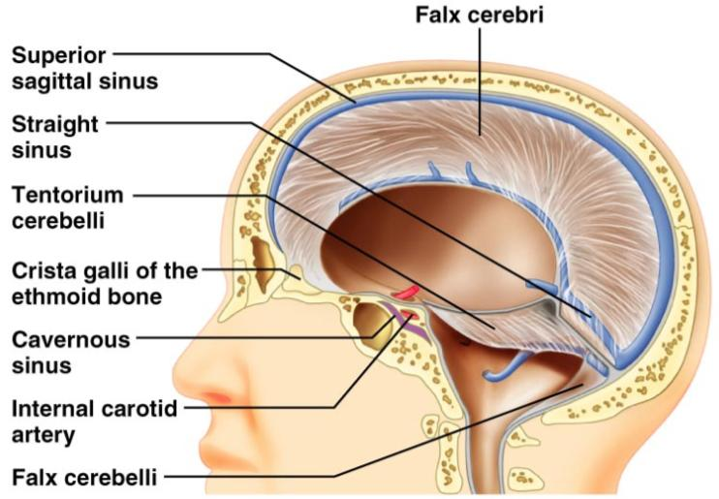
Dura Mater
Figure 12.25

Slide 19
Arachnoid Mater
forms a _______________________ brain covering
It is separated from the dura mater by the _______________________________ space
Beneath the arachnoid is a wide subarachnoid space filled with CSF and large blood vessels
Arachnoid _____________________ protrude superiorly and permit CSF _

Slide 20
Pia Mater
Deep layer composed of __________________________________ connective tissue that clings tightly to the brain

Slide 21
Cerebrospinal Fluid (CSF)
Watery solution similar in composition to _
Forms a _________________________________ that gives _______________________________ to the CNS organs

Slide 22
Cerebrospinal Fluid (CSF)
Prevents the brain from _
Protects the CNS from blows and other trauma
_____________________________________ the brain and carries chemical signals throughout it

Slide 23
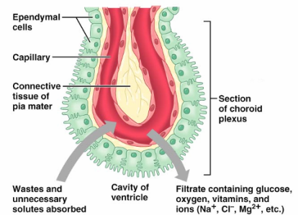
Choroid Plexuses
Clusters of ____________________________ that form tissue fluid filters, which hang from the roof of each ventricle
Help cleanse CSF by _

Slide 24
Blood-Brain Barrier
Protective mechanism that helps maintain a stable environment for the brain
Bloodborne substances are separated from neurons by:
Relatively _______________________ basal lamina
Bulbous feet of _

Slide 25
Blood-Brain Barrier: Functions
__________________________________ barrier that allows nutrients to pass freely
Is ineffective against substances that can diffuse through plasma membranes
______________________________________ in some areas (______________________________________ and the hypothalamus), allowing these areas to monitor the chemical composition of the blood
___________________________________ increases the ability of chemicals to pass through the blood-brain barrier

