Slide 1
From Sensation to Perception
Survival depends upon sensation and perception
Sensation
the _________________________________________in the internal and external environment
Perception
the conscious _______________________________________ of those stimuli

Slide 2
Organization of the Somatosensory System
Input comes from exteroceptors, proprioceptors, and interoceptors
The three main levels of neural integration in the somatosensory system are:
the sensor receptors
ascending pathways
neuronal circuits in the cerebral cortex

Slide 3
Adaptation of Sensory Receptors
___________________________________ occurs when sensory receptors are subjected to an _
Receptor membranes become _
Receptor potentials decline in frequency or stop

Slide 4
Adaptation of Sensory Receptors
Receptors responding to _____________________________________ adapt quickly
Receptors responding slowly include Merkel’s discs, Ruffini’s corpuscles, and interoceptors that respond to chemical levels in the blood
_____________________________________and proprioceptors do not exhibit adaptation

Slide 5
Processing at the Circuit Level
Chains of three neurons conduct sensory impulses upward to the brain
soma reside in dorsal root or cranial ganglia, and conduct impulses _
_______________________________neurons
soma reside in the dorsal horn of the spinal cord or medullary nuclei and transmit impulses _
located in the thalamus and conduct impulses to the somatosensory _

Slide 6
Main Aspects of Sensory Perception
detecting that a stimulus has occurred and requires summation
Magnitude estimation
how much of a stimulus is acting
identifying the site or pattern of the stimulus

Slide 7
Main Aspects of Sensory Perception
Feature abstraction
used to identify a substance that has _
Quality discrimination
the ability to identify ______________________________________ of a sensation (e.g., sweet or sour tastes)
ability to recognize patterns in stimuli (e.g., melody, familiar face)

Slide 8
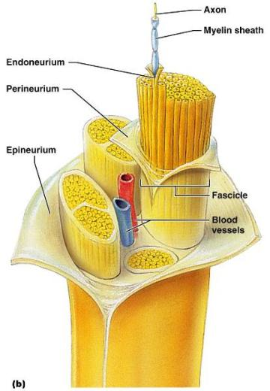
Structure of a Nerve
Nerve
cordlike organ of the PNS consisting of _
Connective tissue coverings include:
_____________________________– loose connective tissue that surrounds axons
_____________________________ coarse connective tissue that bundles fibers into fascicles
_____________________________tough fibrous sheath around a nerve

Slide 9
Classification of Nerves
Sensory and motor divisions
Sensory (afferent)
Motor (efferent)
Mixed

Slide 10
Peripheral Nerves
Mixed nerves
carry ____________________________________ (visceral) impulses
The _____________________________ of mixed nerves are:
Somatic afferent and somatic efferent
Visceral afferent and visceral efferent
Peripheral nerves originate from the brain or spinal column

Slide 11
Regeneration of Nerve Fibers
Damage to nerve tissue is serious _
If the _____________________________ of a damaged nerve remains intact, damage can be repaired
Regeneration involves coordinated activity among:
______________________________________– remove debris
Schwann cells – form regeneration tube and secrete growth factors
__________________________________________– regenerate damaged part

Slide 12
Cranial Nerves
____________________________________ of cranial nerves arise from the brain
They have sensory, motor, or both sensory and motor functions
Each nerve is identified by a ____________________________ (I through XII) and a _
Four cranial nerves carry ______________________________________ that serve muscles and glands

Slide 13
Cranial Nerve I: Olfactory
Arises from the _
Passes through the cribiform plate of the ethmoid bone
Fibers run through the _____________________________________ and terminate in the primary olfactory cortex
Functions solely by carrying _

Slide 14
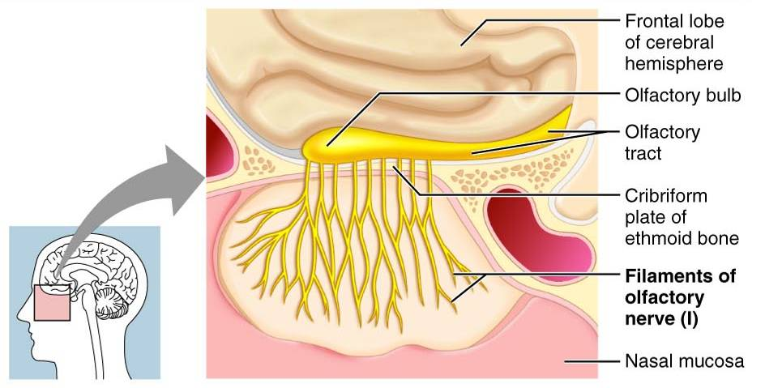
Cranial Nerve I: Olfactory

Slide 15
Cranial Nerve II: Optic
Arises from the _
Optic nerves pass through the optic canals and ______________________________ at the _
They continue to the _________________________________ where they synapse
From there, the _______________________________________ run to the visual cortex
Functions solely by carrying afferent impulses for vision

Slide 16
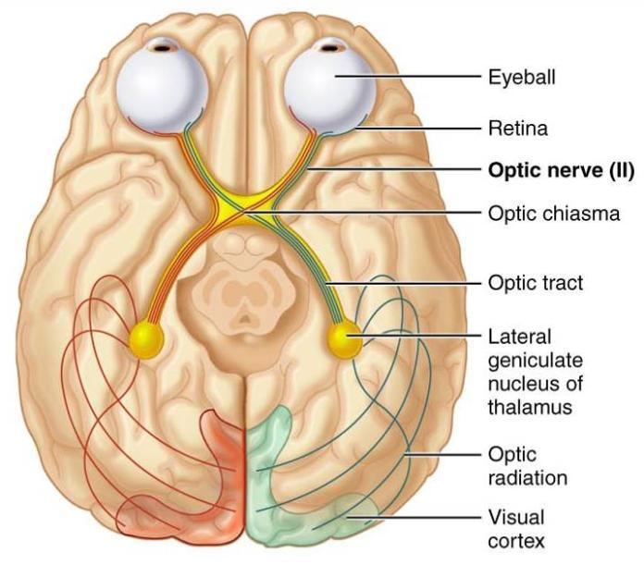
Cranial Nerve II: Optic

Slide 17
Cranial Nerve III: Oculomotor
Fibers extend from the ventral midbrain, pass through the superior orbital fissure, and go to the _
Functions in ____________________________________, directing the eyeball, _______________________________________, and controlling lens shape
Parasympathetic cell bodies are in the ciliary ganglia

Slide 18
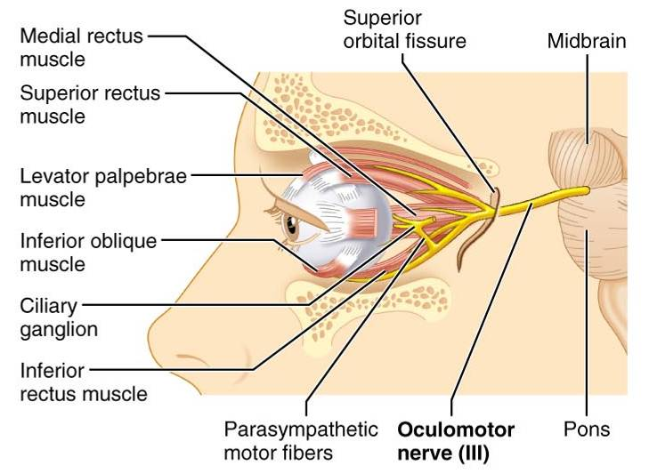
Cranial Nerve III: Oculomotor

Slide 19
Cranial Nerve IV: Trochlear
Fibers emerge from the dorsal midbrain and enter the orbits via the _____________________________________; innervate the _
Primarily a motor nerve that directs the eyeball

Slide 20
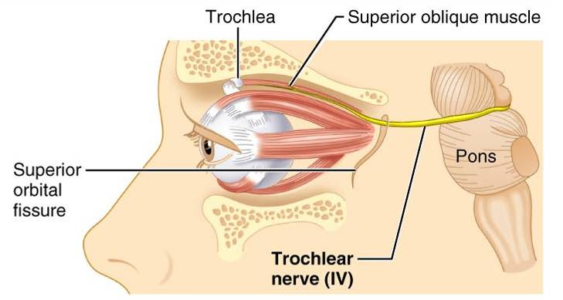
Cranial Nerve IV: Trochlear

Slide 21
Cranial Nerve V: Trigeminal
Three divisions:
Conveys sensory impulses from various areas of the face (V₁) and (V₂), and supplies motor fibers (V₃) for _

Slide 22
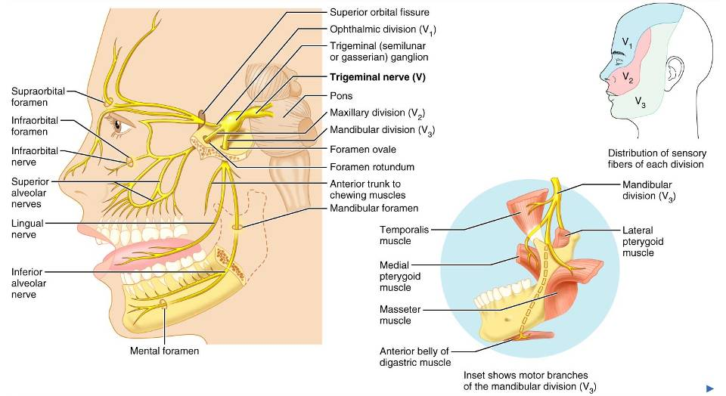
Cranial Nerve V: Trigeminal

Slide 23
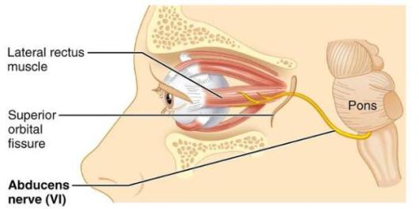
Cranial Nerve VI: Abdcuens
Fibers leave the inferior pons and enter the orbit via the superior orbital fissure
Primarily a ____________________________innervating the _

Slide 24
Cranial Nerve VII: Facial
Fibers leave the pons, travel through the _____________________________________, and emerge through the stylomastoid foramen to the lateral aspect of the face
_____________________________________ with five major branches
Motor functions ____________________________________, and the transmittal of autonomic impulses to lacrimal and salivary glands
Sensory function is __________________________ from the anterior two-thirds of the tongue

Slide 25
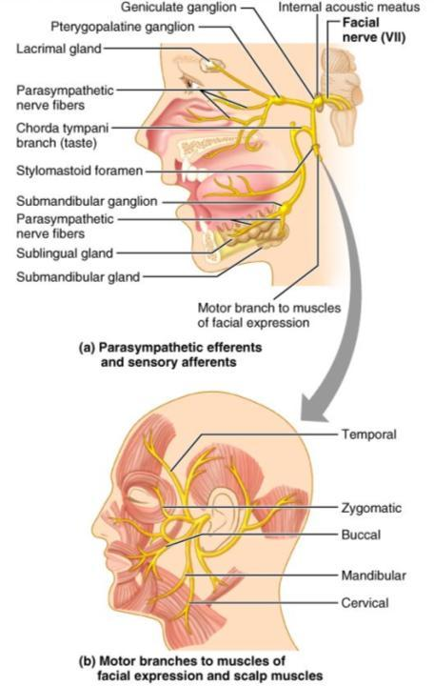
Cranial Nerve VII: Facial

Slide 26
Cranial Nerve VIII: Vestibulocochlear
Fibers arise from the hearing and equilibrium apparatus of the inner ear, pass through the internal acoustic meatus, and enter the brainstem at the pons-medulla border
Two divisions
Functions are solely sensory

Slide 27
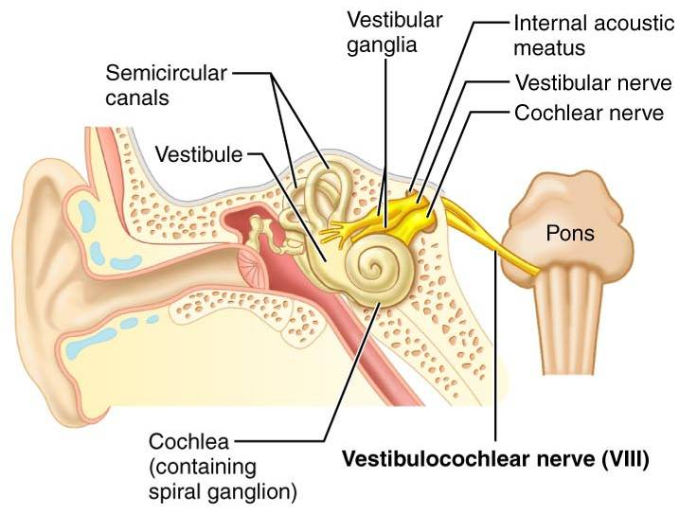
Cranial Nerve VIII: Vestibulocochlear

Slide 28
Cranial Nerve IX: Glossopharyngeal
Fibers emerge from the medulla, leave the skull via the jugular foramen, and run to the _
Nerve IX is a ________________________________ with motor and sensory functions
Motor
innervates part of the ______________________________________________, and provides motor fibers to the parotid salivary gland
Sensory
fibers conduct ___________________________________ and general sensory impulses from the _

Slide 29
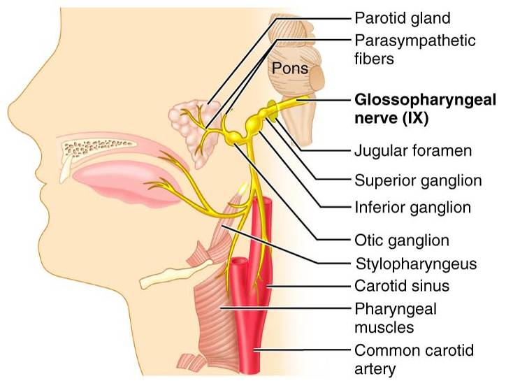
Cranial Nerve IX: Glossopharyngeal

Slide 30
Cranial Nerve X: Vagus
The _________________________ cranial nerve that extends _
Fibers emerge from the medulla via the jugular foramen
The vagus is a _
Most motor fibers are _____________________________________ to the heart, lungs, and visceral organs
Its sensory function is in _

Slide 31
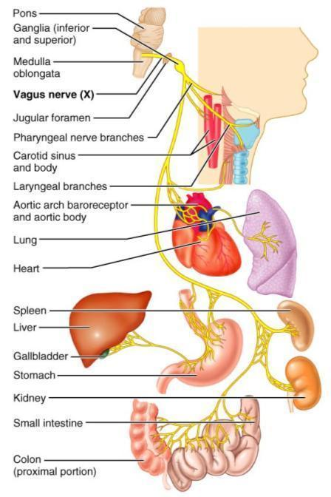
Cranial Nerve X: Vagus

Slide 32
Cranial Nerve XI: Accessory
Formed from a cranial root emerging from the medulla _____________a __________________________________ arising from the superior region of the spinal cord
The spinal root passes upward into the cranium via the foramen magnum
The accessory nerve leaves the cranium via the jugular foramen

Slide 33
Cranial Nerve XI: Accessory
Primarily a motor nerve
Supplies fibers to the _
Innervates the _________________________________________________________________________________, which move the head and neck

Slide 34
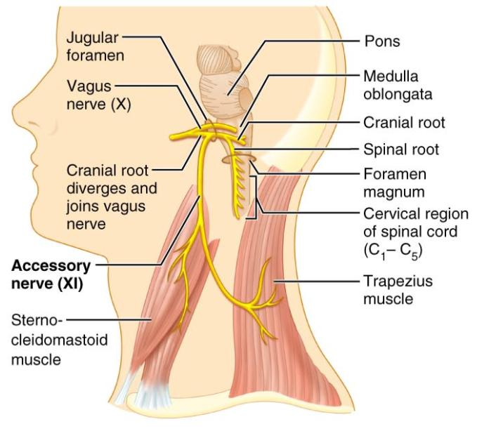
Cranial Nerve XI: Accessory

Slide 35
Cranial Nerve XII: Hypoglossal
Fibers arise from the medulla and exit the skull via the _
Innervates both _____________________________________ of the tongue, which contribute to _

Slide 36
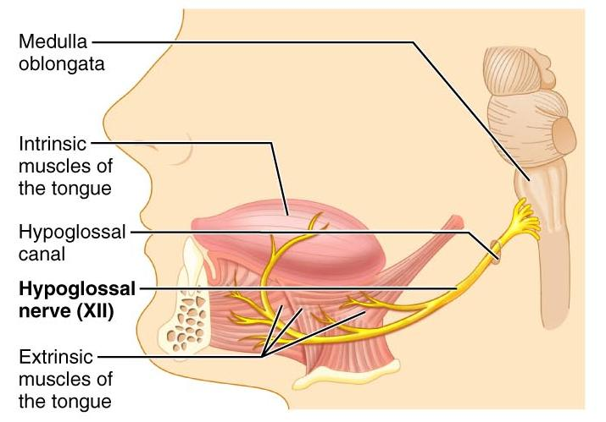
Cranial Nerve XII: Hypoglossal

Slide 37
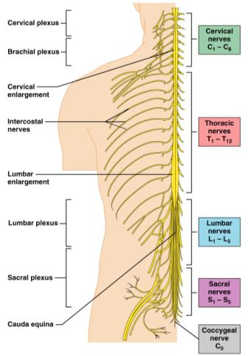
Spinal Nerves
Thirty-one pairs of mixed nerves arise from the spinal cord and supply _
They are named according to their point of issue
8 cervical (C₁-C₈)
12 thoracic (T₁-T₁₂)
5 Lumbar (L₁-L₅)
5 Sacral (S₁-S₅)
1 Coccygeal (C₀)

Slide 38
Spinal Nerves: Roots
Each spinal nerve connects to the spinal cord via _
Each root forms a series of rootlets that attach to the spinal cord
____________________________________ arise from the _________________________________and contain _
Dorsal roots arise from _______________________________________ in the dorsal root ganglion and contain sensory (afferent) fibers

Slide 39
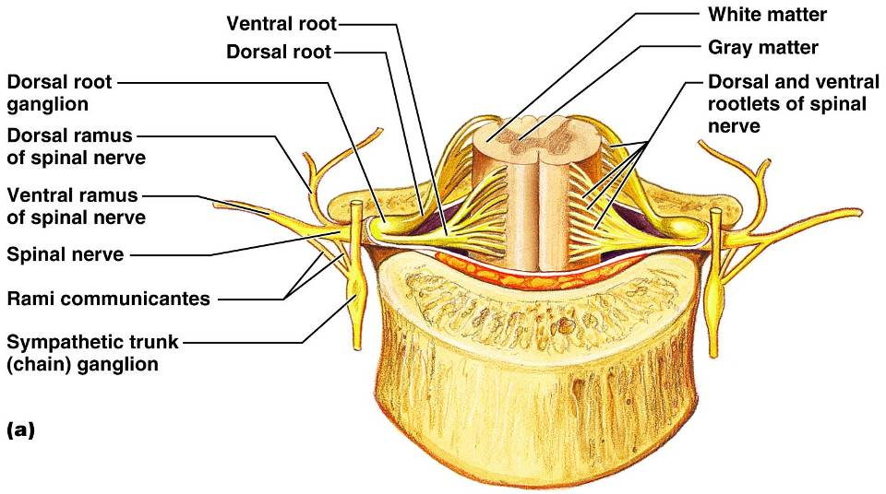
Spinal Nerves: Roots

Slide 40
Spinal Nerves: Rami
The short spinal nerves branch into three or four mixed, distal rami
Tiny _
Rami communicantes at the base of the ventral rami in the thoracic region

