Slide 1
Nerve Plexuses
All ventral rami except T₂-T₁₂ form interlacing nerve ___________________________called _
Plexuses are found in the cervical, brachial, lumbar, and sacral regions
Each resulting branch of a plexus contains _

Slide 2
Nerve Plexuses
Fibers travel to the periphery via several different routes
Each muscle receives a nerve supply _
Damage to _____________________________________ cannot completely paralyze a muscle

Slide 3
Spinal Nerve Innervation:
The back is innervated by ______________________________ via several branches
The thorax is innervated by _________________________________ T₁-T₁₂ as intercostal nerves
Intercostal nerves supply muscles of the ribs, anterolateral thorax, and abdominal wall

Slide 4
Cervical Plexus
The __________________________________ is formed by ventral rami of C₁-C₄
Most branches are ________________________________ nerves of the neck, ear, back of head, and shoulders
The most important nerve of this plexus is the _
The phrenic nerve is the major _

Slide 5
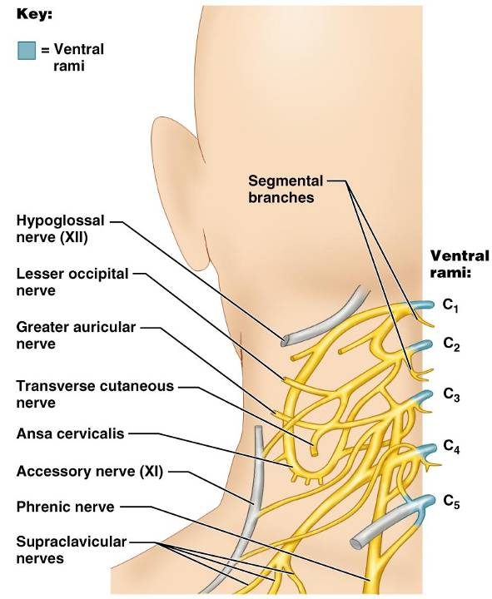
Cervical Plexus

Slide 6
Brachial Plexus
Formed by C₅-C₈ and T₁ (C₄ and T₂ may also contribute to this plexus)
It gives rise to the _

Slide 7
Brachial Plexus
There are four major branches of this plexus
_______________________________________ – five ventral rami (C₅-T₁)
_______________________________________– upper, middle, and lower, which form divisions
_______________________________________– anterior and posterior serve the front and back of the limb
_______________________________________– lateral, medial, and posterior fiber bundles

Slide 8
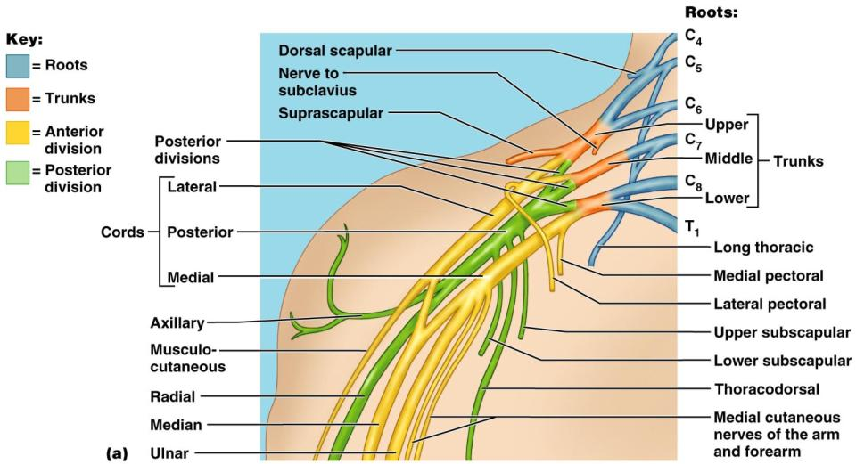
Brachial Plexus

Slide 9
Brachial Plexus: Nerves
Axillary
Musculocutaneous
sends fibers to the biceps brachii and brachialis
branches to most of the flexor muscles of arm
supplies the flexor carpi ulnaris and part of the flexor digitorum profundus
Radial
innervates essentially all _

Slide 10
Lumbar Plexus
Arises from L₁-L₄ and innervates the _
The major nerves are the _

Slide 11
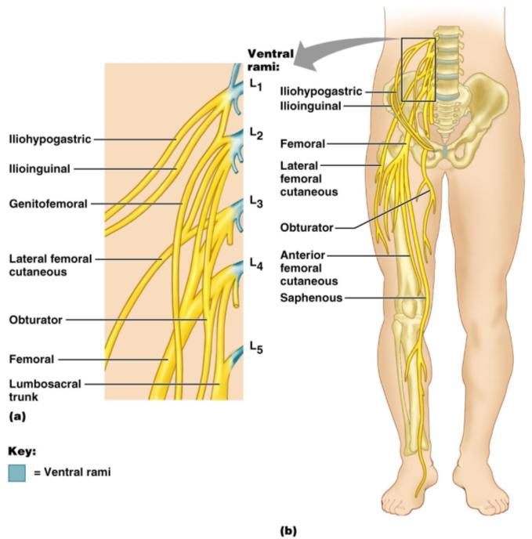
Lumbar Plexus
Figure 13.10

Slide 12
Sacral Plexus
Arises from L₄-S₄ and serves the buttock, lower limb, pelvic structures, and the perineum
The major nerve is the _
The sciatic is actually composed of two nerves:

Slide 13
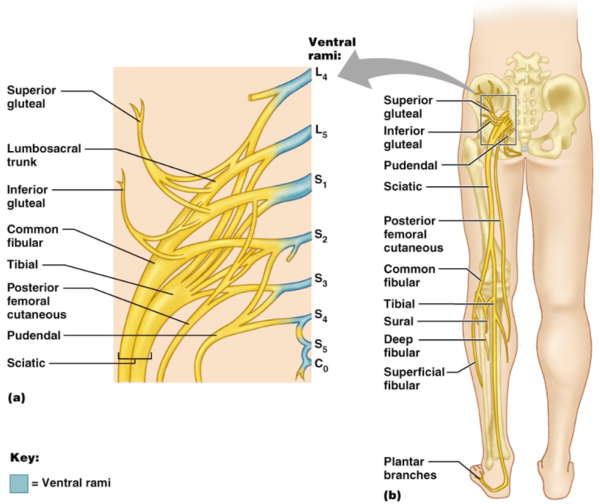
Sacral Plexus

Slide 14
Innervation of Joints
Hilton’s law: any nerve serving a muscle that produces _____________________________ at a joint also innervates the _

Slide 15
Reflexes
A reflex is a _
Reflexes may:
Be inborn _
Involve only peripheral nerves and the _
Involve higher brain centers as well

Slide 16
Reflex Arc
There are five components of a reflex arc
site of stimulus
transmits the afferent impulse to the CNS
either monosynaptic or polysynaptic region within the CNS
conducts efferent impulses from the integration center to an effector
muscle fiber or gland that responds to the efferent impulse

Slide 17
Reflex Arc
Figure 13.14

Slide 18
Stretch and Deep Tendon Reflexes
For skeletal muscles to perform normally:
The Golgi tendon organs (_______________________________________) must constantly inform the brain as to the state of the muscle
Stretch reflexes initiated by muscle spindles must maintain healthy _

Slide 19
Muscle Spindles
Muscle spindles are wrapped with ______________________________________: primary sensory endings of type Ia fibers and secondary sensory endings of type II fibers
These regions are innervated by gamma (γ) efferent fibers
Note: contractile muscle fibers are extrafusal fibers and are innervated by alpha (α) efferent fibers

Slide 20
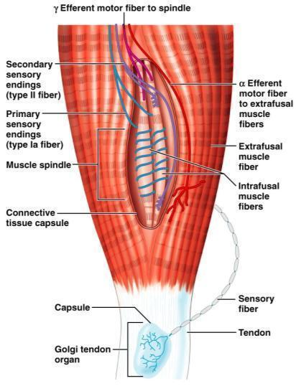
Muscle Spindles
Figure 13.15

Slide 21
Operation of the Muscle Spindles
__________________________________ the muscles activates the muscle spindle
There is an _________________________________________________________________________________ in Ia fibers
___________________________________ the muscle ________________________________________on the muscle spindle
There is a decreased rate of action potential on Ia fibers

Slide 22
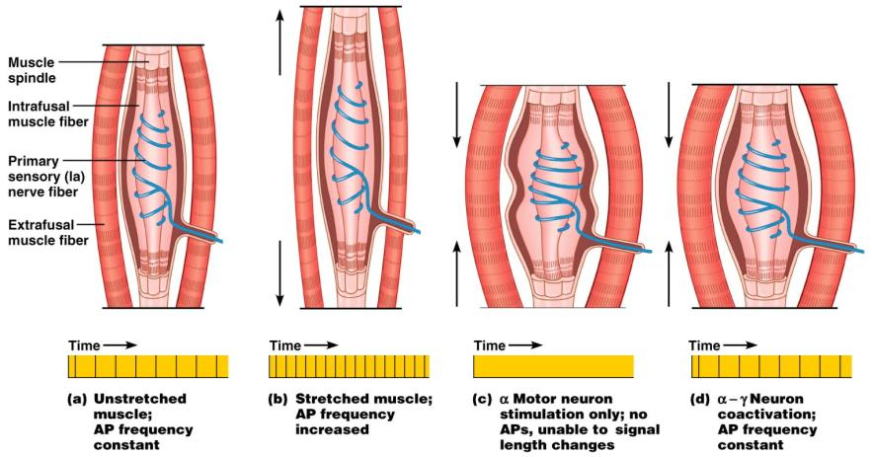
Operation of the Muscle Spindle
Figure 13.17

Slide 23
Stretch Reflex
Stretching the muscle _
Excited γ motor neurons of the spindle cause the stretched muscle to contract
Afferent impulses from the spindle result in inhibition of the antagonist
Example:
Tapping the patellar tendon _
The quadriceps contract and the _

Slide 24
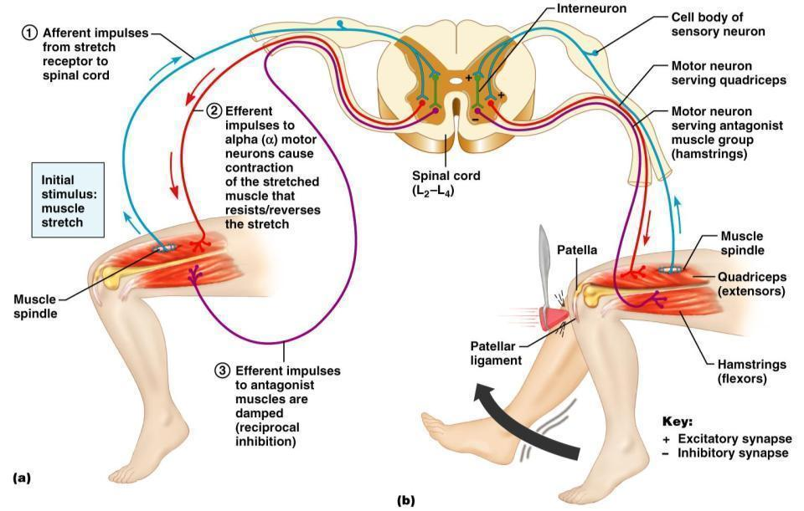
Stretch Reflex

Slide 25
Golgi Tendon Reflex
The _____________________________ of the stretch reflex
____________________________________ the muscle _
Afferent Golgi tendon neurons are stimulated, neurons inhibit the contracting muscle, and the antagonistic muscle is activated
As a result, the contracting muscle relaxes and the antagonist contracts

Slide 26
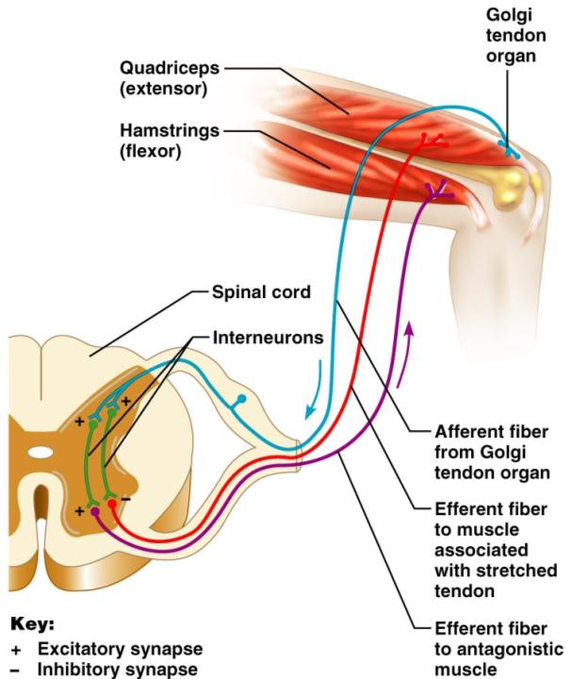
Golgi Tendon Reflex

Slide 27
Flexor and Crossed Extensor Reflexes
_____________________________________ is initiated by a _________________________ stimulus (actual or perceived) that causes automatic _____________________________________ of the threatened body part
The crossed extensor reflex has two parts
The stimulated side is _
The _

Slide 28
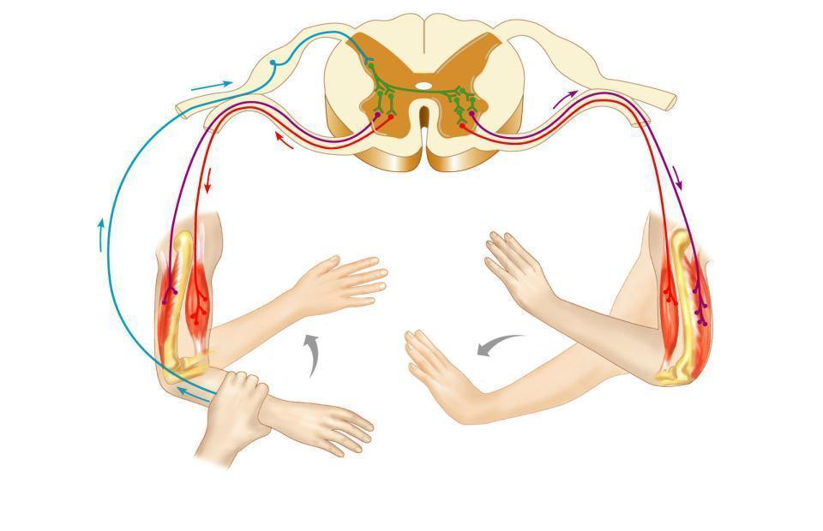
Crossed Extensor Reflex
+
Interneurons
+
–
+
+
–
Afferent
fiber
Efferent
fibers
Efferent
fibers
Extensor
inhibited
Flexor
inhibited
Flexor
stimulated
Flexes
Arm movements
Extensor
stimulated
Extends
Key:
+ Excitatory synapse
– Inhibitory synapse
Right arm
(site of stimulus)
Left arm (site of
reciprocal activation)

Slide 29
Superficial Reflexes
Initiated by gentle ___________________________________ stimulation
Example:
__________________________________________ is initiated by stimulating the lateral aspect of the sole of the foot
The response is _
Indirectly tests for proper ____________________________________________ functioning
_________________________________________ : abnormal plantar reflex indicating corticospinal damage where the great toe dorsiflexes and the smaller toes fan laterally

Slide 30
Autonomic Nervous System (ANS)
The ANS consists of motor neurons that:
Innervate _
Make adjustments to ensure optimal support for body activities
Operate via _
Have ____________________________________ as most of their _

Slide 31
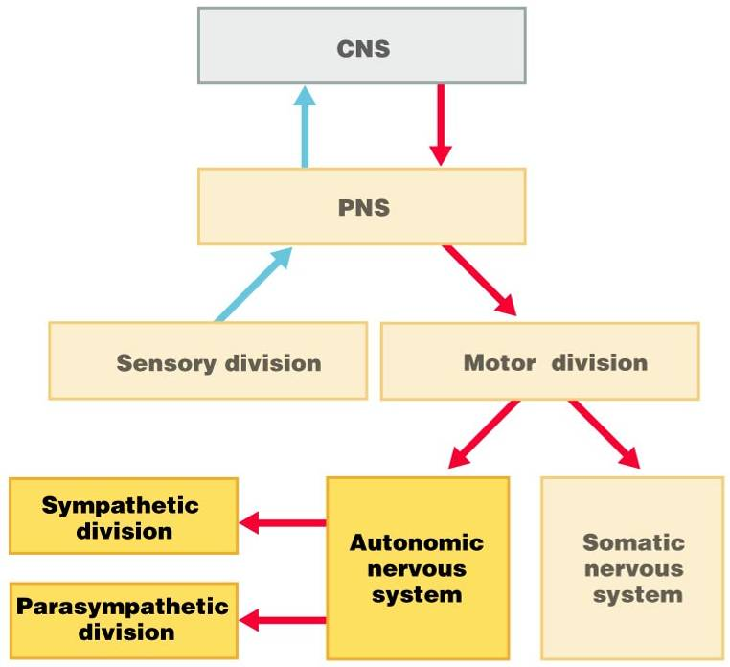

Slide 32
ANS Versus Somatic Nervous System (SNS)
The ANS differs from the SNS in the following three areas
Efferent _
Target organ responses

Slide 33
Effectors
The effectors of the _____________ are _
The effectors of the ________________ are _

Slide 34
Efferent Pathways
_____________________________________ axons of the _______________________________________ extend from the CNS to the effector
Axons of the ANS are a _
The ______________________________________ (first) neuron has a lightly myelinated axon
The _______________________________________ (second) neuron extends to an effector organ

Slide 35
Neurotransmitter Effects
All ____________________________________ neurons release _
which has an _
In the ANS:
Preganglionic fibers _
Postganglionic fibers release
or _
the effect is either _
ANS effect depends on the
neurotransmitter released
and the _

