Slide 1
Divisions of the ANS
ANS divisions:
mobilizes the body during _
performs ___________________________________________ and conserves body energy
The two divisions provide _

Slide 2
Role of the Parasympathetic Division
Concerned with keeping body energy use low
Involves the _
Its activity is illustrated in a person who relaxes after a meal
Blood pressure, heart rate, and respiratory rates are low
Gastrointestinal tract activity is high
The skin is warm and the pupils are constricted

Slide 3
Role of the Sympathetic Division
The sympathetic division is the _
Involves _
exercise, excitement, emergency, and embarrassment

Slide 4
Role of the Sympathetic Division
Promotes adjustments during exercise
blood flow to organs is reduced, _
Its activity is illustrated by a person who is threatened
Heart rate ______________________________ and breathing is _
The skin is cold and sweaty, and the pupils dilate

Slide 5
Anatomy of ANS
Division | Origin of Fibers | Length of Fibers | Location of Ganglia
Sympathetic | Thoracolumbar region of the spinal cord | Short preganglionic and long postganglionic | Close to the spinal cord
Parasympathetic | Brain and sacral spinal cord | Long preganglionic and short postganglionic | In the visceral effector organs

Slide 6
Parasympathetic Division Outflow
Cranial Outflow | Cranial Nerve | Ganglion | Effector Organ(s)
 | Occulomotor (III) | Ciliary | Eye
 | Facial (VII) | Pterygopalatin Submandibular | Salivary, nasal, and lacrimal glands
 | Glossopharyngeal (IX) | Otic | Parotid salivary glands
 | Vagus (X) | Located within the walls of target organs | Heart, lungs, and most visceral organs
Sacral Outflow | S₂-S₄ | Located within the walls of the target organs | Large intestine, urinary bladder, ureters, and reproductive organs

Slide 7
Sympathetic Outflow
Arises from spinal cord segments T₁ through L₂
Sympathetic neurons form _
Preganglionic fibers pass through the ______________________________________ and synapse in the chain (paravertebral) ganglia

Slide 8
Sympathetic Outflow
Fibers from T₅-L₂
form _
synapse with _
Postganglionic fibers innervate the numerous organs of the body

Slide 9
Sympathetic Trunks and Pathways
The __________________________________ form part of the sympathetic trunk or chain
Typically there are 23 ganglia
3 cervical
11 thoracic
4 lumbar
4 sacral
1 coccygeal

Slide 10
Sympathetic Trunks and Pathways
A preganglionic fiber follows one of three pathways upon entering the paravertebral ganglia
Synapse with the _
_______________________________________ the sympathetic chain to synapse in another chain ganglion
Pass through the chain ganglion and _

Slide 11
Pathways with Synapses in Chain Ganglia
Postganglionic axons enter the ventral rami via the _
These fibers innervate _
Rami communicantes are associated _______________ with the sympathetic division

Slide 12
Pathways to the Head
Preganglionic fibers emerge from T₁-T₄ and synapse in the superior cervical ganglion
These fibers:
Serve the _
Stimulate dilator muscles of the _
Inhibit nasal and salivary glands

Slide 13
Pathways to the Thorax
Preganglionic fibers emerge from T₁-T₆ and synapse in the _
Postganglionic fibers emerge from the middle and inferior cervical ganglia and enter nerves C₄-C₈
These fibers innervate the ___________________ via the cardiac plexus, as well as innervating the _

Slide 14
Pathways to the Thorax
Other T₁-T₆ preganglionic fibers synapse in the nearest chain ganglia
Postganglionic fibers directly serve the

Slide 15
Pathways with Synapses in Collateral Ganglia
These fibers (T₅-L₂) leave the sympathetic chain _
They form thoracic, lumbar, and sacral _
Their ganglia include
the
the superior and inferior mesenterics
the

Slide 16
Pathways to the Abdomen
Sympathetic nerves innervating the abdomen have preganglionic fibers from T₅-L₂
They travel through the thoracic splanchnic nerves and synapse at the celiac and superior mesenteric ganglia
Postganglionic fibers serve the

Slide 17
Pathways to the Pelvis
Preganglionic fibers originate from T₁₀-L₂
Most travel via the _____________________________________ splanchnic nerves to the inferior mesenteric and hypogastric ganglia
Postganglionic fibers serve the distal half of the large intestine, the ____________________________________, and the reproductive organs

Slide 18
Pathways with Synapses in the Adrenal Medulla
Fibers of the thoracic splanchnic nerve pass _
Upon stimulation, medullary cells secrete ____________________________________________________________________________into the blood

Slide 19
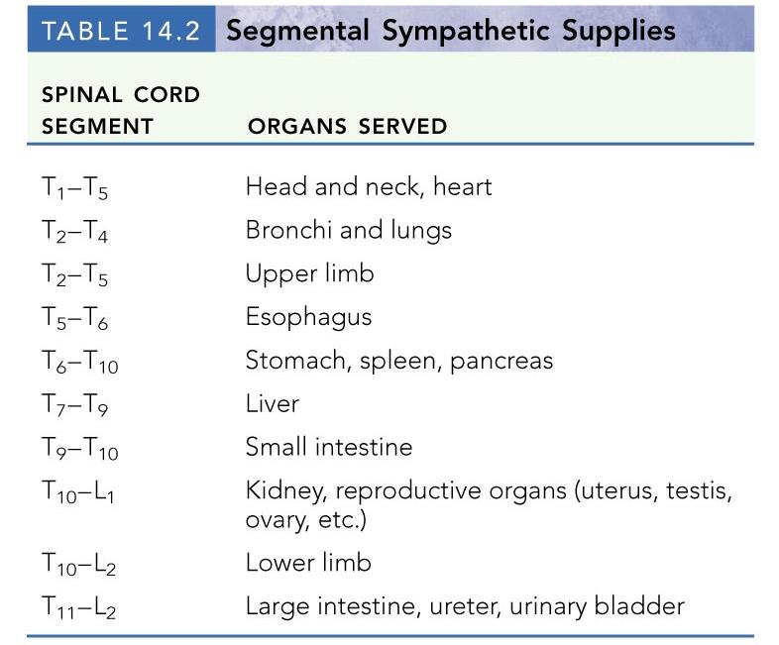

Slide 20
Visceral Reflexes
____________________________reflexes have the same elements as _______________________________reflexes
They are always _
Afferent fibers are found in spinal and autonomic nerves

Slide 21
Referred Pain
Pain stimuli arising from the_______________________________ are _
This may be due to the fact that visceral pain afferents travel along the same pathways as somatic pain fibers

Slide 22
Neurotransmitters and Receptors
Acetylcholine (ACh) and norepinephrine (NE) are the two major neurotransmitters of the _
ACh-releasing fibers
ACh is released by all __________________________________________ axons and all parasympathetic _
Adrenergic fibers
______________________________________________ postganglionic axons that release NE
effects (excitatory/inhibitory) _

