Slide 1
Cholinergic Receptors
The __________________________of receptors that bind ACh are _
These are named after drugs that bind to them and mimic _

Slide 2
Nicotinic Receptors
Nicotinic receptors are found on:
________________________________________ (somatic targets)
All ganglionic neurons of both sympathetic and parasympathetic divisions
The __________________________________ cells of the _
The effect of ACh binding to nicotinic receptors is _

Slide 3
Muscarinic Receptors
Muscarinic receptors occur on all effector cells stimulated by _
The effect of ACh binding:
Can be either _
Depends on the _________________________________________ of the target organ

Slide 4
Adrenergic Receptors
The two types of adrenergic receptors _
Effects of NE binding to:
α receptors is _
β receptors is _
A notable exception
NE binding to β receptors of the heart is stimulatory

Slide 5
Effects of Drugs
Atropine
blocks _
Tricyclic antidepressants
prolong the activity of NE on postsynaptic membranes
Over-the-counter drugs for colds, allergies, and nasal congestion
Beta-blockers
attach mainly to β₁ receptors and _

Slide 6
Interactions of the Autonomic Divisions
Most _________________________ organs are innervated by both _
increase heart and respiratory rates, and inhibit digestion and elimination
decrease heart and respiratory rates, and allow for digestion and the discarding of wastes

Slide 7
Sympathetic Tone
The sympathetic division ______________________________________ and keeps the blood vessels in a continual state of partial constriction
This sympathetic tone (vasomotor tone):
Constricts blood vessels and causes blood pressure to rise as needed
Prompts vessels to _______________________ if blood pressure is to be _

Slide 8
Parasympathetic Tone
Parasympathetic tone:
Dictates normal activity levels of the digestive and urinary systems
The sympathetic division can override these effects during times _
Drugs that block parasympathetic responses increase heart rate and block fecal and urinary retention

Slide 9
Cooperative Effects
ANS ______________________________ is best seen in control of the external genitalia
__________________________________ fibers cause ______________________________and are responsible for erection of the penis and clitoris
________________________________ fibers cause __________________________________ in males and reflex peristalsis in females

Slide 10
Unique Roles of the Sympathetic Division
Regulates many functions not subject to _
These include the activity of the
sweat glands
arrector pili muscles
most blood vessels

Slide 11
Unique Roles of the Sympathetic Division
The sympathetic division controls:
Thermoregulatory responses to _
Release of _
Metabolic effects

Slide 12
Thermoregulatory Responses to Heat
Applying heat to the skin causes ___________________________________ of blood vessels
Systemic body temperature elevation results in widespread dilation of blood vessels
This dilation brings warm blood to the surface
When temperature falls, blood vessels constrict and blood is retained in deeper vital organs

Slide 13
Release of Renin from the Kidneys
Sympathetic impulses activate the kidneys _
Renin is an enzyme that _

Slide 14
Metabolic Effects
The sympathetic division promotes metabolic effects _
Increases the metabolic rate of body cells
Raises _
Mobilizes _
Stimulates the reticular activating system (RAS) of the brain, increasing mental alertness

Slide 15
Localized Versus Diffuse Effects
The parasympathetic division exerts _
The sympathetic division exerts _

Slide 16
Effects of Sympathetic Activation
Sympathetic activation is long-lasting because NE:
Is ___________________________________ more slowly than _
Is an indirectly acting neurotransmitter, using a _
And epinephrine are released into the blood and _

Slide 17
Levels of ANS Control
The hypothalamus is the main ____________________________________ center of ANS activity
Subconscious cerebral input via limbic lobe connections influences hypothalamic function
Other controls come from the _______________________________ , the reticular formation, and the _

Slide 18
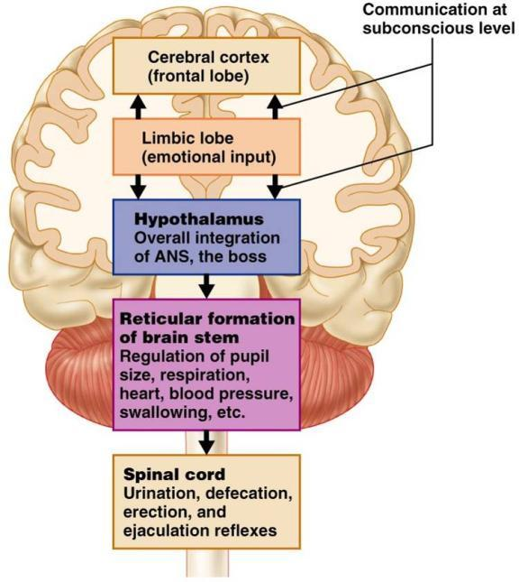
Levels of ANS Control

Slide 19
Hypothalamic Control
Centers of the hypothalamus control:
Body temperature, ________________________________________, and endocrine activity
________________________________________ (rage, pleasure) and biological drives (hunger, thirst, sex)
Reactions to ____________________________ and the “fight-or-flight” system

