Slide 1
Inner Chambers and Fluids
The lens separates the internal eye into _
The posterior segment is filled with _
Transmits light
Supports the posterior surface of the lens
Contributes to intraocular pressure

Slide 2
Anterior Segment
Composed of two chambers
between the cornea and the iris
between the iris and the lens
____________________________ humor
A plasmalike fluid that fills the anterior segment
Drains via the _
Supports, nourishes, and _

Slide 3
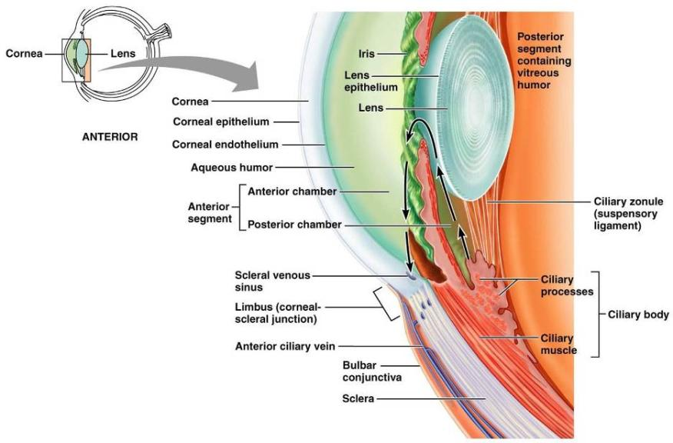
Anterior Segment

Slide 4
Lens
A biconvex, transparent, flexible, ________________________________structure that:
Allows ____________________________________of light onto the retina
Is composed of _
Lens fibers
cells filled with the transparent protein _
With age,
the lens becomes more compact
loses its _

Slide 5
Light
Our eyes respond to a small portion of this spectrum called the _
Different ___________________________ in the retina respond to different __________________________________ of the visible spectrum

Slide 6
Refraction and Lenses
When light passes from one transparent medium to another its speed changes and _
Light passing through a convex lens is bent so that the rays _
When a convex lens forms an image, the image is _

Slide 7
Focusing Light on the Retina
Pathway of light entering the eye:
Light is refracted:
At the cornea
Entering the lens
Leaving the lens
The lens curvature and shape allow for fine focusing of an image

Slide 8
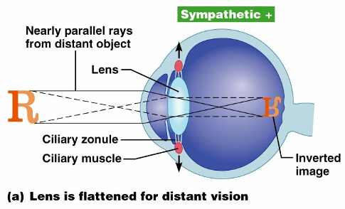
Focusing for Distant Vision
Light from a distance needs ______________________________________ for proper focusing
Far point of vision – the distance beyond which the lens does not need to change shape to focus (20 ft.)

Slide 9
Focusing for Close Vision
Close vision requires:
changing the lens shape by ciliary muscles to increase refractory power
the pupillary reflex constricts the pupils to prevent divergent light rays from entering the eye
medial rotation of the eyeballs toward the object being viewed

Slide 10
Problems of Refraction
normal eye with light focused properly
the focal point is in front of the retina
Corrected with a concave lens
the focal point is behind the retina
Corrected with a convex lens

Slide 11
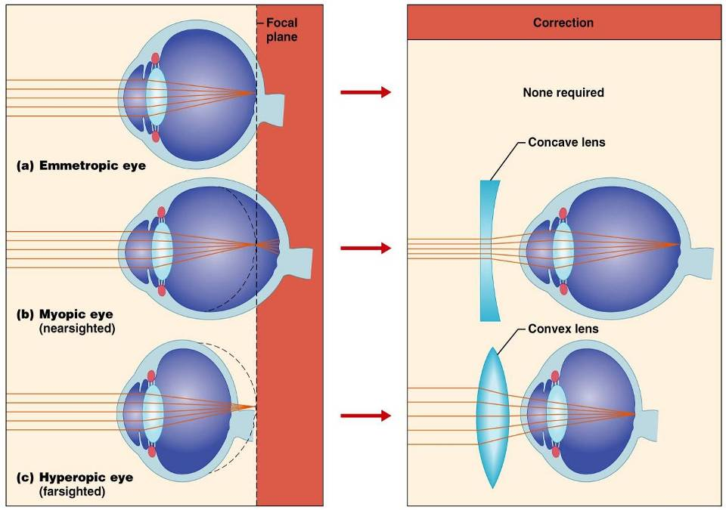

Slide 12
Photoreception: Functional Anatomy of Photoreceptors
process by which the eye detects light energy
Rods and cones contain _

Slide 13
Rods
Functional characteristics
Sensitive to ___________________________ and best suited for _
Absorb _
Perceived input is in _
Sum of visual input from many rods feeds into a single ganglion cell
Results in _

Slide 14
Cones
Functional characteristics
Need ___________________________________ for activation
have low _
Have pigments that allow a _
Each cone synapses with a _
Vision is _

Slide 15
Excitation of Cones
There are three types of cones:
Intermediate colors are perceived by activation of _
Method of excitation is similar to rods

Slide 16
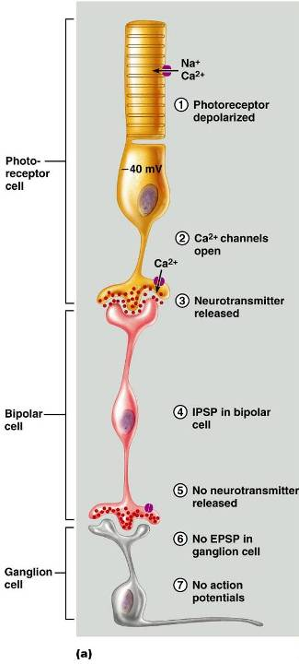
Signal Transmission in the Retina

Slide 17
Adaptation
_____________________________________ (going from dark to light) involves:
Dramatic decreases in retinal sensitivity
Switching from the rod to the cone system
Adaptation to dark is the reverse
Rhodopsin accumulates in the dark and retinal sensitivity is restored

Slide 18
Visual Pathways
Axons of retinal ganglion cells form the optic nerve
Medial fibers of the _
Most fibers of the optic tracts continue to the _

Slide 19
Visual Pathways
Other optic tract fibers end in _
Optic radiations travel from _

Slide 20
Visual Pathways
Some nerve fibers send tracts to the midbrain ending in the _
A small subset of visual fibers contain melanopsin (circadian pigment) which:
Mediates papillary light reflexes
Sets daily _

Slide 21
Depth Perception
Achieved by both eyes viewing the same image from _
Three-dimensional vision results from _____________________________________ of the slightly different images
If only one eye is used, _____________________________________and the observer must rely on learned clues to determine depth

Slide 22
Thalamic Processing
The _____________________________________ of the thalamus:
Relay information on _
Segregate the retinal axons in preparation _
Emphasize visual inputs from regions of high cone density
Sharpen the contrast information received by the retina

Slide 23
Cortical Processing
Basic dark/bright and _
Prestriate cortices (association areas) processes
Form, color, and movement
Visual information then proceeds anteriorly to the:
___________________________________ – processes identification of objects
___________________________________ and postcentral gyrus – processes spatial location

Slide 24
Chemical Senses
Chemical senses
Their chemoreceptors respond to chemicals in aqueous solution
Taste
to substances dissolved _
Smell
to substances dissolved in _

Slide 25
Sense of Smell
The organ of smell is the _____________________________________, which covers the superior nasal concha
Olfactory receptor cells are _____________________________________with radiating olfactory cilia
Basal cells lie at the base of the epithelium

Slide 26
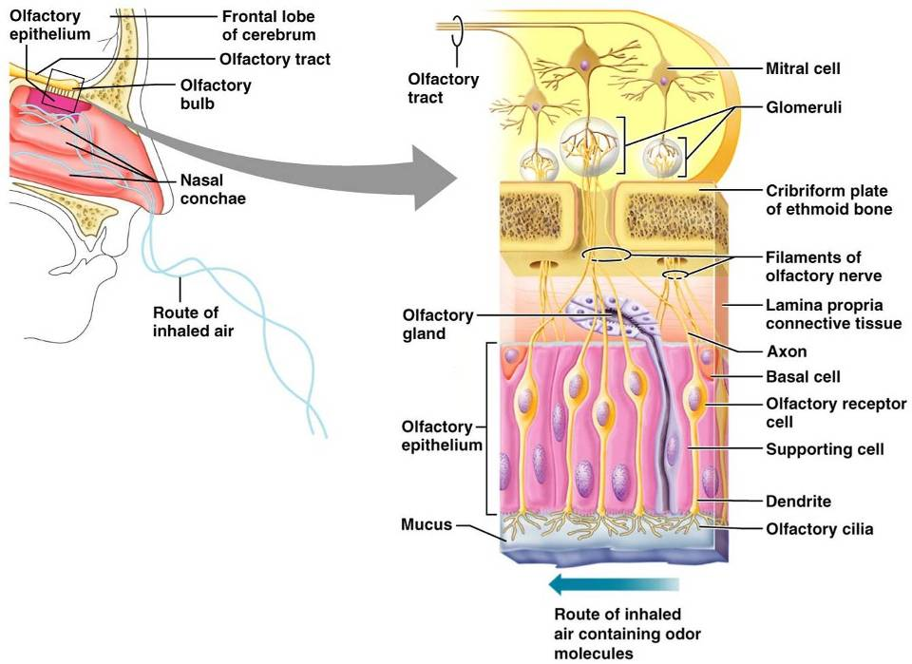
Olfactory Receptors

Slide 27
Physiology of Smell
Olfactory receptors respond to several different odor-causing chemicals
When bound to ligand these proteins _
cAMP (the second messenger) opens ion channels,
causing ___________________________________ of the receptor membrane that then triggers an action potential

Slide 28
Olfactory Pathway
Olfactory receptor cells _
Glomerular mitral cells _
Mitral cells send impulses to:
The
The hypothalamus, amygdala, and _

