Slide 1
Taste Buds
_________________of the 10,000 or so taste buds are found on the _
Taste buds are found in papillae of the tongue mucosa
Papillae come in three types:
Fungiform and circumvallate papillae _

Slide 2
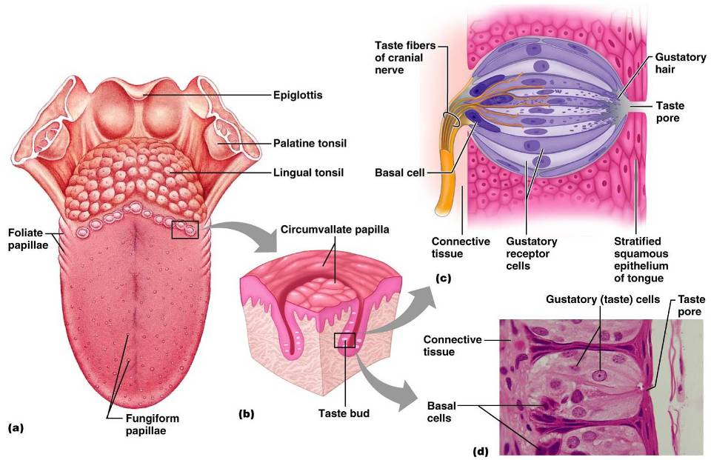

Slide 3
Structure of a Taste Bud
Each _________________________________ taste bud consists of three major cell types
insulate the receptor
dynamic stem cells

Slide 4
Taste Sensations
There are five basic taste sensations
sugars, saccharin, alcohol, and some amino acids
metal ions
hydrogen ions
alkaloids such as quinine and nicotine
elicited by the amino acid glutamate

Slide 5
Physiology of Taste
In order to be tasted, a chemical:
Must be _
Must contact _
Binding of the food chemical:
Depolarizes the taste cell membrane, _
Initiates a generator potential that elicits an _

Slide 6
Gustatory Pathway
Cranial Nerves _________________________ carry impulses from _
These impulses then travel to the _____________________________________, and from there fibers branch to the:
Hypothalamus and limbic system (________________________________of taste)

Slide 7
Influence of Other Sensations on Taste
Taste _
Thermoreceptors, mechanoreceptors, nociceptors also influence tastes
________________________________________ enhance or detract from taste

Slide 8
The Ear: Hearing and Balance
The three parts of the ear are the _
The outer and middle ear are involved with hearing
The inner ear functions
Receptors for hearing and balance:
Respond to _

Slide 9
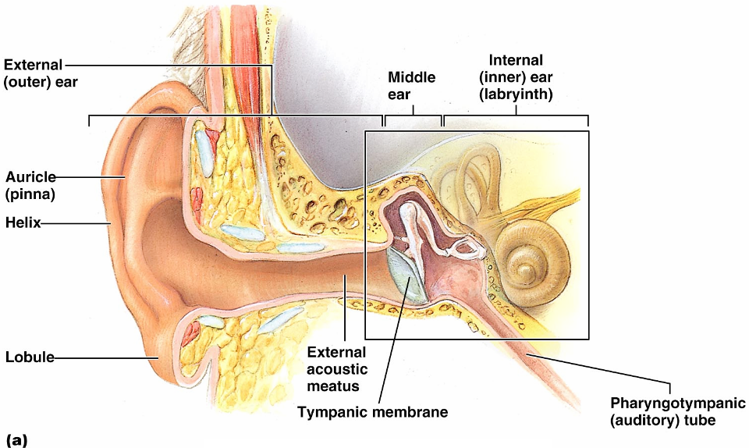
The Ear: Hearing and Balance

Slide 10
Outer Ear
The auricle (pinna) is composed of:
The _
External auditory canal
Short, curved tube filled with _

Slide 11
Outer Ear
Tympanic membrane _
Thin connective tissue membrane that vibrates in response to sound
Transfers sound energy to the _

Slide 12
Middle Ear (Tympanic Cavity)
A small, ___________________________, mucosa-lined cavity
Flanked _
Flanked medially by the _
Epitympanic recess
superior portion of the middle ear
connects the middle ear to the nasopharynx
______________________________________ in the middle ear cavity with the external air pressure

Slide 13
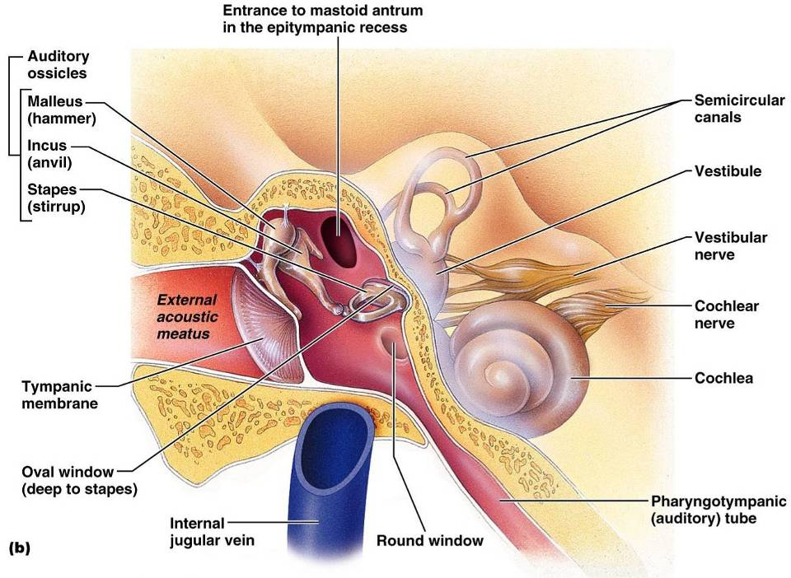
Middle and Internal Ear

Slide 14
Ear Ossicles
The tympanic cavity contains three small bones:
Transmit _________________________________ of the eardrum to the _
Dampened by the _

Slide 15
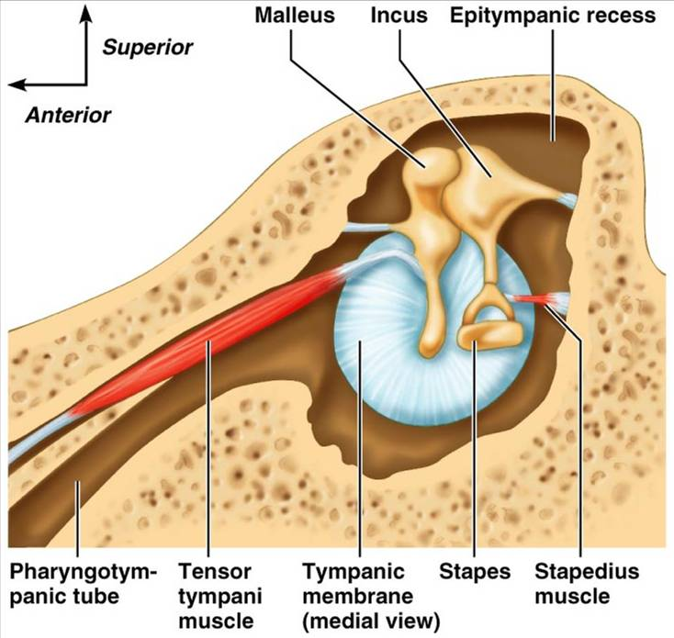

Slide 16
Inner Ear
Tortuous channels worming their way through _
Contains the _
Filled with perilymph
Membranous labyrinth
Series of membranous sacs within the bony labyrinth
Filled with a _

Slide 17
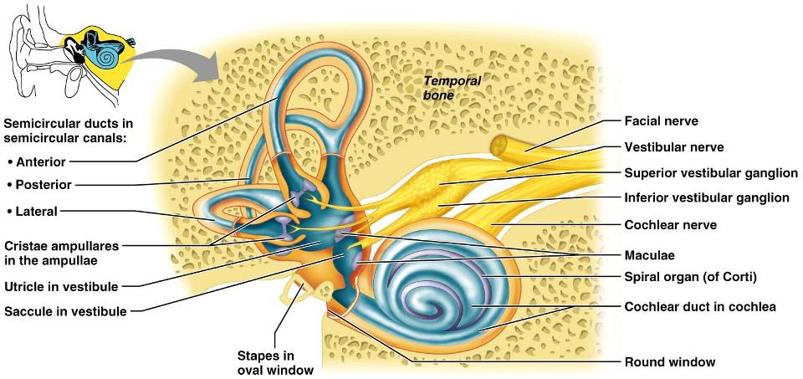
Inner Ear

Slide 18
The Vestibule
The __________________________________ of the bony labyrinth
Suspended in its perilymph are two sacs:
The saccule extends _

Slide 19
The Vestibule
The utricle extends into the _
These sacs:
House ___________________________________ called maculae
Respond to _______________________________ and changes in the _

Slide 20
The Semicircular Canals
Three canals that lie in the _
Membranous semicircular ducts line each canal and communicate with the utricle
The _________________________________is the swollen end of each canal and it houses equilibrium receptors in a region called the _
These receptors respond to _

Slide 21
The Cochlea
A ______________________________, conical, bony chamber that:
Extends from the anterior vestibule
Coils around a bony pillar called the _
Contains the cochlear duct, which ends at the cochlear apex
Contains the _

Slide 22
The Cochlea
The cochlea is divided into three chambers:
Scala _
Scala _
Scala _

Slide 23
The Cochlea
The scala tympani terminates at the _
The scalas tympani and vestibuli:
Are filled with
Are continuous with each other via the _
The scala media is filled with _

Slide 24
The Cochlea
The “floor” of the cochlear duct is composed of:
The bony spiral lamina
The ____________________________________, which supports the organ of Corti
The cochlear branch of nerve VIII runs _

Slide 25
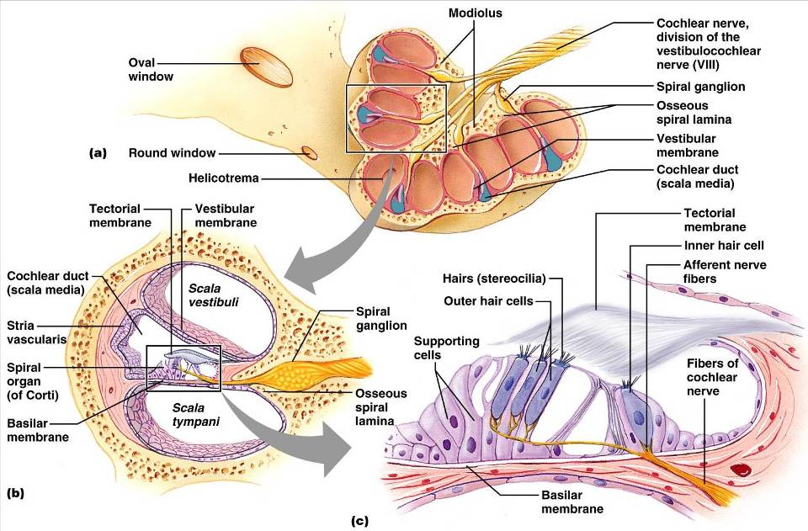

Slide 26
Sound and Mechanisms of Hearing
Sound vibrations beat against the eardrum
The eardrum pushes against the ossicles, which presses fluid in the inner ear against the oval and round windows
This movement sets up _
Moving hair cells stimulates the cochlear nerve _

Slide 27
Properties of Sound
the number of waves that pass a given point in a given time
perception of different frequencies (we hear from 20–20,000 Hz)
intensity of a sound measured in decibels (dB)
subjective interpretation of sound intensity

