Slide 1
Transmission of Sound to the Inner Ear
The route of sound to the inner ear follows this pathway:
Outer ear
Middle ear
Inner ear
scalas vestibuli and tympani to the _
Stimulation of the _
Generation of impulses in the _

Slide 2
Resonance of the Basilar Membrane
Sound waves of low frequency (inaudible):
Travel around the helicotrema
Audible sound waves:
Penetrate through the cochlear duct
Vibrate the _
Excite specific hair cells according to ________________________________________ of the sound

Slide 3
The Organ of Corti
Is composed of ___________________________________ and outer and _
_____________________________________ fibers of the cochlear nerve attach to the base of hair cells
The _
Protrude into the endolymph
Touch the tectorial membrane

Slide 4
Excitation of Hair Cells in the Organ of Corti
Bending cilia:
Opens __________________________________ ion channels
Causes a _________________________________________ and the release of a neurotransmitter
The neurotransmitter causes cochlear fibers to transmit impulses to the brain, where sound is perceived

Slide 5
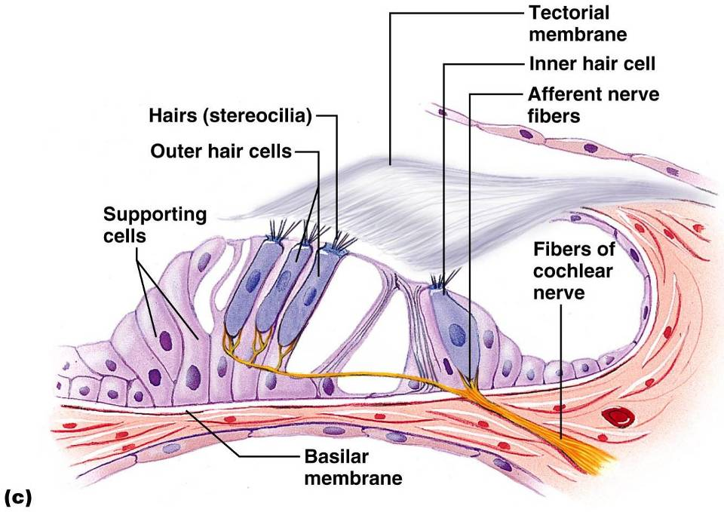

Slide 6
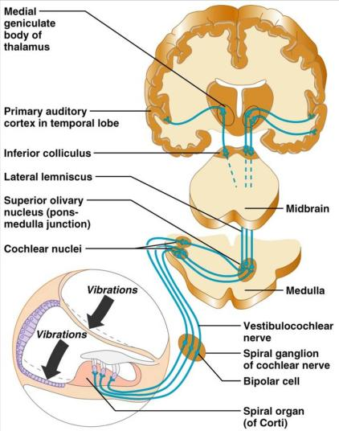
Auditory Pathway to the Brain
Impulses from the cochlea pass via the __________________________to the _
From there, impulses are sent to the:
From there, impulses pass to the _
Auditory pathways _________________________ so that both cortices receive input from both ears

Slide 7
Deafness
something hampers sound conduction to the fluids of the inner ear
results from damage to the ________________________________________ at any point from the cochlear hair cells to the auditory cortical cells

Slide 8
Deafness
ringing or clicking sound in the ears in the absence of auditory stimuli
labyrinth disorder that affects the cochlea and the semicircular canals, causing _

Slide 9
Mechanisms of Equilibrium and Orientation
equilibrium receptors in the semicircular canals and vestibule
Maintains our _
Vestibular receptors
monitor _
Semicircular canal receptors
monitor _

Slide 10
Anatomy of Maculae
____________________________________are the sensory receptors for static equilibrium
Contain supporting cells and hair cells
Each hair cell has stereocilia and kinocilium embedded in the otolithic membrane
jellylike mass studded with tiny stones called _
__________________________________ hairs respond to _
__________________________________ hairs respond to _

Slide 11
Effect of Gravity on Utricular Receptor Cells
Otolithic movement in the _
Depolarizes vestibular nerve fibers
_________________________________the number of action potentials generated
Movement in the _
_______________________________________ vestibular nerve fibers
____________________________________ the rate of impulse propagation

Slide 12
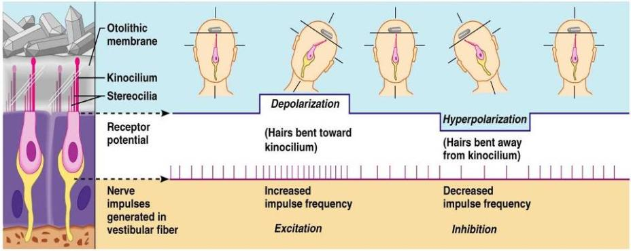
Effect of Gravity on Utricular Receptor Cells

Slide 13
Crista Ampullaris and Dynamic Equilibrium
The _
Is the receptor for _________________________________ equilibrium
Is located in the ampulla of each _
Responds to angular movements
Each crista has support cells and hair cells that extend into a gel-like mass called the _
Dendrites of vestibular nerve fibers encircle the base of the hair cells

Slide 14
Activating Crista Ampullaris Receptors
Cristae respond to _____________________________________ of rotatory movements of the head
Directional bending of hair cells in the cristae causes:
Hyperpolarizations, and fewer impulses reach the brain
The result is that the brain is informed of rotational movements of the head

Slide 15
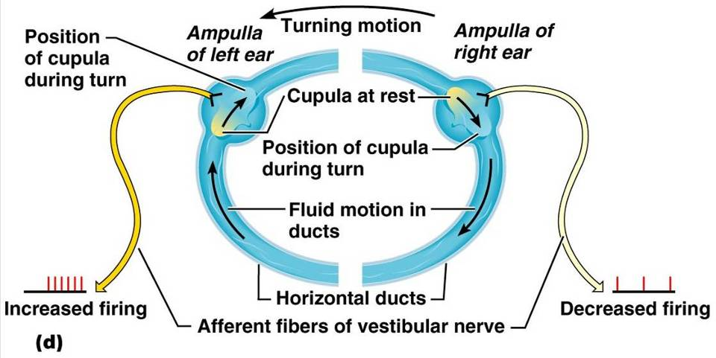
Rotary Head Movement

Slide 16
Balance and Orientation Pathways
There are ______________________________ for balance and orientation
These receptors allow our body to respond reflexively

