Slide 1
Chapter 5 The Integumentary System
Exam Two Material Covers Chapter 5, 6, & 7

Slide 2
Skin (Integument)
Consists of three major regions
outermost _
middle region
Hypodermis (superficial fascia)

Slide 3
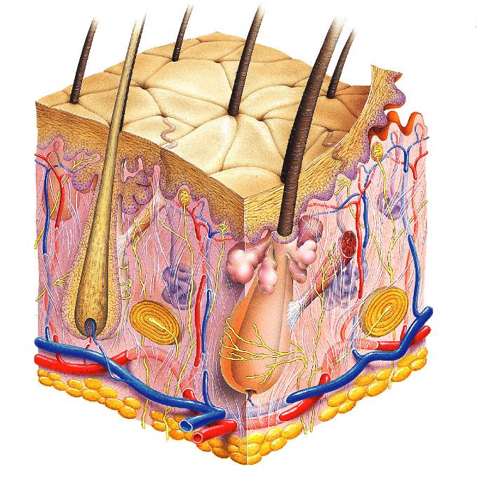
Hair shaft
Pore
Dermal papillae
(papillary layer
of dermis)
Epidermis
Meissner's corpuscle
Free nerve ending
Reticular layer of dermis
Sebaceous (oil) gland
Dermis
Arrector pili muscle
Sensory nerve fiber
Eccrine sweat gland
Pacinian corpuscle
Hypodermis
(superficial
fascia)
Artery
Vein
Hair root
Adipose tissue
Hair follicle
Eccrine sweat
gland
Hair follicle receptor
(root hair plexus)

Slide 4
Epidermis
Composed of keratinized _
consisting of ________________ distinct cell types
produce the _________________________________ protein keratin
Melanocytes
produce the ______________________________________ melanin
Merkel cells
function as _____________________________________________ in association with sensory nerve endings
Langerhans’ cells
epidermal _________________________________________ that help activate the immune system
And four or five layers

Slide 5
Layers of the Epidermis: Stratum Basale (Basal Layer)
firmly attached to the dermis
single row of the _
Cells undergo _
stratum germinativum

Slide 6
Layers of the Epidermis: Stratum Spinosum (Prickly Layer)
Cells contain a weblike system of __________________________________ attached to desmosomes
Melanin _______________________ and Langerhans’ cells are abundant in this layer

Slide 7
Layers of the Epidermis: Stratum Granulosum (Granular Layer)
three to five cell layers

Slide 8
Layers of the Epidermis: Stratum Lucidum (Clear Layer)
superficial to the stratum granulosum
Consists of a few rows of flat, dead keratinocytes
Present only in _

Slide 9
Layers of the Epidermis: Stratum Corneum (Horny Layer)
____________________________________ of keratinized cells
Accounts for three quarters of the epidermal thickness
Functions include:
Protection from _
Rendering the body relatively ______________________________________ to biological, chemical, and physical assaults

Slide 10
Dermis
Second major skin region containing _
Cell types include
White blood cells
Composed of two layers
papillary and reticular

Slide 11
Layers of the Dermis: Papillary Layer
__________________________ layer
Areolar connective tissue
with _
Its superior surface contains _
Dermal papillae contain
capillary loops

Slide 12
Layers of the Dermis: Reticular Layer
Reticular layer
Accounts for approximately 80% of the thickness of the skin
Collagen fibers add _
Elastin fibers provide _

Slide 13
Hypodermis
Subcutaneous layer ________________ to the skin
Composed of _____________________________ connective tissue

Slide 14
Skin Color
Three pigments contribute to skin color
yellow to reddish-brown to black pigment, responsible for dark skin colors
yellow to orange pigment
most obvious in the _
reddish pigment responsible for the pinkish hue of the skin

Slide 15
Sweat Glands
Different types prevent overheating of the body; secrete cerumen and milk
________________________________ sweat glands
found in _
________________________________ sweat glands
found in _
Ceruminous glands
modified apocrine glands in ________________________ that secrete _
Mammary glands
specialized sweat glands that _

Slide 16
Sebaceous Glands
Simple _________________________________ found all over the body
_____________________________ when stimulated by hormones
Secrete an _

Slide 17
Hair
Filamentous strands of dead keratinized cells produced by hair follicles
Contains _
tougher and more durable than soft keratin of the skin
Made up of
Pigmented by melanocytes at the base of the hair

Slide 18
Hair Function and Distribution
Functions of hair include:
Helping to _
_____________________________________ to presence of insects on the skin
_______________________________________ against physical trauma, heat loss, and sunlight

Slide 19
Hair Function and Distribution
Hair is distributed over the entire skin surface except:
Portions of the _

Slide 20
Hair Follicle
Root sheath extending from _
Deep end is expanded forming a hair bulb
A knot of sensory nerve endings (____________________________) wraps around each hair bulb
Bending a hair stimulates these endings, hence our hairs act as _

Slide 21
Types of Hair
pale, ___________________________________ found in children and the adult female
Terminal
_______________________________________ of eyebrows, scalp, axillary, and pubic regions

Slide 22
Hair Thinning and Baldness
Alopecia
hair thinning in both sexes
Alopecia areata:
May be _
True, or frank, baldness
Genetically determined and sex-influenced condition
caused by follicular response to DHT

Slide 23
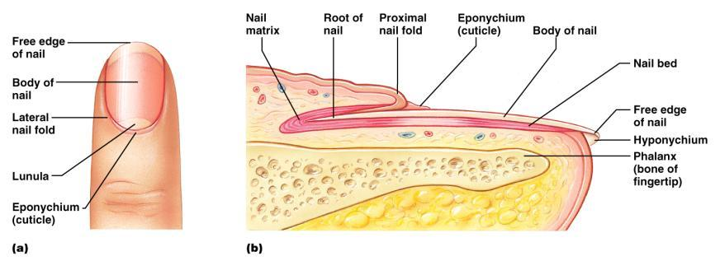
Structure of a Nail
Scalelike ________________________________ on the distal, dorsal surface of fingers and toes

Slide 24
Functions of the Integumentary System
chemical, physical, and mechanical barrier
Body _______________________________ is accomplished by:
_______________________________________ of dermal vessels
Increasing sweat gland secretions to cool the body
Cutaneous sensation
exoreceptors sense touch and pain

Slide 25
Functions of the Integumentary System
Metabolic functions
synthesis of ____________________________ in dermal blood vessels
skin blood vessels store up to 5% of the body’s blood volume
Excretion
limited amounts of ___________________________________ are eliminated from the body in sweat

Slide 26
Skin Cancer
Most skin tumors are _____________________ and do not metastasize
A crucial risk factor for non-melanoma skin cancers is the _
Newly developed skin lotions can fix damaged DNA

Slide 27
Skin Cancer
The three major types of skin cancer are:
Basal cell carcinoma
Squamous cell carcinoma
Melanoma

Slide 28
Basal Cell Carcinoma
________________________________ skin cancer
___________________________________ cells proliferate and invade the dermis and hypodermis
Slow growing
do not often metastasize
Can be cured by _________________________ in 99% of the cases

Slide 29
Squamous Cell Carcinoma
Arises from keratinocytes of _
Arise most often on _
Grows rapidly
metastasizes _
Prognosis is good if treated by radiation therapy or removed surgically

Slide 30
Melanoma
Cancer of ______________________________ is the most dangerous type of skin cancer
Resistant to _

Slide 31
Melanoma
Melanomas have the following characteristics (ABCD rule)
A:
the two sides of the pigmented area do not match
B:
irregular
exhibits indentations
C:
black, brown, tan, and sometimes red or blue
D:
larger than 6 mm (size of a pencil eraser)

Slide 32
Melanoma
Treated by _______________________________ accompanied by immunotherapy
Chance of survival is poor if the lesion is _

Slide 33
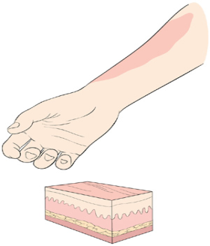
Burns
First-degree
Symptoms
localized _

Slide 34
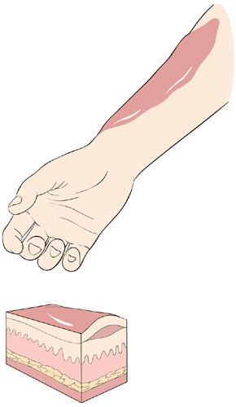
Burns
Second-degree
Symptoms mimic first degree burns
______________________ also appear

Slide 35
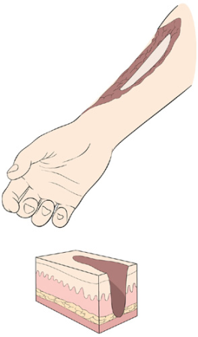
Burns
Third-degree
________________________ of the skin is damaged
Burned area appears gray-white, cherry red, or black
there is no _
nerve endings _

Slide 36
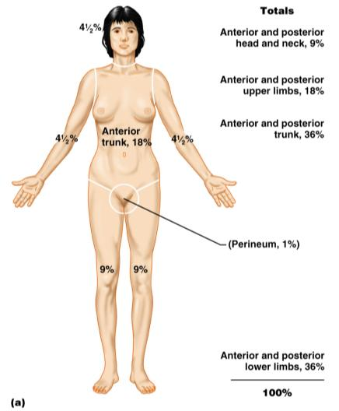
Rule of Nines
Burns considered critical if:
Over 25% of the body has second-degree burns
Over 10% of the body has third-degree burns
There are third-degree burns on face, hands, or feet

Slide 37
Classification of Bones
bones of the skull, vertebral column, and rib cage
bones of the upper and lower limbs, shoulder, and hip

Slide 38
Classification of Bones: By Shape
longer than they are wide

Slide 39
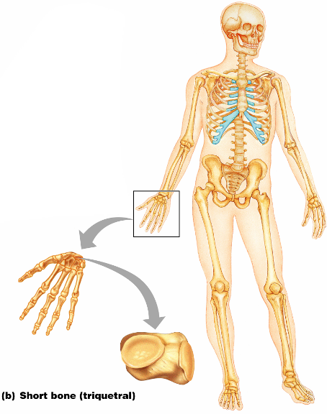
Classification of Bones: By Shape
Cube-shaped bones of the _
Bones that form within tendons _
Figure 6.2b

Slide 40
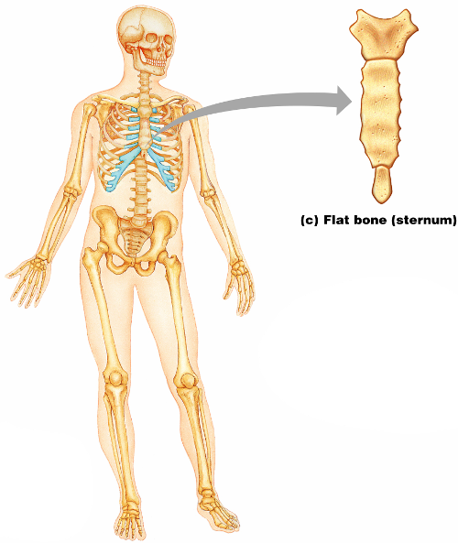
Classification of Bones: By Shape
thin, flattened, and a bit curved
most
Figure 6.2c

Slide 41
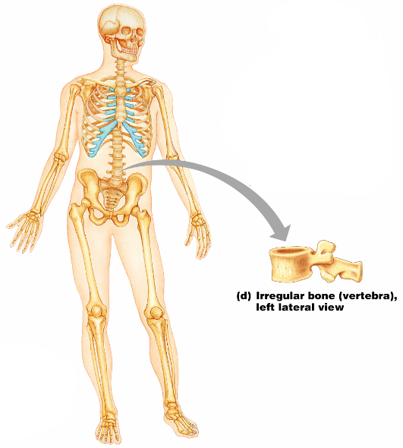
Classification of Bones: By Shape
bones with complicated shapes
Figure 6.2d

