Slide 1
Function of Bones
form the framework that supports the body and cradles soft organs
provide a protective case for the brain, spinal cord, and vital organs
provide levers for muscles

Slide 2
Function of Bones
reservoir for minerals, especially calcium and phosphorus
hematopoiesis occurs within the marrow cavities of bones

Slide 3
Bone Markings
Bulges, depressions, and holes that serve as:
Joint surfaces
Conduits for blood vessels and nerves

Slide 4
Bone Markings: Projections – Sites of Muscle and Ligament Attachment
rounded projection
narrow, prominent ridge of bone
large, blunt, irregular surface
narrow ridge of bone
small rounded projection
raised area above a condyle
sharp, slender projection
any bony prominence

Slide 5
Bone Markings: Projections – Projections That Help to Form Joints
bony expansion carried on a narrow neck
smooth, nearly flat articular surface
rounded articular projection
arm-like bar of bone

Slide 6
Bone Markings: Depressions and Openings
canal-like passageway
cavity within a bone
shallow, basin-like depression
furrow
narrow, slit-like opening
round or oval opening through a bone

Slide 7
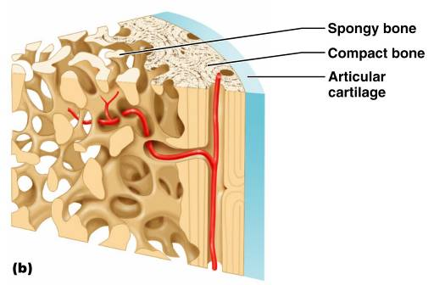
Bone Textures
Compact bone
Spongy bone
honeycomb of trabeculae _

Slide 8
Structure of Long Bone
Long bones consist of a _
Diaphysis
Tubular shaft
Composed of _
surrounds the medullary cavity
Yellow bone marrow in the medullary cavity

Slide 9
Structure of Long Bone
Epiphyses
________________________________ of long bones
Exterior is compact bone, and the _
Joint surface is covered with articular (hyaline) cartilage
Epiphyseal line separates the diaphysis from the epiphyses

Slide 10
Bone Membranes
______________________________ – double-layered protective membrane
Richly supplied with nerve fibers, blood, and lymphatic vessels, which enter the bone via _
Secured to underlying bone by _

Slide 11
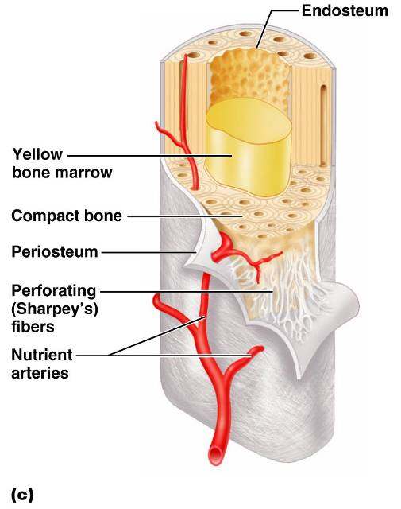
Bone Membranes
delicate membrane covering internal surfaces of bone

Slide 12
Structure of Short, Irregular, and Flat Bones
Thin plates of periosteum-covered compact bone on the outside with endosteum-covered spongy bone on the inside
Have _
Contain bone marrow between the trabeculae

Slide 13
Location of Hematopoietic Tissue (Red Marrow)
In infants
Found in the _
all areas of spongy bone
In adults
Found in the _
the head of the femur
the head of the _

Slide 14
Microscopic Structure of Bone: Compact Bone
_________________________, or osteon – the structural unit of compact bone
weight-bearing, column-like matrix tubes composed mainly of collagen
Haversian, or _
containing blood vessels and nerves
channels lying at right angles to the central canal, connecting blood and nerve supply of the periosteum to that of the Haversian canal

Slide 15
Microscopic Structure of Bone: Compact Bone
Osteocytes
Lacunae
______________________________ in bone that _
Canaliculi
___________________________________ that connect lacunae to each other and the central canal

Slide 16
Chemical Composition of Bone: Organic
Osteoblasts
Osteocytes
mature bone cells
Osteoclasts
large cells that resorb or _

Slide 17
Bone Development
Osteogenesis and ossification – the _________________________________, which leads to:
The formation of the bony skeleton in embryos
Bone growth until early adulthood
Bone thickness, _

Slide 18
Formation of the Bony Skeleton
Begins at ______________________ of embryo development
Intramembranous ossification
bone develops from a _
Endochondral ossification
bone forms by _

Slide 19
Intramembranous Ossification
Formation of most of the _

Slide 20
Stages of Intramembranous Ossification
An _____________________________ appears in the fibrous connective tissue membrane
Bone matrix is secreted within the fibrous membrane
Woven bone and periosteum form
Bone collar of _

Slide 21
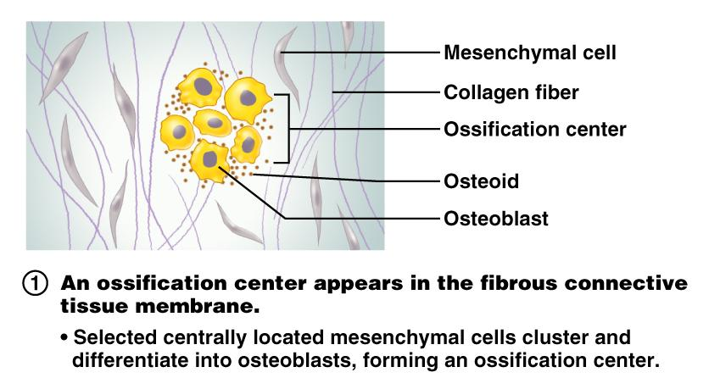
Stages of Intramembranous Ossification
Figure 6.7.1

Slide 22
Stages of Intramembranous Ossification
Figure 6.7.2

Slide 23
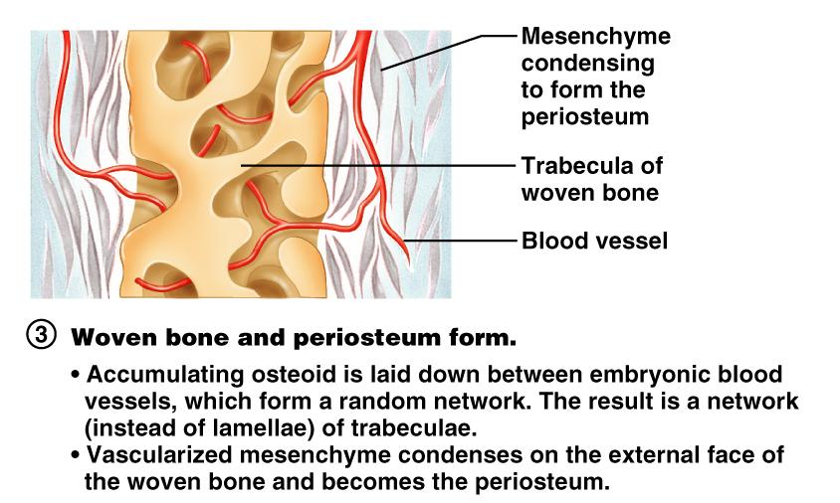
Stages of Intramembranous Ossification
Figure 6.7.3

Slide 24
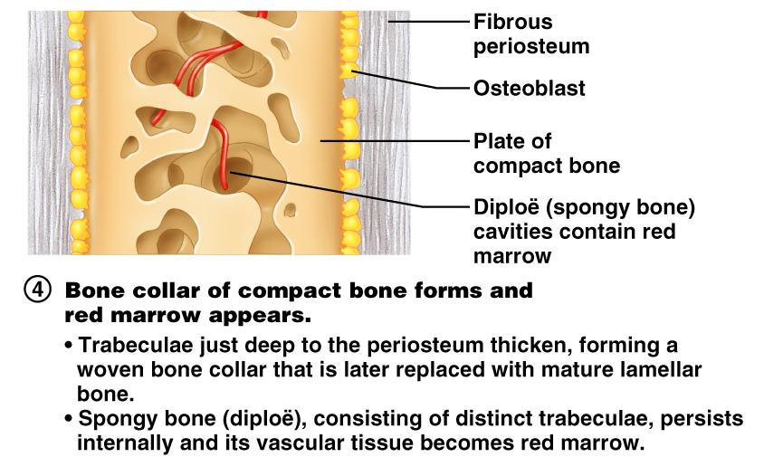
Stages of Intramembranous Ossification
Figure 6.7.4

Slide 25
Endochondral Ossification
Begins in the _
Uses ____________________________” as models for bone construction
Requires breakdown of hyaline cartilage prior to ossification

Slide 26
Stages of Endochondral Ossification
Formation of bone collar
Cavitation of the hyaline cartilage
spongy bone formation
Formation of the medullary cavity; appearance of _
Ossification of the epiphyses, with hyaline cartilage remaining only in the epiphyseal plates

Slide 27
Postnatal Bone Growth
Growth in length of long bones
Cells of the epiphyseal plate proximal to the resting cartilage form three functionally different zones:

Slide 28
Functional Zones in Long Bone Growth
Growth zone
____________________________________, pushing the epiphysis away from the diaphysis
Transformation zone
older cells enlarge, the matrix becomes calcified, cartilage cells die, and the _
Osteogenic zone
new _

Slide 29
Hormonal Regulation of Bone Growth During Youth
During infancy and childhood, epiphyseal plate activity is stimulated by _
During puberty, _
Initially promote adolescent growth spurts
Later induce epiphyseal ___________________________, ending longitudinal bone growth

Slide 30
Response to Mechanical Stress
Wolff’s law
a bone grows or remodels _
Observations supporting Wolff’s law include
Long bones are thickest midway along the shaft (where bending stress is greatest)
Curved bones are thickest where they are most likely to buckle

Slide 31
Bone Fractures (Breaks)
Bone fractures are classified by:
The _____________________________ of the bone ends after fracture
The _______________________________ of the break
The ______________________________ of the bone to the long axis
Whether or not the bones ends penetrate the skin

Slide 32
Types of Bone Fractures
bone ends retain their normal position
bone ends are out of normal alignment

Slide 33
Types of Bone Fractures
bone is broken all the way through
bone is not broken all the way through
the fracture is ___________________________________ of the bone

Slide 34
Types of Bone Fractures
the fracture is __________________________________to the long axis of the bone
Compound (open)
bone ends do not penetrate the skin

Slide 35
Common Types of Fractures
Comminuted
bone fragments into __________________________ common in the elderly
ragged break when bone is _____________________________________ common sports injury
broken bone portion pressed inward; typical skull fracture

Slide 36
Common Types of Fractures
Compression
___________________________________; common in porous bones
epiphysis separates from diaphysis along epiphyseal line; occurs where cartilage cells are dying
incomplete fracture where one side of the bone breaks and the other side bends; _

Slide 37
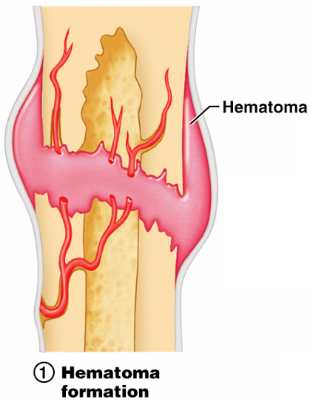
Stages in the Healing of a Bone Fracture
Torn blood vessels hemorrhage
A mass of clotted blood (_______________) forms at the fracture site
Site becomes swollen, painful, and inflamed
Figure 6.13.1

Slide 38
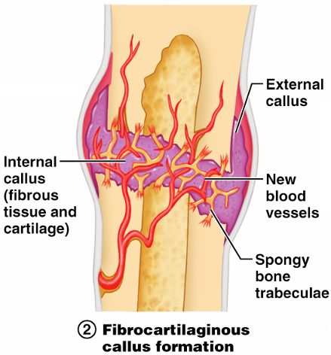
Stages in the Healing of a Bone Fracture
Fibrocartilaginous _
Granulation tissue (soft callus) forms a few days after the fracture
__________________________________ and phagocytic cells begin cleaning debris
Figure 6.13.2

Slide 39
Stages in the Healing of a Bone Fracture
The fibrocartilaginous callus forms when:
___________________________________ migrate to the fracture and begin reconstructing the bone
Fibroblasts secrete __________________________________ that connect broken bone ends
Osteoblasts begin forming spongy bone

Slide 40
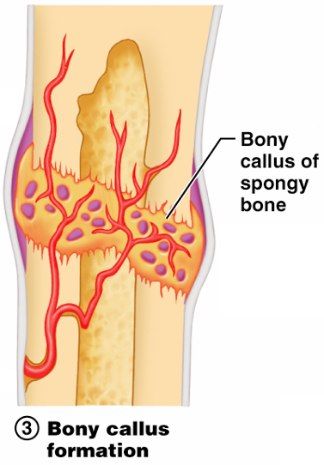
Stages in the Healing of a Bone Fracture
Bony callus formation
New bone trabeculae appear in the fibrocartilaginous callus
Fibrocartilaginous callus _
Bone callus _____________________________________, and continues until firm union is formed 2-3 months later
Figure 6.13.3

Slide 41
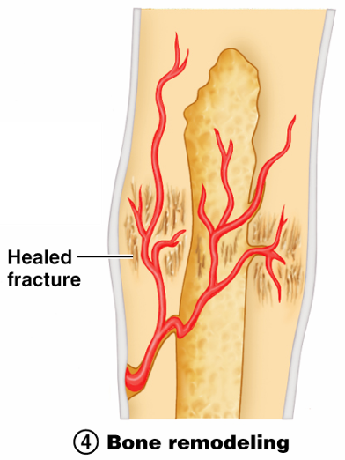
Stages in the Healing of a Bone Fracture
Bone remodeling
Excess material on the bone shaft exterior and in the medullary canal is removed
________________ is laid down to reconstruct shaft walls
Figure 6.13.4

