Slide 1
Homeostatic Imbalances
Bones are inadequately mineralized causing softened, weakened bones
Main symptom is pain when weight is put on the affected bone
Caused by insufficient _

Slide 2
Homeostatic Imbalances
Rickets
Bones of children are inadequately mineralized causing softened, weakened bones
________________________________ and deformities of the pelvis, skull, and rib cage are common
Caused by insufficient _

Slide 3
Isolated Cases of Rickets
Rickets has been _
Only isolated cases appear
Example: Infants of breastfeeding mothers deficient in Vitamin D will also be Vitamin D deficient and develop rickets

Slide 4
Homeostatic Imbalances
Osteoporosis
Group of diseases in which _
Occurs most often in postmenopausal women
Bones become so fragile that sneezing or stepping off a curb _

Slide 5
Osteoporosis: Treatment
Increased _
Hormone (estrogen) replacement therapy (HRT) slows bone loss
Natural progesterone cream prompts new bone growth
Statins increase bone mineral density

Slide 6
Chapter Seven

Slide 7
The Axial Skeleton
Eighty bones segregated into three regions

Slide 8
The Skull
______________________________ bony structure
formed by the _
Cranium
protects the brain and is the site of attachment for head and neck muscles
Facial bones
Supply the framework of the _
Provide openings for the passage of air and food
Anchor the facial muscles of expression

Slide 9
Anatomy of the Cranium
The eight cranial bones thin and remarkably strong for their weight
two _
two _
Sphenoid
ethmoid

Slide 10
Wormian Bones
_________________________________ that appear within sutures

Slide 11
Facial Bones
__________________________ of which only the mandible and vomer are unpaired
The paired bones are
Zygomatics
Palatines
inferior conchae

Slide 12
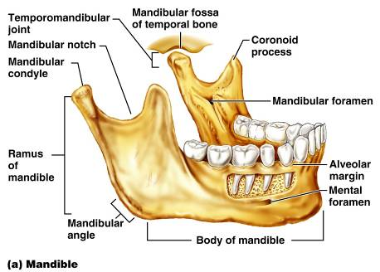
Mandible and Its Markings
The mandible is the _____________________ bone of the face
Its major markings include the
mandibular condyle,
alveolar margin, and
mental foramina

Slide 13
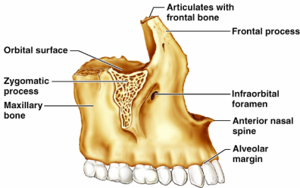
Maxillary Bones
upper jaw and the central portion of the facial skeleton
Their major markings include
palatine,
frontal,
zygomatic processes
the alveolar margins
inferior orbital fissure
the maxillary sinuses

Slide 14
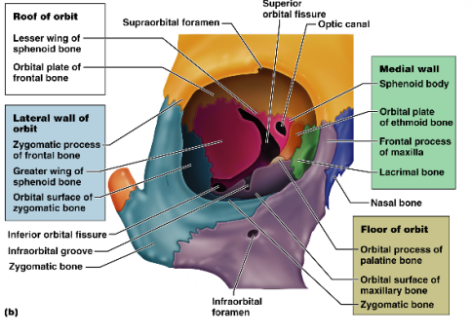
Orbits
Bony cavities in which the eyes are firmly encased and _
Formed by parts of seven bones
Zygomatic
Palatine
Lacrimal
ethmoid

Slide 15
Hyoid Bone
lies just inferior to the mandible in the anterior neck
Only bone of the body that __________________________________ directly with another bone
Attachment point for neck muscles that raise and lower the larynx during swallowing and speech

Slide 16
Vertebral Column
Formed from 26 irregular bones (vertebrae) connected in such a way that a flexible curved structure results
Cervical vertebrae
_____bones of the neck
Thoracic vertebrae
_____ bones of the torso
Lumbar vertebrae
_____ bones of the lower back
Sacrum
bone inferior to the lumbar vertebrae that articulates with the hip bones

Slide 17
Vertebral Column: Curvatures
cervical and lumbar
Secondary curvatures
cervical and lumbar – are convex anteriorly and are _
thoracic and sacral
present at birth
convex posteriorly
causing the infant spine to arch like a four-legged animal

Slide 18
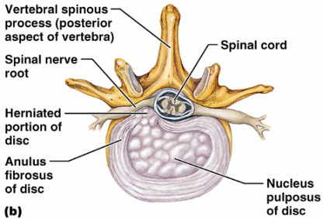
Vertebral Column: Intervertebral Discs
Cushion-like pad composed of two parts
inner gelatinous nucleus that gives the disc its elasticity and compressibility
surrounds the nucleus pulposus with a collar composed of collagen and fibrocartilage

Slide 19
General Structure of Vertebrae
disc-shaped, weight-bearing region
composed of pedicles and laminae that, along with the centrum, enclose the vertebral foramen
make up the vertebral canal through which the spinal cord passes

Slide 20
General Structure of Vertebrae
project posteriorly,
project laterally
Superior and inferior _
protrude superiorly and inferiorly from the pedicle-lamina junctions
Intervertebral foramina
________________________________ formed from notched areas on the _

Slide 21
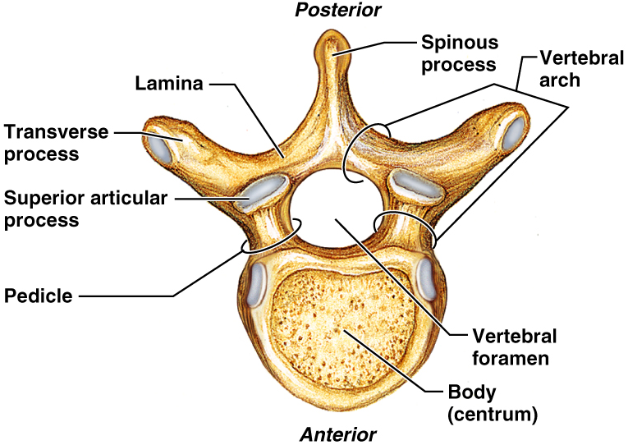
General Structure of Vertebrae

Slide 22
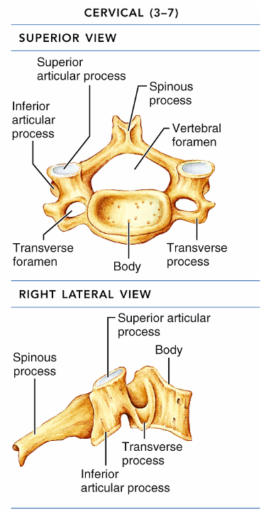
Cervical Vertebrae
Seven vertebrae (C₁-C₇) are the _
C₃-C₇
oval body
short spinous processes,
large, triangular vertebral foramina
Each transverse process contains a _

Slide 23
Cervical Vertebrae: The Atlas (C₁)
The atlas has ___________________ and ______________________
It consists of anterior and posterior arches, and _
The superior surfaces of lateral masses articulate with the _

Slide 24
Cervical Vertebrae: The Axis (C₂)
The axis has a body, spine, and vertebral arches as do other cervical vertebrae
Also has the _______________________
projects superiorly from the body and is cradled in the anterior arch of the atlas
The dens is a ______________ for the rotation of the atlas

Slide 25
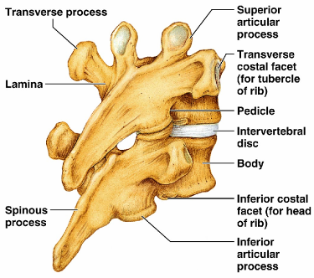
Thoracic Vertebrae
12 Thoracic vertebrae
Major markings include
two _
two demifacets on the heart-shaped body,
_______________ vertebral foramen
transverse processes,
facets prevents flexion and extension
____________________________ of this area of the spine

Slide 26
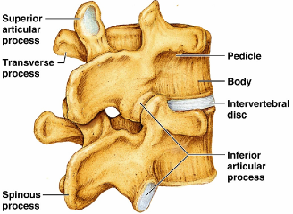
Lumbar Vertebrae
five lumbar vertebrae
have an enhanced _
They have
__________________________ pedicles and laminae
_______________________ hatchet-shaped spinous processes,
triangular-shaped vertebral foramen
Orientation of articular facets locks the lumbar vertebrae together to _

Slide 27
Sacrum
Sacrum
five fused vertebrae (S₁-S₅
shape the _
It articulates with L₅ superiorly, and with the auricular surfaces of the hip bones
Major markings include
transverse lines
dorsal sacral foramina

Slide 28
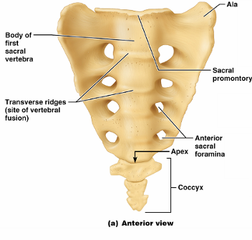
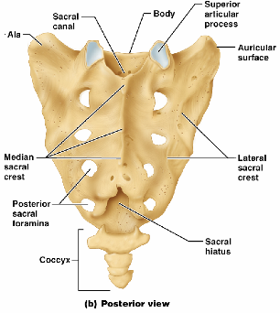
Coccyx
Coccyx (Tailbone)
The coccyx is made up of _____________________ that articulate superiorly with the sacrum

Slide 29
Bony Thorax (Thoracic Cage)
The thoracic cage is composed of
the _
____________________________ laterally
____________________________________ anteriorly

Slide 30
Bony Thorax (Thoracic Cage)
Functions
Forms a ____________________________ around the heart, lungs, and great blood vessels
Supports the _________________________ and upper limbs
Provides attachment for many neck, back, chest, and shoulder muscles
Uses _______________________________ to lift and depress the thorax during breathing

Slide 31
Sternum (Breastbone)
A dagger-shaped, _
lies in the anterior midline of the thorax
Results from the fusion of three bones –
Superior: _
the _
Inferior: _
Anatomical landmarks include the jugular (suprasternal) notch, the sternal angle, and the xiphisternal joint

Slide 32
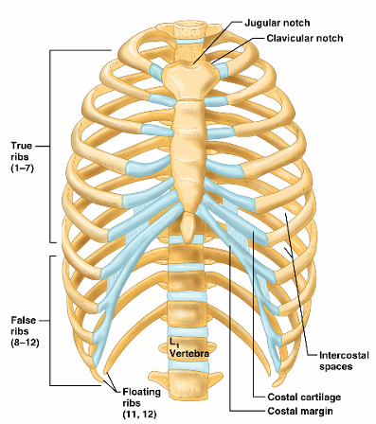
Ribs
There are twelve pair of ribs
All ribs attach _
The superior 7 pair
attach directly to the sternum via costal cartilages
Ribs 8-10 (
attach indirectly to the sternum via costal cartilage
Ribs 11-12
have no anterior attachment

Slide 33
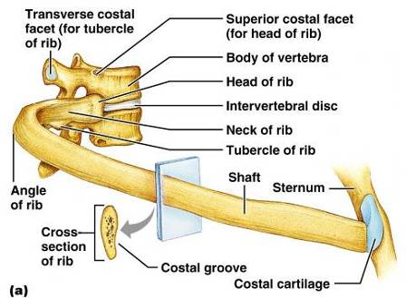
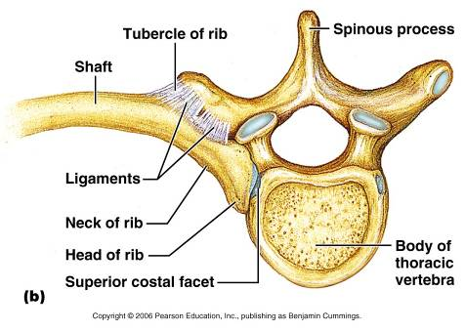
Structure of a Typical True Rib
Bowed, flat bone consisting of a _

Slide 34
Appendicular Skeleton
The _____________________________ skeleton is made up of
the bones of the _
and their _
attach the upper limbs to the body trunk
secures the lower limbs

Slide 35
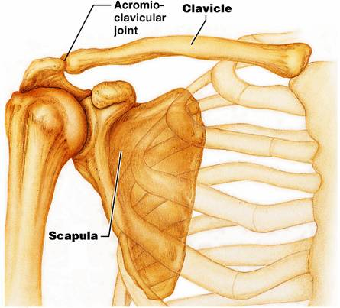
Pectoral Girdles (Shoulder Girdles)
The pectoral girdles consist of the ____________________ and the _
They provide attachment points for muscles that move the upper limbs
Arrangement allows _

Slide 36
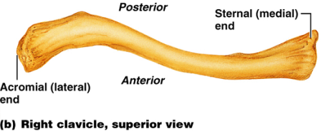
Clavicles (Collarbones)
Slender, doubly curved long bones lying across the _
The ______________________________ end articulates with the scapula
The sternal (medial) end articulates _

Slide 37
Scapulae (Shoulder Blades)
Triangular, flat bones lying on the _
between the _
Scapulae have three borders and three angles

Slide 38
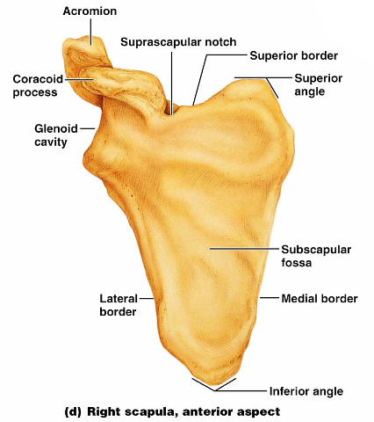
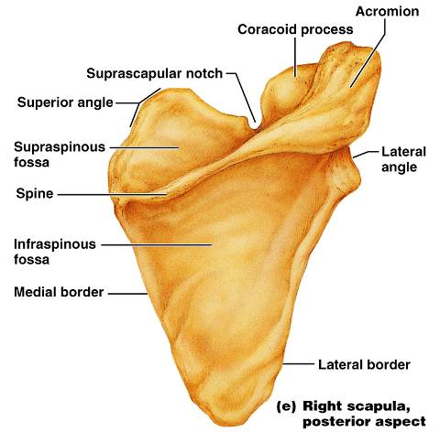
Major markings include the suprascapular notch, the supraspinous and infraspinous fossae, the spine, the acromion, and the coracoid process
Figure 7.22d

Slide 39
The Upper Limb
The upper limb consists of the
forearm
hand
Thirty-seven bones form the skeletal framework of each upper limb

Slide 40
Arm
The ______________________________ is the sole bone of the arm
It articulates with the ________________________________ at the shoulder, and the radius and ulna at the elbow

Slide 41
Arm
Major markings
Proximal humerus includes the head, anatomical and surgical necks, greater and lesser tubercles, and the intertubercular groove

Slide 42
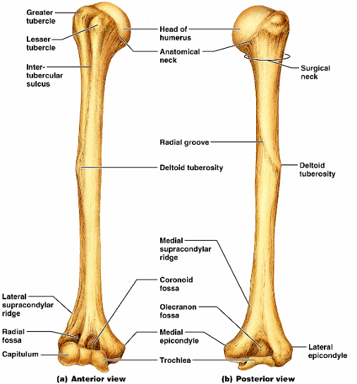
Humerus of the Arm
Distal humerus includes the
medial and lateral epicondyles,
the coronoid
Medial portion includes the
radial groove
deltoid process

Slide 43
Forearm
The bones of the forearm are the _
They articulate proximally with the humerus and _
They also _________________________________ proximally and distally at small radioulnar joints
_______________________________ connects the two bones along their entire length

Slide 44
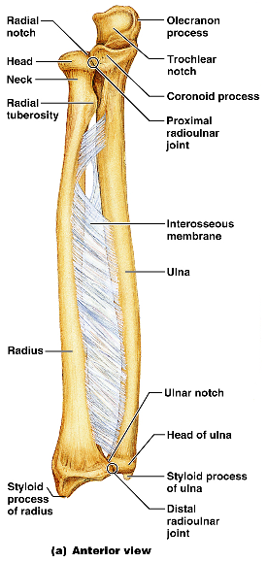
Ulna
The ulna lies _____________ in the forearm and is slightly longer than the radius
Forms the major portion of the _______________________ with the humerus
Its major markings include the olecranon, coronoid process, trochlear notch, radial notch, and the styloid process

Slide 45
Radius
The radius lies opposite ___________________ the ulna and is thin at its proximal end, widened distally
The superior surface of the head articulates with _
Medially, the head articulates with the _
Major markings include the radial tuberosity, ulnar notch, and styloid process

Slide 46
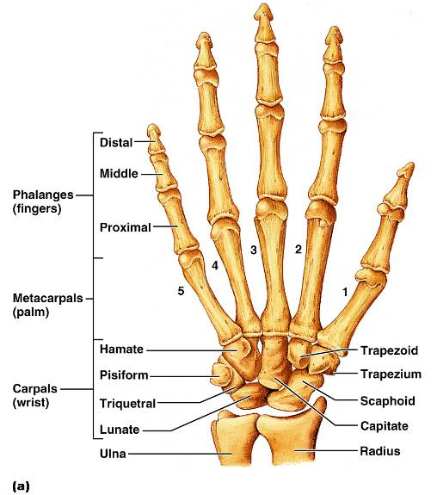
Hand
Skeleton of the hand contains
bones of the palm_
bones of the fingers _

Slide 47
Carpus (Wrist)
Consists of eight bones
____________________, lunate, ___________________, and pisiform proximally
Trapezium, ___________________, capitate, and _________________________ distally

Slide 48
Metacarpus (Palm)
Five numbered (1-5) metacarpal bones radiate from the wrist to form the palm
Their ____________________________________ proximally, and with each other medially and laterally
Heads articulate with _

Slide 49
Phalanges (Fingers)
Each hand contains 14 miniature long bones called phalanges
Fingers (digits) are numbered 1-5, beginning with the _
Each finger (except the thumb) has three phalanges – _
The thumb has _

Slide 50
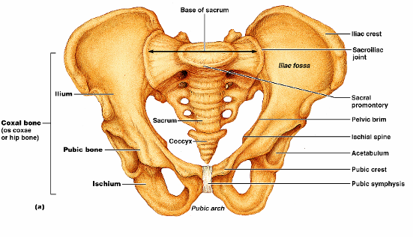
Pelvic Girdle
The hip is formed by a __________________________ (os coxae, or coxal)
Together with the ________________________________ these bones form the bony pelvis

Slide 51
Pelvic Girdle (Hip)
The pelvis
Attaches the lower limbs to the axial skeleton with the strongest ligaments of the body
Supports the visceral organs of the pelvis

Slide 52
Ilium
The ilium is a large flaring bone that forms the superior region of the coxal bone
It consists of
a superior _
The broad posterolateral surface is called the gluteal surface

Slide 53
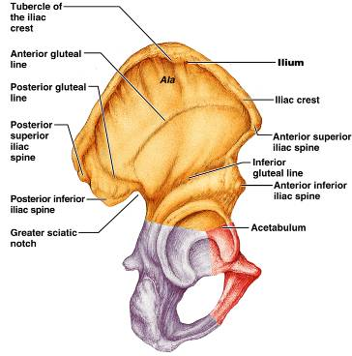
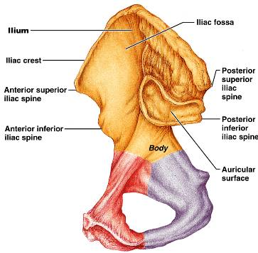
Ilium
The ___________________ articulates with the sacrum (sacroiliac joint)
Major markings include the iliac crests, four spines, greater sciatic notch, iliac fossa, arcuate line, and the pelvic brim

Slide 54
Ischium
The ischium forms the posteroinferior part of the hip bone
The ______________________________, and the thinner ramus articulates with the _
Major markings include the ischial spine, lesser sciatic notch, and the ischial tuberosity

Slide 55
Pubis
The pubic bone forms the anterior portion of the hip bone
It articulates with the _
Major markings include superior and inferior rami, the pubic crest, pubic tubercle, pubic arch, pubic symphysis, and obturator foramen (along with ilium and ischium)

Slide 56
Comparison of Male and Female Pelvic Structure
Female pelvis
Tilted forward, _
True pelvis defines birth canal
Cavity of the true pelvis is broad, shallow, and has greater capacity
Male pelvis
Tilted less forward
Adapted for support of _
Cavity of true pelvis is _

Slide 57
Comparison of Male and Female Pelvic Structure
Characteristic | Female | Male
Bone thickness | Lighter, thinner, and smoother | Heavier, thicker, and more prominent markings
Pubic arch/angle | 80˚–90˚ | 50˚–60˚
Acetabula | Small; farther apart | Large; closer together
Sacrum | Wider, shorter; sacral curvature is accentuated | Narrow, longer; sacral promontory more ventral
Coccyx | More movable; straighter | Less movable; curves ventrally

Slide 58
The Lower Limb
The three segments of the lower limb are the _
They carry the weight of the erect body, and are subjected to exceptional forces when one jumps or runs

Slide 59
Femur
The sole bone of the thigh is the femur, the _____________________________ bone in the body
It articulates _______________________ and _

Slide 60
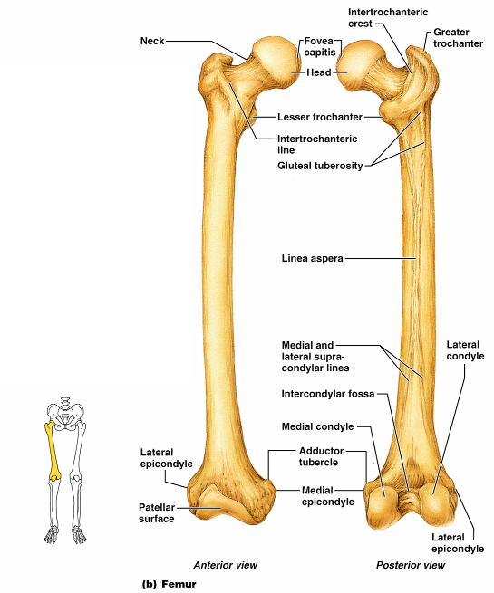
Femur
Major markings include the
head,
fovea capitis
greater and lesser trochanters
gluteal tuberosity
lateral and medial condyles
Epicondyles
linea aspera
patellar surface,
intercondylar notch
Figure 7.28b

Slide 61
Leg
The tibia and fibula form the skeleton of the leg
They are connected to each other by the _
They articulate with the femur proximally and with the _
They also articulate with each other via the _

Slide 62
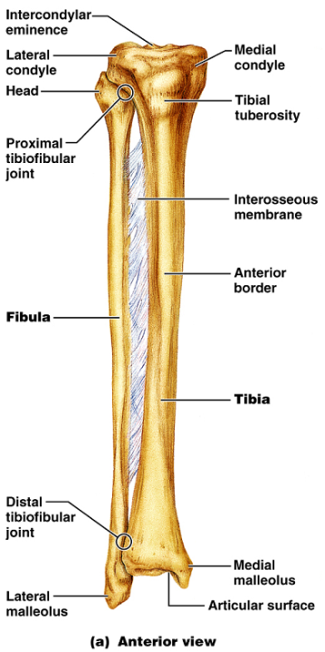
Tibia
____________________ of the body from the femur and _
Major markings include medial and lateral condyles, intercondylar eminence, the tibial tuberosity, anterior crest, medial malleolus, and fibular notch

Slide 63
Fibula
Sticklike bone with slightly expanded ends located _
Major markings include the _

Slide 64
Foot
The skeleton of the foot includes the
The foot supports body weight and acts as a lever to propel the body forward in walking and running

Slide 65
Tarsus
Composed of seven bones that form the posterior half of the foot
Body weight is carried _
Talus articulates with the tibia and fibula superiorly, and the calcaneus inferiorly
Other tarsus bones include the cuboid and navicular, and the medial, intermediate, and lateral cuneiforms

Slide 66
Calcaneus
Forms the _
Carries the _
Point of attachment for the __________________________________ of the calf muscles

Slide 67
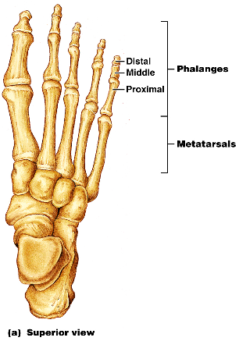
Metatarsus and Phalanges
_
Five (1-5) long bones that articulate with the proximal phalanges
The enlarged head of ________________________ forms the “ball of the foot”
Phalanges
The 14 bones of the toes
Each digit has three phalanges except the _

