Slide 1
Chapter 5
The Integumentary System

Slide 2
Skin (Integument)
Consists of three major regions
outermost _
middle region
Hypodermis (superficial fascia)

Slide 3
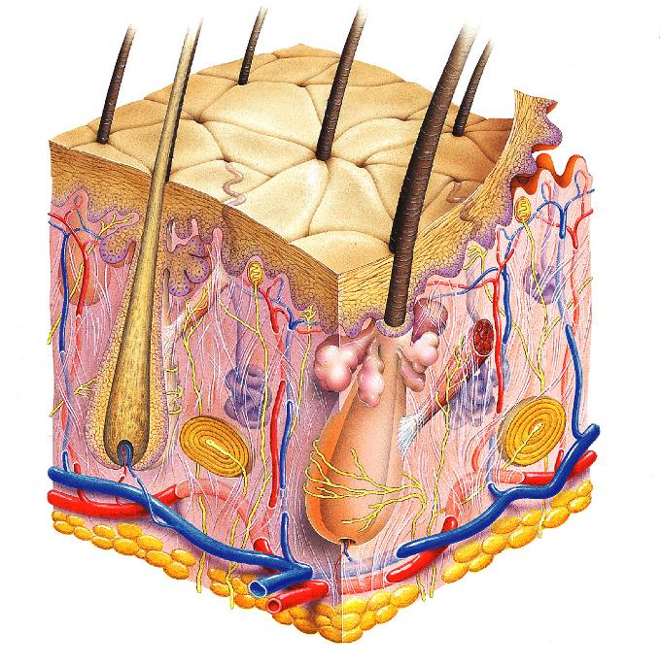
Hair shaft
Pore
Dermal papillae
(papillary layer
of dermis)
Epidermis
Meissner's corpuscle
Free nerve ending
Reticular layer of dermis
Sebaceous (oil) gland
Dermis
Arrector pili muscle
Sensory nerve fiber
Eccrine sweat gland
Pacinian corpuscle
Hypodermis
(superficial
fascia)
Artery
Vein
Hair root
Adipose tissue
Hair follicle
Eccrine sweat
gland
Hair follicle receptor
(root hair plexus)

Slide 4
Epidermis
Composed of keratinized _
consisting of ________________ distinct cell types
produce the _________________________________ protein keratin
Melanocytes
produce the ______________________________________ melanin
Merkel cells
function as _____________________________________________ in association with sensory nerve endings
Langerhans’ cells
epidermal _________________________________________ that help activate the immune system
And four or five layers

Slide 5
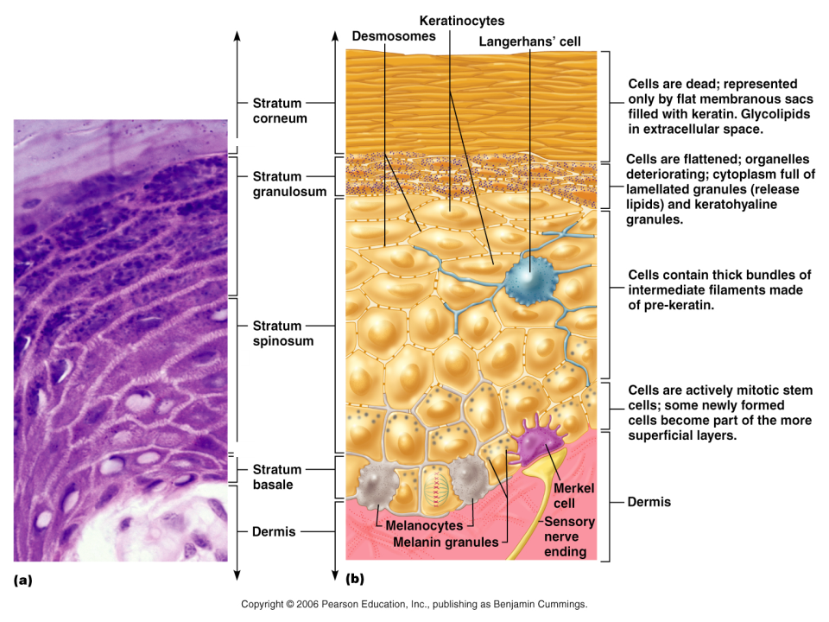

Slide 6
Layers of the Epidermis: Stratum Basale (Basal Layer)
firmly attached to the dermis
single row of the _
Cells undergo _
stratum germinativum

Slide 7
Layers of the Epidermis: Stratum Spinosum (Prickly Layer)
Cells contain a weblike system of __________________________________ attached to desmosomes
Melanin _______________________ and Langerhans’ cells are abundant in this layer

Slide 8
Layers of the Epidermis: Stratum Granulosum (Granular Layer)
three to five cell layers

Slide 9
Layers of the Epidermis: Stratum Lucidum (Clear Layer)
superficial to the stratum granulosum
Consists of a few rows of flat, dead keratinocytes
Present only in _

Slide 10
Layers of the Epidermis: Stratum Corneum (Horny Layer)
____________________________________ of keratinized cells
Accounts for three quarters of the epidermal thickness
Functions include:
Protection from _
Rendering the body relatively ______________________________________ to biological, chemical, and physical assaults

Slide 11
Dermis
Second major skin region containing _
Cell types include
White blood cells
Composed of two layers
papillary and reticular

Slide 12
Layers of the Dermis: Papillary Layer
__________________________ layer
Areolar connective tissue
with _
Its superior surface contains _
Dermal papillae contain
capillary loops

Slide 13
Layers of the Dermis: Reticular Layer
Reticular layer
Accounts for approximately 80% of the thickness of the skin
Collagen fibers add _
Elastin fibers provide _

Slide 14
Hypodermis
Subcutaneous layer ________________ to the skin
Composed of _____________________________ connective tissue

Slide 15
Skin Color
Three pigments contribute to skin color
yellow to reddish-brown to black pigment, responsible for dark skin colors
yellow to orange pigment
most obvious in the _
reddish pigment responsible for the pinkish hue of the skin

Slide 16
Sweat Glands
Different types prevent overheating of the body; secrete cerumen and milk
________________________________ sweat glands
found in _
________________________________ sweat glands
found in _
Ceruminous glands
modified apocrine glands in ________________________ that secrete _
Mammary glands
specialized sweat glands that _

Slide 17
Sebaceous Glands
Simple _________________________________ found all over the body
_____________________________ when stimulated by hormones
Secrete an _

Slide 18
Hair
Filamentous strands of dead keratinized cells produced by hair follicles
Contains _
tougher and more durable than soft keratin of the skin
Made up of
Pigmented by melanocytes at the base of the hair

Slide 19
Hair Function and Distribution
Functions of hair include:
Helping to _
_____________________________________ to presence of insects on the skin
_______________________________________ against physical trauma, heat loss, and sunlight

Slide 20
Hair Function and Distribution
Hair is distributed over the entire skin surface except:
Portions of the _

Slide 21
Hair Follicle
Root sheath extending from _
Deep end is expanded forming a hair bulb
A knot of sensory nerve endings (____________________________) wraps around each hair bulb
Bending a hair stimulates these endings, hence our hairs act as _

Slide 22
Types of Hair
pale, ___________________________________ found in children and the adult female
Terminal
_______________________________________ of eyebrows, scalp, axillary, and pubic regions

Slide 23
Hair Thinning and Baldness
Alopecia
hair thinning in both sexes
Alopecia areata:
May be _
True, or frank, baldness
Genetically determined and sex-influenced condition
caused by follicular response to DHT

