Slide 1
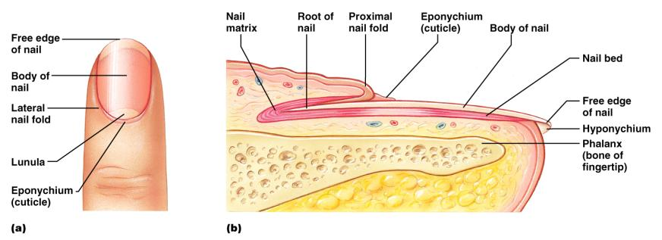
Structure of a Nail
Scalelike ________________________________ on the distal, dorsal surface of fingers and toes

Slide 2
Functions of the Integumentary System
chemical, physical, and mechanical barrier
Body _______________________________ is accomplished by:
_______________________________________ of dermal vessels
Increasing sweat gland secretions to cool the body
Cutaneous sensation
exoreceptors sense touch and pain

Slide 3
Functions of the Integumentary System
Metabolic functions
synthesis of ____________________________ in dermal blood vessels
skin blood vessels store up to 5% of the body’s blood volume
Excretion
limited amounts of ___________________________________ are eliminated from the body in sweat

Slide 4
Skin Cancer
Most skin tumors are _____________________ and do not metastasize
A crucial risk factor for non-melanoma skin cancers is the _
Newly developed skin lotions can fix damaged DNA

Slide 5
Skin Cancer
The three major types of skin cancer are:
Basal cell carcinoma
Squamous cell carcinoma
Melanoma

Slide 6
Basal Cell Carcinoma
________________________________ skin cancer
___________________________________ cells proliferate and invade the dermis and hypodermis
Slow growing
do not often metastasize
Can be cured by _________________________ in 99% of the cases

Slide 7
Squamous Cell Carcinoma
Arises from keratinocytes of _
Arise most often on _
Grows rapidly
metastasizes _
Prognosis is good if treated by radiation therapy or removed surgically

Slide 8
Melanoma
Cancer of ______________________________ is the most dangerous type of skin cancer
Resistant to _

Slide 9
Melanoma
Melanomas have the following characteristics (ABCD rule)
A:
the two sides of the pigmented area do not match
B:
irregular
exhibits indentations
C:
black, brown, tan, and sometimes red or blue
D:
larger than 6 mm (size of a pencil eraser)

Slide 10
Melanoma
Treated by _______________________________ accompanied by immunotherapy
Chance of survival is poor if the lesion is _

Slide 11
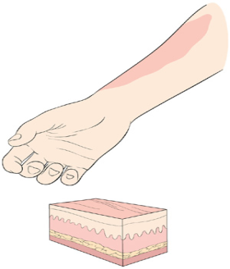
Burns
First-degree
Symptoms
localized _

Slide 12
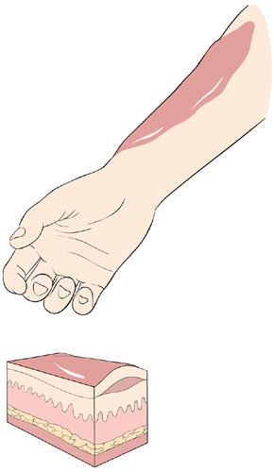
Burns
Second-degree
Symptoms mimic first degree burns
______________________ also appear

Slide 13
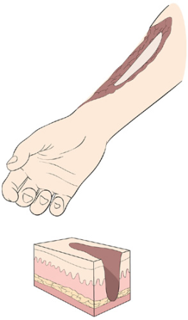
Burns
Third-degree
________________________ of the skin is damaged
Burned area appears gray-white, cherry red, or black
there is no _
nerve endings _

Slide 14
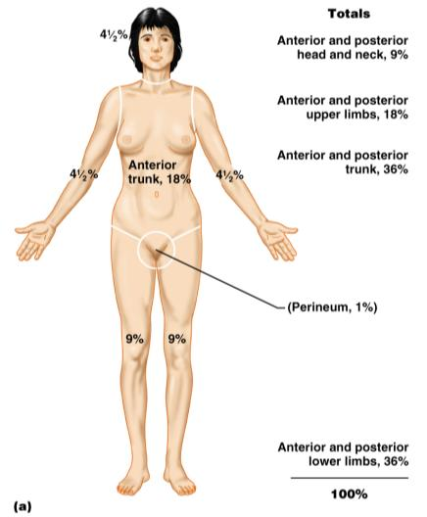
Rule of Nines
Burns considered critical if:
Over 25% of the body has second-degree burns
Over 10% of the body has third-degree burns
There are third-degree burns on face, hands, or feet

Slide 15
Classification of Bones
bones of the skull, vertebral column, and rib cage
bones of the upper and lower limbs, shoulder, and hip

Slide 16
Classification of Bones: By Shape
longer than they are wide

Slide 17
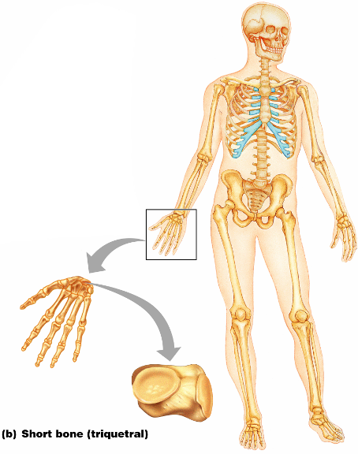
Classification of Bones: By Shape
Cube-shaped bones of the _
Bones that form within tendons _
Figure 6.2b

Slide 18
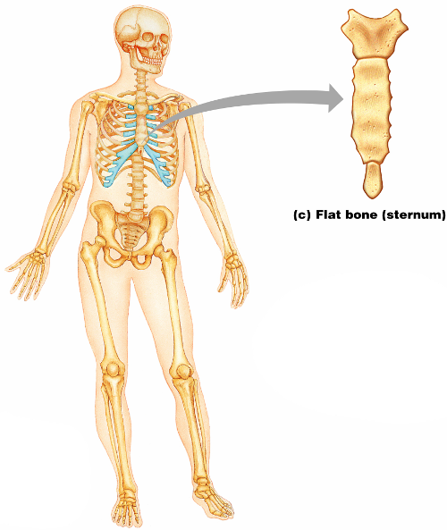
Classification of Bones: By Shape
thin, flattened, and a bit curved
most
Figure 6.2c

Slide 19
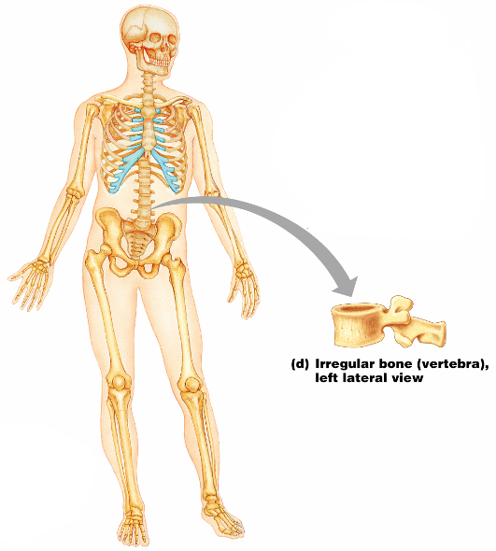
Classification of Bones: By Shape
bones with complicated shapes
Figure 6.2d

