Slide 1
Chapter Seven

Slide 2
The Axial Skeleton
Eighty bones segregated into three regions

Slide 3
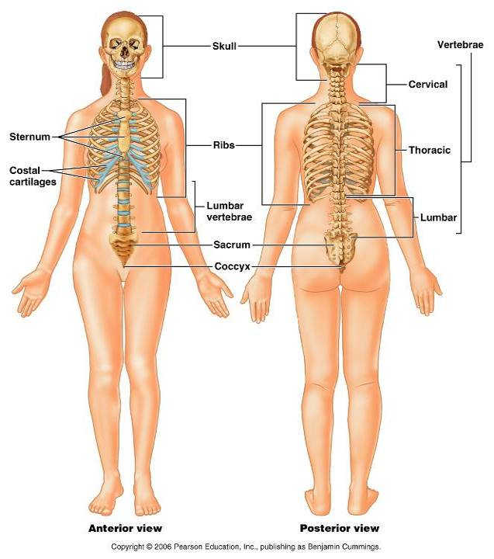
Bones of the Axial Skeleton
Figure 7.1

Slide 4
The Skull
______________________________ bony structure
formed by the _
Cranium
protects the brain and is the site of attachment for head and neck muscles
Facial bones
Supply the framework of the _
Provide openings for the passage of air and food
Anchor the facial muscles of expression

Slide 5
Anatomy of the Cranium
The eight cranial bones thin and remarkably strong for their weight
two _
two _
Sphenoid
ethmoid

Slide 6
Wormian Bones
_________________________________ that appear within sutures

Slide 7
Facial Bones
__________________________ of which only the mandible and vomer are unpaired
The paired bones are
Zygomatics
Palatines
inferior conchae

Slide 8
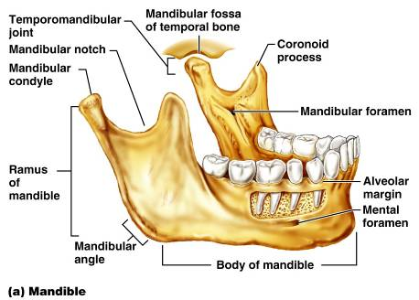
Mandible and Its Markings
The mandible is the _____________________ bone of the face
Its major markings include the
mandibular condyle,
alveolar margin, and
mental foramina

Slide 9
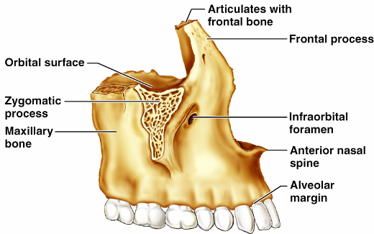
Maxillary Bones
upper jaw and the central portion of the facial skeleton
Their major markings include
palatine,
frontal,
zygomatic processes
the alveolar margins
inferior orbital fissure
the maxillary sinuses

Slide 10
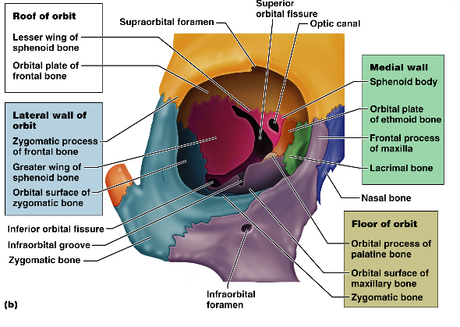
Orbits
Bony cavities in which the eyes are firmly encased and _
Formed by parts of seven bones
Zygomatic
Palatine
Lacrimal
ethmoid

Slide 11
Hyoid Bone
lies just inferior to the mandible in the anterior neck
Only bone of the body that __________________________________directly with another bone
Attachment point for neck muscles that raise and lower the larynx during swallowing and speech

Slide 12
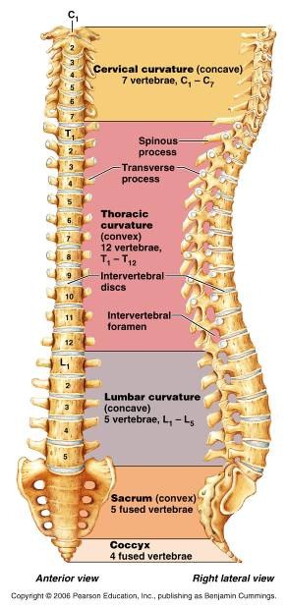
Vertebral Column
Formed from 26 irregular bones (vertebrae) connected in such a way that a flexible curved structure results
Cervical vertebrae
_____bones of the neck
Thoracic vertebrae
_____ bones of the torso
Lumbar vertebrae
_____ bones of the lower back
Sacrum
bone inferior to the lumbar vertebrae that articulates with the hip bones

Slide 13
Vertebral Column: Curvatures
cervical and lumbar
Secondary curvatures
cervical and lumbar – are convex anteriorly and are _
thoracic and sacral
present at birth
convex posteriorly
causing the infant spine to arch like a four-legged animal

Slide 14
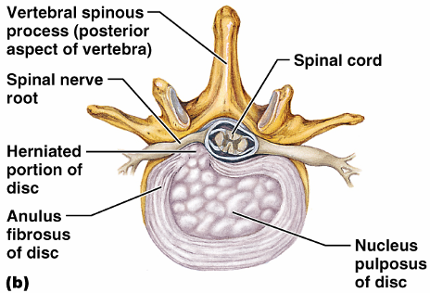
Vertebral Column: Intervertebral Discs
Cushion-like pad composed of two parts
inner gelatinous nucleus that gives the disc its elasticity and compressibility
surrounds the nucleus pulposus with a collar composed of collagen and fibrocartilage

Slide 15
General Structure of Vertebrae
disc-shaped, weight-bearing region
composed of pedicles and laminae that, along with the centrum, enclose the vertebral foramen
make up the vertebral canal through which the spinal cord passes

Slide 16
General Structure of Vertebrae
project posteriorly,
project laterally
Superior and inferior _
protrude superiorly and inferiorly from the pedicle-lamina junctions
Intervertebral foramina
________________________________ formed from notched areas on the _

Slide 17
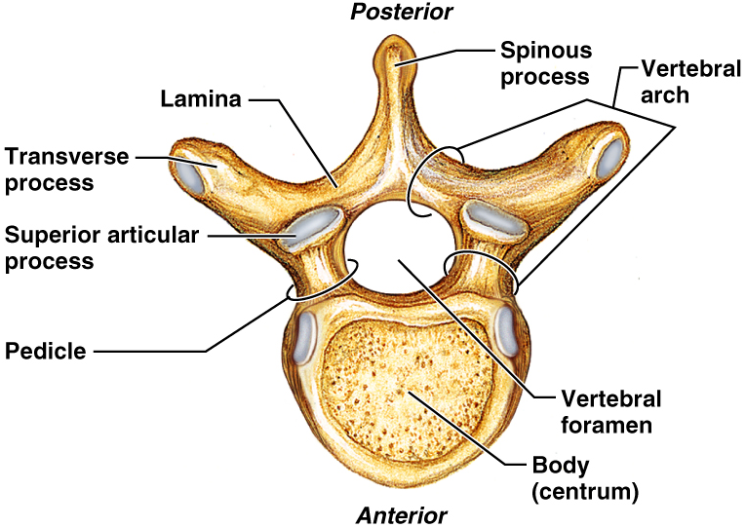
General Structure of Vertebrae

Slide 18
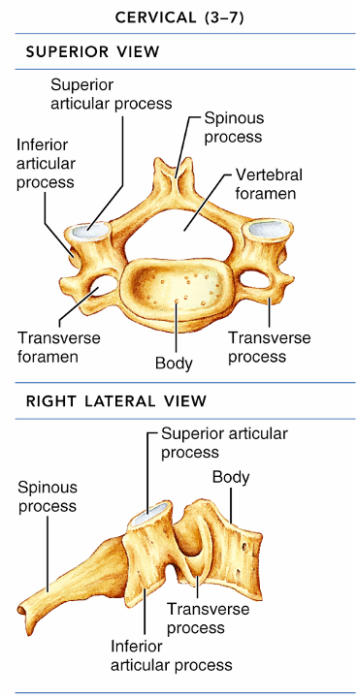
Cervical Vertebrae
Seven vertebrae (C₁-C₇) are the _
C₃-C₇
oval body
short spinous processes,
large, triangular vertebral foramina
Each transverse process contains a _

Slide 19
Cervical Vertebrae: The Atlas (C₁)
The atlas has ___________________ and ______________________
It consists of anterior and posterior arches, and _
The superior surfaces of lateral masses articulate with the _

Slide 20
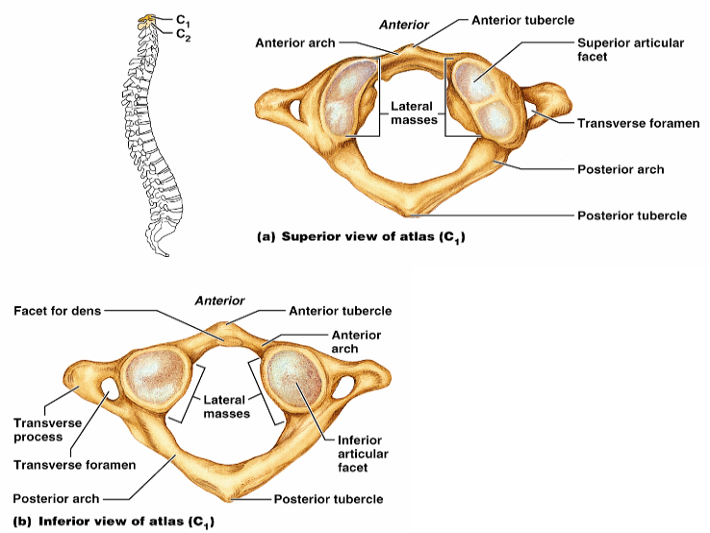
Cervical Vertebrae: The Atlas (C₁)
Figure 7.16a, b

Slide 21
Cervical Vertebrae: The Axis (C₂)
The axis has a body, spine, and vertebral arches as do other cervical vertebrae
Also has the _______________________
projects superiorly from the body and is cradled in the anterior arch of the atlas
The dens is a ______________ for the rotation of the atlas

Slide 22
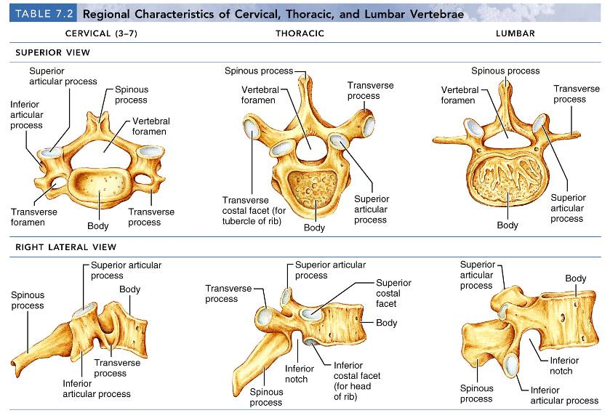
Regional Characteristics of Vertebrae

Slide 23
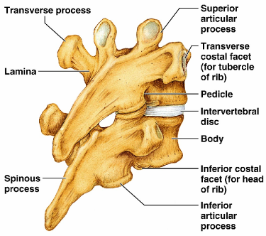
Thoracic Vertebrae
12 Thoracic vertebrae
Major markings include
two _
two demifacets on the heart-shaped body,
_______________ vertebral foramen
transverse processes,
facets prevents flexion and extension
____________________________ of this area of the spine

Slide 24
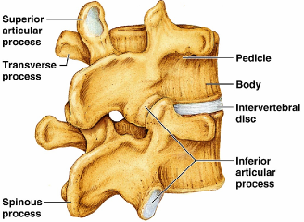
Lumbar Vertebrae
five lumbar vertebrae
have an enhanced _
They have
__________________________ pedicles and laminae
_______________________ hatchet-shaped spinous processes,
triangular-shaped vertebral foramen
Orientation of articular facets locks the lumbar vertebrae together to _

Slide 25
Sacrum
Sacrum
five fused vertebrae (S₁-S₅
shape the _
It articulates with L₅ superiorly, and with the auricular surfaces of the hip bones
Major markings include
transverse lines
dorsal sacral foramina

Slide 26
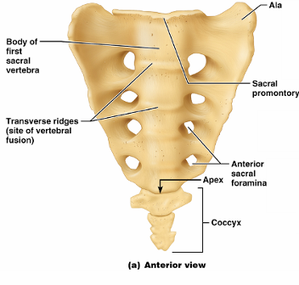
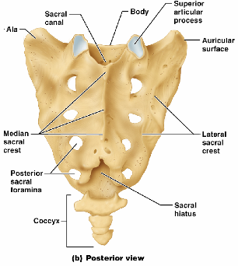
Coccyx
Coccyx (Tailbone)
The coccyx is made up of _____________________ that articulate superiorly with the sacrum

Slide 27
Bony Thorax (Thoracic Cage)
The thoracic cage is composed of
the _
____________________________ laterally
____________________________________ anteriorly

Slide 28
Bony Thorax (Thoracic Cage)
Functions
Forms a ____________________________ around the heart, lungs, and great blood vessels
Supports the _________________________ and upper limbs
Provides attachment for many neck, back, chest, and shoulder muscles
Uses _______________________________ to lift and depress the thorax during breathing

Slide 29
Sternum (Breastbone)
A dagger-shaped, _
lies in the anterior midline of the thorax
Results from the fusion of three bones –
Superior: _
the _
Inferior: _
Anatomical landmarks include the jugular (suprasternal) notch, the sternal angle, and the xiphisternal joint

Slide 30
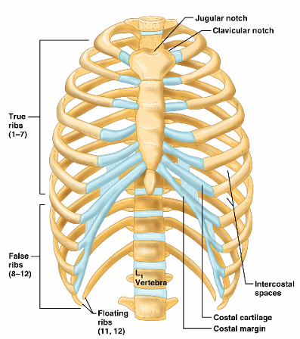
Ribs
There are twelve pair of ribs
All ribs attach _
The superior 7 pair
attach directly to the sternum via costal cartilages
Ribs 8-10 (
attach indirectly to the sternum via costal cartilage
Ribs 11-12
have no anterior attachment

Slide 31
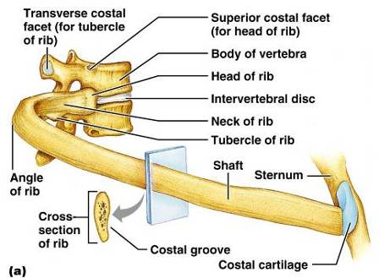
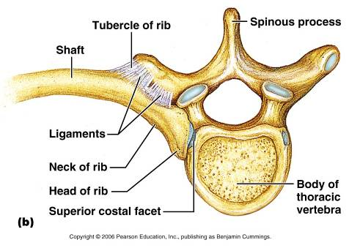
Structure of a Typical True Rib
Bowed, flat bone consisting of a _

Slide 32
Appendicular Skeleton
The _____________________________ skeleton is made up of
the bones of the _
and their _
attach the upper limbs to the body trunk
secures the lower limbs

Slide 33
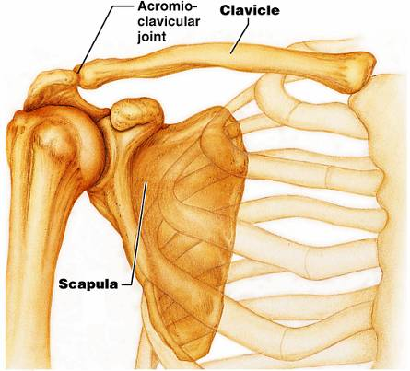
Pectoral Girdles (Shoulder Girdles)
The pectoral girdles consist of the ____________________ and the _
They provide attachment points for muscles that move the upper limbs
Arrangement allows _

Slide 34
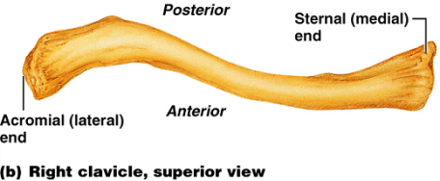
Clavicles (Collarbones)
Slender, doubly curved long bones lying across the _
The ______________________________ end articulates with the scapula
The sternal (medial) end articulates _

Slide 35
Scapulae (Shoulder Blades)
Triangular, flat bones lying on the _
between the _
Scapulae have three borders and three angles

Slide 36
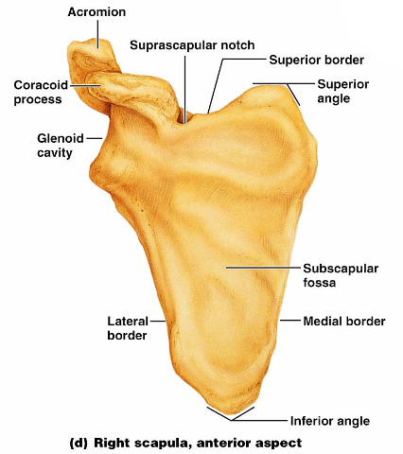
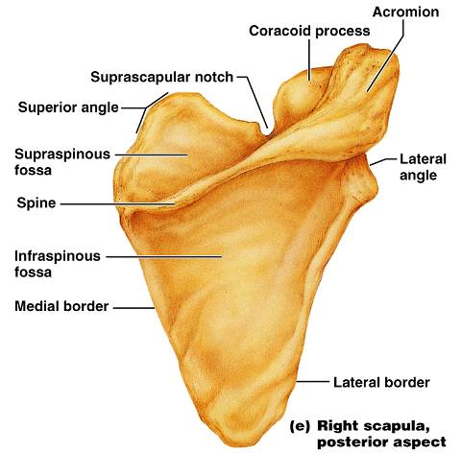
Major markings include the suprascapular notch, the supraspinous and infraspinous fossae, the spine, the acromion, and the coracoid process
Figure 7.22d

Slide 37
The Upper Limb
The upper limb consists of the
forearm
hand
Thirty-seven bones form the skeletal framework of each upper limb

Slide 38
Arm
The ______________________________ is the sole bone of the arm
It articulates with the ________________________________ at the shoulder, and the radius and ulna at the elbow

Slide 39
Arm
Major markings
Proximal humerus includes the head, anatomical and surgical necks, greater and lesser tubercles, and the intertubercular groove

Slide 40
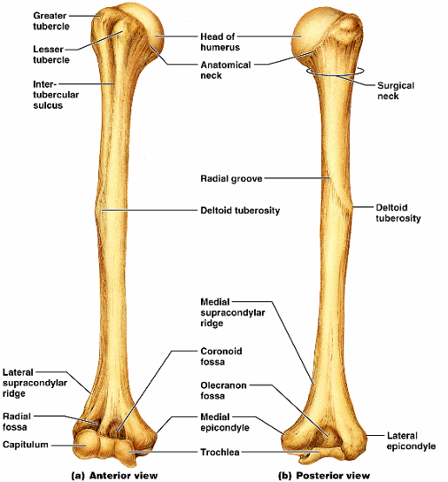
Humerus of the Arm
Distal humerus includes the
medial and lateral epicondyles,
the coronoid
Medial portion includes the
radial groove
deltoid process

Slide 41
Forearm
The bones of the forearm are the _
They articulate proximally with the humerus and _
They also _________________________________ proximally and distally at small radioulnar joints
_______________________________ connects the two bones along their entire length

Slide 42
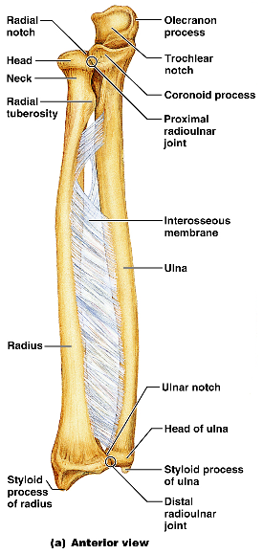
Ulna
The ulna lies _____________ in the forearm and is slightly longer than the radius
Forms the major portion of the _______________________ with the humerus
Its major markings include the olecranon, coronoid process, trochlear notch, radial notch, and the styloid process

Slide 43
Radius
The radius lies opposite ___________________ the ulna and is thin at its proximal end, widened distally
The superior surface of the head articulates with _
Medially, the head articulates with the _
Major markings include the radial tuberosity, ulnar notch, and styloid process

