Slide 1
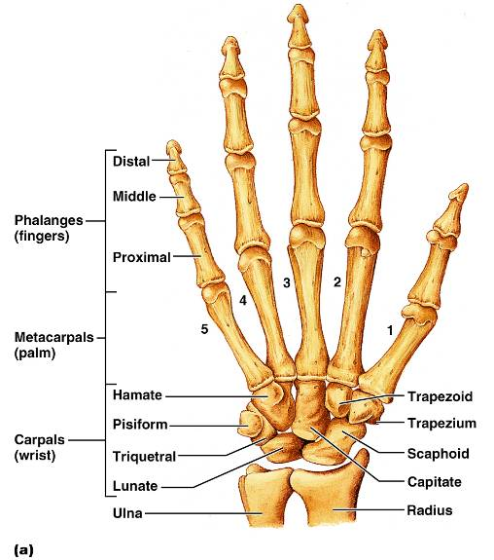
Hand
Skeleton of the hand contains
bones of the palm_
bones of the fingers _

Slide 2
Carpus (Wrist)
Consists of eight bones
____________________, lunate, ___________________, and pisiform proximally
Trapezium, ___________________, capitate, and _________________________ distally

Slide 3
Metacarpus (Palm)
Five numbered (1-5) metacarpal bones radiate from the wrist to form the palm
Their ____________________________________ proximally, and with each other medially and laterally
Heads articulate with _

Slide 4
Phalanges (Fingers)
Each hand contains 14 miniature long bones called phalanges
Fingers (digits) are numbered 1-5, beginning with the _
Each finger (except the thumb) has three phalanges – _
The thumb has _

Slide 5
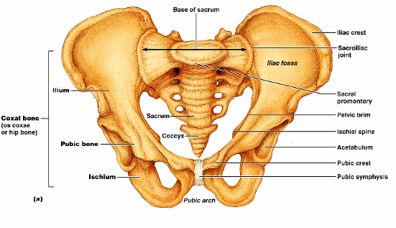
Pelvic Girdle
The hip is formed by a __________________________ (os coxae, or coxal)
Together with the ________________________________ these bones form the bony pelvis

Slide 6
Pelvic Girdle (Hip)
The pelvis
Attaches the lower limbs to the axial skeleton with the strongest ligaments of the body
Supports the visceral organs of the pelvis

Slide 7
Ilium
The ilium is a large flaring bone that forms the superior region of the coxal bone
It consists of
a superior _
The broad posterolateral surface is called the gluteal surface

Slide 8
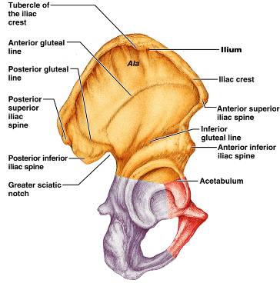
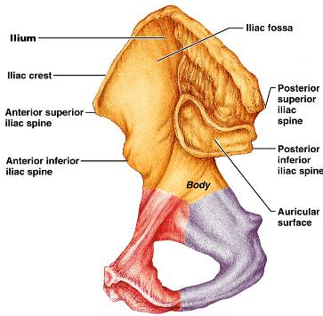
Ilium
The ___________________ articulates with the sacrum (sacroiliac joint)
Major markings include the iliac crests, four spines, greater sciatic notch, iliac fossa, arcuate line, and the pelvic brim

Slide 9
Ischium
The ischium forms the posteroinferior part of the hip bone
The ______________________________, and the thinner ramus articulates with the _
Major markings include the ischial spine, lesser sciatic notch, and the ischial tuberosity

Slide 10
Pubis
The pubic bone forms the anterior portion of the hip bone
It articulates with the _
Major markings include superior and inferior rami, the pubic crest, pubic tubercle, pubic arch, pubic symphysis, and obturator foramen (along with ilium and ischium)

Slide 11
Comparison of Male and Female Pelvic Structure
Female pelvis
Tilted forward, _
True pelvis defines birth canal
Cavity of the true pelvis is broad, shallow, and has greater capacity
Male pelvis
Tilted less forward
Adapted for support of _
Cavity of true pelvis is _

Slide 12
Comparison of Male and Female Pelvic Structure
Characteristic | Female | Male
Bone thickness | Lighter, thinner, and smoother | Heavier, thicker, and more prominent markings
Pubic arch/angle | 80˚–90˚ | 50˚–60˚
Acetabula | Small; farther apart | Large; closer together
Sacrum | Wider, shorter; sacral curvature is accentuated | Narrow, longer; sacral promontory more ventral
Coccyx | More movable; straighter | Less movable; curves ventrally

Slide 13
The Lower Limb
The three segments of the lower limb are the _
They carry the weight of the erect body, and are subjected to exceptional forces when one jumps or runs

Slide 14
Femur
The sole bone of the thigh is the femur, the _____________________________ bone in the body
It articulates _______________________ and _

Slide 15
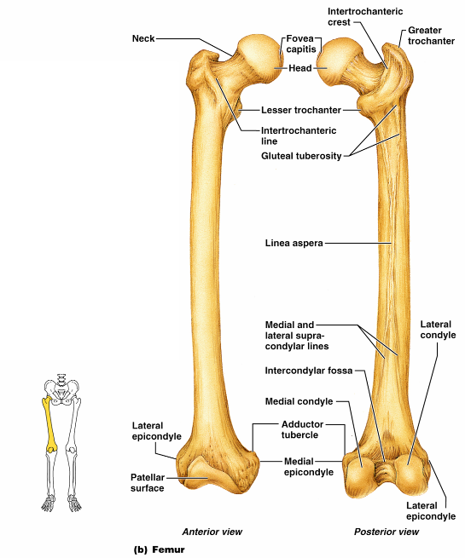
Femur
Major markings include the
head,
fovea capitis
greater and lesser trochanters
gluteal tuberosity
lateral and medial condyles
Epicondyles
linea aspera
patellar surface,
intercondylar notch
Figure 7.28b

Slide 16
Leg
The tibia and fibula form the skeleton of the leg
They are connected to each other by the _
They articulate with the femur proximally and with the _
They also articulate with each other via the _

Slide 17
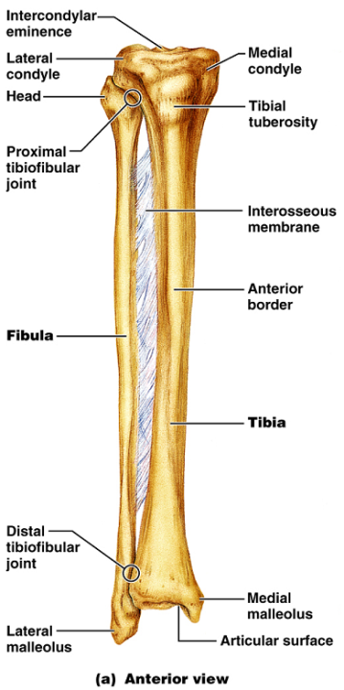
Tibia
____________________ of the body from the femur and _
Major markings include medial and lateral condyles, intercondylar eminence, the tibial tuberosity, anterior crest, medial malleolus, and fibular notch

Slide 18
Fibula
Sticklike bone with slightly expanded ends located _
Major markings include the _

Slide 19
Foot
The skeleton of the foot includes the
The foot supports body weight and acts as a lever to propel the body forward in walking and running

Slide 20
Tarsus
Composed of seven bones that form the posterior half of the foot
Body weight is carried _
Talus articulates with the tibia and fibula superiorly, and the calcaneus inferiorly
Other tarsus bones include the cuboid and navicular, and the medial, intermediate, and lateral cuneiforms

Slide 21
Calcaneus
Forms the _
Carries the _
Point of attachment for the __________________________________ of the calf muscles

Slide 22
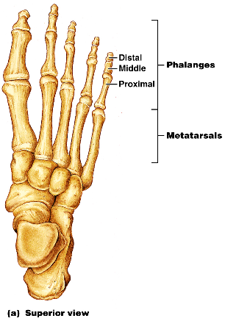
Metatarsus and Phalanges
_
Five (1-5) long bones that articulate with the proximal phalanges
The enlarged head of ________________________ forms the “ball of the foot”
Phalanges
The 14 bones of the toes
Each digit has three phalanges except the _

