Slide 1
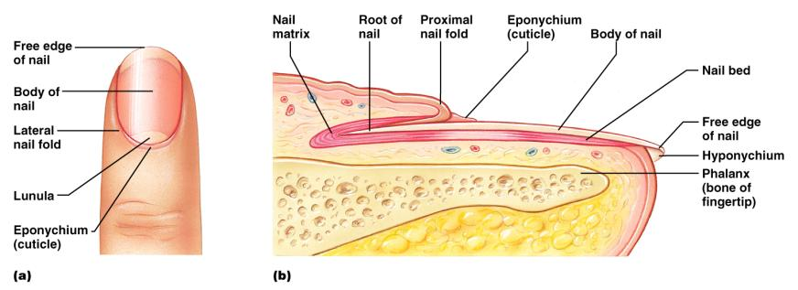
Structure of a Nail
Scalelike ________________________________ on the distal, dorsal surface of fingers and toes

Slide 2
Functions of the Integumentary System
chemical, physical, and mechanical barrier
Body _______________________________ is accomplished by:
_______________________________________ of dermal vessels
Increasing sweat gland secretions to cool the body
Cutaneous sensation
exoreceptors sense touch and pain

Slide 3
Functions of the Integumentary System
Metabolic functions
synthesis of ____________________________ in dermal blood vessels
skin blood vessels store up to 5% of the body’s blood volume
Excretion
limited amounts of ___________________________________ are eliminated from the body in sweat

Slide 4
Skin Cancer
Most skin tumors are _____________________ and do not metastasize
A crucial risk factor for non-melanoma skin cancers is the _
Newly developed skin lotions can fix damaged DNA

Slide 5
Skin Cancer
The three major types of skin cancer are:
Basal cell carcinoma
Squamous cell carcinoma
Melanoma

Slide 6
Basal Cell Carcinoma
________________________________ skin cancer
___________________________________ cells proliferate and invade the dermis and hypodermis
Slow growing
do not often metastasize
Can be cured by _________________________ in 99% of the cases

Slide 7
Squamous Cell Carcinoma
Arises from keratinocytes of _
Arise most often on _
Grows rapidly
metastasizes _
Prognosis is good if treated by radiation therapy or removed surgically

Slide 8
Melanoma
Cancer of ______________________________ is the most dangerous type of skin cancer
Resistant to _

Slide 9
Melanoma
Melanomas have the following characteristics (ABCD rule)
A:
the two sides of the pigmented area do not match
B:
irregular
exhibits indentations
C:
black, brown, tan, and sometimes red or blue
D:
larger than 6 mm (size of a pencil eraser)

Slide 10
Melanoma
Treated by _______________________________ accompanied by immunotherapy
Chance of survival is poor if the lesion is _

Slide 11
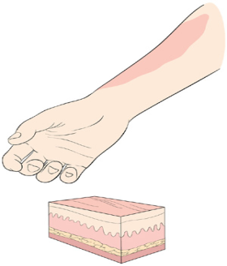
Burns
First-degree
Symptoms
localized _

Slide 12
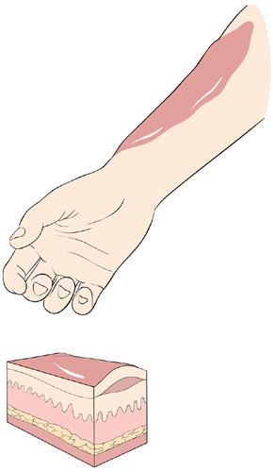
Burns
Second-degree
Symptoms mimic first degree burns
______________________ also appear

Slide 13
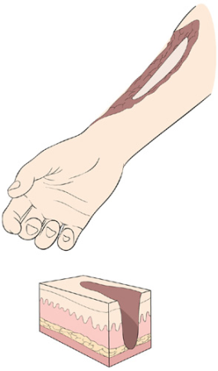
Burns
Third-degree
________________________ of the skin is damaged
Burned area appears gray-white, cherry red, or black
there is no _
nerve endings _

Slide 14
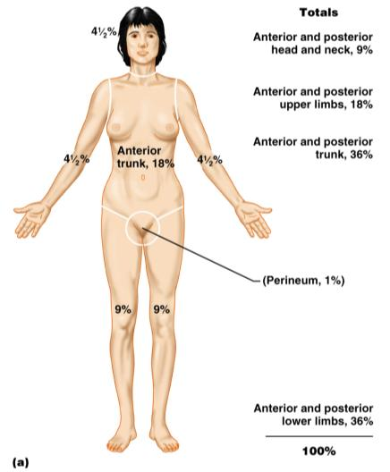
Rule of Nines
Burns considered critical if:
Over 25% of the body has second-degree burns
Over 10% of the body has third-degree burns
There are third-degree burns on face, hands, or feet

Slide 15
Classification of Bones
bones of the skull, vertebral column, and rib cage
bones of the upper and lower limbs, shoulder, and hip

Slide 16
Classification of Bones: By Shape
longer than they are wide

Slide 17
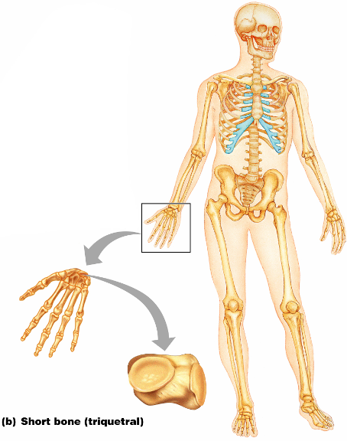
Classification of Bones: By Shape
Cube-shaped bones of the _
Bones that form within tendons _
Figure 6.2b

Slide 18
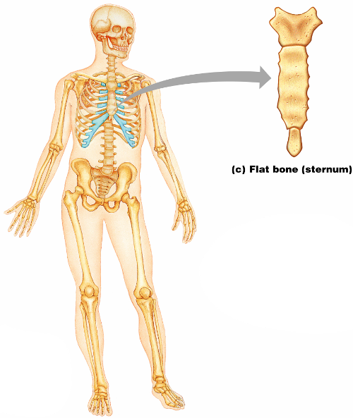
Classification of Bones: By Shape
thin, flattened, and a bit curved
most
Figure 6.2c

Slide 19
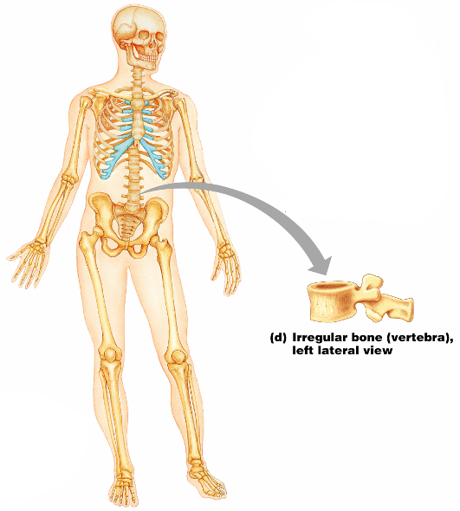
Classification of Bones: By Shape
bones with complicated shapes
Figure 6.2d

Slide 20
Function of Bones
reservoir for minerals, especially calcium and phosphorus
hematopoiesis occurs within the marrow cavities of bones

Slide 21
Bone Markings
Bulges, depressions, and holes that serve as:
Joint surfaces
Conduits for blood vessels and nerves

Slide 22
Bone Markings: Projections – Sites of Muscle and Ligament Attachment
rounded projection
narrow, prominent ridge of bone
large, blunt, irregular surface
narrow ridge of bone
small rounded projection
raised area above a condyle
sharp, slender projection
any bony prominence

Slide 23
Bone Markings: Projections – Projections That Help to Form Joints
bony expansion carried on a narrow neck
smooth, nearly flat articular surface
rounded articular projection
arm-like bar of bone

Slide 24
Bone Markings: Depressions and Openings
canal-like passageway
cavity within a bone
shallow, basin-like depression
furrow
narrow, slit-like opening
round or oval opening through a bone

Slide 25
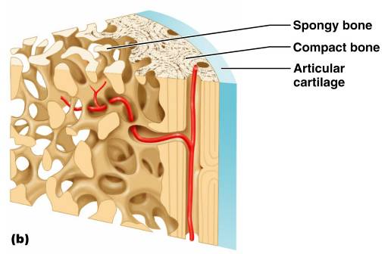
Bone Textures
Compact bone
Spongy bone
honeycomb of trabeculae _

Slide 26
Structure of Long Bone
Long bones consist of a _
Diaphysis
Tubular shaft
Composed of _
surrounds the medullary cavity
Yellow bone marrow in the medullary cavity

Slide 27
Structure of Long Bone
Epiphyses
________________________________ of long bones
Exterior is compact bone, and the _
Joint surface is covered with articular (hyaline) cartilage
Epiphyseal line separates the diaphysis from the epiphyses

Slide 28
Bone Membranes
______________________________ – double-layered protective membrane
Richly supplied with nerve fibers, blood, and lymphatic vessels, which enter the bone via _
Secured to underlying bone by _

Slide 29
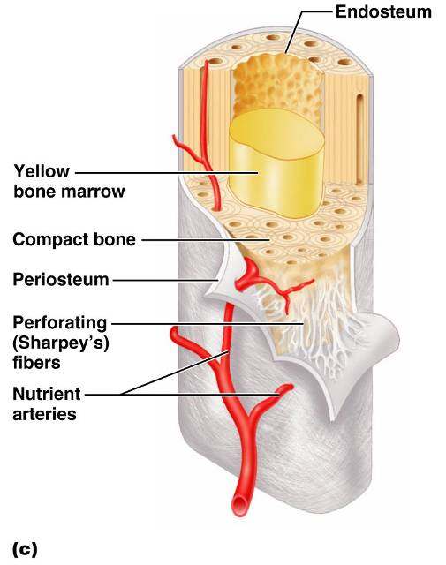
Bone Membranes
delicate membrane covering internal surfaces of bone

Slide 30
Structure of Short, Irregular, and Flat Bones
Thin plates of periosteum-covered compact bone on the outside with endosteum-covered spongy bone on the inside
Have _
Contain bone marrow between the trabeculae

Slide 31
Location of Hematopoietic Tissue (Red Marrow)
In infants
Found in the _
all areas of spongy bone
In adults
Found in the _
the head of the femur
the head of the _

Slide 32
Microscopic Structure of Bone: Compact Bone
_________________________, or osteon – the structural unit of compact bone
weight-bearing, column-like matrix tubes composed mainly of collagen
Haversian, or _
containing blood vessels and nerves
channels lying at right angles to the central canal, connecting blood and nerve supply of the periosteum to that of the Haversian canal

Slide 33
Microscopic Structure of Bone: Compact Bone
Osteocytes
Lacunae
______________________________ in bone that _
Canaliculi
___________________________________ that connect lacunae to each other and the central canal

Slide 34
Chemical Composition of Bone: Organic
Osteoblasts
Osteocytes
mature bone cells
Osteoclasts
large cells that resorb or _

Slide 35
Bone Development
Osteogenesis and ossification – the _________________________________, which leads to:
The formation of the bony skeleton in embryos
Bone growth until early adulthood
Bone thickness, _

Slide 36
Formation of the Bony Skeleton
Begins at ______________________ of embryo development
Intramembranous ossification
bone develops from a _
Endochondral ossification
bone forms by _

Slide 37
Intramembranous Ossification
Formation of most of the _

Slide 38
Stages of Intramembranous Ossification
An _____________________________ appears in the fibrous connective tissue membrane
Bone matrix is secreted within the fibrous membrane
Woven bone and periosteum form
Bone collar of _

Slide 39
Endochondral Ossification
Begins in the _
Uses ____________________________” as models for bone construction
Requires breakdown of hyaline cartilage prior to ossification

Slide 40
Stages of Endochondral Ossification
Formation of bone collar
Cavitation of the hyaline cartilage
spongy bone formation
Formation of the medullary cavity; appearance of _
Ossification of the epiphyses, with hyaline cartilage remaining only in the epiphyseal plates

Slide 41
Postnatal Bone Growth
Growth in length of long bones
Cells of the epiphyseal plate proximal to the resting cartilage form three functionally different zones:

Slide 42
Functional Zones in Long Bone Growth
Growth zone
____________________________________, pushing the epiphysis away from the diaphysis
Transformation zone
older cells enlarge, the matrix becomes calcified, cartilage cells die, and the _
Osteogenic zone
new _

Slide 43
Hormonal Regulation of Bone Growth During Youth
During infancy and childhood, epiphyseal plate activity is stimulated by _
During puberty, _
Initially promote adolescent growth spurts
Later induce epiphyseal ___________________________, ending longitudinal bone growth

Slide 44
Response to Mechanical Stress
Wolff’s law
a bone grows or remodels _
Observations supporting Wolff’s law include
Long bones are thickest midway along the shaft (where bending stress is greatest)
Curved bones are thickest where they are most likely to buckle

Slide 45
Bone Fractures (Breaks)
Bone fractures are classified by:
The _____________________________ of the bone ends after fracture
The _______________________________ of the break
The ______________________________ of the bone to the long axis
Whether or not the bones ends penetrate the skin

Slide 46
Types of Bone Fractures
bone ends retain their normal position
bone ends are out of normal alignment

Slide 47
Types of Bone Fractures
bone is broken all the way through
bone is not broken all the way through
the fracture is ___________________________________ of the bone

Slide 48
Types of Bone Fractures
the fracture is __________________________________to the long axis of the bone
Compound (open)
bone ends do not penetrate the skin

Slide 49
Common Types of Fractures
Comminuted
bone fragments into __________________________ common in the elderly
ragged break when bone is _____________________________________ common sports injury
broken bone portion pressed inward; typical skull fracture

Slide 50
Common Types of Fractures
Compression
___________________________________; common in porous bones
epiphysis separates from diaphysis along epiphyseal line; occurs where cartilage cells are dying
incomplete fracture where one side of the bone breaks and the other side bends; _

Slide 51
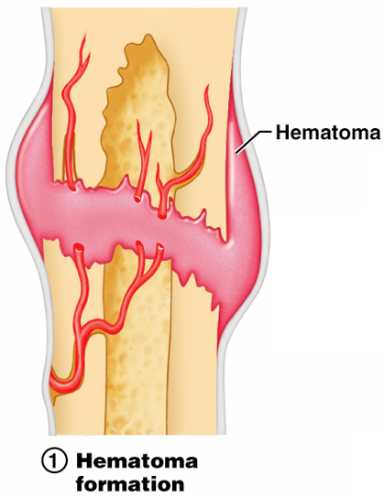
Stages in the Healing of a Bone Fracture
Torn blood vessels hemorrhage
A mass of clotted blood (_______________) forms at the fracture site
Site becomes swollen, painful, and inflamed
Figure 6.13.1

Slide 52
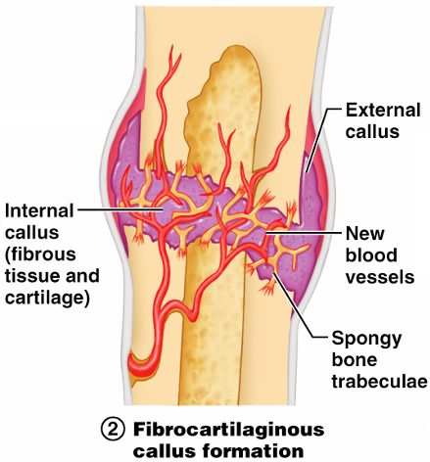
Stages in the Healing of a Bone Fracture
Fibrocartilaginous _
Granulation tissue (soft callus) forms a few days after the fracture
__________________________________ and phagocytic cells begin cleaning debris
Figure 6.13.2

Slide 53
Stages in the Healing of a Bone Fracture
The fibrocartilaginous callus forms when:
___________________________________ migrate to the fracture and begin reconstructing the bone
Fibroblasts secrete __________________________________ that connect broken bone ends
Osteoblasts begin forming spongy bone

Slide 54
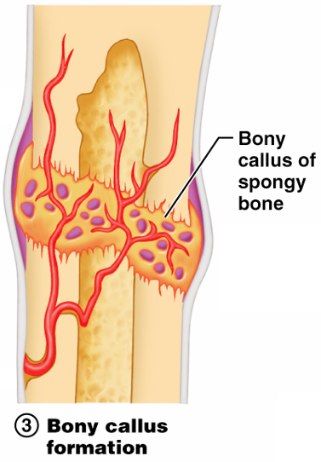
Stages in the Healing of a Bone Fracture
Bony callus formation
New bone trabeculae appear in the fibrocartilaginous callus
Fibrocartilaginous callus _
Bone callus _____________________________________, and continues until firm union is formed 2-3 months later
Figure 6.13.3

Slide 55
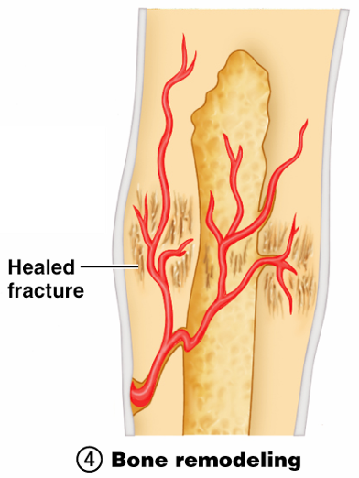
Stages in the Healing of a Bone Fracture
Bone remodeling
Excess material on the bone shaft exterior and in the medullary canal is removed
________________ is laid down to reconstruct shaft walls
Figure 6.13.4

Slide 56
Homeostatic Imbalances
Bones are inadequately mineralized causing softened, weakened bones
Main symptom is pain when weight is put on the affected bone
Caused by insufficient _

Slide 57
Homeostatic Imbalances
Rickets
Bones of children are inadequately mineralized causing softened, weakened bones
________________________________ and deformities of the pelvis, skull, and rib cage are common
Caused by insufficient _

Slide 58
Isolated Cases of Rickets
Rickets has been _
Only isolated cases appear
Example: Infants of breastfeeding mothers deficient in Vitamin D will also be Vitamin D deficient and develop rickets

Slide 59
Homeostatic Imbalances
Osteoporosis
Group of diseases in which _
Occurs most often in postmenopausal women
Bones become so fragile that sneezing or stepping off a curb _

Slide 60
Osteoporosis: Treatment
Increased _
Hormone (estrogen) replacement therapy (HRT) slows bone loss
Natural progesterone cream prompts new bone growth
Statins increase bone mineral density

