Slide 1
Temporomandibular Joint (TMJ)
Mandibular condyle articulate with the _
Two types of movement
____________________________– depression and elevation of mandible
Side to side – (____________________________) grinding of teeth

Slide 2
Sprains
The _____________________________ reinforcing a joint are _
Partially torn ligaments slowly repair themselves
___________________________________ ligaments require prompt surgical repair

Slide 3
Cartilage Injuries
The snap and pop of overstressed cartilage
Common aerobics injury
Repaired with _

Slide 4
Dislocations
Occur when bones are forced out of alignment
Usually accompanied by ___________________________________ inflammation, and joint immobilization
Caused by serious falls and are common sports injuries
_
______________________________________ dislocation of a joint

Slide 5
Inflammatory and Degenerative Conditions
Bursitis
An inflammation of a ______________________ , usually caused by a _
Symptoms are _
Treated with anti-inflammatory drugs; excessive fluid may be aspirated

Slide 6
Inflammatory and Degenerative Conditions
Tendonitis
Inflammation of _______________________________________ typically caused by overuse
Symptoms and treatment are similar to _

Slide 7
Arthritis
More than ______________________________ of inflammatory or degenerative diseases that damage the joints
Most widespread crippling disease in the U.S.
Symptoms
pain, stiffness, and _
Acute forms are caused by ___________________________ and are treated with antibiotics
Chronic forms include osteoarthritis, rheumatoid arthritis, and gouty arthritis

Slide 8
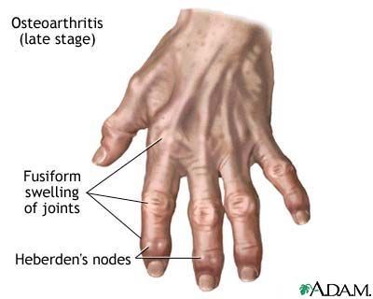
Osteoarthritis (OA)
Most common chronic arthritis; often called “______________________________ ” arthritis
Affects _______________________more than men
______________of all Americans develop OA
More prevalent in the aged, and is probably related to the normal aging process

Slide 9
Osteoarthritis: Course
OA reflects the years of ________________________________________ causing increased production of metalloproteinase enzymes that break down cartilage
As one ages, cartilage is destroyed more quickly than it is replaced
The exposed bone ends ________________________, enlarge, form bone spurs, and _
Joints most affected are the cervical and lumbar spine, fingers, knuckles, knees, and hips

Slide 10
Osteoarthritis: Treatments
OA is slow and _
Treatments include:
Mild ___________________________________, along with moderate activity
Magnetic therapy
Glucosamine sulfate decreases pain and inflammation

Slide 11
Rheumatoid Arthritis (RA)
Chronic, inflammatory, ______________________________________ of unknown cause, with an insidious onset
Usually arises between the ages of ________________, but may occur at any age
Signs and symptoms include joint tenderness, anemia, osteoporosis, _________________________, and cardiovascular problems
The course of RA is marked with _

Slide 12
Rheumatoid Arthritis: Course
RA begins with _________________________ of the affected joint
Inflammatory chemicals are _________________________________ released
Inflammatory blood cells migrate to the joint, causing swelling

Slide 13
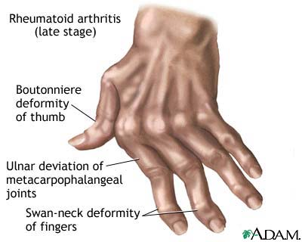
Rheumatoid Arthritis:
Inflamed ________________________________ thickens into a pannus
Pannus ______________________________ , scar tissue forms, articulating bone ends connect
The end result, _______________________, produces bent, deformed fingers

Slide 14
Rheumatoid Arthritis: Treatment
Conservative therapy – _________________, long-term use of antibiotics, and physical therapy
Progressive treatment – anti-inflammatory drugs or _
The drug Enbrel, a biological response modifier, neutralizes the harmful properties of inflammatory chemicals

Slide 15
Comparison of arthritic joints

Slide 16
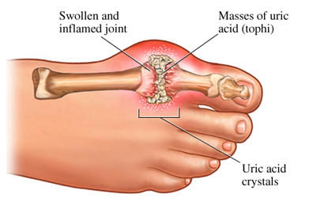
Gouty Arthritis
Deposition of ________________________________________in joints and soft tissues, followed by an _
Typically, gouty arthritis affects the joint at the _
In untreated gouty arthritis, the _________________________________________ and immobilize the joint
Treatment – colchicine, nonsteroidal anti-inflammatory drugs, and glucocorticoids

Slide 17
Muscle Overview
The three types of muscle tissue are
These types differ in structure, location, function, and means of activation

Slide 18
Muscle Similarities
Skeletal and smooth _________________________ are elongated
called _
Muscle contraction depends on two kinds of myofilaments
Muscle terminology is similar
muscle plasma membrane
cytoplasm of a muscle cell
Prefixes
myo, mys, and sarco all refer to _

Slide 19
Skeletal Muscle Tissue
Has obvious ____________________called _
Is controlled _
Contracts rapidly
but _
Is responsible for overall body motility
Is extremely _
can exert wide range of forces

Slide 20
Cardiac Muscle Tissue
Occurs _
Is ______________________________ like skeletal muscle
not _
Rhythmicity controlled by _
Pacemaker located within the heart
Neural controls temper the heart’s response
Elevates or depresses rate as needed

Slide 21
Smooth Muscle Tissue
Found in the walls of hollow _______________________________organs,
the _
urinary bladder,
respiratory passages
Forces food and other substances through internal body channels
It is _

Slide 22
Functional Characteristics of Muscle Tissue
the ability to receive and respond to stimuli
the ability to shorten forcibly
the ability to be stretched or extended
the ability to recoil and resume the original resting length

Slide 23
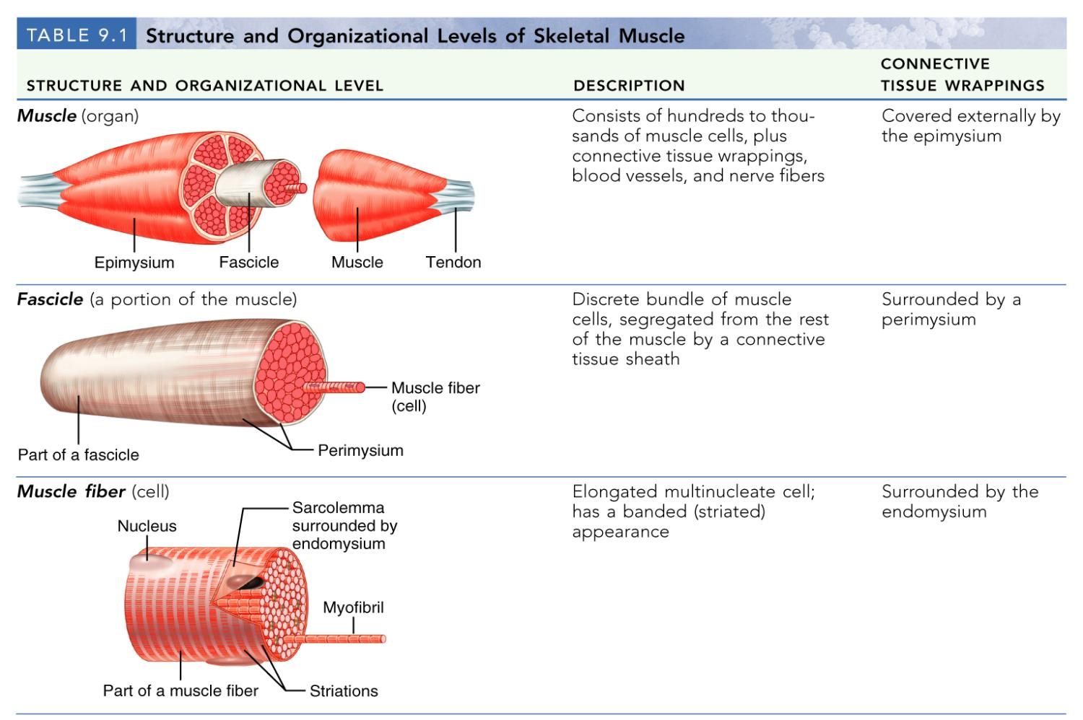
Structure and Organization of Skeletal Muscle

Slide 24
Structure and Organization of Skeletal Muscle
Table 9.1b

Slide 25
Skeletal Muscle
Each muscle is a ___________________________ composed of muscle tissue, blood vessels, nerve fibers, and connective tissue

Slide 26
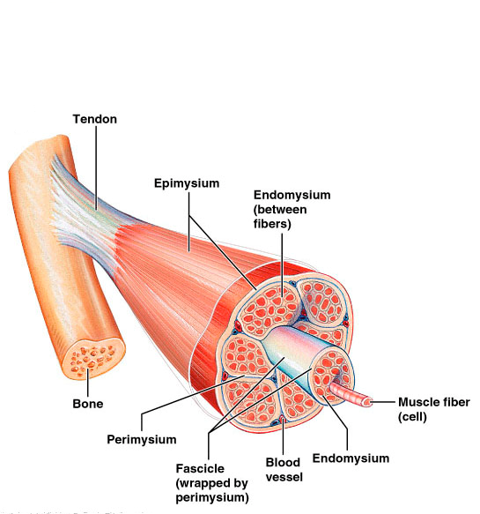
Skeletal Muscle
The three connective tissue sheaths are:
fine sheath of _____________________ tissue composed of reticular fibers surrounding each muscle fiber
fibrous connective tissue that surrounds groups of muscle fibers called _
an overcoat of dense regular connective tissue that surrounds the entire muscle

Slide 27
Skeletal Muscle: Attachments
Most skeletal muscles ______________________________ and are attached to bone _
When muscles contract the movable bone, the muscle’s _

Slide 28
Skeletal Muscle: Attachments
Muscles attach:
epimysium of the muscle is fused to the _
connective tissue wrappings extend beyond the muscle as a _

Slide 29
Microscopic Anatomy of a Skeletal Muscle Fiber
Each fiber is a long, cylindrical cell with __________________________________ just beneath the sarcolemma
Fibers are up to __________________________ long
Each cell is a ___________________________ produced by fusion of embryonic cells

Slide 30
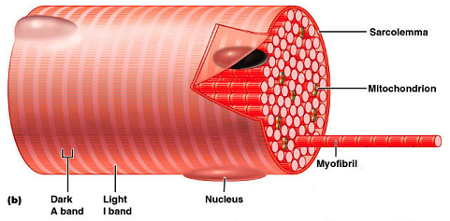
Myofibrils
Myofibrils are densely packed, rodlike contractile elements
They make up most of the _
The arrangement of myofibrils creates a repeating series of _

Slide 31
Sarcomeres
The smallest ________________________ of a muscle
Composed of ______________________________ made up of contractile proteins
Myofilaments are of two types – _

Slide 32
Myofilaments: Banding Pattern
Thick filaments are composed of the _
extend the entire length of an A band
extend across the I band and partway into the A band
Z-disc
coin-shaped sheet of proteins (connectins) that anchors the thin filaments and connects myofibrils to one another

Slide 33
Ultrastructure of Myofilaments: Thick Filaments
Each ________________________________ molecule has a rod-like tail and two globular heads
two interwoven, heavy polypeptide chains
two smaller, light polypeptide chains called cross bridges

Slide 34
Ultrastructure of Myofilaments: Thin Filaments
Thin filaments are chiefly composed of the protein _
The subunits contain the ____________________________ to which myosin heads attach during contraction
Tropomyosin and troponin are regulatory subunits bound to actin

Slide 35
Sarcoplasmic Reticulum (SR)
SR is ___________________________________ that runs longitudinally and _
Functions in the regulation of _

Slide 36
T Tubules
T tubules are continuous with the _
They conduct impulses to the _
These impulses signal for the release of _

Slide 37
Sliding Filament Model of Contraction
Thin filaments _____________________ past the thick ones so that the actin and myosin filaments overlap to a greater degree
In the relaxed state, thin and thick filaments overlap _
Upon stimulation, myosin heads bind to actin and sliding begins

Slide 38
Sliding Filament Model of Contraction
Each myosin head binds and detaches several times during contraction, ______________________________________ to generate tension and propel the thin filaments to the center of the sarcomere
As this event occurs throughout the sarcomeres, the _

Slide 39
Skeletal Muscle Contraction
In order to contract, a skeletal muscle must:
Be ____________________________by a nerve ending
Send an electrical current, or ________________________________, along its sarcolemma
Have a ___________________ in intracellular Ca²⁺ levels, the final trigger for contraction
Linking the ______________________________________ is excitation-contraction coupling

Slide 40
Nerve Stimulus of Skeletal Muscle
Skeletal muscles are stimulated by _______________________________ of the somatic nervous system
Axons of these neurons travel in ____________________to muscle cells
Axons of motor neurons __________________ profusely as they enter muscles
Each axonal branch forms a _______________________________________ with a single muscle fiber

Slide 41
Neuromuscular Junction
The neuromuscular junction is formed from:
___________________________________, which have small membranous sacs (synaptic vesicles) that contain the neurotransmitter acetylcholine (ACh)
The __________________________________of a muscle, which is a specific part of the sarcolemma that contains ACh receptors and helps form the neuromuscular junction

Slide 42
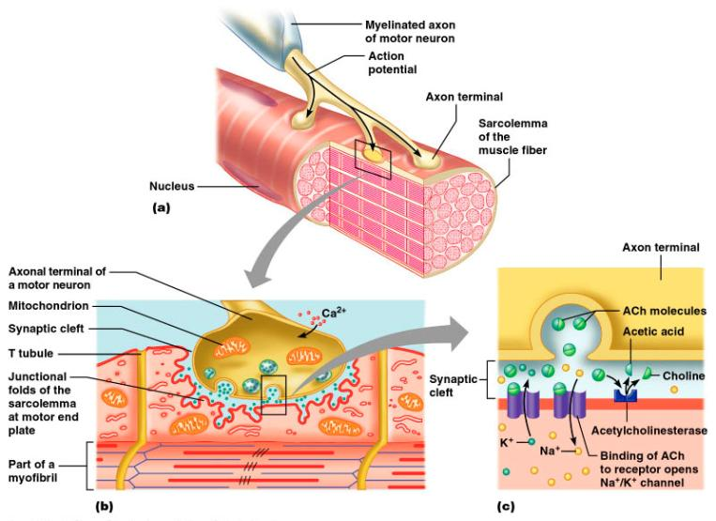
Neuromuscular Junction
Though exceedingly close, axonal ends and muscle fibers are ____________________________________ called the synaptic cleft

Slide 43
Neuromuscular Junction
When a nerve impulse reaches the end of an axon at the neuromuscular junction:
___________________________________________ calcium channels open and allow Ca²⁺ to enter the axon
Ca²⁺ causes axonal vesicles to ____________________ with the axonal membrane
This fusion releases _____________________ into the synaptic cleft
ACh _______________________________ across the synaptic cleft to ACh receptors on the sarcolemma
Binding of ACh to its receptors _

Slide 44
Destruction of Acetylcholine
ACh bound to ACh receptors is quickly _____________________________________by the enzyme _
This destruction prevents __________________________________ in the absence of additional stimuli

