Slide 1
Joints (Articulations)
___________________________________ parts of the skeleton
Articulation – _
Functions of joints
Give the skeleton _
Hold the skeleton together

Slide 2
Classification of Joints: Structural
Structural classification focuses on the material binding bones together and _
The three structural classifications are:

Slide 3
Classification of Joints: Functional
________________________________ classification is based on the _____________________________________ allowed by the joint
The three functional classes of joints are:
_______________________________________ – immovable
_______________________________________ – slightly movable
_______________________________________ – freely movable

Slide 4
Fibrous Structural Joints
The bones are joined by _
There is _
Most are _
There are three types – sutures, syndesmoses, and gomphoses

Slide 5
Fibrous Structural Joints: Sutures
Occur between the _
Comprised of interlocking junctions completely _
Bind bones tightly together, but allow for growth during youth
In middle age, skull bones _

Slide 6
Fibrous Structural Joints: Syndesmoses
Bones are connected by a _
Movement varies from immovable to slightly variable
Examples include the connection between the _

Slide 7
Fibrous Structural Joints: Gomphoses
The ___________________________________ between a tooth and its alveolar socket
The fibrous connection is the _

Slide 8
Cartilaginous Joints
Articulating bones are united by cartilage
Two types –

Slide 9
Cartilaginous Joints: Synchondroses
A bar or plate of hyaline cartilage unites the bones
All synchondroses are synarthrotic
Examples include:
Joint between the _

Slide 10
Cartilaginous Joints: Symphyses
___________________________________ covers the articulating surface of the bone and is ___________________________ to an intervening pad of fibrocartilage
Amphiarthrotic joints designed for _
Examples include _

Slide 11
Synovial Joints
Those joints in which the articulating bones are separated by a _
All are ______________________________ diarthroses
Examples – ___________________________, and most joints of the body

Slide 12
Synovial Joints: General Structure
Synovial joints all have the following
Joint _______________________________ cavity
Articular capsule
Reinforcing _

Slide 13
Synovial Joints: Friction-Reducing Structures
__________________________________ – flattened, fibrous sacs lined with synovial membranes and containing synovial fluid
Common where ligaments, muscles, skin, tendons, or _
Tendon sheath – ___________________________________ that wraps completely around a tendon

Slide 14
Synovial Joints: Stability
Stability is determined by:
Articular surfaces – _
Ligaments – unite bones and _

Slide 15
Synovial Joints: Stability
Muscle tone is accomplished by:
_______________________________________ across joints acting as stabilizing factors
Tendons that are kept tight at all times by muscle tone

Slide 16
Synovial Joints: Movement
The two muscle attachments across a joint are:
__________________________________ – attachment to the immovable bone
__________________________________ – attachment to the movable bone
Described as movement along transverse, frontal, or sagittal planes

Slide 17
Synovial Joints: Range of Motion
______________________________________ – slipping movements only
______________________________________ – movement in one plane
______________________________________ – movement in two planes
______________________________________ – movement in or around all three planes

Slide 18
Gliding Movements
One flat bone surface glides or slips over another similar surface
Examples – ___________________________ and intertarsal joints, and between the _

Slide 19
Angular Movement
Flexion —
Extension — reverse of flexion; _
Dorsiflexion and plantar flexion

Slide 20
Angular Movement
Abduction — movement _
Adduction — movement _
Circumduction — _

Slide 21
Rotation
The turning of a bone _
Examples
Between _
Hip and _

Slide 22
Special Movements
Inversion and eversion
Elevation and depression

Slide 23
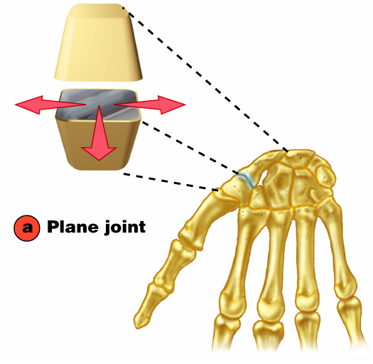
Plane Joint
Plane joints
Articular surfaces are essentially _
Allow only _
Only examples of _

Slide 24
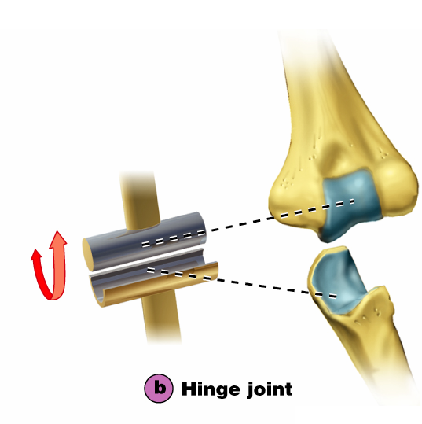
Types of Synovial Joints
Hinge joints
Cylindrical projections of one bone fits into a trough-shaped surface on another
Motion is along a _
Uniaxial joints permit _
Examples: _

Slide 25
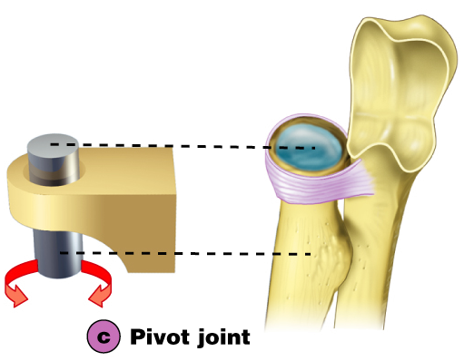
Pivot Joints
Rounded end of one bone protrudes into a “sleeve,” or ring, composed of bone (and possibly ligaments) of another
Only _
Examples: joint between the _

Slide 26
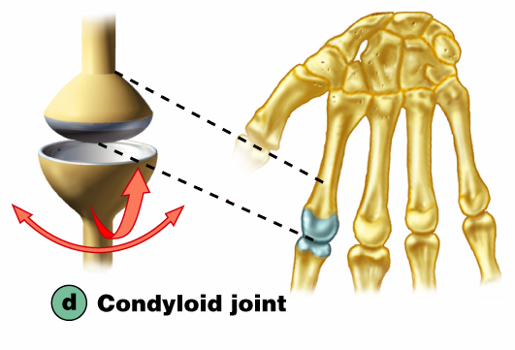
Condyloid or Ellipsoidal Joints
Oval articular surface of one bone fits into a complementary depression in another
Both _
Biaxial joints permit all angular motions
Examples: radiocarpal (wrist) joints, and _

Slide 27
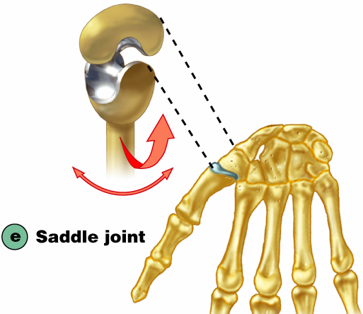
Saddle Joints
Similar to condyloid joints but allow _
Each articular surface has both a _
Example: _

Slide 28
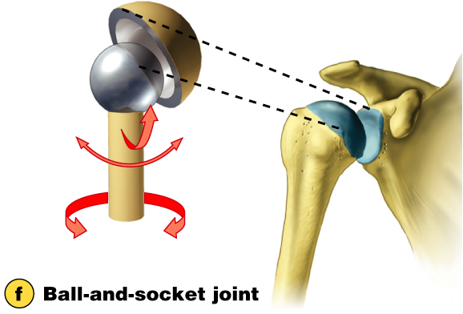
Ball-and-Socket Joints
A spherical or hemispherical head of one bone articulates with a _
Multiaxial joints permit the _
Examples: _

Slide 29
Synovial Joints: Knee
_________________________________ joint of the body
Allows _
Three joints in one surrounded by a single joint cavity
Femoropatellar joint
Lateral and medial tibiofemoral joints

Slide 30
Synovial Joints: Knee Ligaments and Tendons – Anterior View
Tendon of the quadriceps femoris muscle
Lateral and medial patellar retinacula
Fibular and tibial collateral ligaments
Patellar ligament

Slide 31
Synovial Joints: Knee – Other Supporting Structures
Medial meniscus (semilunar cartilage)
Lateral meniscus

Slide 32
Synovial Joints: Shoulder (Glenohumeral)
_________________________________ in which ________________________________ to obtain greater freedom of movement
Head of humerus articulates with the _

Slide 33
Synovial Joints: Elbow
_______________________________ that allows flexion and extension only
Radius and ulna articulate with the humerus

Slide 34
Synovial Joints: Shoulder Stability
Weak stability is maintained by:
Thin, loose joint capsule
Four ligaments – coracohumeral, and three glenohumeral
Tendon of the ____________________________, which travels through the intertubercular groove and secures the humerus to the glenoid cavity
_______________________________________ that encircles the shoulder joint and blends with the articular capsule

Slide 35
Synovial Joints: Hip (Coxal) Joint
Head of the femur articulates with the _
Good range of motion, but limited by the _

Slide 36
Temporomandibular Joint (TMJ)
Mandibular condyle articulate with the temporal bone
Two types of movement
Hinge –
Side to side –

Slide 37
Sprains
The ligaments reinforcing a joint are stretched or torn
___________________________________ slowly repair themselves
Completely torn ligaments require prompt surgical repair

Slide 38
Cartilage Injuries
The snap and pop of overstressed cartilage
Repaired with _

Slide 39
Dislocations
Occur when bones are _
Usually accompanied by _
Caused by serious falls and are common sports injuries
Subluxation

