Slide 1
Inflammatory and Degenerative Conditions
An inflammation of a bursa, usually caused by _
Symptoms are _
Treated with anti-inflammatory drugs; excessive fluid may be aspirated

Slide 2
Inflammatory and Degenerative Conditions
Inflammation of tendon sheaths typically _
Symptoms and treatment are _

Slide 3
Arthritis
More than 100 different types of inflammatory or degenerative diseases that damage the joints
Most widespread crippling disease in the U.S.
Symptoms
Acute forms are caused by bacteria and are treated with antibiotics
Chronic forms include _

Slide 4
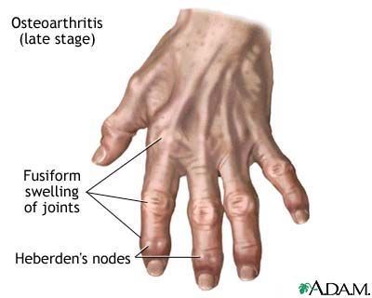
Osteoarthritis (OA)
Most common chronic arthritis; often called _
Affects women more than men
85% of all Americans develop OA
More prevalent in the aged, and is _

Slide 5
Osteoarthritis: Course
OA reflects the _________________________ and compression causing increased production of metalloproteinase enzymes that break down cartilage
As one ages, cartilage is _
The exposed bone ends thicken, enlarge, ______________________________________, and restrict movement
Joints most affected are the cervical and lumbar spine, fingers, knuckles, knees, and hips

Slide 6
Osteoarthritis: Treatments
OA is _
Treatments include:
Mild pain relievers, along with moderate activity
Magnetic therapy
Glucosamine sulfate decreases pain and inflammation

Slide 7
Rheumatoid Arthritis (RA)
Chronic, ____________________________, ______________________ disease of unknown cause, with an insidious onset
Usually arises between the ages of 40 to 50, but may occur at any age
Signs and symptoms include joint tenderness, anemia, osteoporosis, muscle atrophy, and cardiovascular problems
The course of RA is marked with _

Slide 8
Rheumatoid Arthritis: Course
RA begins with ________________________ of the affected joint
_____________________________________ are inappropriately released
Inflammatory blood cells migrate to the joint, causing swelling

Slide 9
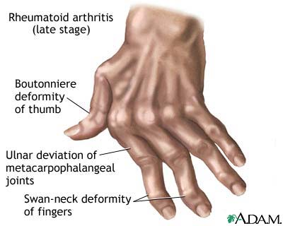
Rheumatoid Arthritis: Course
Inflamed synovial membrane thickens into a pannus
Pannus ______________________________, scar tissue forms, articulating bone ends connect
The end result, _

Slide 10
Rheumatoid Arthritis: Treatment
Conservative therapy – aspirin, long-term use of antibiotics, and physical therapy
Progressive treatment – anti-inflammatory drugs or immunosuppressants
The drug Enbrel, a biological response modifier, neutralizes the harmful properties of inflammatory chemicals

Slide 11
Comparison of arthritic joints

Slide 12
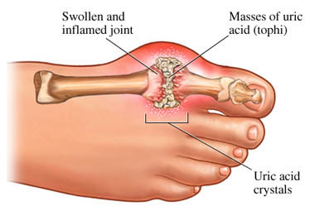
Gouty Arthritis
Deposition of ______________________________________ in joints and soft tissues, followed by an _
Typically, gouty arthritis affects the joint at the base of the _
In untreated gouty arthritis, the _
Treatment – colchicine, nonsteroidal anti-inflammatory drugs, and glucocorticoids

Slide 13
Chapter Nine

Slide 14
Muscle Overview
The three types of muscle tissue are
These types differ in structure, location, function, and means of activation

Slide 15
Muscle Similarities
Skeletal and smooth muscle cells are elongated
called _
Muscle contraction depends on two kinds of myofilaments
Muscle terminology is similar
muscle plasma membrane
___________________________________________ of a muscle cell
Prefixes
myo, mys, and sarco all refer to muscle

Slide 16
Skeletal Muscle Tissue
Has obvious stripes called striations
Is controlled _
Contracts _
but _
Is responsible for overall body motility
Is extremely _
can exert wide range of forces

Slide 17
Cardiac Muscle Tissue
Occurs only in the heart
Is _________________________ like skeletal muscle
Rhythmicity controlled by _
Pacemaker located within the heart
______________________________controls temper the heart’s response
Elevates or depresses rate as needed

Slide 18
Smooth Muscle Tissue
Found in the walls of ______________________ organs,
the stomach,
urinary bladder,
respiratory passages
Forces food and other substances through internal body channels
It is _

Slide 19
Functional Characteristics of Muscle Tissue
Excitability, or irritability
the ability to _
Contractility
the ability to _
Extensibility
the ability to be _
the ability to ____________________________ and resume the original resting length

Slide 20
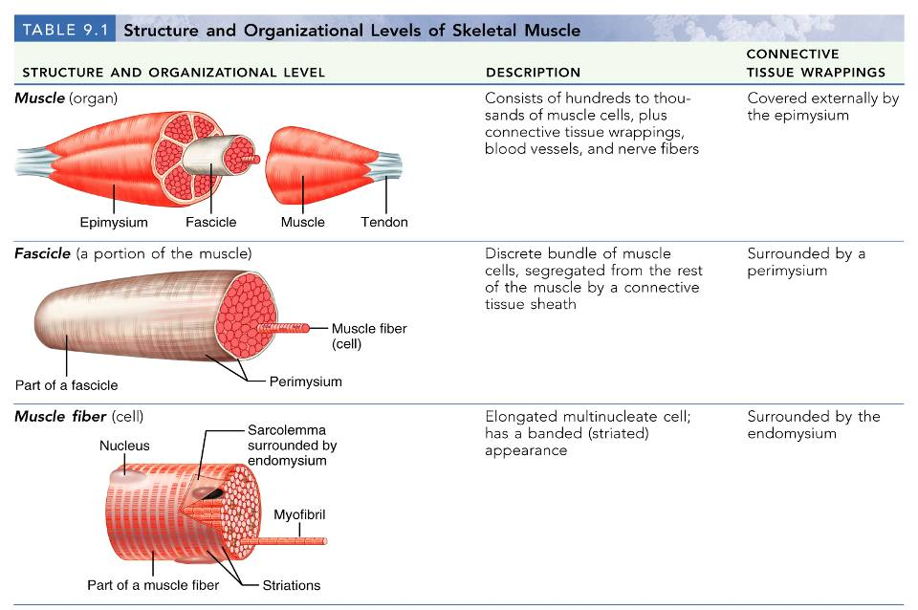
Structure and Organization of Skeletal Muscle

Slide 21
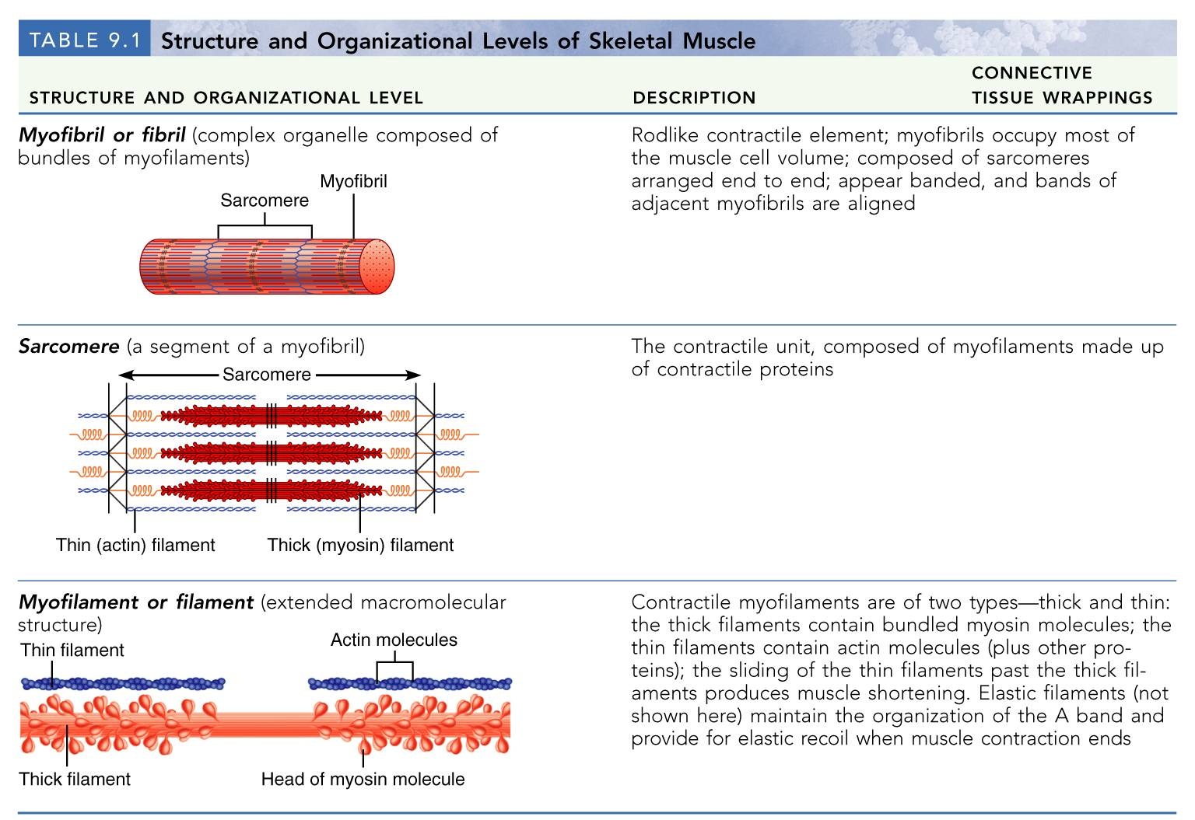
Structure and Organization of Skeletal Muscle
Table 9.1b

Slide 22
Skeletal Muscle
_______________________________________ composed of muscle tissue, blood vessels, nerve fibers, and connective tissue

Slide 23
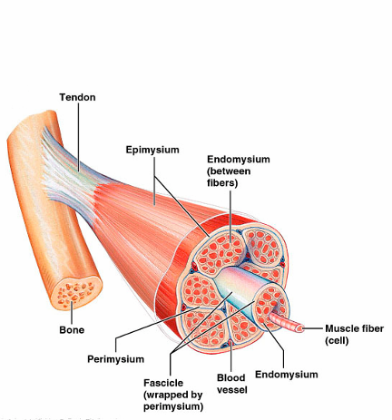
Skeletal Muscle
The three connective tissue sheaths are:
fine sheath of connective tissue composed of reticular fibers surrounding _
fibrous connective tissue that surrounds _
an overcoat of dense regular connective tissue that _

Slide 24
Skeletal Muscle: Attachments
Most skeletal muscles span joints and are attached to bone in at least two places
When muscles contract the movable bone, the muscle’s _

Slide 25
Skeletal Muscle: Attachments
Muscles attach:
Directly
epimysium of the muscle is _______________________________________ of a bone
Indirectly
connective tissue wrappings extend beyond the muscle as a _

Slide 26
Microscopic Anatomy of a Skeletal Muscle Fiber
Each fiber is a long, cylindrical cell with ____________________________ just beneath the sarcolemma
Fibers are up to hundreds of centimeters long
Each cell is a ___________________________ produced by fusion of embryonic cells

Slide 27
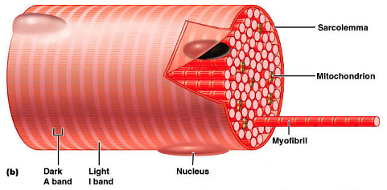
Myofibrils
Myofibrils are densely packed, rodlike contractile elements
They make up _
The arrangement of myofibrils creates a repeating series of _

Slide 28
Sarcomeres
The smallest contractile unit of a muscle
Composed of myofilaments made up _
Myofilaments are of two types –

Slide 29
Myofilaments: Banding Pattern
Thick filaments are composed of the _
extend the _
________________________ filaments
extend across the I band and partway into the A band
Z-disc
coin-shaped sheet of proteins (connectins) that ________________________________________ and connects myofibrils to one another

Slide 30
Ultrastructure of Myofilaments: Thick Filaments
Each ______________________________ molecule has a rod-like tail and two globular heads
two interwoven, heavy polypeptide chains
two smaller, light polypeptide chains called cross bridges

Slide 31
Ultrastructure of Myofilaments: Thin Filaments
________________ filaments are chiefly composed of the _
The subunits contain the ____________________________ to which myosin heads attach during contraction
Tropomyosin and troponin are __________________________ bound to actin

Slide 32
Sarcoplasmic Reticulum (SR)
SR is __________________________________ that runs longitudinally and surrounds each myofibril
Functions in the _

Slide 33
T Tubules
T tubules are continuous with the sarcolemma
They _________________________________ to the deepest regions of the muscle
These impulses signal for the _

Slide 34
Sliding Filament Model of Contraction
Thin filaments slide past the thick ones so that the actin and myosin filaments overlap to a greater degree
In the ____________________________ state, thin and thick filaments overlap _
Upon stimulation, _

Slide 35
Sliding Filament Model of Contraction
Each myosin head binds and detaches several times during contraction, acting like a ratchet to generate tension and propel the thin filaments to the center of the sarcomere
As this event occurs throughout the sarcomeres, the muscle shortens
http://www.wiley.com/college/pratt/0471393878/student/animations/actin_myosin/actin_myosin.swf

Slide 36
Skeletal Muscle Contraction
In order to contract, a skeletal muscle must:
Be stimulated _
Propagate an electrical current, or __________________________________, along its sarcolemma
Have a rise in _______________________________ levels, the final trigger for contraction
Linking the electrical signal to the contraction is excitation-contraction coupling

Slide 37
Nerve Stimulus of Skeletal Muscle
Skeletal muscles are stimulated by _________________________ of the somatic nervous system
Axons of these neurons travel in nerves to muscle cells
Axons of motor neurons ______________________________ as they enter muscles
Each axonal branch forms a ______________________ with a single muscle fiber

Slide 38
Neuromuscular Junction
The neuromuscular junction is formed from:
_____________________________________, which have small membranous sacs (________________________________) that contain the neurotransmitter _
The _____________________________________ of a muscle, which is a specific _____________________________________ that contains ___________________________________ and helps form the neuromuscular junction

Slide 39
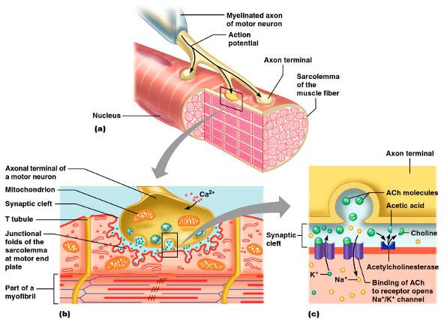
Neuromuscular Junction
Though exceedingly close, axonal ends and muscle fibers are _

Slide 40
Neuromuscular Junction
When a nerve impulse reaches the end of an axon at the neuromuscular junction:
__________________________________________ open and allow Ca²⁺ to enter the axon
Ca²⁺ causes axonal vesicles to ________________ with the axonal membrane
This fusion _________________________________ into the synaptic cleft
ACh diffuses across the synaptic cleft to _
Binding of ACh to its receptors initiates an action potential in the muscle

Slide 41
Destruction of Acetylcholine
ACh bound to ACh receptors is quickly destroyed by the _
This destruction prevents continued muscle fiber contraction in the absence of additional stimuli

Slide 42
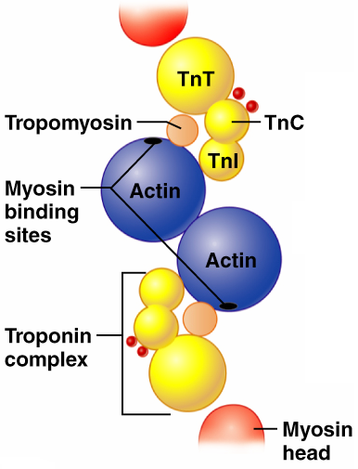
Role of Ionic Calcium (Ca²⁺) in the Contraction Mechanism
At ______________ intracellular Ca²⁺ concentration:
Tropomyosin _____________________ on actin
Myosin cross bridges cannot attach to binding sites on actin
Muscle _
Figure 9.11a

Slide 43
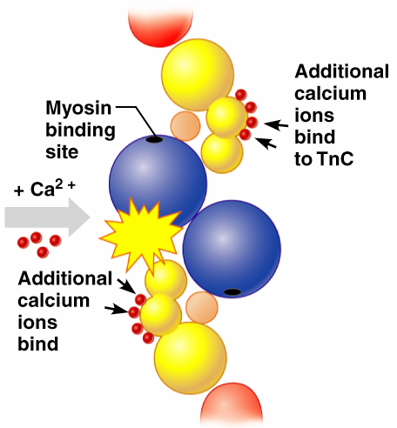
Role of Ionic Calcium (Ca²⁺) in the Contraction Mechanism
At higher intracellular Ca²⁺ concentrations:
Additional _
Calcium-activated troponin binds an additional two Ca²⁺ at a separate regulatory site
Figure 9.11b

Slide 44
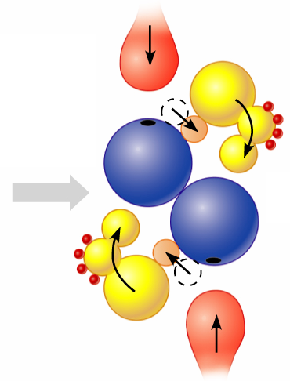
Role of Ionic Calcium (Ca²⁺) in the Contraction Mechanism
Calcium-activated troponin undergoes a __________________ change
This change moves tropomyosin away from _
Figure 9.11c

Slide 45
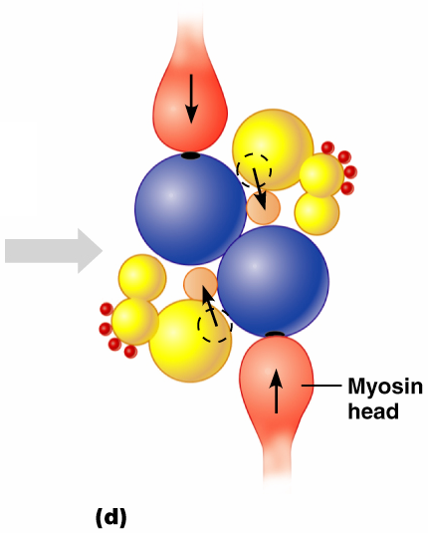
Role of Ionic Calcium (Ca²⁺) in the Contraction Mechanism
____________________ can now bind and cycle
This permits contraction to begin
sliding of the thin filaments by the myosin cross bridges
Figure 9.11d

Slide 46
Sequential Events of Contraction
Cross bridge formation
_____________________________________ attaches to actin filament
Working (power) stroke
myosin head ____________________________ actin filament toward M line
Cross bridge detachment
______________________________________ and the cross bridge detaches
“Cocking” of the myosin head
energy from hydrolysis of ___________________ cocks the myosin head into the _

Slide 47
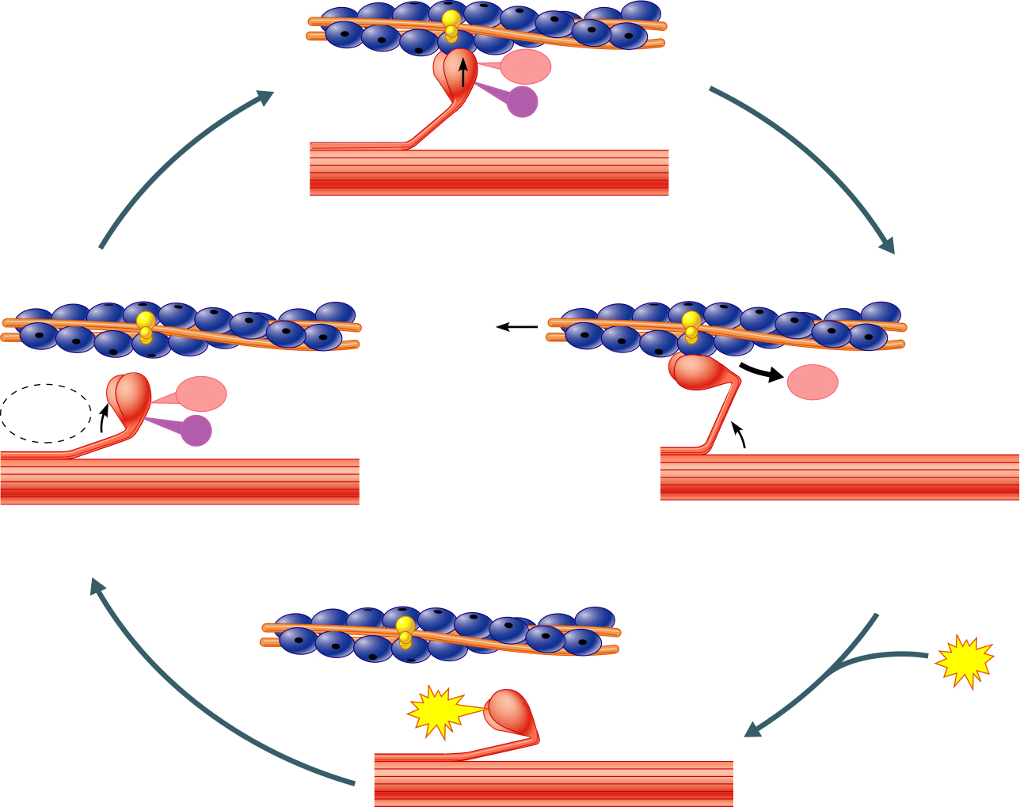
Myosin head
(high-energy
configuration)
ADP
P_{i}
1
Myosin head attaches to the actin
myofilament, forming a cross bridge.
Thin filament
ATP
ADP
ADP
Thick filament
hydrolysis
P_{i}
4
As ATP is split into ADP and P_{i}, the myosin
head is energized (cocked into the high-energy
conformation).
2
Inorganic phosphate (P_{i}) generated in the
previous contraction cycle is released, initiating
the power (working) stroke. The myosin head
pivots and bends as it pulls on the actin filament,
sliding it toward the M line. Then ADP is released.
ATP
ATP
Myosin head
(low-energy
configuration)
3
As new ATP attaches to the myosin head, the link between
myosin and actin weakens, and the cross bridge detaches.
Figure 9.12

Slide 48
Contraction of Skeletal Muscle Fibers
Contraction
refers to the _
ends when cross bridges become inactive, the tension generated declines, and _

Slide 49
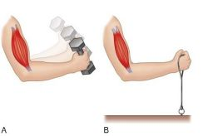
Contraction of Skeletal Muscle (Organ Level)
The two types of muscle contractions are:
Isotonic contraction
___________________ muscle length
muscle shortens during contraction
Iso = same;
_______________________ contraction
muscle does not shorten during contraction
Iso = same; metric =length

