Slide 1
Chapter 10

Slide 2
Interactions of Skeletal Muscles
Skeletal muscles work _
Muscles ______________________ (never push)
As muscles shorten, the insertion generally _

Slide 3
Muscles: Functional Groups
provide the major force for producing a specific movement
oppose or reverse a particular movement
Add force to a movement
Reduce undesirable or unnecessary movement
Fixators
synergists that ____________________________ a bone or muscle’s origin

Slide 4
Naming Skeletal Muscles
bone or body region associated with the muscle
_________________________of muscle
e.g., the deltoid muscle _

Slide 5
Naming Skeletal Muscles
maximus (largest), minimus (smallest), longus (long)
_____________________ (fibers run straight), _________________________, and oblique (fibers run at angles to an imaginary defined axis)

Slide 6
Naming Skeletal Muscles
biceps (__________________________) and triceps (______________________________)
Location of attachments
named according to _
flexor or extensor, as in the names of muscles that flex or extend, respectively

Slide 7
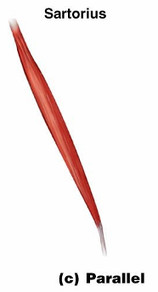
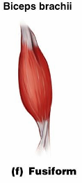
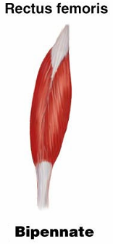
Arrangement of Fascicles
Parallel
fascicles run parallel to the _
Fusiform
short fascicles that attach obliquely to a central tendon running the length of the muscle

Slide 8
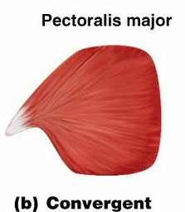
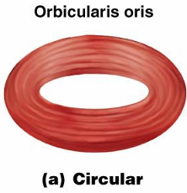
Arrangement of Fascicles
fascicles converge from a broad origin to a single tendon insertion
fascicles are arranged in concentric rings

Slide 9
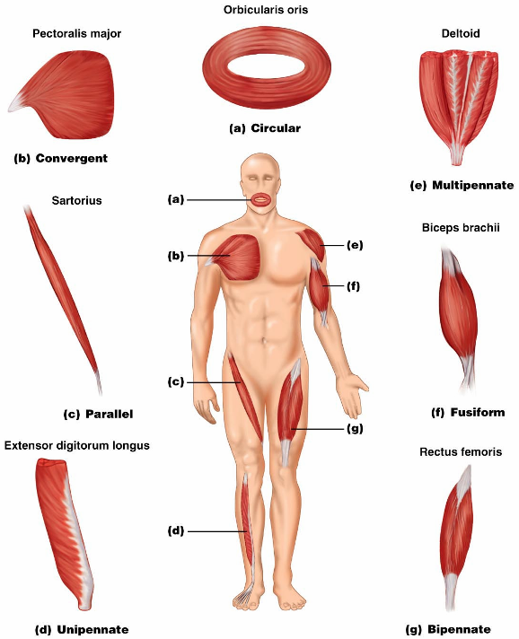

Slide 10
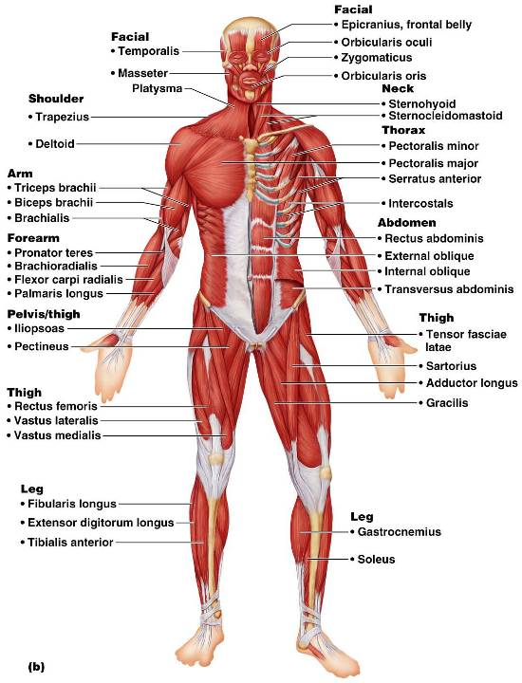
Anterior View
The 40 superficial muscles here are divided into 10 regional areas of the body
Figure 10.4b

Slide 11
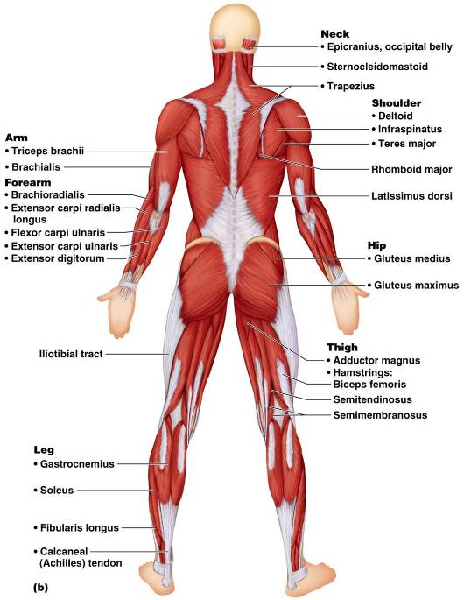
Posterior View
The 27 superficial muscles here are divided into seven regional areas of the body
Figure 10.5b

Slide 12
Muscles: Name, Action, and Innervation
Name and description of the muscle
be alert to _
Origin and insertion
there is always a _
Action
best learned by acting out a muscle’s movement on one’s own body
Nerve supply
name of major nerve that innervates the muscle

Slide 13
Muscles of the Scalp
_____________________________ (occipitofrontalis) – bipartite muscle consisting of the:
Galea aponeurotica – __________________________________ connecting above muscles
These two muscles have alternate actions of _

Slide 14
Muscles of the Face
11 muscles are involved in lifting the eyebrows, flaring the nostrils, opening and closing the eyes and mouth, and smiling
All are innervated by _
Usually ___________________________ (rather than bone), and adjacent muscles often fuse

Slide 15
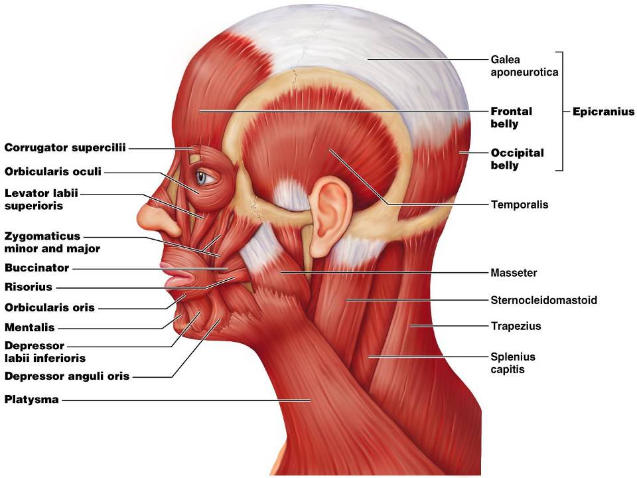

Slide 16
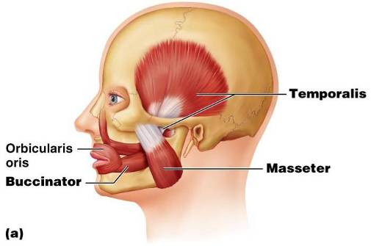
Muscles of Mastication
There are _____________________________ ___________ of muscles involved in mastication
Prime movers
Grinding movements
All are innervated by __________________________________ (trigeminal nerve)

Slide 17
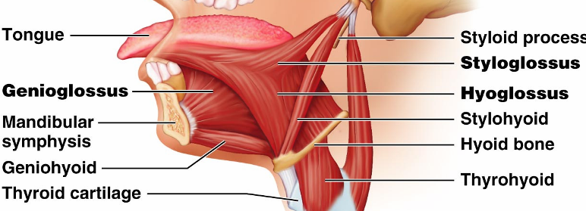
Extrinsic Tongue Muscles
_____________________ major muscles that anchor and move the tongue
All are innervated by _

Slide 18
Muscles of the Neck: Head Movements
Major _
Synergists to head flexion
suprahyoid and infrahyoid
sternocleidomastoid and scalene muscles
Head extension
deep splenius muscles and aided by the _

Slide 19
Trunk Movements: Deep Back Muscles
The prime mover of _
Erector spinae muscles consist of three columns on each side of the vertebrae
Lateral bending of the back
unilateral contraction of these muscles
Other deep back extensors include the semispinalis muscles and the quadratus lumborum

Slide 20
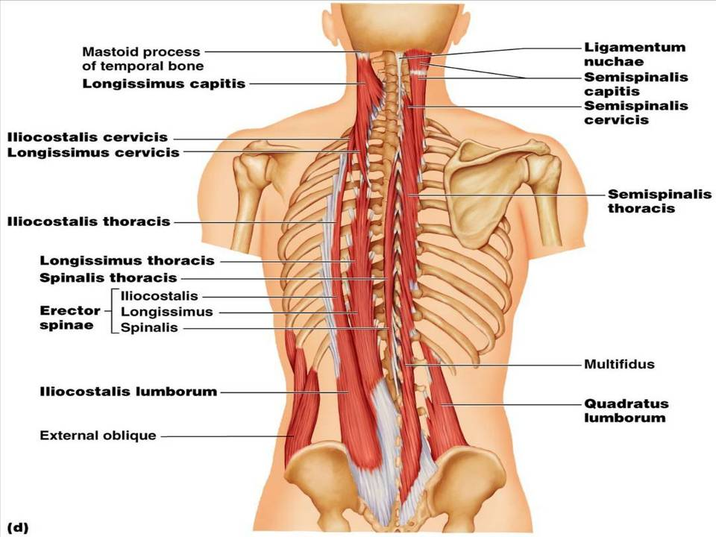
Figure 10.9d

Slide 21
Trunk Movements: Short Muscles
Four short muscles extend from one vertebra to another
These muscles are synergists in _

Slide 22
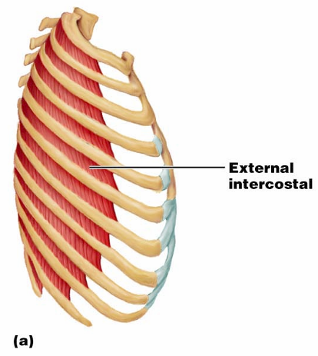
Muscles of Respiration: External Intercostals
The primary function of ___________________ muscles is to promote movement for breathing
___________________
more superficial layer that _

Slide 23
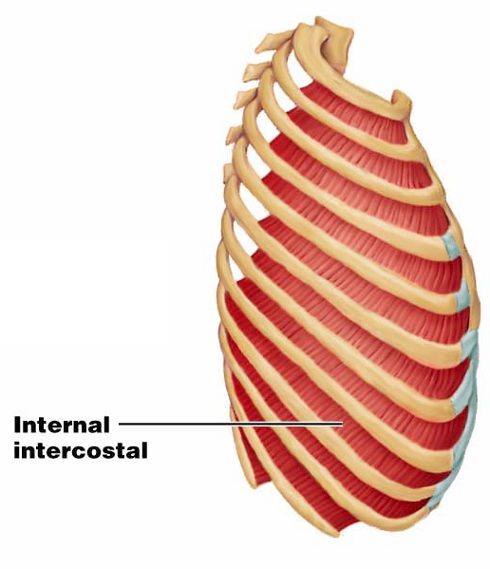
Muscles of Respiration: Internal Intercostals
deeper layer that aids in forced _
most important muscle _

Slide 24
Muscles of the Abdominal Wall
The abdominal wall is composed of four paired muscles
their fasciae, and their aponeuroses
Fascicles of these muscles run at right and oblique angles to one another, giving the abdominal wall added strength

Slide 25
Muscles of the Abdominal Wall
In addition to forming the abdominal wall, these muscles:
Are involved with ____________________________ and ____________________________ of the trunk
Help promote urination, defecation, childbirth, vomiting, coughing, and screaming

Slide 26
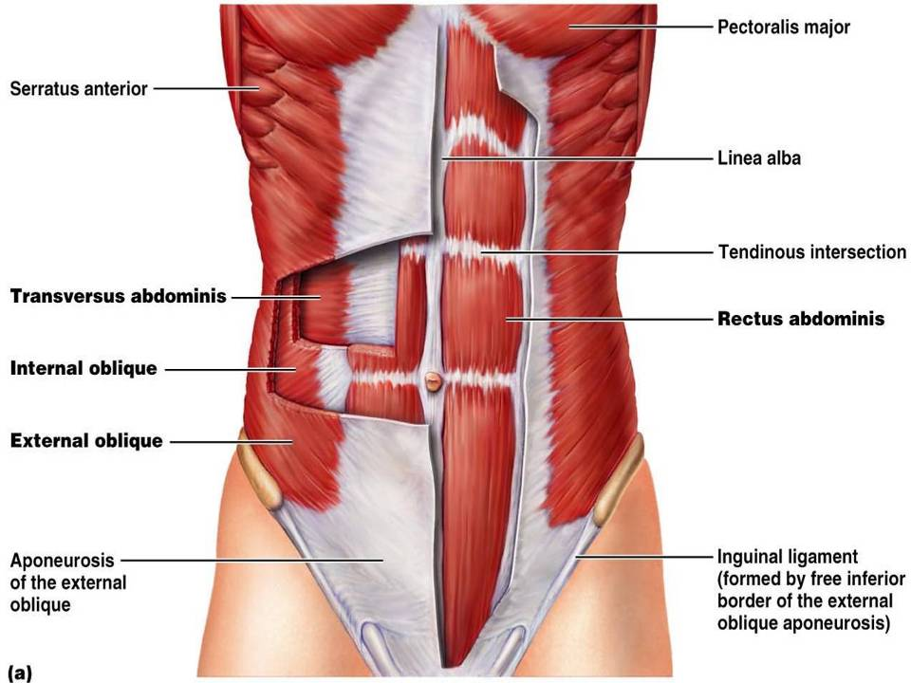

Slide 27
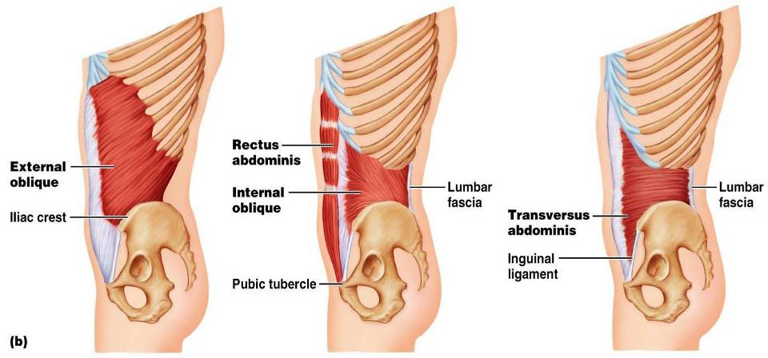
Muscles of the Abdominal Wall

Slide 28
Extrinsic Shoulder Muscles
Muscles of the _
Anterior:
pectoralis major, pectoralis minor, serratus anterior, and subclavius
Posterior:
latissimus dorsi, trapezius muscles, levator scapulae, and rhomboids
These muscles are involved with the movements of the scapula including ____________________________________________________________________________________ and lateral and medial movements
Prime movers of _________________________ are the _

Slide 29
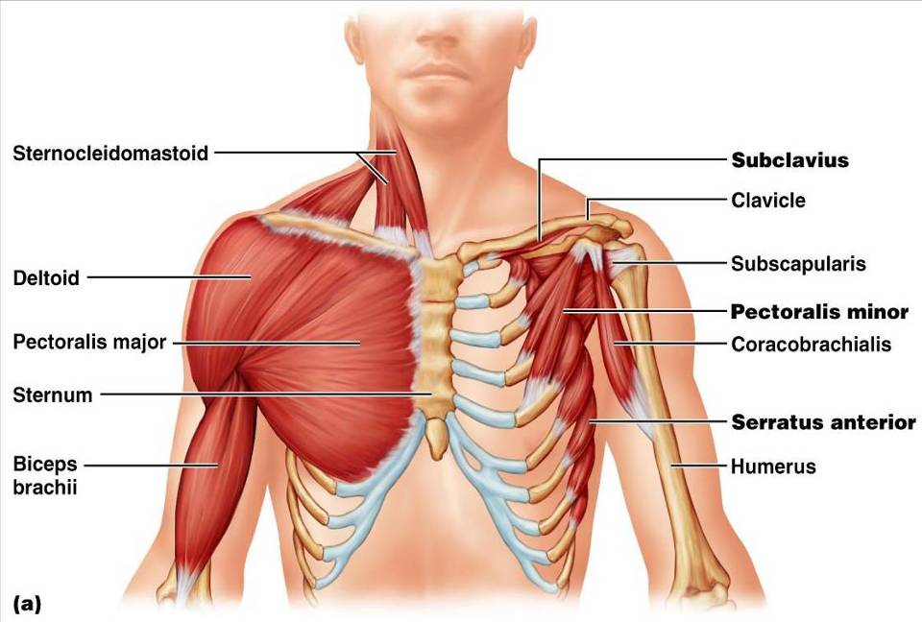
Extrinsic Shoulder Muscles
Figure 10.13a

Slide 30
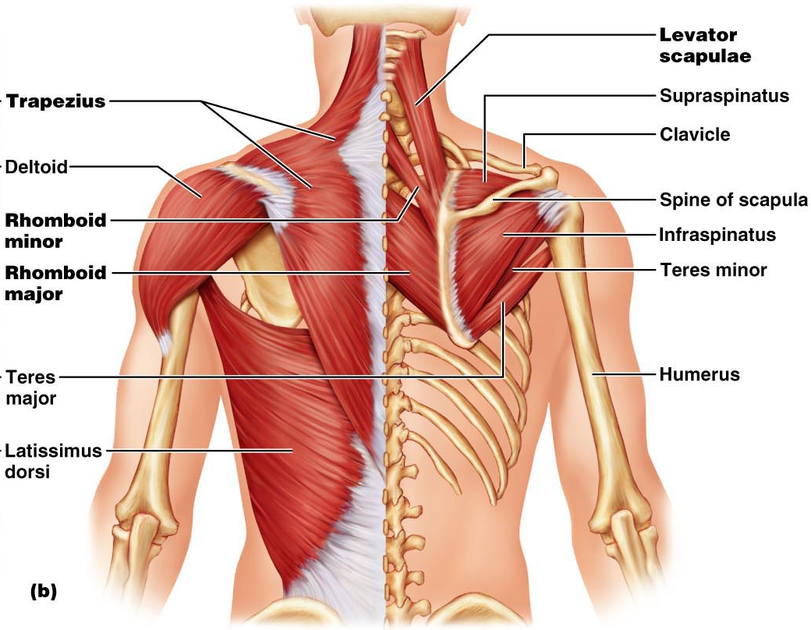
Figure 10.13b

Slide 31
Muscles Crossing the Shoulder
Nine muscles cross the shoulder joint and insert into the humerus
Prime movers include:
arm flexion
arm extension
Middle fibers of the deltoid

Slide 32
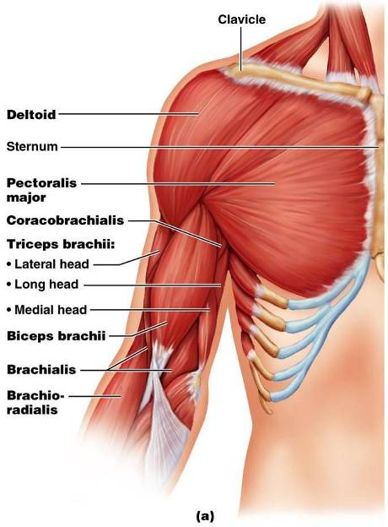
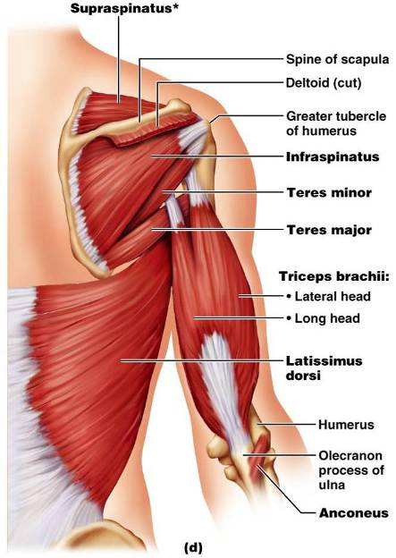
Muscles Crossing the Shoulder

Slide 33
Muscles Crossing the Shoulder
Rotator cuff muscles
Function mainly to reinforce the capsule of the shoulder
Secondarily act as synergists and _

Slide 34
Muscles Crossing the Elbow
Forearm extension
prime mover of forearm _
The _
weak synergist
The _

Slide 35
Muscles Crossing the Elbow
Forearm flexion
chief forearm _
________________________________________ and _
synergist
The brachioradialis
helps _

Slide 36
Muscles of the Forearm
Forearm muscle groups:
those that cause _
those that move _
These muscles insert via the flexor and extensor retinacula
Most __________________________ muscles are _
Most __________________________ muscles are _

Slide 37
Muscles of the Forearm
The ____________________________ and ________________________________ are not flexors, but ___________________________ the forearm
The supinator muscle is a synergist with the biceps brachii in supinating the forearm

Slide 38
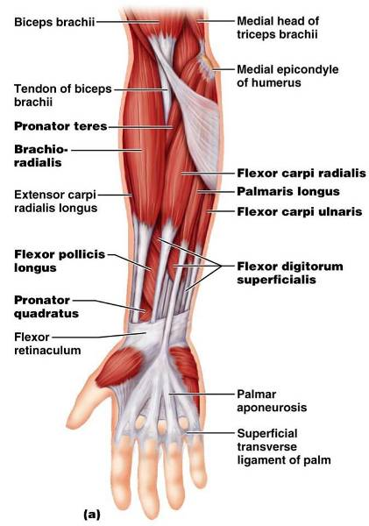
Muscles of the Forearm: Anterior
These muscles are primarily _

Slide 39
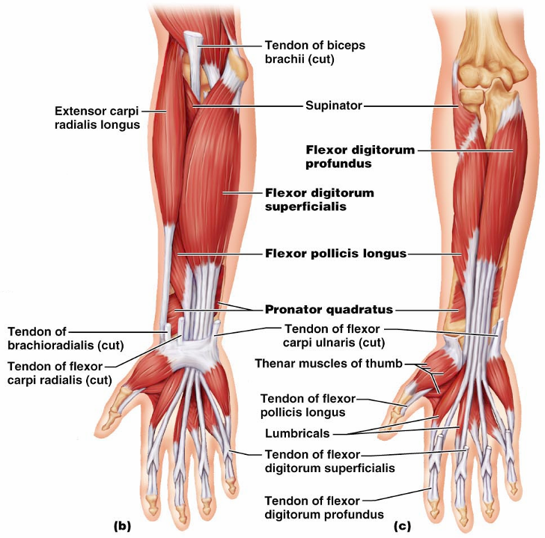
Figure 10.15b, c

Slide 40
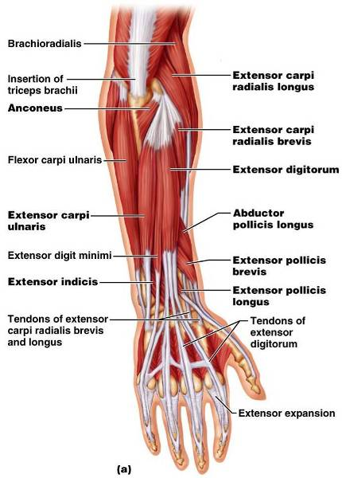
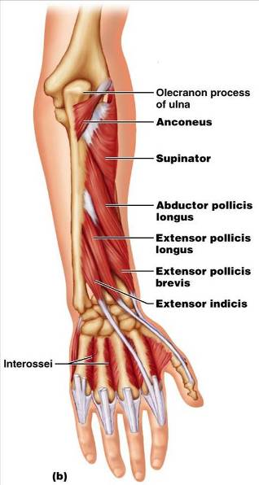
Muscles of the Forearm: Posterior
These muscles are primarily extensors of the wrist and digits
Figure 10.16a

Slide 41
Intrinsic Muscles of the Hand
These small muscles:
Lie in the _
none on the dorsal side
Move the _
Control ____________________________ movements
Are the main ____________________________________ of the fingers
Produce opposition
move the thumb toward the little finger

Slide 42
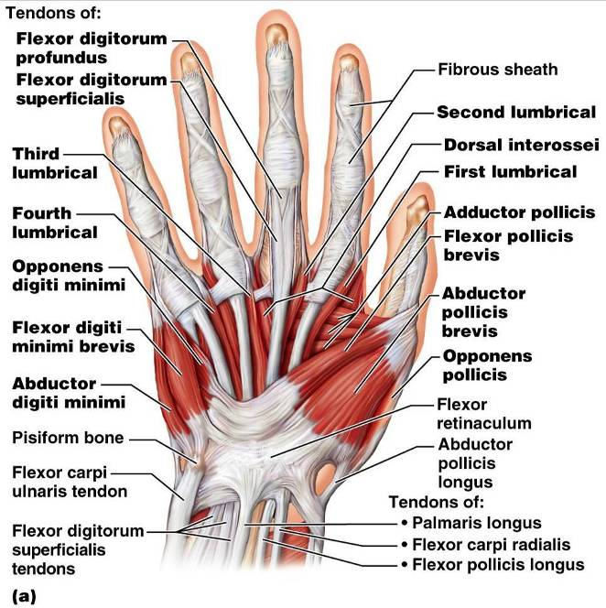
Intrinsic Muscles of the Hand

Slide 43
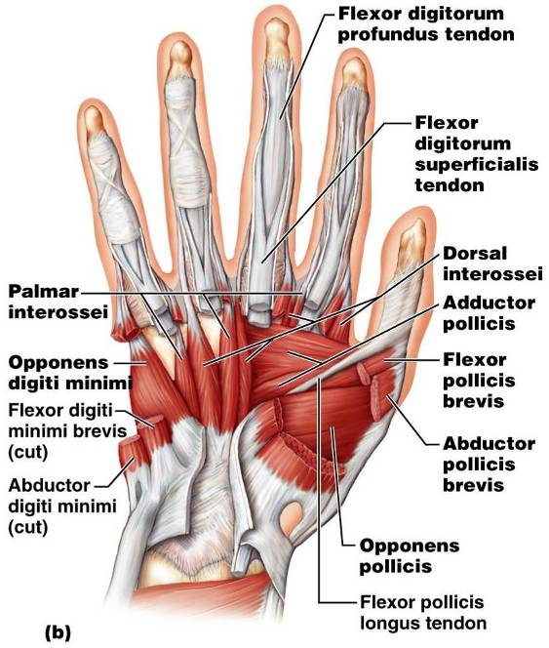
Intrinsic Muscles of the Hand

Slide 44
Finger and Thumb Movements
Flexion
Thumb –
Fingers –
Extension
Thumb –
Fingers –

Slide 45
Intrinsic Muscles of the Hand: Groups
There are ______________________________ of intrinsic hand muscles
The thenar eminence and hypothenar eminence
each have a _
The midpalm muscles, the lumbricals and interossei,
The interossei

Slide 46
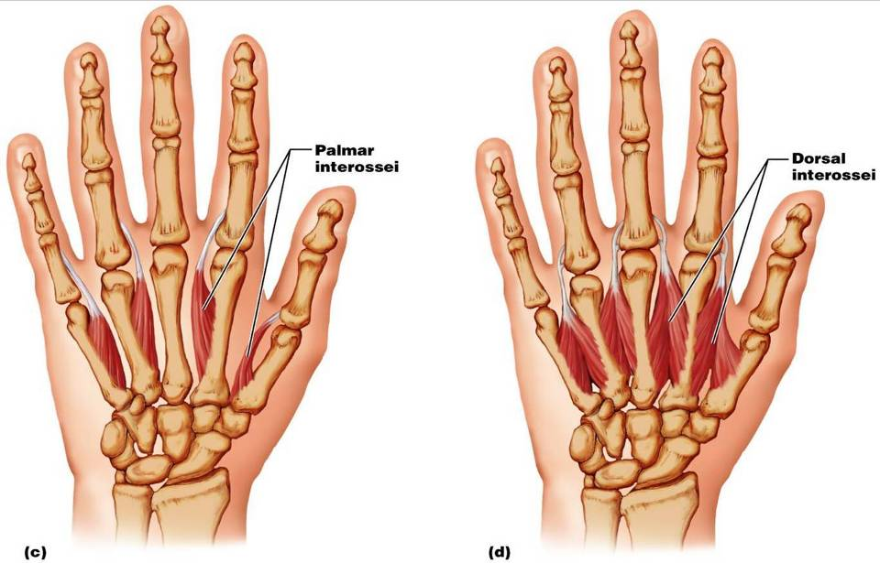
Intrinsic Muscles of the Hand: Groups

Slide 47
Muscles Crossing Hip and Knee Joints
Most ________________________________ muscles of the hip and thigh
___________________________________ at the hip
___________________________________ at the knee
Posterior compartment muscles of the hip and thigh
The medial compartment muscles
These three groups are enclosed by the _

Slide 48
Movements of the thigh at the Hip: Flexion and Extension
The ball-and-socket hip joint permits
Abduction
Adduction
The most important thigh flexors
tensor fasciae latae,
The ________________________ located adductor muscles and sartorius assist in thigh flexion

Slide 49
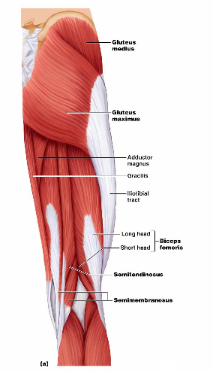
Movements of the Thigh at the Hip: Flexion and Extension
Thigh extension is primarily effected by the _
Forceful extension is aided by the gluteus maximus

Slide 50
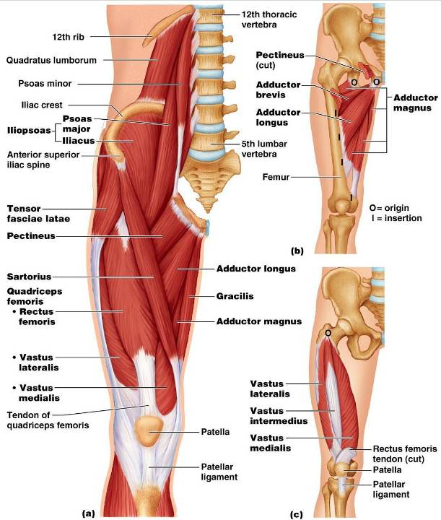

Slide 51
Movements of the Thigh at the Hip:
______________________________ assisted by
antagonized by
lateral rotators
Thigh adduction is the role of _
adductor _
adductor _
adductor _

Slide 52
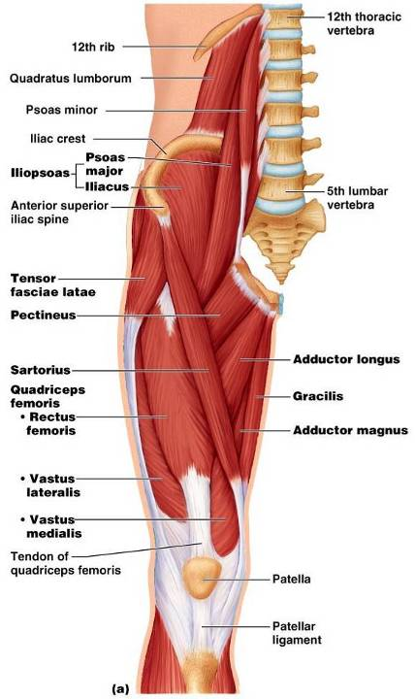
Movements of the Knee Joint
The _
______________ the knee
and act as antagonists to the quadriceps femoris

Slide 53
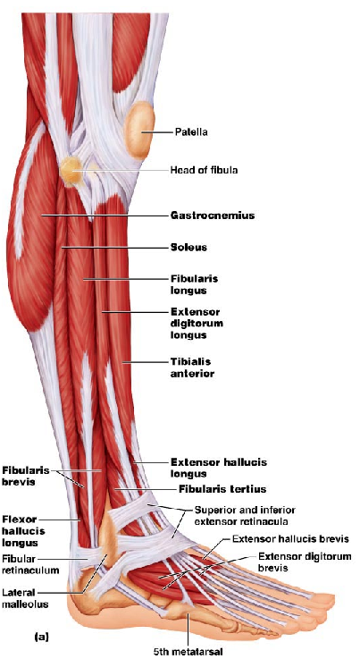
Fascia of the Leg
A deep fascia of the leg is continuous with the fascia lata
_______________________________________________________________: anterior, lateral, and posterior
Distally, the fascia thickens and forms the flexor, extensor, and fibular retinaculae

Slide 54
Muscles of the Leg: Movements
Various leg muscles produce the following movements at the:
Ankle
Intertarsal joints
Toes

Slide 55
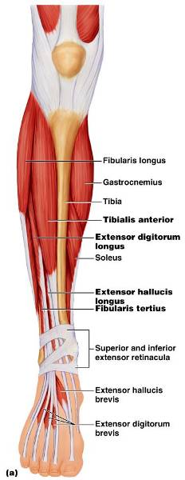
Muscles of the Anterior Compartment
primary toe extensors and ankle dorsiflexors
Figure 10.21a

Slide 56
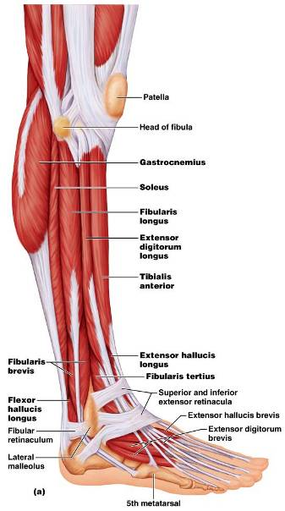
Muscles of the Lateral Compartment
Plantar-flex and evert the foot
Figure 10.22a

Slide 57
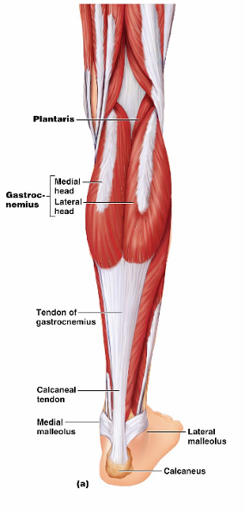
Muscles of the Posterior Compartment
flex the foot and the toes
Tibialis posterior
flexor hallucis longus
Figure 10.23a

Slide 58
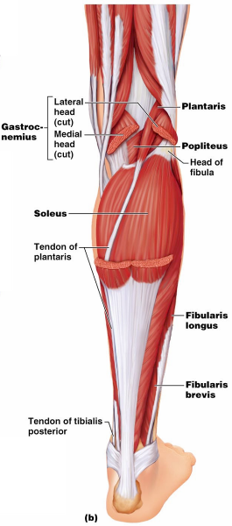
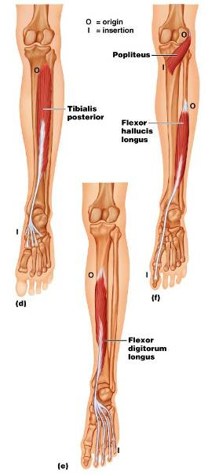
Muscles of the Posterior Compartment
Figure 10.23b, c

Slide 59
Muscle Actions of the Thigh: Summary
Thigh muscles:
Extend the leg (anterior compartment)

Slide 60
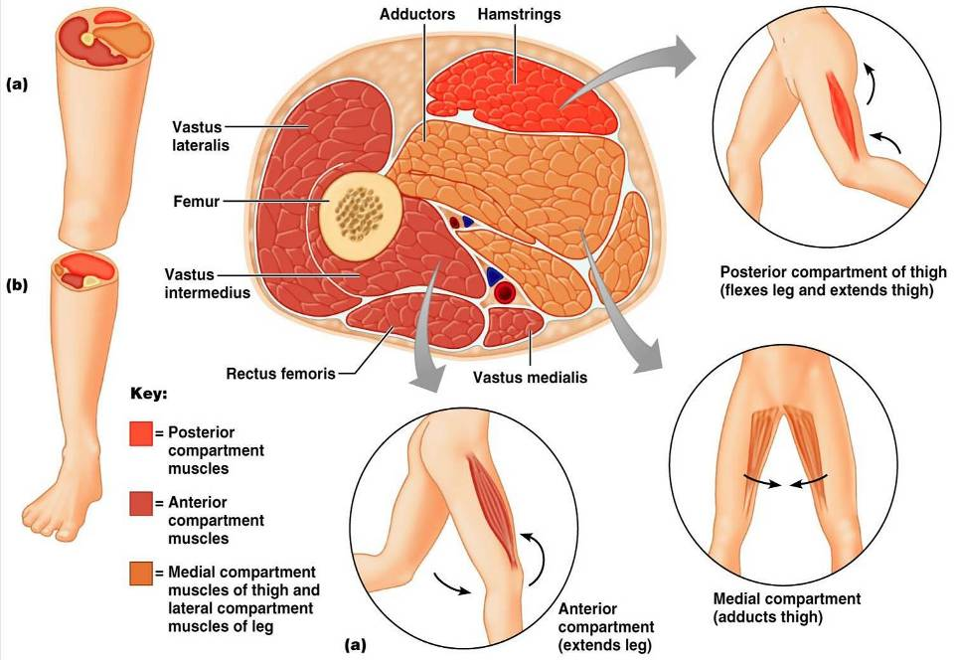

Slide 61
Muscle Actions of the Leg: Summary
Leg muscles:
Plantar flex and evert the foot
Plantar flex the foot and flex the toes
Dorsiflex the foot and extend the toes

Slide 62
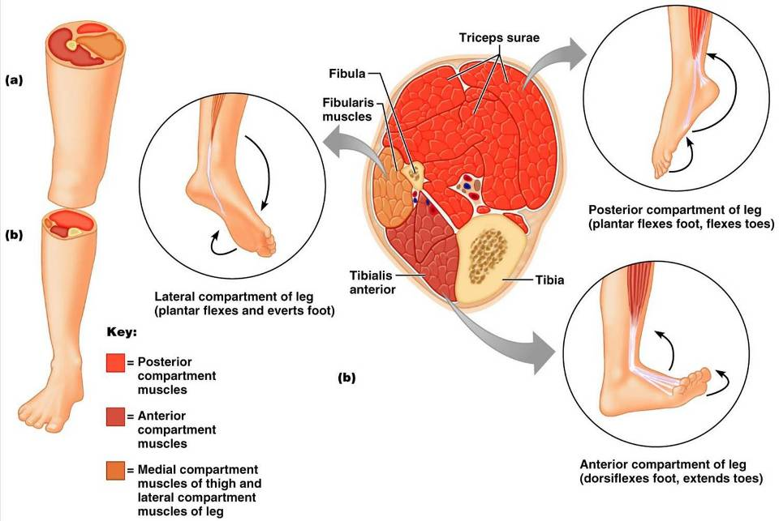

Slide 63
Intrinsic Muscles of the Foot
These muscles help flex, extend, abduct, and adduct the toes
In addition, along with some leg tendons, they _
There is a _____________________________, the extensor digitorum brevis, which _
The plantar muscles occur in four layers

Slide 64
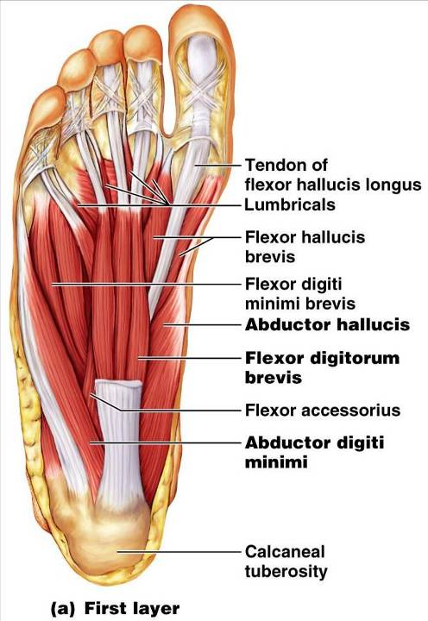
Plantar Muscles: First Layer (Superficial)
Superficial muscles of the _
These muscles are similar to the corresponding muscles of the hand

Slide 65
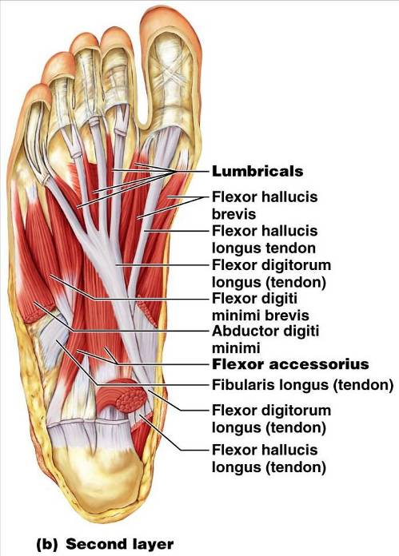
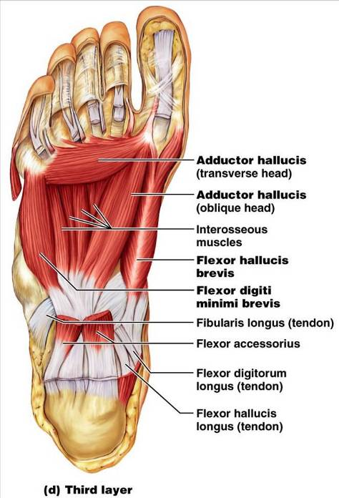

Slide 66
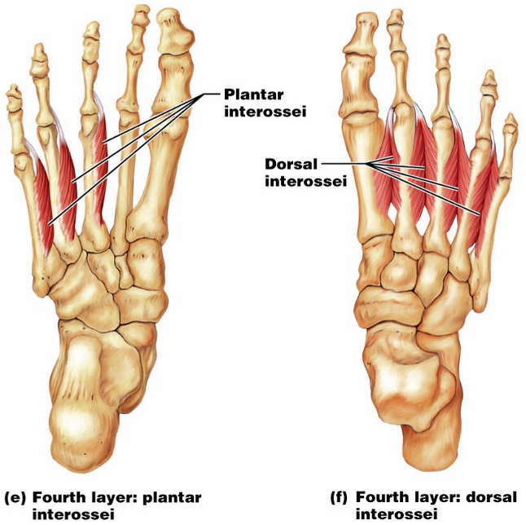
Plantar Muscles: Fourth Layer

