Slide 1
Exam One Material
Chapters 1 - 4

Slide 2
Overview of Anatomy and Physiology
Anatomy
Physiology
Study of the _
Subdivisions based on organ systems (e.g., renal or cardiovascular physiology)
Often focuses on _
Body's abilities depend on chemical reactions in individual cells

Slide 3
Principle of Complementarity
Anatomy and physiology are inseparable
What a structure can do depends on its specific form

Slide 4
Levels of Structural Organization
Atoms and molecules (chapter 2); and organelles (chapter 3)
Cells (chapter 3)
Groups of similar cells (chapter 4)
Contains two or more types of tissues
Organs that work closely together
All organ systems

Slide 5
Interdependence of Body Cells
Humans are multicellular
To function, must keep individual cells alive
All cells depend on _
All body functions spread among different organ systems
Organ systems cooperate to maintain life

Slide 6
Homeostasis
Homeostasis
A dynamic state of equilibrium
Maintained by contributions of all organ systems

Slide 7
Homeostatic Control Mechanisms
Involve continuous _____________________________________of all variables
____________________________________ necessary for monitoring and regulation
Functions of nervous and endocrine systems
Nervous and endocrine systems accomplish communication via _

Slide 8
Components of a Control Mechanism
Monitors environment
Responds to stimuli
Determines set point at which variable is maintained
Receives input from receptor
Determines appropriate response
Receives output from control center
Provides the means to respond
Response either reduces (negative feedback) or enhances stimulus (positive feedback)

Slide 9
Negative Feedback
Most feedback mechanisms in body
Response _
Variable changes in opposite direction of initial change
Examples
Regulation of body temperature
Regulation of blood volume by ADH

Slide 10
Positive Feedback
Response enhances or exaggerates original stimulus
May exhibit a _
Usually controls _____________________________________ that do not require continuous adjustment
Enhancement of labor contractions by _
Platelet plug formation _

Slide 11
Homeostatic Imbalance
Disturbance of homeostasis
Contributes to changes associated with _
Control systems less efficient
If negative feedback mechanisms overwhelmed

Slide 12
Anatomical Position
Standard anatomical body position
Palms facing forward
Always use directional terms as if body is in anatomical position
Right and left refer to body being viewed, not those of observer

Slide 13
Regional Terms
Two major divisions of body
Head, neck, and trunk
Limbs
Regional terms designate specific areas within body divisions

Slide 14
Body Planes
Three most common
Lie at right angles to each other
Sagittal plane
Frontal (coronal) plane
Transverse (horizontal) plane

Slide 15
Sagittal Plane
Sagittal plane
Divides body _
Produces a sagittal section if cut along this plane
Midsagittal (median) plane
Not on midline

Slide 16
Body Planes
Divides body vertically into anterior and posterior parts
Produces a frontal or _

Slide 17
Body Planes
Transverse (horizontal) plane
Divides body horizontally (90° to vertical plane) _
Produces a _
Oblique section
Result of cuts at angle other than 90° to vertical plane

Slide 18
Body Cavities
_____________________________ of internal body cavities
Provide different degrees of protection to organs

Slide 19
Dorsal Body Cavity
Protects nervous system
Two subdivisions:
Cranial cavity
Vertebral cavity

Slide 20
Ventral Body Cavity
Houses _
Two subdivisions (___________________________________)
Thoracic cavity
Abdominopelvic cavity

Slide 21
Ventral Body Cavity
Thoracic cavity subdivisions
Two _
Each houses _
Contains pericardial cavity
Surrounds _
Pericardial cavity

Slide 22
Ventral Body Cavity
Abdominopelvic cavity subdivisions
Contains stomach, intestines, spleen, and liver
Contains urinary bladder, reproductive organs, and rectum

Slide 23
Membranes in Ventral Body Cavity
Serous membrane or _
Parietal serosa lines _
Visceral serosa covers _
Layers separated by slit-like cavity filled _
Fluid secreted by both layers of membrane

Slide 24
Serous Membranes
Named for specific cavity and organs with which associated
Each has parietal and visceral layers
Pericardium
Lungs
Abdominopelvic cavity

Slide 25
Other Body Cavities
Exposed to environment
Nasal cavity
Orbital cavities
Not exposed to environment

Slide 26
Matter
Matter—anything that has mass and occupies space
Weight—pull of gravity on mass
3 states of matter
Solid—
Liquid—
Gas— changeable shape and volume

Slide 27
Composition of Matter: Elements
Elements
Matter is composed of elements
Elements cannot be broken into simpler substances by ordinary chemical methods
Each has unique properties
Detectable with our senses, or are measurable
How atoms interact (bond) with one another

Slide 28
Composition of Matter
Atoms
Give each element its physical & chemical properties
Smallest particles of an element with properties of that element
One- or two-letter chemical shorthand for each element

Slide 29
Atomic Structure
Atoms are composed of subatomic particles
Protons, neutrons, electrons
Protons and neutrons _
Electrons orbit nucleus _

Slide 30
Atomic Structure: The Nucleus
Almost entire mass of the atom
Neutrons
Mass = 1 atomic mass unit (amu)
Protons
Mass = 1 amu

Slide 31
Atomic Structure: Electrons
Electrons in orbitals within electron cloud
1/2000 the mass of a proton (0 amu)
Number of protons and electrons _

Slide 32
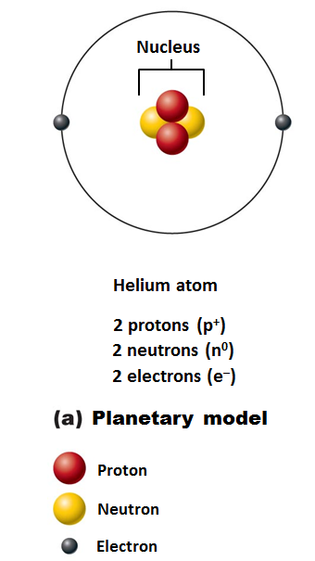
Models of the Atom
Planetary model
Incorrectly depicts fixed circular electron paths

Slide 33
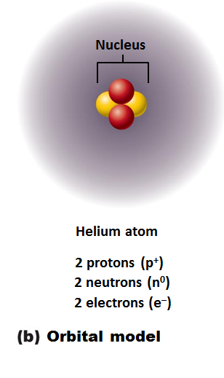
Models of the Atom
current model used by chemists
an electron cloud
Useful for predicting chemical behavior of atoms

Slide 34
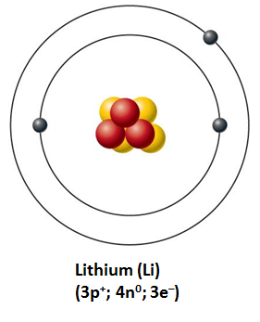
Identifying Elements
Different elements contain _
Hydrogen has 1 proton, 0 neutrons, and 1 electron
Lithium has 3 protons, 4 neutrons, and 3 electrons

Slide 35
Atomic Number and Mass Number
Atomic number =
Mass number
Total number of _
Total mass of atom

Slide 36
Isotopes and Atomic Weight
Isotopes
Structural variations of atoms
Differ in the number of _
Atomic numbers same; mass numbers different

Slide 37
Isotopes and Atomic Weight
Atomic weight
___________________________ of mass numbers (relative weights) _

Slide 38
Combining Matter: Molecules and Compounds
Most atoms chemically combined with other atoms to form molecules and compounds
Two or more atoms bonded together
Can be the _
Or _
Smallest particle of a compound with specific characteristics of the compound
Compound
Two or more different kinds of atoms bonded together
C₆H₁₂O₆ , but not H₂

Slide 39
Mixtures
Most matter exists as mixtures
Two or more components _
Three types of mixtures

Slide 40
Types of Mixtures: Solutions
Homogeneous mixtures
Most are true solutions in body
Gases, liquids, or solids dissolved in water
Usually transparent, e.g., atmospheric air or saline solution
Solvent
Substance present in greatest amount
Present in smaller amounts
Ex. If glucose is dissolved in blood, glucose is solute; blood is solvent

Slide 41
Colloids and Suspensions
Colloids
a substance _
emulsions
Heterogeneous mixtures
cytosol
Other examples:
Fog (water dispersed in air)
Smoke (burned particulates suspended in air)
Milk (fats dispersed in water)

Slide 42
Colloids and Suspensions
Suspensions
Heterogeneous mixtures
Large, _
Unlike colloids which don’t separate
Other examples
Muddy water
Flour/water

Slide 43
Mixtures versus Compounds
Mixtures
_________________________________________ between components
Can be separated by physical means, such as _
Compounds
Can be separated only by breaking bonds

Slide 44
Chemical Bonds
Chemical bonds are ______________________________________ between electrons of reacting atoms
Electrons can occupy up to seven electron shells (energy levels) around nucleus
Electrons in _
Have most potential energy
Are _
Octet rule (rule of eights)
Except for the first shell (full with ___________________________) atoms interact to have eight electrons in their valence shell

Slide 45
Chemically Inert Elements
Valence shell fully occupied or contains eight electrons
Noble gases
Helium
Neon
Argon
Krypton
Xenon
Radon

Slide 46
Chemically Reactive Elements
Tend to gain, lose, or share electrons (form bonds) with other atoms to achieve stability

Slide 47
Types of Chemical Bonds
Three major types

Slide 48
Ionic Bonds
Ions
Atom gains or loses electrons and becomes charged
Transfer of valence shell electrons from one atom to another forms ions
One becomes an _
Atom that gained one or more electrons
One becomes a _
Atom that lost one or more electrons
Attraction of opposite charges results in an ionic bond

Slide 49
Ionic Compounds
Most ionic compounds are _
When dry salts form __________________________ instead of individual molecules
Example is NaCl (sodium chloride)

Slide 50
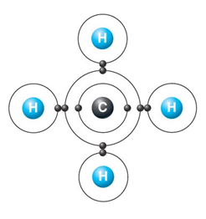
Covalent Bonds
Formed by sharing of _
Allows each atom to fill its valence shell _

