Slide 1
Atomic Structure
Determined by numbers of _
Nucleus consists of _

Slide 2
Atomic Structure
Neutrons
Mass = 1 atomic mass unit (amu)
Mass = 1 amu

Slide 3
Atomic Structure
Orbit nucleus
Negative charge
1/2000 the mass of a proton (0 amu)

Slide 4
Models of the Atom
__________________________ model: current model used by chemists
Depicts probable regions of greatest electron density _
Useful for predicting chemical behavior of atoms

Slide 5
Models of the Atom
Planetary model—________________________, outdated model
Incorrectly depicts _
Useful for illustrations (as in the text)

Slide 6
Identifying Elements
Atomic _______________________ = number of__________________________ in nucleus

Slide 7
Identifying Elements
Mass number = mass of _
Mass numbers of atoms of an element _
_____________________________________ are structural variations of elements that differ in the number of neutrons they contain

Slide 8
Identifying Elements
Atomic ____________________________ = average of _______________________________ of all isotopes

Slide 9
Molecules and Compounds
Most atoms combine chemically with other atoms to form molecules and compounds
two or more atoms bonded together (e.g., H₂ or C₆H₁₂O₆)
two or more different kinds of atoms bonded together (e.g., C₆H₁₂O₆)

Slide 10
Mixtures
Most matter exists as mixtures
Two or more components _
Three types of mixtures

Slide 11
Solutions
_______________________ mixtures
Usually transparent, e.g., atmospheric air _
Solvent
Present in greatest amount, usually a liquid
Solute(s)
Present in smaller amounts

Slide 12
Colloids
Heterogeneous __________________________ mixtures
Large solute particles that do not settle out

Slide 13
Suspensions
Heterogeneous mixtures
_________________________ solutes tend to settle out

Slide 14
Chemical Bonds
Electrons occupy up to seven electron shells (_________________________________) around nucleus
Except for the first shell which is ________________________________________, atoms interact in a manner to have ____________________________________ electrons in their outermost energy level (valence shell)

Slide 15
Chemically Inert Elements
Stable and _
Outermost energy level _____________________________ or contains eight electrons

Slide 16
Chemically Reactive Elements
Outermost energy level _____________________________________ by electrons
Tend to ________________________________________ with other atoms to achieve stability

Slide 17
Types of Chemical Bonds

Slide 18
Ionic Bonds
Ions are formed by ____________________ of valence shell electrons between atoms
Anions
have _____________________________ one or more electrons
Cations
have ______________________________one or more electrons
Attraction of opposite charges results in an _

Slide 19
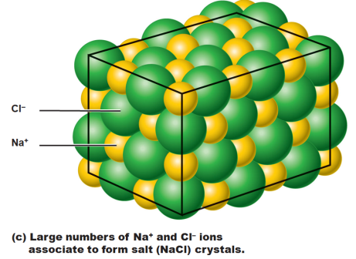
Formation of an Ionic Bond
Ionic compounds form _______________________________ instead of individual molecules
NaCl (sodium chloride)

Slide 20
Covalent Bonds
Formed by ____________________________ of two or more valence shell electrons
Allows each atom to _____________________________________ at least part of the time

Slide 21
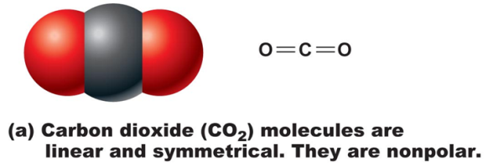
Covalent Bonds
Sharing of electrons may be _
_________________________________produces electrically balanced ________________________ molecules
CO₂

Slide 22
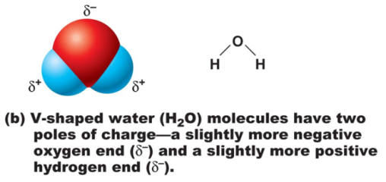
Covalent Bonds
________________________________sharing by atoms with different electron-attracting abilities produces _
H₂O

Slide 23
Hydrogen Bonds
Attractive force between electropositive hydrogen of one molecule and an electronegative atom of another molecule
Common between _________________________ such as water
Also act as _______________________________, holding a large molecule in a three-dimensional shape

Slide 24
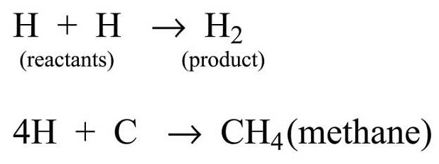
Chemical Reactions
Occur when chemical bonds are _
Written in symbolic form using chemical equations
Chemical equations contain:
Number and type of reacting substances, and products produced
Relative amounts of _

Slide 25
Patterns of Chemical Reactions
____________________________ (combination) reactions
____________________________ reactions
____________________________reactions

Slide 26
Synthesis Reactions
A + B → AB

Slide 27
Decomposition Reactions
AB → A + B
Reverse synthesis reactions

Slide 28
Exchange Reactions
AB + C → AC + B
Also called _
Bonds are both made and broken

Slide 29
Oxidation-Reduction (Redox) Reactions
Decomposition reactions: Reactions in which ______________________ is broken down for ________________________
Also called _____________________________ because electrons are exchanged or shared differently
Electron donors _
Electron acceptors receive electrons and become _

Slide 30
Chemical Reactions
All chemical reactions are theoretically _
A + B → AB
AB → A + B
Chemical __________________________________ occurs if neither a forward nor reverse reaction is dominant
Many biological reactions are essentially irreversible due to

Slide 31
Factors Influencing Rate of Chemical Reactions
chemical reactions proceed quicker at higher temperatures
Particle size
the __________________________________ the particle the faster the chemical reaction
________________________________ reacting particle concentrations produce ____________________________________reactions

Slide 32
Factors Influencing Rate of Chemical Reactions
increase the rate of a reaction without being chemically changed

Slide 33
Classes of Compounds
______________________________ compounds
_________________________ , salts, and many acids and bases
Do not contain _
__________________________________ compounds
Carbohydrates, fats, proteins, and nucleic acids
Contain carbon, _

Slide 34
Water
60%–80% of the volume of living cells
_____________________________________ in living organisms because of its properties

Slide 35
Acid-Base Concentration
Acid solutions _
As [H⁺] increases, _
Alkaline solutions contain _
As ________________________________ (or as [OH–] increases),

Slide 36
pH: Acid-Base Concentration
__________ = the negative logarithm of [H⁺] in moles per liter
Neutral solutions:
Pure water is pH neutral (_______________________________________)
pH of pure water = _
All neutral solutions are pH 7

Slide 37
pH: Acid-Base Concentration
Acidic solutions
Acidic pH: 0–6.99
pH scale is logarithmic: ________________________________________ more H⁺ than a pH 6 solution
Alkaline solutions
Alkaline (basic) pH: 7.01–14

Slide 38
Acid-Base Homeostasis
pH change interferes with cell function and may _
Slight change in pH _
pH is regulated by _

Slide 39
Organic Compounds
Contain carbon
except _____________________________, which are inorganic
Unique to living systems
Include _

Slide 40
Organic Compounds
Many are _
chains of similar units
_____________________________________ or building blocks
Synthesized by _
Broken down by _

Slide 41
Carbohydrates
Functions
Major source of _______________________________ (e.g., glucose)
_____________________________________ molecules (e.g., ribose sugar in RNA)
Contain C, H, and O
(CH₂0)_{n}
Three classes

Slide 42
Monosaccharides
Simple sugars containing _
(CH₂0)_{n}

Slide 43
Disaccharides
Too large to _

Slide 44
Polysaccharides
____________________________ of simple sugars, e.g., _
Not very soluble

Slide 45
Lipids
Contain C, H, O (less than in carbohydrates), and sometimes P
Main types:
Eicosanoids

Slide 46
Triglycerides
Neutral fats
____________________________ and liquid oils
Composed of __________________________________ bonded to a glycerol molecule
Main functions
Insulation

Slide 47
Saturation of Fatty Acids
________________________________ fatty acids
Single bonds between C atoms; maximum number of H
Solid animal fats, e.g., butter
________________________________fatty acids
One or more double bonds between C atoms
Plant oils, e.g., olive oil

Slide 48
Phospholipids
Modified triglycerides:
Glycerol + two fatty acids and a _
“Head” and “tail” regions have different properties
Important in _

Slide 49
Steroids
Steroids—interlocking four-ring structure
______________________________ , vitamin D, steroid hormones, and bile salts

Slide 50
Other Lipids in the Body
Other fat-soluble vitamins
Vitamins _
Lipoproteins
_____________________________________ in the blood

