Slide 1
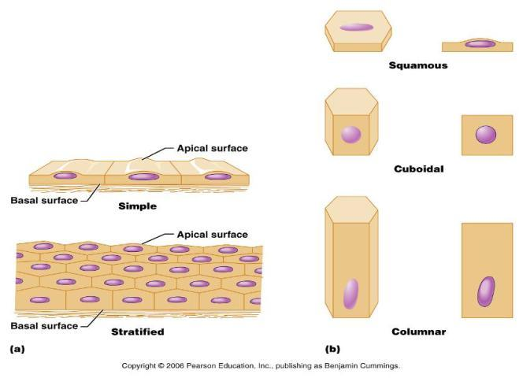
Classification of Epithelia
Squamous, cuboidal, or columnar

Slide 2
Epithelia: Simple Squamous
Single layer _
disc-shaped nuclei
little cytoplasm
Functions
Provide a slick, friction-reducing lining in lymphatic and cardiovascular systems
Present in the kidney glomeruli, lining of heart, blood vessels, lymphatic vessels, and serosa

Slide 3
Epithelia: Simple Cuboidal
Single layer of _______________________ with large, _
Function in _
Present in kidney tubules, ducts and secretory portions of small glands, and ovary surface

Slide 4
Epithelia: Simple Columnar
Single layer _
many contain _
Goblet cells are often found in this layer
Function in absorption and secretion
digestive tract
gallbladder
Ciliated type line
small bronchi
some regions of the uterus
Cilia help move substances through internal passageways

Slide 5
Epithelia: Pseudostratified Columnar
Single layer of cells with different heights; some do not reach the free surface
Function in
propulsion of mucus
Present in the
male sperm-carrying ducts (nonciliated)

Slide 6
Epithelia: Stratified Squamous
Thick membrane composed of _
Function in _
external part of the _
keratinized cells
linings of the esophagus, mouth, and vagina
Non-keratinized cells

Slide 7
Epithelia: Stratified Cuboidal and Columnar
Stratified cuboidal
Quite _______________in the body
Found in some sweat and mammary glands
Typically _

Slide 8
Epithelia: Stratified Cuboidal and Columnar
Stratified columnar
Limited distribution in the body
Found in the _________________________, male urethra, and lining some glandular ducts
Also occurs at _____________________________________ between two other types of epithelia

Slide 9
Epithelia: Transitional
Several cell layers, basal cells are _
________________________________ to permit the distension of the urinary bladder
Lines the urinary bladder, ureters, and part of the urethra

Slide 10
Epithelia: Glandular
A gland is one or more cells that _
Classified by:
Site of product release
Relative number of cells forming the gland

Slide 11
Endocrine Glands
Ductless glands that _
Secretions include amino acids, proteins, glycoproteins, and steroids

Slide 12
Exocrine Glands
More numerous
Secrete products
onto _
into _
Examples include
mucous, sweat, oil, and salivary glands
The only important _
Multicellular exocrine glands are composed of a duct and secretory unit

Slide 13
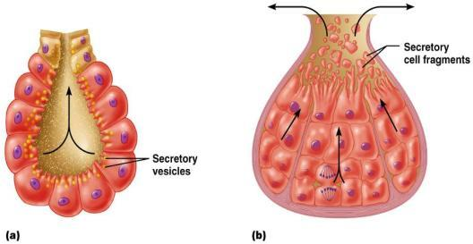
Modes of Secretion
Merocrine
products are secreted by ______________________ (e.g., pancreas, sweat, and salivary glands)
Holocrine
products are secreted by the ___________________ of gland cells (e.g., sebaceous glands)

Slide 14
Connective Tissue
Found throughout the body; most abundant and widely distributed in primary tissues
Connective tissue proper

Slide 15
Functions of Connective Tissue
Protection
Insulation

Slide 16
Characteristics of Connective Tissue
Connective tissues have:
Nonliving extracellular matrix, consisting of ground substance and _

Slide 17
Structural Elements of Connective Tissue
Ground substance
unstructured material that fills the space between cells
Fibers
fibroblasts, chondroblasts, osteoblasts, and hematopoietic stem cells

Slide 18
Ground Substance
Interstitial (tissue) fluid
Proteoglycans
Functions as a ____________________________ through which nutrients diffuse between blood capillaries and cells

Slide 19
Fibers
Collagen
tough; provides _
Elastic
long, thin fibers that _
______________________________ collagenous fibers that form delicate networks

Slide 20
Cells
connective tissue proper
Osteoblasts
Hematopoietic stem cells
White blood cells, plasma cells, macrophages, and mast cells

Slide 21
Connective Tissue Proper: Loose
________________________ connective tissue
Gel-like matrix with all three connective tissue fibers
Fibroblasts, macrophages, mast cells, and some white blood cells
________________________________________ throughout the body

Slide 22
Connective Tissue Proper: Loose
____________________________connective tissue
closely packed _
Reserves _
________________________________ against heat loss
Found under skin, around kidneys, within abdomen, and in breasts
Local fat deposits serve nutrient needs of highly active organs

Slide 23
Connective Tissue Proper: Loose
Reticular connective tissue
Loose ground substance _
Reticular cells lie in a fiber network
Forms a soft ______________________________, or stroma, that supports other cell types
Found in ________________________________, bone marrow, and the spleen

Slide 24
Connective Tissue Proper: Dense Regular
Parallel collagen fibers
a few elastic fibers
Major cell type _
Attaches muscles to bone or to other muscles, and bone to bone
Found in _

Slide 25
Connective Tissue Proper: Dense Irregular
___________________________ arranged collagen fibers with some elastic fibers
Major cell type is _
Withstands tension in many directions providing _
Found in the dermis, submucosa of the digestive tract, and fibrous organ capsules

Slide 26
Connective Tissue: Hyaline Cartilage
Amorphous, firm matrix
network of collagen fibers
________________________________ lie in _
Supports
reinforces
resists compression
Forms the _
Found in embryonic skeleton, the end of long bones, nose, trachea, and larynx

Slide 27
Connective Tissue: Elastic Cartilage
Similar to hyaline cartilage but with _
Maintains shape and structure while _
Supports ___________________________________ and the epiglottis

Slide 28
Connective Tissue: Fibrocartilage Cartilage
Matrix similar to hyaline cartilage
less firm
Provides ______________________________ and absorbs compression shock
Found in ___________________________, the _______________________________, and in discs of the knee joint

Slide 29
Connective Tissue: Bone (Osseous Tissue)
Hard, ______________________________ with collagen fibers
_____________________________ are found in ___________________________ and are well vascularized
Supports, protects, and provides levers for muscular action
Stores _
Marrow inside bones is the site of hematopoiesis

Slide 30
Connective Tissue: Blood
___________________________________ in a fluid matrix (plasma)
Contained within blood vessels
Functions in the ________________________ of respiratory gases, nutrients, and wastes

Slide 31
Nervous Tissue
________________________________ with long cellular processes and support cells
Transmits ____________________________ from sensory receptors to effectors
Found in the brain, spinal cord, and peripheral nerves

Slide 32
Muscle Tissue: Skeletal
Long, cylindrical, _______________________ cells with obvious _
Initiates and controls _
Found in skeletal muscles that attach to bones or skin

Slide 33
Muscle Tissue: Cardiac
Branching, striated, ____________________________ cells interlocking at _
Propels blood into the circulation
Found in the walls of the _

Slide 34
Muscle Tissue: Smooth
Sheets of ___________________________ with central nuclei that have _
Propels substances along internal passageways (i.e., peristalsis)
Found in the walls of _

