Slide 1
Serous Membrane (Serosa)
Thin, _____________________________________ separated by serous fluid
Parietal serosa lines _
Visceral serosa covers _

Slide 2
Other Body Cavities
____________________________ and digestive cavities
__________________________ cavity
Orbital cavities
Middle ear cavities
___________________________ cavities
End Chapter One. Start Chapter Two

Slide 3
Matter
Anything that has mass and occupies space
States of matter:
definite shape and volume
definite volume, changeable shape
changeable shape and volume

Slide 4
Composition of Matter
Elements
Cannot be broken down by ordinary chemical means
Each has unique properties:
Physical properties
Are detectable with our _
Chemical properties
How _

Slide 5
Composition of Matter
Atoms
Unique _________________________________ for each element
Atomic symbol: one- or two-letter chemical shorthand for each element

Slide 6
Major Elements of the Human Body
Oxygen (O)
Hydrogen (H)
About 96% of body mass

Slide 7
Lesser Elements of the Human Body
About 3.9% of body mass:
Calcium (Ca)
phosphorus (P)
potassium (K)
sulfur (S)
sodium (Na)
chlorine (Cl)
magnesium (Mg)
iodine (I
iron (Fe)

Slide 8
Trace Elements of the Human Body
< 0.01% of body mass:
Part of _
chromium (Cr)
manganese (Mn

Slide 9
Atomic Structure
Determined by numbers of _
Nucleus consists of _

Slide 10
Atomic Structure
Neutrons
Mass = 1 atomic mass unit (amu)
Mass = 1 amu

Slide 11
Atomic Structure
Orbit nucleus
Negative charge
1/2000 the mass of a proton (0 amu)

Slide 12
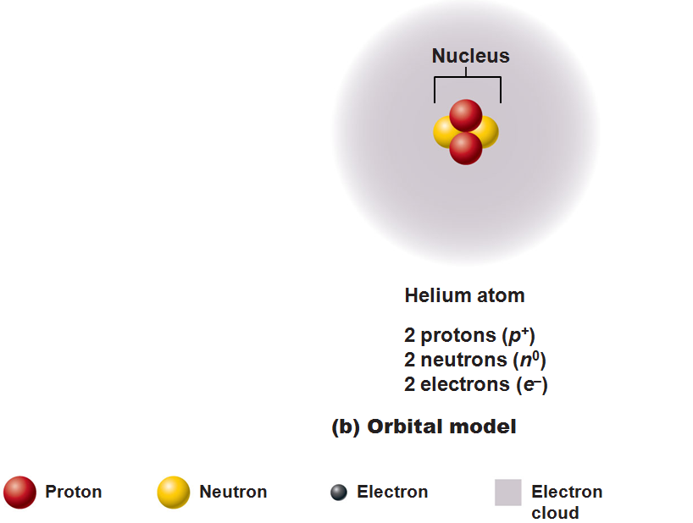
Models of the Atom
__________________________ model: current model used by chemists
Depicts probable regions of greatest electron density _
Useful for predicting chemical behavior of atoms

Slide 13
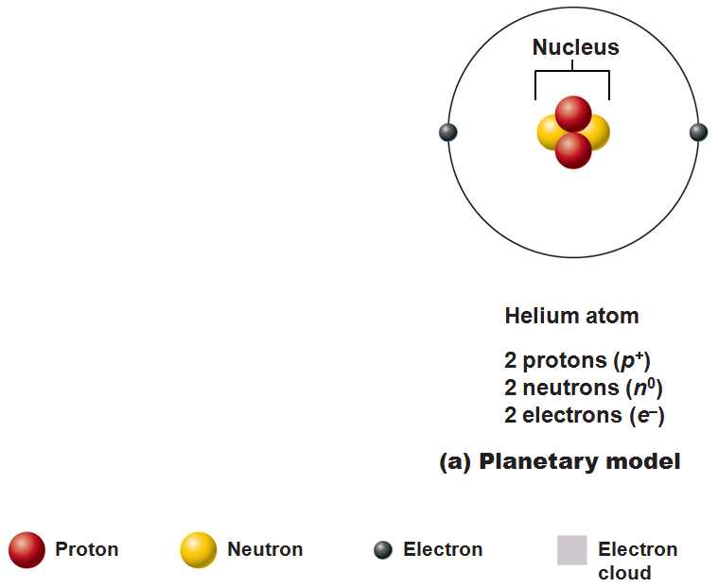
Models of the Atom
Planetary model—________________________, outdated model
Incorrectly depicts _
Useful for illustrations (as in the text)

Slide 14
Identifying Elements
Atomic _______________________ = number of__________________________ in nucleus

Slide 15
Identifying Elements
Mass number = mass of _
Mass numbers of atoms of an element _
_____________________________________ are structural variations of elements that differ in the number of neutrons they contain

Slide 16
Identifying Elements
Atomic ____________________________ = average of _______________________________ of all isotopes

Slide 17
Molecules and Compounds
Most atoms combine chemically with other atoms to form molecules and compounds
two or more atoms bonded together (e.g., H₂ or C₆H₁₂O₆)
two or more different kinds of atoms bonded together (e.g., C₆H₁₂O₆)

Slide 18
Mixtures
Most matter exists as mixtures
Two or more components _
Three types of mixtures

Slide 19
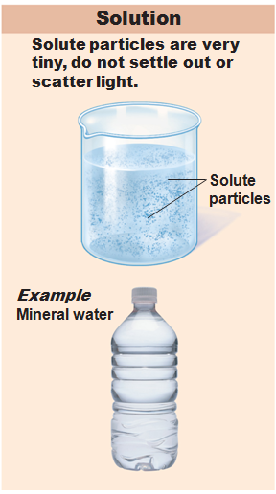
Solutions
______________________ mixtures
Usually transparent, e.g., atmospheric air _
Solvent
Present in greatest amount, usually a liquid
Solute(s)
Present in smaller amounts

Slide 20
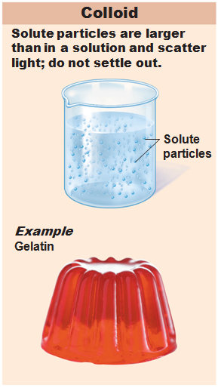
Colloids
Heterogeneous __________________________ mixtures
Large solute particles that do not settle out

Slide 21
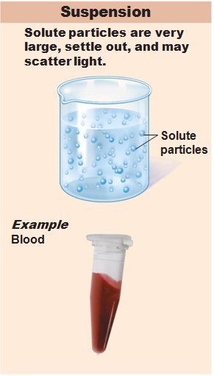
Suspensions
Heterogeneous mixtures
_________________________ solutes tend to settle out

Slide 22
Chemical Bonds
Electrons occupy up to seven electron shells (_________________________________) around nucleus
Except for the first shell which is ________________________________________, atoms interact in a manner to have ____________________________________ electrons in their outermost energy level (valence shell)

Slide 23
Chemically Inert Elements
Stable and _
Outermost energy level _____________________________ or contains eight electrons

Slide 24
Chemically Reactive Elements
Outermost energy level _____________________________________ by electrons
Tend to ________________________________________ with other atoms to achieve stability

Slide 25
Types of Chemical Bonds

Slide 26
Ionic Bonds
Ions are formed by ____________________ of valence shell electrons between atoms
Anions
have _____________________________ one or more electrons
Cations
have ______________________________one or more electrons
Attraction of opposite charges results in an _

Slide 27
Formation of an Ionic Bond
Ionic compounds form _______________________________ instead of individual molecules
NaCl (sodium chloride)

Slide 28
Covalent Bonds
Formed by ____________________________ of two or more valence shell electrons
Allows each atom to _____________________________________ at least part of the time

Slide 29
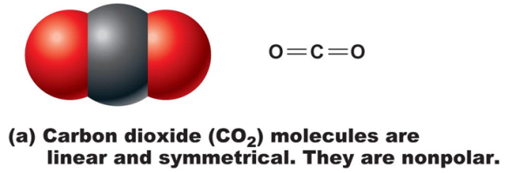
Covalent Bonds
Sharing of electrons may be _
_________________________________produces electrically balanced ________________________ molecules
CO₂

Slide 30
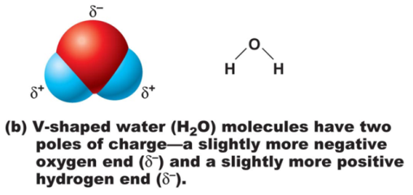
Covalent Bonds
________________________________sharing by atoms with different electron-attracting abilities produces _
H₂O

Slide 31
Hydrogen Bonds
Attractive force between electropositive hydrogen of one molecule and an electronegative atom of another molecule
Common between _________________________ such as water
Also act as _______________________________, holding a large molecule in a three-dimensional shape

Slide 32
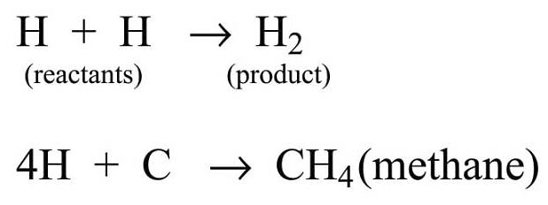
Chemical Reactions
Occur when chemical bonds are _
Written in symbolic form using chemical equations
Chemical equations contain:
Number and type of reacting substances, and products produced
Relative amounts of _

Slide 33
Patterns of Chemical Reactions
____________________________ (combination) reactions
____________________________ reactions
____________________________reactions

Slide 34
Synthesis Reactions
A + B → AB

Slide 35
Decomposition Reactions
AB → A + B
Reverse synthesis reactions

Slide 36
Exchange Reactions
AB + C → AC + B
Also called _
Bonds are both made and broken

Slide 37
Oxidation-Reduction (Redox) Reactions
Decomposition reactions: Reactions in which ______________________ is broken down for ________________________
Also called _____________________________ because electrons are exchanged or shared differently
Electron donors _
Electron acceptors receive electrons and become _

Slide 38
Chemical Reactions
All chemical reactions are theoretically _
A + B → AB
AB → A + B
Chemical __________________________________ occurs if neither a forward nor reverse reaction is dominant
Many biological reactions are essentially irreversible due to

Slide 39
Factors Influencing Rate of Chemical Reactions
chemical reactions proceed quicker at higher temperatures
Particle size
the __________________________________ the particle the faster the chemical reaction
________________________________ reacting particle concentrations produce ____________________________________reactions

Slide 40
Factors Influencing Rate of Chemical Reactions
increase the rate of a reaction without being chemically changed

