Slide 1
Nucleus
Contains _
Gene-containing control center of the cell
Contains the ______________________________with blueprints for nearly all cellular proteins
Dictates the kinds and amounts of proteins to be synthesized

Slide 2
Nuclear Envelope
_________________________________ double membrane barrier _
Encloses jellylike _

Slide 3
Nuclear Envelope
Outer membrane is continuous with the __________________________and is studded with _
Inner membrane is lined with the nuclear lamina,
which maintains the shape of the nucleus
Pore complex regulates transport of large molecules into and out of the nucleus

Slide 4
Nucleoli
Dark-staining spherical bodies _
Site of _

Slide 5
Chromatin
Form condensed, barlike bodies of ____________________________when the nucleus starts to divide

Slide 6
Cell Cycle
Growth (G₁), synthesis (S), growth (G₂)
Mitosis and cytokinesis

Slide 7
Interphase: DNA Replication
DNA helices begin ________________________________from the nucleosomes
_________________________untwists the double helix and exposes complementary strands
Each nucleotide strand serves as a template for building a new complementary strand

Slide 8
DNA Replication
uses _______________________________ to begin DNA synthesis
___________________________________ continues from the primer and adds complementary nucleotides to the template

Slide 9
DNA Replication
Since DNA polymerase only works in one direction:
A continuous ____________________________ is synthesized
A discontinuous ___________________________is synthesized
DNA ligase splices together the short segments of the discontinuous strand
Two new telomeres are also synthesized
This process is called semiconservative replication

Slide 10
Cell Division
Essential for body growth and tissue repair
nuclear division
division of the _

Slide 11
Mitosis
The phases of mitosis are:

Slide 12
Cytokinesis
Cleavage furrow formed in __________________________________ by contractile ring
Cytoplasm is ____________________________________ after mitosis ends

Slide 13
Early and Late Prophase
Asters are seen as _
Centriole pairs separate and the mitotic spindle is formed

Slide 14
Metaphase
_____________________________________of the cell with their centromeres aligned at the exact center, or equator, of the cell
This arrangement of chromosomes along a plane midway between the poles is called the _

Slide 15
Anaphase
_______________________________ of the chromosomes split
Motor proteins in kinetochores _

Slide 16
Telophase and Cytokinesis
New sets of chromosomes extend into chromatin
_____________________________________ from the rough ER
Generally cytokinesis completes cell division

Slide 17
Control of Cell Division
Chemical signals such as ________________________________ and hormones
Cyclins and cyclin-dependent kinases (Cdks) complexes

Slide 18
Protein Synthesis
DNA serves as master blueprint for protein synthesis
_____________________________________ carrying instructions for a polypeptide chain
_____________________________ of nucleotide bases form the genetic library
Each triplet specifies coding for an _

Slide 19
Roles of the Three Types of RNA
carries the genetic information from DNA in the nucleus to the ribosomes in the cytoplasm
bound to amino acids base pair with the _____________________ of mRNA at the ribosome to begin the process of protein synthesis
a structural component of ribosomes

Slide 20
Transcription
Transfer of information from the sense strand of _

Slide 21
Transcription: RNA Polymerase
An enzyme that oversees the synthesis of RNA
Adds complementary ___________________________ triphosphates on the DNA template
Joins these RNA nucleotides together
Encodes a termination signal to _

Slide 22
Genetic Code
_______________________________ code for _____________________________ according to a genetic code

Slide 23
Information Transfer from DNA to RNA
DNA triplets are ________________________ into mRNA codons by RNA polymerase
Codons base pair with __________________________________ at the _
Amino acids are peptide bonded at the ribosomes to form polypeptide chains
Start and stop codons are used in initiating and ending translation

Slide 24
Tissues
Groups of cells similar in structure and function
The four types of tissues

Slide 25
Epithelial Membranes
skin
lines ______________________________ open to the exterior (e.g., digestive and respiratory tracts)
Serous
moist membranes found _

Slide 26
Epithelial Tissue
Cellularity
composed almost _
Special contacts
form continuous sheets held together by _

Slide 27
Epithelial Tissue
__________________________ by connective tissue
reticular and basal laminae
___________________________ but innervated
contains ___________________________________ but supplied by nerve fibers
rapidly replaces lost cells by cell division

Slide 28
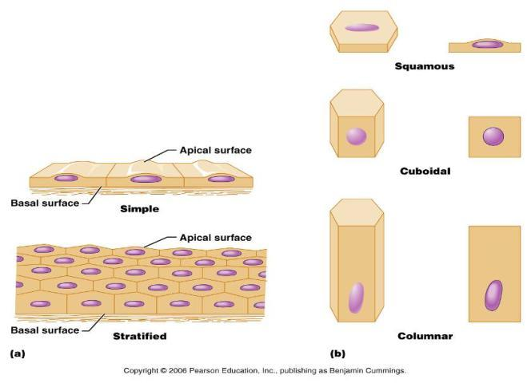
Classification of Epithelia
Squamous, cuboidal, or columnar

Slide 29
Epithelia: Simple Squamous
Single layer _
disc-shaped nuclei
little cytoplasm
Functions
Provide a slick, friction-reducing lining in lymphatic and cardiovascular systems
Present in the kidney glomeruli, lining of heart, blood vessels, lymphatic vessels, and serosa

Slide 30
Epithelia: Simple Cuboidal
Single layer of _______________________ with large, _
Function in _
Present in kidney tubules, ducts and secretory portions of small glands, and ovary surface

Slide 31
Epithelia: Simple Columnar
Single layer _
many contain _
Goblet cells are often found in this layer
Function in absorption and secretion
digestive tract
gallbladder
Ciliated type line
small bronchi
some regions of the uterus
Cilia help move substances through internal passageways

Slide 32
Epithelia: Pseudostratified Columnar
Single layer of cells with different heights; some do not reach the free surface
Function in
propulsion of mucus
Present in the
male sperm-carrying ducts (nonciliated)

Slide 33
Epithelia: Stratified Squamous
Thick membrane composed of _
Function in _
external part of the _
keratinized cells
linings of the esophagus, mouth, and vagina
Non-keratinized cells

Slide 34
Epithelia: Stratified Cuboidal and Columnar
Stratified cuboidal
Quite _______________in the body
Found in some sweat and mammary glands
Typically _

Slide 35
Epithelia: Stratified Cuboidal and Columnar
Stratified columnar
Limited distribution in the body
Found in the _________________________, male urethra, and lining some glandular ducts
Also occurs at _____________________________________ between two other types of epithelia

Slide 36
Epithelia: Transitional
Several cell layers, basal cells are _
________________________________ to permit the distension of the urinary bladder
Lines the urinary bladder, ureters, and part of the urethra

Slide 37
Epithelia: Glandular
A gland is one or more cells that _
Classified by:
Site of product release
Relative number of cells forming the gland

Slide 38
Endocrine Glands
Ductless glands that _
Secretions include amino acids, proteins, glycoproteins, and steroids

Slide 39
Exocrine Glands
More numerous
Secrete products
onto _
into _
Examples include
mucous, sweat, oil, and salivary glands
The only important _
Multicellular exocrine glands are composed of a duct and secretory unit

Slide 40
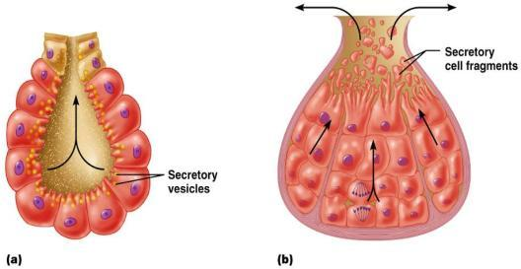
Modes of Secretion
Merocrine
products are secreted by ______________________ (e.g., pancreas, sweat, and salivary glands)
Holocrine
products are secreted by the ___________________ of gland cells (e.g., sebaceous glands)

