Slide 1
BSC 181
Betsy A. Wargo, D.C.

Slide 2
Introduction
Dr. Wargo
bawargo@ilstu.edu
Office hours:
Class Website: http://www.bio.ilstu.edu/bawargo
This website is an integral part of class. You will find lecture notes here as well as announcements.
Background
Graduated from ISU 1994
Major: Biology
Graduated from National College of Chiropractic 1997
B.S. in Human Biology
Doctorate for Chiropractic

Slide 3
Introduction
Syllabus
Exams
Six semester exams worth 100 points
From exams 1-5, your lowest exam will be dropped. Exam six is not available for dropping
No make up exams
Grading
90% A; 80% B etc
Because there is extra credit built into your exams, an 89 is a B, a 79 is a C, etc.

Slide 4
Comment on grades and goals
My goal as an instructor is to present material to you in an understandable fashion, to elaborate on the text.
My goal is for you to understand, and more importantly, apply the information you’ve been presented.

Slide 5
Comment on grades and goals
My goal is to create challenging exams that reflect the material and your comprehension.
There is a great deal of information in this class
For summer semester, there is a very limited time frame in which you have to learn this information
I know that some of you are grade oriented. Please be aware that I am not. I much prefer questions regarding content than exam scores. For those of you considering careers in health care, I consider it vitally important that you have this information as a good building tool.

Slide 6
Introduction
Assignments: Instructions are also available on the class website.
Encourage Active Study
Ten high-quality quiz questions
Eight multiple choice questions that include at least four options. Indicate the correct response.
Two short answer questions. Asked and answered correctly
Assignment will be submitted through Blackboard.
No late assignments will be accepted

Slide 7
Introduction
Format
Class will consist of PowerPoint lecture based on the information from your text book.
Lectures are intended to help you digest and comprehend the material from your book, not replace it.
Templates for the lectures will be available online for you to download and print.
A picture is worth a thousand words…
Generally, if I draw it on the board, make sure it gets into your notes.
The templates are for your convenience. You do not have to use them. Some students prefer to bring in laptops and takes their notes in that format. Do what works best for you to get this material in a digestible format.

Slide 8
Introduction
Studying
Read related materials before you come in.
Some students find it better to hear lecture, and then read the textbook.
Don’t leave confused.
Study as soon after class as possible.
Spread study time out.
Ask for help when you don’t understand.

Slide 9
Introduction
Active versus Passive Studying
Passive:
reading or re-reading notes, listening to taped lectures
Low energy requirements
Begin to understand material

Slide 10
Introduction
Active Studying
Developing comprehension
Re-writing sections you don’t understand
Study efficiently!
Note-cards
Vocabulary
Know root words, prefixes, suffixes.
These will make it easier to interpret terms that you may be unfamiliar with.

Slide 11
Introduction
Study groups
Discussing pathways or processes
Explaining to those who don’t get it yet
Forcing verbal recall of written material
Making exam questions
Answering exam questions correctly
Exchanging and reviewing assignments. This then becomes a study guide for class material.
Using supplemental study sites for practice quizzes

Slide 12
Introduction
Exam Format
Exams will be created from material presented in lecture
You may be responsible for diagrams (Anatomy)
Multiple choice options will have one correct response

Slide 13
Lab
There will be no lab this week
Please be sure to bring the BSC 181 lab manual with you to lab
Lab manuals can be purchased at the Phi Sigma bookstore (Felmley 101A) this week and next for $15.00
Lab format
There will be four lab practicals this semester
Lab assignments (case studies or article summaries) may be assigned throughout the semester.

Slide 14
Ready?
Before we begin, take a moment to introduce yourself to your neighbors make sure you have contact information from a classmate should you need to get a copy of the notes

Slide 15
Overview of Anatomy and Physiology
Anatomy
the study of the ______________________ of body parts and _
Physiology
the study of the _______________________ of the body’s structural machinery

Slide 16
Gross Anatomy
Regional
gross anatomy of the body studied by system
Cytology
study of the _
Histology
study of _

Slide 17
Physiology
Focuses on
operation of _
the functions of the body, often at the cellular or molecular level
Renal
Cardiovascular
operation of the _

Slide 18
Levels of Structural Organization
Chemical
_____________________ combined to form molecules
cells are made of molecules
Tissue
consists of similar _

Slide 19
Levels of Structural Organization
Organ
made up of _
consists of different organs that work closely together
Organismal
made up of the _

Slide 20
Integumentary System
skin, _________________________, oil glands, _
Protects deep tissues from injury and _

Slide 21
Skeletal System
Composed of _
____________________________ body organs
Provides the _____________________ for muscles
Site of blood cell formation
Stores minerals

Slide 22
Muscular System
Composed of _
Allows manipulation of the environment, locomotion, and facial expression
Produces _

Slide 23
Nervous System
Composed of the _
Is the fast-acting control system of the body
Responds to _________________ by activating _

Slide 24
Cardiovascular System
Composed of the _
The heart pumps blood
The blood vessels ______________________________ throughout the body

Slide 25
Lymphatic System
Composed of ____________________, thymus, __________________, lymph nodes, and lymphatic vessels
Picks up ___________________________ and returns it to blood
Disposes of _______________________ in the lymphatic stream
Houses ____________________________ involved with _

Slide 26
Respiratory System
Composed of the nasal cavity, pharynx, trachea, bronchi, and lungs
Keeps blood _____________________________ and removes _

Slide 27
Digestive System
Composed of the ________________, esophagus, stomach, _________________________ , large intestine, ________________, anus, and _
_____________________________ into absorbable units that enter the blood
_________________________indigestible foodstuffs as feces

Slide 28
Urinary System
Composed of kidneys, ureters, urinary bladder, and urethra
Eliminates _________________________ from the body
Regulates water, ___________________, and ________________________ of the blood

Slide 29
Male Reproductive System
Composed of ___________________, penis, testes, _________________, and ductus deferens
Main function is the _
Testes produce sperm and male sex hormones
Ducts and glands _

Slide 30
Female Reproductive System
Composed of _____________________, ovaries, _________________________, uterus, and _
Main function is the _
Ovaries produce eggs and female sex hormones
Remaining structures serve as sites for fertilization and development of the fetus
_________________________________ produce milk to nourish the newborn

Slide 31
Organ Systems Interrelationships
The integumentary system __________________________ the body from the external environment
Digestive and respiratory systems, in contact with the external environment, _

Slide 32
Organ Systems Interrelationships
Nutrients and oxygen are distributed _
Metabolic wastes are eliminated _

Slide 33
Necessary Life Functions
Maintaining _
the internal environment remains distinct from the external environment
Cellular level
accomplished by _
Organismal level
accomplished by the _

Slide 34
Necessary Life Functions
Movement
Responsiveness
ability to sense changes in the environment and respond to them
breakdown of ingested foodstuffs

Slide 35
Necessary Life Functions
all the chemical reactions that occur in the body
Excretion
removal of _________________________ from the body
increase in size of a body part or of the organism

Slide 36
Necessary Life Functions
Reproduction
cellular and organismal levels
Cellular
an original cell _
Organismal
sperm and egg ____________________to make a whole new person

Slide 37
Survival Needs
Nutrients
needed for _
Oxygen
necessary for _
Water
provides the necessary _______________________ for chemical reactions
Normal body temperature
necessary for ______________________________ to occur at life-sustaining rates
Atmospheric pressure
required for proper breathing and gas exchange in the lungs

Slide 38
Homeostasis
Homeostasis
ability to ___________________________________ in an ever-changing outside world
The internal environment of the body is in a dynamic state of equilibrium
Chemical, thermal, and neural factors interact to maintain homeostasis

Slide 39
Homeostatic Control Mechanisms
Variables produce a change in the body
The _____________________________ of control mechanisms:
monitors the environments and responds to changes (stimuli)
determines the set point at which the variable is maintained
provides the means to respond to stimuli

Slide 40
Negative Feedback
In negative feedback systems, _
Example: Regulation of room temperature

Slide 41
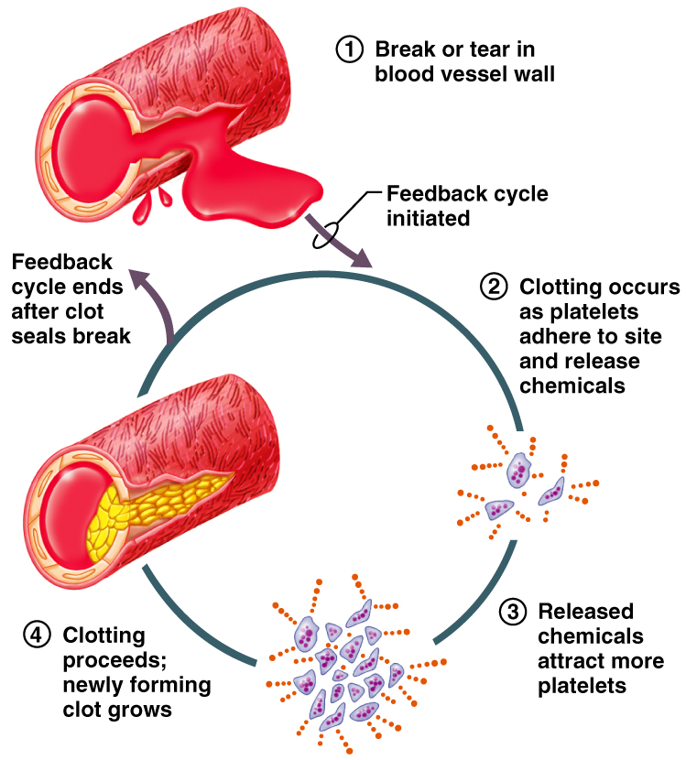
Positive Feedback
In positive feedback systems, the output _
Example: Regulation of blood clotting
Figure 1.6

Slide 42
Homeostatic Imbalance
Disturbance of homeostasis or the body’s normal equilibrium
Overwhelming the usual negative feedback mechanisms allows destructive positive feedback mechanisms to take over

